Slide 1
IOT BASED SOIL NUTRIENT PARAMETER MEASURING AND MONITORING SYSTEM
PRESENTED BY
SANJAY KUMAR.S, SANJAY PRASATH.K, SELVA.L, & SHYAM SUNDAR.S
Under the Guidance and supervision of
C.BHAVYA. M.Sc., M.Phil.,
ASSISTANT PROFESSOR
Dr.P.VENKATESHWARI. MSc., M.Phil., Ph.D.
HEAD, DEPARTMENT OF ELECTRONICS
RATHNAVEL SUBRAMANIAM COLLEGE OF ARTS AND SCIENCE
(AUTONOMOUS)
[AFFILIATED TO BHARATHIAR UNIVERSITY]
SULUR, COIMBATORE-641 402
2022

Slide 2
ABSTRACT
This project is done to study about the soil testing with the help of sensors and their record baseline values of soil quality indicators of our Garden soil for subsequent evaluation and comparison.
An acceptably accurate and rapid soil chemical analysis for assessing available nutrient status and identify nutrient deficiencies for making fertilizer recommendation.
Predict crop response to added nutrients and build a nutrient management plan.
The identify nutrient values are send to the cloud with the help of GSM Module and we, saw the data by the mobile application.

Slide 3
CONTENTS
INTRODUCTION
BLOCK DIAGRAM
CIRCUIT DIAGRAM
PCB LAYOUT
APPLICATION
ADVANTAGES AND DISADVANTAGES
CONCLUSION
PHOTOGRAPHY

Slide 4
INTRODUCTION
Farmers have obtained new technology and tools to increase their profits with both the birth of sass and cloud technologies increasing the number of discerning consumers and unprecedented temperature values over the past few years.
Measurement of soil content n (nitrogen), P (phosphorus) and K (potassium0 is necessary to determine how much additional nutrient content is to be added to soil to increase crop fertility.
It help grow agricultural crops, sustain landscapes and revegetate deranged soils in dry areas and less then average rainfall periods.
It has certain needs to agriculture production including frost protection, weed growth in grain field and soil acquisition avoidance.
Wherever there was automation and people were replaced by automatic machinery.

Slide 5
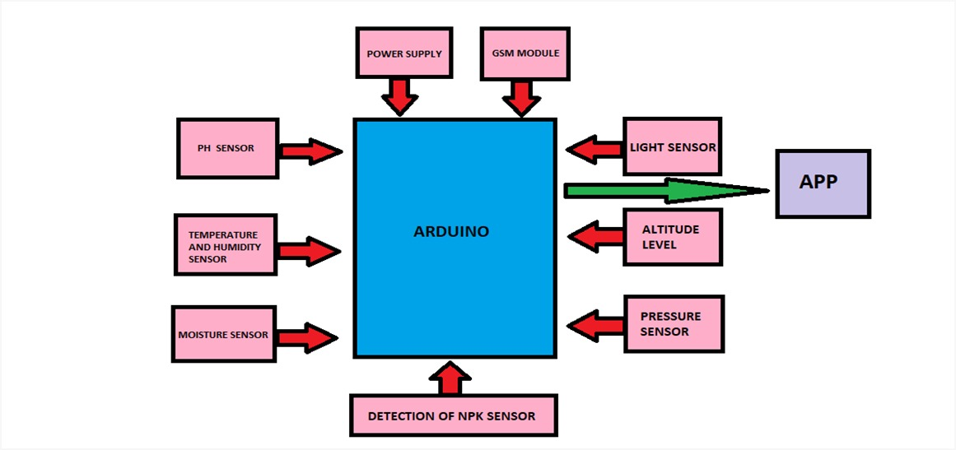
BLOCK DIAGRAM

Slide 6
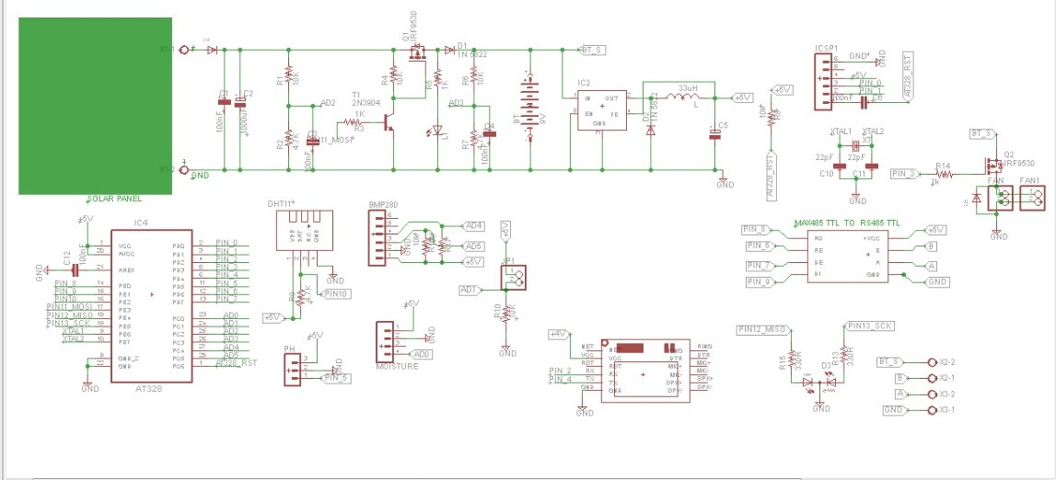
CIRCUIT DIAGRAM

Slide 7
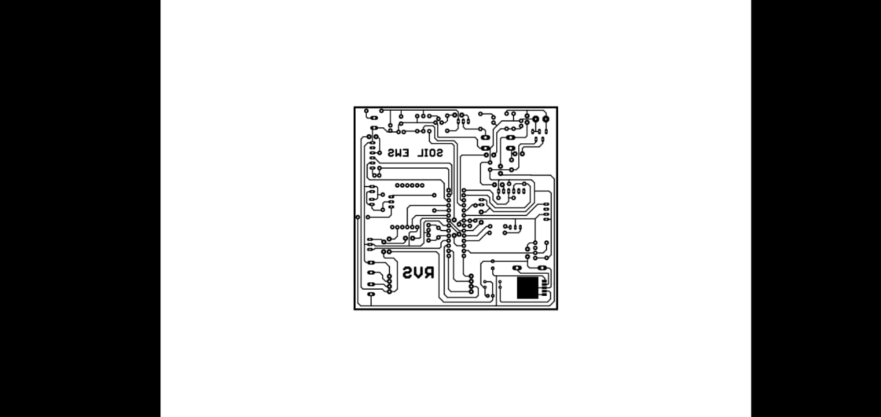
PCB LAYOUT

Slide 8
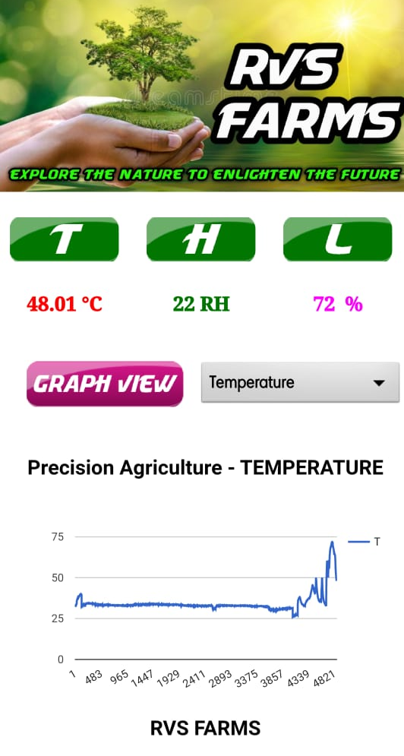
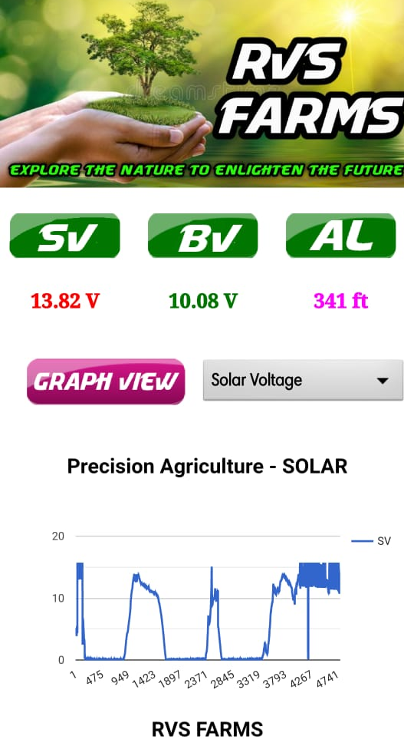
APPLICATION Based on testing of soil nutrient measuring devices for citrus plants in RVS FARMS. The NPK sensor will measure the nutrients in the soil for citrus seedlings, and the results read by the NPK sensor will be sent to the Cloud, making it easier for farmers to seed citrus seeds.
The above results shows that, the temperature, humidity and light intensity of the sun and the corresponding graphical values are plotted through the cloud API’s
The second image shows that, the Solar Voltage value, Battery Voltage value and Altitude level of the system and the corresponding values are plotted through the Graphs

Slide 9
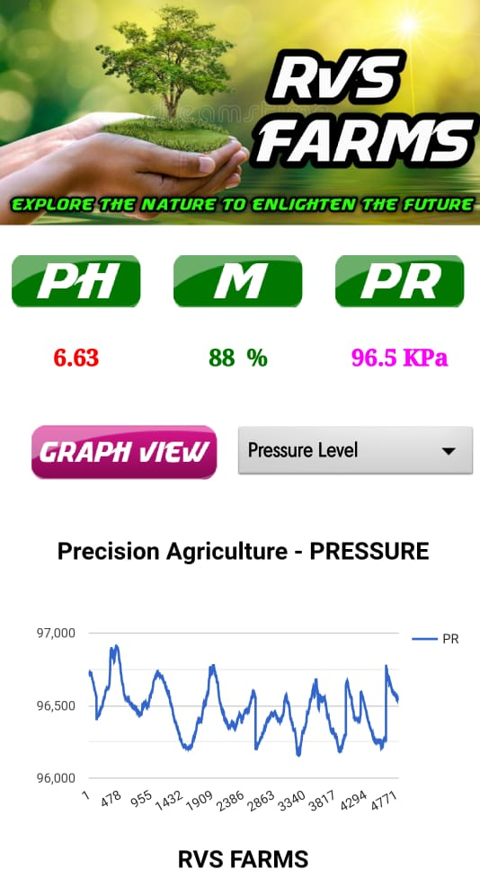
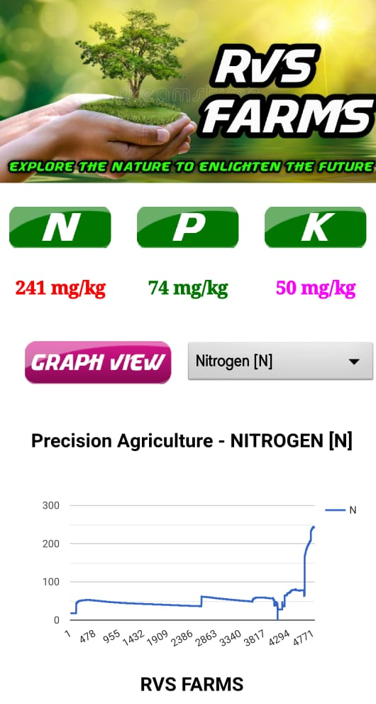
RVS FARMS
The Third image shows that, the pH value, Moisture and the pressure Level of the SOIL.
The fourth image shows that the Nitrogen, Phosphorus and Potassium level of the soil and the corresponding values are plotted through the Graphs

Slide 10
ADVANTAGES AND DISADVANTAGES
Accurate and real – time soil data has become one of the most valuable resources among farmers.
Optical and electrochemical techniques of these sensors system only a few of them are commercially available for monitoring.
Real – time soil sensors data can be exploited in manners that increase product quality, promote food security and ensure environmental protection.
Easy to handle the human interface access facility.
Low cost – excessive usage and every 30 seconds one’s update information comes directly mobile application in our phone.
This charging method for solar power it is not necessary for man to come to charge himself.
The movement of nutrients, especially NO3 – and H2 PO4 and pesticides form soils into receiving waters can pose problems for the management of water quality in catchments.
This circuit is complex.
Electronics Basic Knowledge is required.

Slide 11
CONCLUSION
Remote monitoring of soil parameters is an emerging trend which has the potential to transform agricultural practices and increase productivity. pH value, temperature and moisture content of soil are the basic parameters which help in characterizing the soil and therefore in taking proper decisions regarding fertilizer application and choice of crops shown. In this work, antimony electrode is used for pH measurement. For soil moisture content estimation, the inverse relation between soil resistance and soil moisture has been utilized and corresponding circuitry has been developed. The determination of soil temperature is done using the DS18B20 sensor working on the Dallas one wire protocol. The system is integrated with data in cloud storage store in from there it will be updated every 30 seconds as the information comes directly through the app on our phone. for the transfer of data to a nearby cell phone. The entire system is developed on Arduino ATmega328P Uno.

Slide 12
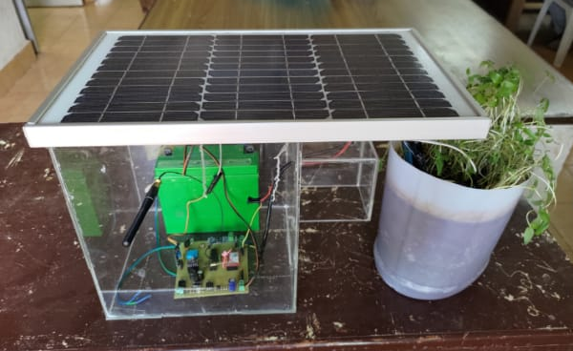
PHOTOGRAPHY

Slide 13
THANK YOU

