Slide 1

Internship Project

Slide 2

Project Leadership
Sharat Manikonda
Director at Innodatatics and Sponsor
linkedin.com/in/sharat-chandra

Slide 3

Team Members
Name: Sanjay Kumar Nayak
Linkedln: linkedin.com/in/sanjaynayak14

Slide 4

Contents
Business objective
Business Constraints
Project Architecture
Data collection and details
Exploratory Data Analysis
Visualization
Notes:
Change

Slide 5
Project Overview and Scope
Overview
The project involves designing and manufacturing high-performance fuel pumps for vehicles. These fuel pumps are crucial components that take fuel as input and deliver it to the engine at a high velocity, ensuring optimal performance and speed of the vehicle.
Scope
The scope includes researching, designing, manufacturing, and testing high-performance fuel pumps for vehicles, with a focus on optimizing speed and efficiency. Additionally, it involves establishing distribution channels and providing ongoing support while striving for continuous improvement.

Slide 6
Business Problem
Machines which manufacture the pumps. Unplanned machine downtime which is leading to loss of productivity.

Slide 7
Business Objective
Objective
Constraints
Minimize maintenance cost
Minimize unplanned machine downtime.

Slide 8
CRISP-ML(Q) Methodology
There are six stages of CRISP-ML(Q) Methodology
1. Business and data understanding
2. Data understanding 3. Data preparation 4. Descriptive/univariate Analysis 5. Graphical Representation

Slide 9


Technical Stacks
SQL Version(MySQL 8.0 )
2. Python Version(Python 3.10.2)

Slide 10
Data Collection and Understanding
Data collection
For data collection, the client provides relevant information such as vehicle specifications, fuel types, usage patterns, and performance requirements. Data understanding involves analyzing this information to identify trends, patterns, and insights that inform the design and manufacturing process of the fuel pumps. This includes understanding the dynamics of fuel flow, engine requirements, environmental factors, and market demands to develop optimal solutions. Data Understanding The dataset appears to be related to machine downtime, containing information on various parameters monitored during machine operation. Numerical Variables: Hydraulic_Pressure, Coolant_Pressure, Air_System_Pressure, Coolant_Temperature, Hydraulic_Oil_Temperature, Spindle_Bearing_Temperature, Spindle_Vibration, Tool_Vibration, Spindle_Speed, Voltage, Torque, Cutting, Downtime. Categorical Variables: Date, Machine_ID, Assembly_Line_No.

Slide 11
Data Information
Date: Contains date values with 2500 non-null entries.
Machine_ID: Contains machine ID values with 2500 non-null entries.
Assembly_Line_No: Contains assembly line numbers with 2500 non-null entries.
Hydraulic_Pressure: Contains hydraulic pressure values with 2490 non-null entries.
Coolant_Pressure: Contains coolant pressure values with 2481 non-null entries.
Air_System_Pressure: Contains air system pressure values with 2483 non-null entries.
Coolant_Temperature: Contains coolant temperature values with 2488 non-null entries.
Hydraulic_Oil_Temperature: Contains hydraulic oil temperature values with 2484 non-null entries.
Spindle_Bearing_Temperature: Contains spindle bearing temperature values with 2493 non-null entries.
Spindle_Vibration: Contains spindle vibration values with 2489 non-null entries.
Tool_Vibration: Contains tool vibration values with 2489 non-null entries.
Spindle_Speed: Contains spindle speed values with 2494 non-null entries.
Voltage: Contains voltage values with 2494 non-null entries.
Torque: Contains torque values with 2479 non-null entries.
Cutting: Contains cutting values with 2493 non-null entries.
Downtime: Contains downtime values with 2500 non-null entries.

Slide 12
Data Dictionary
Detail Of Data:
Date: object
Machine_ID: object
Assembly_Line_No: object
Hydraulic_Pressure: float64
Coolant_Pressure: float64
Air_System_Pressure: float64
Coolant_Temperature: float64
Hydraulic_Oil_Temperature: float64
Spindle_Bearing_Temperature: float64
Spindle_Vibration: float64
Tool_Vibration: float64
Spindle_Speed: float64
Voltage: float64
Torque: float64
Cutting: float64
Downtime: object

Slide 13
System Requirements
Processor: AMD Ryzen 5 5500U with Radeon Graphics2.10 GHz
RAM: 8.00 GB
System: type64-bit operating system, x64-based processor

Slide 14
Exploratory Data Analysis [EDA]
1. Data Summary: Understand dataset structure, data types, and spot anomalies.
2. Descriptive Statistics: Compute basic statistics for numeric variables.
3. Data Visualization: Use plots to explore distributions, relationships, and patterns.
4. Outlier Detection: Identify and handle outliers that deviate significantly.
5. Feature Relationships: Analyze correlations and interactions between variables.
6. Data Cleaning: Address missing values and correct errors.
7. Pattern Recognition: Identify trends, seasonality, and recurring patterns.
Notes:
EDA is used for seeing what the data can tell us before the modeling task.
Change

Slide 15
Missing Values Observation
Import Libraries: Import pandas, matplotlib, and seaborn libraries.
Load Dataset: Load your dataset into a pandas DataFrame (df).
Check for Missing Values: Use df.isnull().sum() to count missing values for each column.
Plot Missing Values: Visualize missing values using seaborn's barplot function.

Slide 16
Data Preprocessing
Handling Missing Values:
Identify missing values in the dataset.
Decide on a strategy to handle missing values (e.g., imputation, deletion).
Implement the chosen strategy (e.g., fill missing values with mean, median, or mode, or remove rows/columns with missing values).
Encoding Categorical Variables:
Convert categorical variables into a numerical format suitable for machine learning algorithms.
Use techniques like one-hot encoding or label encoding.
Notes:
Keep observations

Slide 17
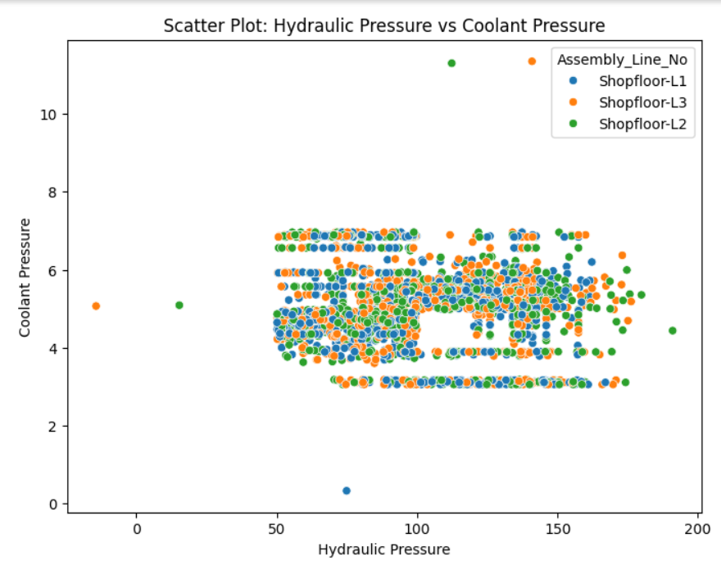
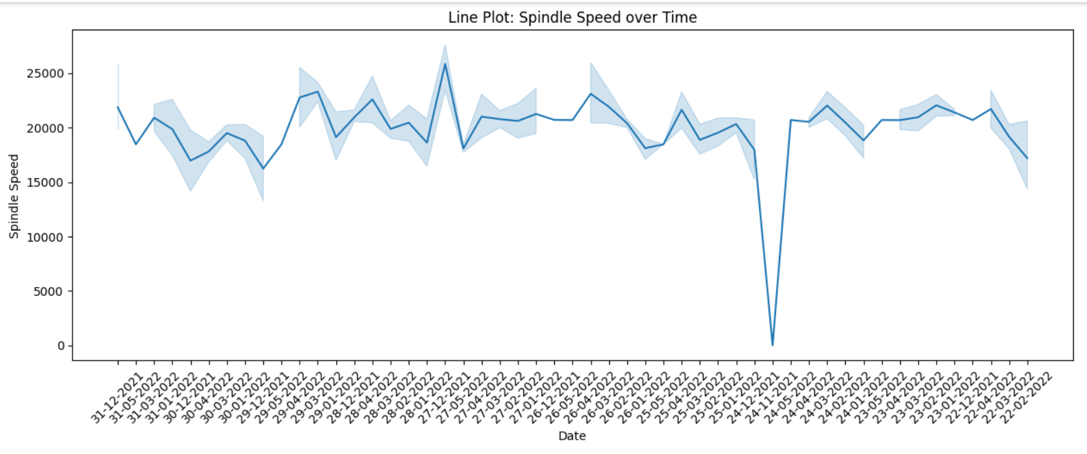
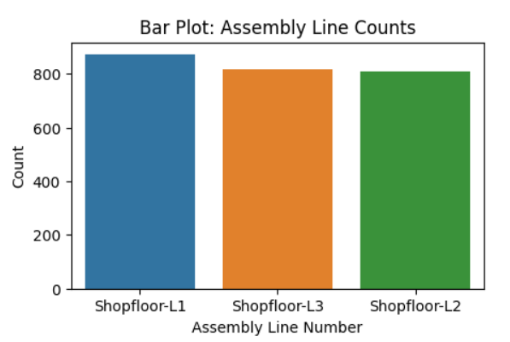
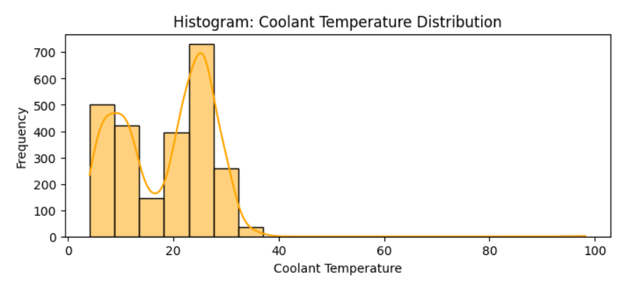
Data Visualization
Notes:
Add graphical

Slide 18
Challenges
Analyzing data faces challenges including data quality, volume, variety, interpretability, bias, security,
computational resources, domain knowledge, reproducibility, and time constraints.

Slide 19
Future Scopes
The future scope for this project includes advanced modeling techniques, real-time monitoring, predictive maintenance implementation,
data integration, optimization, dashboard development, predictive analytics for business planning, collaboration, scalability, and regulatory compliance.

Slide 20

Queries ?
What are the summary statistics for key variables?
2.How many missing values are there in each column?
3.Can we filter the dataset based on specific criteria?
4.What new features can we derive from existing variables?
5.How can we visualize the distribution of data?

Slide 21


