Slide 1

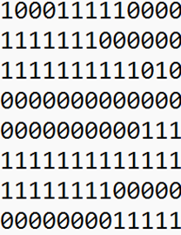
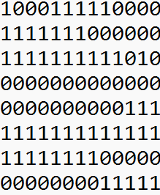



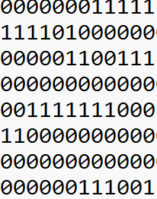



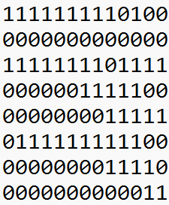






b
c
d
e
a
Encoder
Decoder
Reconstructed Test patterns
Test Patterns
a.
1D Conv Relu(32,3)
b.
1D Conv Relu(16,3)
c.
1D Conv Relu(16,3)
d.
1D Conv Relu(32,3)
Max Pooling(2)
Max Pooling(2)
Upsampling(2)
Upsampling(2)

Slide 2
b
c
d
e
a
Encoder
Decoder
Reconstructed Test patterns
Test Patterns
a.
1D Conv Relu(32,3)
b.
1D Conv Relu(16,3)
c.
1D Conv Relu(16,3)
d.
1D Conv Relu(32,3)
Max Pooling(2)
Max Pooling(2)
Upsampling(2)
Upsampling(2)

Slide 3
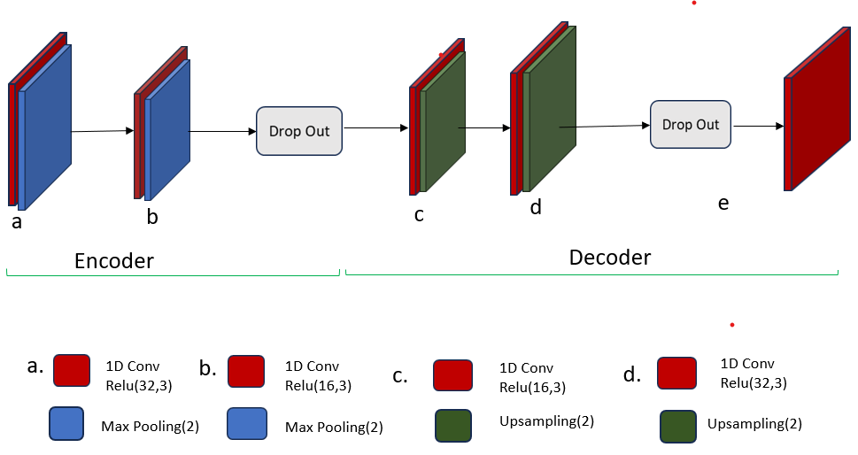
Unsupervised Feature Extraction Through Convolutional Neural Network Based Autoencoder Model
Test Inputs
ATALANTA Tool
Correct outputs
Code
Fault Mask
Classification
Faults

Slide 4
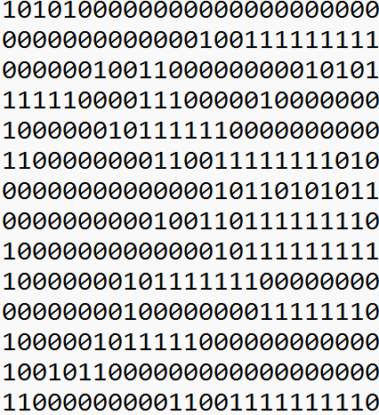

ATALANTA Tool

