Slide 1
Architecture Knowledge Assistant
Complete System Architecture
Phase 1 → Phase 2 → Phase 3 Evolution
Architecture Team | June 2026

Slide 2
The Evolution Story — Three Phases
Phase 1: FOUNDATION — "Can we build a RAG system?"
✅ Full RAG pipeline: Scan → Extract → Chunk → Embed → Retrieve → Generate
✅ ChromaDB (local vector store), semantic search only
✅ 12 Python modules, 89 chunks indexed, FastAPI + Streamlit
✅ Cost: ~₹8K-11K/month
Phase 2: ENTERPRISE — "Can we make it production-ready?"
✅ Azure AI Search (hybrid: vector + BM25 keyword search)
✅ Streaming responses (word-by-word), response caching
✅ Feature flags (switch Phase 1 ↔ 2 in .env)
✅ Azure Document Intelligence ready (OCR for diagrams)
✅ Cost: ~₹15K-18K/month
Phase 3: INTELLIGENT — "Can it think and plan?"
✅ Agentic RAG with OpenAI function calling (tool-use)
✅ Multi-model routing: Nano (simple) / Mini (standard) / Full (complex)
✅ Multi-hop retrieval: per-client searches, cross-client reasoning
✅ Self-correction: broadens search when initial results are insufficient
✅ Cost: ~₹700/month with model routing (93% less than Full for simple queries)

Slide 3
Phase 1 — Foundation RAG
ChromaDB + Semantic Search + Fixed Pipeline
What we built:
• Document ingestion: PPT/PDF/DOCX → text extraction → preprocessing → chunking
• Vector storage: ChromaDB (local, 89 chunks, 1536-dim embeddings)
• Retrieval: Semantic search only (cosine similarity, top-K=8)
• Generation: GPT-4.1 with grounding prompt + citations
• Intent detection: comparison, explanation, specific, listing, general
• Client auto-detection: folder name = client name (automatic metadata)
• API: FastAPI with 5 endpoints (/health, /ingest, /query, /stats, /clients)
• UI: Streamlit chat interface with sources panel
Key numbers:
• 4 clients, 72 slides, 89 chunks indexed
• 8 section types detected automatically
• Answers include [Source: file.pptx, Slide X] citations
• Evaluation framework: 10 golden Q&A pairs, 70% quality gate

Slide 4
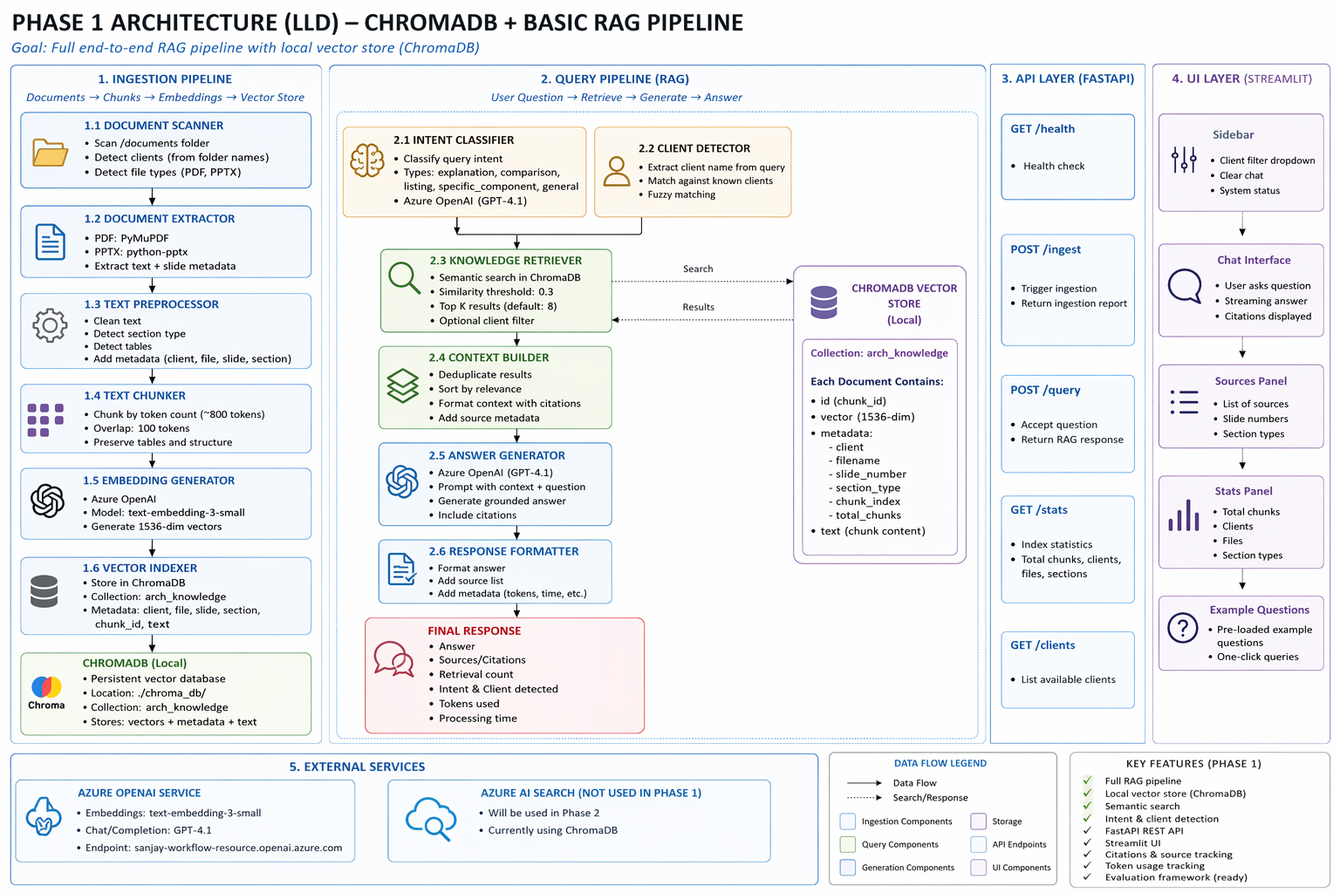
Phase 1 Architecture — Low-Level Design
[ INSERT PHASE 1 LLD DIAGRAM HERE ]
→ Save the Phase 1 LLD image and insert it here (Delete this text after inserting)

Slide 5
Phase 2 — Enterprise RAG (Azure-Native)
Hybrid Search + Streaming + Caching + Feature Flags
What changed from Phase 1:
Search (the biggest improvement):
• ChromaDB (vector only) → Azure AI Search (vector + BM25 keyword + score fusion)
• "account number 556008695729" → now found via BM25 exact match!
• Comparison retrieval: 3+3 chunks → 4+4 chunks (more context)
New capabilities:
• Streaming responses: words appear one-by-one (SSE via /query/stream)
• Response caching: repeat queries return instantly (in-memory, 1hr TTL)
• Feature flags: USE_AZURE_SEARCH, USE_DOC_INTELLIGENCE (switch in .env)
• Azure Document Intelligence: ready but OFF (reserved for live demo)
What stayed the same:
• Same ingestion pipeline (scan → extract → chunk → embed)
• Same generation (GPT-4.1 + system prompt + citations)
• Same UI (Streamlit) — but now with streaming display

Slide 6
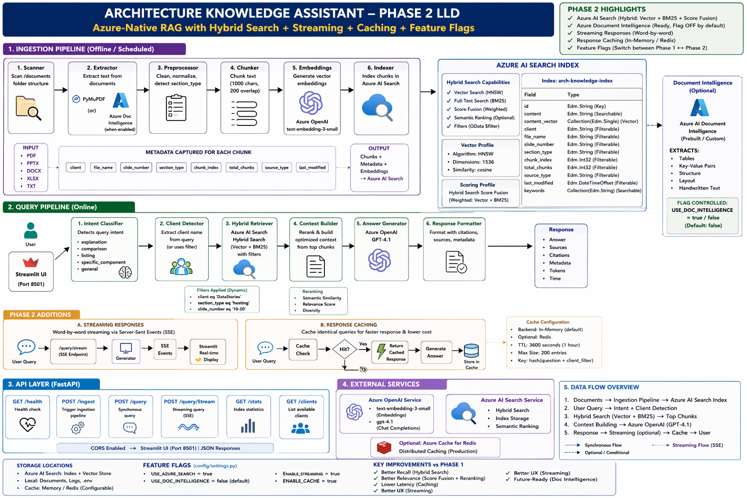
Phase 2 Architecture — Low-Level Design
[ INSERT PHASE 2 LLD DIAGRAM HERE ]
→ Save the Phase 2 LLD image and insert it here (Delete this text after inserting)

Slide 7
Phase 1 vs Phase 2 — What Changed
Component | Phase 1 | Phase 2 | Impact
Vector Store | ChromaDB (local) | Azure AI Search (cloud) | Managed, scalable, hybrid search
Search Type | Semantic only | Hybrid (vector + BM25 + fusion) | Finds exact terms + meaning
Reranking | None | Available on Basic tier | Better precision on top results
Streaming | No (full response at once) | Yes (word-by-word SSE) | User sees first words in 1s
Caching | No | In-memory (1hr TTL, 200 max) | Repeat queries: instant + free
Doc Extraction | python-pptx only | python-pptx OR Azure Doc Intelligence | OCR reads diagram text
Config Switch | Hardcoded | Feature flags in .env | Switch Phase 1↔2 without code change
API Endpoints | 5 | 6 (added /query/stream) | Streaming support
Monthly Cost | ~₹8K-11K | ~₹15K-18K | Azure AI Search adds ₹7K

Slide 8
Phase 3 — Agentic RAG
Intelligent Agent that Thinks, Plans, Acts, and Answers using Tools
What's new — the agent DECIDES what to do:
Agent Loop (Think → Act → Observe → Repeat):
• LLM reads question → decides which tools to call
• Executes tools (search, list clients, get stats)
• Reads results → decides if more info needed → calls more tools
• When satisfied → generates comprehensive answer with citations
Multi-Model Routing:
• Simple queries ("How is DataStories hosted?") → GPT-4.1 Mini ($0.001)
• Complex queries ("Compare budgets across all clients") → GPT-4.1 Full ($0.014)
• Classification tasks → GPT-4.1 Nano ($0.0002)
• Average 80% cost reduction on simple queries
Self-Correction:
• Agent searches with section_type="budget" → 0 results
• Agent adapts: removes filter, searches broader → finds results
• Phase 1-2 would just return "no information found"
Real results:
• Simple query: 1 tool call, 1 iteration, Mini model, 10.7s
• Budget comparison: 4 tool calls, 2 iterations, Full model, 15.2s
• Cross-client AWS: 7 tool calls, 5 iterations, Full model, 19.3s

Slide 9
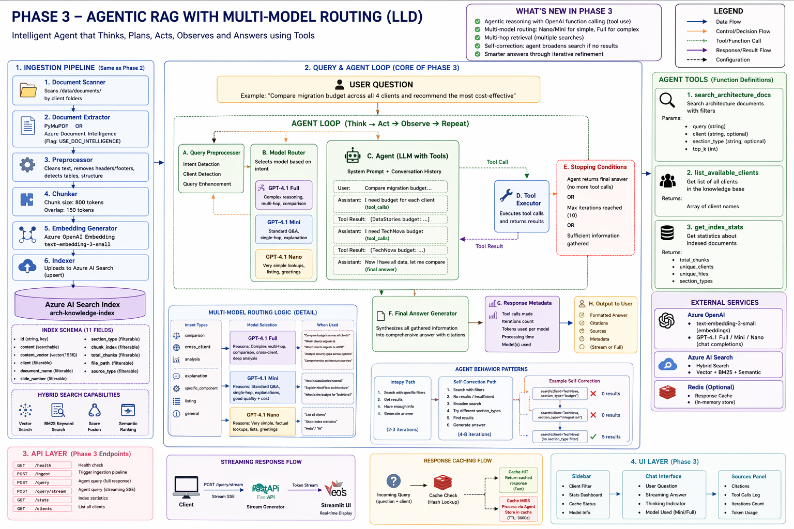
Phase 3 Architecture — Low-Level Design
[ INSERT PHASE 3 LLD DIAGRAM HERE ]
→ Save the Phase 3 LLD image and insert it here (Delete this text after inserting)

Slide 10
The Complete Journey — By The Numbers
Metric | Phase 1 | Phase 2 | Phase 3
Search Type | Semantic only | Hybrid (vector+BM25) | Hybrid + agent-chosen
LLM Models | GPT-4.1 (all queries) | GPT-4.1 (all queries) | Mini/Full/Nano (routed)
Tool Calls/Query | 0 (fixed pipeline) | 0 (fixed pipeline) | 1-21 (dynamic)
Iterations/Query | 1 (always) | 1 (always) | 1-6 (adaptive)
Self-Correction | ❌ No | ❌ No | ✅ Broadens search
Cross-Client Query | Limited (1 search) | Better (hybrid) | ✅ Per-client searches
Streaming | ❌ No | ✅ Word-by-word | ✅ Word-by-word
Caching | ❌ No | ✅ In-memory (1hr) | ✅ In-memory (1hr)
Simple Query Cost | $0.014 | $0.014 | $0.001 (93% less)
Exact Term Search | ❌ Misses | ✅ BM25 finds | ✅ BM25 finds
Feature Flags | ❌ No | ✅ Switch in .env | ✅ Switch in .env

Slide 11
Thank You
Questions & Discussion
3 Phases | 89 Chunks | 4 Clients | Hybrid Search | Agentic RAG
Architecture Team | June 2026
"The best way to learn RAG is to build RAG."

