Slide 1
UNIT - 1
Internet
Internet is defined as an Information super Highway, to access information over the web
Internet is a world-wide global system of interconnected computer networks.
Internet uses the standard Internet Protocol (TCP/IP).
Every computer in internet is identified by a unique IP address.
IP Address is a unique set of numbers (such as 110.22.33.114) which identifies a computer location.
A special computer DNS (Domain Name Server) is used to give name to the IP Address so that user can locate a computer by a name.
For example, a DNS server will resolve a name http://www.google.com to a particular IP address to uniquely identify the computer on which this website is hosted.
Internet is accessible to every user all over the world.

Slide 2
Evolution
The concept of Internet was originated in 1969 and has undergone several technological
The origin of Internet devised from the concept of Advanced Research Project Agency Network (ARPANET).
ARPANET was developed by United States Department of Defense.
Basic purpose of ARPANET was to provide communication among the various bodies of government.
Initially, there were only four nodes, formally called Hosts.
In 1972, the ARPANET spread over the globe with 23 nodes located at different countries and thus became known as Internet.
By the time, with invention of new technologies such as TCP/IP protocols, DNS, WWW, browsers, scripting languages etc.

Slide 3
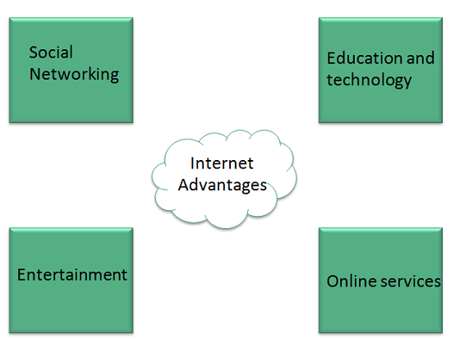
Facebook, Twitter, Yahoo, Google+
Online Television, Online Games, Songs, Videos
Internet Banking, Matrimonial Services, Online Shopping, Online Ticket Booking, Online Bill Payment, Data Sharing, E-mail

Slide 4
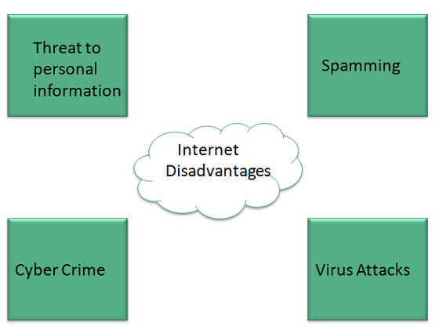
Disadvantages

Slide 5
Intranet
Intranet is defined as private network of computers within an organization with its own server and firewall.
Intranet is system in which multiple PCs are networked to be connected to each other.
PCs in intranet are not available to the world outside of the intranet.
Usually each company or organization has their own Intranet network and members/employees of that company can access the computers in their intranet.
Every computer in internet is identified by a unique IP address.
Each computer in Intranet is also identified by a IP Address, which is unique among the computers in that Intranet.

Slide 6
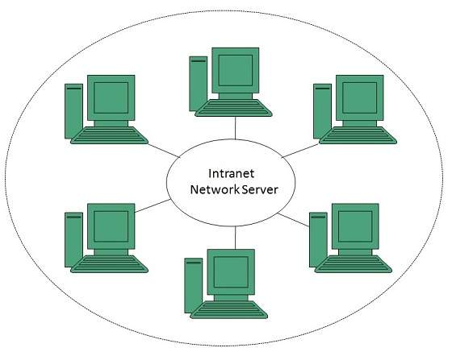
Intranet | Internet
Localized Network. | Worldwide Network
Doesn't have access to Intranet | Have access to Internet.
More Expensive | Less Expensive
More Safe | Less Safe
More Reliability | Less Reliability

Slide 7
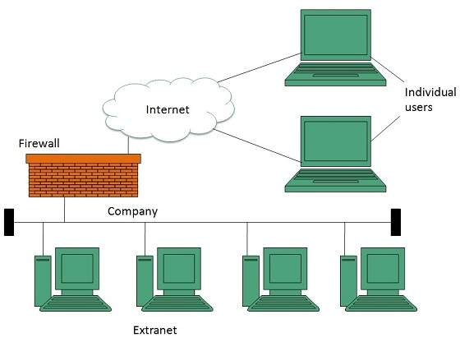
Extranet
Extranet refers to network within an organization, using internet to connect to the outsiders in controlled manner. It helps to connect businesses with their customers and suppliers and therefore allows working in a collaborative manner.

Slide 8
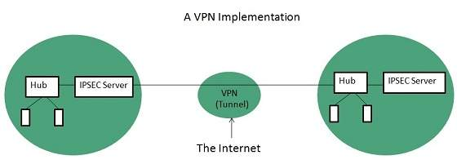
Extranet is implemented as a Virtual Private Networks (VPN) because it uses internet to connect to corporate organization and there is always a threat to information security. VPN offers a secure network in public infrastructure (Internet).
VPN uses Internet Protocol Security Architecture (IPSEC) Protocol to provide secure transactions by adding an additional security layer to TCP/IP protocol.

Slide 9
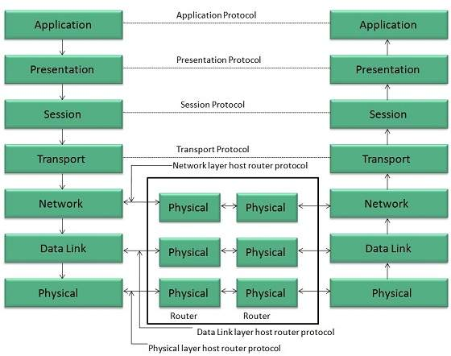
Reference Model
We have two reference models such as OSI model and TCP/IP reference model, however, the OSI model is a hypothetical one but the TCP/IP is absolutely practical model.
OSI is acronym of Open System Interface. This model is developed by the International organization of Standardization (ISO) and therefore also referred as ISO-OSI Model.

Slide 10
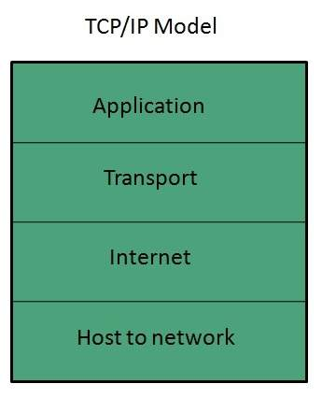
TCP/IP Model
TCP/IP model is practical model and is used in the Internet. TCP/IP is acronym of Transmission Control Protocol and Internet Protocol.
The TCP/IP model combines the two layers (Physical and Data link layer) into one layer

Slide 11
DNS
Domain Name System helps to resolve the host name to an address. It uses a hierarchical naming scheme and distributed database of IP addresses and associated names
IP Address
IP address is a unique logical address assigned to a machine over the network.
IP address is the unique address assigned to each host present on Internet.
IP address is 32 bits (4 bytes) long.
IP address consists of two components: network component and host component.
Each of the 4 bytes is represented by a number from 0 to 255, separated with dots.
For example 192.168.4.124

Slide 12
Uniform Resource Locator (URL)
Uniform Resource Locator (URL) refers to a web address which uniquely identifies a document over the internet.
URL Types
There are two forms of URL as listed below:
Absolute URL
Relative URL
Absolute URL
Absolute URL is a complete address of a resource on the web. This completed address comprises of protocol used, server name, path name and file name.
For example http:// www. parishkar.org/index.html
http is the protocol.
parishkar.org is the server name.
index.htm is the file name.

Slide 13
The protocol part tells the web browser how to handle the file. Similarly we have some other protocols also that can be used to create URL are:
FTP
https
Gopher
mailto
news
Relative URL
Relative URL is a partial address of a webpage. Unlike absolute URL, the protocol and server part are omitted from relative URL.
For example http:// www. parishkar.org/b-c-a/computer.jpg

Slide 14
Domain Name System Architecture
The Domain name system comprises of Domain Names, Domain Name Space, Name Server
Domain Name is a symbolic string associated with an IP address. There are several domain names available; some of them are generic such as com, edu, gov, net etc
Domain Name | Meaning
Com | Commercial business
Edu | Education
Gov | U.S. government agency
Int | International entity
Mil | U.S. military
Net | Networking organization
Org | Non profit organization

Slide 15
DNS Working
DNS translates the domain name into IP address automatically
When we type www.parishkar.org into the browser, it asks the local DNS Server for its IP address.
When the local DNS does not find the IP address of requested domain name, it forwards the request to the root DNS server and again enquires about IP address of it.
Internet Service Providers (ISP)
Internet Service Provider (ISP) is a company offering access to internet. They offer various services:
Internet Access
Domain name registration
Dial-up access
Leased line access

Slide 16
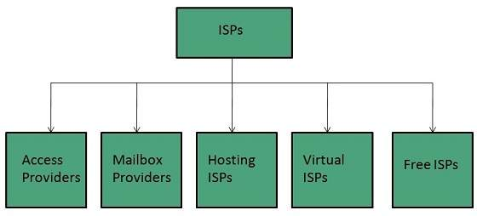
Connection Types
Dial-up Connection
ISDN
DSL
Cable TV Internet connections
Satellite Internet connections
Wireless Internet Connections

Slide 17
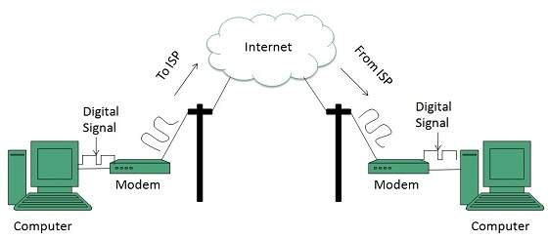
Dial-up Connection
Dial-up connection uses telephone line to connect PC to the internet. It requires a modem to setup dial-up connection. This modem works as an interface between PC and the telephone line.
Dial-up connection uses either of the following protocols:
Serial Line Internet Protocol (SLIP)
Point to Point Protocol (PPP)

Slide 18
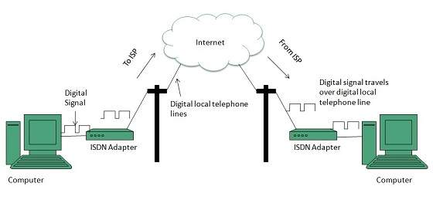
ISDN
ISDN is acronym of Integrated Services Digital Network. It establishes the connection using the phone lines which carry digital signals instead of analog signals.
There are two techniques to deliver ISDN services:
Basic Rate Interface (BRI)
Primary Rate Interface (PRI)

Slide 19
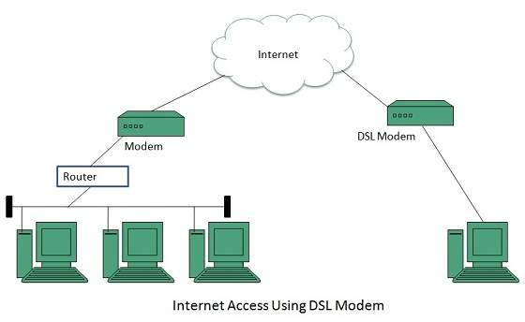
DSL
DSL is acronym of Digital Subscriber Line. It is a form of broadband connection as it provides connection over ordinary telephone lines.
Asymmetric DSL (ADSL)
Symmetric DSL (SDSL)
High bit-rate DSL (HDSL)
Rate adaptive DSL (RDSL)
Very high bit-rate DSL (VDSL)
ISDN DSL (IDSL)
These technologies differ in their upload and download speed, bit transfer rate and level of service.

Slide 20
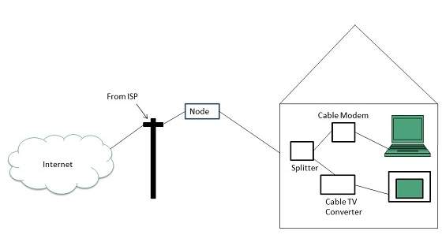
Cable TV Internet Connection
Cable TV Internet connection is provided through Cable TV lines. It uses coaxial cable which is capable of transferring data at much higher speed than common telephone line.

Slide 21
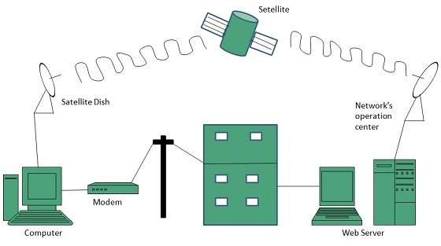
Satellite Internet Connection
Satellite Internet connection offers high speed connection to the internet. There are two types of satellite internet connection: one way connection or two way connection.
In one way connection, we can only download data but if we want to upload, we need a dialup access through ISP over telephone line.
In two way connection, we can download and upload the data by the satellite. It does not require any dialup connection.

Slide 22
Wireless Internet Connection
Wireless Internet Connection makes use of radio frequency bands to connect to the internet and offers a very high speed. The wireless internet connection can be obtained by either WiFi or Bluetooth.
Wi Fi wireless technology is based on IEEE 802.11 standards which allow the electronic device to connect to the internet.
Bluetooth wireless technology makes use of short-wavelength radio waves and helps to create personal area network (PAN).

Slide 23
Transmission Control Protocol (TCP)
TCP is a connection oriented protocol and offers end-to-end packet delivery. It acts as back bone for connection.
Transmission Control Protocol (TCP) corresponds to the Transport Layer of OSI Model.
TCP is a reliable and connection oriented protocol.
TCP offers following services to the processes at the application layer:
Stream Delivery Service
Sending and Receiving Buffers
Bytes and Segments
Full Duplex Service
Connection Oriented Service
Reliable Service

Slide 24
Internet Protocol (IP)
Internet Protocol is connectionless and unreliable protocol. It ensures no guarantee of successfully transmission of data.
In order to make it reliable, it must be paired with reliable protocol such as TCP at the transport layer.
File Transfer Protocol (FTP)
FTP is used to copy files from one host to another. FTP offers the mechanism for the same in following manner:
FTP creates two processes such as Control Process and Data Transfer Process at both ends i.e. at client as well as at server.
FTP establishes two different connections: one is for data transfer and other is for control information.
Control connection is made between control processes while Data Connectionis made between<="" b="">
FTP uses port 21 for the control connection and Port 20 for the data connection.

Slide 25
Hyper Text Transfer Protocol (HTTP)
HTTP is a communication protocol. It defines mechanism for communication between browser and the web server. It is also called request and response protocol because the communication between browser and server takes place in request and response pairs.
HTTP Request
HTTP request comprises of lines which contains:
Request line
Header Fields
Message body
Email
Email is a service which allows us to send the message in electronic mode over the internet. It offers an efficient, inexpensive and real time mean of distributing information among people.

Slide 26
E-Mail Address
Each user of email is assigned a unique name for his email account. This name is known as E-mail address. Different users can send and receive messages according to the e-mail address.
E-mail is generally of the form username@domainname. For example, test@gmail.com is an e-mail address where test is username and google.com is domain name.
The username and the domain name are separated by @ (at) symbol.
E-mail addresses are not case sensitive.
Spaces are not allowed in e-mail address

Slide 27
E-mail Message Components
E-mail Header
The first five lines of an E-mail message is called E-mail header. The header part comprises of following fields:
From
Date
To
Subject
CC
BCC

Slide 28
From
The From field indicates the sender’s address i.e. who sent the e-mail.
Date
The Date field indicates the date when the e-mail was sent.
To
The To field indicates the recipient’s address i.e. to whom the e-mail is sent.
Subject
The Subject field indicates the purpose of e-mail. It should be precise and to the point.
CC
CC stands for Carbon copy. It includes those recipient addresses whom we want to keep informed but not exactly the intended recipient.
BCC
BCC stands for Black Carbon Copy. It is used when we do not want one or more of the recipients to know that someone else was copied on the message.
Greeting
Greeting is the opening of the actual message. Eg. Hi Sir or Hi Guys etc.

Slide 29
Text
It represents the actual content of the message.
Signature
This is the final part of an e-mail message. It includes Name of Sender, Address, and Contact Number
Advantages
E-mail has prooved to be powerful and reliable medium of commmunication.
Reliable
Convenience
Speed
Inexpensive
Printable
Global
Generality

Slide 30
Disadvantages
Apart from several benefits of E-mail, there also exists some disadvantages.
Forgery
Overload
Misdirection
Junk
No response
E-mail Protocols are set of rules that help the client to properly transmit the information to or from the mail server. we will discuss various protocols such as SMTP, POP, and IMAP.
SMPTP
SMTP stands for Simple Mail Transfer Protocol. It was first proposed in 1982. It is a standard protocol used for sending e-mail efficiently and reliably over the internet.

Slide 31
IMAP
IMAP stands for Internet Mail Access Protocol. It was first proposed in 1986. There exist five versions of IMAP as follows:
Original IMAP
IMAP2
IMAP3
IMAP2bis
IMAP4
Key Points:
IMAP allows the client program to manipulate the e-mail message on the server without downloading them on the local computer.
The e-mail is hold and maintained by the remote server.
It enables us to take any action such as downloading, delete the mail without reading the mail.It enables us to create, manipulate and delete remote message folders called mail boxes.
IMAP enables the users to search the e-mails.
It allows concurrent access to multiple mailboxes on multiple mail servers.

Slide 32
POP
POP stands for Post Office Protocol. It is generally used to support a single client. There are several versions of POP but the POP 3 is the current standard.
POP is an application layer internet standard protocol.
Since POP supports offline access to the messages, thus requires less internet usage time.
POP does not allow search facility.
In order to access the messaged, it is necessary to download them.
It allows only one mailbox to be created on server.
It is not suitable for accessing non mail data.
POP commands are generally abbreviated into codes of three or four letters. Eg. STAT.

Slide 33
E-mail System
E-mail system comprises of the following three components:
Mailer
Mail Server
Mailbox
Mailer
It is also called mail program, mail application or mail client. It allows us to manage, read and compose e-mail.
Mail Server
The function of mail server is to receive, store and deliver the email. It is must for mail servers to be Running all the time because if it crashes or is down, email can be lost.
Mailboxes
Mailbox is generally a folder that contains emails and information about them.

Slide 34
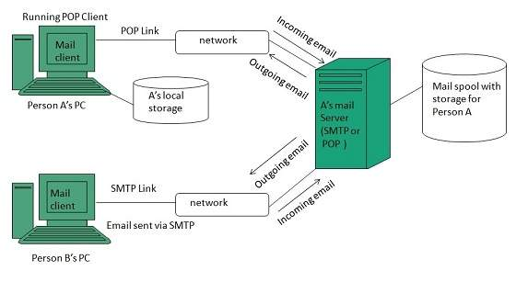
Working of E-mail

Slide 35
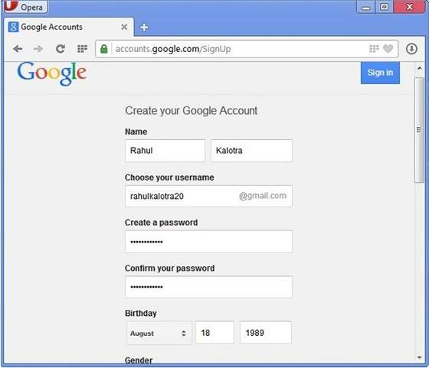
Creating Email Account
There are various email service provider available such as Gmail, hotmail, ymail, rediff mailetc. Here we will learn how to create an account using Gmail.
Open gmail.com and click create an account.
Now a form will appear. Fill your details here and click Next Step.

Slide 36
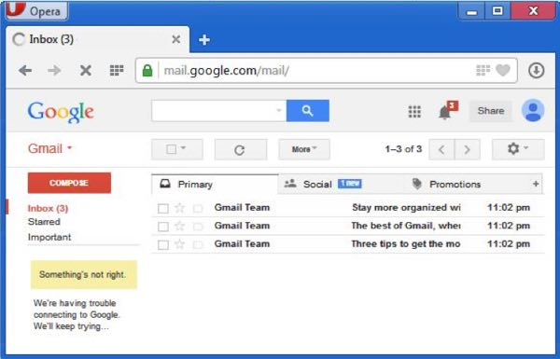
This step allows you to add your picture. If you don’t want to upload now, you can do it later. Click Next Step.
Now a welcome window appears. Click Continue to Gmail.
Wow!! You are done with creating your email account with Gmail. It’s that easy. Isn’t it?
Now you will see your Gmail account as shown in the following image:

Slide 37
Gmail manages the mail into three categories namely Primary, Social and Promotions.
Compose option is given at the right to compose an email message.
Inbox, Starred, Sent mail, Drafts options are available on the left pane which allows you to keep track of your emails.
Composing and Sending Email
Sender’s address in To field
Cc (if required)
Bcc (if required)
Subject of email message
Text
Signature
Now a day, the mail client comes with enhanced features such as attachment, address book, and MIME support

Slide 38
Attachment
Ability to attach file(s) along with the message is one of the most useful features of email. The attachment may be a word document, PowerPoint presentation, audio/video files, or images.
Address Book
Address book feature of a mail program allows the users to store information about the people whom they communicate regularly by sending emails.
MIME Types
MIME is acronym of Multipurpose Internet Mail Extensions. MIME compliant mailer allows us to send files other than simple text i.e. It allows us to send audio, video, images, document, and pdf files as an attachment to an email.

Slide 39
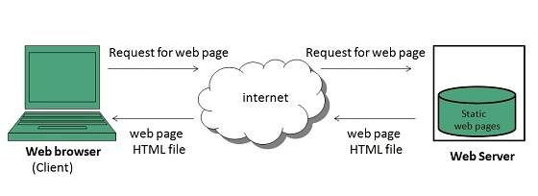
Website is a location on web and is hosted on a web server. It is a set of related web pages. It is accessed using Internet address known as Uniform Resource Locator
Static Websites
Static websites are also known as flat or stationary websites. They are loaded on the client’s browser as exactly they are stored on the web server. Such websites contain only static information. User can only read the information but can’t do any modification or interact with the information.
Static websites are created using only HTML. Static websites are only used when the information is no more required to be modified.

Slide 40
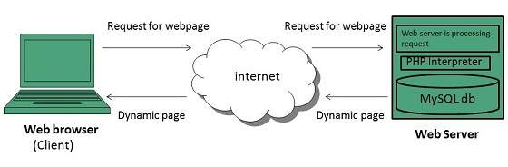
Dynamic Websites
Dynamic websites shows different information at different point of time. It is possible to change a portion of a web page without loading the entire web page. It has been made possible using Ajax technology.
Server-side dynamic web page
It is created by using server-side scripting. There are server-side scripting parameters that determine how to assemble a new web page which also include setting up of more client-side processing.
Client-side dynamic web page
It is processed using client side scripting such as javascript. And then passed in to Document Object Model (DOM).

Slide 41
Internet Forums
An internet forum is message board where people can hold conversation by posting messages
A forum can contain several sub forums.
Each of sub forums may contain a number of topics.
Within a forum’s topic, each new discussion started is called a thread.
This thread can be replied by as many people as so wish
Blog
The term Blog is taken from web log. It is a kind of web site that is updated regularly, with content about almost anything. In other words, blog is a Content Management System (CMS), an easy way of publishing articles on the internet.

Slide 42
Blogging Terminologies
Blog
A type of website used to publish content on the internet.
Blogger
A person who writes for a blog.
Blogging
Writing for blogs is referred as blogging.
Blogosphere
A term is used to refer all the blogs on the web.
E-commerce
E-Commerce or Electronics Commerce is a methodology of modern business which addresses the need of business organizations, vendors and customers to reduce cost and improve the quality of goods and services while increasing the speed of delivery.

Slide 43
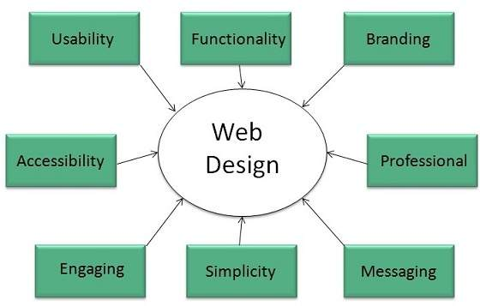
Web designing has direct link to visual aspect of a web site. Effective web design is necessary to communicate ideas effectively.

Slide 44
Websites are always to prone to security risks. Cyber crime impacts your business by hacking your website. Your website is then used for hacking assaults that install malicious software or malware on your visitor’s computer.
Security Considerations
Updated Software
It is mandatory to keep you software updated. It plays vital role in keeping your website secure.
SQL Injection
It is an attempt by the hackers to manipulate your database. It is easy to insert rogue code into your query that can be used to manipulate your database such as change tables, get information or delete data.
Cross Site Scripting (XSS)
It allows the attackers to inject client side script into web pages. Therefore, while creating a form It is good to endure that you check the data being submitted and encode or strip out any HTML.

Slide 45
Error Messages
You need to be careful about how much information to be given in the error messages. For example, if the user fails to log in the error message should not let the user know which field is incorrect: username or password.
Validation of Data
The validation should be performed on both server side and client side.
Passwords It is good to enforce password requirements such as of minimum of eight characters, including upper case, lower case and special character. It will help to protect user’s information in long run.
Upload files
The file uploaded by the user may contain a script that when executed on the server opens up your website.
SSL (Secure Sockets Layer)
It is good practice to use SSL protocol while passing personal information between website and web server or database.

Slide 46
web browser
A web browser is an interface that helps a computer user gain access to all the content that is on the Internet and the hard disk of the computer. It can access web pages, images, text documents, audio and video files, games, etc. More than one web browser can be installed in the computer.
Internet Explorer It was developed by Microsoft in 1994 and released in 1995 as a supportive package to Microsoft Windows line of operating systems. According to statistics, its usage share from 1999 to 2003-04 was around 95%. Microsoft occasionally releases updates for the previous versions of IE, which have some enhanced capabilities. IE has come up a preview release of Internet Explorer 10.
Mozilla Firefox It is owned by Mozilla Corporation and was the result of an experimentation. 'Mozilla Firefox' was officially announced in February 2004. It was earlier named Phoenix, Firebird, and eventually Firefox. It is the second-most famous browser after Internet Explorer, as there were around 100 million downloads within a year of its release. Until November 2008, 700 million downloads were recorded.

Slide 47
What are Cookies ?
A cookie is a text file that a Web browser stores on a user’s machine. Cookies are a way for Web applications to maintain application state. They are used by websites for authentication, storing website information/preferences, other browsing information and anything else that can help the Web browser while accessing Web servers.
Web Browsers and Servers use HTTP protocol to communicate and HTTP is a stateless protocol. But for a commercial website, it is required to maintain session information among different pages
How It Works ?
Your server sends some data to the visitor's browser in the form of a cookie. The browser may accept the cookie. If it does, it is stored as a plain text record on the visitor's hard drive. Now, when the visitor arrives at another page on your site, the browser sends the same cookie to the server for retrieval. Once retrieved, your server knows/remembers what was stored earlier.

Slide 48
Cookies are a plain text data record of 5 variable-length fields −
Expires − The date the cookie will expire. If this is blank, the cookie will expire when the visitor quits the browser.
Domain − The domain name of your site.
Path − The path to the directory or web page that set the cookie. This may be blank if you want to retrieve the cookie from any directory or page.
Secure − If this field contains the word "secure", then the cookie may only be retrieved with a secure server. If this field is blank, no such restriction exists.
Name=Value − Cookies are set and retrieved in the form of key-value pairs

Slide 49
Safari This is a web browser from Apple Inc., which is compatible with Mac OS X, Microsoft Windows, and the iPhone OS. Safari was released by Apple in January 2003 as a public beta. If you need to fill an online form with your personal information, AutoFill is a feature that automatically does that for you, with the help of information that is stored in your address book or Outlook.
Opera This browser was developed by Opera Software in 1996. It is a well-known browser that is mainly used in Internet-activated mobile phones, PDAs, and smartphones. Opera Mini and Opera Mobile are the browsers used in smartphones. It is compatible with many operating systems such as Solaris, Linux, Mac OS X, and Microsoft Windows.
Google Chrome This web browser was developed by Google. Its beta and commercial versions were released in September 2008 for Microsoft Windows. The browser versions for Mac OS X are under development. The browser options are very similar to that of Safari, the settings locations are similar to Internet Explorer 7, and the window design is based on Windows Vista.

