Slide 1

›
Kelvin
127.0.0.1:8000 — home page
COMPILER DESIGN PROJECT
Write a sentence.
Ship firmware.
An AI-assisted DSL compiler for IoT automation
Plain English in. A hand-written C++ compiler checks it in seven phases and generates C, Arduino, Python and JavaScript.
TEAM
R. Sanjay · Settipalli Tejovardhan · Ashutosh
Notes:
Good morning. We are R. Sanjay, Settipalli Tejovardhan and Ashutosh. Our Compiler Design project is Kelvin, an AI-assisted compiler for IoT automation rules. The idea is simple: a person describes a rule in plain English, an AI turns it into our small rule language, and our own compiler, written by hand in C++, checks it through all seven compiler phases and generates real code. On the right is the home page of the website we built around the compiler.

Slide 2
Smart homes run on rules, but people don't write code
01 · THE PROBLEM
Automation is a set of rules: if a sensor reads something, switch a device.
The people who want the rules (home owners, farmers, facility staff) are not programmers.
AI understands English, but it is sometimes wrong, and a wrong rule can switch off a heater or flood a garden.
Our answer: let the AI draft the rule, and let a real compiler check every rule before it runs.
ENGLISH
“If the temperature is above 30 and the door is open, turn on the fan.”
DSL · checked by iotc
SENSOR temperature : NUMBER
SENSOR door : STATE
DEVICE fan
IF temperature > 30 AND door == OPEN
THEN turn_on(fan)
Notes:
Smart homes and IoT systems are controlled by rules: if a sensor reads a value, switch a device. The people who want these rules are usually not programmers. AI models can read English, but they are not always exactly right, and a wrong rule in a real house can be dangerous. So our approach is: the AI only drafts the rule, and our compiler checks it completely before it is used. On the right is the example from our problem statement, the English sentence and the DSL program it becomes.

Slide 3
Three parts, one pipeline
02 · WHAT WE BUILT
01
02
03
AI assistant
Hand-written compiler
Website and Studio
English or voice to DSL with free models: Ollama (local), Groq or Gemini, plus an offline converter.
C++17, no Lex or Yacc. Lexer, LL(1) parser, AST, semantic and rule analysis, IR, CFG optimizer, code generation.
Watch every phase, run the generated code, and simulate it in a smart-home digital twin.
Every answer is compiled before you see it.
Output: C, Arduino, Python, JavaScript.
Phone remote, share links, PDF report.
7
4
121
4,865
compiler phases
code targets
automated tests passing
lines of hand-written C++
Notes:
Our project has three parts that work as one pipeline. First, an AI assistant that converts English or speech into our language using free models: a local Ollama model, Groq or Gemini, with an offline converter as a fallback. Second, the core of the project: a compiler written by hand in C++, with all seven phases. Third, a website where you can see every phase, run the generated code and simulate the result in a smart home. Some numbers: 7 phases, 4 code targets, 121 automated tests that all pass, and 4865 lines of C++ that we wrote ourselves.

Slide 4
From a sentence to running code
03 · ARCHITECTURE
INPUT
FRONT END
MIDDLE
BACK END
English
Lexer
Three-address IR
Code generation
typed or spoken
lexer.cpp
ir.cpp
codegen.cpp: C · Arduino · Py · JS
AI assistant
Parser → AST
CFG & dataflow
Runtimes
ai.py
parser.cpp · ast.cpp
cfg.cpp
runtime/iot_runtime.*
DSL source
Semantic & rules
Optimizer, 8 passes
Digital twin
by hand or by AI
semantic.cpp · rule_analysis.cpp
optimizer.cpp
runs the optimized IR
No parser generators · no frameworks · Python standard library only · works offline
Notes:
This is the architecture. The input is an English sentence, typed or spoken, which the AI assistant turns into our DSL; or the user writes the DSL directly. The front end has the lexer, the parser that builds the abstract syntax tree, and semantic analysis with rule analysis. The middle end produces three-address intermediate code, builds a control-flow graph and optimizes it with eight passes. The back end generates code for four targets, and the digital twin runs the optimized intermediate code in the browser. We did not use any parser generator or framework; the server uses only the Python standard library and everything works offline.

Slide 5
A small language with a precise grammar
04 · THE LANGUAGE
smart_home.iot
Declarations: SENSOR name : NUMBER | STATE, and DEVICE names.
Rules: IF … THEN … with any number of ELSE IF and an optional ELSE.
Conditions: comparisons, AND, OR, NOT, parentheses and arithmetic (+ − × ÷).
Actions: turn_on, turn_off, toggle, set_level.
Types: NUMBER, STATE (ON, OFF, OPEN, CLOSED, TRUE, FALSE) and BOOL.
# Smart home rules
SENSOR temperature : NUMBER
SENSOR door : STATE
SENSOR motion : STATE
DEVICE fan, light, ac
IF temperature > 30 AND door == OPEN
THEN turn_on(fan)
ELSE IF temperature > 26
THEN set_level(fan, 50)
ELSE turn_off(fan)
IF motion == ON OR temperature >= 35
THEN turn_on(light)
set_level(ac, 22.5)
LL(1) 61 productions · 0 conflicts
The compiler computes FIRST, FOLLOW and the parse table from its own grammar.
Notes:
This is our rule language. A program first declares its sensors, which are NUMBER or STATE, and its devices. Then it has rules: IF a condition THEN actions, with any number of ELSE IF branches and an optional ELSE. Conditions can use comparisons, AND, OR, NOT, parentheses and arithmetic. There are four built-in actions. The grammar is LL(1): it has 61 productions, and the compiler itself computes the FIRST and FOLLOW sets and the parse table and finds zero conflicts, which proves it is LL(1).

Slide 6
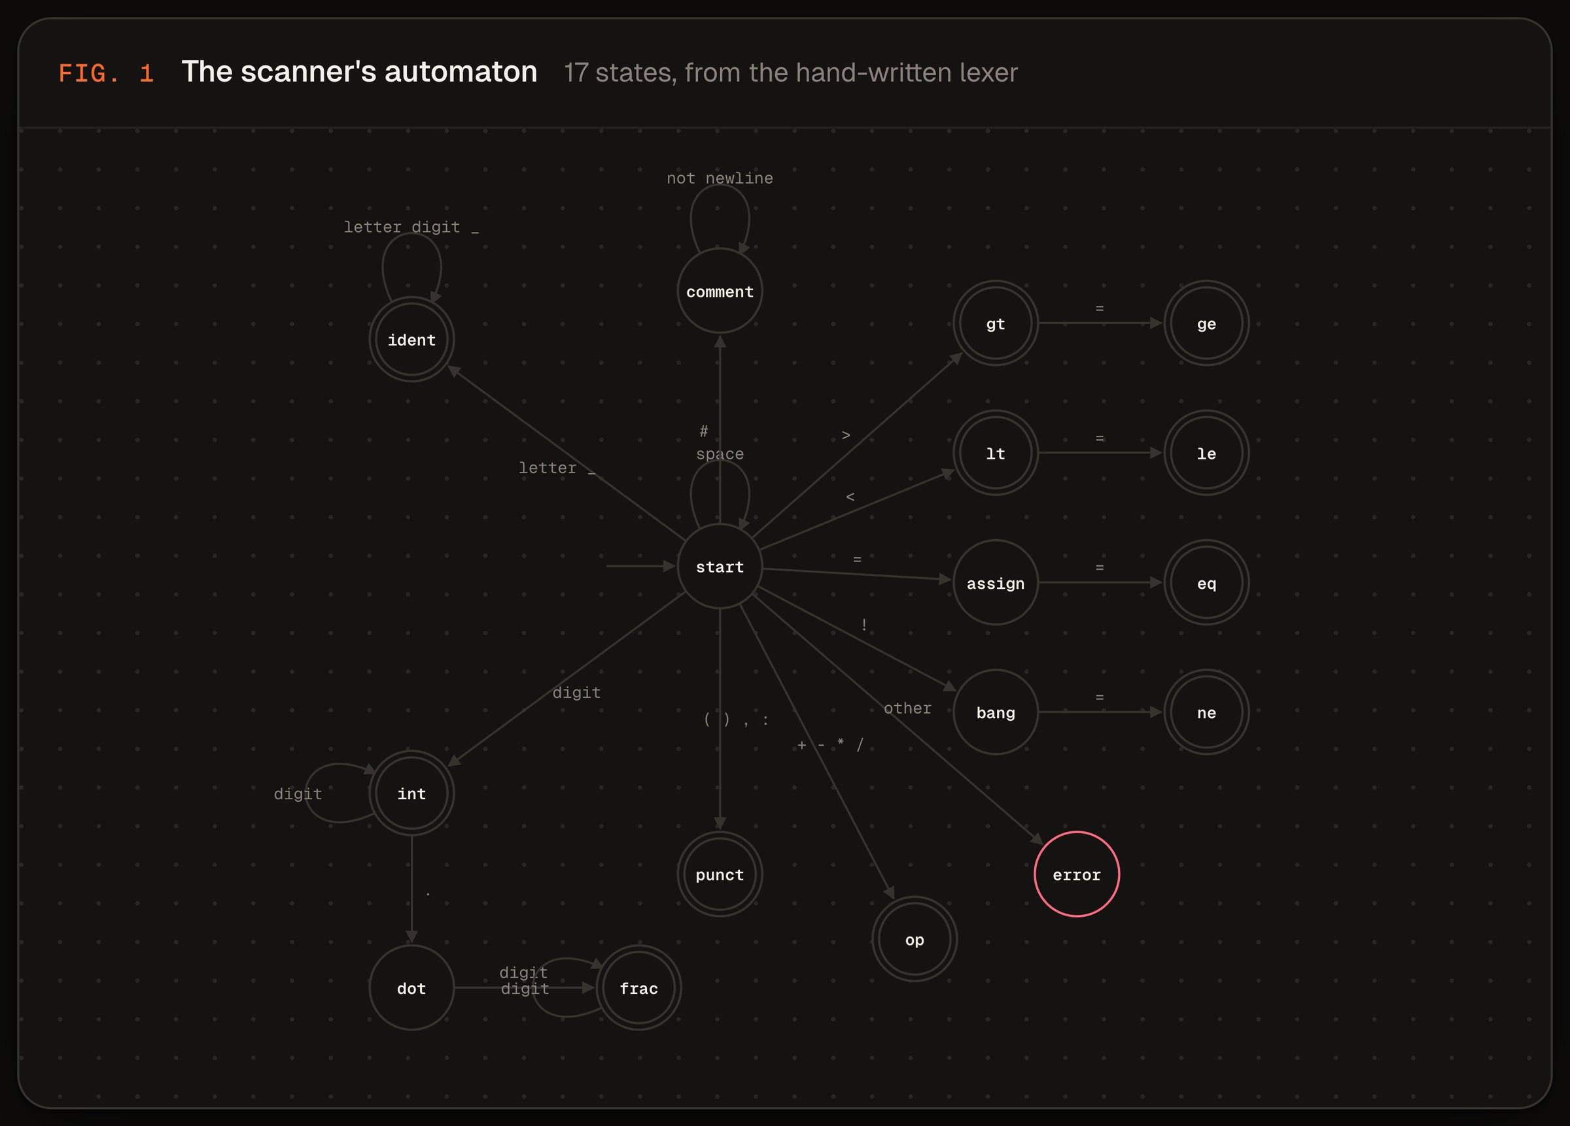
Lexer and parser, written by hand
05 · PHASES 1–2
Scanner DFA — from the compiler
Lexer: a hand-coded DFA with 17 states. It reads one character at a time and takes the longest match (maximal munch).
Errors with fixes: a bad character or '=' instead of '==' is reported with its line, column and a one-click fix.
Parser: recursive descent; each grammar rule is one C++ function (parseExpr, parseAnd, parseRelational …).
Error recovery: panic mode, so several syntax errors are reported in one run.
Notes:
Phase one is the lexer. It is a hand-written deterministic finite automaton with 17 states; the website draws it, as you can see here. It reads one character at a time and always takes the longest possible token, which is called maximal munch. Errors like a stray character, or a single equals sign instead of double equals, come with an exact position and a suggested fix. Phase two is the parser. It is recursive descent: every grammar rule is one C++ function. When it finds a syntax error it uses panic-mode recovery, skipping to a safe token, so it can report several errors in a single run.

Slide 7
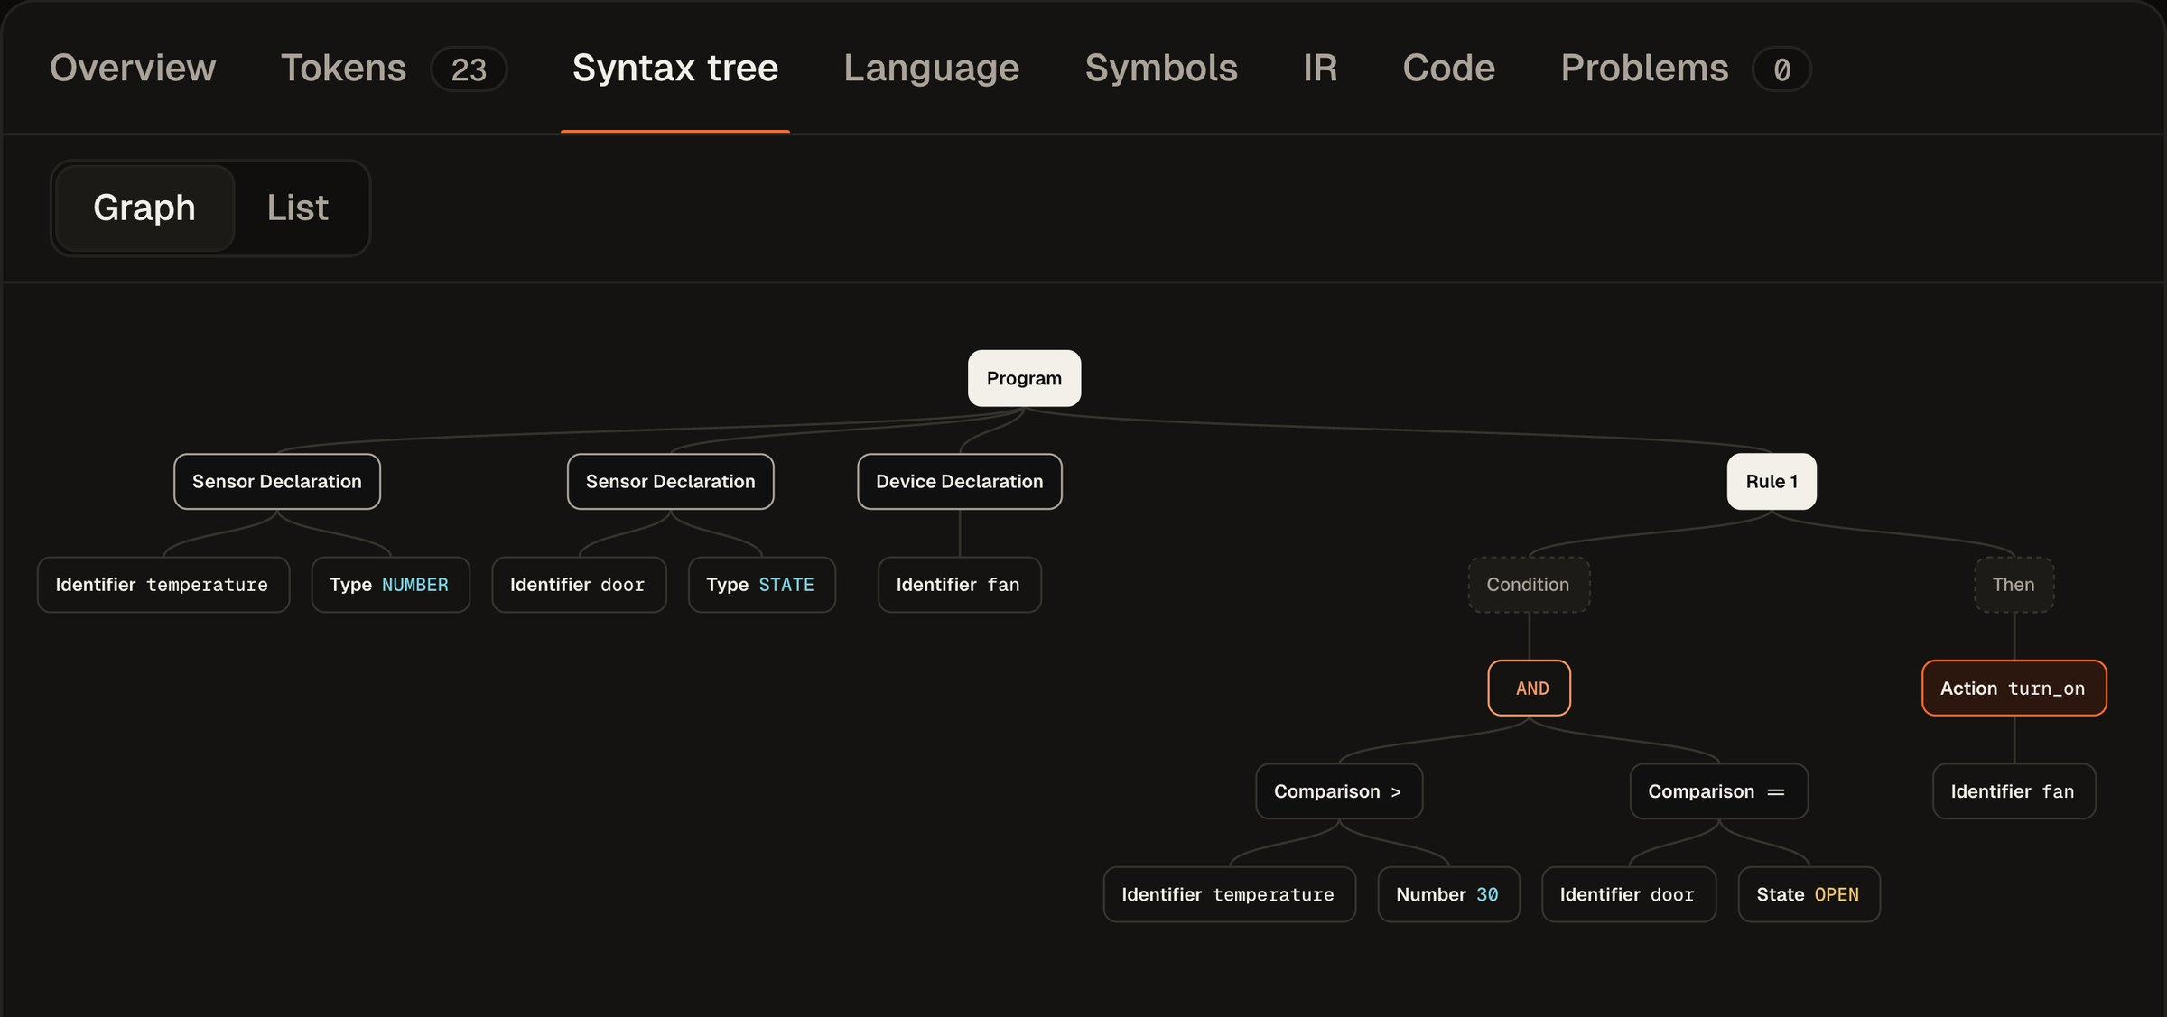
The abstract syntax tree
06 · PHASE 3
Studio · Syntax tree
One expression tree for conditions and arithmetic: binary, unary and operand nodes.
Precedence is built into the grammar: NOT binds tighter than AND, and AND tighter than OR.
Every node keeps its source position, so hovering a node highlights the matching code, tokens, IR and C lines.
Drawn live: pan, zoom and collapse, or switch to a list view.
Notes:
Phase three builds the abstract syntax tree. Conditions and arithmetic share one expression tree made of binary, unary and operand nodes. Operator precedence comes from the grammar itself: NOT binds tighter than AND, and AND tighter than OR. Every node remembers where it came from in the source, which is why, on the website, hovering a node lights up the matching source code, tokens, intermediate code and generated C at the same time.

Slide 8
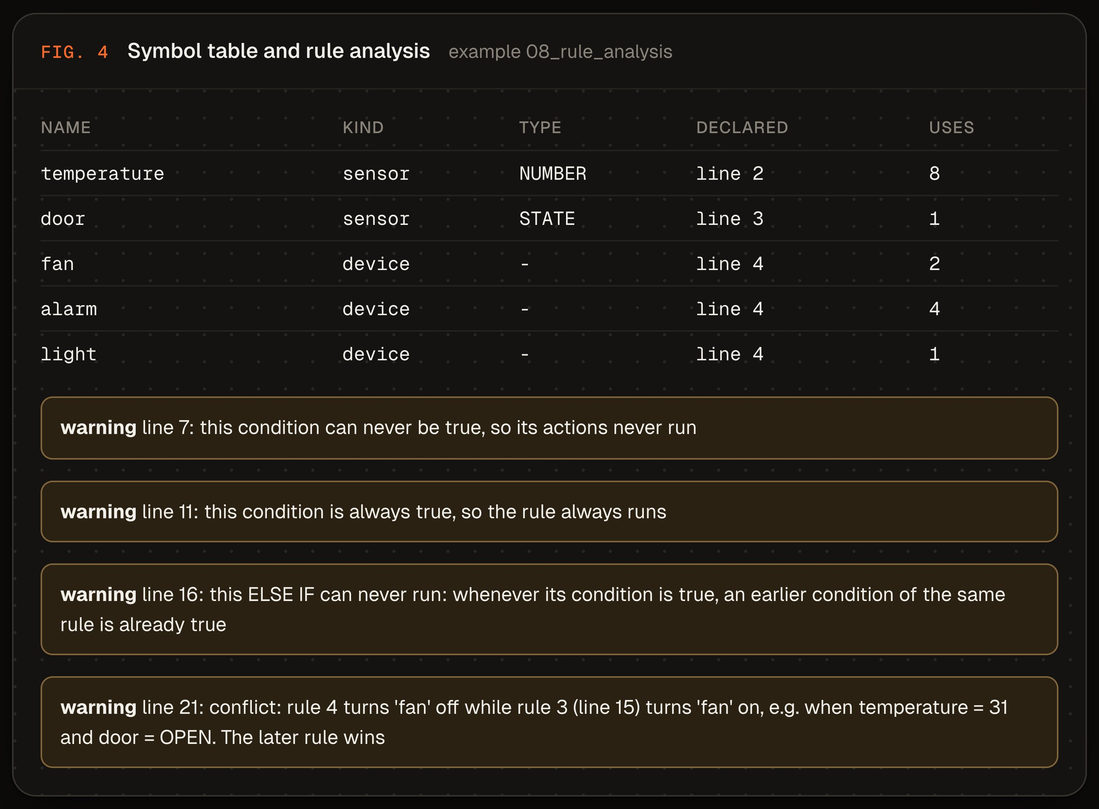
Semantic and rule analysis
07 · PHASE 4
Symbol table and warnings — example 08
Symbol table and types: every name declared once, NUMBER vs STATE checked, action arguments checked.
Helpful errors: “did you mean 'temperature'?” and one-click fixes such as declaring a missing device.
Rule analysis: conditions are put in normal form (DNF) and checked with interval and state-set reasoning.
It finds impossible conditions, always-true conditions, unreachable ELSE IFs, and two rules fighting over a device, with example inputs.
Notes:
Phase four is semantic analysis. The compiler builds a symbol table, checks that every name is declared exactly once, that number sensors are compared with numbers and state sensors with states, and that actions get the right arguments. Error messages include suggestions such as 'did you mean temperature', and many come with a one-click fix. We also added rule analysis, which goes beyond a normal compiler: each condition is converted to disjunctive normal form and checked with interval and state-set reasoning. That lets the compiler warn about conditions that can never be true, conditions that are always true, ELSE IF branches that can never run, and two rules that set the same device differently, and it even gives an example input where they clash.

Slide 9
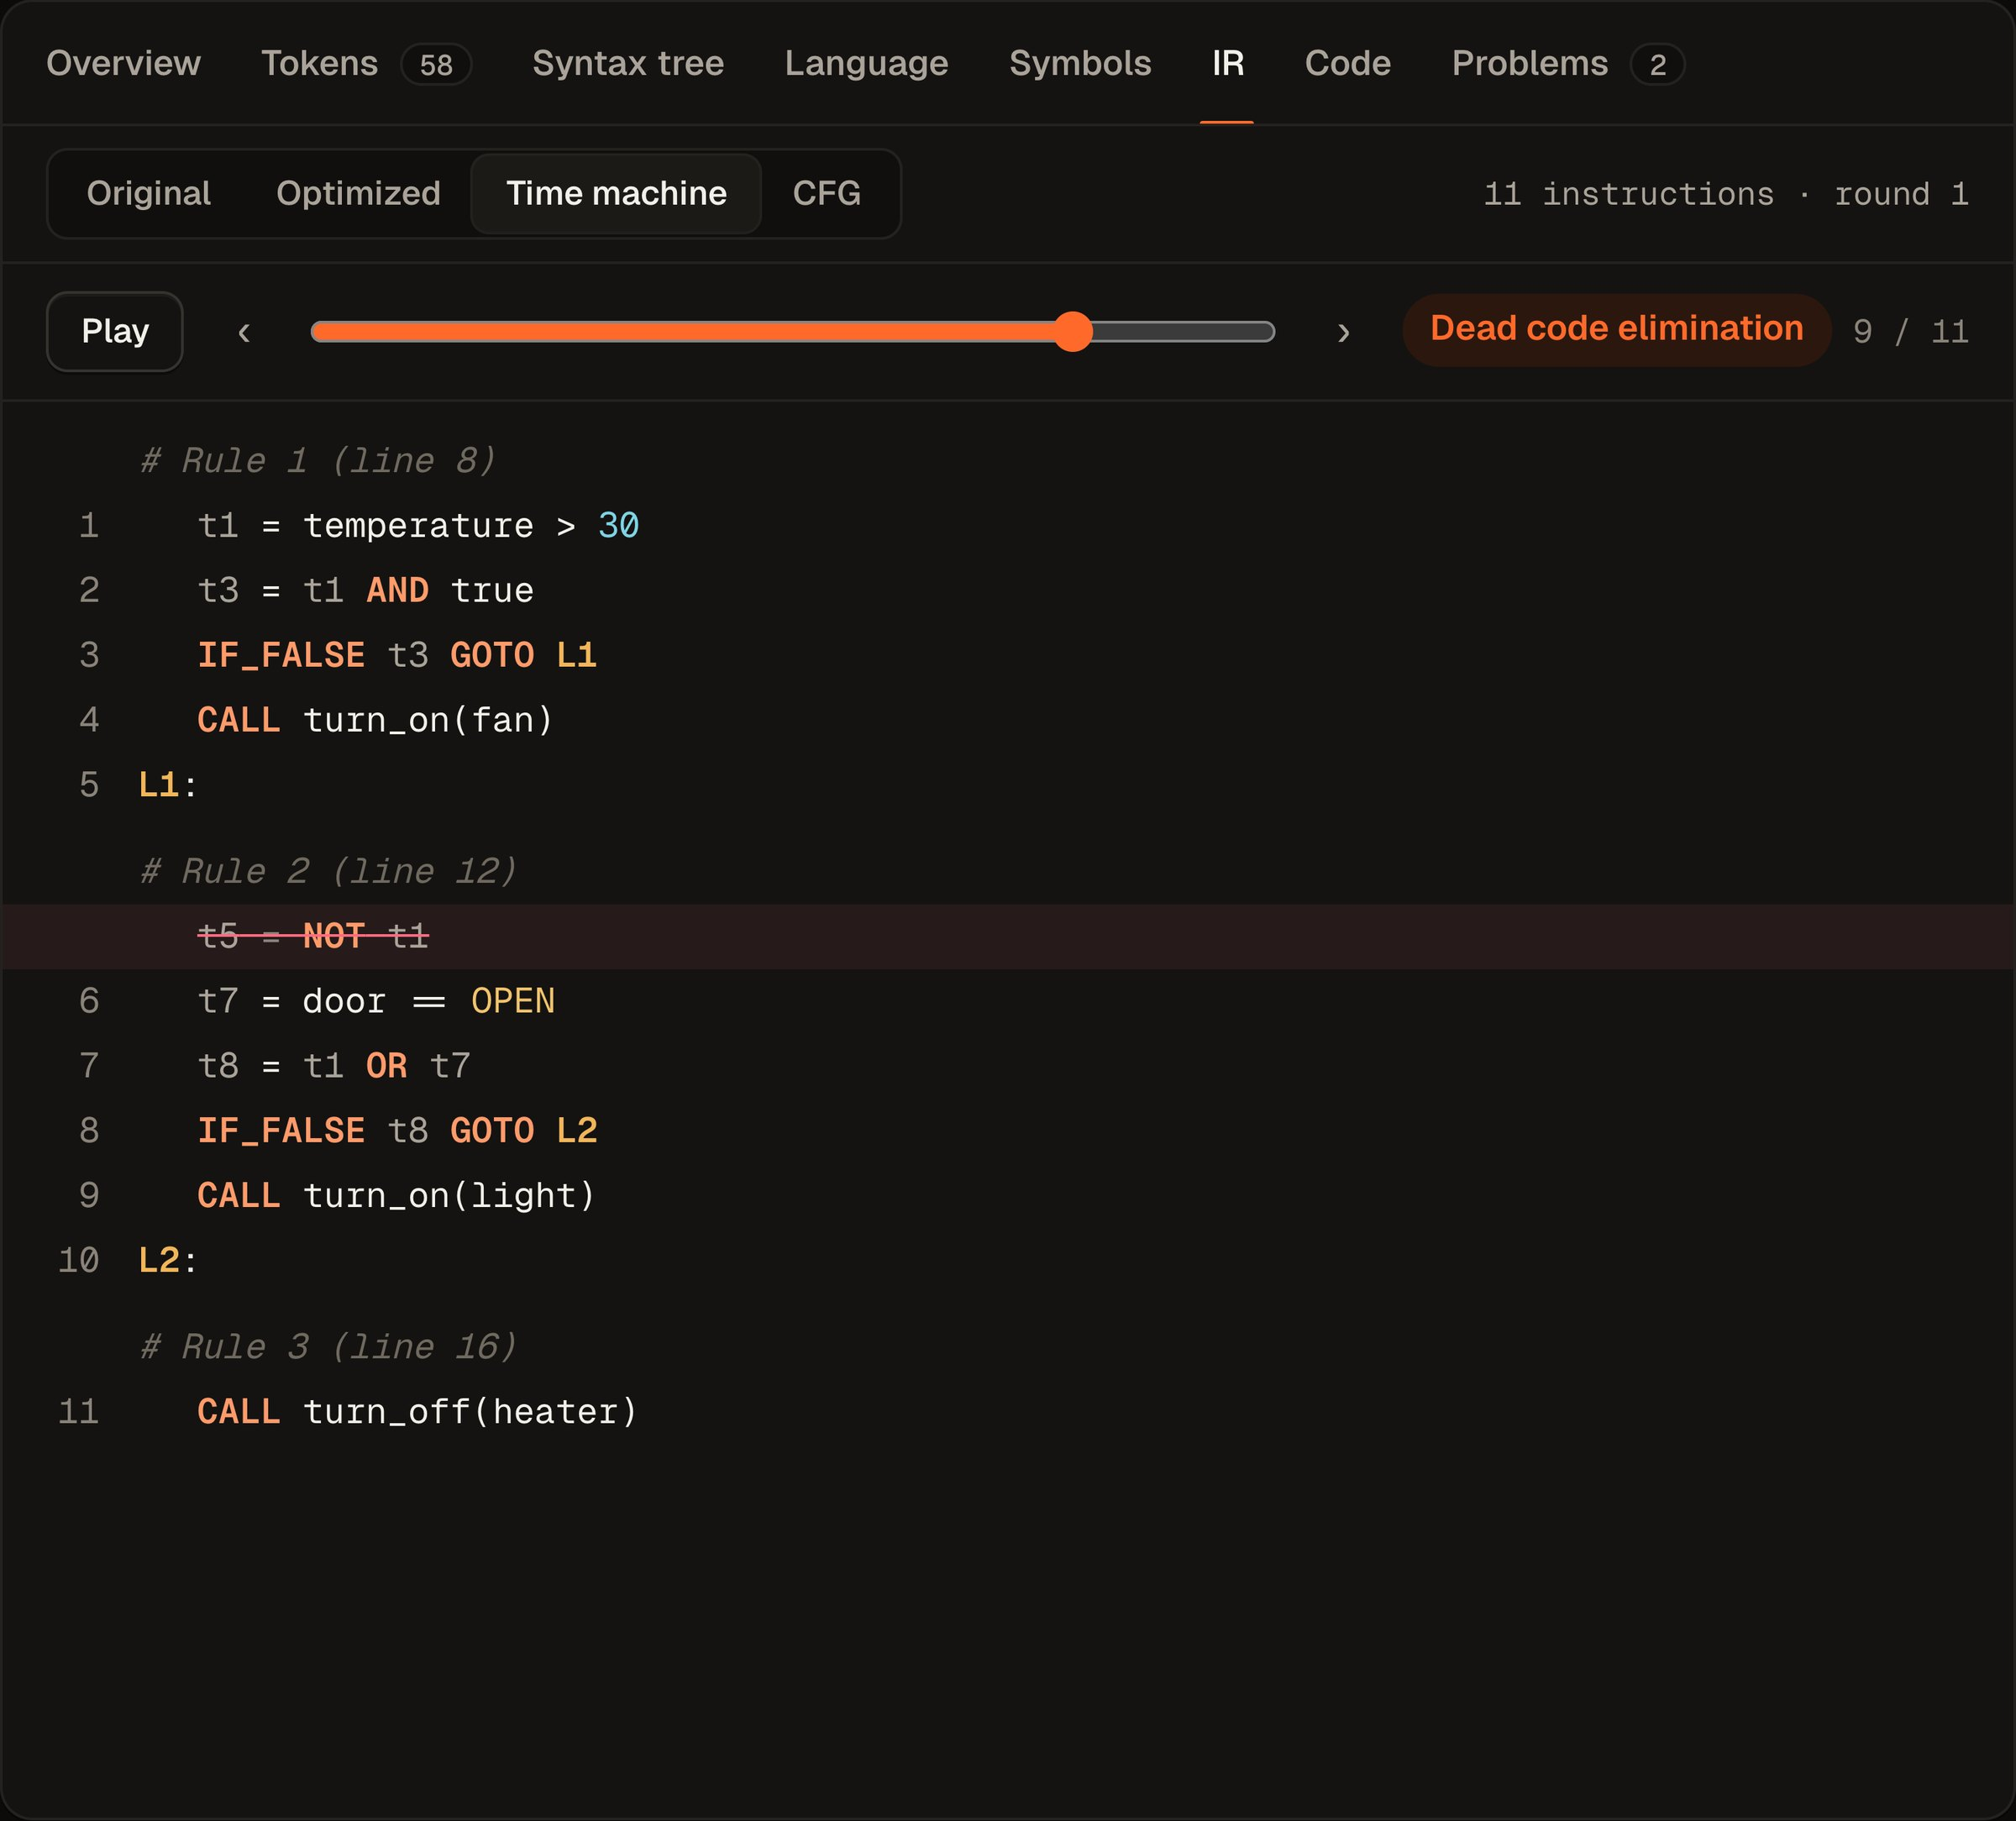
Intermediate code and optimization
08 · PHASES 5–6
Studio · Optimizer time machine
Three-address code with temporaries (t1, t2) and labels (L1, L2); each instruction keeps its source span.
Basic blocks and a CFG; liveness and available-expressions dataflow analysis.
Eight passes until nothing changes: constant folding, algebraic simplification, CSE, copy propagation, constant branches, unreachable code, jumps, dead code.
21 → 10
−52%
instructions in example 07
smaller after optimization
Notes:
Phase five generates three-address intermediate code, with temporaries like t1 and labels like L1, and each instruction remembers which part of the source produced it. Phase six splits the code into basic blocks, builds a control-flow graph and runs two dataflow analyses: liveness, and available expressions. On top of that, eight optimization passes run repeatedly until nothing changes. The screenshot is the optimizer time machine: you can step through each pass and see exactly which lines were removed. On our optimization example, the code goes from 21 instructions to 10.

Slide 10
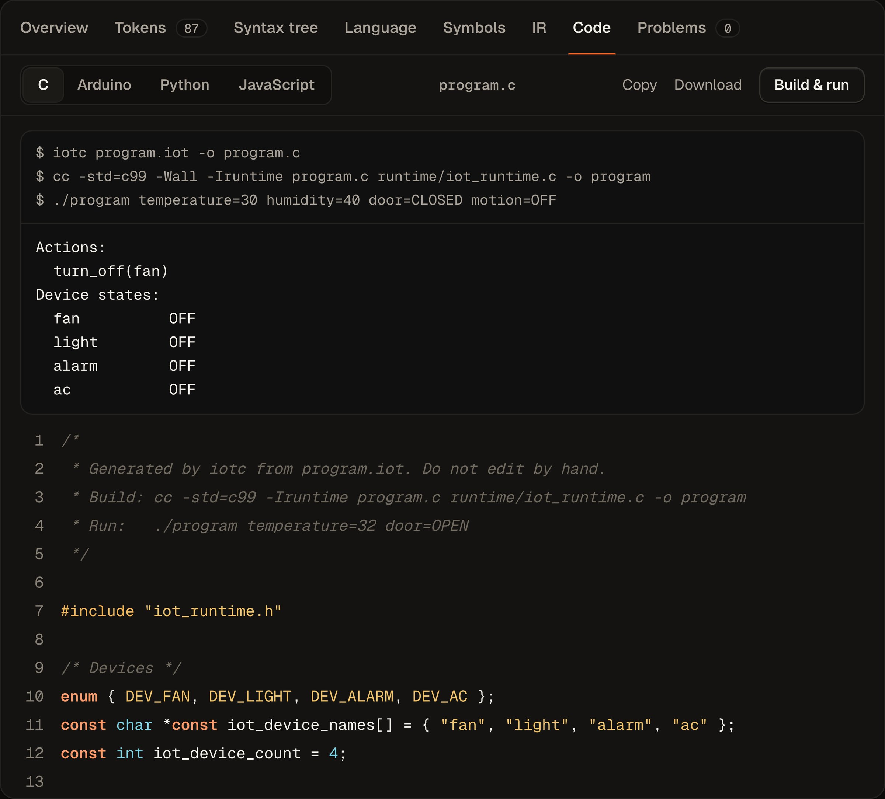
One compiler, four targets
09 · PHASE 7
C
Arduino
Python
JavaScript
Studio · Code · Build & run
One structured emitter, four back ends. If/else structure is recovered from the optimized IR, so the output reads like hand-written code.
C links with our runtime; Build & run in the Studio compiles it with a real C compiler and runs it.
Arduino / ESP32 sketch with setup() and loop() and a pin table.
Tested: for every example and several inputs, C, Python and JavaScript produce identical output.
Notes:
Phase seven is code generation. We wrote one structured emitter with four back ends: C, Arduino or ESP32 firmware, Python and JavaScript. The emitter recovers the if-else structure from the optimized intermediate code, so the output looks like code a person would write. The C output links with our small runtime, and the Build and run button in the Studio really compiles it with the system C compiler and runs it, as you can see here. Our tests check that for every example and several inputs, the C, Python and JavaScript programs print exactly the same result.

Slide 11
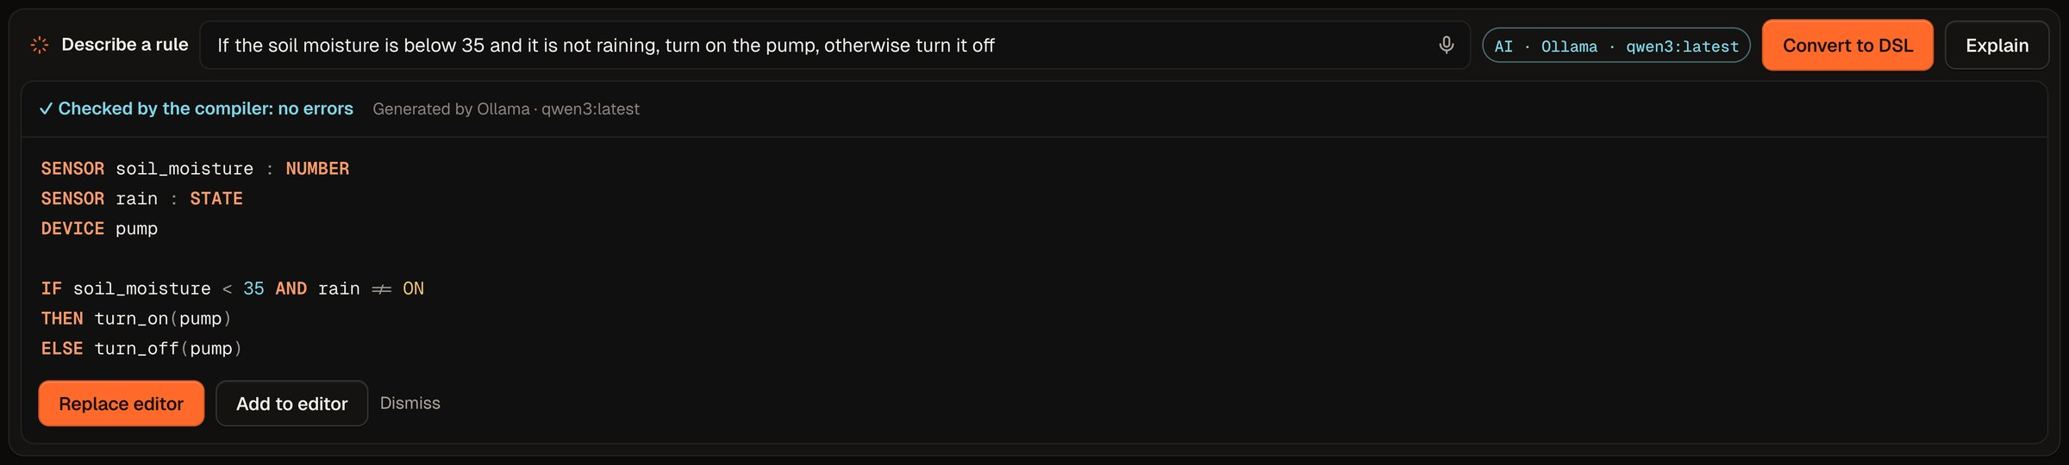
The model proposes. The compiler decides.
10 · AI, KEPT HONEST
Free models: a local Ollama model (qwen3), Groq or Gemini; an offline converter works with no AI at all.
Every answer is compiled. If it has errors, the compiler's messages go back to the model for one repair attempt.
Meaning check: every number in the sentence must appear in the program, and every sensor must be used.
AI fix is offered only if the error disappears and no new error appears.
INPUT
“If the soil is dry, water the plants”
MODEL
Ollama · Groq · Gemini · offline
GATE
iotc compiles and checks meaning
Studio · AI answer, verified by the compiler
YOU
review, then insert or replace
Notes:
This slide shows how we use AI safely. The model only proposes; our compiler decides. We use free models: a local Ollama model, Groq or Gemini, and an offline rule-based converter that works without any AI. Every answer is compiled by our compiler before the user sees it. If it has errors, the error messages go back to the model for one repair attempt. We also check meaning: every number in the sentence must appear in the program, and every declared sensor must be used, because we found that a small local model sometimes drops part of a sentence. And in the Problems tab, an AI fix is only offered if it really removes the error without adding new ones.

Slide 12
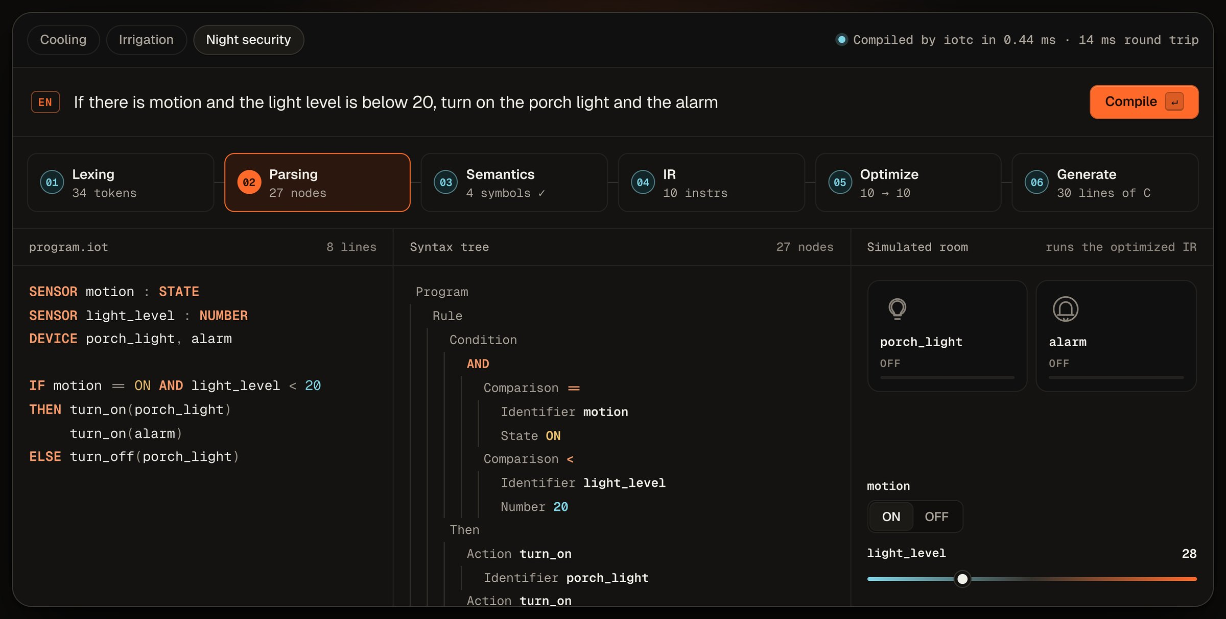
A home page with a live compiler demo
11 · THE WEBSITE
Home page · live demo
Not a recording: each preset, or a sentence you type, is compiled by the real compiler.
Six phase boxes show real results: tokens, tree nodes, symbols, instructions.
A simulated room runs the optimized code; moving the slider switches the device.
Every number on the site comes from the project (tests, code size, examples).
Notes:
This is the home page of our website. The demo at the top is not a video: each preset, or any sentence you type, is sent to our compiler right now. The six boxes show the real result of each phase, like the number of tokens and the instructions before and after optimization. On the right, the optimized code runs in a small simulated room, so if I move the temperature slider, the fan turns on or off. All numbers on the website, like the test count, are generated from the project by a script whenever the tests run.

Slide 13
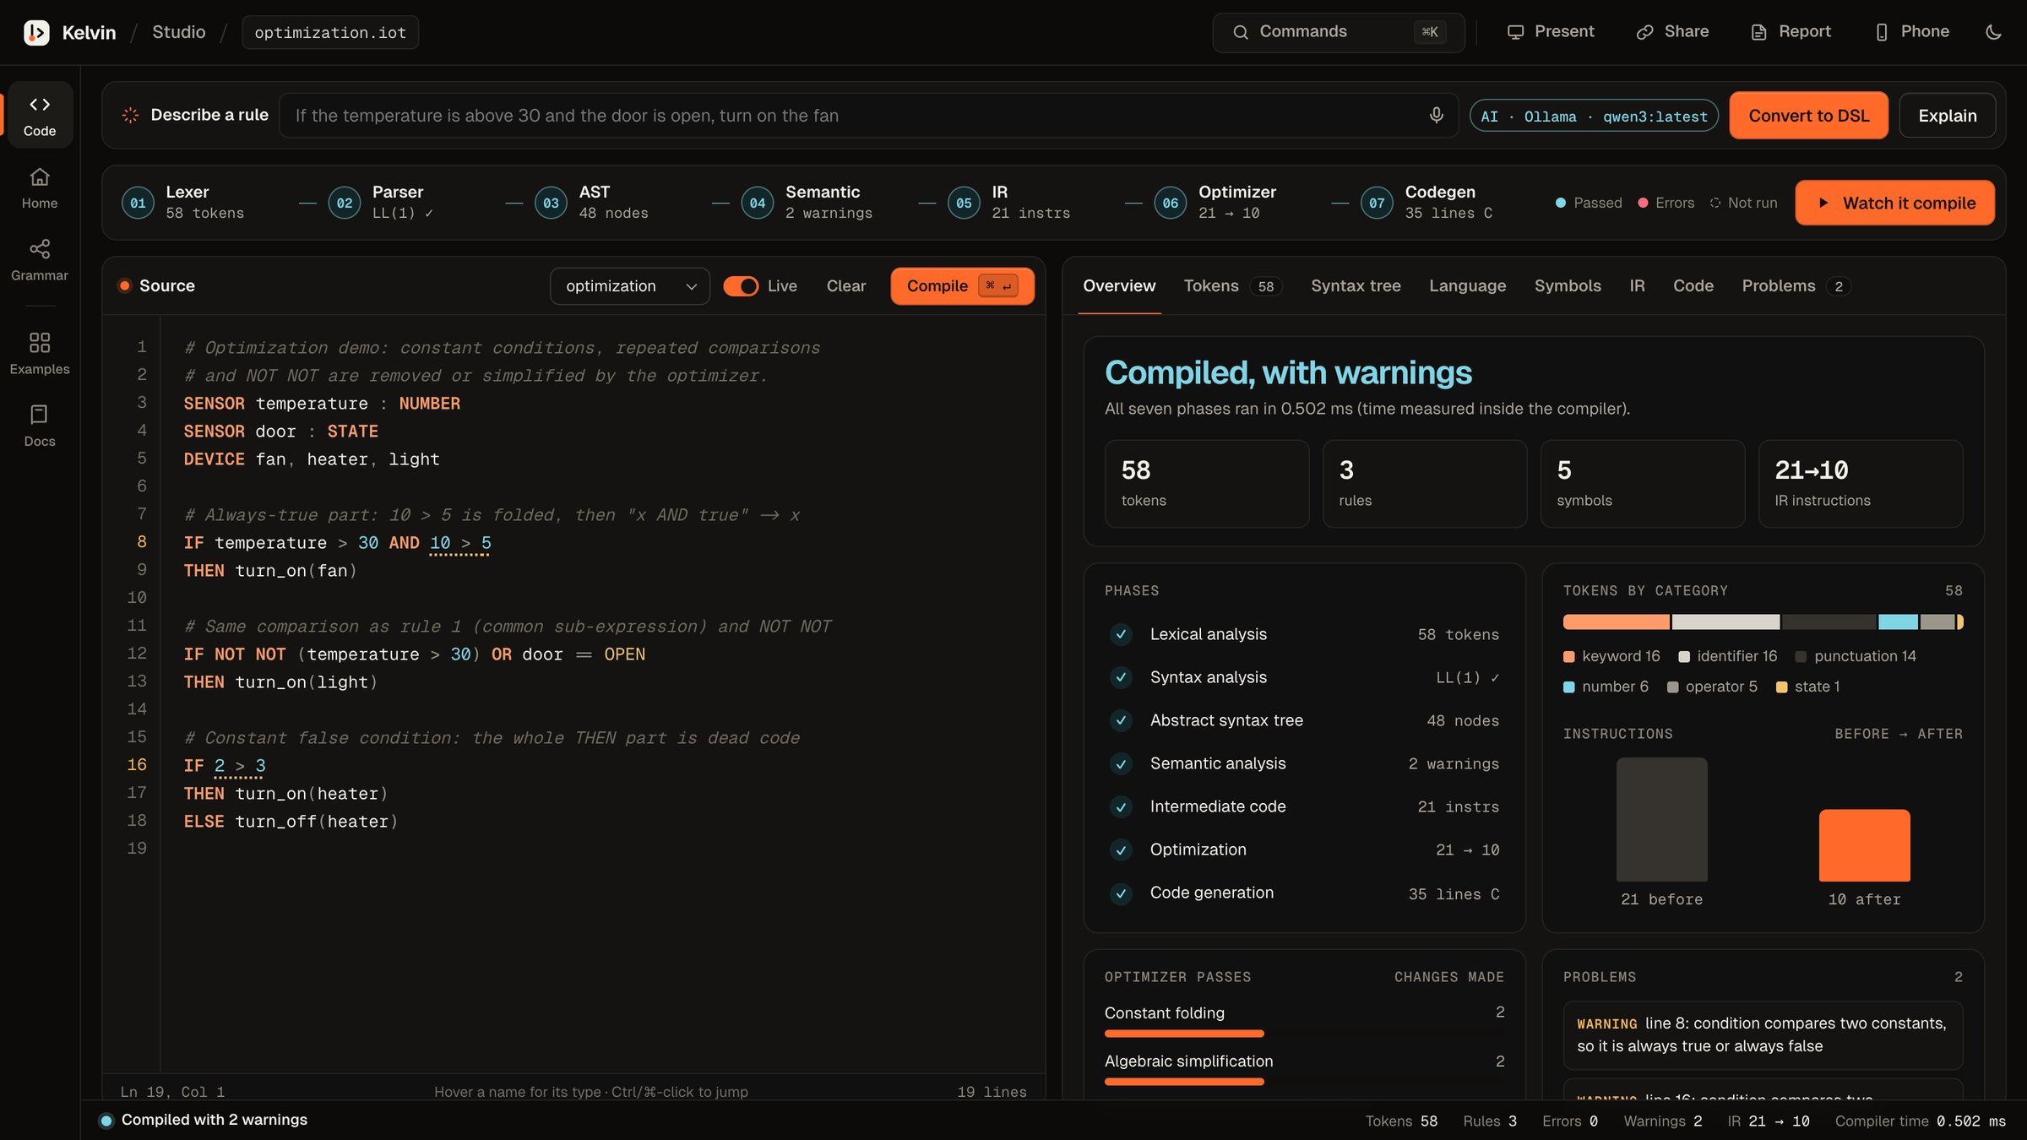
A workbench for every phase
12 · THE STUDIO
/studio · Overview
Smart editor: compiles as you type, autocomplete, types on hover.
Phase strip: each phase shows what it produced; click to open it.
Tabs: overview, tokens, tree, grammar, symbols, IR, code, problems.
Presentation mode, command menu (Ctrl/⌘ K), share link and PDF report.
Notes:
This is the Studio, the main tool. On the left is the editor. It compiles as we type, suggests keywords and names, and shows each name's type when we hover. Across the top, the seven phases each show what they produced, and clicking a phase opens its output. The tabs on the right show every phase in detail, and the Overview tab summarises the whole compilation with charts. There is also a guided presentation mode, a command menu, share links and a printable report.

Slide 14
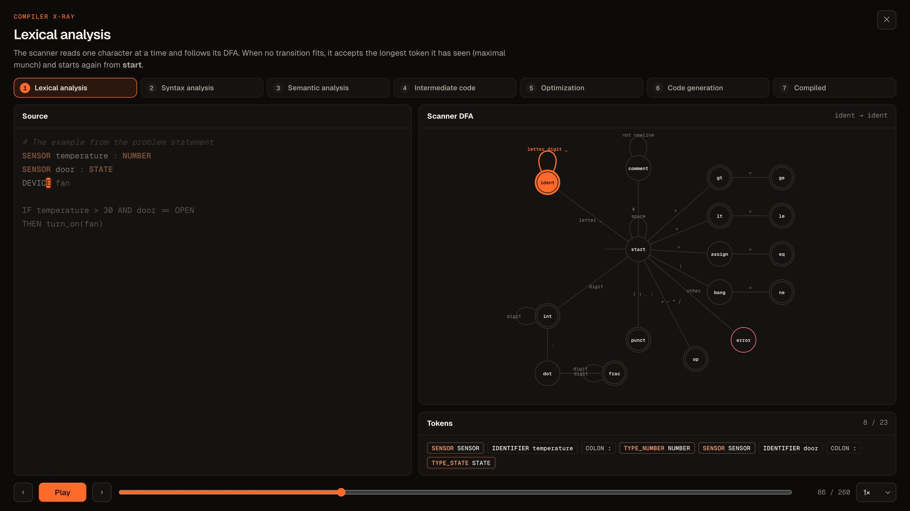
Watch the compiler work
13 · COMPILER X-RAY
Compiler X-ray
Replays a real compilation from traces the C++ compiler records.
Scanner: the DFA lights up character by character.
Parser: the call stack grows and the tree builds node by node.
Then symbol table, IR, each optimizer pass and the generated code.
Notes:
Watch it compile opens the Compiler X-ray. It replays a real compilation, using traces recorded by the C++ compiler. First the scanner: the automaton lights up as each character is read. Then the parser: you can see the recursive-descent call stack, parseRule, parseExpr and so on, while the syntax tree grows node by node. After that the symbol table fills in, the intermediate code appears, each optimizer pass runs, and finally the code is generated. It is the clearest way to see what each phase actually does.

Slide 15
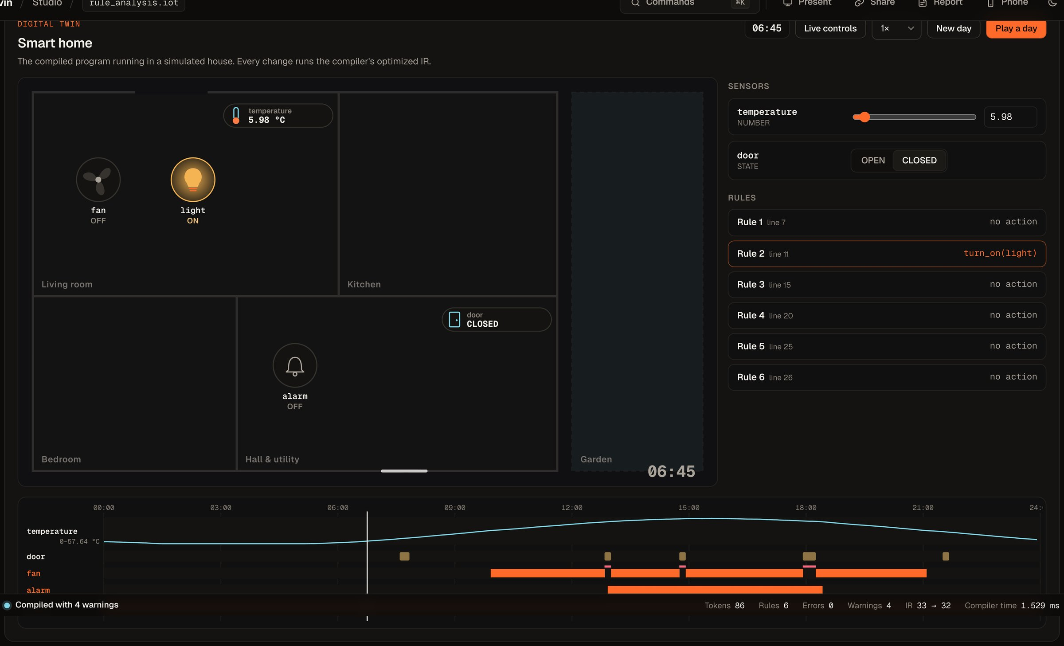
The program runs a house
14 · DIGITAL TWIN
Studio · Smart home, 24-hour day
An animated floor plan driven by the optimized IR in a small virtual machine.
Play a day: sensors follow daily curves; heaters warm the room and pumps water the soil.
Conflicts show in red when two rules fight over a device.
Phone remote: scan a QR code and move the sensors from a phone.
Notes:
The compiled program then runs in a digital twin of a house. The devices are animated: the fan spins, lights glow, the heater shows heat. Every change runs the optimized intermediate code in a small virtual machine. Play a day simulates 24 hours: sensors follow realistic daily curves and the devices affect the room, so the heater really warms it. When two rules fight over the same device, it turns red on the plan and in the chart. With the phone remote, anyone can scan a QR code and control the sensors from their phone.

Slide 16
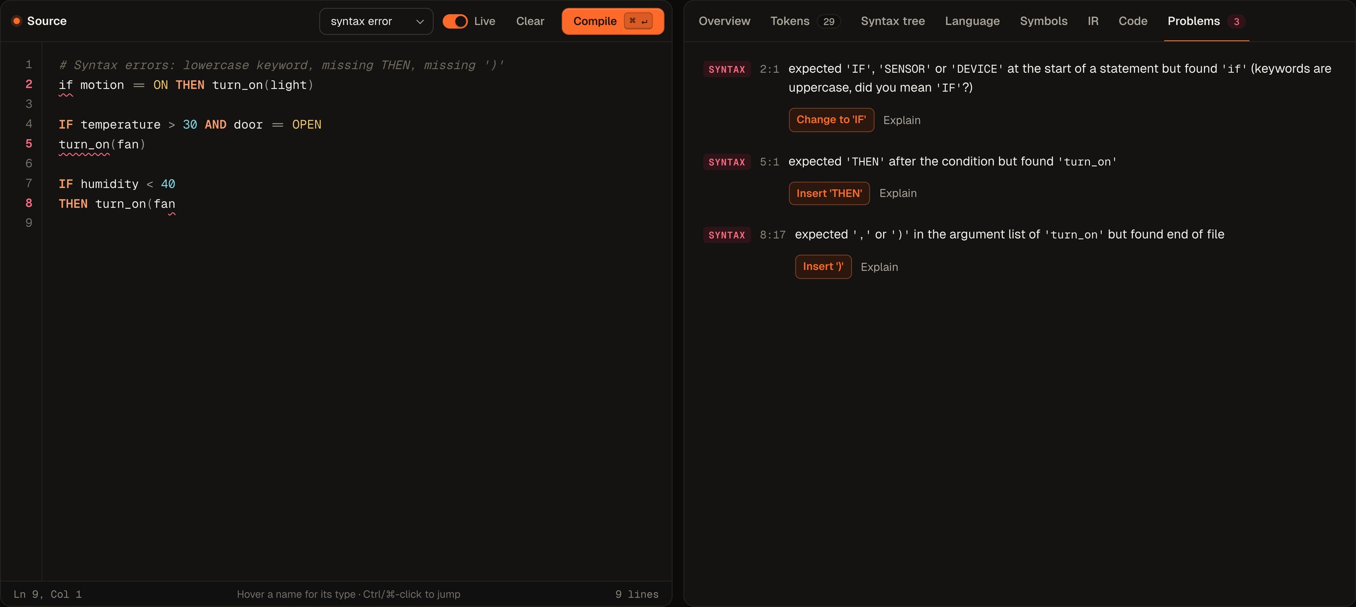
Clear errors with one-click fixes
15 · ERRORS
Studio · example 05, syntax errors
Every phase reports its own errors with line and column.
Quick fixes come from the compiler: “Change to 'IF'”, “Insert 'THEN'”, “Insert ')'”.
Failed phases are red; later phases show “not run”.
Undo works after every fix.
Notes:
Good error handling is a big part of a compiler. Here we load an example with three syntax errors: a lowercase keyword, a missing THEN and a missing bracket. The parser recovers and reports all three in one run, with line and column. Each error has a quick-fix button that comes from the compiler itself, for example 'Change to IF' or 'Insert THEN', and undo works after each fix. The phase strip shows the parser in red and the later phases as not run.

Slide 17
Measured, not claimed
16 · TESTING AND RESULTS
102
compiler checks passing (tests/run_tests.sh)
19
Python unit tests: server, phone remote, AI checks
C, Python and JavaScript give identical output for every example.
Every Arduino sketch compiles.
Grammar: 0 LL(1) conflicts.
Notes:
Everything is tested. The chart shows the number of three-address instructions before and after optimization for each valid example; the biggest win is the optimization example, which loses more than half its code, while examples that are already minimal stay the same. The shell test script runs 102 checks on every phase, all passing, plus 19 Python unit tests for the server, the phone remote's security and the AI checks. The tests also confirm that the C, Python and JavaScript programs behave identically, that every Arduino sketch compiles, and that the grammar has no LL(1) conflicts.

Slide 18
Simple tools, no dependencies
17 · TECHNOLOGY
Compiler
C++17, hand-written (no Lex/Yacc)
terminal
$ make # build the compiler
$ make run # start the website
$ make remote # …with the phone remote
$ make test # run every test
Server
Python 3, standard library only
Website
HTML, CSS, JavaScript; fonts bundled
AI
Ollama (local) · Groq · Gemini · offline
Tests
Shell script + Python unittest
Then open http://127.0.0.1:8000
Everything runs on one laptop, offline.
Notes:
We kept the technology simple on purpose. The compiler is plain C++17, written by hand. The server uses only Python's standard library. The website is plain HTML, CSS and JavaScript with no frameworks. For AI we use free options, including a model that runs locally on the laptop. Running the project takes four commands: make builds the compiler, make run starts the website, make remote also enables the phone remote, and make test runs every test. Everything runs on one laptop and works offline.

Slide 19
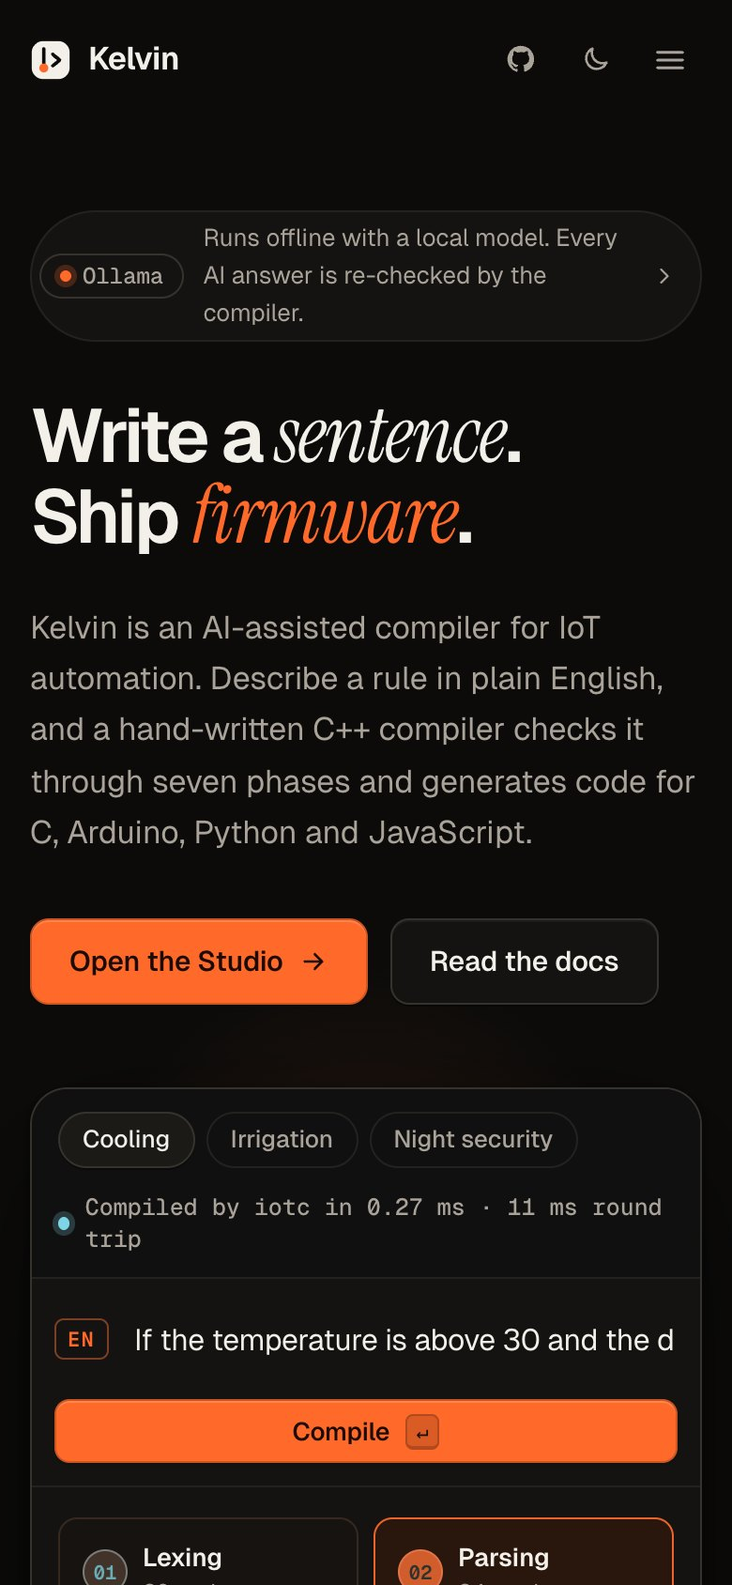
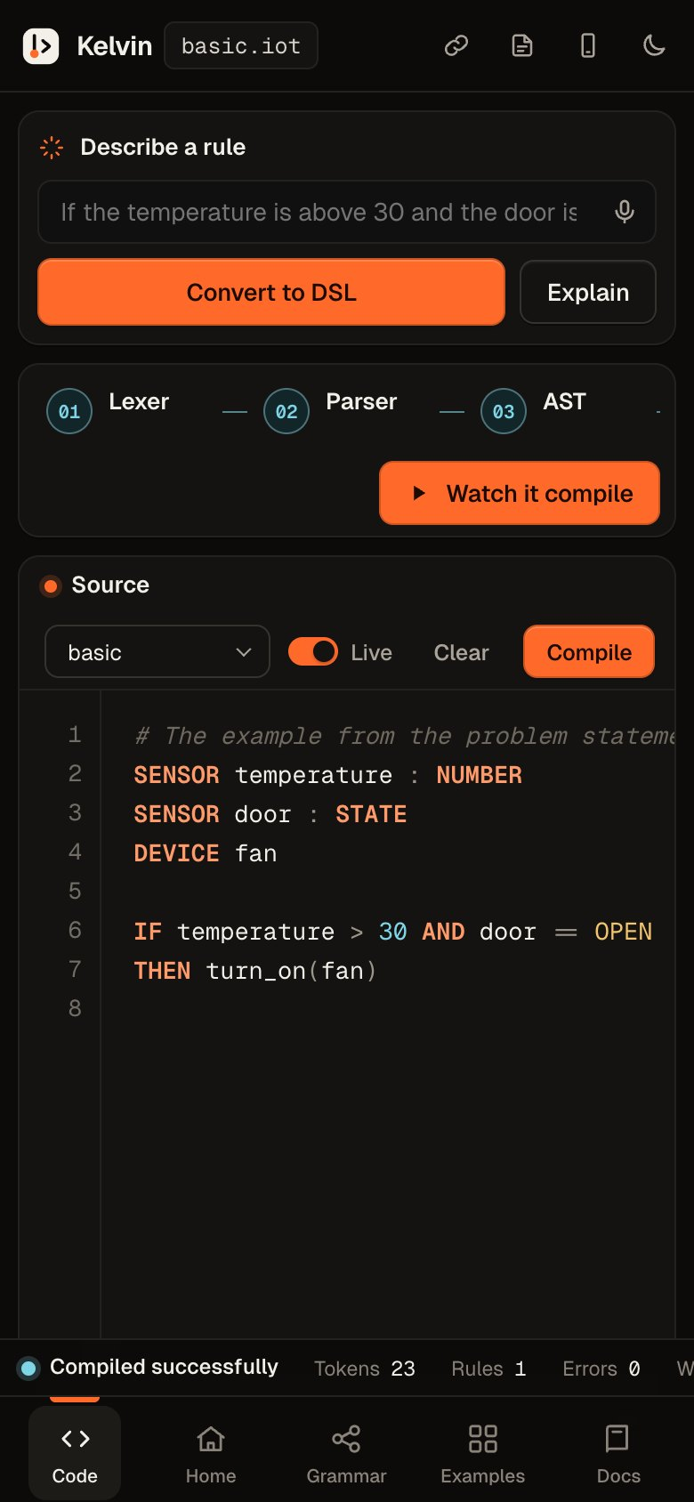
phone · home
phone · studio
THANK YOU
From intent to firmware,
checked at every step.
RS
R. Sanjay
ST
Settipalli Tejovardhan
A
Ashutosh
Questions?
Notes:
To sum up: Kelvin takes a rule from plain English to firmware, and the compiler checks it at every step, from the lexer to code generation. The website works on a laptop and on a phone. Thank you for listening. We are happy to answer questions, and we can show any part of the compiler live.

