Slide 1
Build an Alexa skill for Amazon Echo Gym Buddy
By Sanjaykumar Ramachandran

Slide 2

The Importance of Gym Workout Planning
Gym workout planning is crucial for achieving fitness goals. Without a plan, individuals may find themselves wandering around the gym aimlessly, not knowing what exercises to do or how many sets and reps to perform. This can lead to a lack of progress and even injury.
According to a study by the American Council on Exercise, individuals who followed a workout plan were more likely to stick with their exercise routine and see results compared to those who did not have a plan. In addition, having a plan allows individuals to track their progress and make adjustments as needed to continue making gains.

Slide 3
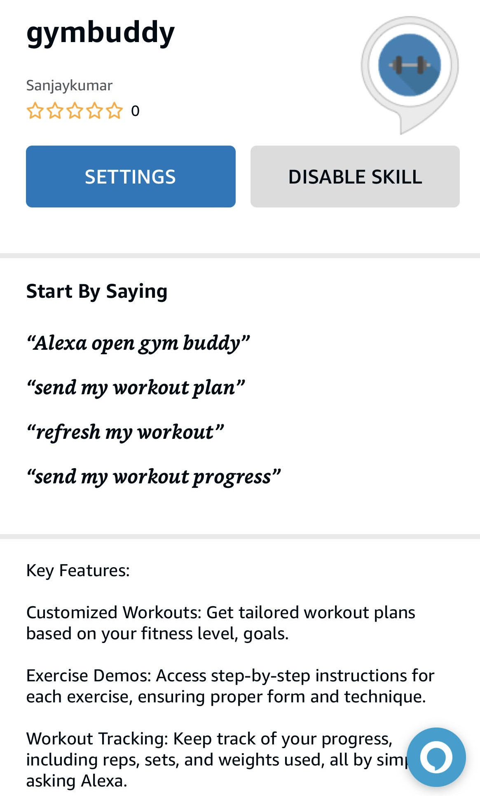
Functions provided by Gym Buddy skill
Generate weekly workout plan based on fitness goal and fitness level
Demonstrate instructions for workouts
Recording/Logging the workout
Refresh and get new workout timely
Guide through workouts

Slide 4
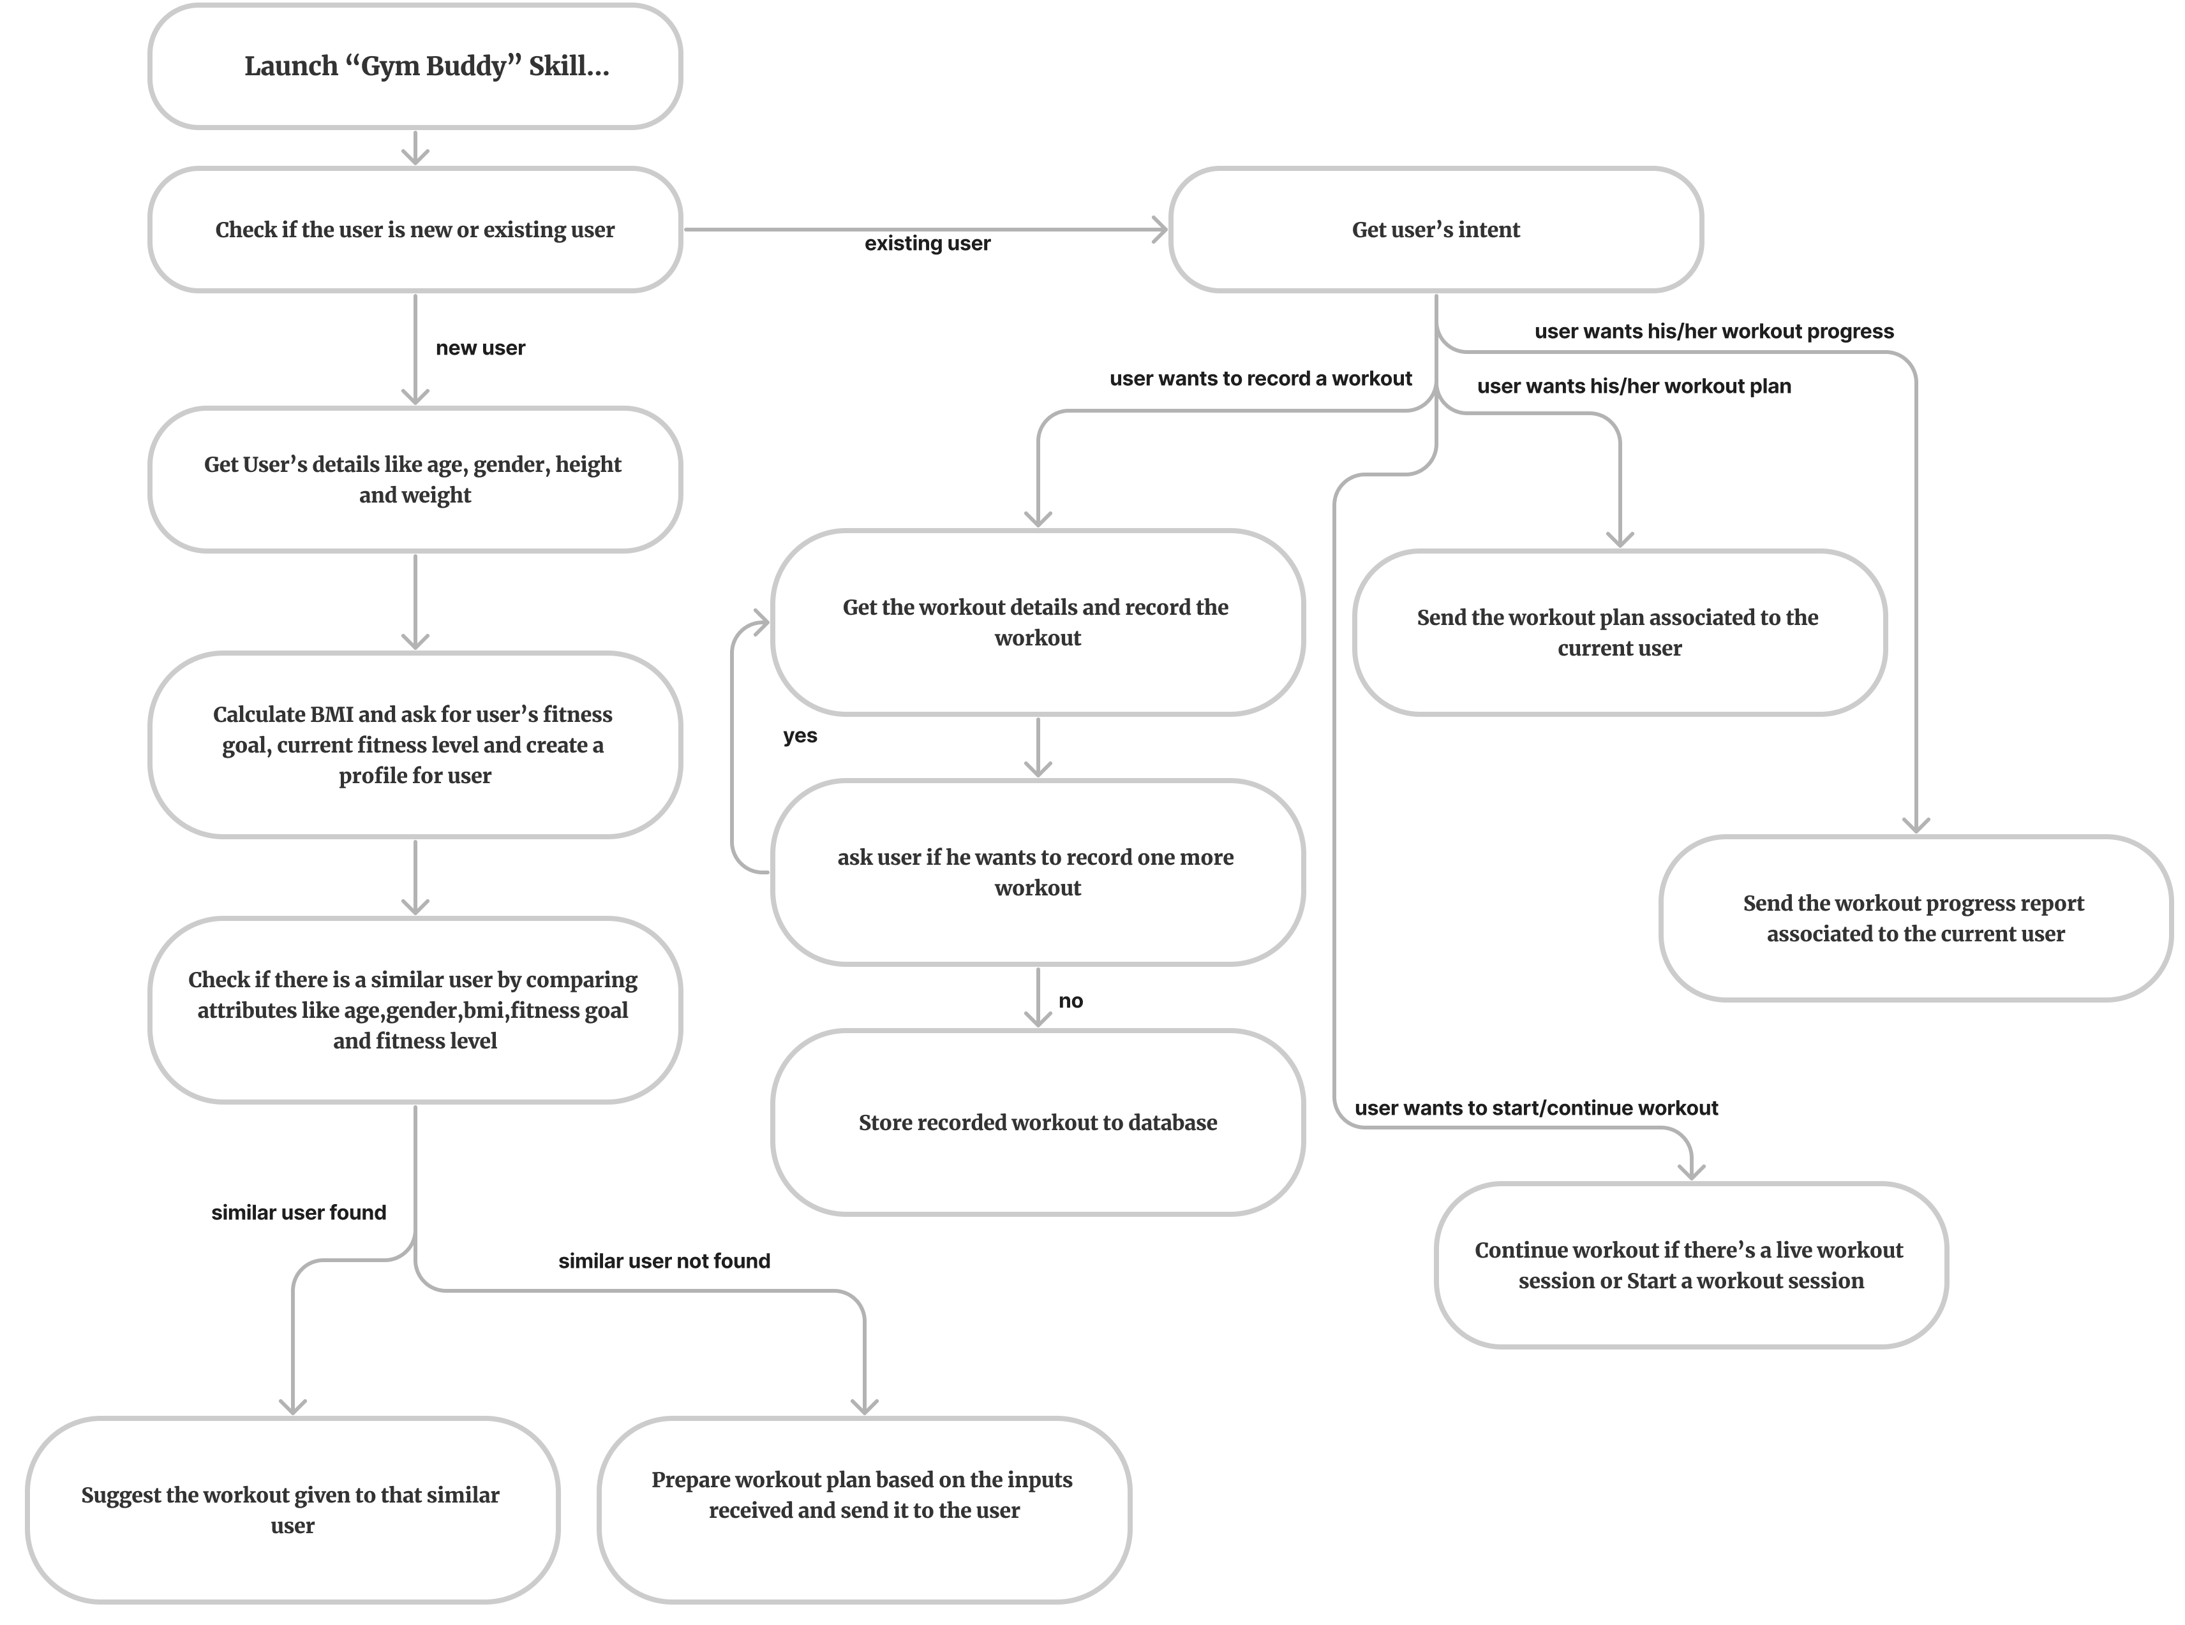
Design of the skill

Slide 5
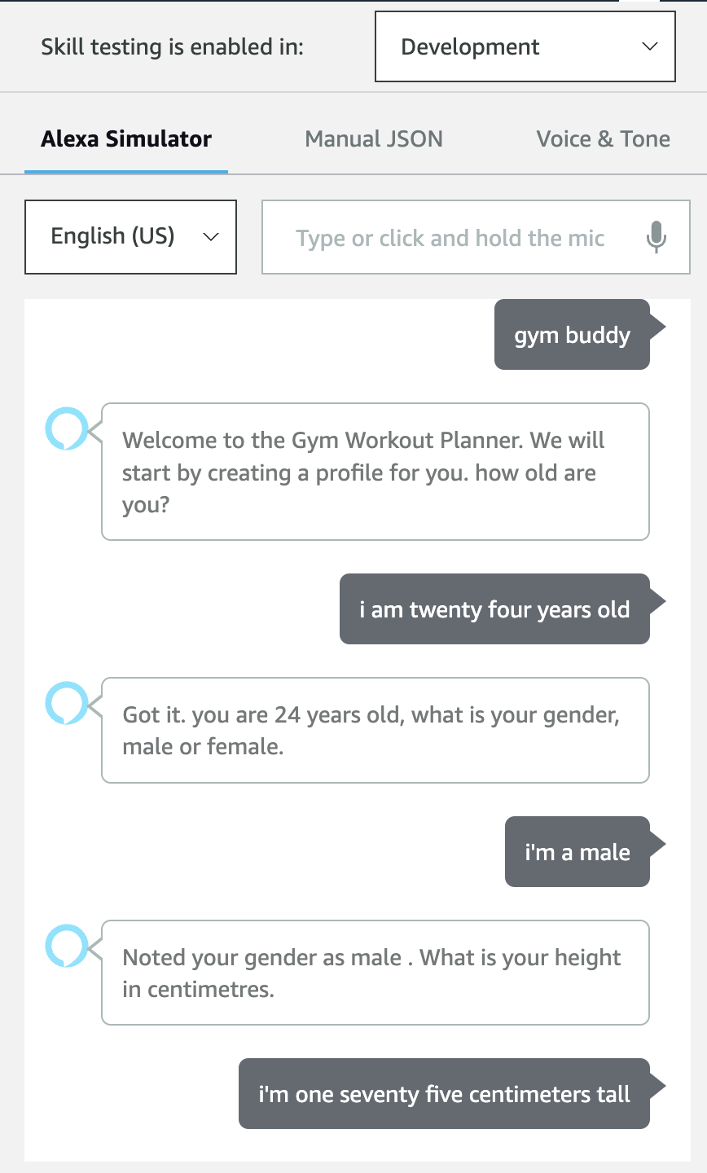
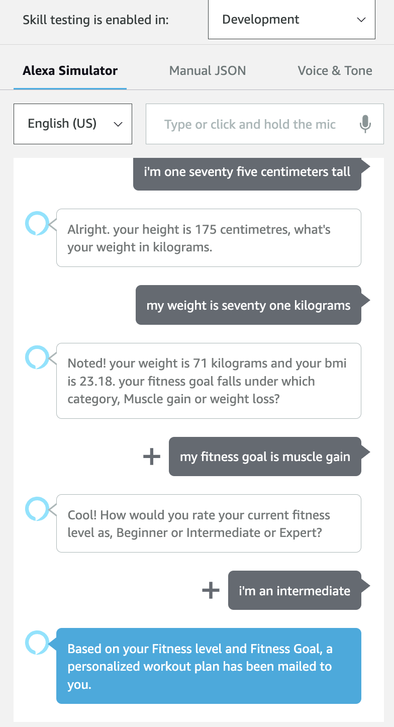
New user
A user profile is established by collecting essential demographic and fitness-related information, including age, gender, height, weight, current fitness level, and desired fitness goals.
To provide an appropriate workout plan, the database is scanned to identify a comparable user profile. Subsequently, workout plan is recommended that has proven effective for user with similar profile.
If no closely matching user profile is available in the database, a data-driven approach is used to generate workout plan, which is tailored specifically to the individual's fitness level and desired fitness objectives.

Slide 6
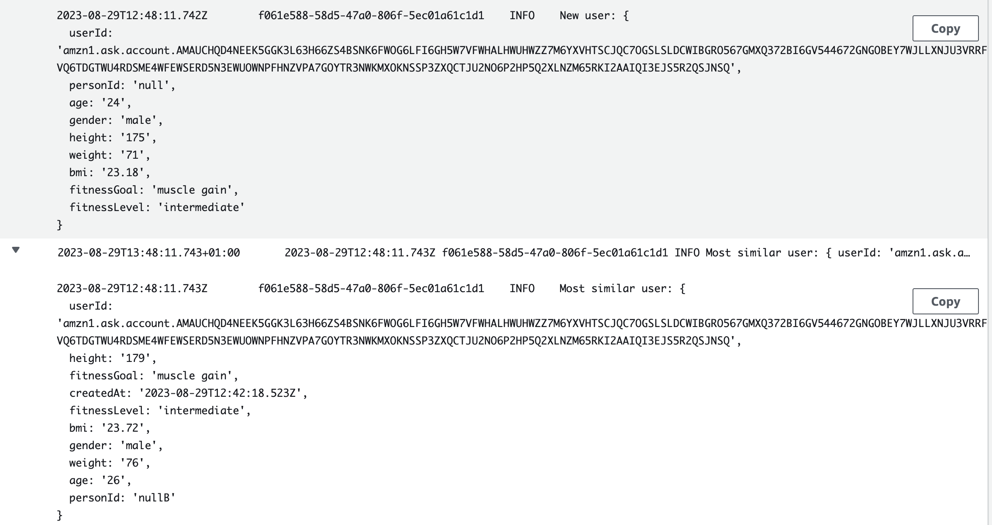
Recommender System Implementation
The attributes of new user such as age, gender, BMI, fitness level and fitness goal are used to compare similarity among other users and most similar user is found. This recommender system operates by suggesting a workout plan that is linked to the similar user to the new user. The idea behind this assumption is that if a user with a high degree of similarity finds their current workout plan helpful, a new user with a high degree of similarity may also find that workout plan useful.

Slide 7
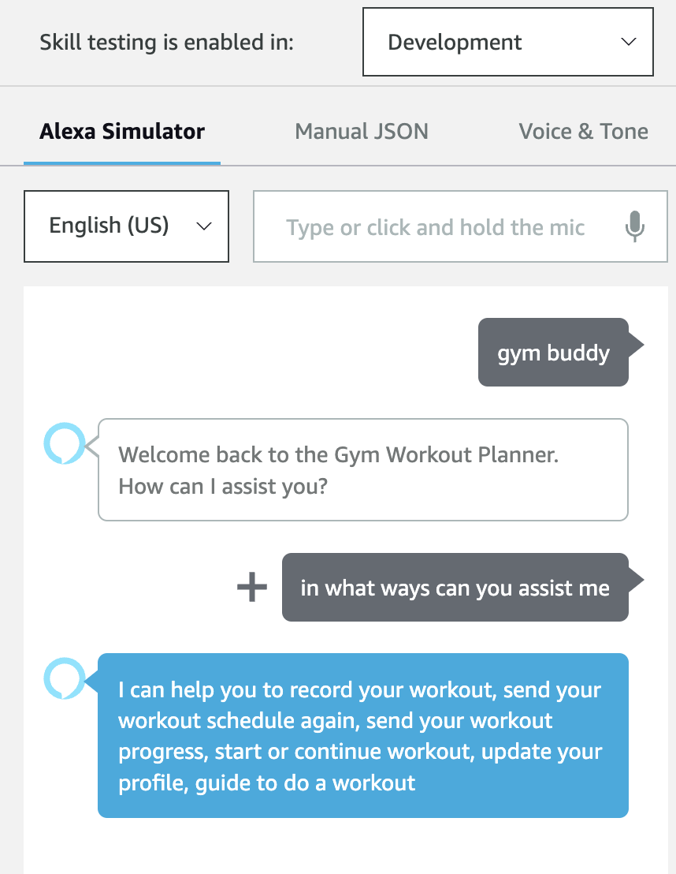
Existing User
If the user is an existing user, all available options are enabled for the user to use.

Slide 8
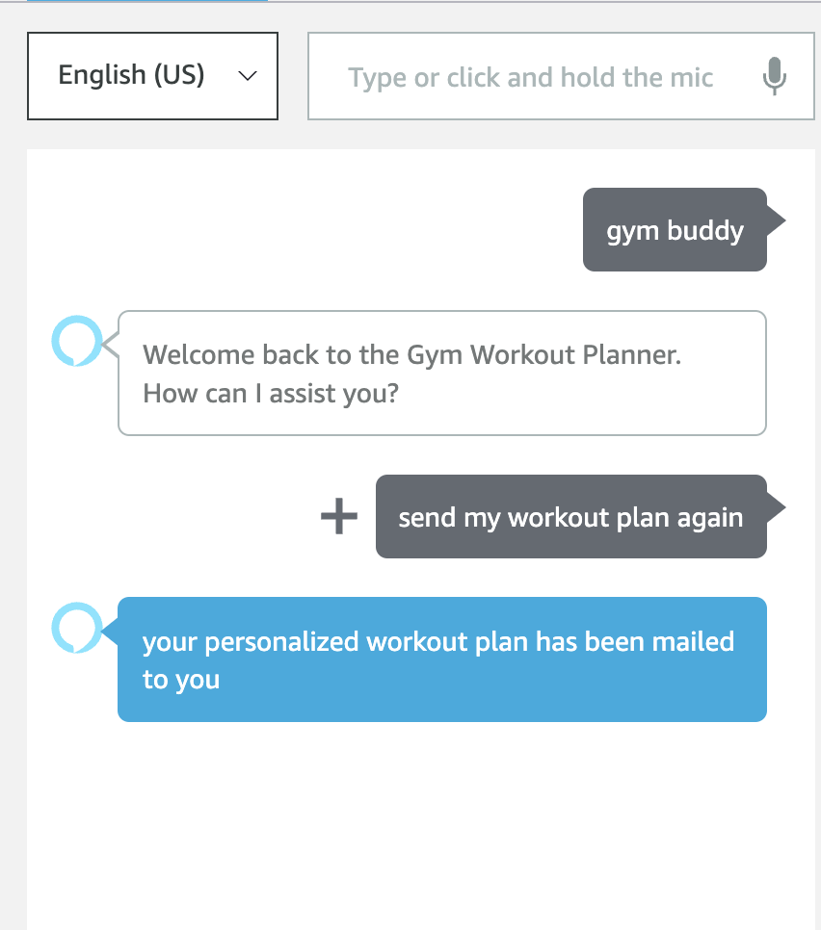
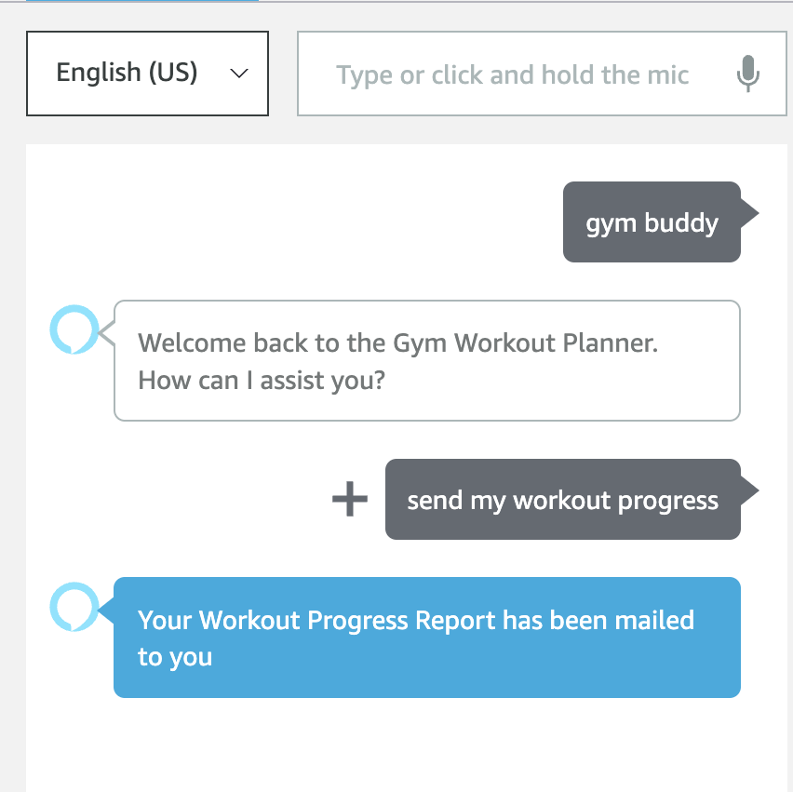
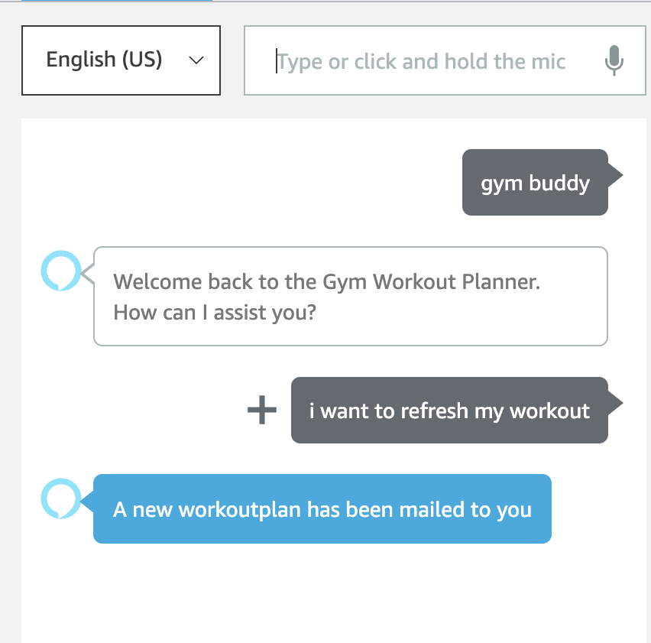
Available options
Resend workout plan
Get workout progress
Refresh workout plan

Slide 9
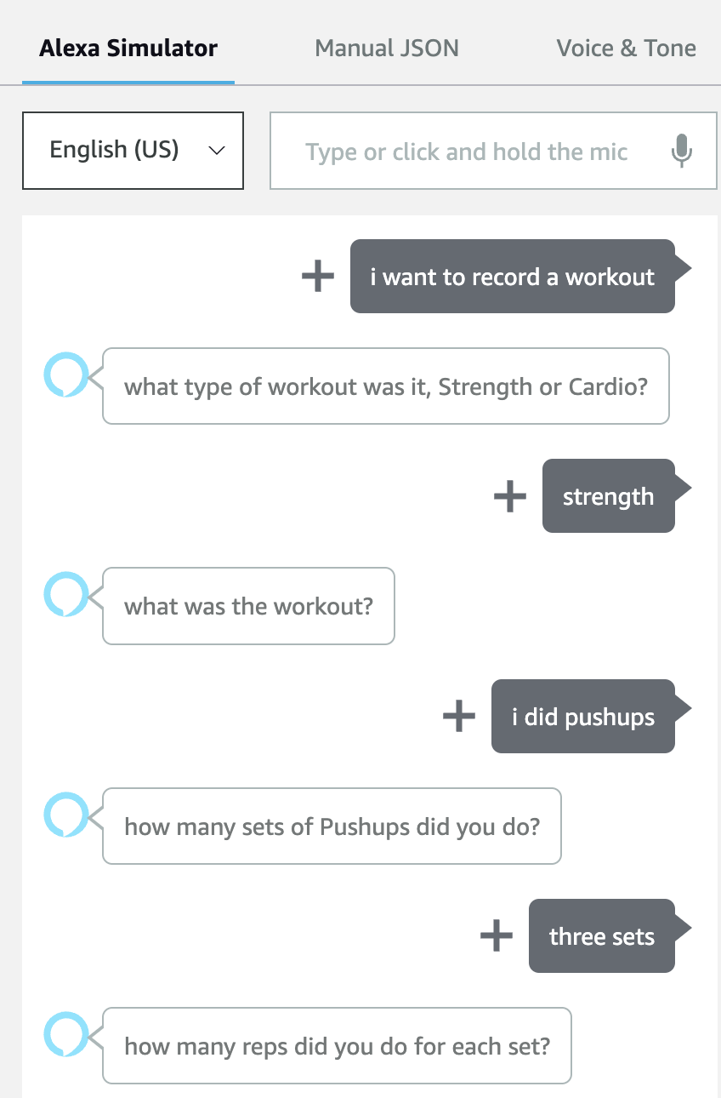
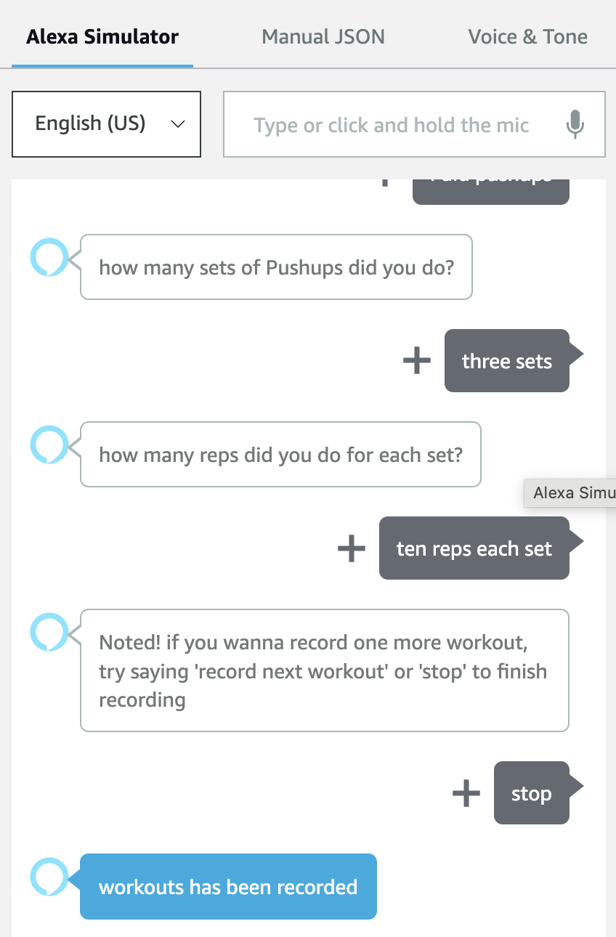
Available options
Conversation flow for ‘recording a workout’

Slide 10
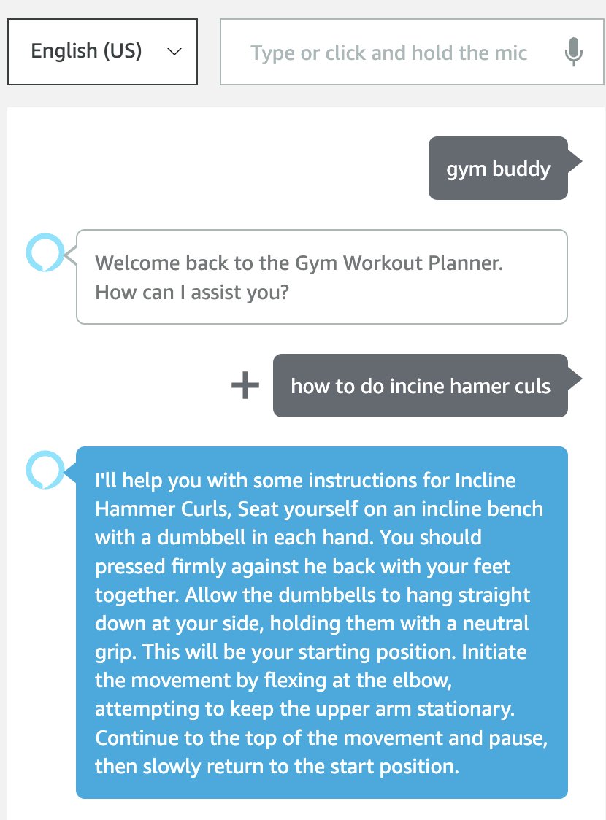
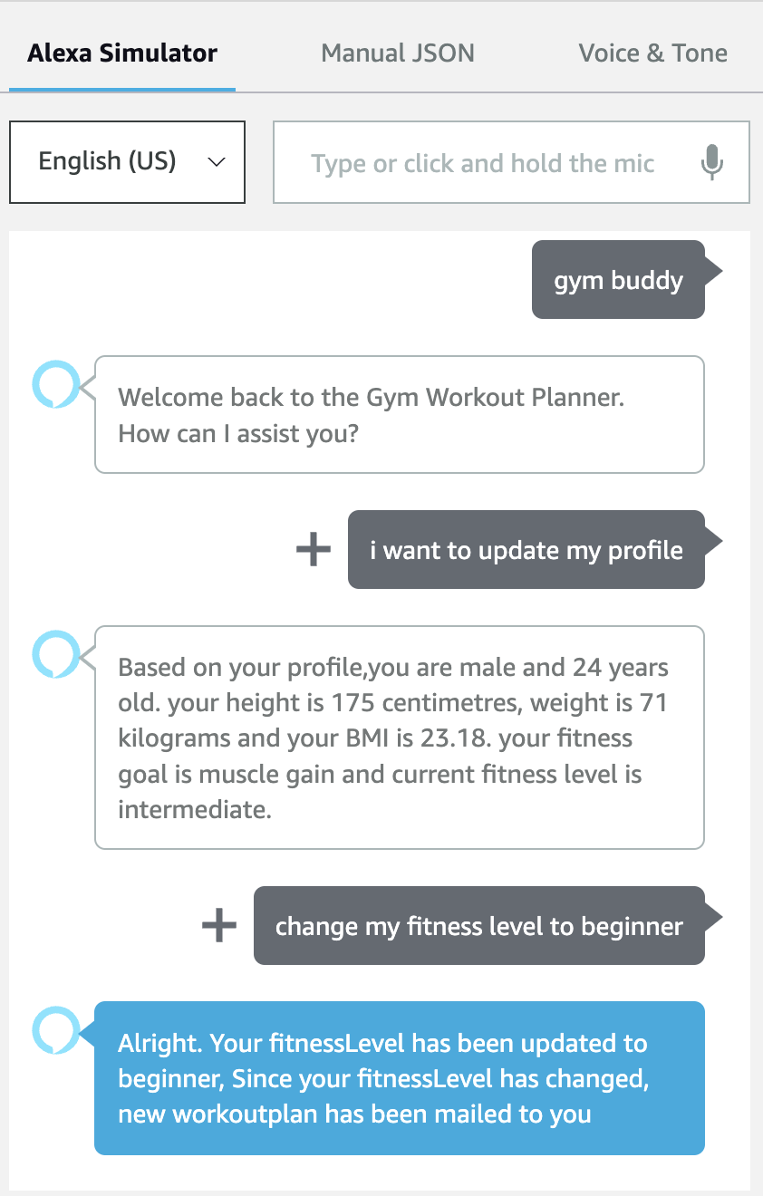
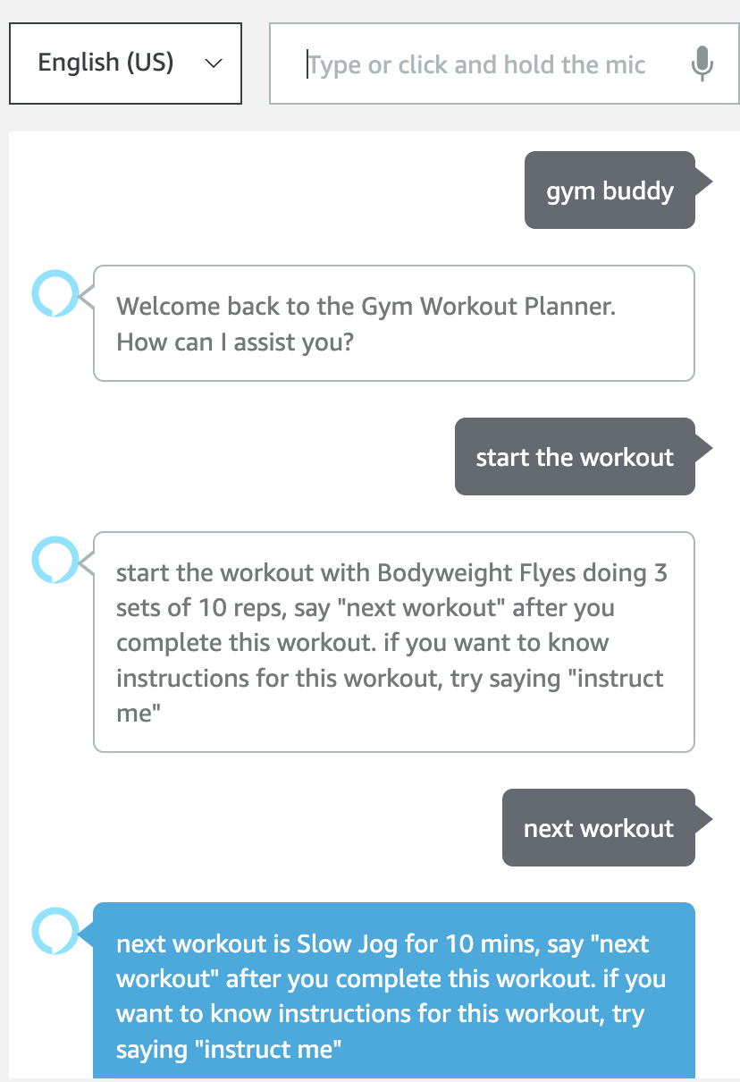
Available options
Workout instructions
Update profile
Workout session

Slide 11
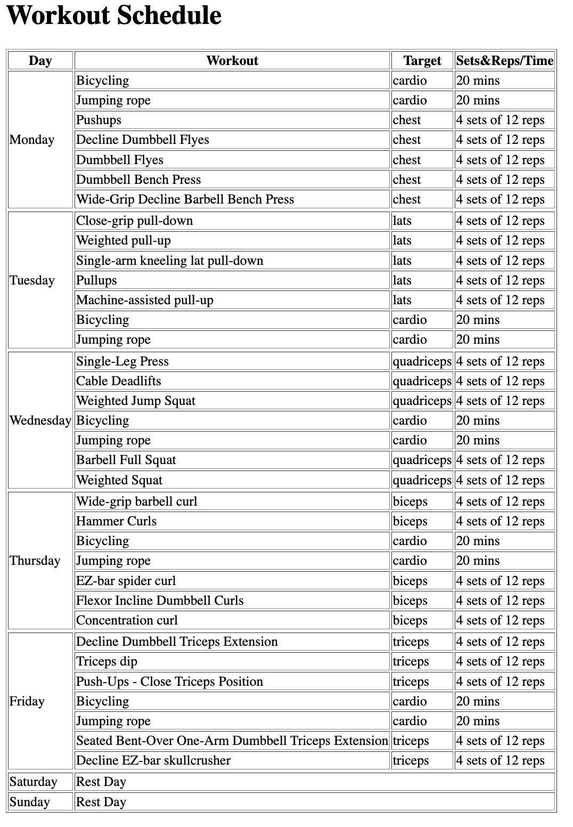
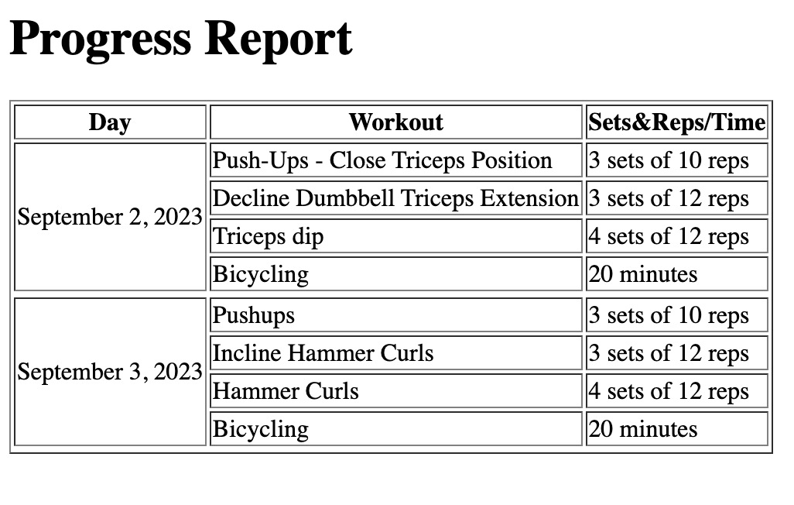
Sample workout plan of user with fitness goal as ‘muscle gain’ and fitness level of ‘intermediate'
Sample workout progress report

Slide 12
Thank you

