Slide 1


Slide 2
About

Slide 3
How Google Start
Goole began in march 1995 as a research project of two PHD students Larry Page and Sergey Brin.
Nick name of his project was “BackRub”
Larry and Sergey use Page Rank algorithm in Google for display search result.
Domain Google.com registered in Sept. 15, 1997.
Larry and Sergey formally incorporated their company, Google, on September 4, 1998 at a friend's garage in Menlo Park,California.
Today Google have 70 offices in more than 40 countries and 4 offices are in India (Gurgaon, Mumbai, Bangalore, Hyderabad)

Slide 4
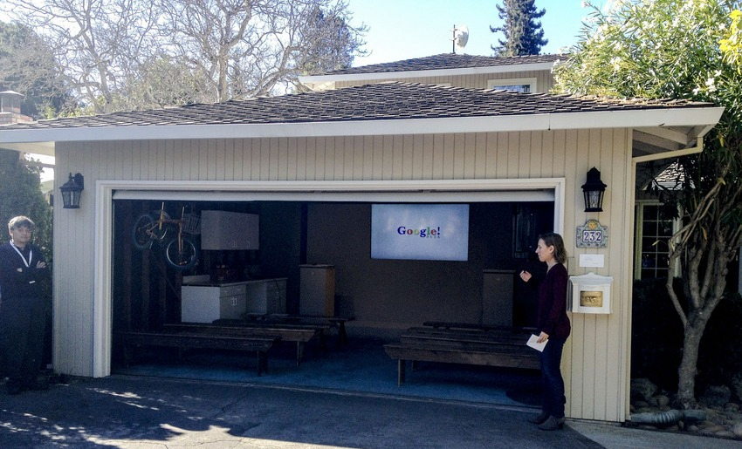
How Google Start
Google First office

Slide 5
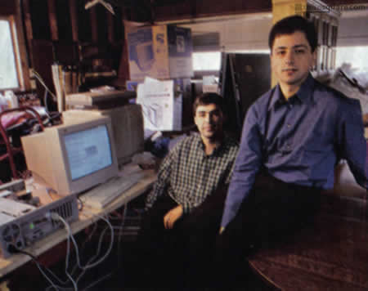
How Google Start
Google First office

Slide 6
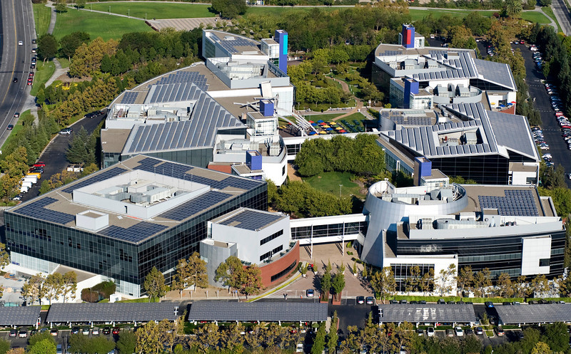
Google Current Head Quarters in California

Slide 7
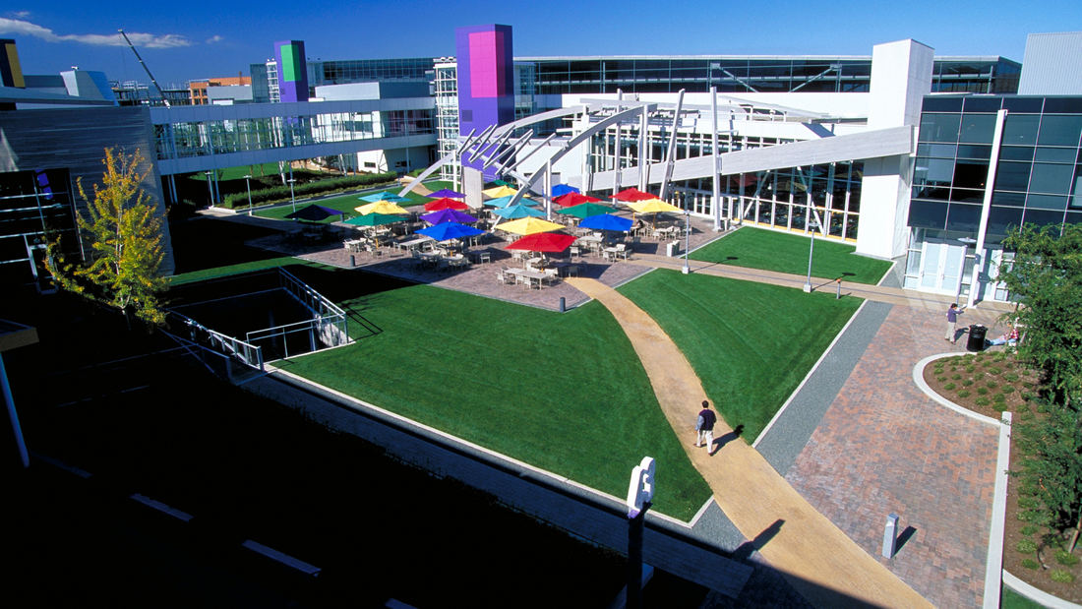
Google Current Head Quarters in California

Slide 8
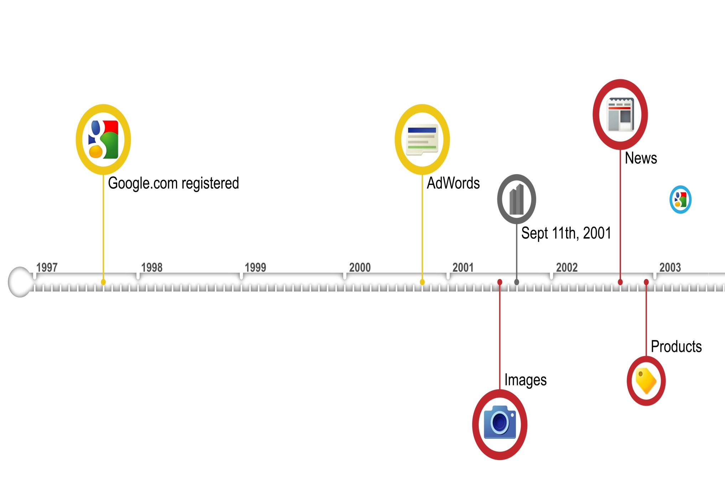
Google Evolution

Slide 9
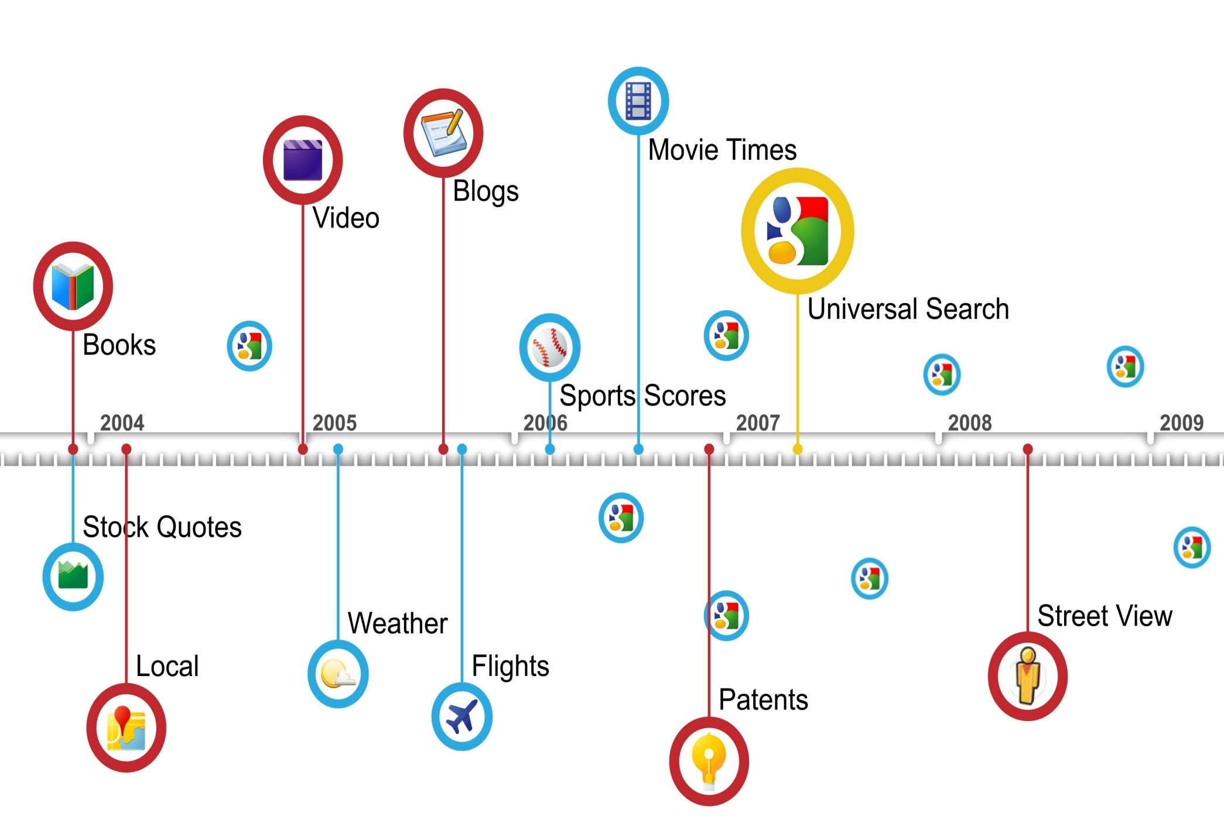
Google Evolution

Slide 10
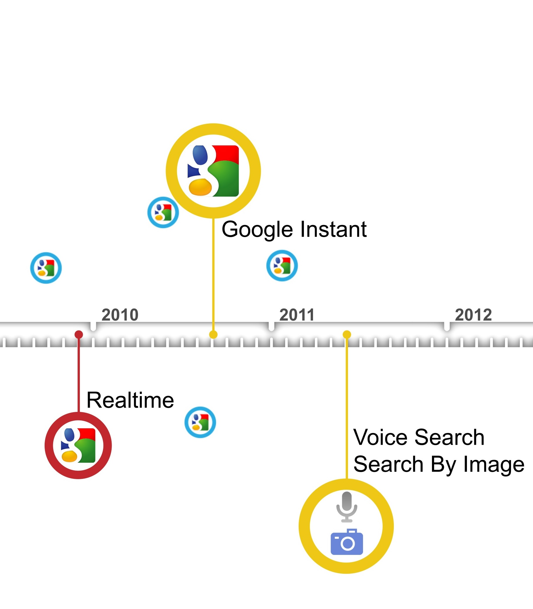
Google Evolution

Slide 11


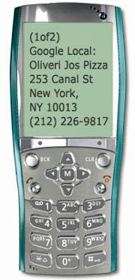
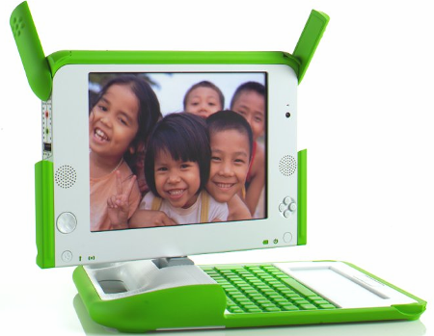
Google Mission
Organize the world's information and make it universally accessible and useful

Slide 12


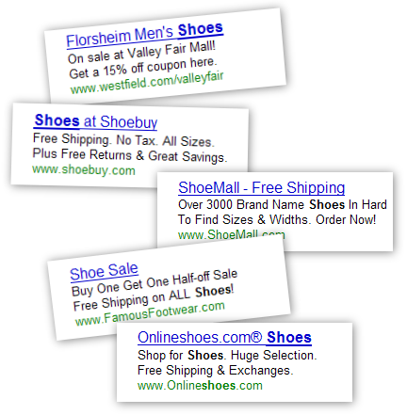


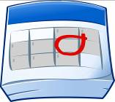



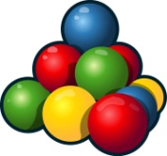
Google Strategy: Search. Ads. Apps.
Search.
Ads.
Apps.

Slide 13
Some Interesting Google Data-Points
Google started in January, 1996 as a research project at Stanford University, by Ph.D. candidates Larry Page and Sergey Brin when they were 24 years old and 23 years old respectively.
The name Google ™ was an accident. A spelling mistake made by the original founders who thought they were going for ˜Googol™”
Searches per day: Average per second search of people search on Google for is 40,000 http://www.internetlivestats.com/google-search-statistics/
Google Adsense income:
Top three companies that earn from Google ad-sence
Ehow.com :- $300,000/month
Mashable.com: $250,000/month
forums.digitalpoint.com: $195,000/month
Google YouTube :
Per day video views: 4B
Per minute video upload: 300 hours

Slide 14
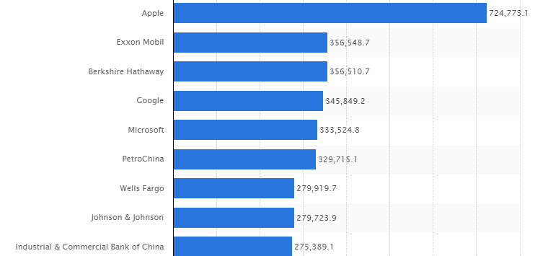
Top companies by market capitalization (2015)

