Slide 1


Slide 2
How Start

Slide 3
How Google Start
Goole began in march 1995 as a research project of two PHD students Larry Page and Sergey Brin.
Nick name of his project was “BackRub”
Larry and Sergey use Page Rank algorithm in Google for display search result.
Domain Google.com registered in Sept. 15, 1997.
Larry and Sergey formally incorporated their company, Google, on September 4, 1998 at a friend's garage in Menlo Park,California.
Today Google have 70 offices in more than 40 countries and 4 offices are in India (Gurgaon, Mumbai, Bangalore, Hyderabad)

Slide 4
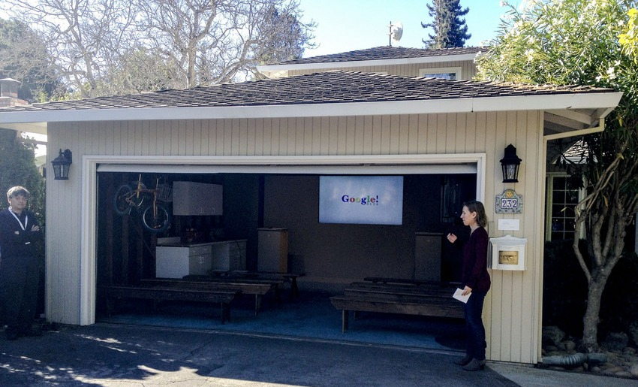
How Google Start
Google First office

Slide 5
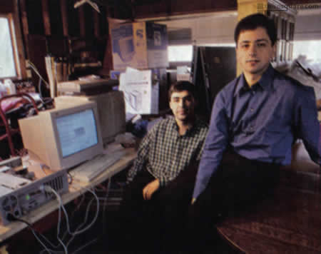
How Google Start
Google First office

Slide 6
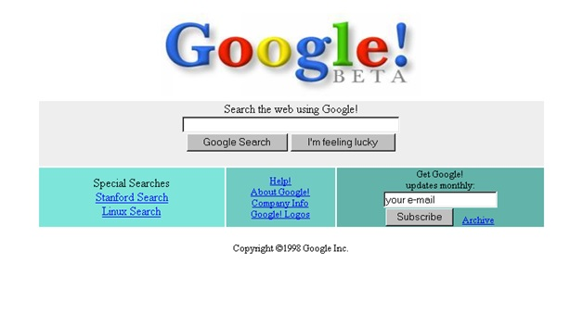
How Google Start
Google beta version

Slide 7
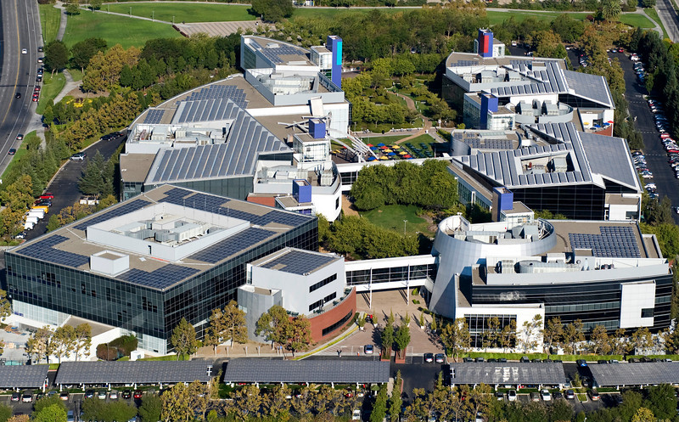
Google Current Head Quarters in California

Slide 8
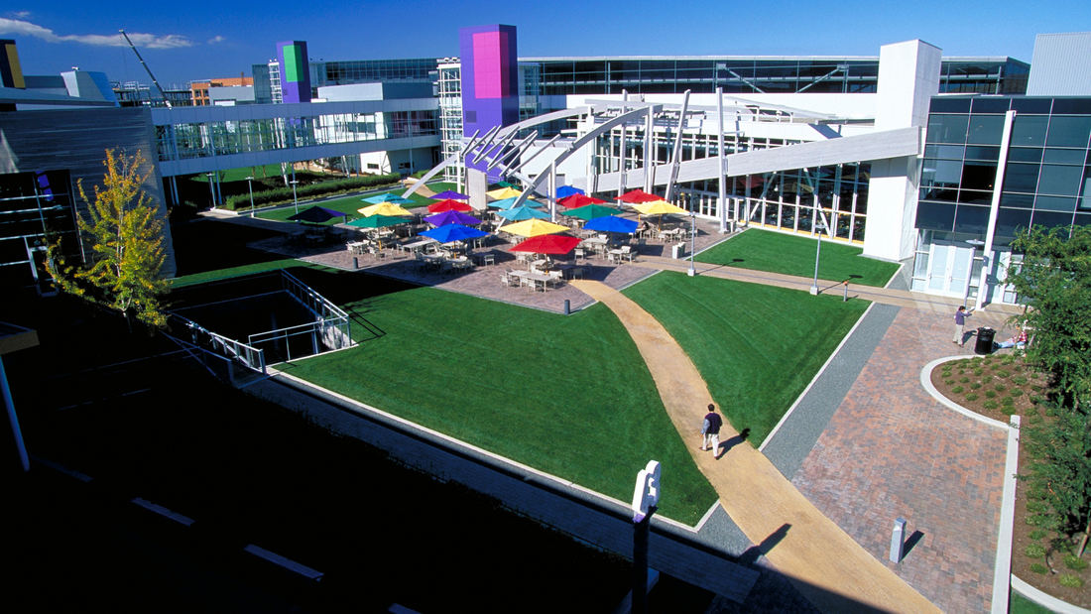
Google Current Head Quarters in California

Slide 9
About

Slide 10
About Google
We can introduce Google by following three lines
Who we are?
What we do?
What we believe?

Slide 11
Google Who we are?
Building great products depends on great people.
And there are more than 40,000 “Googlers” behind the tools that we use every day…
Work Culture:
Believe people make company, so the hire people who are smart and determined.
Believes that treating people well is more important than making a lot of money.
Employees' ideas are very important.
Google offers a unique program called "The 20% project“
By Google “TGIC” QandA program Googlers ask questions directly to Larry, Sergey and other execs about any number of company issues.

Slide 12
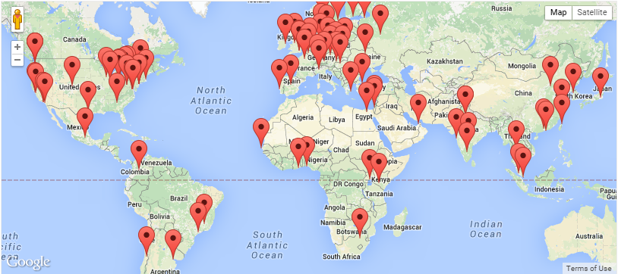
Google Who we are?
Location:
Today Google has more than 70 offices in more than 40 countries.

Slide 13
Google What we believe?
Google wrote these “10 things” when Google was just a few years old. Google still following it.
Focus on the user and all else will follow.
It’s best to do one thing really, really well.
Fast is better than slow.
Democracy on the web works.
You don’t need to be at your desk to need an answer.
You can make money without doing evil.
There’s always more information out there.
The need for information crosses all borders.
You can be serious without a suit.
Great just isn’t good enough.

Slide 14
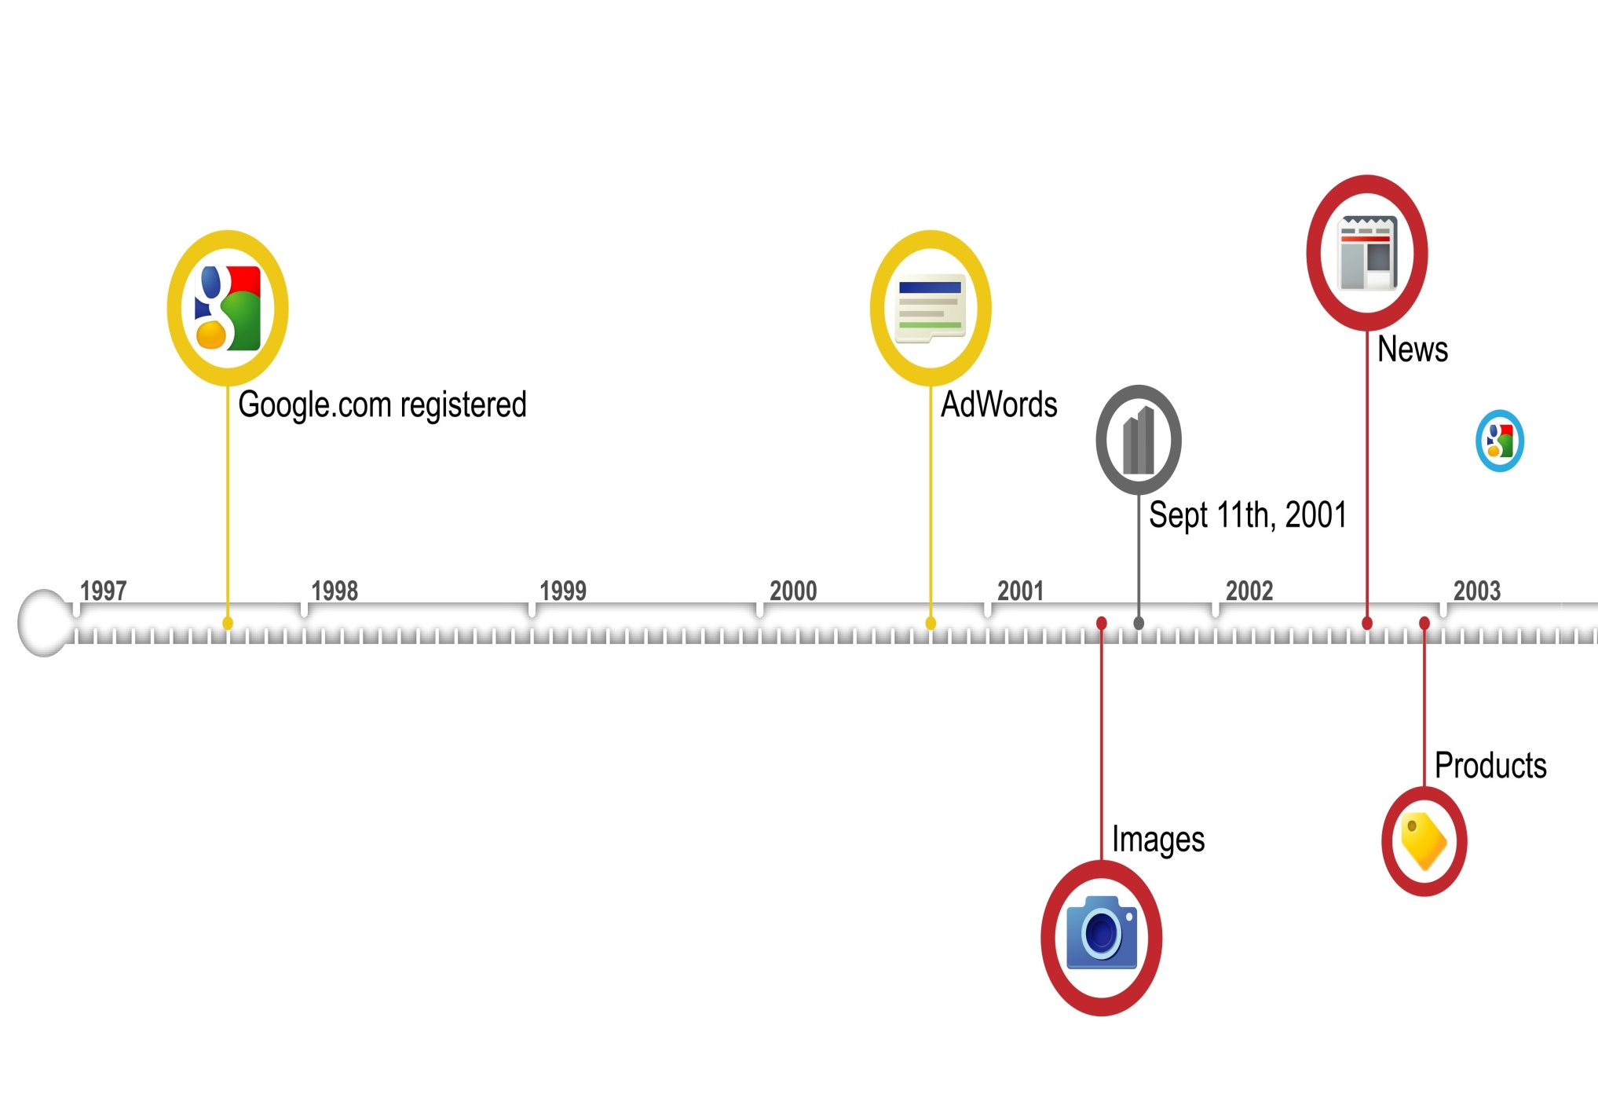
Google Evolution

Slide 15
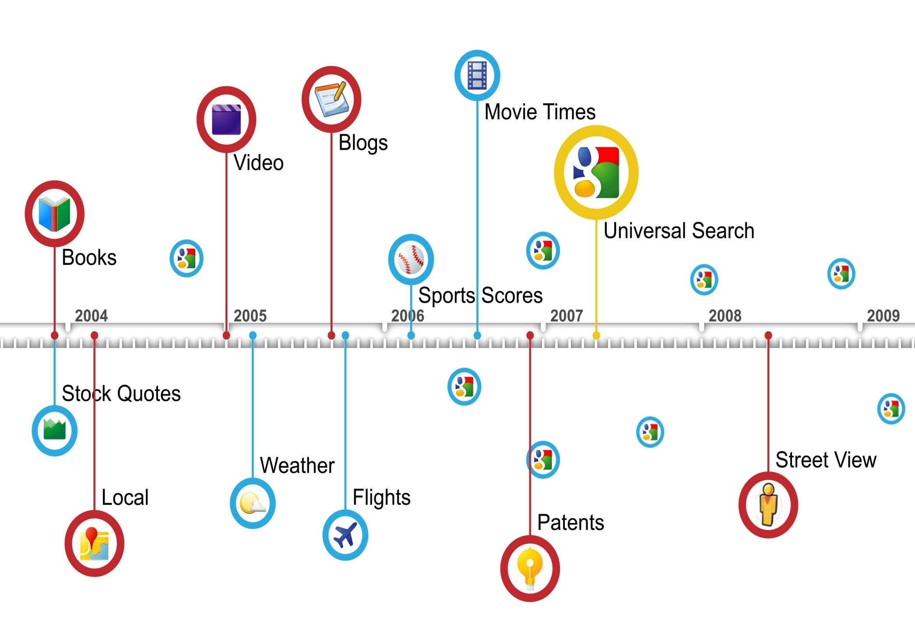
Google Evolution

Slide 16
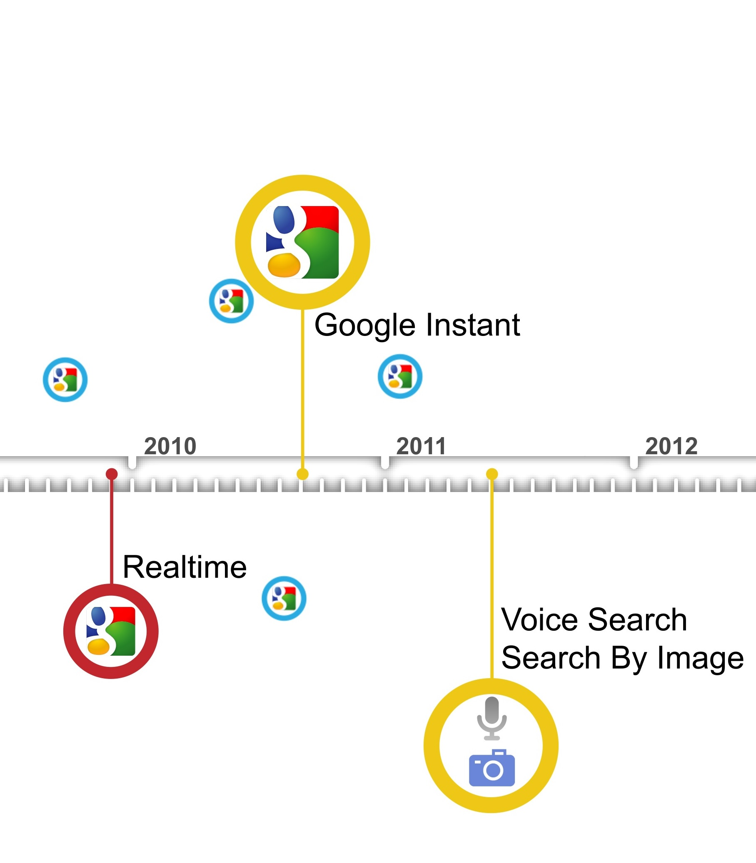
Google Evolution

Slide 17


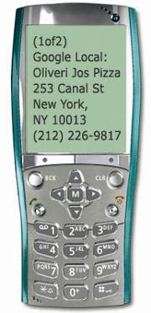
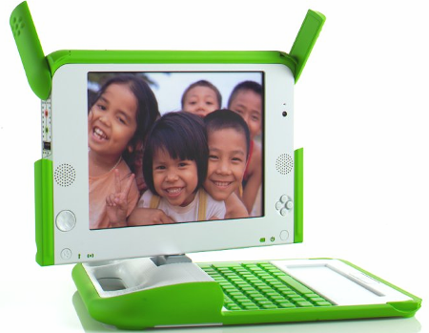
Google Mission
Organize the world's information and make it universally accessible and useful

Slide 18


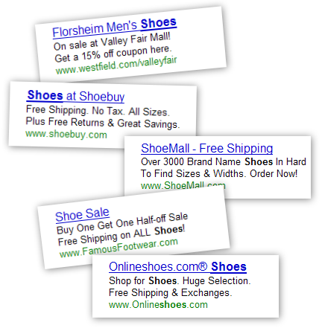


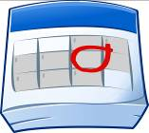



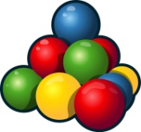
Google Strategy: Search. Ads. Apps.
Search.
Ads.
Apps.

Slide 19
Some Interesting Google Data-Points
Google started in January, 1996 as a research project at Stanford University, by Ph.D. candidates Larry Page and Sergey Brin when they were 24 years old and 23 years old respectively.
The name Google ™ was an accident. A spelling mistake made by the original founders who thought they were going for ˜Googol™”
Searches per day: Average per second search of people search on Google for is 40,000 http://www.internetlivestats.com/google-search-statistics/
Google Adsense income:
Top three companies that earn from Google ad-sence
Ehow.com :- $300,000/month
Mashable.com: $250,000/month
forums.digitalpoint.com: $195,000/month
Google YouTube :
Per day video views: 4B
Per minute video upload: 300 hours

Slide 20
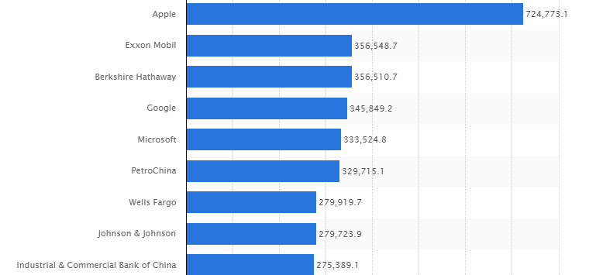
Top companies by market capitalization (2015)

Slide 21
Work Culture

Slide 22
Google work culture
Google has been ranked No.1 in Fortune's latest annual list of '100 Best Companies to Work For
Why?

Slide 23
Google work culture

