Slide 1


Slide 2
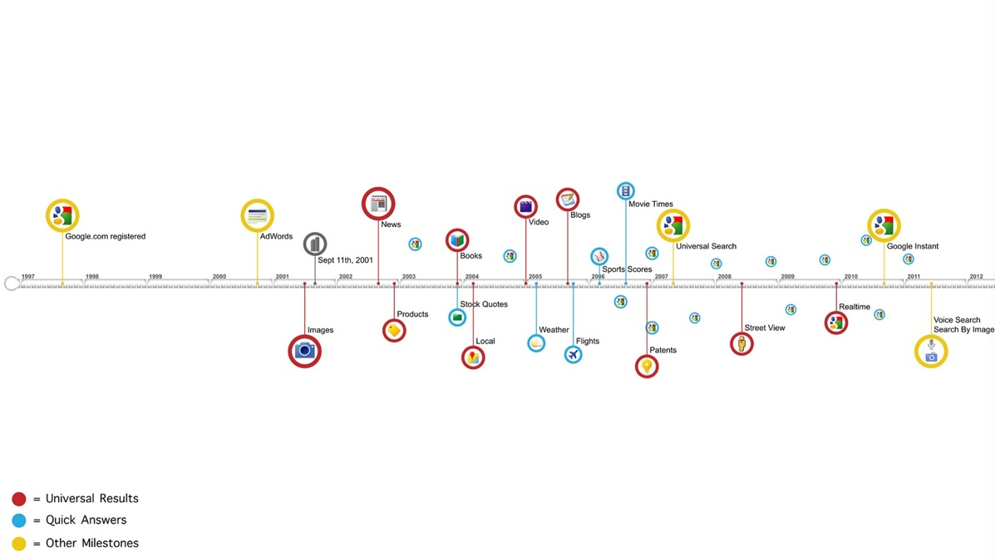
Google Evolution

Slide 3


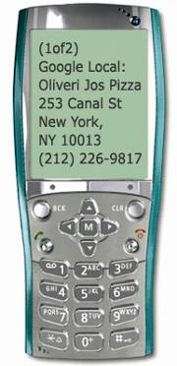

Google Mission
Organize the world's information and make it universally accessible and useful

Slide 4


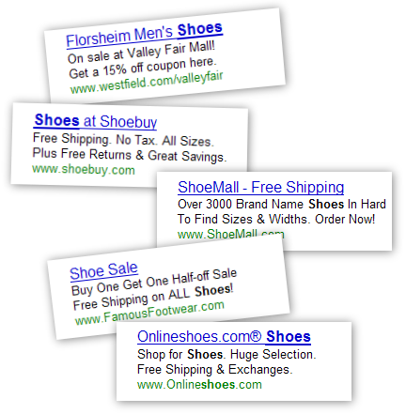







Google Strategy: Search. Ads. Apps.
Search.
Ads.
Apps.

Slide 5
Some Interesting Google Data-Points
Searches per day: Average per second search of people search on Google for is 40,000 http://www.internetlivestats.com/google-search-statistics/
Google Ad-Sence income:
Top three companies that earn from google ad-sence
Ehow.com :- $300,000/month
Mashable.com: $250,000/month
forums.digitalpoint.com: $195,000/month
Google YouTube :
Per day video views: 4B
Per minute video upload: 300 hours
The Google Network reaches more than 80% of worldwide Internet users
The Google Network reaches more Internet users worldwide than any other web property or ad network
PageRank (just one of more than 200 signals we use to determine the rank of a website)
The web changes all the time (10–20% of the web is brand new every time we crawl it)
Google has never seen 20–25% of its queries before, showing the creativity of our users and proving that small indices aren’t useful
Google updates its search algorithms on a weekly basis
Google News: now includes articles from over 10,000 news sources in more than 18 languages worldwide. Among these, over 4,500 are English language news sources
Advertisers: Hundreds of thousands of advertisers worldwide
Client Software: Google Toolbar has millions of users worldwide
Google Desktop: has millions of users worldwide
Audio Advertising: More than 1,600 radio stations available to U.S. AdWords advertisers
Print Advertising: More than 600 newspapers now available to U.S. AdWords advertiser
TV Advertising: We are currently in a closed trial to test an auction-based TV advertising system working with EchoStar and Astound Cable
YouTube: People watch hundreds of millions of videos on YouTube every day
Hundreds of thousands of videos are being uploaded to YouTube daily
Every minute, eight hours of video is uploaded to YouTube

Slide 6
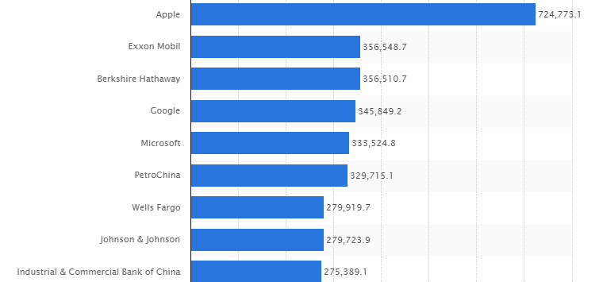
Top companies by market capitalization (2015)

