Slide 1


Slide 2
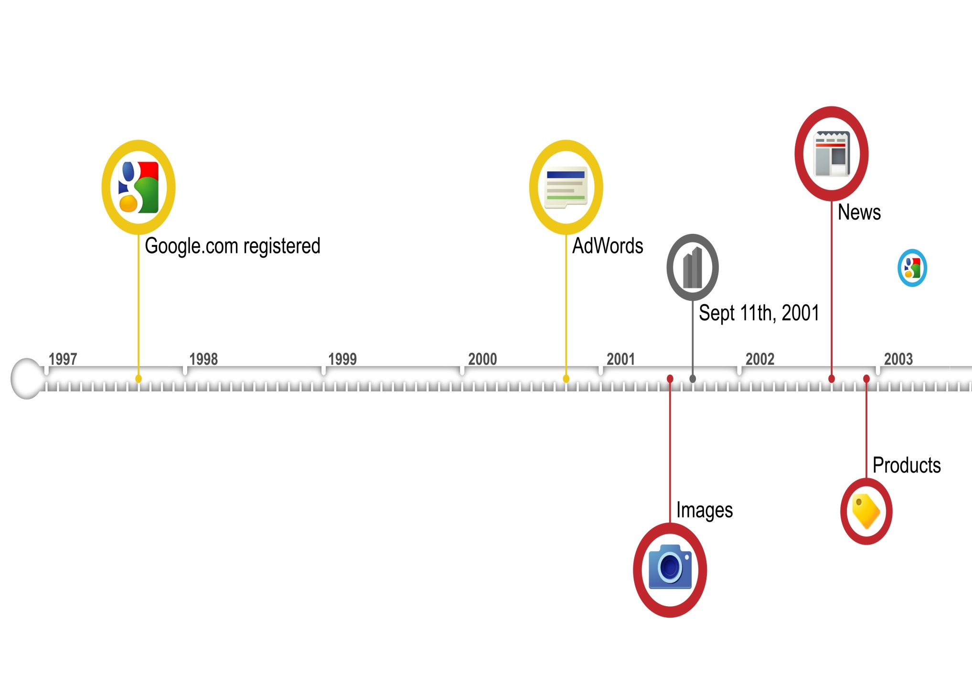
Google Evolution

Slide 3
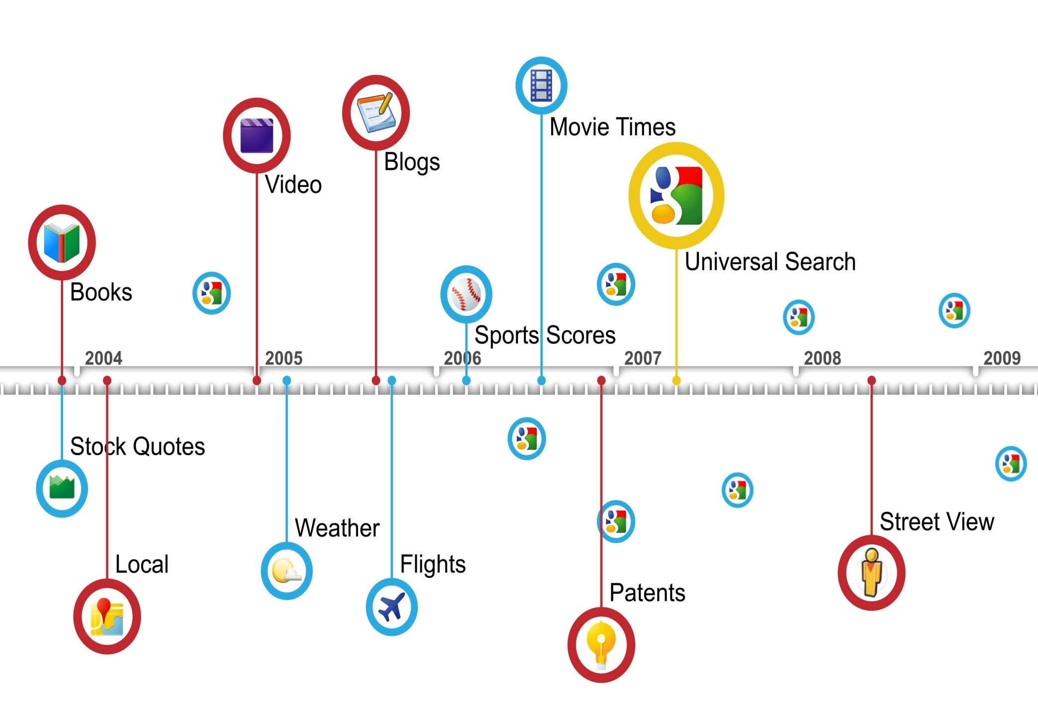
Google Evolution

Slide 4
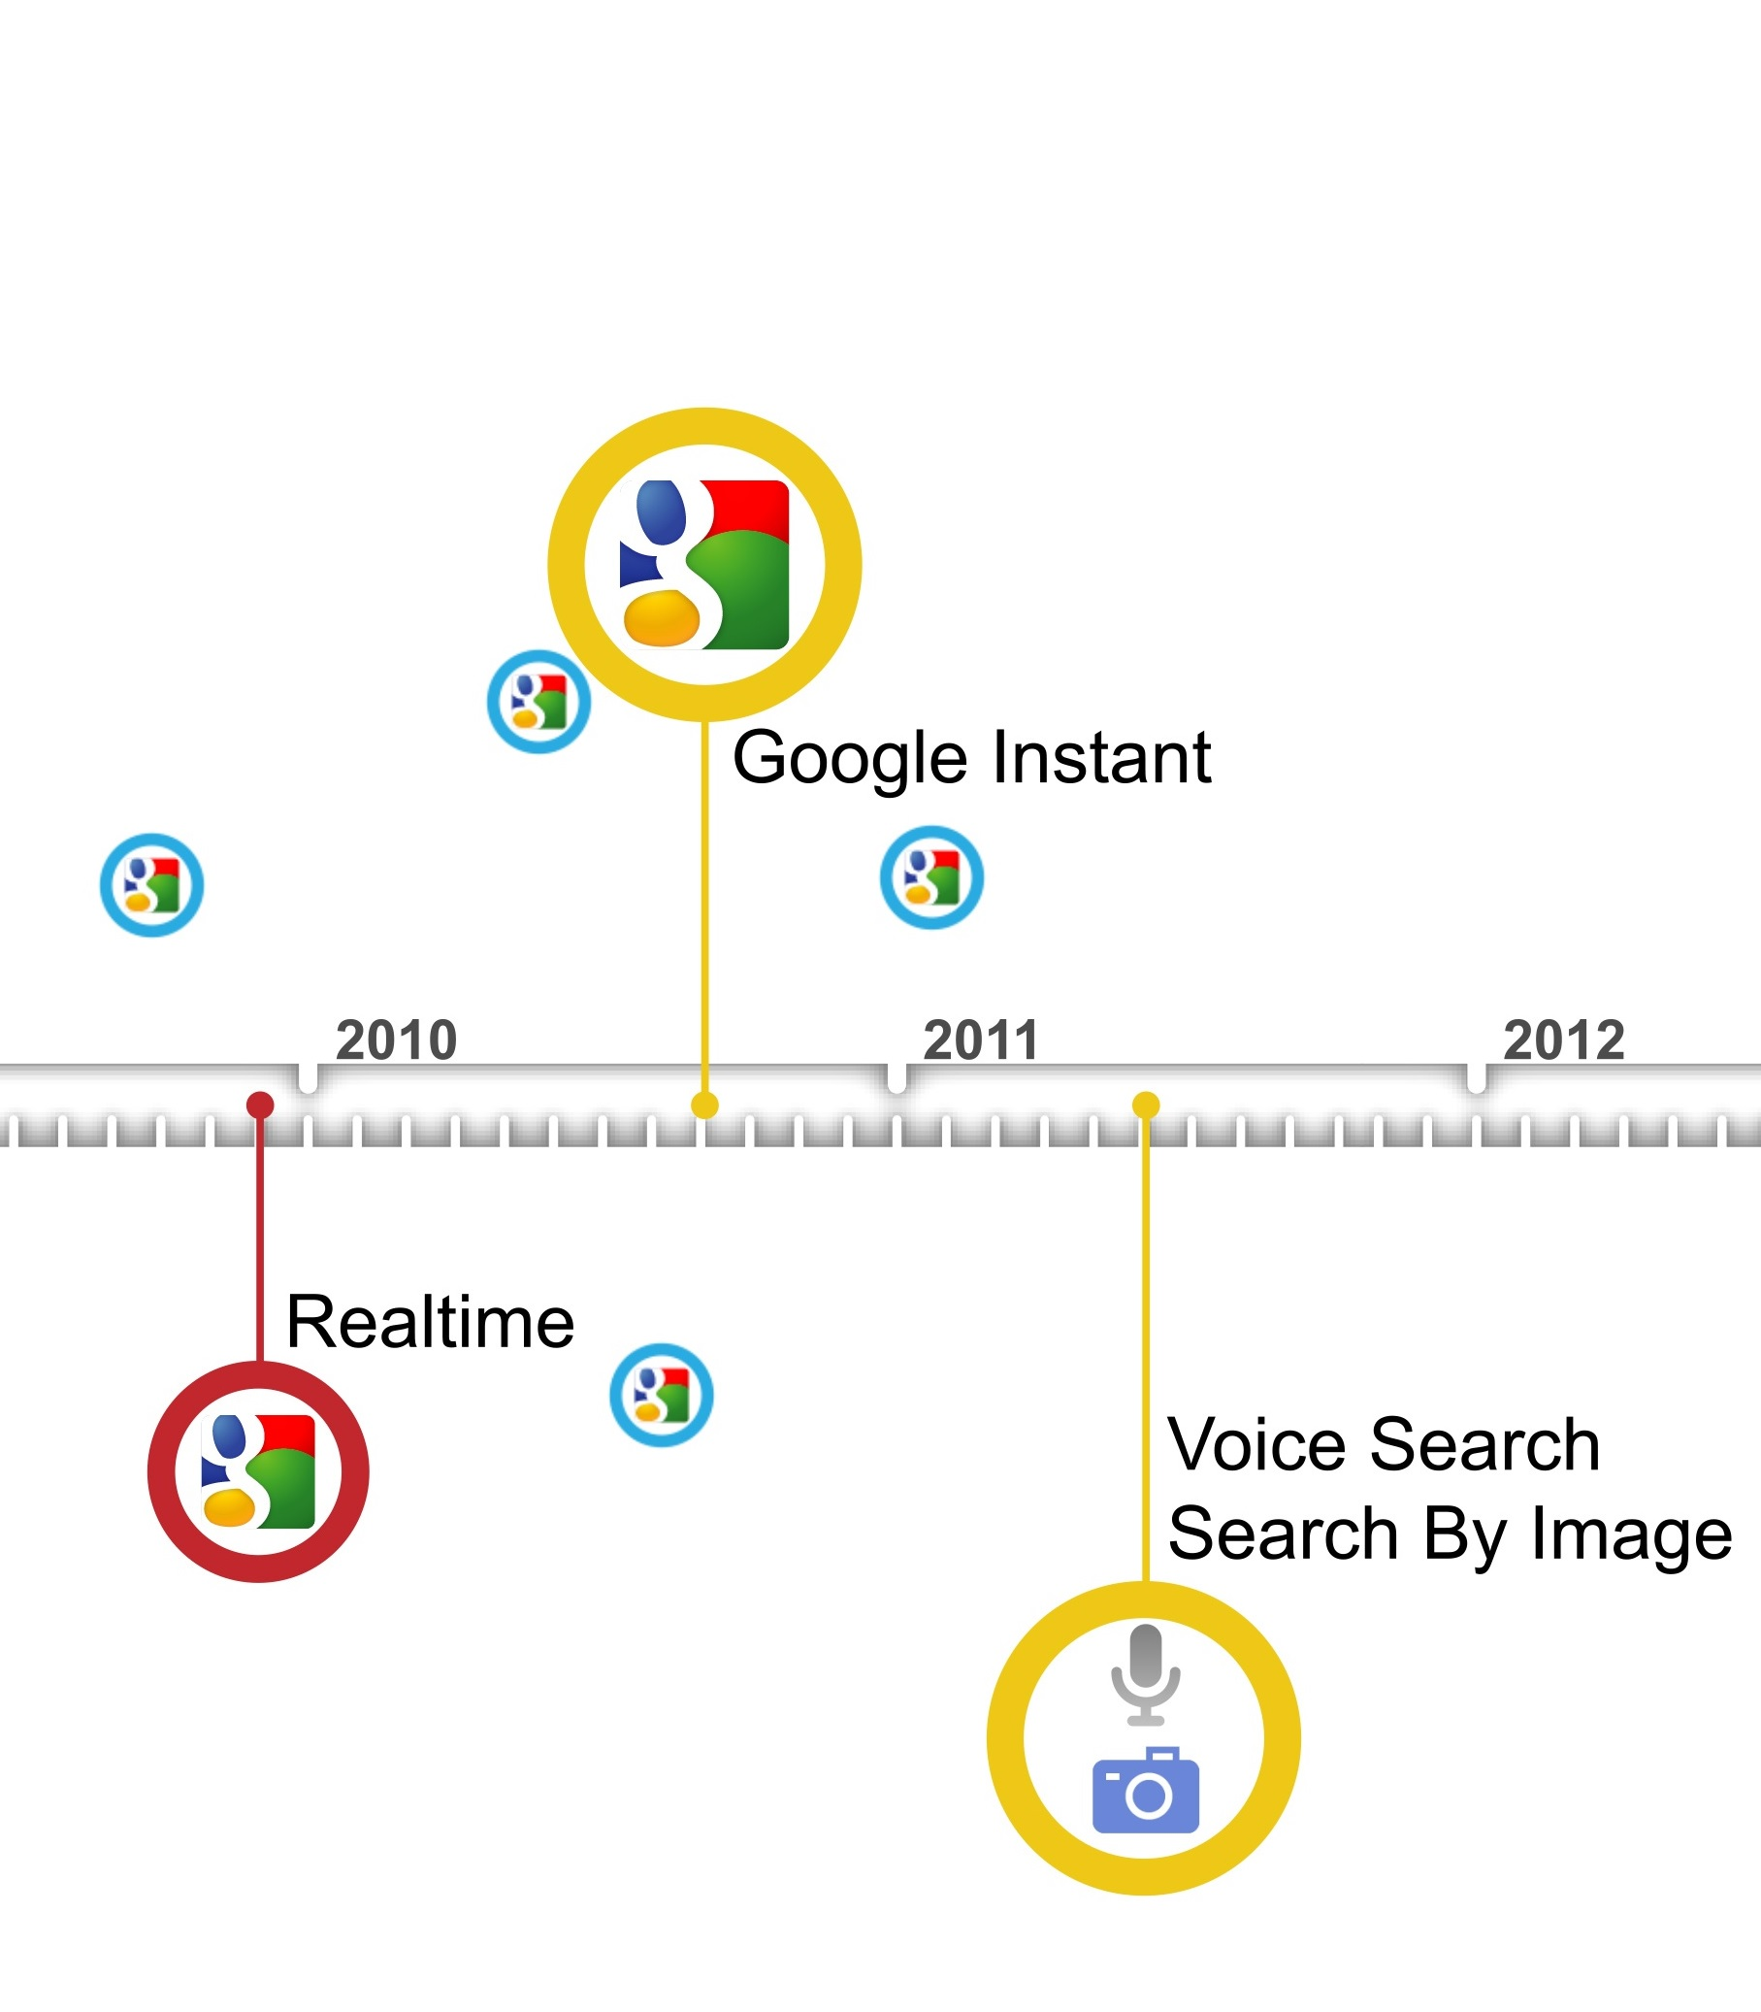
Google Evolution

Slide 5


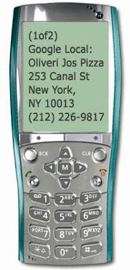

Google Mission
Organize the world's information and make it universally accessible and useful

Slide 6


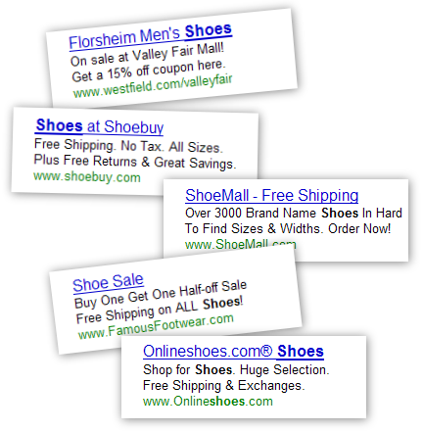







Google Strategy: Search. Ads. Apps.
Search.
Ads.
Apps.

Slide 7
Some Interesting Google Data-Points
Google started in January, 1996 as a research project at Stanford University, by Ph.D. candidates Larry Page and Sergey Brin when they were 24 years old and 23 years old respectively.
The name Google ™ was an accident. A spelling mistake made by the original founders who thought they were going for ˜Googol™”
Searches per day: Average per second search of people search on Google for is 40,000 http://www.internetlivestats.com/google-search-statistics/
Google Adsense income:
Top three companies that earn from Google ad-sence
Ehow.com :- $300,000/month
Mashable.com: $250,000/month
forums.digitalpoint.com: $195,000/month
Google YouTube :
Per day video views: 4B
Per minute video upload: 300 hours

Slide 8
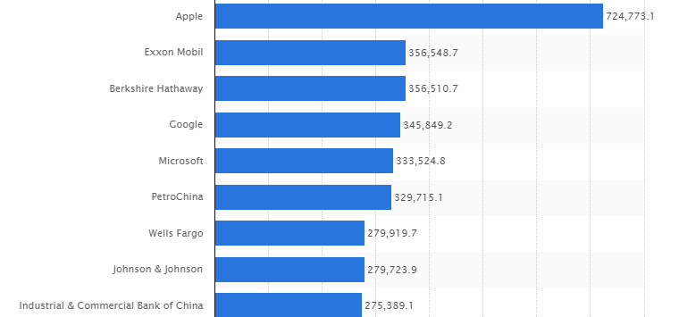
Top companies by market capitalization (2015)

