Slide 1



Submitted To- Lect. JJ Maini
Submitted by- Gurjit Singh
MBA 2nd
R.N- 811

Slide 2
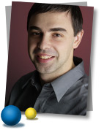
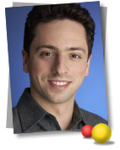

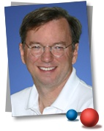

History and Milestones
1998: Larry Page and Sergey Brin create Google searchengine. In September 1998, Google Inc. opened its door in Menlo Park, California.
2000: Google introduces AdWords,
2001: Google hires Dr. Eric Schmidt as new CEO.
Notes:
2

Slide 3
History and Milestones
2002: Introduction of the Google Search Appliance for corporate Search (Googlebot search robot).
2002 : The launch of Google Labs. Google News launched in beta in September of 2002, offering access to 4,500 leading news sources from around the world.
2003: Google acquires Pyra Labs and became the home for Blogger. Google Desktop launched and Google Toolbar improved.

Slide 4






History and Milestones
2004: New web-based mail service called Gmail, which at launch included a gigabyte of free storage for each user.
Acquisition of Picasa, Inc.
2005: The Google Search Appliance spawned a new blue Google Mini. The Mini is the first Google hardware product to be sold only through the Google Store
Personalized Homepage ( iGoogle ).
Launch of Google Talk.
Google acquires Orkut
Notes:
4

Slide 5





History and Milestones
2006: New launches: Page creator, Google Finance, Google Calendar, Custom Search, Trends, Notebook.
Launch of Google packages for Mobile Devices: Google for mobile.
2007: Partnerships and Business Deals > Mobile matters!
China Mobile cooperation: to provide mobile and Internet search services in China .
Notes:
5

Slide 6
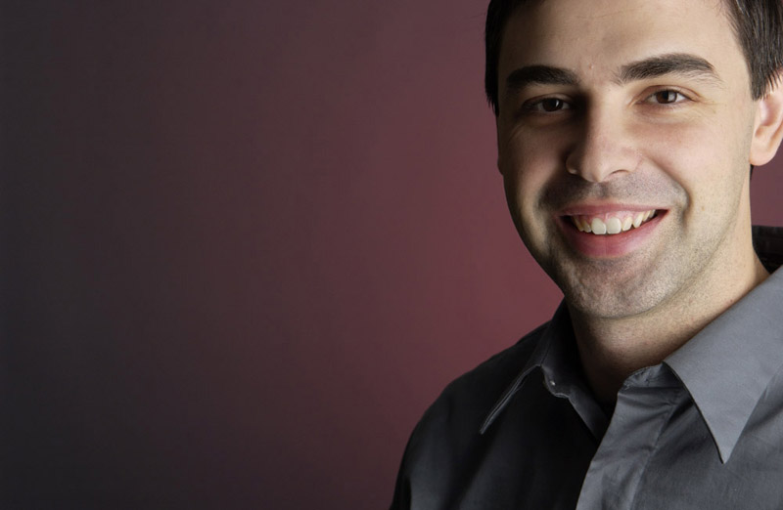
Larry Page
Who is Larry page -
Lawrence "Larry" Page (born March 26, 1973) is an American computer scientist and internet entrepreneur who, with Sergey Brin, is best known as the co-founder of Google. On April 4, 2011, he took on the role of chief executive officer of Google, replacing Eric Schmidt. As of 2011, his personal wealth is estimated to be $16.7 billion.

Slide 7
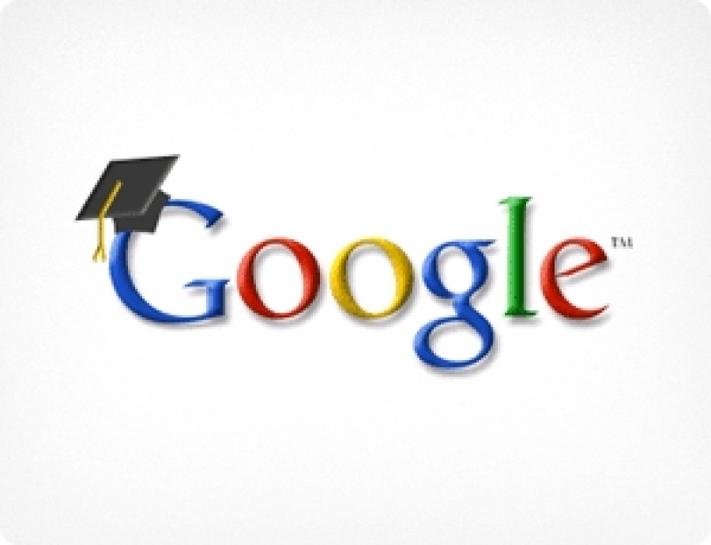
Education
Page attended the Okemos Montessori School (now called Montessori Radmoor) in Okemos, Michigan from 1975 to 1979.
Graduated from East Lansing High School in 1991
He holds a Bachelor of Science in computer engineering from the University of Michigan with honors and a Master of Science in computer science from Stanford University

Slide 8
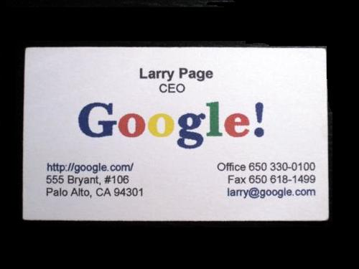
Business
In 1998, Brin and Page founded Google, Inc
Page ran Google as co-president along with Brin until 2001 when they hired Eric Schmidt as Chairman and CEO of Google.
In January 2011 Google announced that Page would replace Schmidt as CEO in April
On April 4, 2011, Page officially became the chief executive of Google,

Slide 9
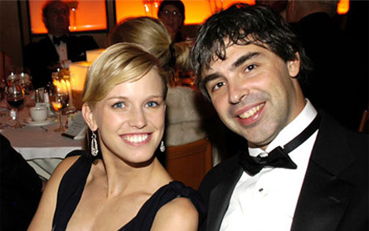
Personal life
Page married Lucinda South worth at Richard Branson's Caribbean island, Necker Island in 2007

Slide 10
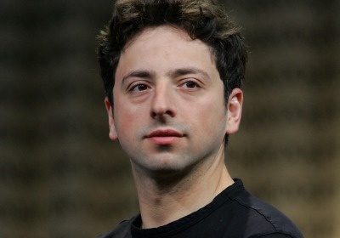
Sergey Brin
Sergey Brin
Sergey Mikhaylovich Brin born August 21, 1973) is a Russian-born American computer scientist and Internet entrepreneur who, with Larry Page, co-founded Google, one of the most profitable Internet companies. As of 2011, his personal wealth is estimated to be $16.7 billion.

Slide 11
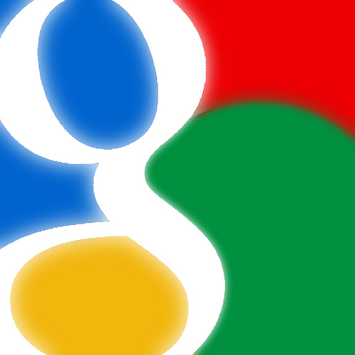
Education
Brin attended grade school at Paint Branch Montessori School in Adelphi, Maryland
In September 1990, after having attended Eleanor Roosevelt High School in Greenbelt,
Brin enrolled in the University of Maryland to study computer science and mathematics, where he received his Bachelor of Science in May 1993 with honors.
Brin began his graduate study in computer science at Stanford University on a graduate fellowship from the National Science Foundation.

Slide 12
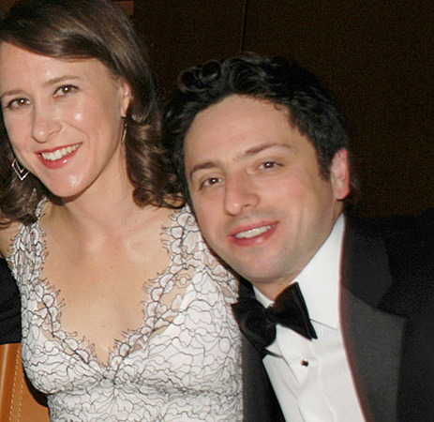
Personal life
In May 2007, Brin married Anne Wojcicki in The Bahamas.

Slide 13
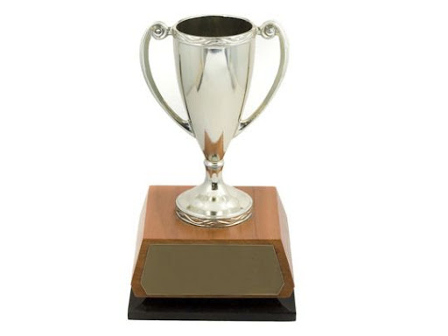
Awards and recognition
PC Magazine has praised Google as among the Top 100 Web Sites and Search Engines (1998)
In 2000, Google earned a Webby Award, a People's Voice Award for technical achievement
in 2001, was awarded Outstanding Search Service.

Slide 14
Awards and recognition
In 2002, Page, along with Sergey Brin, was named to the MIT Technology Review TR100, as one of the top 100 innovators in the world under the age of 35.
In 2004, Page and Brin were named "Persons of the Week" by ABC World News Tonight.
In 2011, page was ranked 24th on the Forbes list of billionaires and as the 11th richest person in the United States.

Slide 15
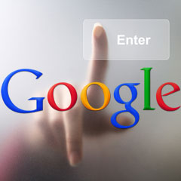
The Future
“The ultimate search engine would understand exactly what you mean and give back exactly what you want.”
- Larry Page

Slide 16
Vision Mission And Focus
The Vision
To make search engines so powerful they would understand "everything in the world".
The Mission
To organize the world's information and make it universally accessible and useful.
The Focus
Google continues to focus on innovation and on the user experience.

Slide 17

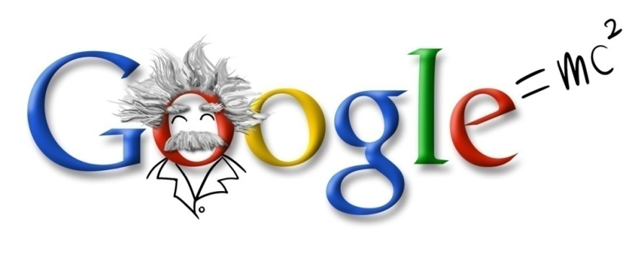
Google’s Value
Focus on the user and all else will follow.
It's best to do one thing really, really well.
Fast is better than slow.
Democracy on the web works.
You don't need to be at your desk to need an answer.
You can make money without doing evil.
There's always more information out there.
The need for information crosses all borders.
You can be serious without a suit.
Great just isn't good enough.

Slide 18


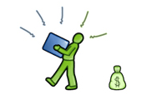

Search=Find=Ad=Click!!
NO changes in Googles Core Business since 1998: “Google does search”
Google offers the best, fastest, (PC&Mobile devices), reliable and easy to use SEARCH services.
Users FIND highly relevant information.
Google exposes highly relevant text, image, animated video or ADS to the user.
As soon as a user clicks on the sponsored links or ads Google CHARGES his client.
Attention SEARCH
4. Action CLICK/$
2. Interest FIND OK
3. Desire ADS
Notes:
18

Slide 19


Keep focus on the user.
Never settle for the best regarding search algorithms improving response speed and accuracy of results.
Get and keep the best brains, brightest and most motivated on board.
Strategic global and local acquisitions in Digital and traditional Advertising.
Mobile search, advertising and content is the future.
Worldwide presence with local focus on content acquisition.

Slide 20
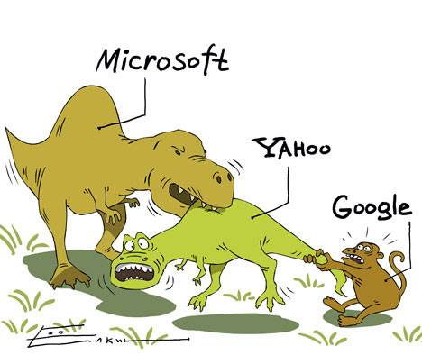
Interesting facts about Google
Google started in January, 1996 as a research project at Stanford University, by Ph.D. candidates Larry Page and Sergey Brin when they were 24 years old and 23 years old respectively.
The name Google™ was an accident. A spelling mistake made by the original founders who thought they were going for ˜Googol™”

Slide 21

Interesting facts about Google
57% of American kids say ‘Google’ as their first word.
620 million visitors visit Google.com daily.
97% of Google Revenue comes from their advertising services.
Google processes 20 Petabyte of information daily.
Google has a world-class staff of more than 2,668 employees known as Googlers

Slide 22


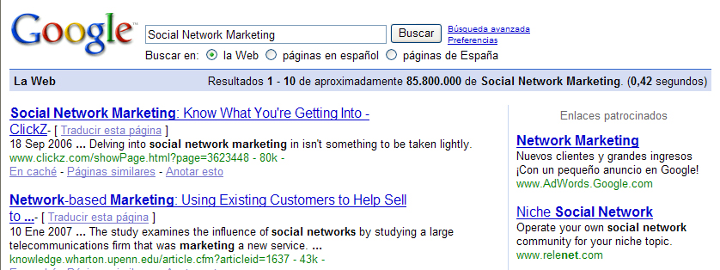
Google’s cash cow –Simple but highly effective
Simple text based ads
Can you imagine that these little text ads could generate billions of dollars of revenue for Google?
They do!
Notes:
22

Slide 23
THANK YOU
AND KEEP GOOGLING

