Slide 1









Namaste Desk
तपाईंको होटलमा के के गर्न सकिन्छ?
Check-in र Check-out
Room Calendar
Billing र Receipt
Guest को सबै details एकैठाउँ भर्नुस् — नाम, phone, ID, dates, room सबै।
कुन room खाली छ, कुन occupied — calendar मा एकैझलक देख्नुस्।
Room charge + खाना + discount + advance — सबै automatic जोडिन्छ, mistake हुँदैन।
Double Booking हुँदैन
Returning Guest Auto-fill
Check-in Sheet Print
Booking.com, Airbnb, Agoda, फोन — जहाँबाट booking आए पनि room clash हुँदैन।
फिर्ता आउने guest को phone type गर्नासाथ सबै details आफैँ भरिन्छ।
Guest को signature को लागि print-ready sheet — ID photo सहित। Government record ready।
Excel Sales Report
Data Backup र Transfer
ID Card Capture
महिनाको सबै bill एक click मा Excel मा। Accountant चाहिँदैन।
6 months को data export गर्नुस् — नयाँ computer मा import गर्दा सबै आउँछ।
Camera बाटै ID photo खिच्नुस् वा file upload गर्नुस् — system मा save हुन्छ।

Slide 2
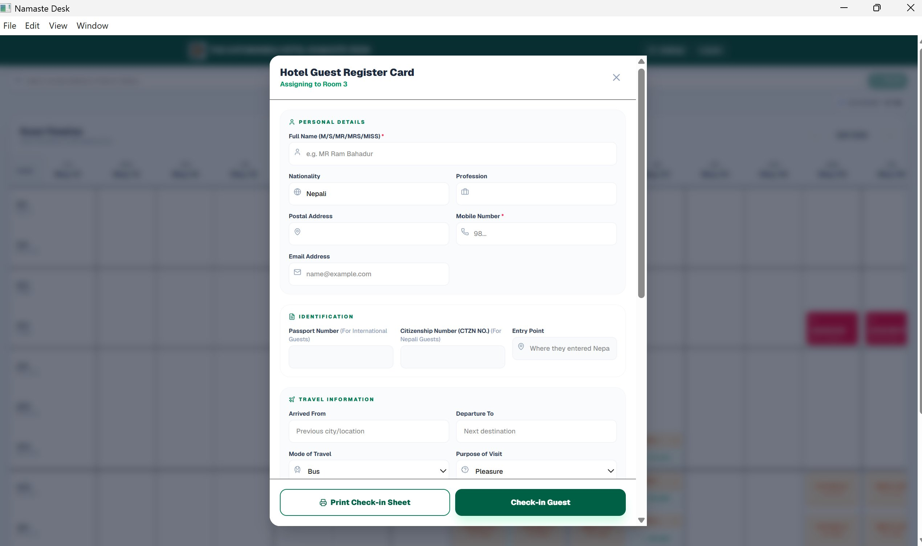
Step 1 — Guest को details भर्नुस्
सिक्न गाह्रो छैन — पहिलो दिनै गर्न सकिन्छ।
1
पूरा नाम, nationality, phone भर्नुस्
Full name, nationality, phone number
2
Email र postal address (optional)
Email and postal address
3
Passport वा Citizenship number
ID number — international or Nepali guest
4
Arrived from, departure to भर्नुस्
Travel route and purpose of visit
✨ Phone type गर्नासाथ पुरानो guest auto-fill हुन्छ!

Slide 3
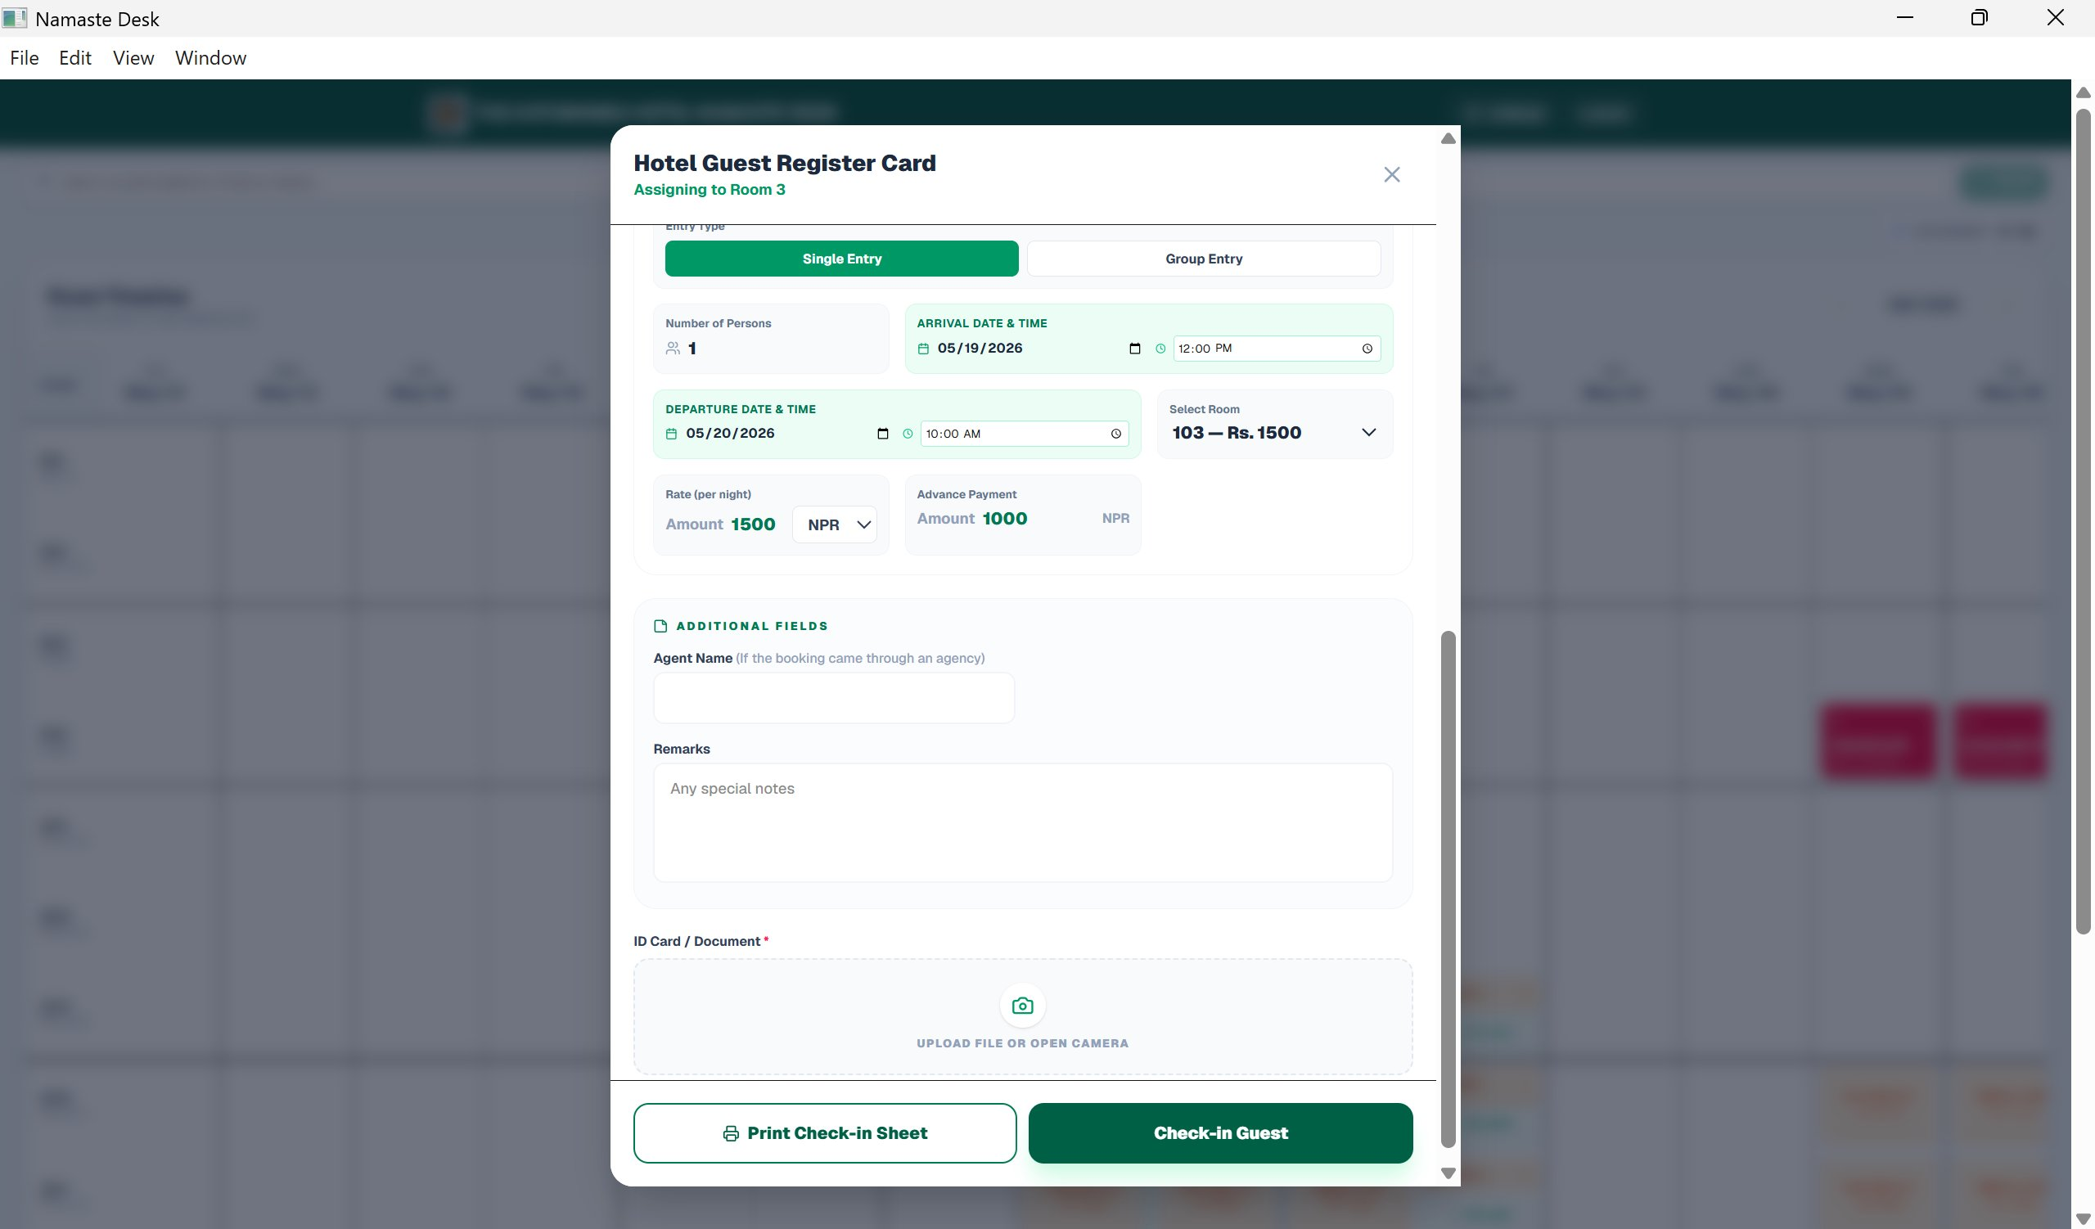
Step 1 (cont.) — Date, Room र Advance
Single वा Group — दुवै एकै form बाट।
1
Single वा Group entry छान्नुस्
Single or group booking toggle
2
Check-in / Check-out date र time
Arrival and departure date + time
3
Room छान्नुस् — rate आफैँ देखिन्छ
Room picker with automatic rate display
4
Advance payment enter गर्नुस्
Record advance paid at check-in
ID card: file upload वा camera बाट capture

Slide 4
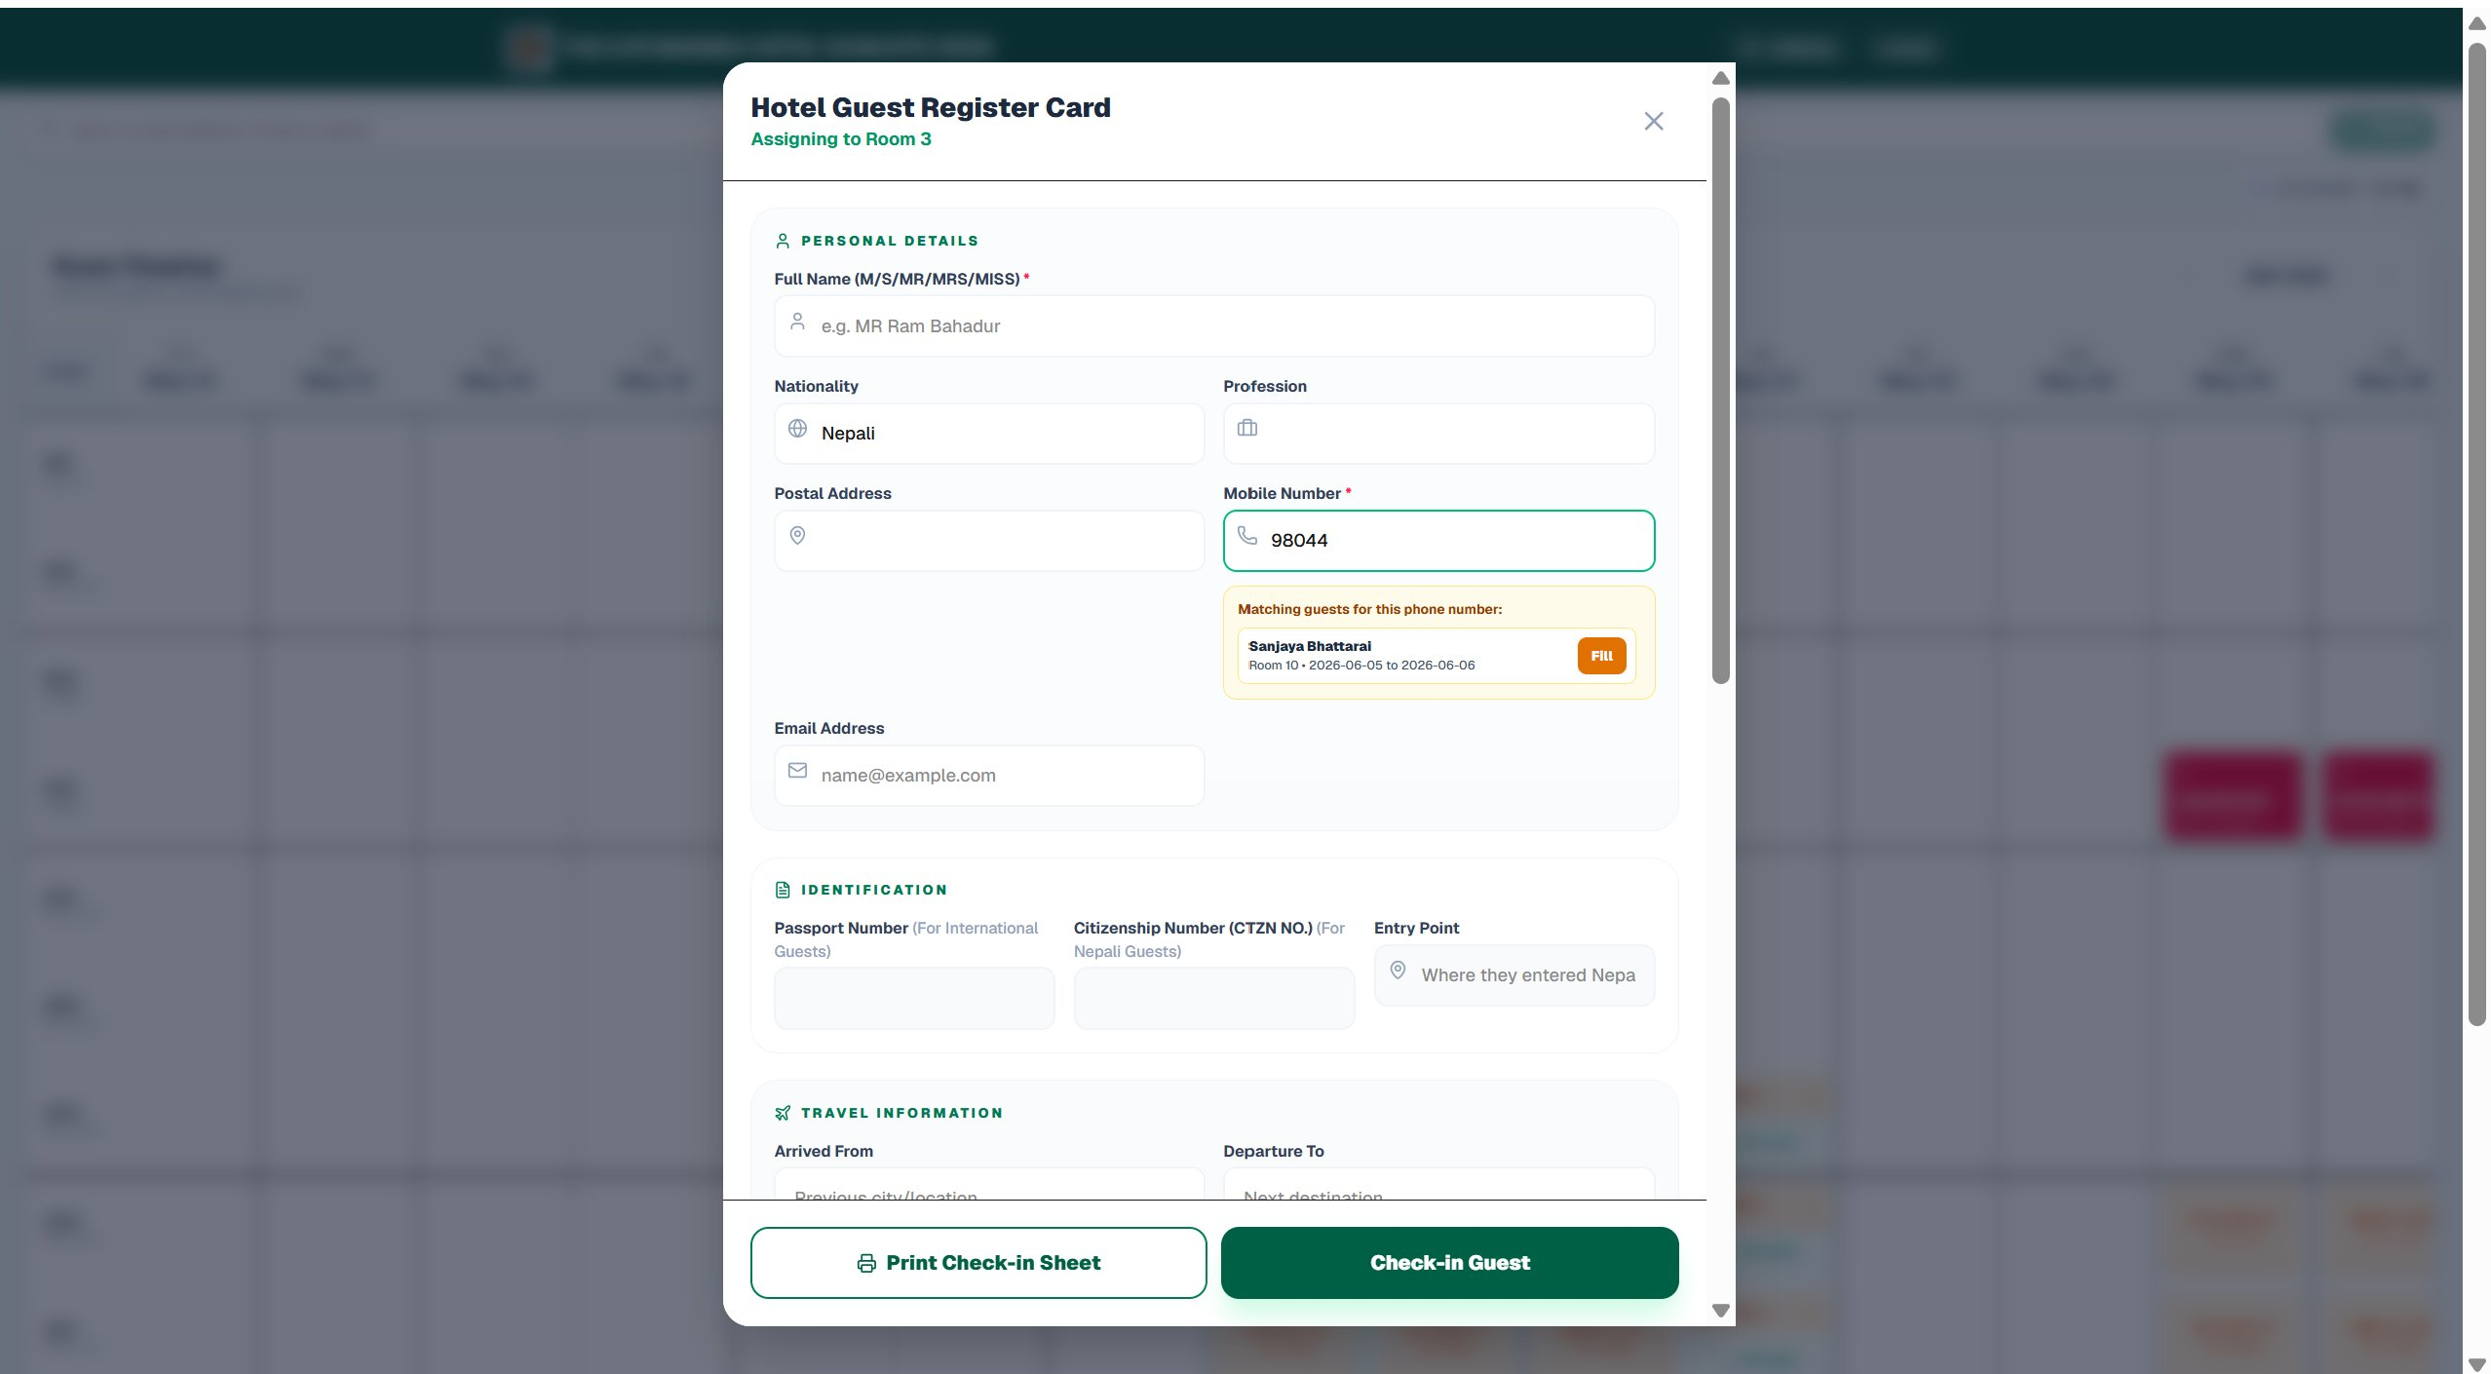
Smart Feature — फिर्ता आउने Guest
Phone नम्बर टाइप गर्नासाथ सबै details आफैँ आउँछ।
1
Phone type गर्नासाथ match देखाउँछ
Instant match as you type
2
"Fill" थिच्नुस् — सबै form भरिन्छ
One click fills all fields
3
ID card पनि automatically load हुन्छ
Previous ID document reloads
4
Check-in time २ मिनेटबाट ३० second
Massive time saving for repeat guests

Slide 5
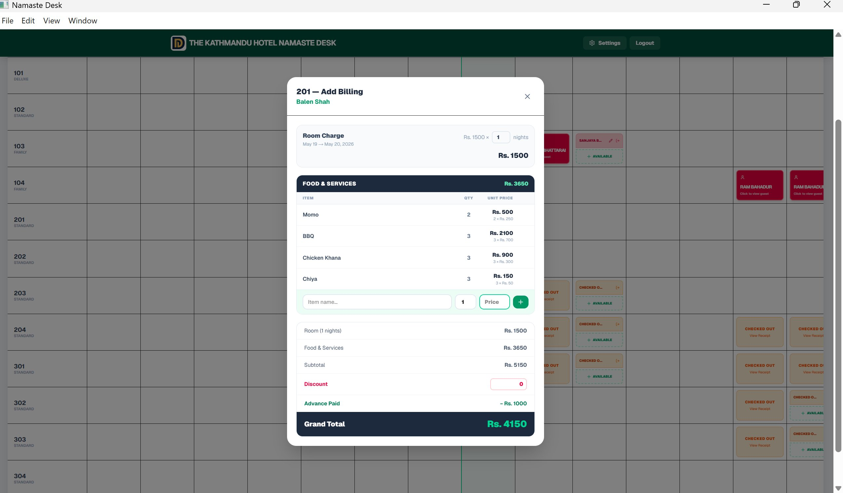
Step 2 — Billing गर्नुस्
Room charge, खाना, discount — सबै आफैँ जोड्छ। Argue गर्नु पर्दैन।
1
Room charge automatic — rate × nights
No manual calculation needed
2
खाना थप्नुस् — item, qty, price
Add food items with quantity and price
3
Discount र Advance auto-deduct
Both deducted automatically
4
Grand Total कहिल्यै गलत हुँदैन
Zero billing errors, zero disputes

Slide 6
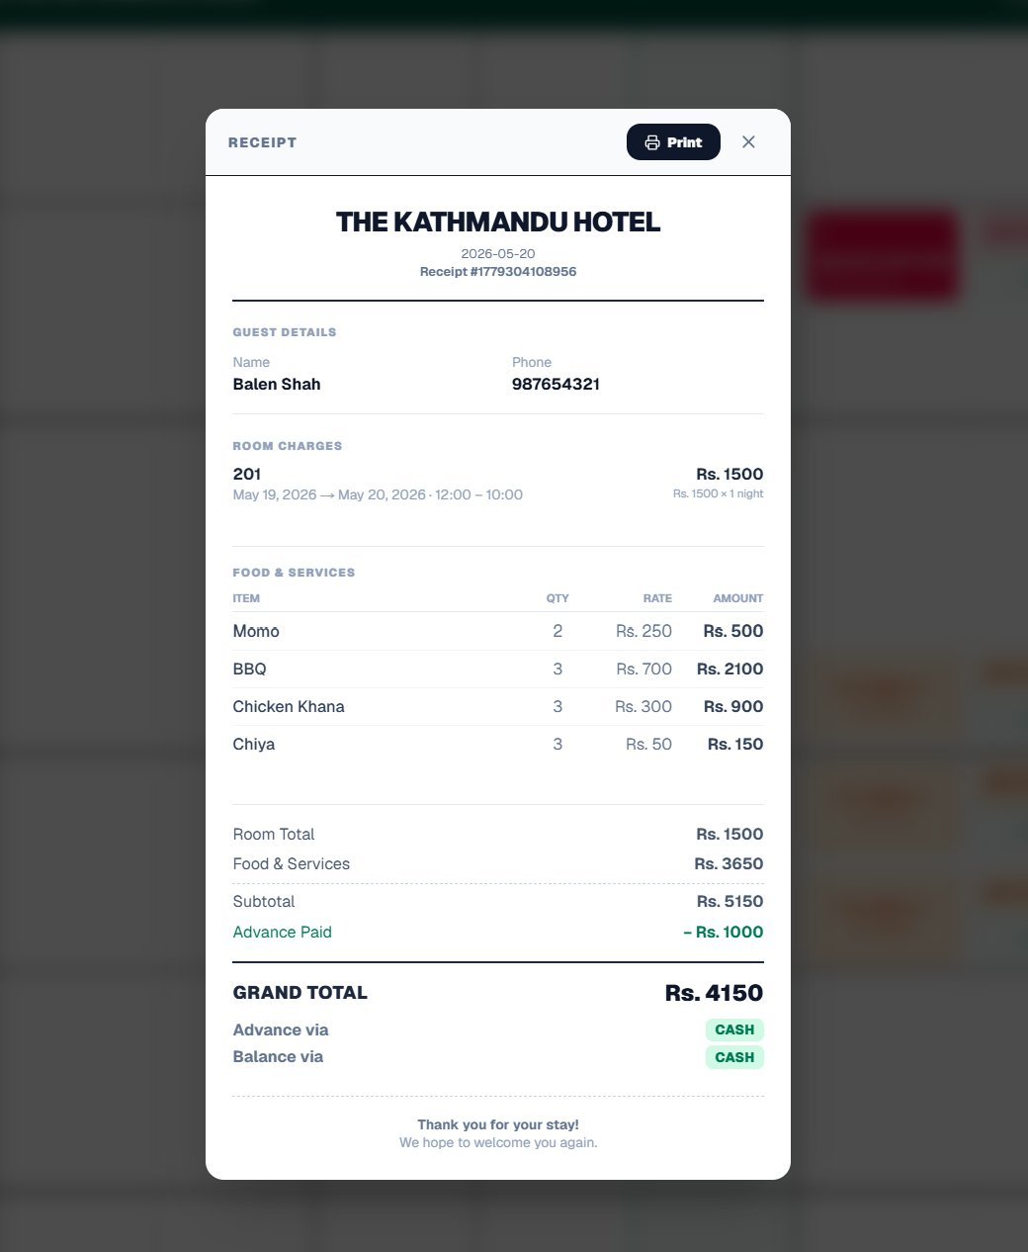
Receipt — Single Room
Checkout भएपछि receipt automatically तयार — print गर्न मिल्छ।
1
Hotel नाम र date automatic आउँछ
Auto-populated hotel header
2
Room charge breakdown देखिन्छ
Per-night breakdown shown
3
Food items qty × rate = amount
Full itemized food bill
4
Advance deduct गरेर Grand Total
Final amount after advance deduction
🖨️ Print button — तुरुन्त print गर्न सकिन्छ

Slide 7
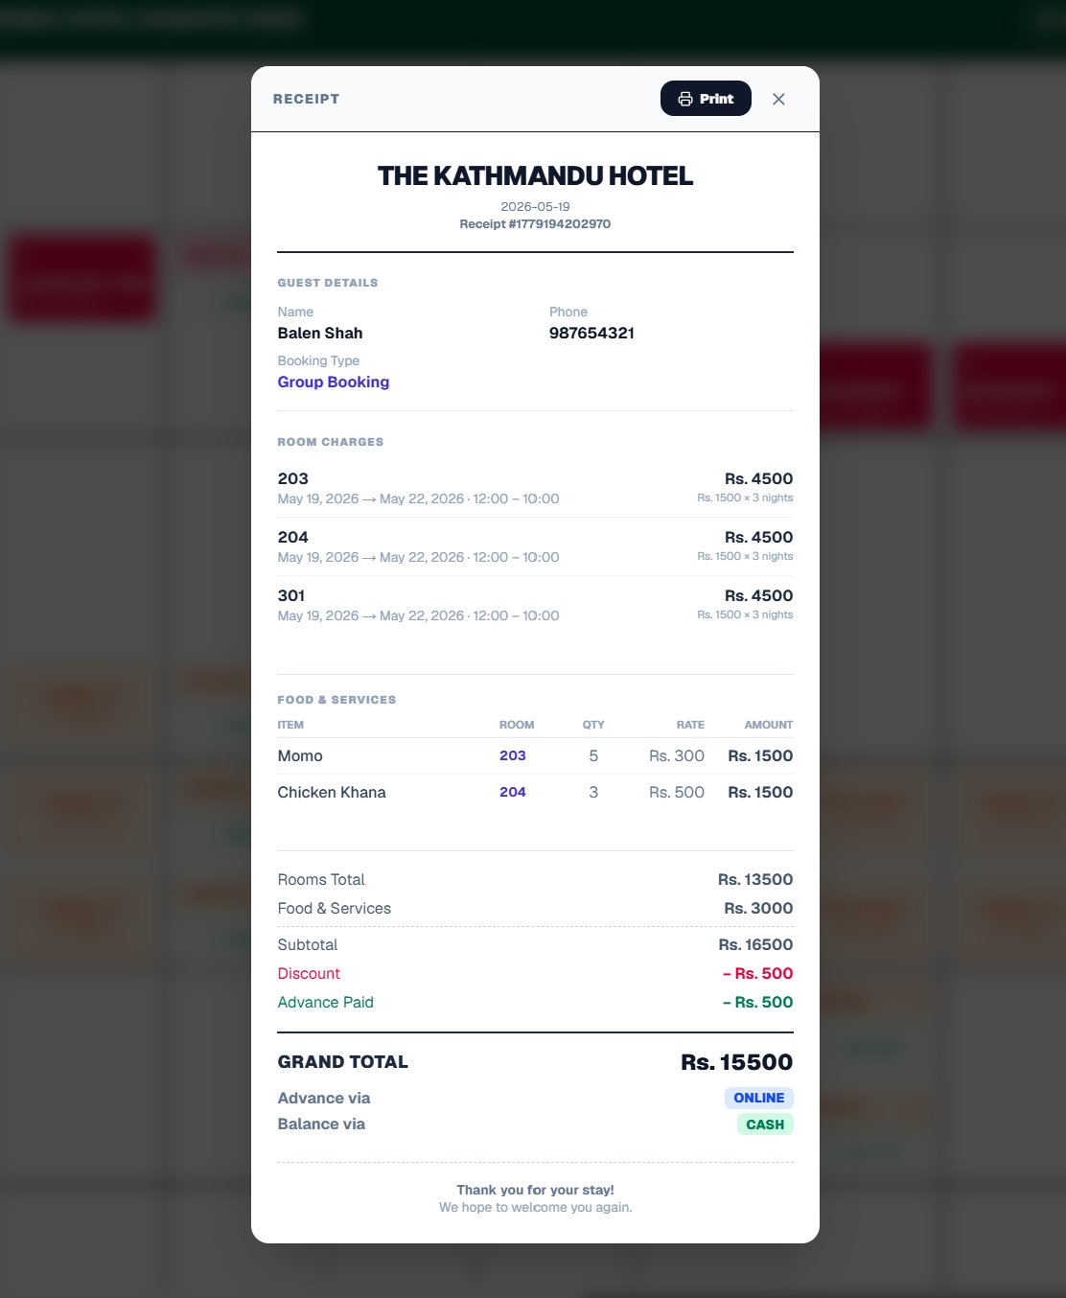
Receipt — Group Booking (धेरै room)
Group मा check-in गरेको सबै room को bill एकैपटक — अलग अलग गर्नु पर्दैन।
1
सबै room एकै receipt मा देखिन्छ
Room 203, 204, 301 all in one bill
2
Per-room food items अलग track
Food tracked per room separately
3
Discount + Advance एकैपटक deduct
Applied once across the group
4
Group Booking label clearly देखिन्छ
Clearly labeled for record-keeping

Slide 8
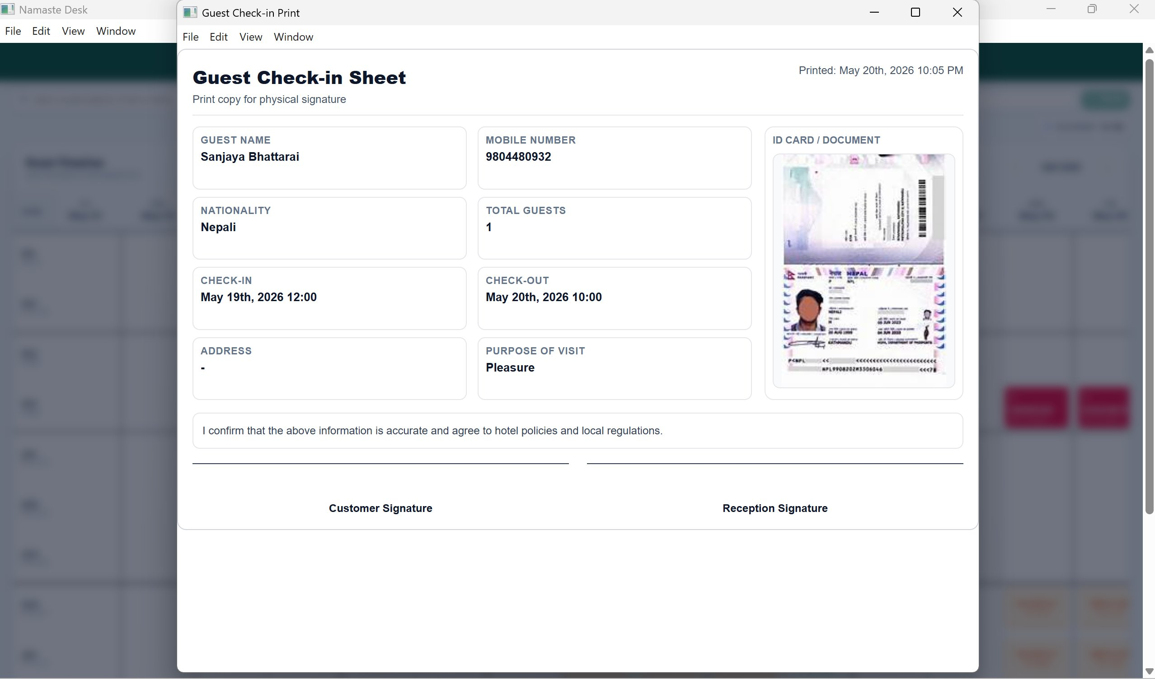
Guest Check-in Sheet — Print
Government compliance को लागि signature sheet — सबै automatic भरिन्छ।
1
Guest को सबै details print हुन्छ
Name, nationality, ID, purpose of visit
2
ID card photo पनि print मा देखिन्छ
Captured ID shown in the sheet
3
Customer र Reception signature line
Both signature fields auto-included
4
Tourism Board / Police को requirement पूरा
Government compliance ready

Slide 9

Sales Report — Excel मा Export
Accountant चाहिँदैन — महिनाको सबै हिसाब एक click मा तयार।
Monthly Bill Report
Customer Details सबै
Data Backup र Transfer
जुन महिनाको चाहिन्छ — त्यही महिना छानेर Export Bills थिच्नुस्। Excel file download हुन्छ।
Guest को नाम, phone, room, dates, amount paid — सबै एउटै file मा।
6 months को data export — नयाँ computer मा Import from File गर्दा सबै आउँछ।

Slide 10

आजैबाट सुरु गर्नुस्।
Extra staff चाहिँदैन। Training धेरै लाग्दैन।
Double booking हुँदैन। Hisab गलत हुँदैन।
एक पटक try गर्नुस् — फरक आफैँ देख्नुहुन्छ।
Demo हेर्नुस् →
सम्पर्क गर्नुस्

