Slide 1
SMART BMI INDICATOR
SANTHOSH KANNA M (211422105147)
SANJAY A(211422105145)
SARAN M(211422105150)
VINOTH KUMAR(211422105912)
Department of Electrical and Electronics Engineering
Guide: Mr. Sundara Moorthy
DATE:26-10-2015

Slide 2
Table Of Content:
1. ABSTRACT
2. INTRODUCTION
3. PROBLEM STATEMENT
4. OBJECTIVES
5. REVIEW/BACKGROUND
6. METHODOLOGY
7.RESULTS AND ANALYSIS
8.CONCLUSION
9.FUTURE WORK
10.ACKNOWLEGMENTS
11.REFERENCES

Slide 3
Abstract
The Smart BMI Indicator is a microcontroller-based system designed to measure, calculate, and analyze Body Mass Index (BMI) automatically. It utilizes load cells for weight detection and ultrasonic sensors for height measurement. The collected data is processed to calculate BMI and categorize users into different health classes such as underweight, normal, overweight, and obese. The project aims to enhance accuracy, reduce manual errors, and promote preventive healthcare
through IoT connectivity and data visualization.

Slide 4
Introduction
The Body Mass Index (BMI) is a vital health indicator that helps determine a person’s physical health and risk of diseases. Traditional BMI measurement involves manual calculation and data entry, which can lead to inaccuracies. The Smart BMI Indicator automates this process using electronic sensors and a microcontroller, ensuring precision and ease of use.
This project highlights the integration of hardware and software to create an efficient, real-time health monitoring device.

Slide 5
Problem Statement
Existing BMI measurement systems depend on manual input and calculations, leading to possible human errors. There is a lack of affordable and automated systems that can measure both height and weight simultaneously.
Motivation: The increasing demand for smart
healthcare devices inspired the development of an automated BMI indicator that ensures accuracy and accessibility.

Slide 6
Objectives
• To design and develop an automated system for BMI measurement.
• To integrate load cell and ultrasonic sensors for accurate data collection.
• To implement a microcontroller-based system for BMI computation.
• To provide real-time analysis and user-friendly data visualization.
• To promote preventive healthcare through regular BMI monitoring.

Slide 7
Review / BLiterature ackground
Several studies have focused on improving BMI accuracy and automation. Earlier models used analog scales and manual entry, whereas recent approaches employ sensors and IoT integration. Research indicates that digital BMI systems reduce human errors and support better health tracking. This project builds on those findings by incorporating AI-based analysis and IoT data sharing.

Slide 8
Methodology
The methodology involves the following stages:
1. Weight Measurement using Load Cell and HX711 Amplifier.
2. Height Detection using Ultrasonic Sensor (HC-SR04).
3. Data Processing through
Microcontroller.
4. BMI Calculation and Categorization.
5. Display Results on LCD/IoT Dashboard.
6. Data Storage and Analysis.

Slide 9
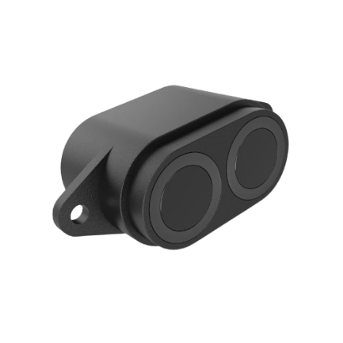








TECHNICAL APPROACH
Weight Measurement
Height Management
Real time BMI Calculation
User
Health Risk Prediction
BMI Categorization

Slide 10
Results and Analysis
The Smart BMI Indicator successfully measured both height and weight with high precision. The calculated BMI values were displayed on an LCD and sent to a web dashboard for analysis. Tests showed less than 2% deviation from standard BMI calculators.

Slide 11
Conclusion
The Smart BMI Indicator project achieved its goal of automating BMI measurement using electronic sensors and microcontrollers. It reduces manual effort and enhances accuracy. The integration of IoT capabilities ensures remote monitoring and data storage. This system promotes awareness about personal health and supports preventive care practices.

Slide 12
Future Work
• Integrate machine learning algorithms for advanced health prediction.
• Add mobile app synchronization for easier access.
• Improve the design for portability and energy efficiency.
• Expand functionality to include heart rate and body fat measurement.

Slide 13
Sustainable Development Goals (SDG) Alignment
This project aligns with the following UN Sustainable Development Goals:
SDG 3 – Good Health and Well-being: Promotes preventive healthcare and physical well-being.
SDG 9 – Industry, Innovation, and Infrastructure: Encourages innovation in digital healthcare systems.
SDG 11 – Sustainable Cities and Communities: Supports healthy lifestyles and smarter health monitoring in communities.

Slide 14
Acknowledgment:
.
We would like to express our sincere gratitude to our guide, Mr. Sundara Moorthy, for his continuous support and guidance throughout this project. We also thank the Department of Electrical and Electronics Engineering, Panimalar Engineering College, for providing the resources and encouragement.

Slide 15
Reference:
[1] World Health Organization, “Obesity and overweight,” World Health Organization, 2020. [Online]. Available: https://www.who.int/news-room/fact-sheets/detail/obesity-and-overweight. [Accessed: Oct. 27, 2025].
[2] Centers for Disease Control and Prevention (CDC), “About Adult BMI,” CDC Healthy Weight, 2023. [Online]. Available: https://www.cdc.gov/healthyweight/assessing/bmi/adult_bmi/index.html. [Accessed: Oct. 27, 2025].
[3] National Institutes of Health (NIH), Clinical Guidelines on the Identification, Evaluation, and Treatment of Overweight and Obesity in Adults, Bethesda, MD: NIH Publication No. 98–4083, 1998.
[4] A. Quetelet, A Treatise on Man and the Development of His Faculties, Edinburgh: William and Robert Chambers, 1842.
[5] A. Keys, F. Fidanza, M. J. Karvonen, N. Kimura, and H. L. Taylor, “Indices of relative weight and obesity,” Journal of Chronic Diseases, vol. 25, no. 6–7, pp. 329–343, 1972, do: 10.1016/0021-9681(72)90027-6.

