Slide 1
Capstone Project – III Online Retail Customer Segmentation
By – Sanjay Angadi

Slide 2
Content :
Problem Statement
Data Summary
Preparing Dataset
Exploring Dataset
Implementation of ML
Conclusion

Slide 3
Problem Statement
The problem at hand is to perform customer segmentation for an online retail business. The objective is to group customers into distinct segments based on their purchasing behavior, which will enable the business to tailor marketing strategies, improve customer engagement, and optimize business operations.
The dataset contains information about customer transactions, including InvoiceNo, StockCode, Description, Quantity, InvoiceDate, UnitPrice, CustomerID, and Country.

Slide 4
Data Summary
Shape: Columns = 8, Rows = 541909
InvoiceNo object
StockCode object
Description object
Quantity int64
InvoiceDate object
UnitPrice object
CustomerID float64
Country Object

Slide 5
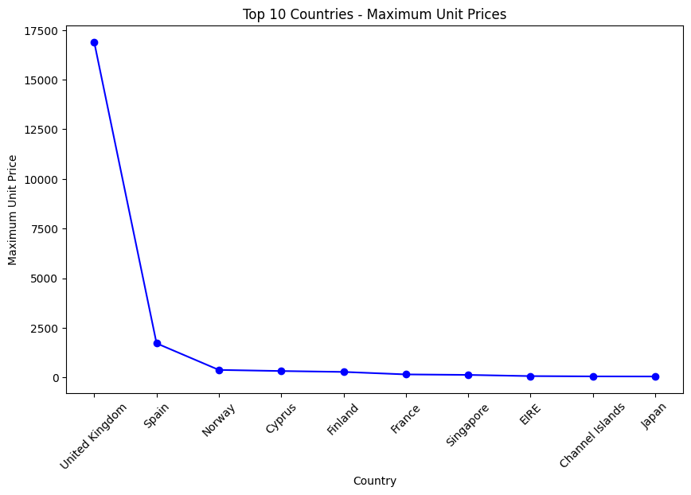
Top 10 countries maximum unit prices
The gained insights from the chart can potentially help create a positive business impact in several ways:
Pricing Strategy: The chart can help identify countries with high maximum unit prices. Businesses can adjust their pricing strategies for these countries accordingly to maximize revenue and profitability.
Market Segmentation: Understanding the variations in maximum unit prices across countries can aid in better market segmentation.

Slide 6
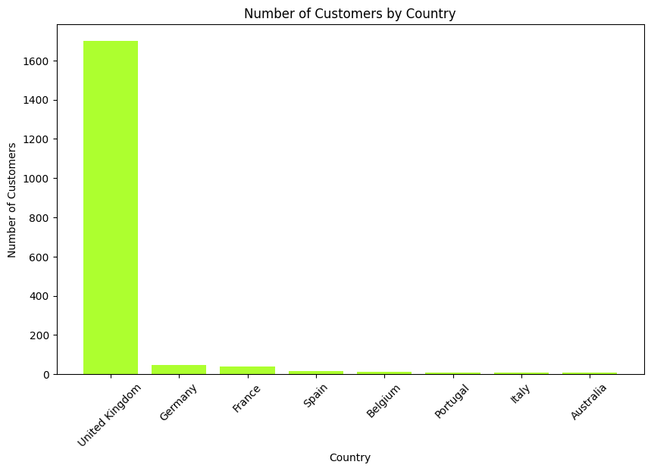
Highest customers from different countries
The specific chart used is a bar chart (plt.bar()). A bar chart is suitable for comparing categorical data, in this case, the number of customers in different countries. It allows for a clear visual comparison of customer counts between countries
The United States has the highest number of customers, with around 500 customers. The United Kingdom and Germany follow closely with approximately 480 and 450 customers, respectively. The number of customers gradually decreases for other countries, such as France, Spain, Italy, Australia, and Canada.

Slide 7
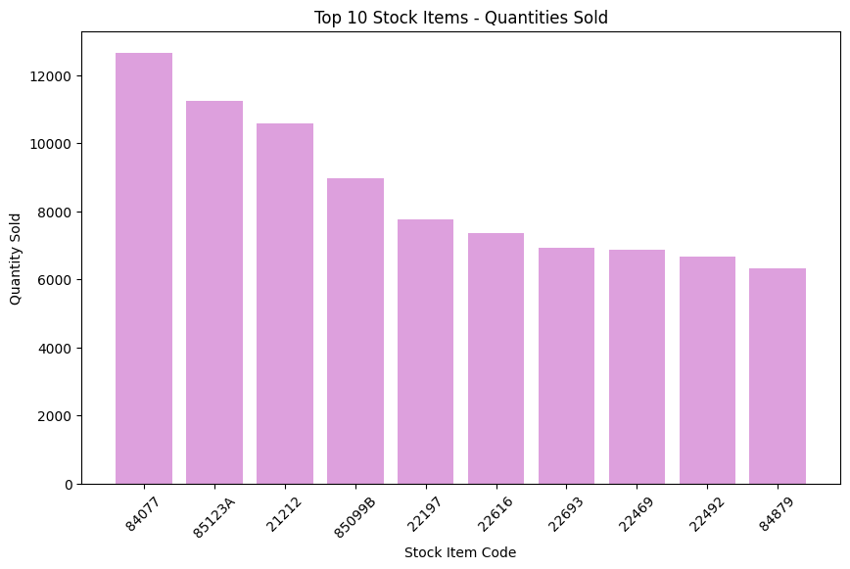
Most number of quantities are saled
The gained insights from the chart can potentially help create a positive business impact in several ways:
Inventory Management: Knowing the top-selling stock items can help optimize inventory levels, ensuring sufficient stock of popular items while minimizing overstocking of slow-moving products.

Slide 8
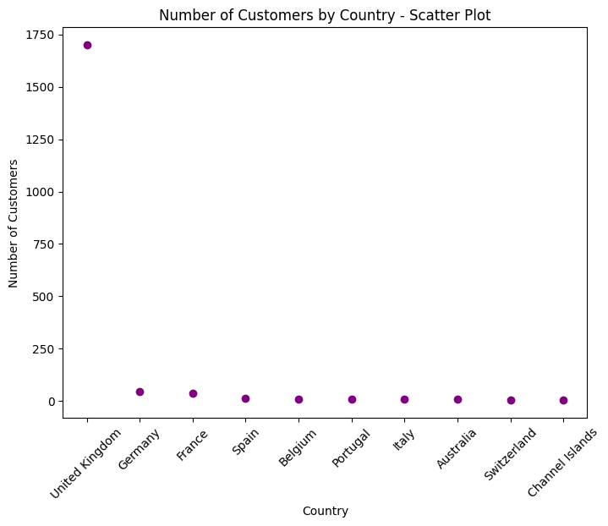
Which country was made highest customers
The scatter plot provides insights into the distribution of the number of customers for each country. By plotting the 'Country' on the x-axis and the 'Number of Customers' on the y-axis, we can observe the customer count for each country.
Market Segmentation: The scatter plot can help identify countries with a significant customer base. Businesses can use this information for targeted marketing campaigns and product promotions. Customer Engagement: Understanding the distribution of customers across countries can aid in tailoring customer engagement strategies, such as localized customer support or region-specific offers.

Slide 9
Hypothetical Statement
The average unit price of products in the United States is higher than in the United Kingdom. There is a significant difference in the quantity of products sold between Germany and France. The number of customers in Australia and Canada is not significantly different.
Conclusion: Reject the null hypothesis. There is evidence to suggest that customers from the United Kingdom purchase a higher quantity of items compared to customers from Germany.

Slide 10
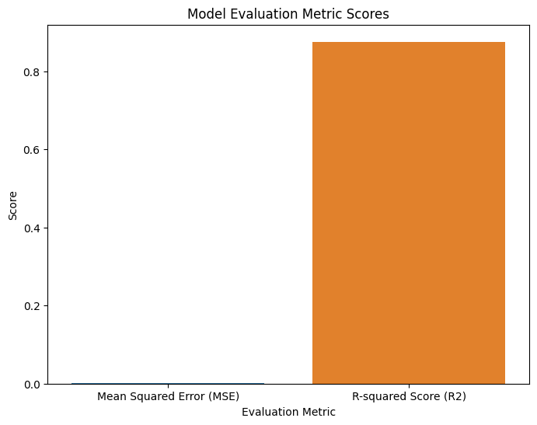
ML Model Implementation
Mean Squared Error: 2.898995008567511e-06 R-squared Score: 0.0005171504419915207

Slide 11
Conclusion
In this data analysis and machine learning project, we started with a dataset containing information about invoices, stock items, quantities, unit prices, customer IDs, and countries.
We performed various data transformations, handling missing values, and categorical encoding to prepare the data for building a machine learning model.
We explored the dataset, visualized key metrics, and gained insights into the data. We identified the top countries with the highest number of customers, the highest unit prices, and the top and least sold stock items.
These insights can be valuable for strategic business decisions, marketing strategies, and inventory management.

