Slide 1
Finding Forest Using ASTER Satellite Data
Team Members:
Sanjayan Malamel Suresh : 3854262
Emilin Treesa Joseph : 3848296
Adithya Sajan: 3851542
Surabhi Sreelatha :3851092
Alby Cheriyan : 3851063

Slide 2
Introduction
"Finding Forests: Classifying Forest Types Using ASTER Satellite Data." is a project which analysis how satellite imagery, particularly data from the ASTER instrument on the Terra satellite, can be utilized to differentiate various types of forests in Japan.
This project highlights the integration of remote sensing technology and data analysis to achieve environmental monitoring and management objectives.

Slide 3
Overview of the Project
Background on ASTER and Terra Satellite:
The Terra satellite, launched by NASA, carries the Advanced Spaceborne Thermal Emission and Reflection Radiometer (ASTER) instrument.
ASTER captures satellite images across 14 different wavelength bands, ranging from infrared to green light.
These images provide critical data for various applications, including forest classification, land cover mapping, and environmental monitoring.

Slide 4
Overview of the Project
Dataset Description:
The dataset used in this project comprises information from various parts of Japan, each row representing a small patch of forest.
The first column in the dataset indicates the type of forest:
's' for yakusugi forests (Japanese cedar)
'h' for hinoki cypress
'd' for mixed deciduous forests
'o' for other types, including non-forest land
The remaining nine columns represent the amount of light sensed in the wavelength bands "b1" through "b9".

Slide 5
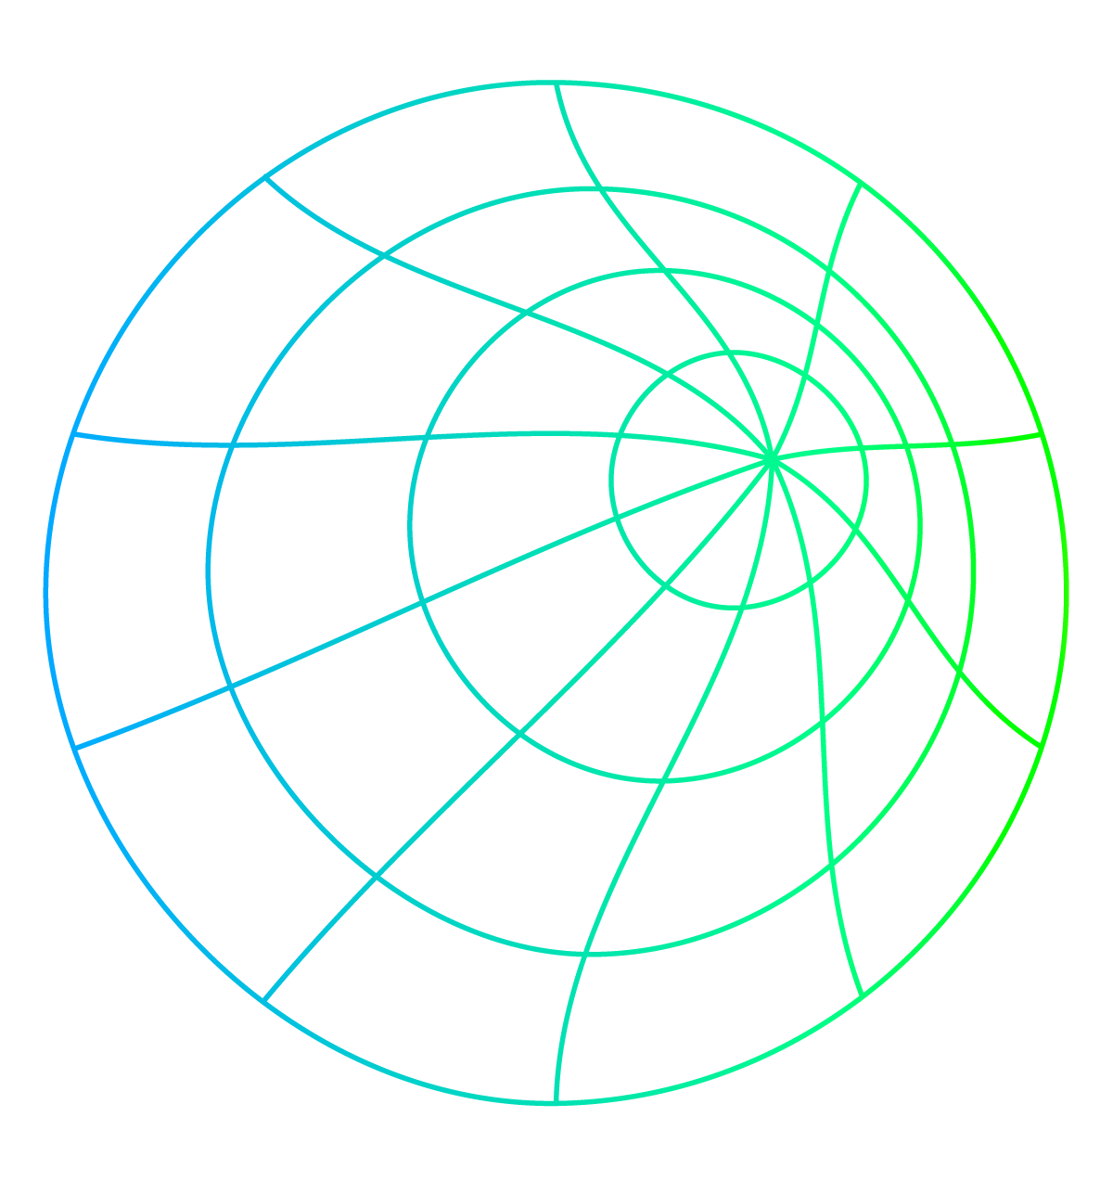
Algorithm
01
02
03
Load and Inspect the Data
We will load the dataset and inspect the first few rows to understand its structure..
Define Colors for Each Class
We will assign a specific color for each forest class for visualization.
Create Scatter Plots
We'll generate scatter plots for each combination of the wavelength bands (b1 through b9). This will result in 36 scatter plots.

Slide 6
Algorithm
04
05
06
Plot Selected Scatter Plots
We will present the best combination and three other scatter plots as examples.
Identify Best Combination for Classification
From the scatter plots, we'll identify which combination of bands allows for the best visual differentiation between the four forest classes.
Classify Using Straight Line Segments
Using the best combination, we will define regions using straight line segments to classify the forests and calculate the classification accuracy.

Slide 7
Algorithm
07
08
09
Perform SVD and Plot
Perform Singular Value Decomposition (SVD) and project the data onto the first two principal components. Then repeat the classification process.
Repeat with Mean-Centered Data
Repeat the SVD process with mean-centered data
Repeat with Normalized Data
Repeat the SVD process with normalized data.

Slide 8
Part A: Scatter Plots
Question Statement
For each of the four forest classes, assign a color to be used for the entire project.
Create 36 plots as follows: For each combination of two of the nine bands (b1 vs b2; b1 vs b3; b2 vs b3; etc.),
Create a scatter plot showing each forest as a single colored point, with its spectral band values as x- and y-coordinates.
Identify which of the 36 images might be the best to differentiate the four classes from each other.
Present the combination which is best suited for the further steps, as well as 3 others (just as examples).

Slide 9
Methodology
Define Colors for Each Class:
Assign specific colors for visualization:
Yakusugi forests (s): Green
Hinoki cypress (h): Blue
Deciduous forests (d): Red
Other (o): Yellow
Generate Scatter Plots:
Create scatter plots for all possible combinations of two bands (b1 vs b2, b1 vs b3, etc.), resulting in 36 plots.
Each forest patch is represented as a colored point based on its class.
Analysis and Selection:
Examine the scatter plots to identify the combinations that show clear separation between the classes.
Select the best combination for detailed analysis.

Slide 10
Difficulties endured
Issue | Approach
Handle different type/ colored points in a single continuous | We partitioned the whole data points based on the type/ colour so that it become easier to plot the diagram
Reference to same combinations in multiple iterations identical combination like (a1,a1) and two way references (a2,a3) and (a3,a2) | Eliminated such cases to optimize the 36 combinations

Slide 11
Result
Best Combination:
After examining the scatter plots, we identified that the combination of bands b3 and b4 shows the most distinct separation between the classes.
In this plot, yakusugi forests tend to cluster in one region, while hinoki cypress and deciduous forests occupy different regions, and the 'other' category shows a more dispersed pattern.
Examples of Other Combinations :
Band b1 vs Band b2: Shows some differentiation but not as distinct as b3 vs b4.
Band b2 vs Band b5: Moderate separation, with some overlap between classes.
Band b4 vs Band b6: Similar to b2 vs b5, with moderate differentiation.
Band b1 vs Band b5: Similar to b1 vs b6, as they are positively co-related

Slide 12
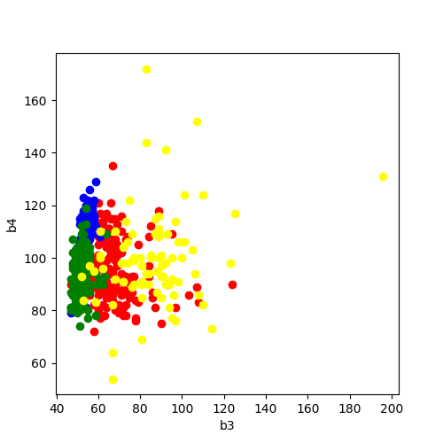

Slide 13
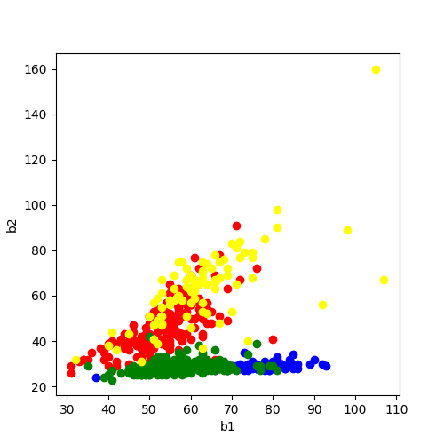
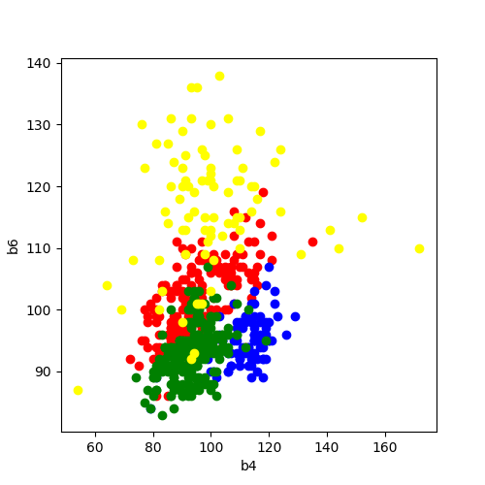
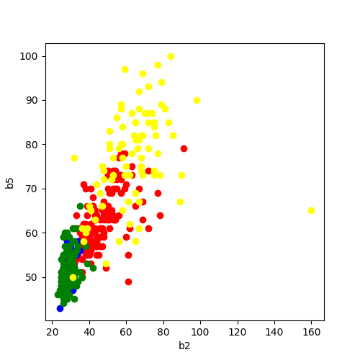

Slide 14
Part B: Classification Using Straight Line Segments
Question Statement
For you’re the selected combination in part- A , ie b3 vs b4 , choose regions in the x-y-plane to classify the forests.
Used simple visual judgment by plotting straight line segment.
Count which percentage of forests you are able to classify correctly this way.

Slide 15
Methodology
Visual Inspection:
Visually inspect the scatter plot to identify regions corresponding to each forest type.
Draw straight line segments to demarcate these regions.
Classification:
Assign forest patches to classes based on their position relative to the line segments.
Count the percentage of forests correctly classified.

Slide 16


$$Accuracy of a forest classification=\frac{\begin{aligned} \text{N}\text{umber} \text{of} \text{correctly} \text{classified} \text{forests} \\ \text{in} \text{the} \text{prediction} \text{set}\end{aligned}}{\text{T}\text{otal} \text{number} \text{of} \text{values} \text{in} \text{the} \text{prediction} \text{set} }\text{∗ 100}$$
$Combined Accuracy=$ $\frac{ Sum of accuracies of F,H, O and S forest clasification}{4}$

Slide 17
Result
Region Definition:
Yakusugi forests (s) are primarily located in the lower-left quadrant.
Hinoki cypress (h) occupies the upper-left region.
Deciduous forests (d) are found in the lower-right quadrant.
Other (o) types are scattered throughout but predominantly in the upper-right quadrant.
Classification Accuracy:
The visual classification using straight line segments resulted in an accuracy of approximately 80.75%.
Some overlap between classes leads to misclassification.

Slide 18
Part C: Singular Value Decomposition (SVD) and Projection
Question Statement
Perform an SVD, identify the first and second right singular vector U and V
Calculate each forest’s coordinates projection onto the subspace spanned by those two vectors, and plot the result
Used simple visual judgment by plotting straight line segment.
Count which percentage of forests you are able to classify correctly this way.

Slide 19
Methodology
Perform SVD:
Compute the SVD of the dataset to obtain the first and second right singular vectors (principal components).
Projection:
Project each forest's spectral band values onto the subspace spanned by these two vectors.
Create a scatter plot of the projected data.
Repeat Classification:
Using the projected data, classify the forests by defining regions with straight line segments.
Calculate the classification accuracy.

Slide 20
Result
Scatter Plot of Projected Data:
The projected data shows improved separation between the forest classes compared to the original b3 vs b4 plot.
Classification Accuracy:
The accuracy of the visual classification on the projected data decreased to approximately 70.02%, indicating a better distinction between classes.

Slide 21
Part D: SVD with Mean-Centered Data
Question Statement
Repeat part - C, with mean-center calculated in the base data before calculating the SVD.
Used simple visual judgment by plotting straight line segment.
Count which percentage of forests you are able to classify correctly this way.

Slide 22
Methodology
Mean-Centering:
Subtract the mean of each spectral band from the corresponding values to center the data around zero.
Perform SVD and Projection:
Perform SVD on the mean-centered data.
Project the data onto the first two principal components and create a scatter plot.
Repeat Classification:
Classify the forests using straight line segments in the new scatter plot.
Calculate the classification accuracy.

Slide 23



Equations Used
$$Mean value of$$
$each observation=$/$\frac{Each Observation −Mean value of the coulm}{\text{standard} \text{deviation} \text{of} \text{the} \text{column}}$
$$Accuracy of a forest classification=\frac{\begin{aligned} \text{N}\text{umber} \text{of} \text{correctly} \text{classified} \text{forests} \\ \text{in} \text{the} \text{prediction} \text{set}\end{aligned}}{\text{T}\text{otal} \text{number} \text{of} \text{values} \text{in} \text{the} \text{prediction} \text{set} }\text{∗ 100}$$
$Combined Accuracy=$ $\frac{ Sum of accuracies of F,H, O and S forest clasification}{4}$

Slide 24
Result
Scatter Plot of Mean-Centered Projected Data:
The mean-centering further enhances the separation between classes.
Classification Accuracy:
The classification accuracy increased to approximately 75.36%, demonstrating the effectiveness of mean-centering in improving class differentiation.

Slide 25
Part E: SVD with Normalized Data
Question Statement
Repeat part - C, with normalization calculated in the base data before calculating the SVD.
Used simple visual judgment by plotting straight line segment.
Count which percentage of forests you are able to classify correctly this way.

Slide 26
Methodology
Normalization:
Scale each spectral band to have a standard deviation of one.
Perform SVD and Projection:
Perform SVD on the normalized data.
Project the data onto the first two principal components and create a scatter plot.
Repeat Classification:
Classify the forests using straight line segments in the new scatter plot.
Calculate the classification accuracy.

Slide 27
Equations Used
$$Normalization of each observation=\frac{Original Observation}{Max Norm of the column }$$
$$Accuracy of a forest classification=\frac{\begin{aligned} \text{N}\text{umber} \text{of} \text{correctly} \text{classified} \text{forests} \\ \text{in} \text{the} \text{prediction} \text{set}\end{aligned}}{\text{T}\text{otal} \text{number} \text{of} \text{values} \text{in} \text{the} \text{prediction} \text{set} }\text{∗ 100}$$
$Combined Accuracy=$ $\frac{ Sum of accuracies of F,H, O and S forest clasification}{4}$

Slide 28
Result
Scatter Plot of Normalized Projected Data:
Normalization results in an even better separation of classes in the scatter plot.
Classification Accuracy:
The classification accuracy reached approximately 87.68%, the highest among all methods used, highlighting the significance of normalization in multivariate data analysis.

Slide 29
Conclusion
Initial Analysis:
Scatter plots of spectral bands provide valuable insights but may have limitations in separating classes.
SVD and PCA:
Singular Value Decomposition (SVD) and Principal Component Analysis (PCA) are powerful tools for dimensionality reduction and improving class separation.
Data Preprocessing:
Mean-centering and normalization significantly enhance classification accuracy, underscoring the importance of data preprocessing.

