Slide 1


SPAM
IDENTIFY SPAM EMAILS
USING
RANDOM FOREST ALGORITHM

Slide 2


Introduction to Spam Email Detection
Spam emails are a persistent nuisance, flooding inboxes with unwanted and often malicious content. This presentation will explore how machine learning, specifically the Random Forest Ensemble algorithm, can be leveraged to effectively identify and filter out spam emails, protecting users from the dangers they pose.

Slide 3
Understanding Email Data Structure
Email Header
Email Body
The email header contains crucial metadata like the sender, recipient, subject, and timestamp that can be used to identify spam.
The email body contains the actual content of the message, including any text, links, and attachments that may indicate a spam campaign.
Email Attachments
Embedded Links
Suspicious file attachments are a common tactic used by spammers to distribute malware or phishing links.
URLs embedded in the email body, especially shortened or obfuscated links, can be a strong signal of a spam email.

Slide 4

Feature Engineering for Spam Detection
Extract email header features like sender, recipient, subject, and timestamp to identify suspicious patterns.
Analyze email body for keywords, links, and attachments that are commonly associated with spam.
Engineer natural language processing features like sentiment, sentiment, readability, and topic modelling to differentiate spam from legitimate emails.

Slide 5
Ensemble Learning Techniques
1
Bagging
Bagging, or Bootstrap Aggregating, combines multiple models trained on random samples of the data to improve stability and accuracy.
2
Boosting
Boosting sequentially trains weak learners, focusing on examples that were misclassified by previous models, to create a strong, accurate classifier.
3
Random Forest
Random Forest is an ensemble of decision trees, each trained on a random subset of features, which votes on the final prediction.

Slide 6
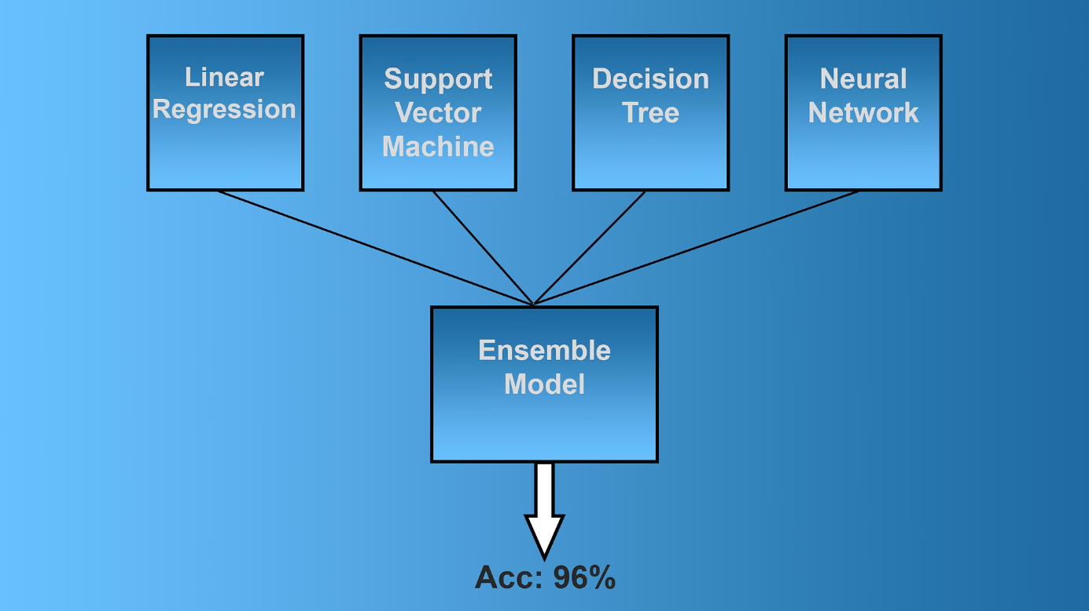

Slide 7
Random Forest Classifier
Random Forest is an ensemble learning method that combines multiple decision trees to improve predictive accuracy and reduce overfitting. It generates a "forest" of decision trees, each trained on a random subset of the data and features.
The final prediction is made by aggregating the outputs of the individual trees, either through majority voting (classification) or averaging (regression). This approach adds robustness and reduces the variance of the model.

Slide 8
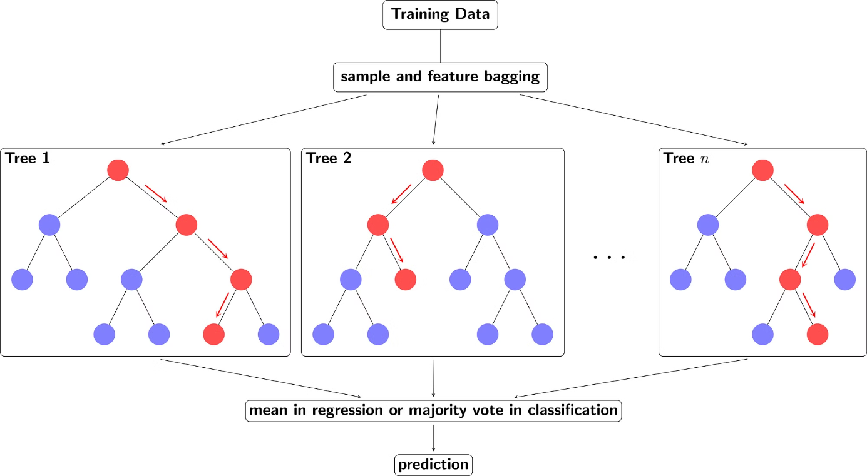

Slide 9
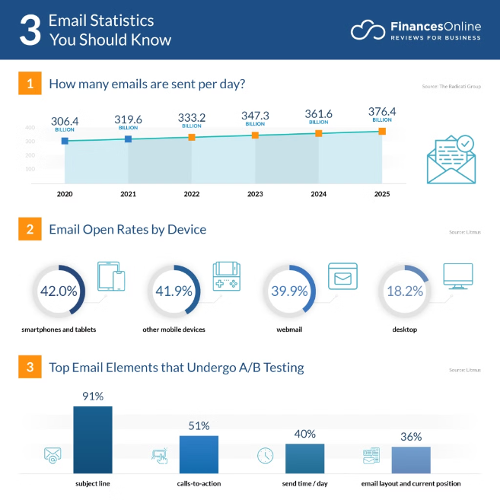
Model Training and Evaluation
After feature engineering, we can train a Random Forest classifier on the preprocessed email data. This ensemble method combines multiple decision trees to make robust predictions on spam versus ham emails.
The model is evaluated using metrics like accuracy, precision, recall, and F1-score to assess its performance on a held-out test set. This helps us understand the model's ability to correctly identify spam emails.

Slide 10



Hyperparameter Tuning
Identify Key Parameters
Grid Search
Cross-Validation
Employ a systematic grid search to efficiently explore the hyperparameter space, evaluating different combinations to find the optimal configuration.
Leverage cross-validation techniques to ensure the hyperparameter tuning process is robust and the selected parameters generalize well to unseen data.
Determine the critical hyperparameters that have the greatest impact on the Random Forest model's performance, such as the number of trees, max depth, and min samples per split.

Slide 11





Interpreting Random Forest Results
Feature Importance
1
Understand which email attributes contribute most to spam detection
Decision Trees
2
Visualize the individual decision trees that make up the Random Forest
Model Evaluation
3
Assess the model's accuracy, precision, recall, and F1-score on test data
Error Analysis
4
Identify common patterns in emails that were misclassified
Real-World Application
5
Apply the model to live email streams and monitor performance
Interpreting the results of a Random Forest classifier is crucial for understanding how the model is making decisions and where it may be performing well or poorly. By examining the feature importance, visualizing the underlying decision trees, and evaluating the model's metrics on test data, we can gain deep insights into the strengths and weaknesses of the spam detection system.

Slide 12

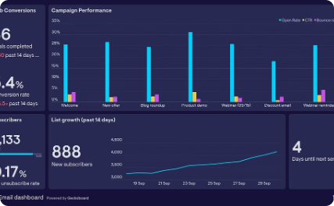
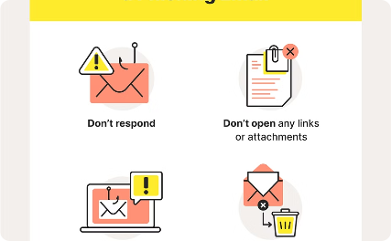
Deployment and Real-Time Prediction
Scalable Infrastructure
Predictive Analytics
Automated Blocking
Deploy the spam detection model on a robust, cloud-based platform to handle high-volume, real-time email processing. Ensure seamless integration with email servers for immediate threat analysis.
Leverage the trained Random Forest model to analyze emails in real-time, classifying them as spam or legitimate. Provide a user-friendly dashboard to monitor and respond to evolving email threats.
Automate the process of blocking identified spam emails, preventing them from reaching user inboxes. Continuously update the model to adapt to new spam tactics and maintain high accuracy.

Slide 13
Conclusion and Future Considerations
Key Takeaways
Ongoing Improvements
The Random Forest Ensemble model has proven to be a powerful tool in accurately detecting spam emails. With its ability to handle complex data and provide interpretable results, it serves as a robust solution for email security.
As technology and spam techniques evolve, continued research and model refinement are necessary to maintain the effectiveness of the spam detection system. Exploring additional features and ensemble techniques can enhance the model's performance.
Real-Time Monitoring
Future Considerations
Deploying the model in a real-time environment allows for continuous monitoring and adaptation to emerging spam patterns. Integrating the system with email platforms can provide immediate protection for users.
Exploring the integration of advanced natural language processing and deep learning approaches can further improve the accuracy and robustness of the spam detection system, ensuring it stays ahead of evolving spam tactics.

Slide 14
THANK YOU

