Slide 1


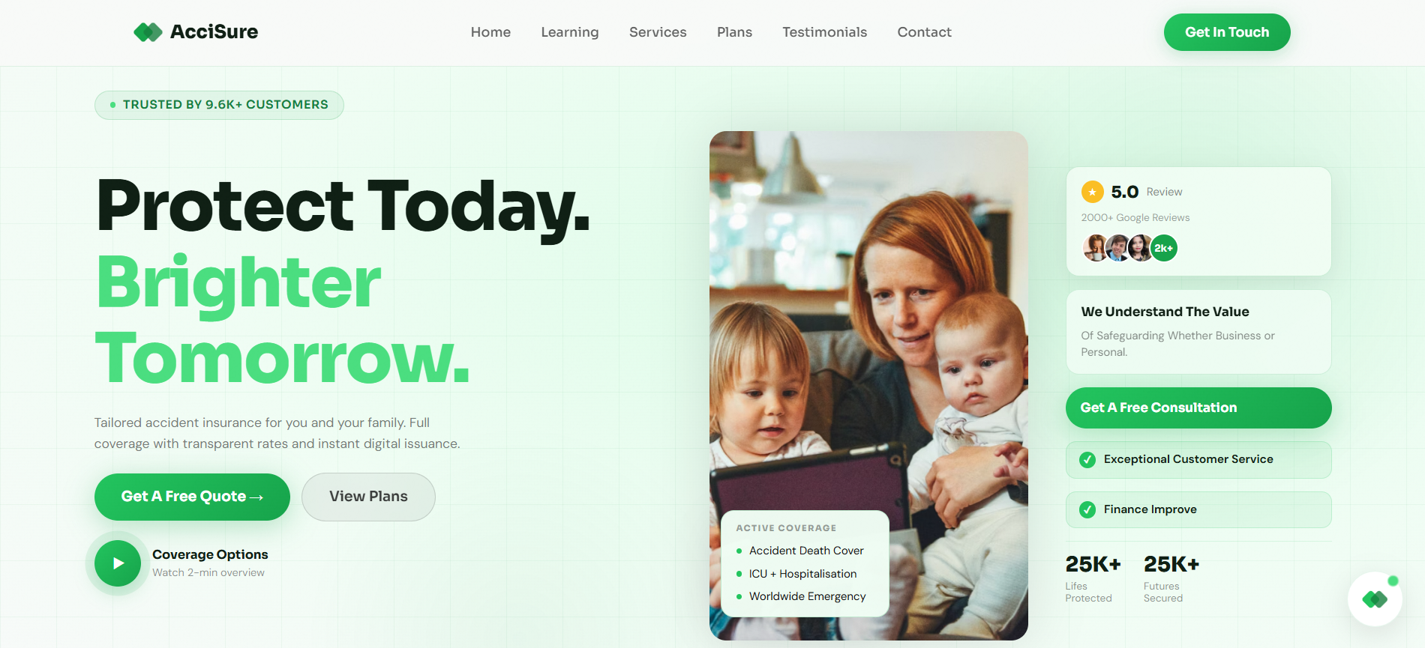

AcciSure: Revolutionising Accident Insurance Through Digital Automation & AI
A comprehensive platform delivering seamless accidental insurance coverage with intelligent automation and real-time support for customers, agents, and claims officers.

Slide 2

Core Technology Stack
AcciSure is built on a modern and robust technology stack, ensuring high performance, scalability, and security across all platform functionalities.
Frontend: Angular
Styling: Tailwind CSS
Modern framework for interactive user interfaces.
Utility-first CSS framework for rapid UI development.
Backend: .NET Core Web API (C#)
Cloud Storage: ImageKit CDN
Robust API for server-side logic and data handling.
Optimized content delivery for media assets.
Real-Time Communication: SignalR & WebRTC
Data Visualization: Chart.js & jsPDF
Enable instant messaging and live interactions.
Libraries for dynamic charts and PDF report generation.
AI & Automation: Vertex AI & N8N
Workflow automation with intelligent AI capabilities.

Slide 3


Slide 4
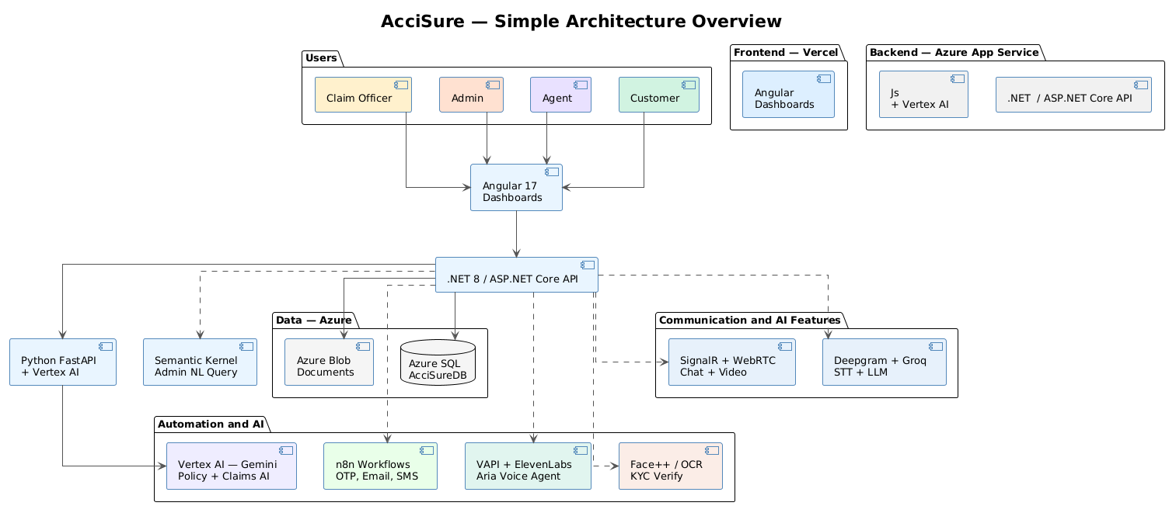


Slide 5
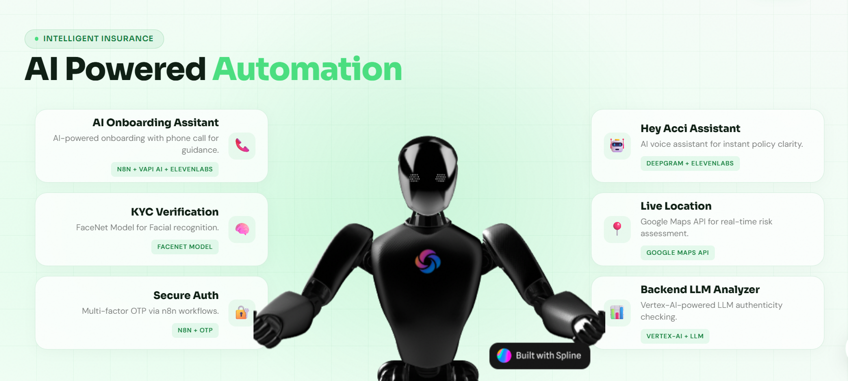


Slide 6
Unique Features
AcciSure integrates cutting-edge technology to redefine the insurance experience, making it smarter, faster, and more secure.
AI Policy Chatbot
AI Claims Intelligence
Real-time Chat
Onboarding Call
Instant, multilingual support for policy queries and guidance, powered by N8N with RAG & LLM.
Automated document summarization and risk scoring for efficient claim assessment using Vertex AI
Seamless, instant communication between customers and agents via SignalR.
An AI-powered onboarding assistant makes a call to the user and guides them through the KYC verification process.
Secure Cloud Storage
AI Voice Assistant in Dashboard
Integrated Video Calls
Face-to-face consultations and document verification using WebRTC.
Encrypted storage and efficient delivery of
documents via ImageKit CDN.
An AI voice assistant integrated into the dashboard that guides users through all operations via voice and chat.

Slide 7






Hey Acci Assistant: Real-Time Voice AI Integration
Our voice-enabled assistant provides customers with instant access to policy and claim information through natural conversation. The system combines cutting-edge speech processing with real-time data integration to deliver responses with minimal latency.
Audio Capture
Vapi AI captures user voice input through secure WebSocket connections, handling multiple concurrent conversations with enterprise-grade reliability.
Speech-to-Text
Groq's Whisper model processes audio with ultra-low latency, achieving industry-leading transcription accuracy and speed for insurance terminology.
Intent Processing
Groq/Mistral LLM analyzes transcribed text to understand user intent, extracting policy numbers, claim IDs, and specific information requests.
Data Fetching
Backend queries Azure SQL database for real-time policy and claim status, ensuring customers receive current, accurate information.
Voice Response
Vapi TTS converts final response to natural-sounding voice with low latency streaming, creating seamless conversational experiences.

Slide 8
Backend LLM Analyzer: Intelligent Dashboard for Claims Operations
Claims officers and agents require comprehensive insights to make informed decisions efficiently. Our backend analyzer leverages large language models to process complex customer and claim data, generating actionable intelligence that surfaces fraud signals, calculates risk scores, and summarizes critical information.
Key Capabilities
Fraud detection using anomaly pattern recognition
Dynamic risk scoring based on claim characteristics
Natural language summarization of complex cases
Correlation analysis across multiple data sources
Automated document classification and tagging
The system integrates directly with Azure SQL to extract structured and unstructured data, then applies advanced LLM processing to identify patterns and anomalies that would be difficult to detect through manual review. Generated insights populate interactive dashboards with visualizations including risk heat maps, trend analysis charts, and correlation matrices.
Data Extraction
LLM Processing
Dashboard Visualization
Azure SQL queries retrieve customer profiles, claim histories, and policy details for comprehensive analysis.
Vertex AI and Groq/Mistral models analyze data patterns, generating insights and identifying potential issues.
Interactive graphs and charts present risk scores, fraud signals, and summary statistics for quick decision-making.

Slide 9
KYC Verification: Face Recognition with AI Validation
Know Your Customer (KYC) compliance requires robust identity verification that balances security with user experience. Our implementation combines facial recognition using FaceNet embeddings with LLM-enhanced validation to create a multi-layered verification system. The approach leverages deep learning for biometric matching while applying contextual analysis to detect spoofing attempts and anomalies.
01
02
Image Capture & Upload
FaceNet Embedding Generation
User uploads identification photo through secure web or mobile interface with quality validation and format standardization.
Python backend processes image through FaceNet model, generating 128-dimensional vector embeddings that represent facial features mathematically.
03
04
Vector Comparison
LLM Metadata Analysis
Azure SQL performs cosine similarity calculations between new embeddings and stored reference vectors, identifying matches above threshold.
Groq/Mistral LLM analyzes image metadata, timestamps, and contextual anomalies to detect potential spoofing or manipulation attempts.
05
06
Verification Score
Data Storage
Combined algorithmic and AI analysis generates weighted verification score with confidence levels and risk flags for manual review if needed.
Encrypted images, embeddings, and verification results stored in Azure SQL with audit trails for compliance and regulatory requirements.

Slide 10
AI Onboarding Assistant: Guided Voice Experience
Customer onboarding represents a critical first interaction that sets expectations for the entire insurance relationship. Our AI-powered onboarding assistant transforms this traditionally paperwork-heavy process into a conversational, guided experience delivered through voice channels. The system combines telephony integration with dynamic LLM processing to adapt to customer responses in real-time.
Call Initiation
1
Customer initiates onboarding call through standard telephone connection, with Vapi AI or Twilio handling telephony infrastructure.
2
Audio Streaming
Continuous audio stream captured and forwarded to n8n workflow orchestrator for real-time processing and routing.
Speech Recognition
3
Deepgram converts streamed audio to text with streaming API support, enabling incremental processing without waiting for complete sentences.
4
LLM Processing
Mistral/Groq LLM interprets customer responses, determines next required information, and generates appropriate guidance dynamically.
Voice Response
5
Generated guidance converted back to natural voice through TTS and streamed in real-time, creating interactive conversation flow.
Technical Advantages
Business Benefits
Streaming processing reduces latency
Dynamic branching based on responses
Handles incomplete or ambiguous input
Multi-lingual support through LLM capabilities
24/7 automated onboarding availability
Consistent process execution
Reduced manual agent workload
Scalable to handle peak volumes

Slide 11
System Architecture Overview
Our insurance platform integrates multiple AI services, cloud databases, and communication channels into a cohesive architecture. The following diagram illustrates the core components and their interactions, showing data flow patterns and system dependencies that enable real-time processing and intelligent automation.
Azure SQL Database
Central data repository storing customer profiles, policy details, claim histories, verification results, and audit logs.
Voice AI Layer
Vapi AI and Twilio handle telephony infrastructure, audio streaming, and real-time voice conversion for customer interactions.
LLM Processing
Groq, Mistral, and Vertex AI models provide intent recognition, data analysis, fraud detection, and conversational intelligence.
n8n Workflow Engine
Orchestrates multi-step processes including OTP delivery, onboarding flows, and system integrations through visual automation.
FaceNet Verification
Python-based facial recognition system generating embeddings and performing biometric matching for KYC compliance.
Twilio APIs
Handles SMS, WhatsApp, and voice communications for OTP delivery, notifications, and telephony integration.

Slide 12
Implementation Roadmap
Deploying an AI-powered insurance platform requires phased approach balancing feature delivery with technical stability. The following roadmap sequences implementation to maximize business value while minimizing technical debt and operational risk.
Phase 1: Core Infrastructure
Establish Azure SQL database schema, implement authentication flows with n8n, configure basic OTP delivery through both SMTP and Twilio channels.
Phase 2: Voice AI Integration
Integrate Vapi AI for telephony, implement Groq Whisper for speech-to-text, connect to backend data systems for policy and claim information retrieval.
Phase 3: Analytics Dashboard
Build backend LLM analyzer using Vertex AI/Groq, develop fraud detection algorithms, create interactive dashboards for claims officers and agents.
Phase 4: KYC Verification
Implement FaceNet integration for facial recognition, develop embedding storage and comparison in Azure SQL, add LLM-enhanced anomaly detection.
Phase 5: Onboarding Assistant
Launch AI-powered onboarding through voice channels, integrate Deepgram for streaming transcription, implement dynamic conversation flows with Mistral/Groq.

Slide 13
Next Steps & Evaluation Metrics
With the technical architecture established, product and engineering stakeholders should evaluate system readiness through defined success metrics. The following criteria provide objective measures for assessing implementation quality and business impact across technical, operational, and customer experience dimensions.
2s
99.5%
Target Response Time
System Uptime
Maximum latency for voice assistant responses, measured from audio completion to first audio output during conversations.
Target availability SLA ensuring continuous access to critical insurance services including claims reporting and policy management.
95%
40%
Verification Accuracy
Process Time Reduction
Minimum accuracy rate for KYC facial recognition, with manual review triggered for scores below threshold.
Target reduction in claims processing time through LLM-generated insights and automated data analysis.
Technical Metrics
Business Metrics
API error rates below 0.5%
Database query latency under 200ms
LLM processing cost per transaction
Concurrent call handling capacity
Customer satisfaction scores
Onboarding completion rate
Fraud detection rate improvement
Agent productivity gains

Slide 14
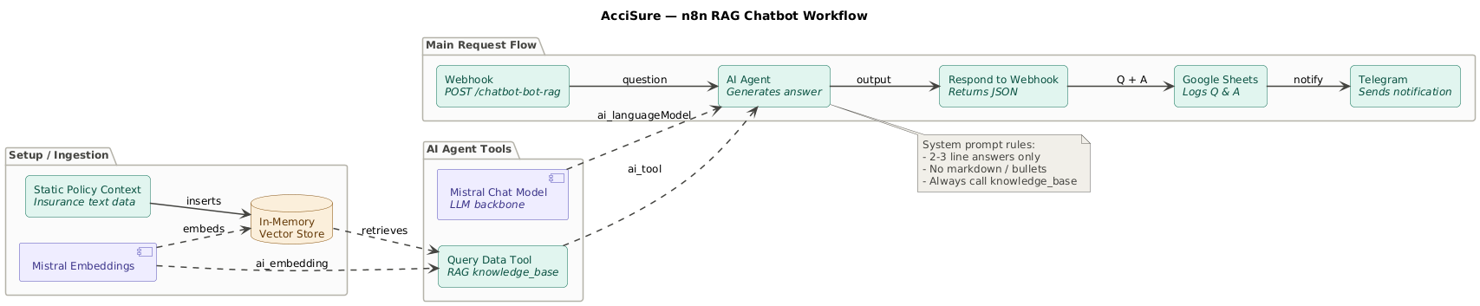

Slide 15
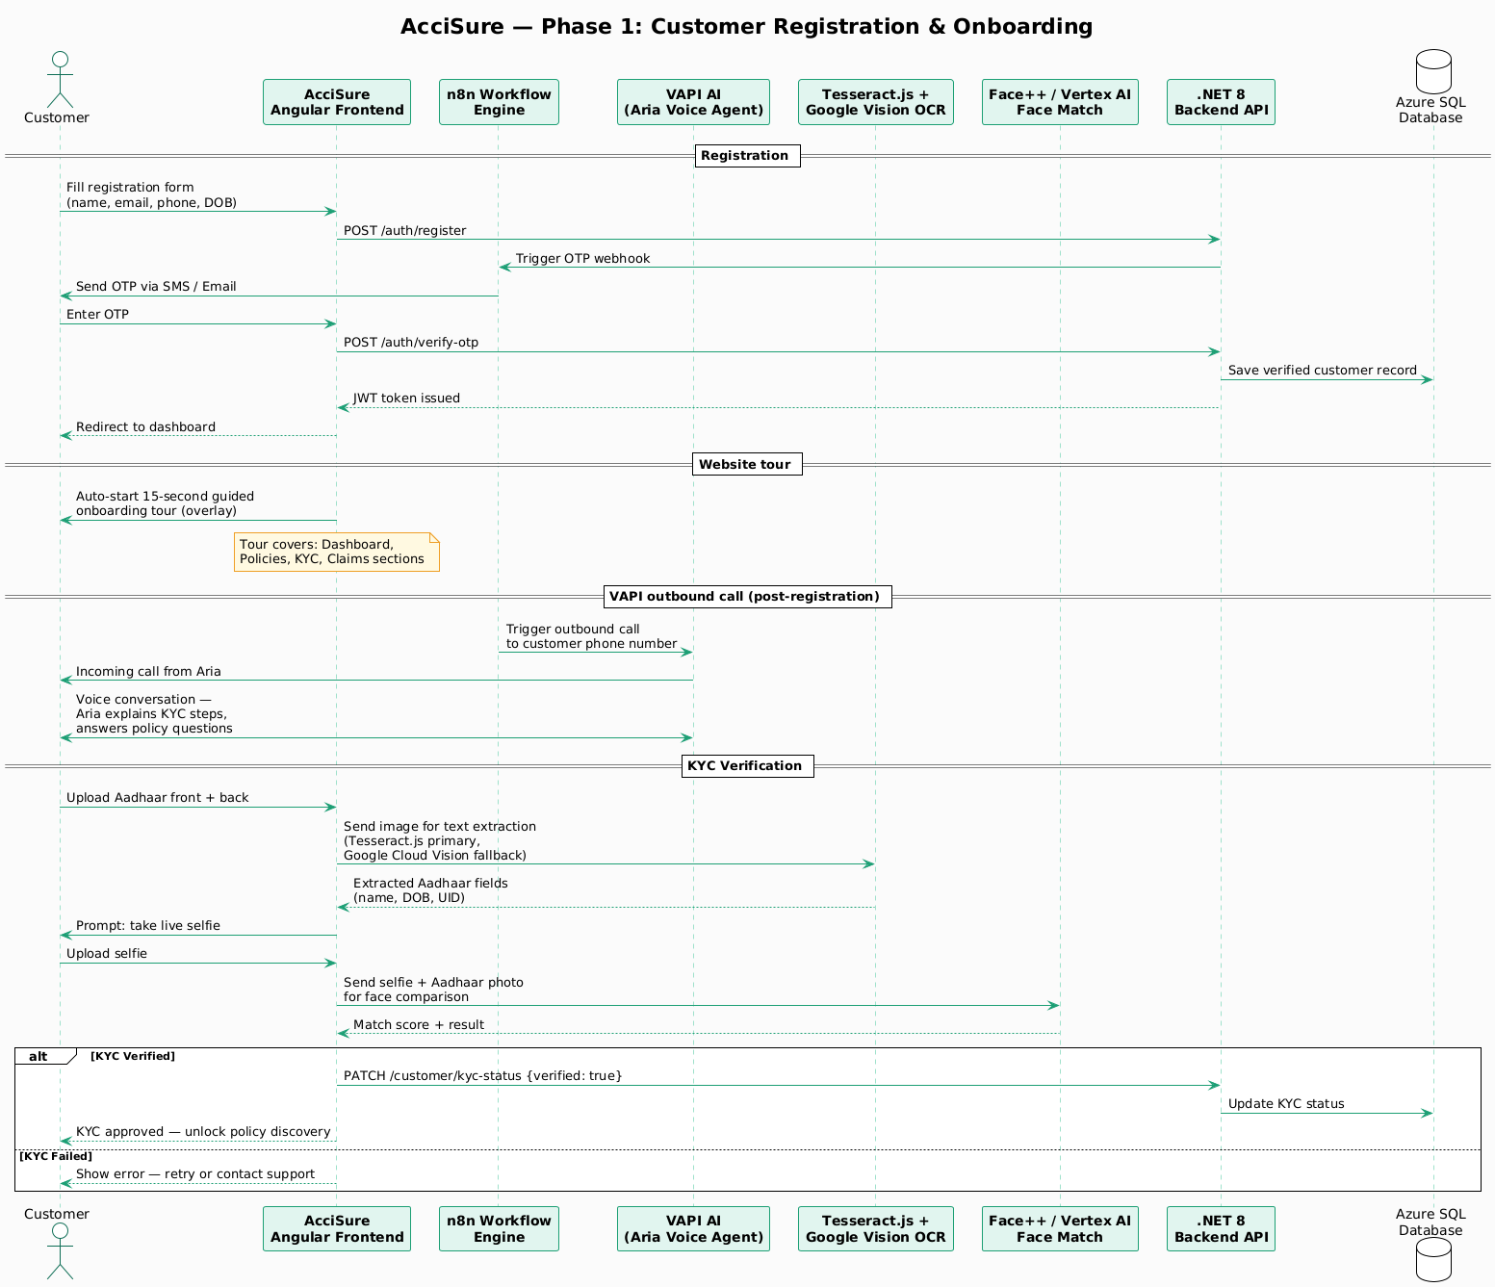
Phase 1 — Customer registration & onboarding

Slide 16
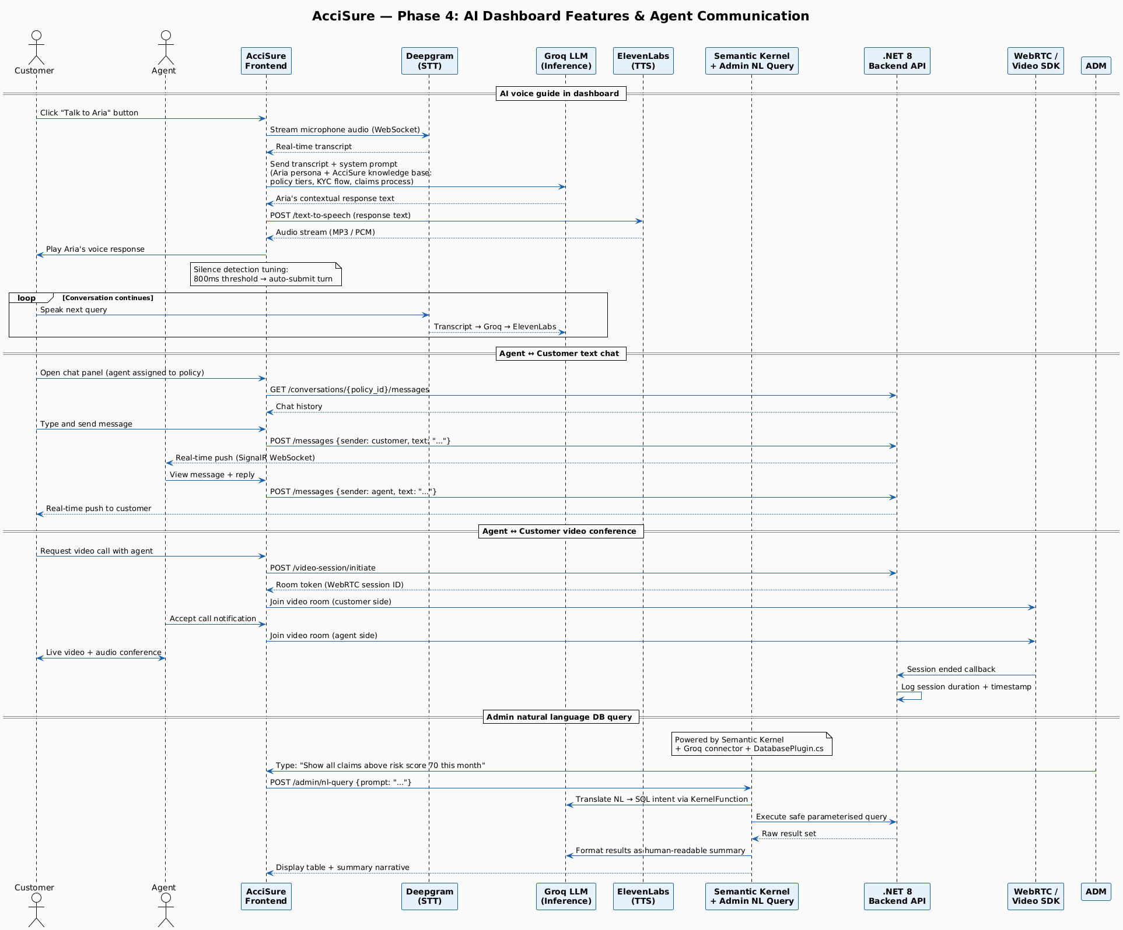
Phase 2 — AI features & communication

Slide 17
Full system activity diagram (all roles combined)

Slide 18
Customer: Application, Payment & Claim Process
01
02
Submit Application
Policy Review
Complete policy application with personal details and coverage preferences
Assigned agent reviews application and communicates via real-time chat
03
04
Approval & Payment
Policy Active
Upon approval, complete secure premium payment through integrated gateway
Instant policy activation with digital certificate and coverage confirmation
05
06
Raise Claim
Claim Approval
Upload required documents through secure cloud storage when incident occurs
Automatic policy coverage update after claims officer approval

Slide 19
Role-Based Access Control Matrix
To ensure data security and operational efficiency, AcciSure implements a robust Role-Based Access Control (RBAC) system. The following matrix outlines the key actions each role can perform within the platform.
Action
Admin
Customer
Agent
Claims Officer
Create Policy
✗
✗
✓
✗
View Policies
✓
✓
✓
✓
Apply for Policy
✗
✓
✗
✗
Approve Policy
✓
✗
✓
✗
Raise Claim
✗
✓
✗
✗
Review Claim
✓
✗
✗
✓
Chat with Users
✓
✓
✓
✓
Manage Users
✓
✗
✗
✗
View Reports
✓
✗
✓
✓
This matrix clearly distinguishes the permissions, ensuring that each role has access only to the functionalities required for their responsibilities, enhancing security and streamlining workflows.

Slide 20
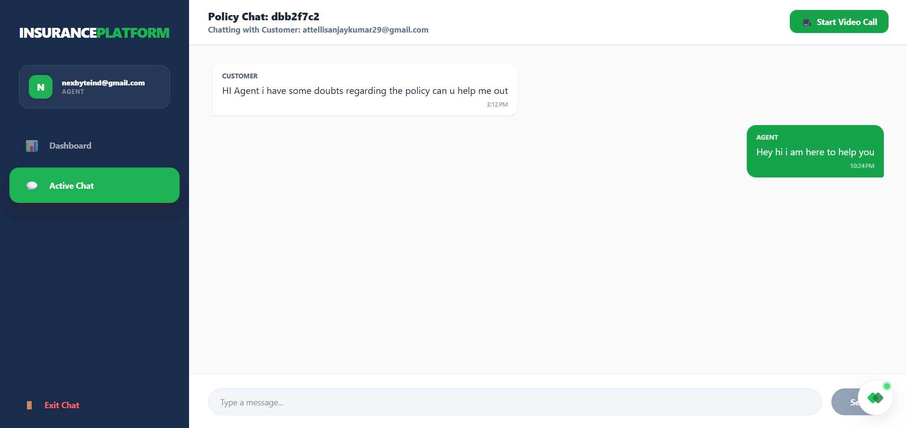
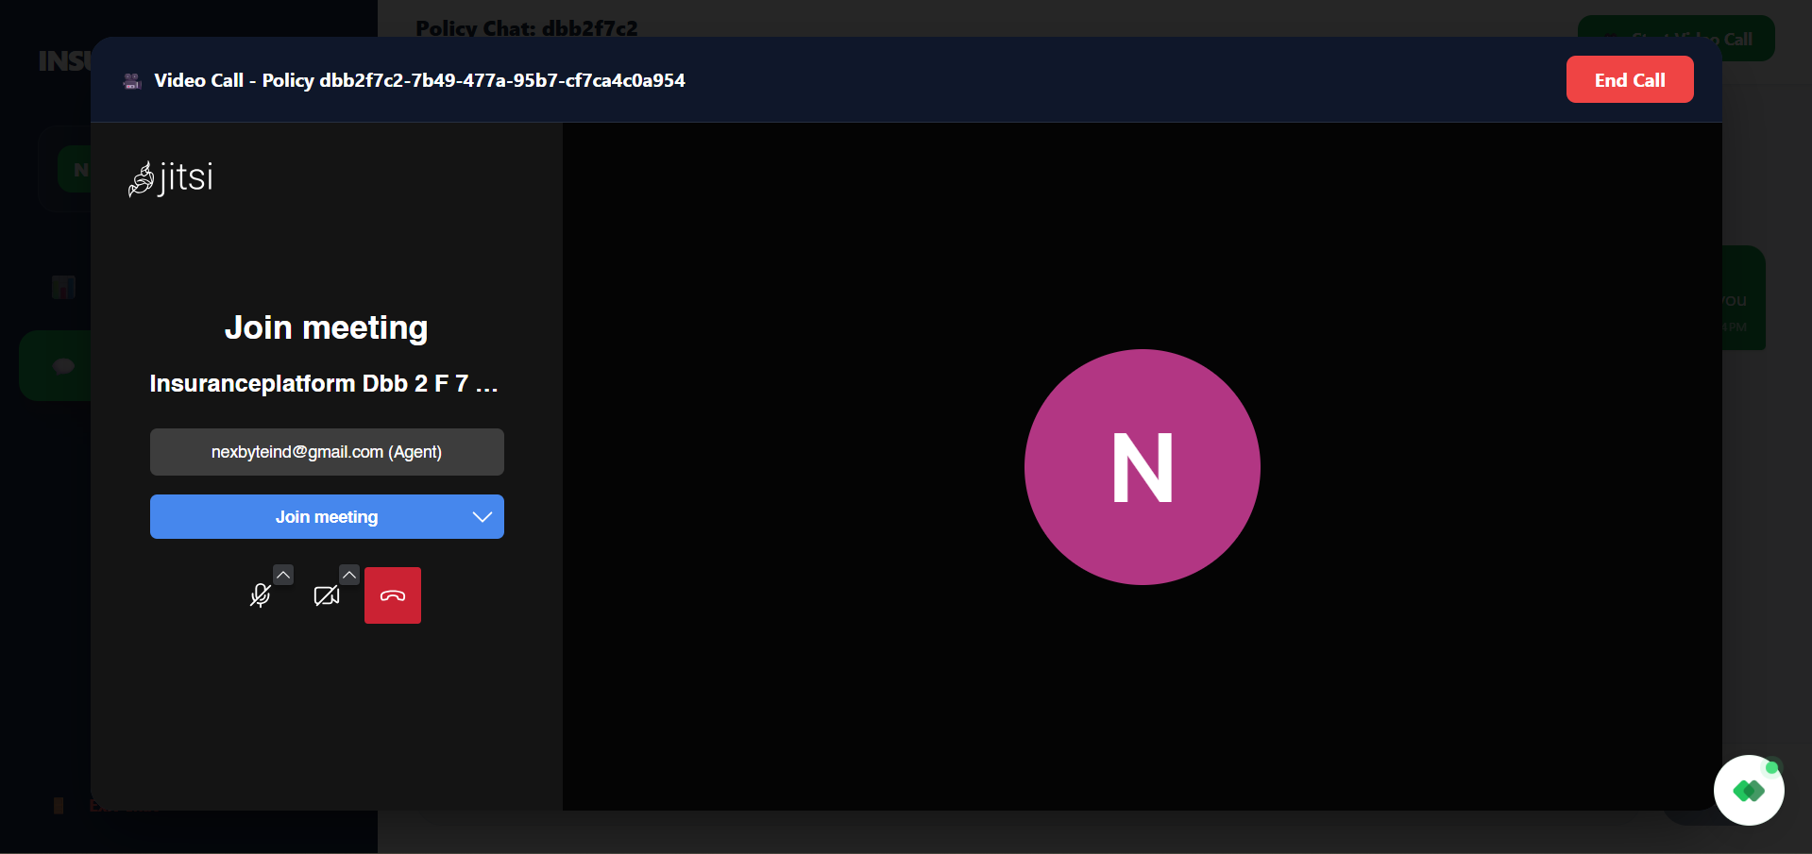
Agent: Customer Support & Communication
Real-Time Chat
Instant messaging capability allowing agents to respond to customer queries, clarify policy terms, and provide status updates without delay
Video Consultations
Face-to-face video call feature enabling detailed discussions about policy options, document verification, and personalized insurance advice
Document Sharing & KYC Verification with Face recognition
Secure file transfer for sharing policy documents, application forms, and supporting materials with end-to-end encryption
The communication tools ensure agents can provide responsive, transparent, and efficient service to customers throughout their insurance journey.

Slide 21





AI-Powered Guidance: Intelligent Customer Support
Interest to Buy
Customer clicks "Interest to Buy" on any policy
Chat Opens
Sidebar chat application launches instantly
AI Responds
AI workflow automation answers questions intelligently in chat and voice mode
Decision Point
Close chat and click "Buy Now" to proceed
Our AI-powered chatbot, built on AI workflow automation, provides instant responses to customer queries about policy details, coverage benefits, claim procedures, and more. This intelligent system ensures 24/7 availability without human intervention, significantly reducing response time while maintaining accuracy.

Slide 22

Thank You
Attelli Sanjay Kumar
The Hartford India Training Program – Capstone Project

