Slide 1
Media Streaming with IBM Cloud Video Streaming

Slide 2
Development Phase 2 :
During this phase of our project, we successfully opened a dedicated channel within IBM Media Streaming
This update reflects our dedication to staying up-to-date with the latest security measures and best practices, ensuring the safety and quality of our media streams.

Slide 3
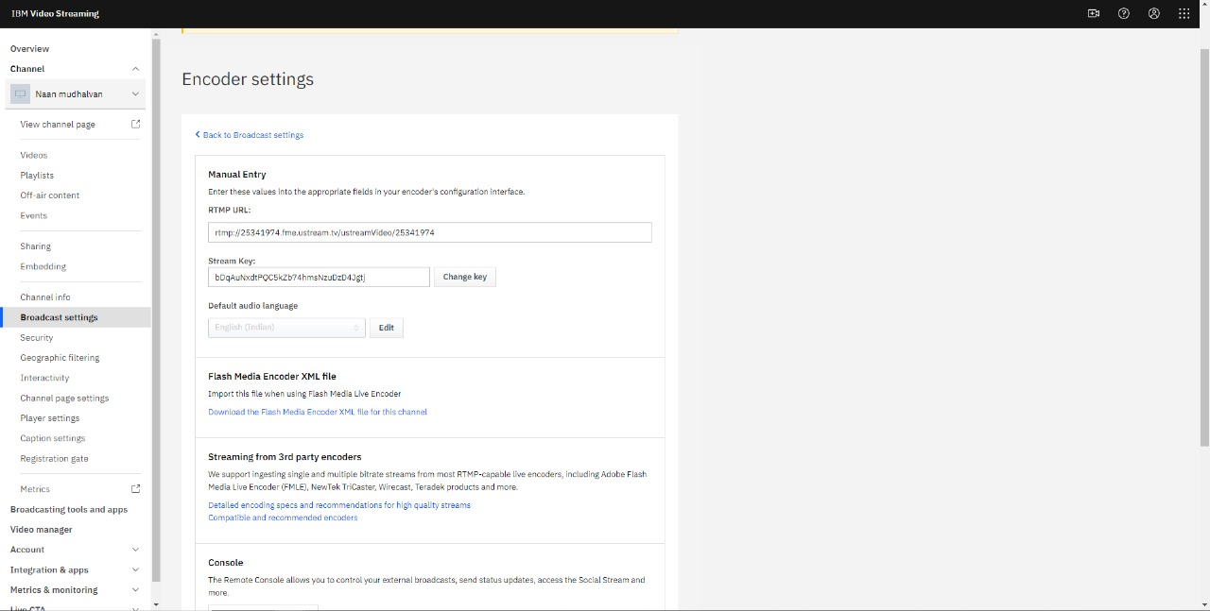

Slide 4
Overall, this phase of the project has seen the realization of a new channel in IBM Media Streaming, highlighting our commitment to innovative solutions.
The update of the stream key further reinforces our dedication to maintaining a secure and high-quality streaming environment, setting the stage for ongoing success in our project.

Slide 5
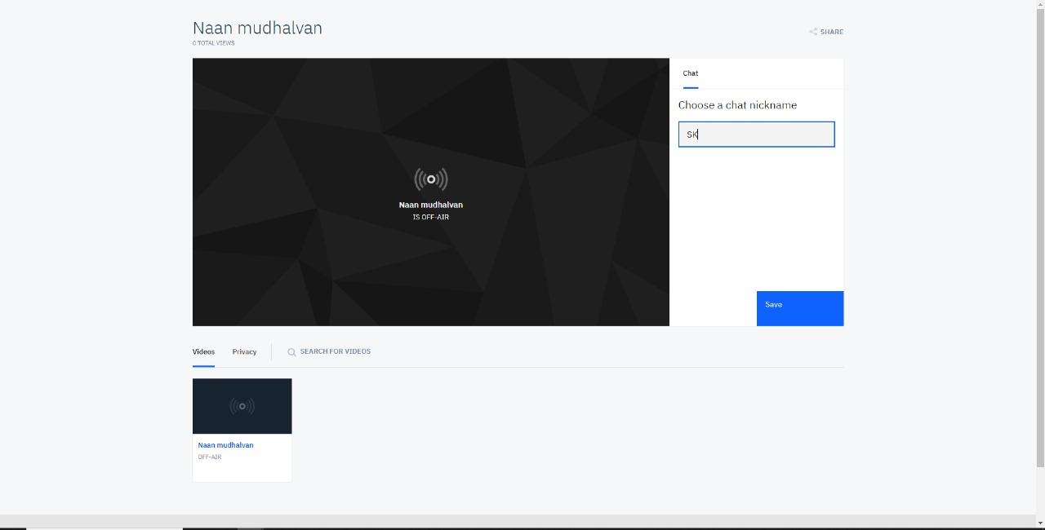

Slide 6
CONCLUSION :
We are going to use OBS (Open Broadcaster Software) to create a media broadcast in the next step.
The stream key will be inserted, and a real-time chat box will be included in this stream.
We've added a live chat window right into our media stream to improve the viewing experience. This cutting-edge characteristic encourages participation,

Slide 7
Thank you

