Slide 1
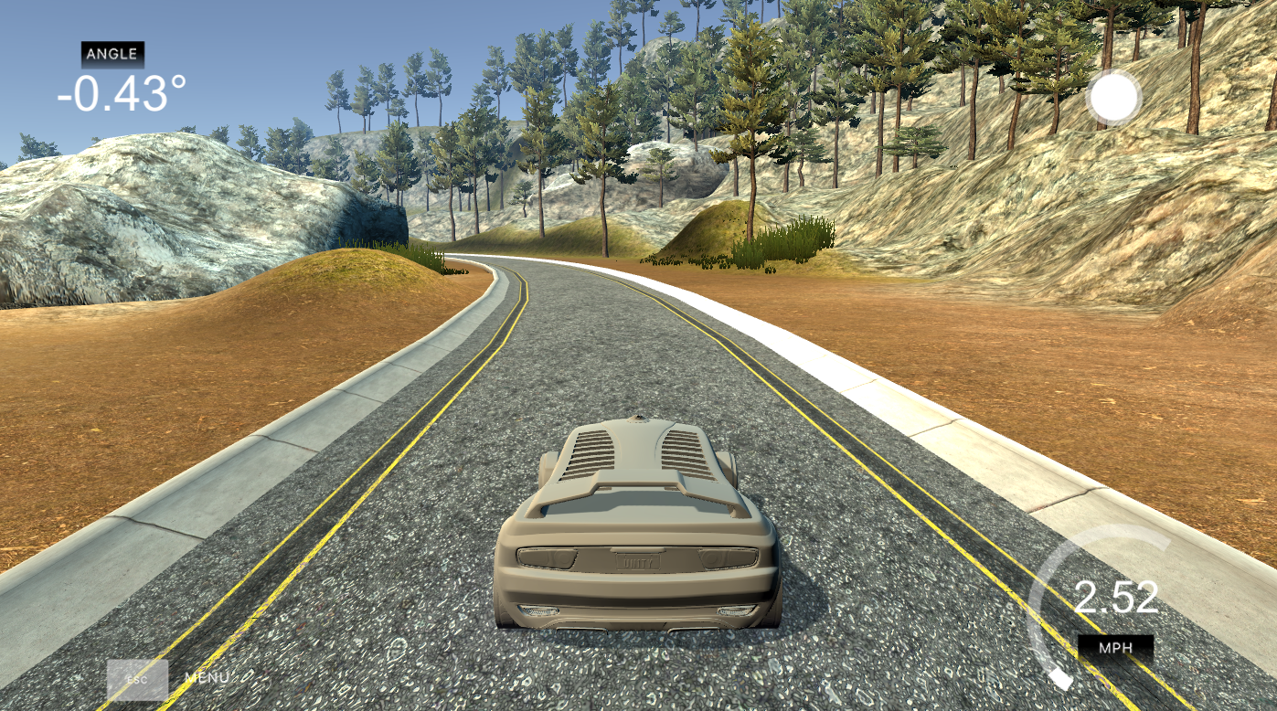
SIMULATION OF SELF DRIVING CAR USNIG DEEP LEARNING
SUBMITTED BY
B. SANJAY(S190386)
M. CHINNA RAO(S190189)
K. SAI KISHORE(S190967)
K. Asritha(S190289)

Slide 2
INTRODUCTION
Overview:
Autonomous driving has gained significant attention due to its potential to improve road safety, reduce traffic accidents, and save time. A key challenge is accurately predicting the steering angle from camera images of the vehicle’s surroundings.
This project aims to solve this by using Convolutional Neural Networks (CNNs) to predict the vehicle's steering angle based on images collected from a driving simulator.
Objective:
The main objective is to predict the steering angle from camera images in the range of -1 to 1 (left to right), based on visual input using CNN-based models.
Steering_Angle(y) = f(Image_Data)

Slide 3
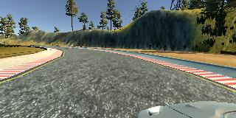
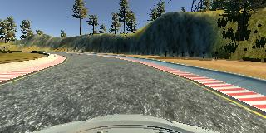
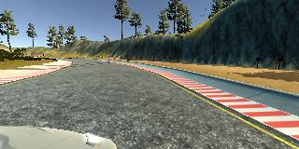
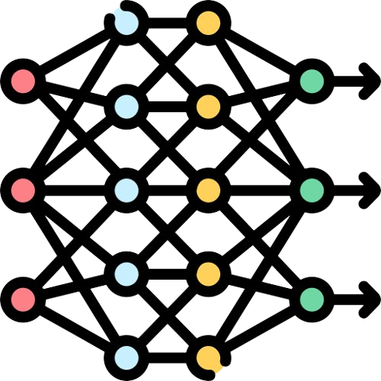
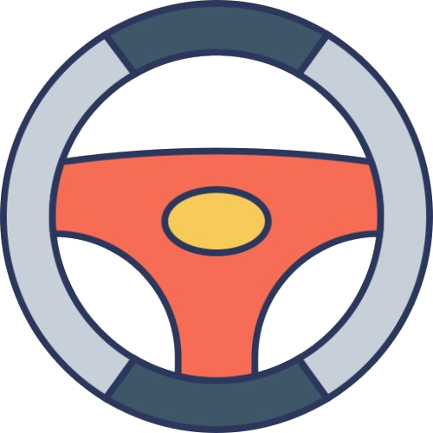
PROBLEM STATEMENT
Given images captured from various angles (left, center, right), the task is to predict the vehicle's steering angle to ensure safe and accurate autonomous driving.
Challenges:
Dealing with diverse road conditions.
Handling Large Variations in steering angles
Generalizing to new tracks and real-world scenarios.
LEFT
CENTER
RIGHT
Steering Angle

Slide 4
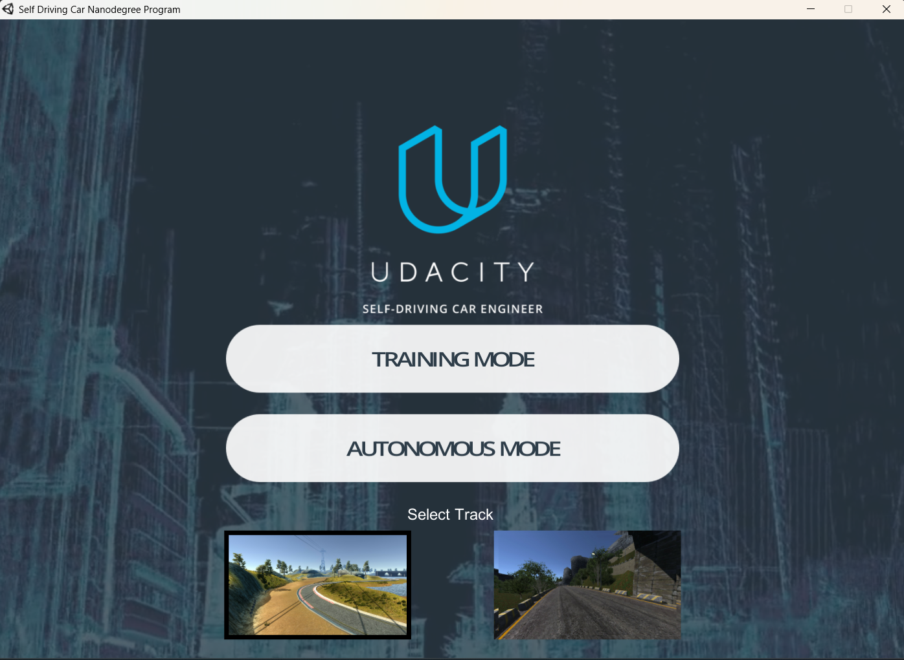
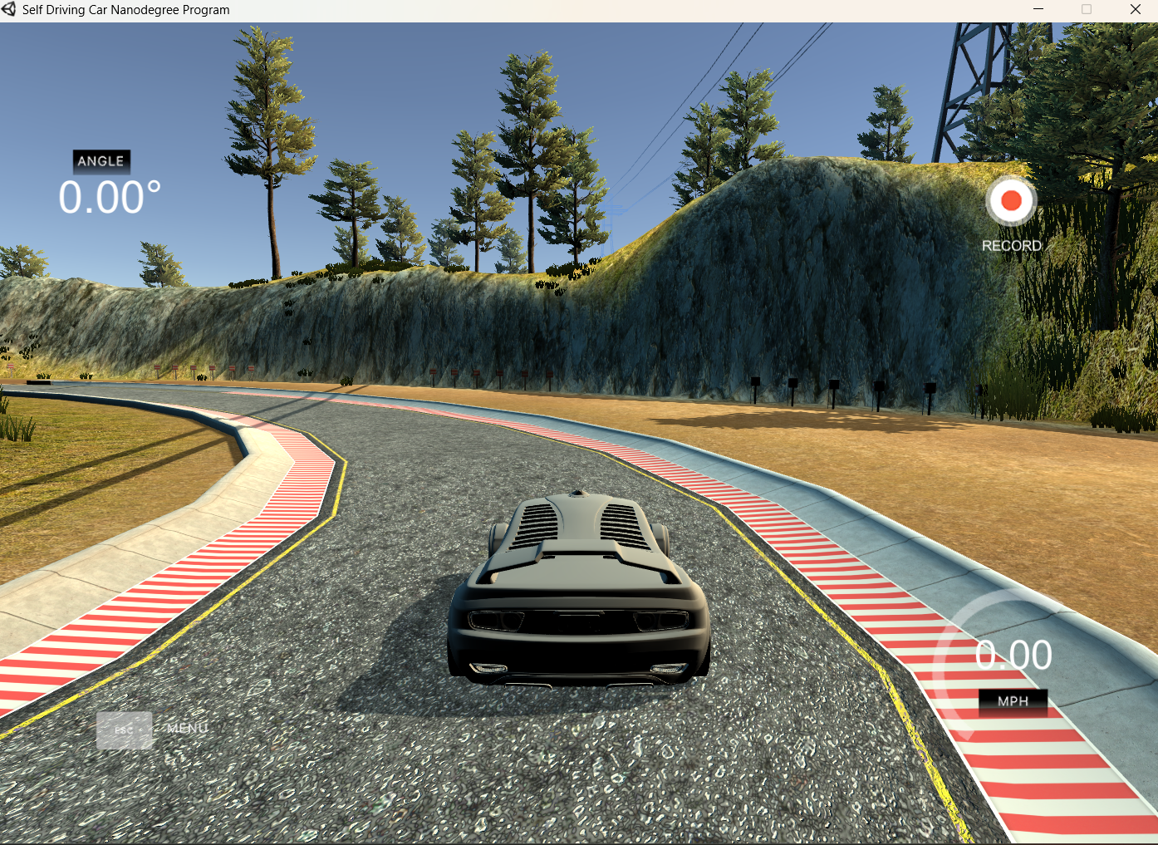
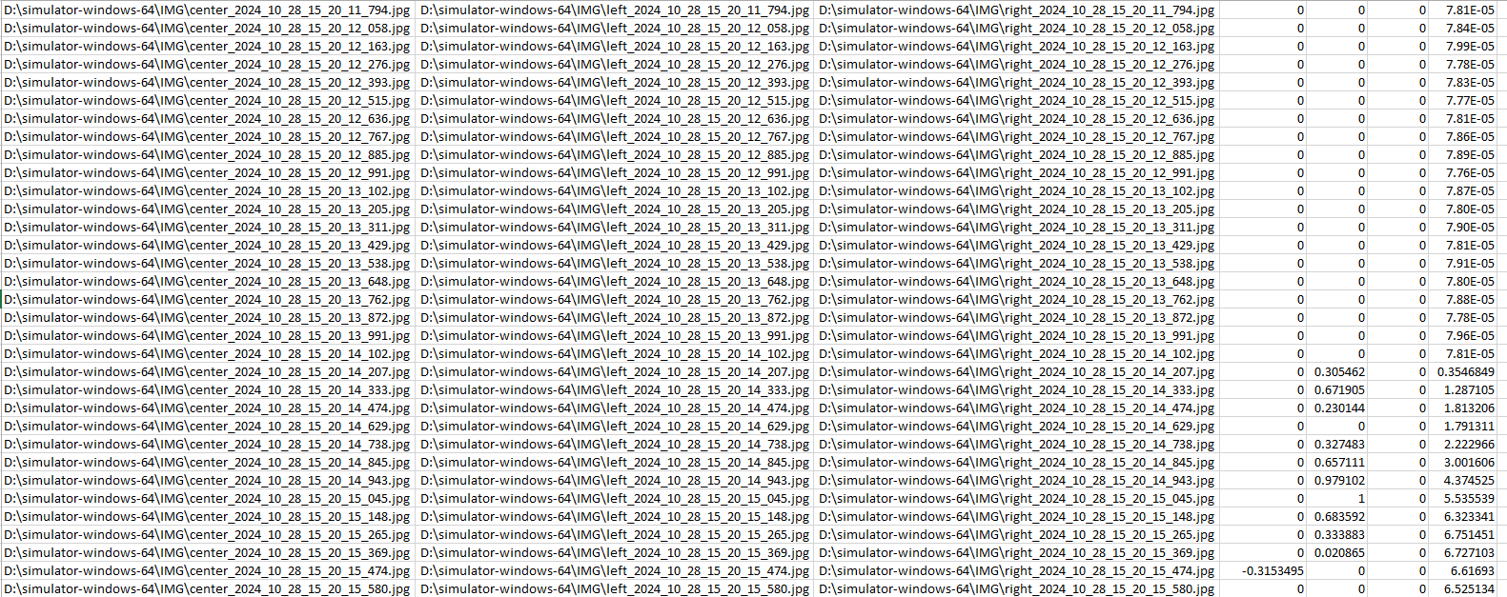
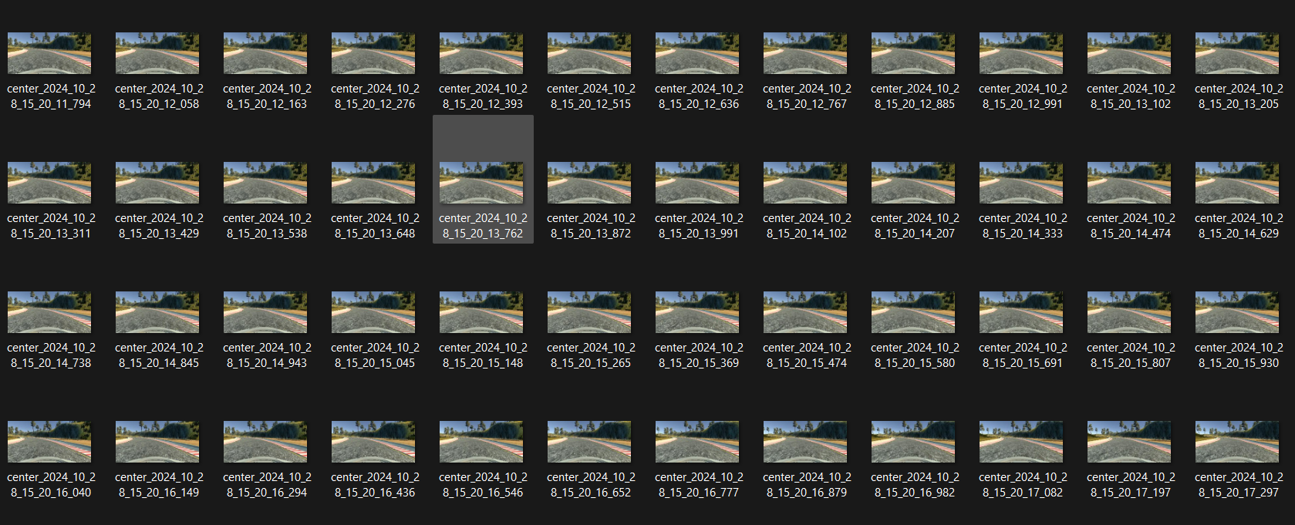
DATA COLLECTION
The data for this project was collected using Udacity’s Self-Driving Car Simulator in training model.
Method:
Images were captured from three different camera angles: left, center, and right.
The images are in RGB format with a resolution of 320x160 pixels.
A CSV file was automatically generated that contains the image paths and their corresponding steering angles (ranging from -1 to 1).
Number of Images Collected: 3997 images were collected, with steering angles recorded for both forward and reverse driving.

Slide 5
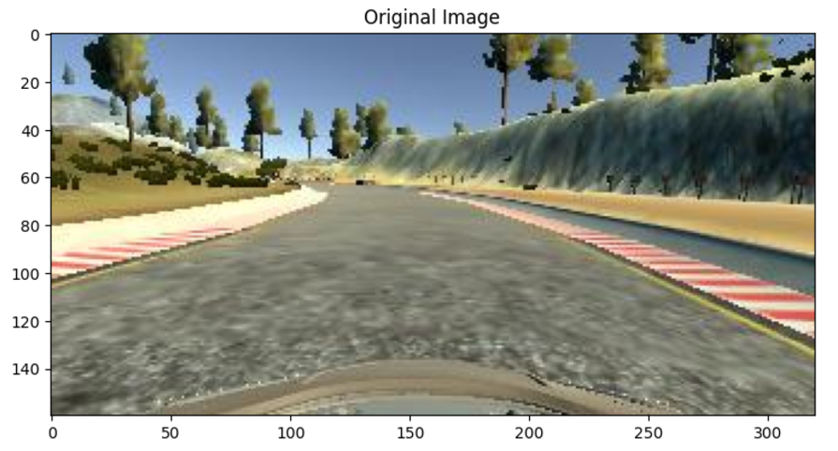
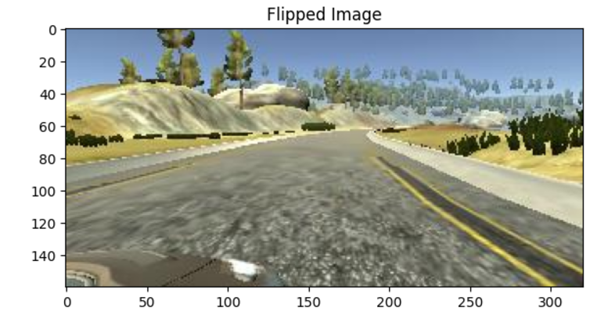
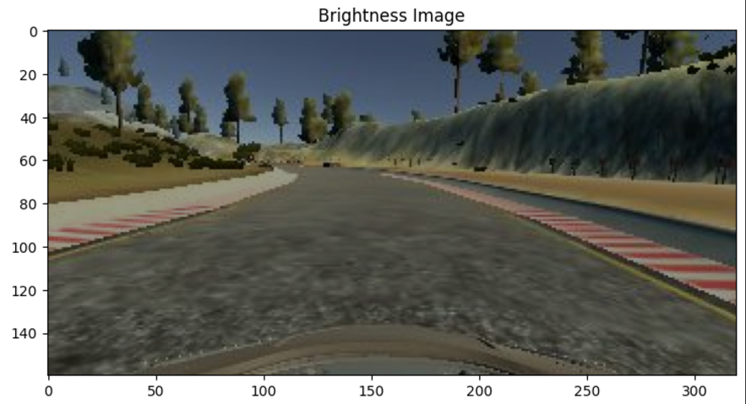
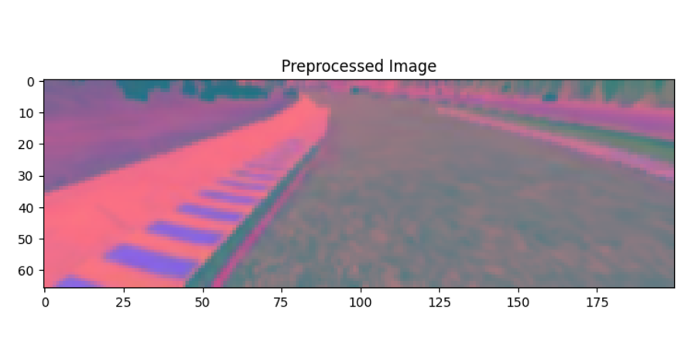
DATA PRE-PROCESSING
Images were flipped horizontally and vertically to augment the dataset and make the model more robust to different scenarios.

Slide 6
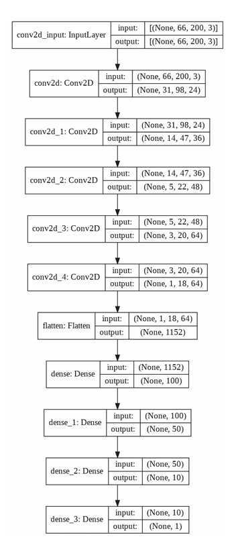
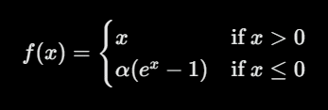
MODEL ARCHITECTURE
The model is a deep CNN with multiple layers designed to learn hierarchical features from the input images. Here’s the breakdown:
Model Layers (Total 11 Layers):
Convolution Layers(2D) – Extract spatial features from the images.
Activation Function(ELU) – Used to avoid dead neurons.
Flatten Layer – Convert 2D to 1D Vector.
Dense Layers – Fully connected layers for steering angle prediction.
Output Layer – A single neuron to predict the steering angle(regression problem).

Slide 7
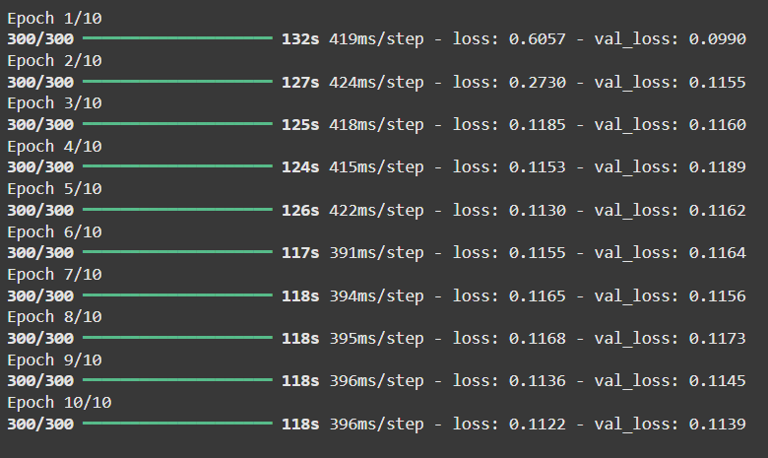
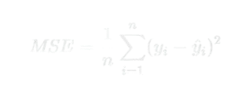
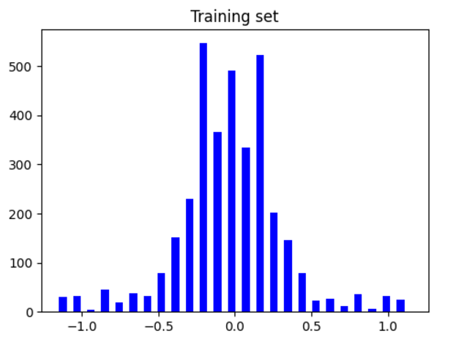
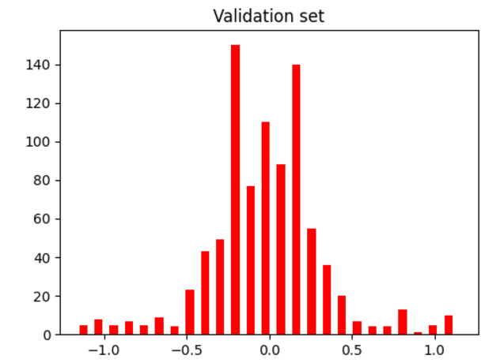
TRAINING & EVALUATION
Training:
Epochs: The model was trained for a set number of epochs (e.g., 10-50) depending on the dataset size and convergence behavior.
Batch Size: A batch size of 64-128 was used for efficient training.
Evaluation Metrics:
Mean Squared Error (MSE): Measures the average squared difference between the predicted and actual steering angles.
Accuracy: Percentage of predictions that are within a certain threshold of the actual steering angle.

Slide 8
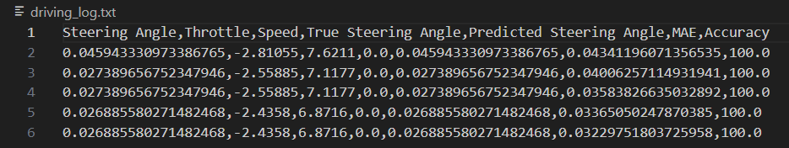
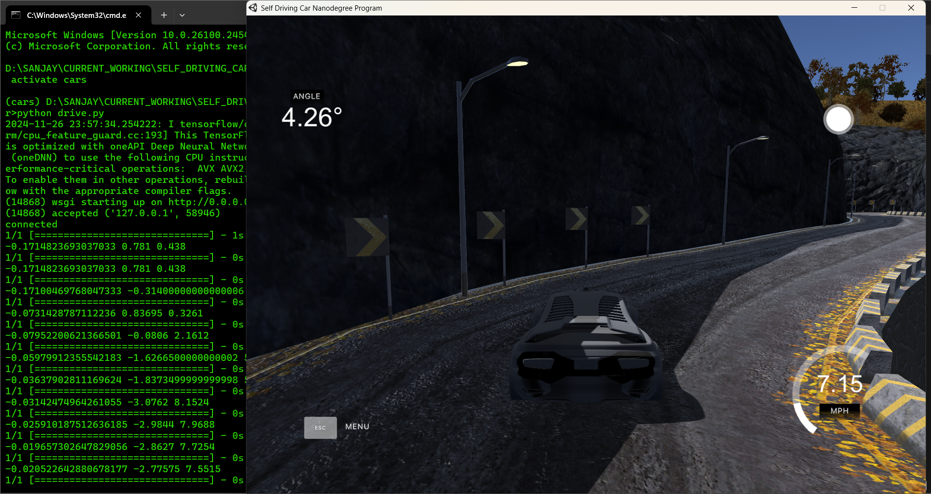
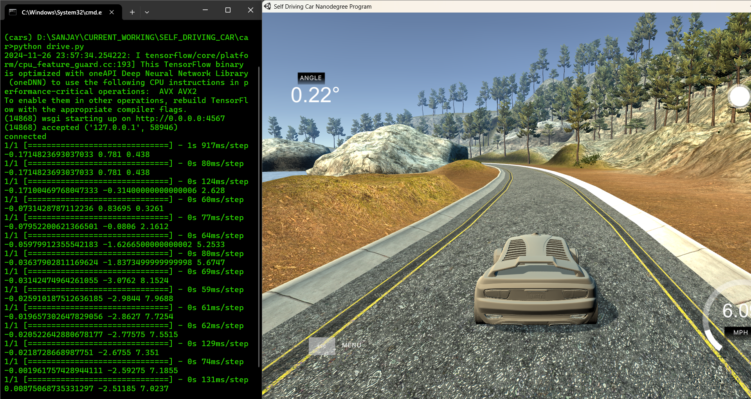
RESULTS

Slide 9
CONCLUSION
Key Findings:
CNNs effectively predict the steering angle of self-driving cars from images.
The ELU activation function enhances training stability and convergence.
Future Work:
Improve model generalization to different driving environments.
Incorporate more complex sensor data such as lidar or radar for better decision-making.
Our project demonstrates the potential of using deep learning and computer vision to solve real-world problems in autonomous driving.

Slide 10
REFERENCES
Bojarski, M., et al., "End to End Learning for Self-Driving Cars", arXiv:1604.07316, 2016.
Albawi, S., et al., "Understanding of Convolutional Neural Networks," ICET 2017.
Guo, H., et al., "Self-Driving Car Steering Angle Prediction Based on Image Recognition," arXiv:1912.05440, 2019.
Yang, Z., et al., "End-to-end Multi-Modal Multi-Task Vehicle Control for Self-Driving Cars," ICPR 2018.

Slide 11
THANK YOU 🤝

