Slide 1

Abhishek Bansal
Amal Nair
Darshan H
Puneet Singhwaiya
Sanjay BN

Slide 2


Slide 3


Slide 4
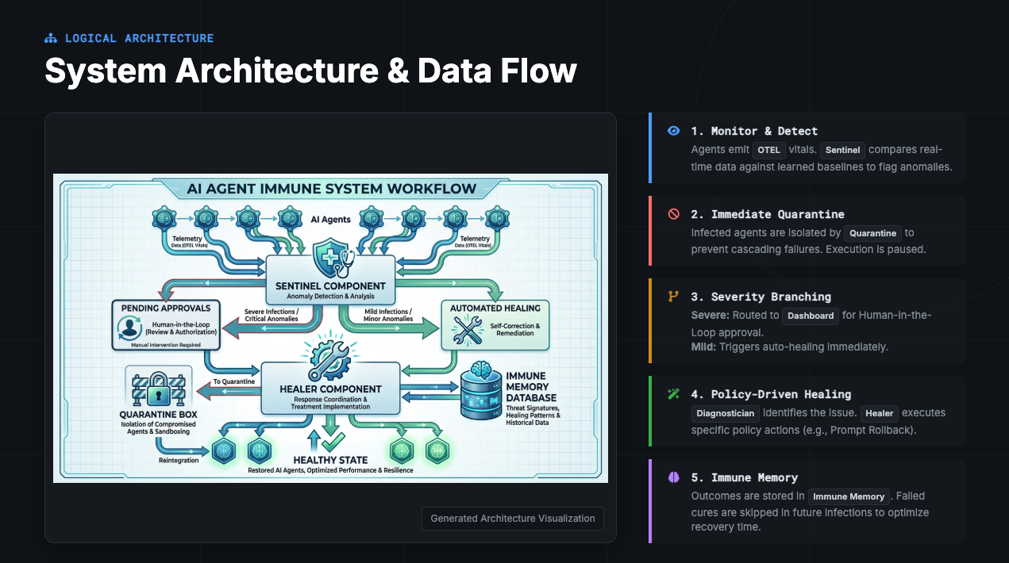

Slide 5


Slide 6
