Slide 1
UE17CS303 - MACHINE LEARNING ASSIGNMENT
Project Title : Classification of Photometric Data As Stars or Quasars Using Decision Trees
Team Members :
Sanjay Chari, PES1201700278
Aditya Shankaran, PES1201700710
Athul Sandosh, PES1201701110

Slide 2
PROBLEM STATEMENT
We were provided with four catalogues, each with a collection of photometric data regarding astronomical entities.
We were required to classify each of the data points in the csv file of every catalog, as star or quasar.
The csv files contain 39 columns, with column headings such as galex_objid, sdss_objid, and so on.
The task given to us was to beat the baseline accuracy mentioned in the paper, using any machine learning algorithm of our choice.

Slide 3
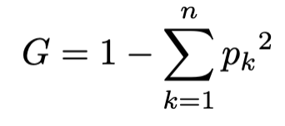
METHOD
We decided to use a decision tree for our classification task, as when we compared its performance with other algorithms, we achieved convergence faster with decision tree, and achieved good accuracy too.
We make use of the CART(Classification And Regression Trees) algorithm to train our tree.
In this algorithm, we make use of a metric called Gini impurity. Gini impurity refers to the distribution of classes for a given node.
A node is pure (G = 0) if all its samples belong to the same class, while a node with many samples from many different classes will have a Gini closer to 1.
Each node is split so that the Gini impurity of the children is minimized.

Slide 4
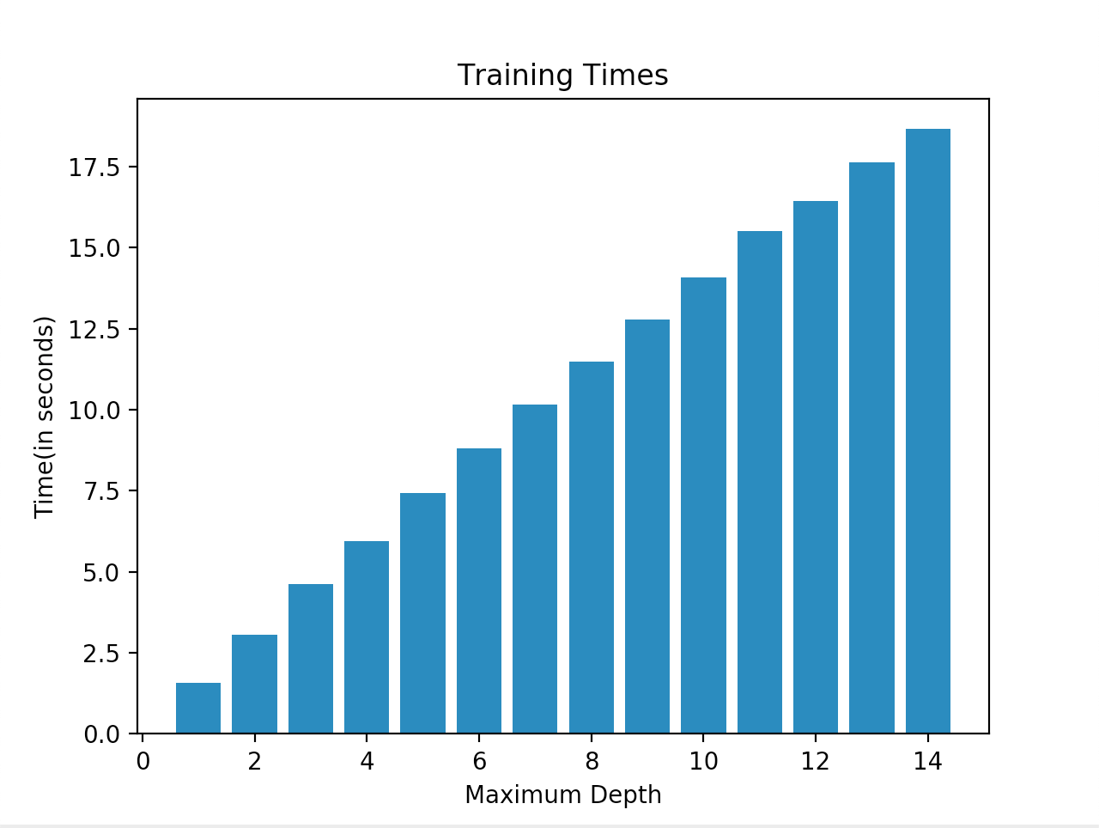
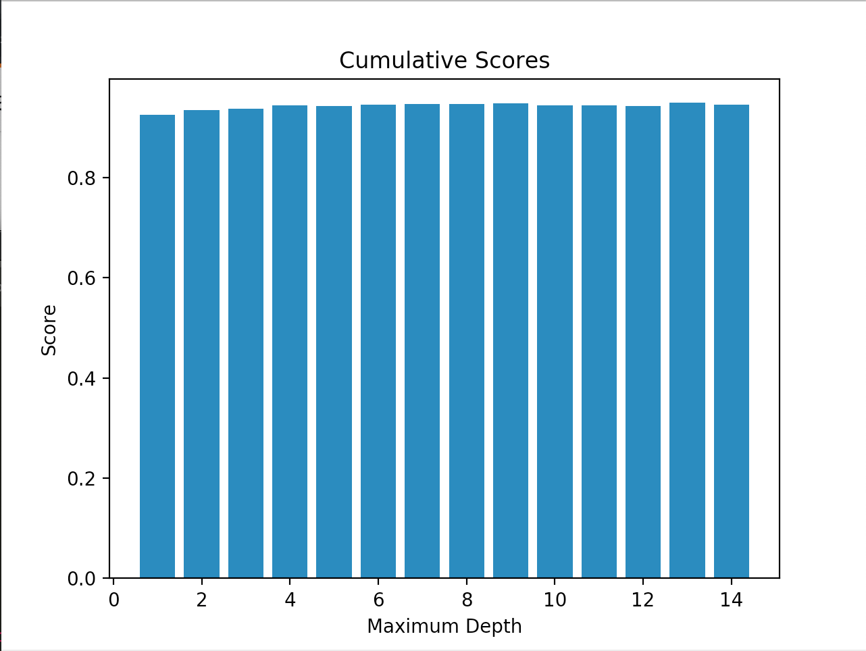
CHOOSING THE OPTIMAL MAXIMUM DEPTH
The algorithm stops when the maximum depth, a hyperparameter, is reached, or when no split can lead to two children purer than their parent.
To choose the optimal value for the maximum depth hyperparameter, we compared the training time and average of validation accuracy, precision, recall and f1 scores for various values of maximum depth across all catalogues.
As can be observed in the graphs, the average of the scores plateaus at maximum depth = 8, while the training time goes on increasing.
For this reason, the value of maximum depth was chosen to be 8.

Slide 5
RESULTS
We performed 10-fold cross validation on our model to check our results. The results obtained are summarized below :
In conclusion, we were able to achieve reasonable results when compared to the baseline paper using decision trees.
Catalogue | Accuracy | Precision | Recall | F1 Score | Time(in s)
1 | 0.9505 | 0.9809 | 0.9648 | 0.9725 | 9.4159
2 | 0.9391 | 0.9598 | 0.9704 | 0.9650 | 47.5209
3 | 0.9478 | 0.9634 | 0.9776 | 0.9704 | 54.3841
4 | 0.8504 | 0.8821 | 0.8711 | 0.8764 | 413.3804

Slide 6
THANK YOU

