Slide 1
FACTOR ANALYSIS
PRINCIPAL COMPONENT ANALYSIS
REGRESSION ANALYSIS
PRESENTED BY:
Chanda Pandey 920
Shifa khan 907
Sanjay Chauhan 904

Slide 2
Objective
Using PYTHON
Applying factor analysis in data having large number of variable to reduce dimensionality preserving the most important information using PCA technique.
Identify underlying patterns and relationships.
Simplify data to apply regression analysis.
Employ regression analysis to assess the predictive power of the identified factors in estimating divorce risk.

Slide 3

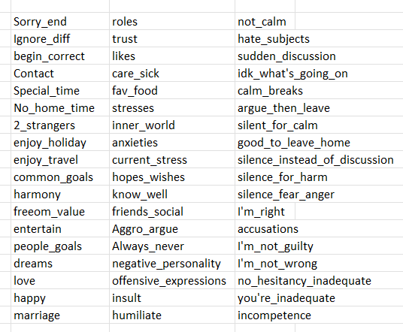
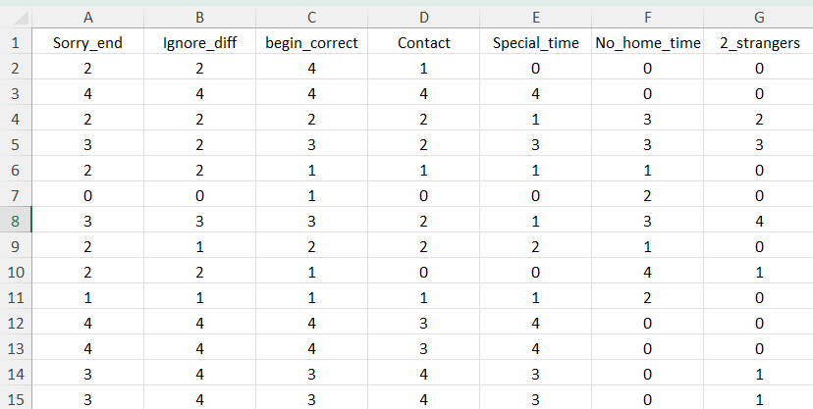
About Dataset
This dataset contains 170 marriage couples record.
Total 54 features as questions asked and a final answer - Divorced or not.
All answers are in a scale of 0-4
(0=Never, 1=Seldom, 2=Averagely, 3=Frequently, 4=Always)

Slide 4

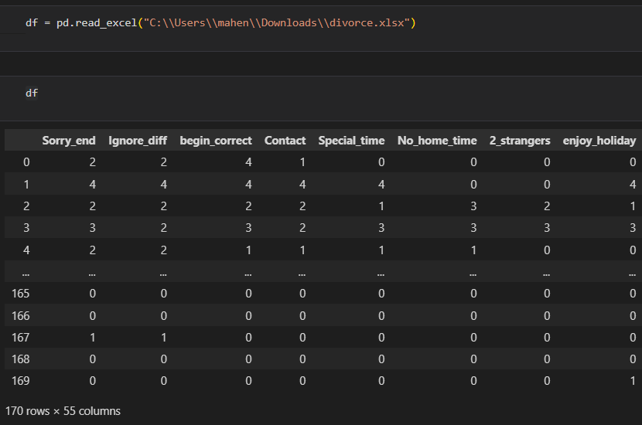

Factor Analysis
# Import all the necessary libraries
# Import data using pandas
# Drop the dependent variable.

Slide 5
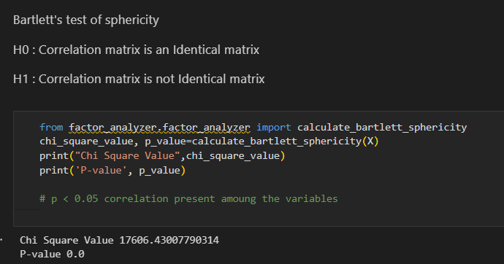
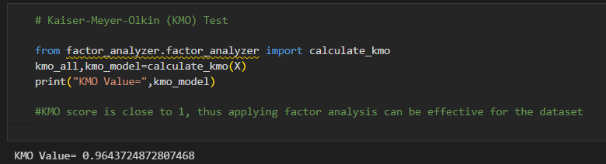
# for checking adequacy of the data
1. Bartlett’s test of Sphericity
2. Kaiser-Meyer Olkin test
i.e. correlation between pairs of variables explained by the other variables.
We reject null hypothesis
i.e. there is correlation between variables.

Slide 6
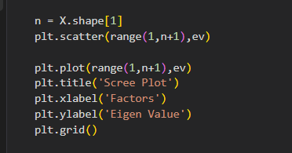
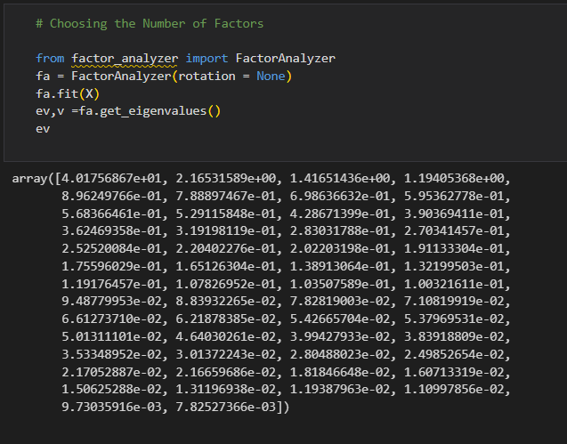
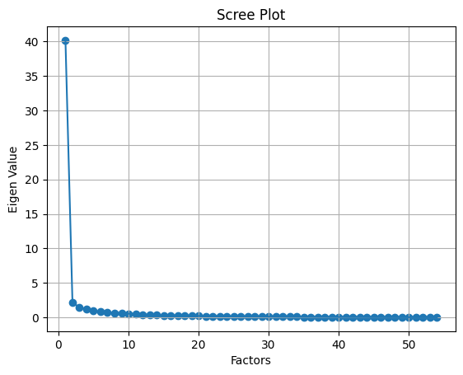
# To decide how many factors should extract
1. Eigen Value criterion
2. Scree plot criterion

Slide 7

# Execution Of Factor Analysis
Methods of Extraction of Factors :
Principal component analysis
Using unweighted least square methods
Generalized least square method
Maximum likelihood method
Principal axis factoring
Alpha
Image factoring
Types of Rotation
Orthogonal
Oblique
Varimax
Quartimax
Equimax

Slide 8
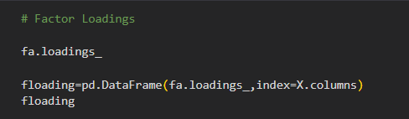
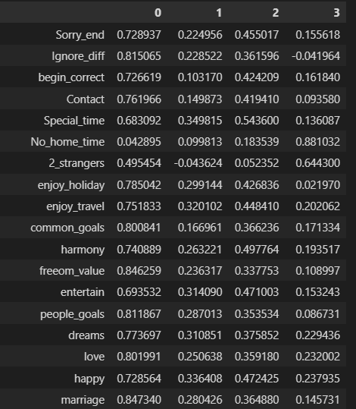
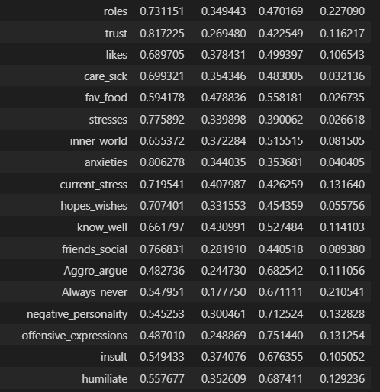
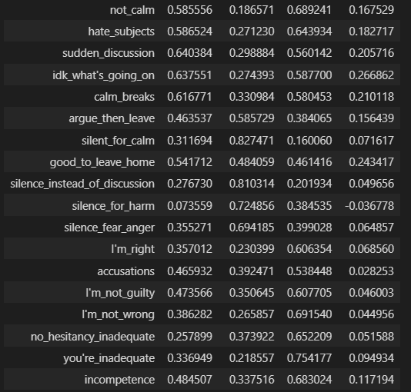
# Loading Matrix

Slide 9
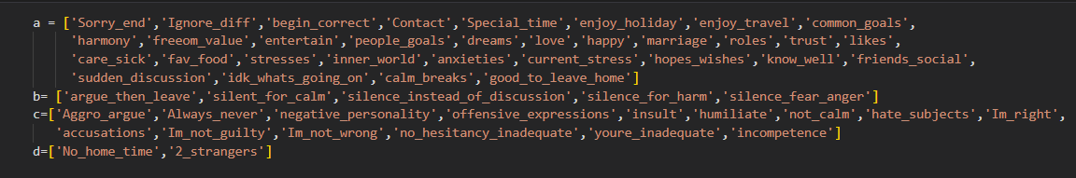
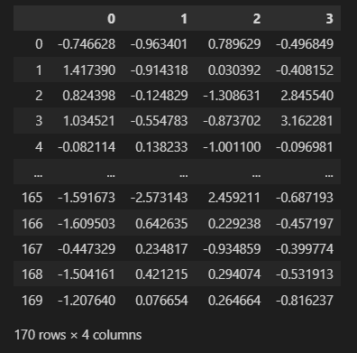
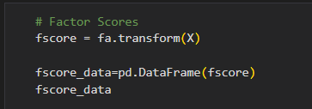
# According to varimax rotation
# Factor Scores

Slide 10
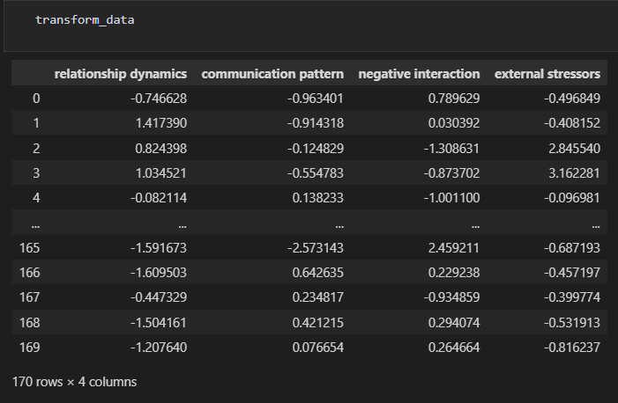
# New Dataset

Slide 11

Regression Analysis
# Logistic Regression
Logistic regression is a supervised machine learning algorithm that accomplishes binary classification tasks by predicting the probability of an outcome. The model delivers a binary or dichotomous outcome.
Logistic regression uses a logistic function called a sigmoid function to map predictions and their probabilities. The sigmoid function refers to an S-shaped curve that converts any real value to a range between 0 and 1.

Slide 12
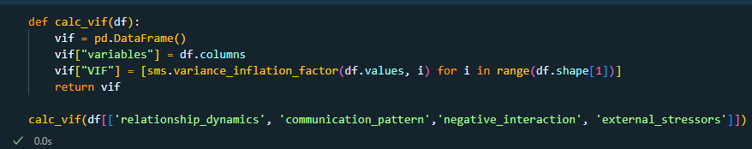
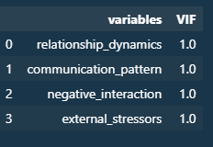
# Checking Multicollinearity

Slide 13


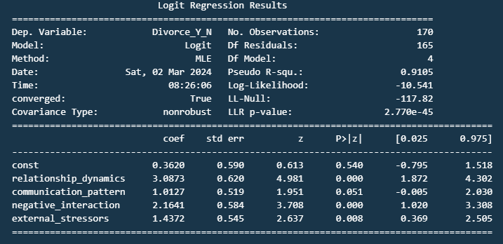
# Fitting the Model

Slide 14
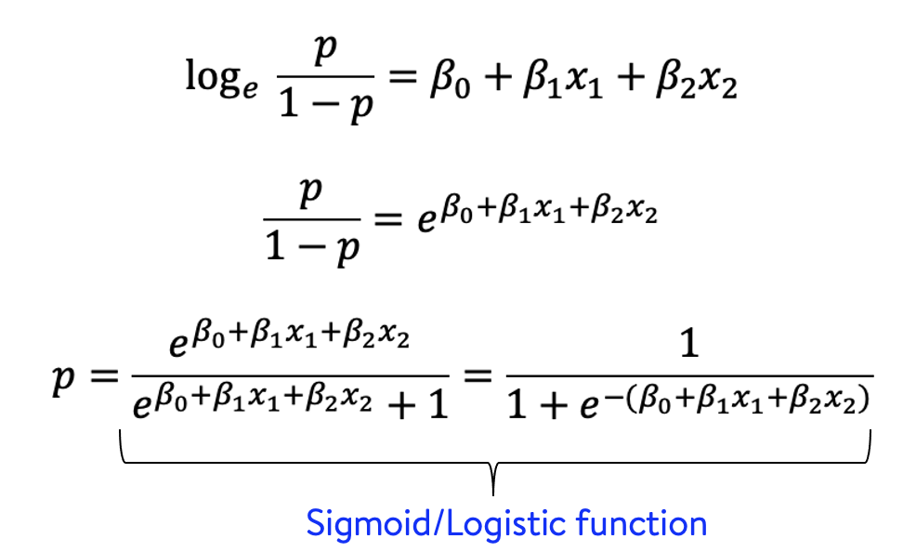
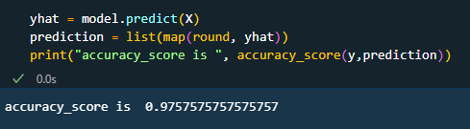
# Fitted Model
Y = 0.3620 + 3.0873 X1 +1.0127 X2 + 2.1641 X3 + 1.4372 X4
# Check Accuracy Score

Slide 15

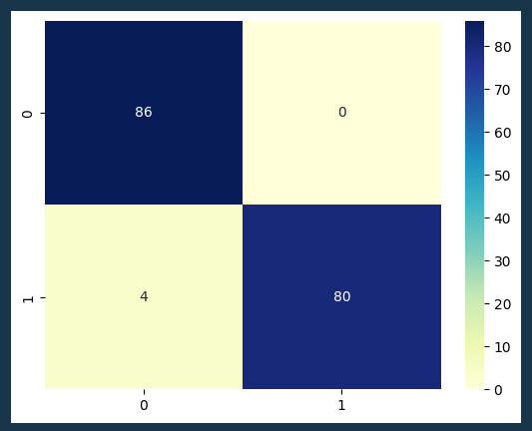
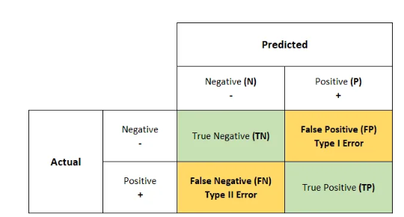
# Confusion Matrix

Slide 16
Thank You !

