Slide 1

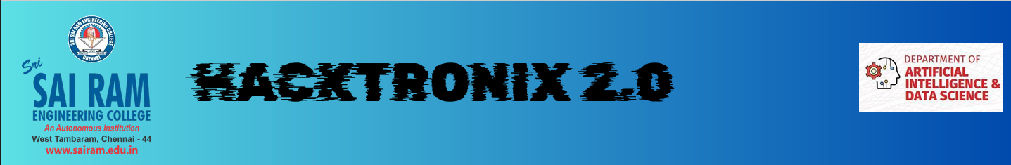





Sri
SAI RAM
ENGINEERING COLLEGE
An Autonomous Institution
West Tambaram, Chennai - 44
www.sairam.edu.in
HACKTRONIX 2.0
Problem Statement Category :
Software
Problem Statement ID :
SW-01 :ARTIFICIAL INTELLIGENCE & GENERATIVE AI
Project Title :
Infrared Image Colorization and Enhancement for Improved Object Interpretation
Team Name :
PixelSentinel
College Name :
Sathyabama Institute of Science and Technology
Team Lead Name :
Sanjay B L
*no extra slides should be added, maintain the same template

Slide 2

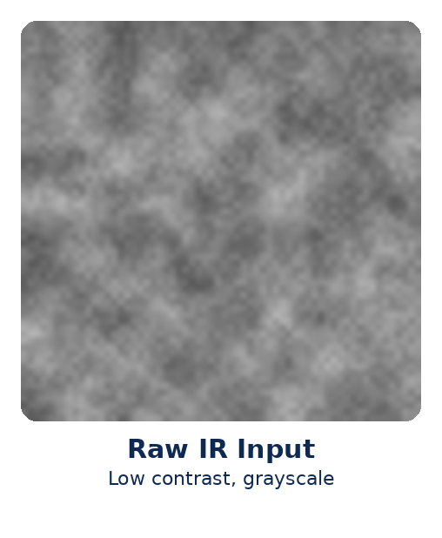
PIXELSENTINEL
Problem Statement
Infrared satellite images are grayscale, low contrast, and hard to interpret — human analysts and AI models struggle to identify roads, buildings, and vegetation
Existing tools fail completely under night-time or bad weather conditions, and there is no reliable way to convert raw IR satellite data into meaningful visual output
Ground-level colorization models (e.g. PearlGAN, FoalGAN) are not built for satellites — they hallucinate wrong colors for terrain and are never validated on orbital imagery
No existing model uses physical satellite spectral data to verify color accuracy before presenting results to analysts

Slide 3
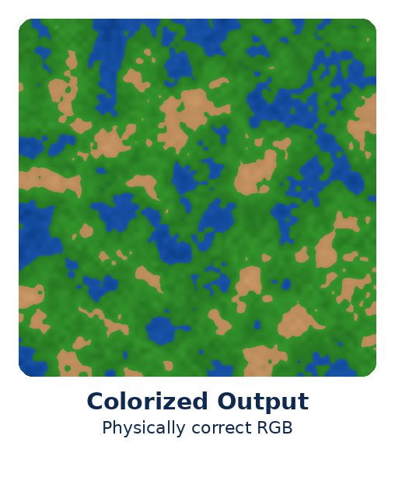
PIXELSENTINEL
Proposed Solution
PixelSentinel enhances infrared satellite images using super-resolution, then translates them to realistic RGB
Uses NDVI and NDWI spectral indices to force physically correct colors — water is blue, vegetation is green, no guessing
Validated on actual downstream tasks like object detection, not just visual appearance
First pipeline purpose-built for orbital satellite IR data (Landsat 8/9), with a zero-hallucination guarantee

Slide 4
PIXELSENTINEL
Tech Stack
Backend
Python • PyTorch / TensorFlow • FastAPI / Flask
Computer Vision & Geospatial
OpenCV • Rasterio • GDAL • NumPy • Albumentations • Google Earth Engine
PixelSentinel
Tech Stack
AI Models
Real-ESRGAN • Pix2Pix (U-Net + PatchGAN) • U-Net / DeepLabV3+ • YOLO • NDVI / NDWI
Evaluation Metrics
PSNR • SSIM • FID • Inference Time per Tile
Frontend & Demo
Streamlit / React Dashboard • Side-by-side Comparison • Confidence Scores

Slide 5
PIXELSENTINEL
Workflow
1
5
STEP 1 · Satellite IR Image
Landsat 8/9 Band 10/11 (Thermal IR) ingested
STEP 5 · NDVI / NDWI Verification
Enforces physically correct colors
2
6
STEP 2 · Preprocessing
Co-registration, atmospheric correction, normalization
STEP 6 · YOLO + DeepLabV3+
Object detection & segmentation validation
3
7
STEP 3 · Real-ESRGAN
Super-resolution enhancement of the IR tile
STEP 7 · Intelligence Dashboard
Enhanced satellite output delivered
4
STEP 4 · Pix2Pix U-Net
IR → RGB colorization

Slide 6
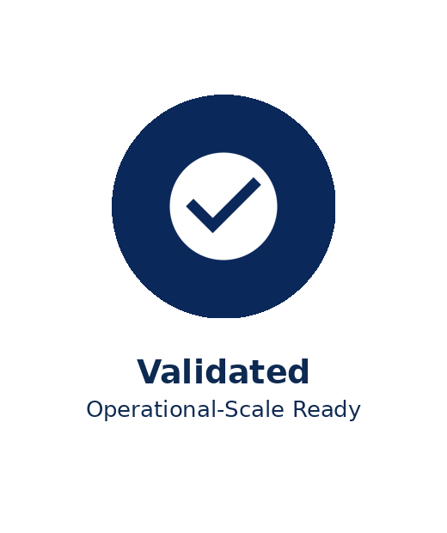
PIXELSENTINEL
Result / Impact
First IR colorization pipeline purpose-built and validated on Landsat orbital satellite data — not repurposed from ground-level thermal camera models
Semantic constraint module (NDVI/NDWI) eliminates hallucinated colors in the output
Output validated against downstream object detection accuracy, not just visual realism
Geospatial tile-aware pipeline ensures consistent color mapping and is deployable at operational scale
Inference time optimized per tile for scalable, real-world deployment

