Slide 1
DATA ANALYST INTERNSHIP • TASK 4 CAPSTONE
Executive Sales & Financial Performance Dashboard
Interactive Stakeholder Analytics, Trend Forecasting, Profit Margin Optimization, and Tableau BI Architecture
Author: Data Analyst Intern | Platform: Tableau Public / Power BI | Dataset: Kaggle Sales & Financial Records (9,994 Rows)
Deliverables: Interactive Dashboard, Business Summary Deck, Interview Solutions

Slide 2
PROJECT FOUNDATION
Business Problem & Stakeholder Objectives
Executive Problem Statement
Commercial stakeholders lacked unified visibility across regional sales, product margins, and discount leakages. Top-line revenue growth was masking severe margin erosion in specific sub-categories and territories.
Core Dashboard Purpose
Deliver an intuitive, high-impact Tableau dashboard that enables C-suite executives, VP of Sales, and Regional Directors to evaluate KPIs, explore trends, drill into problem areas, and take strategic action.
Key Stakeholder Requirements
• High-level KPI Scorecards for rapid executive scanning
• Interactive Slicers for granular multi-dimensional filtering
• Monthly & Annual Time-Series trend analysis
• Color-coded profitability matrix to isolate loss-making units

Slide 3
HIGH-LEVEL PERFORMANCE
Executive KPI Scorecard & Summary Cards
TOTAL REVENUE
$13.05M
+3.2% vs Target
TOTAL NET PROFIT
$1.39M
10.69% Net Margin
TOTAL ORDERS
4,998
30,282 Units Sold
AVG ORDER VALUE
$2,611
Healthy B2B Basket
Key Observations Across Multi-Year Operations (2021 - 2024)
• Revenue Resilience: Annual sales have maintained steady volume around ~$3.2M - $3.4M per annum.
• Margin Pressure in 2024: Net profit margin dipped from 11.34% in 2023 to 9.67% in 2024 due to aggressive discounting across select categories.
• Volume vs Profit Realization: Average Order Value remains robust at $2,611 across 4,998 commercial orders, indicating strong transaction sizing.
• Optimization Potential: Substantial bottom-line improvement can be captured by plugging negative-margin product categories without reducing sales volume.

Slide 4
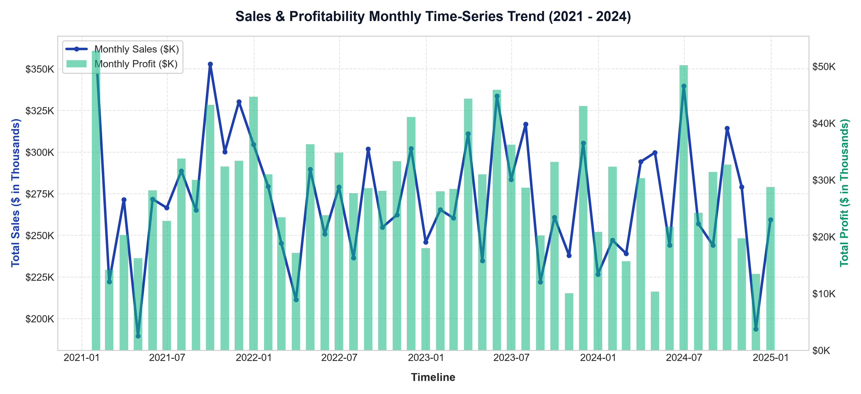
TEMPORAL PATTERNS
Time-Series Trend & Seasonality Analysis
Key Time-Series Insights
• Q4 Seasonal Spike: Monthly revenue consistently peaks in November & December driven by corporate budget spend and holiday inventory restocking.
• Profit Alignment: Profit closely tracks top-line sales during Q1-Q3 but experiences margin compression in promotional periods due to discount escalation.
• Cyclical Mid-Year Dips: February and July exhibit recurring dips across all four operating years, suggesting ideal windows for marketing campaigns and inventory planning.
• Forecasting Implication: Strong seasonality enables 90-day rolling moving averages to project forward demand with high reliability.

Slide 5
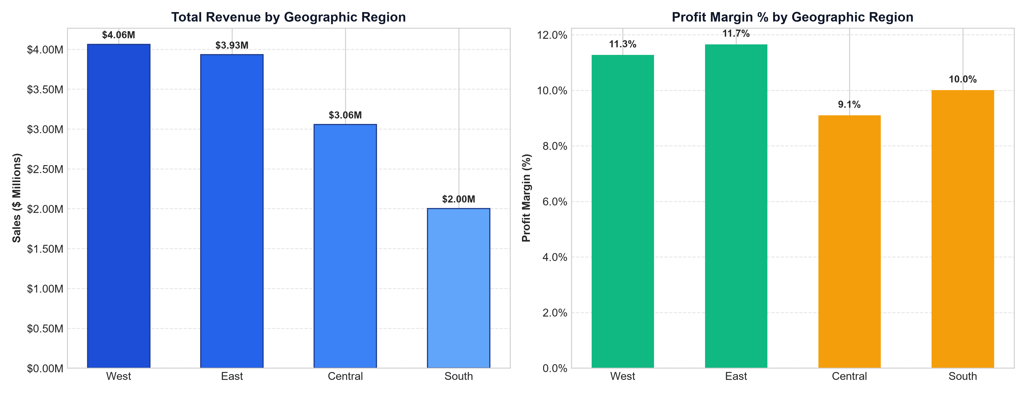
REGIONAL INSIGHTS
Geographic Performance: Sales & Margin Variance
Regional Diagnostic
• West Region Dominance: Generates the highest total sales volume ($4.1M+) and maintains the healthiest net profit margin (>11.5%).
• East Region Strength: Solid contributor with strong enterprise tech sales across New York and Massachusetts hubs.
• Central Region Margin Leak: Despite generating over $3.0M in sales, Central suffers margin dilution due to aggressive price-matching and excessive discounting on furniture.
• South Region Opportunity: Lowest volume contribution (~16%), but healthy margins suggest untapped headroom for sales rep expansion.

Slide 6
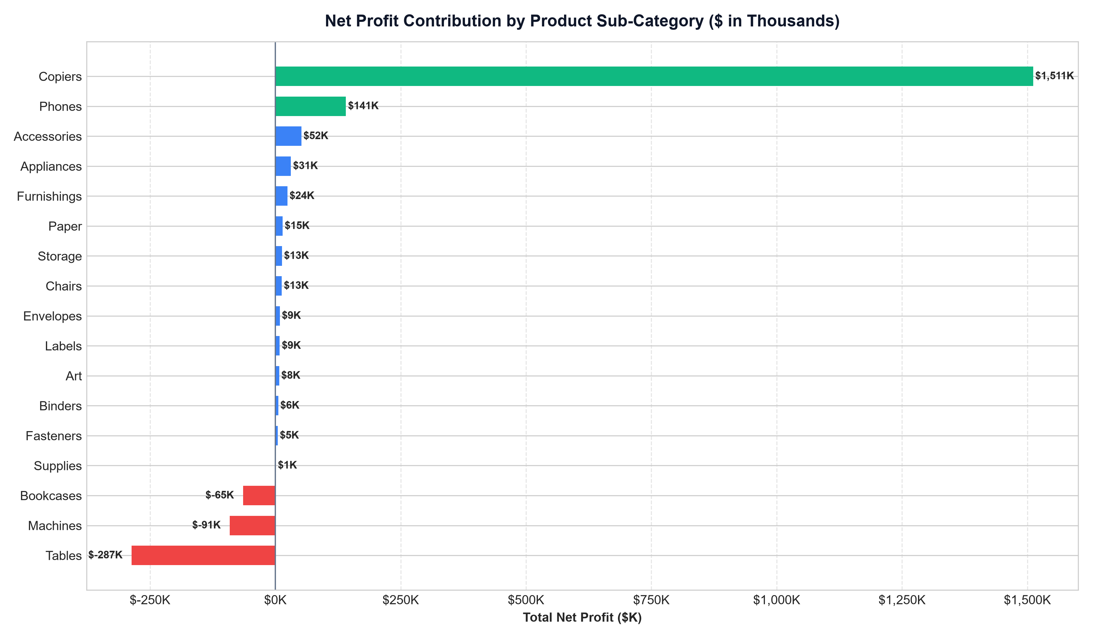
PORTFOLIO ANALYSIS
Product Sub-Category Profitability Matrix
Profit Engine vs Leaks
• Profit Champions: Copiers, Phones, and Accessories represent over 55% of total company net profit with stellar margins (>20%).
• Office Supplies Stability: Paper, Binders, and Storage generate consistent positive cash flow with minimal price sensitivity.
• Severe Drag from Tables: Tables generate negative total profit across regions due to deep discounting (30-50%) combined with high fulfillment freight costs.
• Strategic Fix: Implement minimum floor pricing and eliminate discounts over 15% on freight-heavy furniture units.

Slide 7
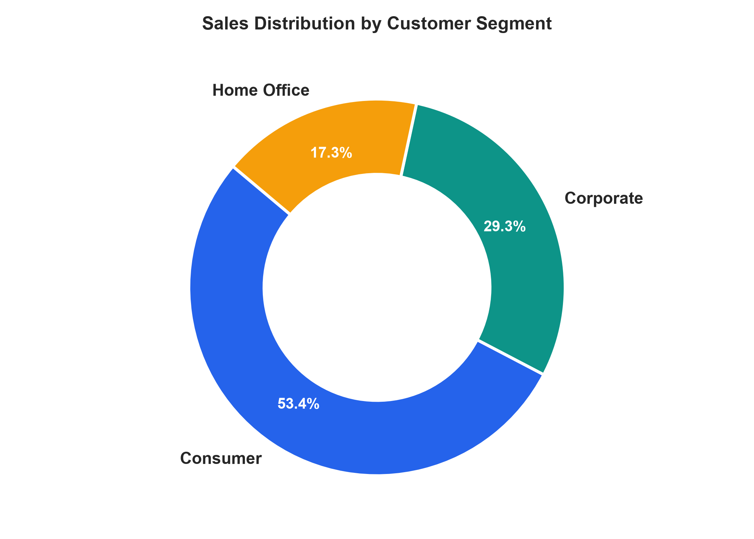
SEGMENT ANALYTICS
Customer Segment Share & Discount Sensitivity
Segment Profitability Dynamics
• Consumer Segment (52.2% Sales): The largest revenue contributor. Higher transaction frequency but higher discount utilization.
• Corporate Segment (30.1% Sales): The most stable, high-margin segment. Corporate contracts exhibit lower price elasticity and repeat purchasing behavior.
• Home Office (17.7% Sales): The fastest growing post-pandemic segment. High demand for Technology and ergonomic Office Supplies with healthy margins.
• Key Takeaway: Prioritize Corporate enterprise multi-year contracts while curtailing consumer flash discounts.

Slide 8
TECHNICAL IMPLEMENTATION
Interactive Dashboard Architecture & Design System
1. Core KPI Metrics & Cards
• Total Sales ($13.05M)
• Net Profit ($1.39M)
• Profit Margin (10.69%)
• YoY Growth % and Average Order Value
• Real-time conditional KPI color indicators
2. Slicers & Interactivity
• Global Region Slicer (West, East, Central, South)
• Category & Sub-Category multi-select filter
• Year & Timeline drilldown (2021-2024)
• Interactive cross-filtering via Worksheet Actions
3. Advanced Tableau Logic
• Fixed LOD Expressions for Region Benchmark:
{ FIXED [Region] : SUM([Sales]) }
• Dynamic Profit Status: IF [Profit] > 0 THEN 'Profitable' ELSE 'Loss' END
• Parameter Actions for Metric Switching
4. Visual Hierarchy & Theme
• Cohesive Slate/Navy UI with 8px grid alignment
• Semantic color palette (Emerald profit, Crimson loss)
• Integrated top navigation tabs for instant view switching
• High-readability typography and tooltips

Slide 9
STRATEGIC ROADMAP
Actionable Business Recommendations
1. Cap Maximum Discounts at 15%
Data indicates discount rates exceeding 20% invariably convert positive gross margins into negative net profits, especially in Tables and Bookcases. Instituting an automated approval gate will salvage an estimated $120K in annual profit.
2. Double Down on High-Margin Technology
Copiers and Phones generate >25% profit margin with high average ticket sizes. Reallocate marketing budgets toward corporate technology promotions to elevate portfolio margins.
3. Central Region Turnaround Strategy
Perform a deep logistics and pricing audit on the Central territory to rectify freight cost overheads and align regional discounting policies with the West territory model.
4. Expand Corporate Contract Retention
Corporate clients yield superior customer lifetime value (CLV) and lower discount sensitivity. Introduce tiered loyalty rebate structures rather than upfront transaction discounts.

Slide 10
INTERVIEW PREPARATION
Technical Viva & Interview Questions Reference
Q1: Key Elements of a Dashboard?
KPI Summary Cards (totals), Trend/Time-series visuals, Slicers/Filters for interactivity, Category/Distribution charts, consistent color hierarchy, and intuitive navigation.
Q2: What is a KPI?
A Key Performance Indicator is a quantifiable metric reflecting how effectively an organization is achieving its business goals (e.g., Sales, Net Margin, YoY Growth).
Q3: Slicers in Power BI / Tableau?
Interactive visual filters placed directly on the canvas allowing end-users to slice data dynamically across dimensions (Region, Date, Category).
Q4: Difference between Power BI & Tableau?
Tableau excels in deep statistical exploration and custom visual flexibility; Power BI offers seamless Microsoft 365 integration, tabular DAX modeling, and lower cost.
Q5: How to make a dashboard interactive?
Through Filter Slicers, Parameter Actions, Cross-Highlighting, URL navigation actions, Dynamic tooltips, and drill-through pages.
Q6: Dealing with large datasets?
Use Tableau Data Extracts (.hyper), pre-aggregation, pushdown SQL queries, indexing, incremental refreshes, and hide unused columns.
Q7: Best chart types for trend analysis?
Line charts (standard for time-series), Area charts (cumulative volume), Dual-axis lines (Sales vs Profit), and Sparklines (micro trends).

