Slide 1
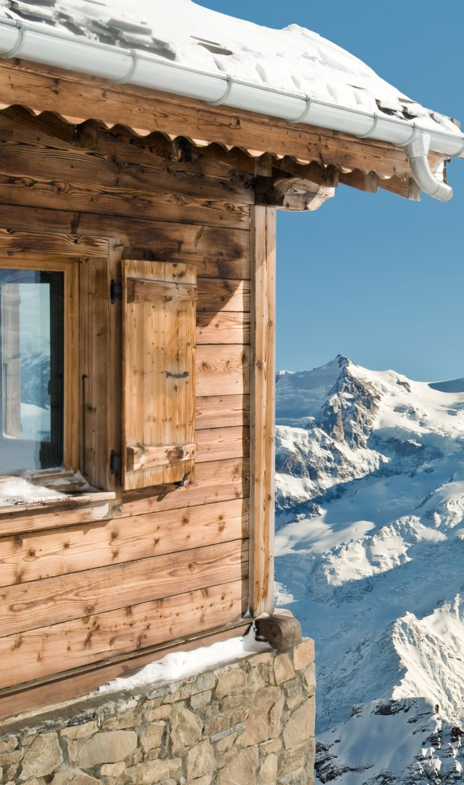
Big Mountain Resort Pricing Analysis

Slide 2
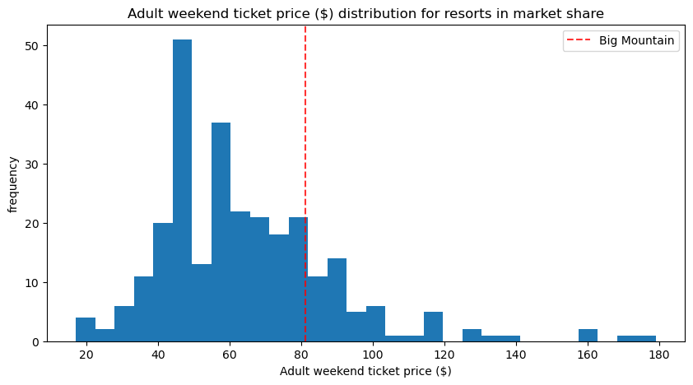
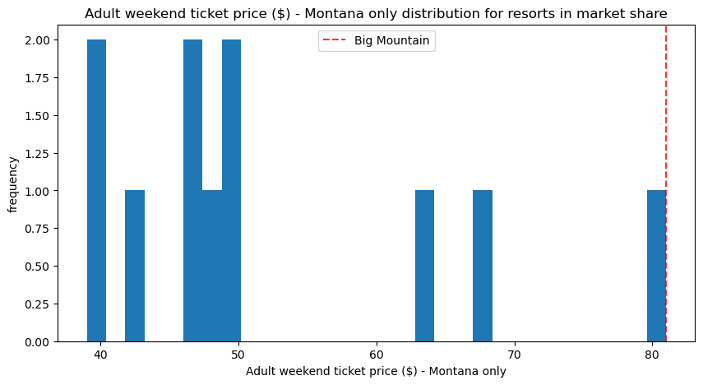
The problem: Current Ticket Strategy
Big Mountain Resort's current adult weekend ticket price: $81.00
Lower than what the market could support.
Revenue loss due to underpricing.

Slide 3
Recommendation and key findings
The discrepancy between current pricing and potential market-supported pricing.
Determine optimal ticket pricing using data-driven analysis.
Cost cutting measures:
Closing up to 10 runs
Vertical Drop and adding a chair lift
Snow Making and Vertical Drop
Longest Run Expansion

Slide 4
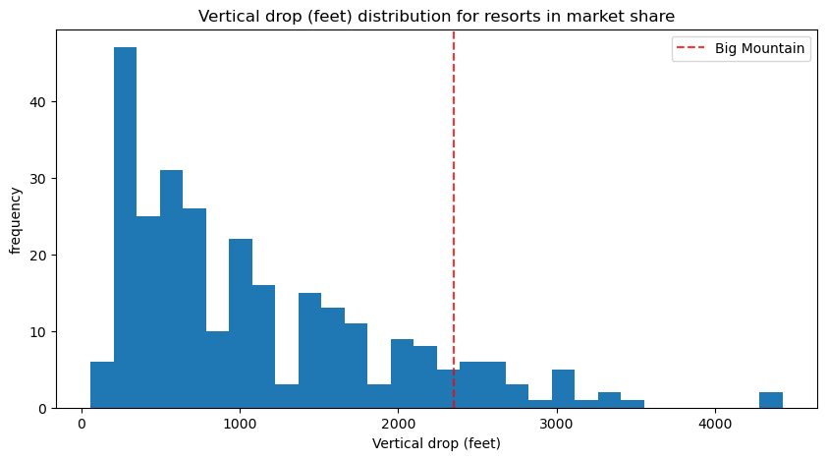
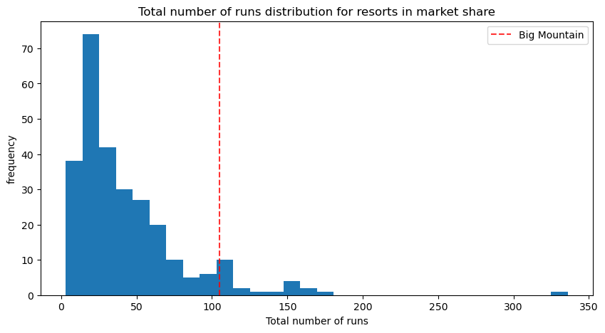
Modeling results and analysis
Big Mountain VS others

Slide 5
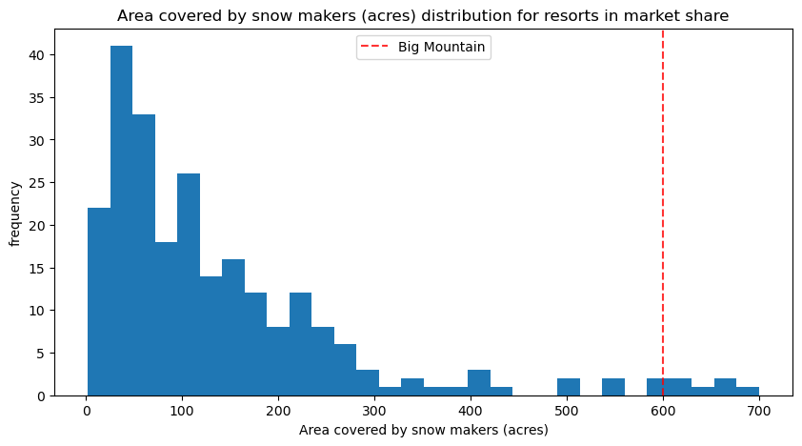
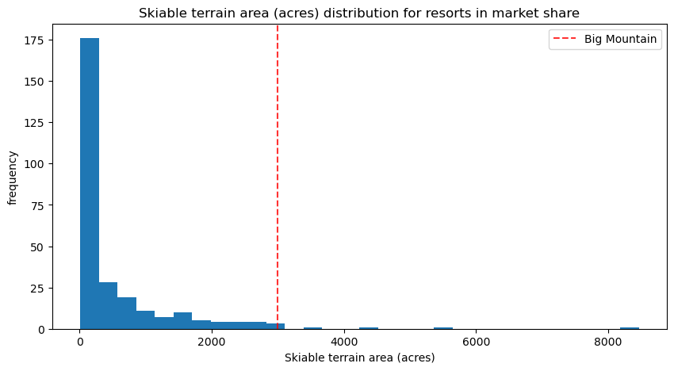
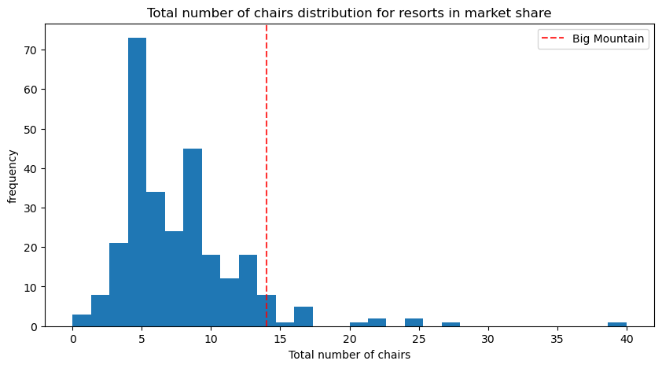
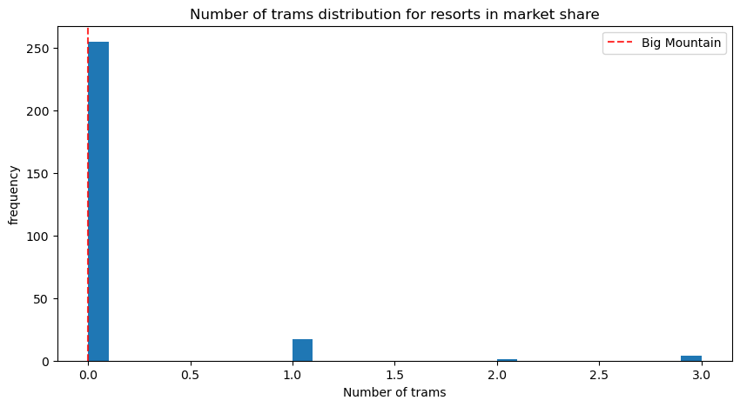
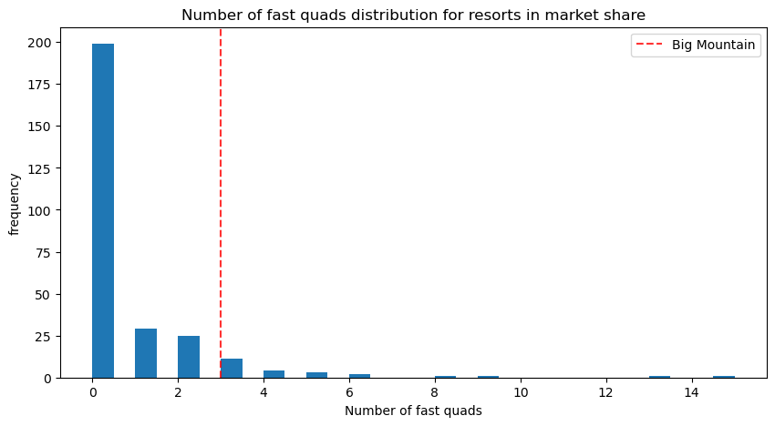
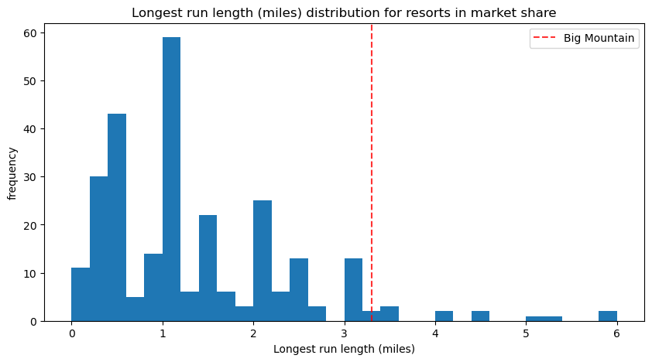

Slide 6
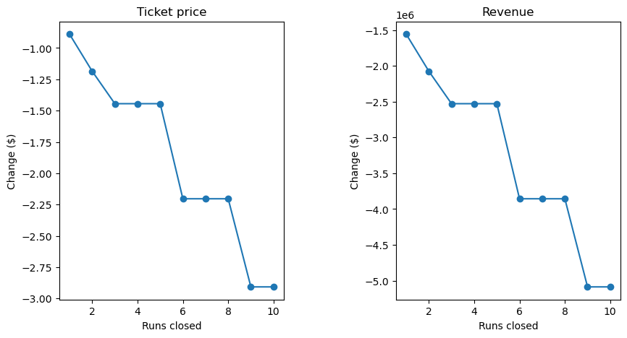
Cost cutting scenarios:
Scenario 1: Closing Runs
Closing just one run won’t significantly impact revenue.
Closing more runs could even reduce ticket price revenue

Slide 7
Scenario 2: Vertical Drop and adding a chair lift
Adding a new ski run to increase the vertical drop by 150 feet.
Adding an additional chair lift.
Could raise ticket prices by $2.22.
Seasonal revenue projection $3,888,889.
Extra operational costs should be assessed carefully.
Scenario 3: Snow Making and Vertical Drop
Adding 2 acres of snow making increases operational cost
Doesn't justify the ticket price increase
Scenario 4: Longest Run Expansion:
Increasing the longest run by 0.2 miles and 4 acres of snow making: no effect on ticket price

Slide 8
Conclusion
Current ticket prices are underpriced.
There is potential for an increase model suggests $97.96.
Installing a new chair lift is a smart move among all scenarios.
Testing and implementation of the model must be done carefully.
Integration to BI analytics for independent scenario testing is recommendation.

