Slide 1
AI × KNOWLEDGE GRAPHS
Graph Mind
An MCP server on Neo4j that lets any AI tool query your knowledge graph — in plain English.
Natural language in. Graph intelligence out.
FastPath — no LLM
Read-only by design
Runs in VS Code
Hackathon Submission
Notes:
Open: 'Your most valuable enterprise data isn't rows - it's relationships. Graph Mind lets any AI tool ask those relationships questions in plain English, fast and safely.' Point at the three pills: no-LLM FastPath, read-only, and it already runs in VS Code.

Slide 2



The problem
Your richest data is relational — but it's trapped.
Locked in the graph
Cypher is a wall
AI can't plug in safely
Org structure, skills, reporting lines, and collaboration live in graph databases only specialists can reach.
Answering 'who is my manager's manager's manager?' means hand-writing graph queries. Business users can't.
Every AI tool needs bespoke, brittle glue — and giving an LLM raw DB access risks your data.
GRAPH MIND
2
Notes:
Three pains: the value is in relationships, but they're unreachable, query-only-by-experts, and risky to hand to an AI. Tee up: 'what if any AI could just ask - safely?'

Slide 3



The solution
Graph Mind is an MCP server on Neo4j that turns natural language into safe graph answers.
Ask in plain English
Plugs into your tools
Safe & transparent
No Cypher. FastPath turns common questions straight into graph queries — no LLM needed.
Live in VS Code and any MCP AI tool, plus our own graph UI — all over HTTP.
Read-only by design; every answer shows the exact Cypher it ran.
GRAPH MIND
3
Notes:
The one-liner to remember: MCP server on Neo4j, natural language in, safe graph intelligence out. Three differentiators: no-Cypher via FastPath, plugs into VS Code + any AI, read-only and transparent.

Slide 4
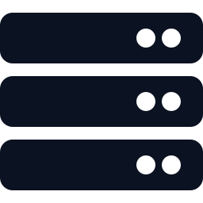

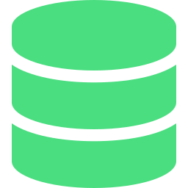

How it works
Everything talks HTTP. Graph Mind does the translation — and the guarding — in the middle.
CONSUMERS
VS Code
via MCP
Graph Mind
AI Tools
MCP Server
Simple → FastPath (regex)
Cypher
Claude, agents
Neo4j
Complex → LLM API
Graph Mind UI
Knowledge graph
our web client
Multi-layer guard · read-only
MCP / HTTP
Results return to the UI as an interactive graph + the exact Cypher.
GRAPH MIND
4
Notes:
Left to right. Three consumers - VS Code, AI agents, our UI - all hit the same server over MCP/HTTP. Inside: FastPath handles common questions with no LLM; the LLM path covers complex phrasing; the read-only guard means only GET queries ever reach Neo4j. Results come back as a visual graph plus the Cypher.

Slide 5



FastPath: skip the LLM for simple queries
Simple questions become Cypher by regex — no model call. Complex ones use the LLM API.
Simple → FastPath
regex, no LLM
Plain-English
question
Cypher
query
Neo4j
answer
Complex → LLM API
unusual phrasing
No LLM, no cost
Deterministic
Read-only & safe
Simple queries never call an LLM — zero token cost.
Same question → same Cypher. Predictable, easy to test.
Patterns are bounded — no surprise or destructive queries.
GRAPH MIND
5
Notes:
The fast-path / slow-path story: simple, common questions take the FastPath - regex straight to Cypher, no model, no tokens, no latency, no hallucination. Only complex or unusual phrasing falls through to the LLM API. So most traffic is free and deterministic, and the LLM is a fallback, not the default.

Slide 6




Multi-layer security
Defense in depth — an AI that can read your graph and physically can't harm it.
LAYER 01
LAYER 02
Keyword & injection scan
Read-only enforcement
Incoming questions are scanned for dangerous keywords and prompt-injection patterns before anything runs.
Only MATCH / RETURN traversals execute. CREATE, MERGE, SET, DELETE and DROP are blocked at the server.
LAYER 03
LAYER 04
Abuse throttling
Transparent & auditable
Failed and blocked attempts are capped with retry limits and rate limiting — the guard can't be brute-forced.
Every answer ships with the exact Cypher it ran — so nothing is ever a black box.
GRAPH MIND
6
Notes:
The trust slide for enterprise judges. Four independent layers, not one switch: we scan inputs for bad keywords/injection, enforce read-only at the server, throttle failed/blocked retries so the guard can't be brute-forced, and surface the exact Cypher for audit. Key line: even a jailbroken or injected model can only read.

Slide 7

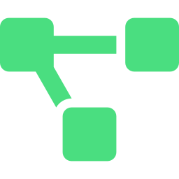

What we built
A working end-to-end demo — in VS Code and in our own visual graph UI.
ASK ANYTHING
“Who is my manager’s manager’s manager?”
Two surfaces, one server
VS Code — ask graph questions in your editor
“Who shares a skill AND a project with Arjun?”
Web UI — results render as an interactive graph
“Shortest path from me to the Payments lead?”
Cypher shown with every answer
FastPath + read-only under the hood
“Who can cover the Risk Architect role?”
Live on a real employee graph in Neo4j
GRAPH MIND
7
Notes:
Demo cue. Run the multi-hop one live - 'my manager's manager's manager' - it lands instantly because FastPath handles it. Show it once in VS Code, once in the web UI where the result draws as a graph with the Cypher beside it. Emphasize: not slideware, it runs, and it's read-only.

Slide 8


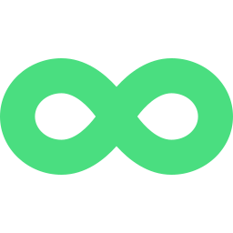
Why MCP changes the game
Build the bridge once — every AI tool can cross it.
One standard, not N×M glue
Composable with agents
Future-proof
MCP is the protocol AI tools already speak. We implemented it once — VS Code worked for free.
Graph Mind is a tool any agent can call mid-reasoning, blending graph facts with everything else.
As new AI clients adopt MCP, they get instant, safe access to your graph — no extra work for us.
GRAPH MIND
8
Notes:
The leverage point: MCP turns this from 'a chatbot for our graph' into reusable infrastructure. Concrete proof - we built the server, and VS Code integration came essentially for free because it speaks MCP.

Slide 9




Plug-in spotlight: Audience Builder
A notification composer builds send-lists straight from the graph — over UI or MCP.
ALSO UNLOCKS
Reach & de-dupe
For the iNOTIFY composer
Who a broadcast hits, duplicates collapsed across channels.
Plug in via UI or MCP
Stop hand-curating recipient lists. The composer just asks — “everyone in APAC Payments reachable on Teams” — and Graph Mind returns the matching audience.
Escalation paths
Walk the chain of command to find who to notify next.
TARGET BY ATTRIBUTE
Always live
Region
Department
Role
Channel
Audiences refresh as the graph changes — never stale.
Composer → Graph Mind (UI / MCP) → live audience set
GRAPH MIND
9
Notes:
This is the concrete, near-term hook — and it maps to a real product surface. The notification composer calls Graph Mind (via UI or MCP) to assemble an audience by region, department, role, channel, etc., instead of maintaining static distribution lists. Because it's a graph, audiences stay live and you can de-dupe across channels and resolve escalation paths for free.

Slide 10




Beyond employees
The same server works for any connected data. Employees were just the start.
Org intelligence
Skills discovery
Succession & impact
Reporting lines, span of control, team topology.
Find who knows what, across the whole company.
Who can cover a role; what breaks if someone leaves.
Collaboration graph
Risk & fraud
Any knowledge graph
Who works with whom; hidden connectors.
Suspicious paths in transactions or access.
Supply chains, infra, customers — plug it in.
GRAPH MIND
10
Notes:
Zoom out: nothing in the architecture is employee-specific. FastPath patterns and the read-only guard apply to any graph. Point at risk/fraud and supply chain to signal enterprise scale.

Slide 11
The stack
Lean, standard pieces — wired together over HTTP.
Neo4j
FastPath
MCP Server
Web UI
Graph database storing connected data and running Cypher.
Regex engine: NL → Cypher with no LLM call. LLM as fallback.
Multi-layer guard, over HTTP. Works in VS Code & any AI tool.
Runs queries; renders results as a graph beside the Cypher.
GRAPH MIND
11
Notes:
Keep short - judges scan it. Message: proven parts, one open protocol, and a clever no-LLM shortcut. Buildable and maintainable, not a fragile hack.

Slide 12
THE VISION
Turn any knowledge graph into
something
an AI can reason over — safely, just by asking.
WHAT'S NEXT
Broaden FastPath pattern coverage
Per-user auth & access control on the MCP layer
Approved write actions — beyond read-only
Graph Mind — natural language in, graph intelligence out.
Notes:
Close on the vision line - note the word 'safely', tying back to read-only. Then one breath on what's next. End with the tagline and point to the live demo for questions.

