Slide 1
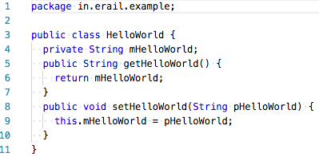

1
2
3

Slide 2
Firewall
API Framework
API Server
Vertx Eventbus
Internet
Nginx
Keycloak
Server
Service
Firewall
AWS Lambda
Lambda Proxy Integration
Internet
Amazon API Gateway
Amazon Cognito
Service

