Slide 1
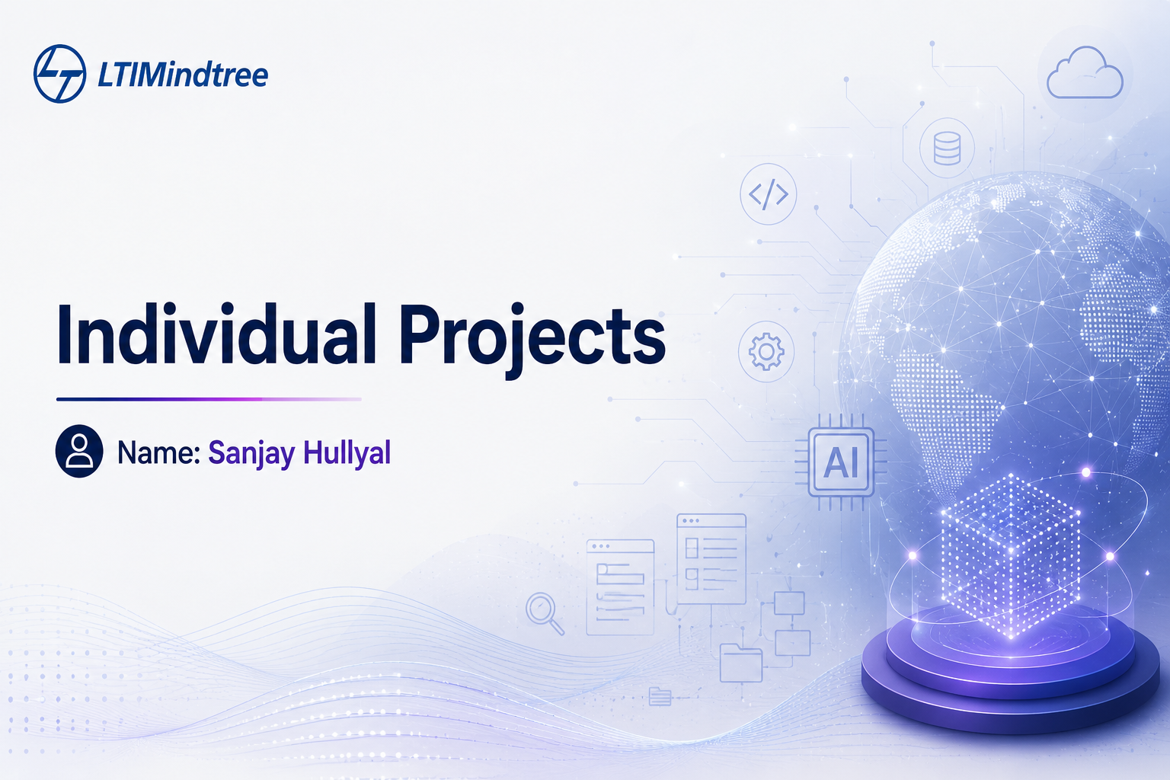

Slide 2
AutoDiag-RAG - Hybrid Retrieval for Automotive Fault Diagnosis & Warranty Validation
Problem, objectives & end-to-end system goals
!
Problem Statement
✓
Objectives
Technicians and warranty desks must manually cross-reference informal customer symptom reports against thousands of dense Technical Service Bulletins (TSBs) and separately worded warranty documents to answer two questions:
01
Build a modular hybrid retrieval pipeline (BM25 + dense) that routes symptom queries to the correct knowledge base — technical or warranty.
02
Ground every diagnostic and coverage answer in cited source documents, eliminating fabricated part numbers or coverage claims.
“What is actually wrong?”
03
Implement confidence-gated generation — defer to human technician review when retrieved evidence is thin or conflicting.
“Is it covered under warranty?”
This manual process is slow, inconsistent, and error-prone — and an incorrect coverage decision carries real financial consequences.
04
Accept both typed text and voice input (speech-to-text) for realistic customer interaction.
05
Deploy a fully evaluated, cloud-hosted end-to-end application — not a notebook-only prototype.
01 / 02

Slide 3
Scaling diagnostic accuracy with
hybrid BM25 and dense retrieval
Replacing manual Technical Service Bulletin (TSB) lookups with an end-to-end RAG architecture for warranty validation.
D
Dataset
T
Technical Stack
E
Expected Outcomes
Technical Corpus
NHTSA Technical Service Bulletins (real, public API) — published symptom → cause → fix records. Feeds the diagnostic index.
Retrieval: LlamaIndex — hybrid BM25 + dense, router query engine
A live, cloud-deployed application accepting text and voice symptom queries
Re-ranking: Cross-encoder re-ranker
Query Simulation Set
Cited diagnostic + warranty coverage responses grounded in real bulletins and terms
NHTSA Complaints API — real, informal customer symptom descriptions. Used to test realistic input phrasing.
Voice Input: faster-whisper (speech-to-text)
Evaluation: RAGAS (faithfulness, retrieval metrics)
Warranty Corpus
Measured retrieval quality (Recall@5, MRR) and generation faithfulness (RAGAS) against the gold evaluation set
Public manufacturer warranty booklets (Toyota, Honda, Hyundai, etc.) — real coverage terms and exclusions.
Vector DB: Qdrant Cloud
LLM: Local LLM (generation + reasoning)
Gold Evaluation Set
Backend / Frontend: FastAPI + Streamlit
Demonstrated confidence-gating — the system defers uncertain cases to human review instead of guessing
40–50 complaint → correct-TSB → coverage pairs, manually built and verified by the team — no pre-existing correspondence dataset exists.
Deployment: Render + Streamlit Community Cloud
02 / 02

Slide 4
Agentic IT Operations & Autonomous Troubleshooting System
Understanding the user's real IT environment before recommending software, dependency and configuration changes.
!
Problem Statement
✓
Objectives
D
Dataset / Data Generation
Users frequently make IT changes such as software upgrades, package installations, configuration changes, or system migrations without knowing their downstream impact.
01
Build a Personal IT Environment Model — automatically discover OS, installed software, versions, projects, dependencies, services, and configurations.
Environment data: collected from the user's authorized machine using system/API tools — installed software, versions, processes, projects, package manifests, Docker configurations, etc.
02
Perform Change Impact Analysis — identify applications, dependencies, and services that may be affected by a proposed change.
Dependency data: extracted from files such as requirements.txt, package.json, pom.xml, build.gradle, Dockerfiles and similar manifests.
Existing AI assistants mainly provide generic recommendations and do not have a structured understanding of the user's actual software, project, and dependency environment.
03
Provide Risk-Aware Recommendations — classify changes as Low/Medium/High risk and explain the reasons.
Knowledge data: official technical documentation and release/compatibility information.
A change that appears harmless can break applications, dependencies, development environments, or cloud resources.
04
Perform What-if Analysis — simulate proposed changes without modifying the actual environment.
Evaluation data: a synthetically generated benchmark of controlled IT change scenarios with known expected impacts, e.g., Python/Java upgrades, package removal, dependency upgrades and configuration changes.
05
Provide Evidence-Based Decisions — combine environment data, dependency relationships, technical documentation, and previous change history to generate recommendations.
Relevance: directly supports environment discovery, dependency mapping, impact prediction and risk assessment.
03 / 04

Slide 5
Technical Stack & Expected Outcomes
An agentic architecture combining environment discovery, dependency analysis, RAG and risk-aware decision support.
T
Technical Stack
E
Expected Outcomes
Agents
Backend & Data
Automated IT environment inventory and dependency graph.
LangGraph — agent workflow, state management and decision flow
FastAPI — backend/API layer
PostgreSQL — environment, dependency and change-history storage
Identification of direct and indirect impacts of proposed IT changes.
LLM — reasoning, tool selection and recommendation generation
pgvector — semantic retrieval and agent memory
Risk classification with explainable recommendations and supporting evidence.
RAG + Embeddings — technical documentation and compatibility knowledge
Frontend
What-if analysis that predicts potential failures before the actual change is performed.
Environment Integration
Streamlit— interactive dashboard for proposed changes, impact analysis and risk visualization
PowerShell / Python system APIs — Windows environment discovery
Reduction in trial-and-error during software upgrades and environment changes.
Git / GitHub — project and dependency information
Evaluation using impact prediction accuracy, risk-classification accuracy, dependency identification accuracy and unsafe recommendation rate.
Docker — container/environment analysis
Goal: safer, evidence-based changes before execution.
04 / 04

