Slide 1


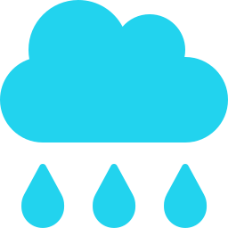

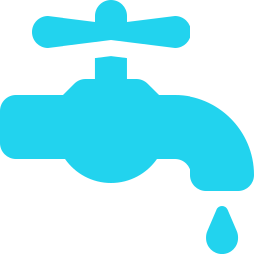


TCS AI HACKATHON 2026 · CHALLENGE 12
AI intelligence layer
What if a City Could Predict Its Water Crisis Before It Happens?
Rainfall & forecast
WARD 42
CRITICAL
AquaMind AI – From Water Data to Intelligent Action
Reservoir
42
“Which ward needs attention right now, and what should we do next?”
TODAY: SIX DISCONNECTED SIGNALS
Water consumption
Rainfall
Reservoirs
Supply networks
Leakage incidents
Citizen complaints
AquaMind AI
An AI-powered City Water Intelligence & Decision Support Platform
Reason → Predict → Prioritize → Recommend → Communicate → Verify → Adapt
Notes:
Open with the question. Water corporations already have data from six sources, but nothing connects them into a decision. AquaMind AI is the decision-intelligence layer: it reasons, predicts, prioritizes, recommends, communicates, verifies and adapts.

Slide 2





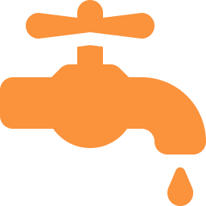




See the Entire City's Water Health. In One Intelligent View
CITY WATER HEALTH
1,240 MLD
1,085 MLD
1,112 MLD
7
18 mm
92%
Total water available
City consumption today
Tomorrow's predicted demand
Active critical alerts
Rainfall forecast, 48 h
Potable-water supply available
SMART WARD MAP
WARD 42 · CRITICAL
AI identifies:
W20
W21
W22
W23
W24
W25
High demand
Low supply availability
W30
W31
W32
W33
W34
W35
Abnormal consumption
Multiple citizen complaints
W40
W41
W42
W43
W44
W45
DRILL-DOWN
W50
W51
W52
W53
W54
W55
CITY
ZONE
WARD
CRITICAL POINT
Normal
Watch
High Risk
Critical
From a city-wide overview to the exact location requiring action.
Illustrative demo data
Notes:
This is the Commissioner's view. Six city health indicators on top, a ward map in four risk levels, and an explainable reason for the worst ward. Drill from city to zone to ward to the exact pipeline or infrastructure point. Figures shown are illustrative demo data.

Slide 3







AquaMind Doesn't Just Monitor. It Thinks Ahead
DATA
INTELLIGENCE · REASON → PREDICT → PRIORITIZE
ACTION
Rainfall
AI RECOMMENDATION
1
DEMAND FORECASTING
Reservoir levels
Ward 42
Tomorrow · 7-day · Ward-level demand
Predicted demand will exceed planned supply.
Water consumption
Supply and flow data
2
CRITICAL POINT DETECTION
Recommended action: review supply allocation and dispatch an engineering inspection team.
Fixed sensors
Abnormal consumption · Infrastructure problems · High-risk wards · Shortage risk
Citizen complaints
EXPLAINABLE AI
3
PREDICTIVE MAINTENANCE
What happened?
Historical patterns
Pipeline risk · Water-loss investigation · Inspection priority
Why did it happen?
Weather forecasts
What is the evidence?
Notes:
Eight data streams feed three AI capabilities: demand forecasting, critical point detection, predictive maintenance. The output is a recommendation with its reasoning attached: what happened, why, and the evidence. Data becomes intelligence becomes action.

Slide 4






Detect. Communicate. Act. Verify
1
MONITOR
2
DETECT
3
PRIORITIZE
4
COMMUNICATE
Fixed sensors and city data watch the system continuously.
AI flags anomalies and critical wards.
Severity · population impact · loss risk · asset importance · complaints
Smart alerts to Officer · Engineering Team · City Administrator / IAS
AI LEARNS
7
MEASURE & ADAPT
6
INTERVENE
5
VERIFY
from verified outcomes, then feeds back into monitoring.
Compare sensor patterns before vs after the intervention.
Human teams approve and perform the action.
AquaBot inspects high-risk sections. Anomalies are verified, not assumed.
BEFORE
AFTER
AI RECOMMENDS.
HUMANS DECIDE.
OUTCOMES IMPROVE THE SYSTEM.
High pressure / flow anomaly
High estimated water loss
Normal sensor pattern
Reduced estimated water loss
Notes:
The response loop: monitor, detect, prioritize, communicate, verify, intervene, measure and adapt. Pressure or flow anomalies are not treated as proof of a leak. They trigger verification, where a targeted AquaBot inspection can confirm. Humans approve every consequential action, and verified outcomes teach the system.

Slide 5


From Reactive Water Management to Predictive Water Resilience
TODAY
WITH AQUAMIND AI
AquaResilience Score™
Fragmented data
City-wide water intelligence
AI-powered prioritization
28
Ward 42
Reactive maintenance
Ward-level consumption insights
Faster communication and response
Critical: attend first
Delayed response
Early critical-point detection
Predictive maintenance
Problems found after escalation
Demand and shortage forecasting
Human-controlled decisions
Water availability
Demand stability
Limited city-wide visibility
Rainfall-aware planning
Intervention verification
Infrastructure risk
Rainfall conditions
Complaint severity
Population impact
AquaMind AI helps cities move from asking:
to knowing:
What went wrong?
What may happen next — and what should we do now?
SANJAY HARI RABINESH RUDHRAN SURUTHI NANDHANA
Notes:
Close on the shift: from reactive to predictive. The AquaResilience Score gives every ward a single number built from availability, demand stability, infrastructure risk, rainfall, complaints and population impact, so the Commissioner knows which ward needs attention first. Score shown is illustrative.

