Slide 1
Numerical Methods
ESC101: Fundamentals of Computing
Purushottam Kar

Slide 2
Agenda
Finding the square root of a number
Finding the root (zero) of an arbitrary function
Learn a generalization of the binary search method

Slide 3
Finding Square Roots
The Babylonian Method

Slide 4
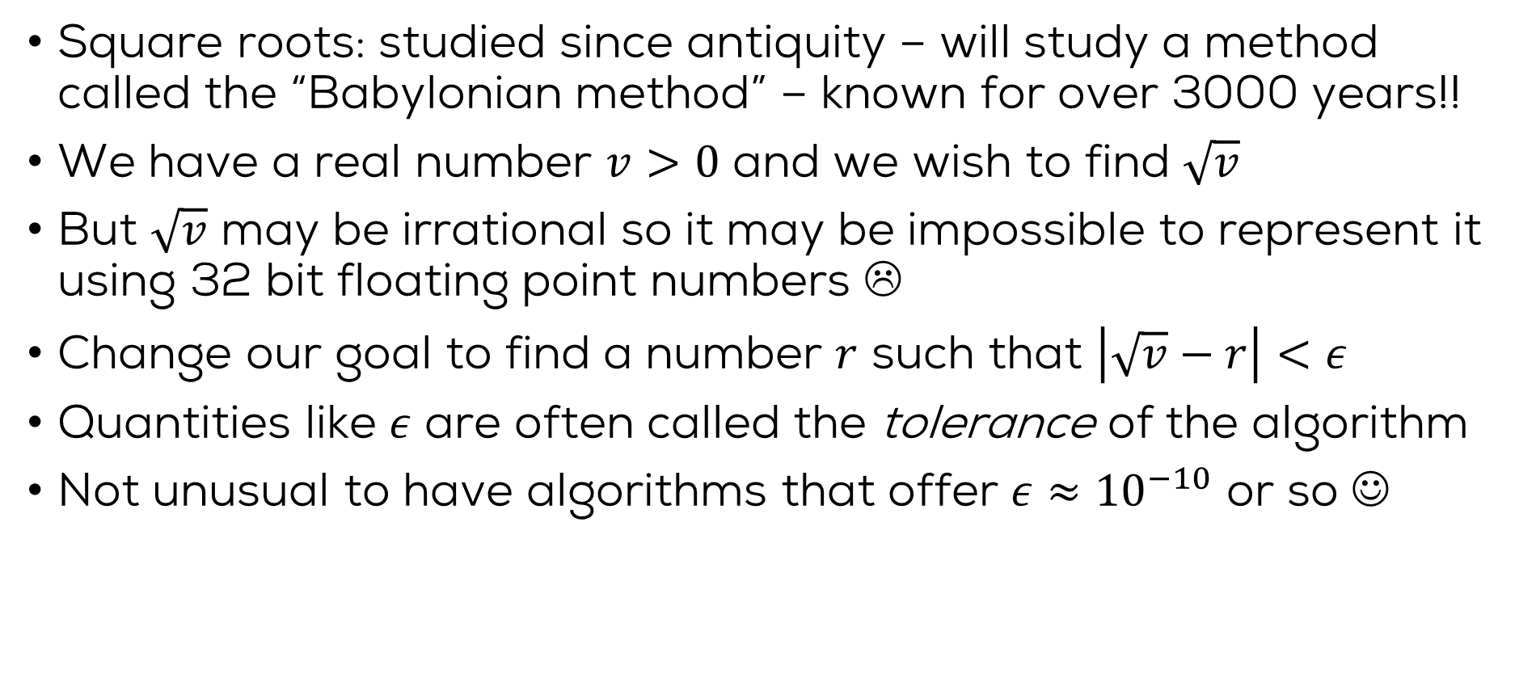
The trick of the Babylonians
Square roots: studied since antiquity – will study a method called the “Babylonian method” – known for over 3000 years!!
We have a real number $v>0$ and we wish to find $\sqrt{v}$
But $\sqrt{v}$ may be irrational so it may be impossible to represent it using 32 bit floating point numbers ☹
Change our goal to find a number $r$ such that $\left|\sqrt{v}−r\right|<ε$
Quantities like $ε$ are often called the tolerance of the algorithm
Not unusual to have algorithms that offer $ε≈{10}^{−10}$ or so ☺

Slide 5
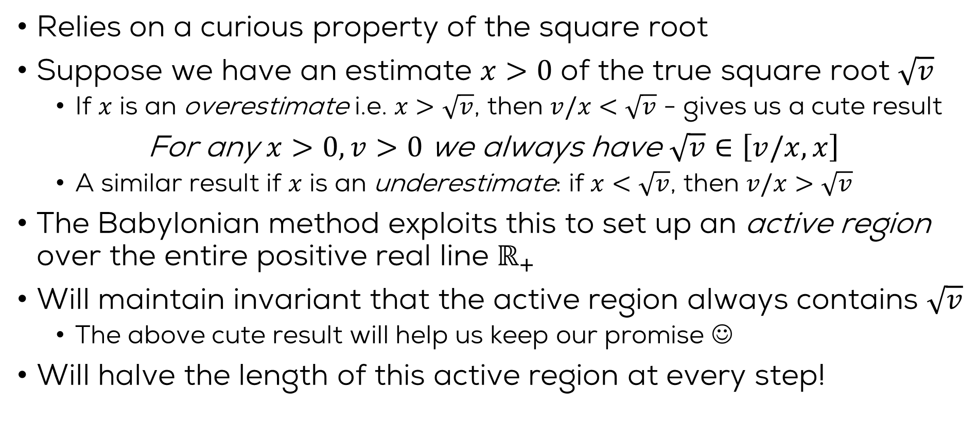
The trick of the Babylonians
Relies on a curious property of the square root
Suppose we have an estimate $x>0$ of the true square root $\sqrt{v}$
If $x$ is an overestimate i.e. $x>\sqrt{v}$, then $v/x<\sqrt{v}$ - gives us a cute result
For any $x>0,v>0$ we always have $\sqrt{v}∈\left[v/x,x\right]$
A similar result if $x$ is an underestimate: if $x<\sqrt{v}$, then $v/x>\sqrt{v}$
The Babylonian method exploits this to set up an active region over the entire positive real line $ℝ_{+}$
Will maintain invariant that the active region always contains $\sqrt{v}$
The above cute result will help us keep our promise ☺
Will halve the length of this active region at every step!

Slide 6


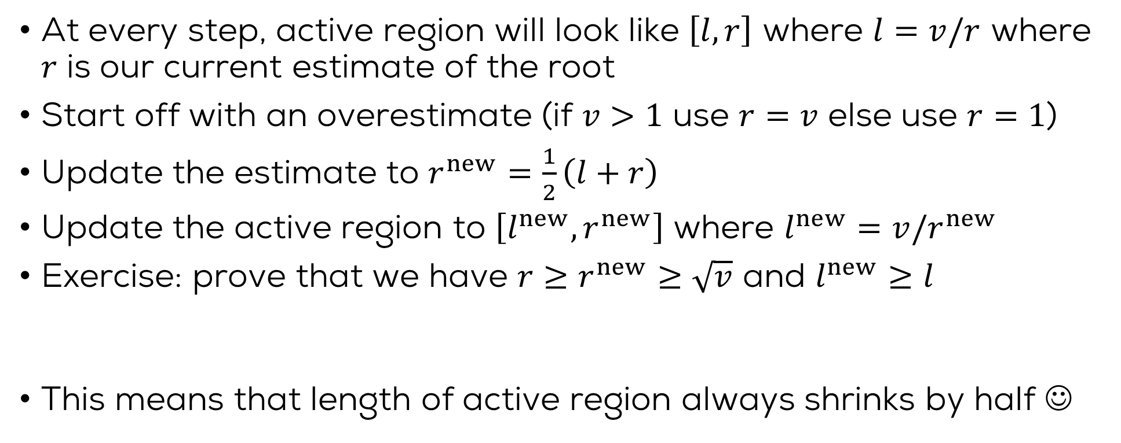



The Babylonian Method
$$v=16$$
1.88
3.08
5.19
8.5
3.86
4.13
3.997
4.002
1 2 3 4 5 6 7 8 9 10 11 12 13 14 15 16 17 18
At every step, active region will look like $\left[l,r\right]$ where $l=v/r$ where $r$ is our current estimate of the root
Start off with an overestimate (if $v>1$ use $r=v$ else use $r=1$)
Update the estimate to $r^{new}=\frac{1}{2}\left(l+r\right)$
Update the active region to $\left[l^{new},r^{new}\right]$ where $l^{new}=v/r^{new}$
Exercise: prove that we have $r≥r^{new}≥\sqrt{v}$ and $l^{new}≥l$
This means that length of active region always shrinks by half ☺
$$l$$
$$l^{new}$$
$$r^{new}$$
$$r$$

Slide 7
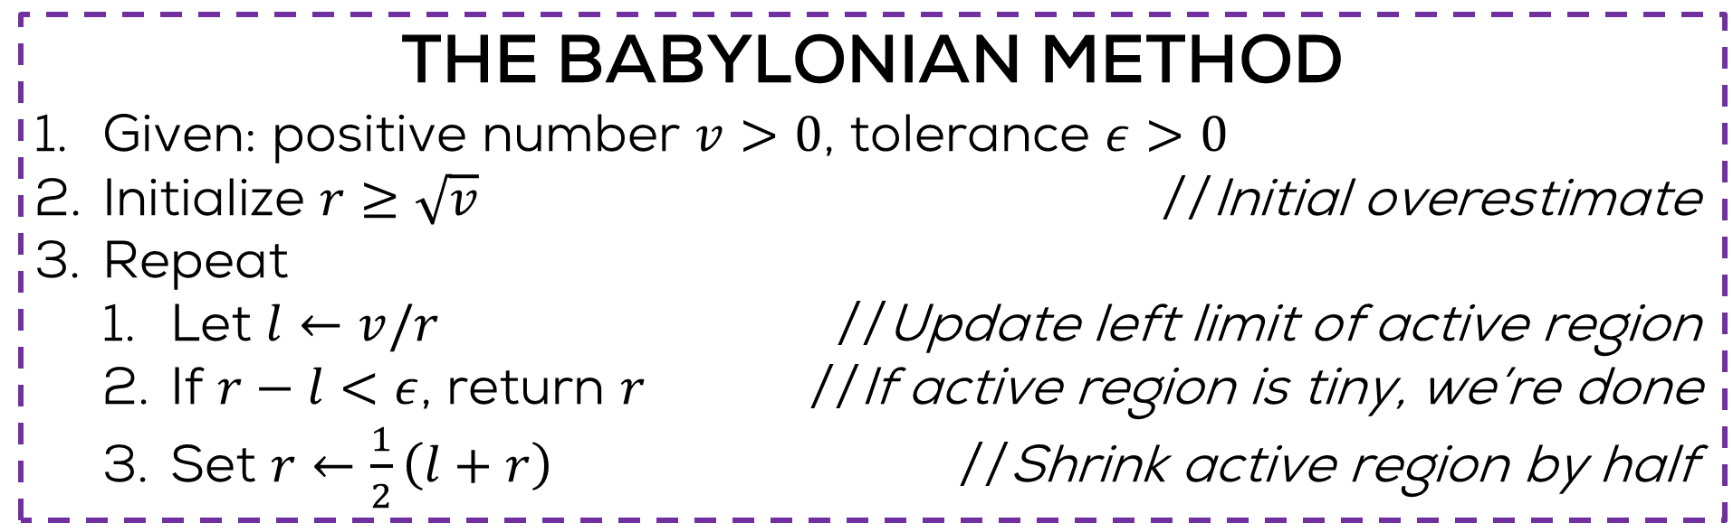
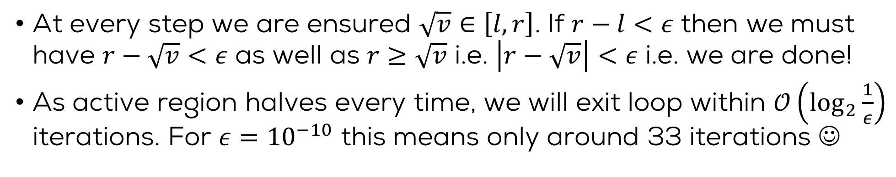

The Babylonian Method
THE BABYLONIAN METHOD
Given: positive number $v>0$, tolerance $ε>0$
Initialize $r≥\sqrt{v}$ //Initial overestimate
Repeat
Let $l←v/r$ //Update left limit of active region
If $r−l<ε$, return $r$ //If active region is tiny, we’re done
Set $r←\frac{1}{2}\left(l+r\right)$ //Shrink active region by half
Several algorithms exist for finding square roots. If you are interested, check out www.youtube.com/watch?v=Bwt5EZEb1Ns
Actually, a more careful analysis can show that the method takes only $𝒪\left(\log{\log{\frac{1}{ε}}}\right)$ iterations – wow!
At every step we are ensured $\sqrt{v}∈\left[l,r\right]$. If $r−l<ε$ then we must have $r−\sqrt{v}<ε$ as well as $r≥\sqrt{v}$ i.e. $\left|r−\sqrt{v}\right|<ε$ i.e. we are done!
As active region halves every time, we will exit loop within $𝒪\left(\log_{2}{\frac{1}{ε}}\right)$ iterations. For $ε={10}^{−10}$ this means only around 33 iterations ☺

Slide 8
Finding Roots of Functions
The Bisection Method

Slide 9
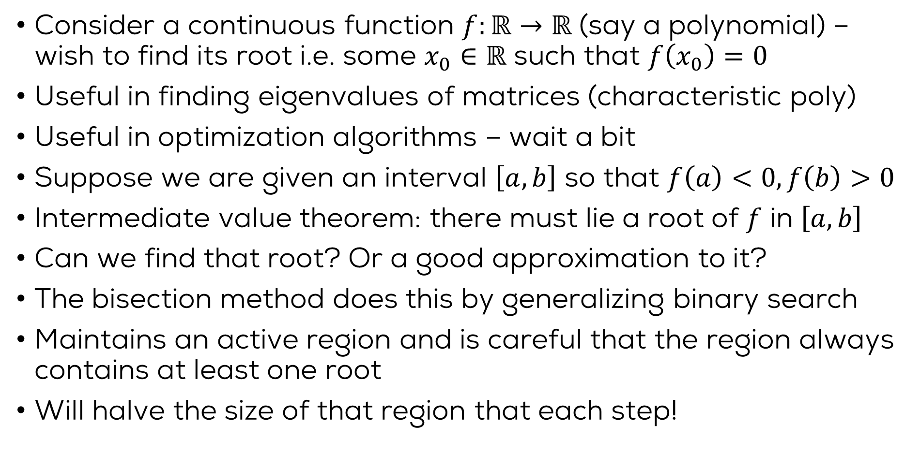
The Bisection Method
Consider a continuous function $f:ℝ→ℝ$ (say a polynomial) – wish to find its root i.e. some $x_{0}∈ℝ$ such that $f\left(x_{0}\right)=0$
Useful in finding eigenvalues of matrices (characteristic poly)
Useful in optimization algorithms – wait a bit
Suppose we are given an interval $\left[a,b\right]$ so that $f\left(a\right)<0,f\left(b\right)>0$
Intermediate value theorem: there must lie a root of $f$ in $\left[a,b\right]$
Can we find that root? Or a good approximation to it?
The bisection method does this by generalizing binary search
Maintains an active region and is careful that the region always contains at least one root
Will halve the size of that region that each step!
Okay so suppose we want to find any one of those many roots ☺
Wait – this only tells us that there exist an odd number of roots in this interval – there may be more than one root

Slide 10

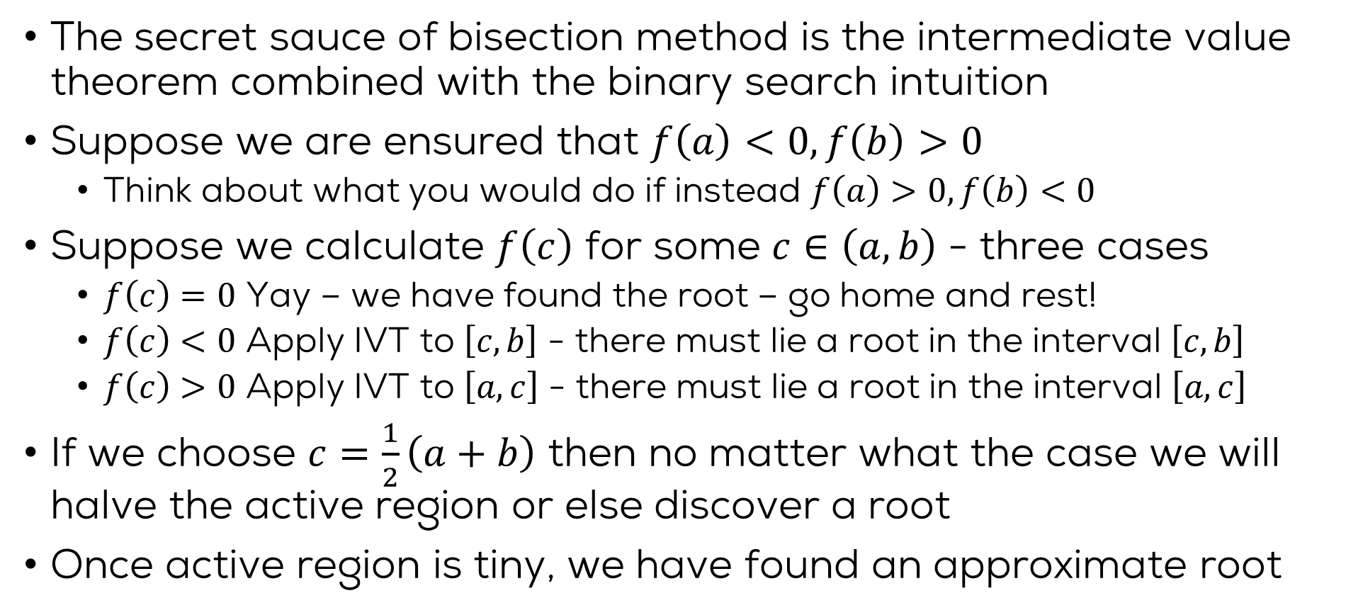
The Bisection Method
The secret sauce of bisection method is the intermediate value theorem combined with the binary search intuition
Suppose we are ensured that $f\left(a\right)<0,f\left(b\right)>0$
Think about what you would do if instead $f\left(a\right)>0,f\left(b\right)<0$
Suppose we calculate $f\left(c\right)$ for some $c∈\left(a,b\right)$ - three cases
$f\left(c\right)=0$ Yay – we have found the root – go home and rest!
$f\left(c\right)<0$ Apply IVT to $\left[c,b\right]$ - there must lie a root in the interval $\left[c,b\right]$
$f\left(c\right)>0$ Apply IVT to $\left[a,c\right]$ - there must lie a root in the interval $\left[a,c\right]$
If we choose $c=\frac{1}{2}\left(a+b\right)$ then no matter what the case we will halve the active region or else discover a root
Once active region is tiny, we have found an approximate root
Actually all this tells us that $\left[c,b\right]$ contains an odd number of roots and $\left[a,c\right]$ contains an even (possibly 0) number of roots

Slide 11

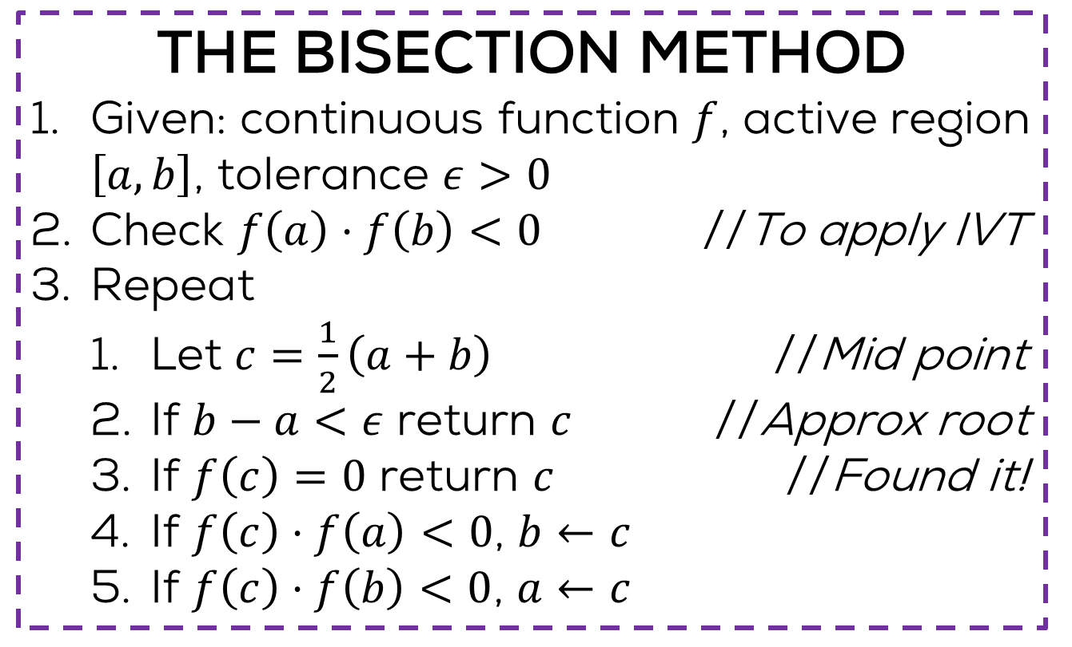

The Bisection Method
THE BISECTION METHOD
Given: continuous function $f$, active region $\left[a,b\right]$, tolerance $ε>0$
Check $f\left(a\right)⋅f\left(b\right)<0$ //To apply IVT
Repeat
Let $c=\frac{1}{2}\left(a+b\right)$ //Mid point
If $b−a<ε$ return $c$ //Approx root
If $f\left(c\right)=0$ return $c$ //Found it!
If $f\left(c\right)⋅f\left(a\right)<0$, $b←c$
If $f\left(c\right)⋅f\left(b\right)<0$, $a←c$
Some of these intuitions extend to higher dimensions. If you are interested, check out www.youtube.com/watch?v=b7FxPsqfkOY
Can you show that this method stops in $𝒪\left(\log{\frac{1}{ε}}\right)$ iterations?
Can you find the square root of numbers using this method? Hint $f\left(x\right)=x^{2}−v$

Slide 12
Finding Roots of Functions
The Newton Raphson Method

Slide 13

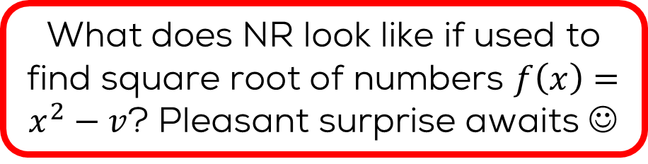


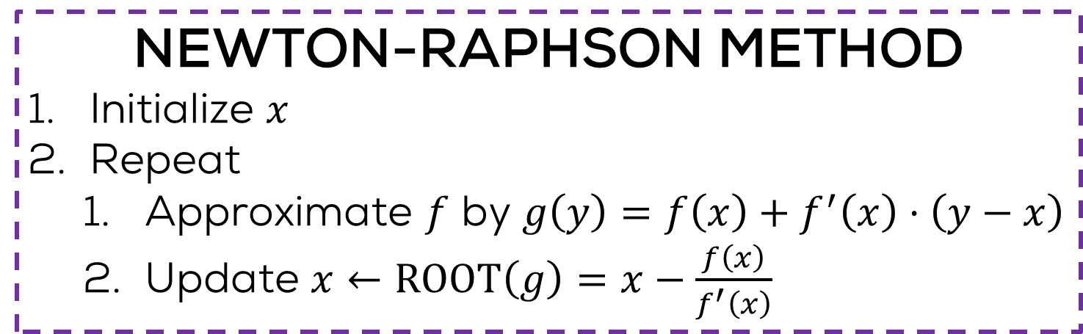
The Newton-Raphson Method
Finding roots of linear functions is easy $f\left(x\right)=ax+b$, $x_{0}=\frac{−b}{a}$
But my function is nonlinear ☹
Take a linear approximation to it
Also check out the secant method and the Regula Falsi method (do not require derivative calculation)
What does NR look like if used to find square root of numbers $f\left(x\right)=x^{2}−v$? Pleasant surprise awaits ☺
How does one do that?
Many ways e.g. Taylor’s expansion
NEWTON-RAPHSON METHOD
Initialize $x$
Repeat
Approximate $f$ by $g\left(y\right)=f\left(x\right)+f^{′}\left(x\right)⋅\left(y−x\right)$
Update $x←\text{ROOT}\left(g\right)=x−\frac{f\left(x\right)}{f^{′}\left(x\right)}$
No guarantees in general. Depends a lot on initialization
Tangent to $f$ at $x$
Where tangent intersects x axis

