Slide 1
Mr C has Character
ESC101: Fundamentals of Computing
Purushottam Kar

Slide 2
Mid-sem Theory Exam
September 22nd, 2018 (Saturday)
Time: 1PM – 3PM
Room: announced shortly
Syllabus: till whatever is covered till Sep 14th tutorial
No Make-up Exam – do not miss this exam
Open handwritten notes – no printouts, mobiles, iPads.

Slide 3
Doubt-clearing Session
Date: September 15th, 2018 (coming Saturday)
Time: 5PM – 7PM
Room: CC-02
Students not comfortable with English are welcome
Other students also welcome to clear doubts
Please revise and have list of doubts before coming
Will not cover lectures again in detail – only doubts

Slide 4
Advanced Track
29 students selected for advanced track
If you have accepted advanced track, no need to come to lab today onwards
Will receive mail this evening with mentor allocation
Please contact mentors immediately and decide on project ideas
Must have a preliminary project idea by end of this week (Friday evening September 14th, 2018)

Slide 5

Arrays
a is like a street on which here are several houses with addresses a[0], a[3] etc
Can use integer expressions as array subscripts not float/double
The English word array means “objects in a line” or “an ordered series or arrangement” – The soldiers standing in an array impressed the visiting head of the state on 26 Jan
In C, an array is a sequence of variables can have array of ints, longs, floats, doubles
5
b
int a[6],b=5;
Array subscript
Segmentation faults
I may not even give a warning when you compile
a
4
3
a[b-4] = 4;
Hmm … a[1] = 4
So a[a[1]] = a[4]
Perfect recipe for program crashes
a[0]
a[1]
a[2]
a[3]
a[4]
a[5]
a[4] = 3;
a[-1] = 6;
printf("%d", a[a[1]]);
a[6] = 4;
3

Slide 6


Arrays – take care of syntax
Cannot send a letter to a street ☺ Can send letter to a house.
int a[6];
a[0] to a[5] are just integer variables. Use them as you did any other integer variable – first variable is a[0] not a[1]
a = 564; does not make sense – a isn’t a single int variable
If you want to give values to whole array
Can do it at the time of declaring the array itself
Can do it later as well
Wow … so a[int_expr] is a perfect way to refer to elements of array a whenever int_expr is an expression that takes int values.
int a[6] = {3,7,6,2,1,0};
a[(int)1.0] is okay too since it has been typecast to int
a[1.0] is illegal. Array subscript must be integer
int a[6];
for(i=0;i<6;i++) a[i] = 10;
However, a[2*i+1] where i is integer perfectly fine

Slide 7



A Few Sample Problems
Given a 10 dimensional array in input, find the sum of first, third, fifth … i.e. odd location elements of the array and sum of even location elements in the array
Given two lists of integers on two separate lines, find the smallest integer in the first list that is not present in the second list.
In second problem, have to revisit list elements – go back and forth – arrays allow conveniently storing the full list
In first problem, need not store the entire list first
Break it up into smaller sub-problems
Sub-prob 1: Find all integers in first array that are not present in second array
Sub-prob 2: Give the above numbers, find the smallest using a running-minimum
How to solve second problem?
Then let’s code!
I already know how to solve both sub-problems!

Slide 8
Streaming and Online Problems
Many problems involving a list of integers can be solved without storing the entire list in an array first
Find sum of all odd location integers in a list
Find sum of all odd integers in a list
Find longest sequence of consecutive ones in a list
etc, etc …
Such problems often called online or streaming problems
Streaming and online algorithms are critical in machine learning, big data processing
Companies like Google cannot afford to store all data
Get data, process it, and throw it away
Entire areas devoted to this: data streaming, online machine learning

Slide 9
More on initializing arrays
Can be initialized at time of declaration itself
Can be partly initialized as well
However, after declaration done, have to be initialized one by one!
int a[6] = {3,7,6,2,1,0};
a
3
7
6
2
1
0
int a[6] = {3,7,6};
a
3
7
6
int a[6];
a = {3,7,6,2,1,0};
int a[6];
a[2] = 6;

Slide 10
More on initializing arrays
Can be initialized at time of declaration itself
Can be partly initialized as well
Over initialization may crash
Better way to initialize is the following
Warning: uninitialized arrays contain garbage, not zeros
Highly compiler dependent feature
int a[6] = {3,7,6,2,1,0};
a
3
7
6
2
1
0
int a[6] = {3,7,6};
a
3
7
6
int a[6] = {1,2,3,4,5,6,7,8,9};
I will figure out how much space needed
int a[] = {1,2,3,4,5,6,7,8,9};

Slide 11


More about arrays
Arrays can not be copied like normal variables
Will result in an error
Arrays can also not be checked for equality directly
Will not result in error but b == a will always be false
Reason will be clear in a couple of weeks
int a[3] = {1,2,3}, b[3];
b = a;
For strings (basically char arrays), nice library functions exist to do assignment, equality checks
Do it yourself, element by element, using a for loop
int a[3] = {1,2,3}, b[3] = {4,5,6};
if(b == a) printf("Equal");
So how do I copy arrays and check for equality?
What is a char?

Slide 12
Char: new datatype
Close cousin of the int and long datatypes
Internally stored as an integer between 0 and 127
#include <stdio.h>
int main(){
char a = ‘p’;
scanf(“%c”, &a);
printf(“My first char %c”, a);
return 0;
}
Char constants enclosed in ‘ ’
Integer arithmetic applies to char as well +, -, /, *, %, ()
Can use it for nice tricks but be careful
Can typecast to/from char
Can have char arrays – strings
Case sensitive ‘a’, ‘A’ different
p
a
%c

Slide 13
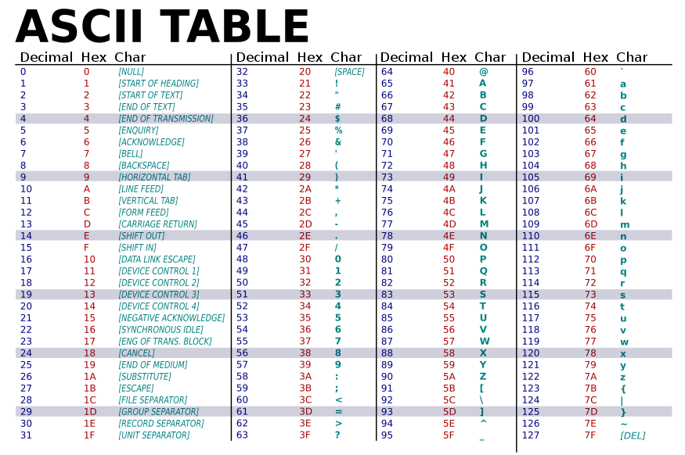
American Standard Code for Information Interchange
\t
\n

Slide 14
Take care with char
char a = p; Mr C will search for a variable named p.
To assign character constant ‘p’ to a, char a = ‘p’;
Note that ‘5’ and 5 are different according to Mr C
‘5’ is a character constant stored internally as the integer 53
5 is an integer constant stored internally as the integer 5 itself
Be very careful if mixing %c with other format specifiers like %d, %ld, %f, %lf in scanf and printf statements
getchar(), putchar() shortcuts to read/print single char
When using characters in arithmetic, relational, logical expressions, integer (ASCII) value of character gets used

