Slide 1
Take Care with Char
ESC101: Fundamentals of Computing
Purushottam Kar

Slide 2
Mid-sem Theory Exam
September 22nd, 2018 (Saturday)
Time: 1PM – 3PM
Room: announced shortly
Syllabus: till whatever is covered till Sep 14th tutorial
No Make-up Exam – do not miss this exam
Open handwritten notes – no printouts, mobiles, iPads.

Slide 3
Doubt-clearing Session
Date: September 15th, 2018 (coming Saturday)
Time: 5PM – 7PM
Room: CC-02
Students not comfortable with English are welcome
Other students also welcome to clear doubts
Please revise and have list of doubts before coming
Will not cover lectures again in detail – only doubts

Slide 4
Advanced Track
29 students selected for advanced track
Sorry for delay in sending out mentor allocation
Had a marathon 4 hours grading session last night ☺
Will definitely send out notifications this afternoon

Slide 5
Char: new datatype
Close cousin of the int and long datatypes
Internally stored as an integer between 0 and 127
#include <stdio.h>
int main(){
char a = ‘p’;
scanf(“%c”, &a);
printf(“My first char %c”, a);
return 0;
}
Char constants enclosed in ‘ ’
Integer arithmetic applies to char as well +, -, /, *, %, ()
Can use it for nice tricks but be careful
Can typecast to/from char
Can have char arrays – strings
Case sensitive ‘a’, ‘A’ different
p
a
%c

Slide 6
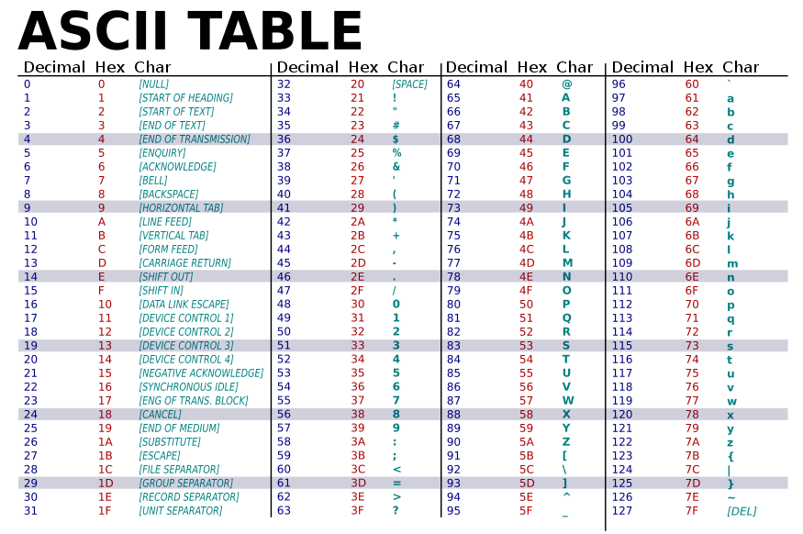
American Standard Code for Information Interchange
\t
\n
Many more characters e.g. Bengali, Kannada, Japanese, Cyrillic characters, available using UTF-8 (Unicode Transformation Format)
Cant use char datatype for these, need to use wchar_t (wide character) or else int datatype to store those

Slide 7
Take care with char
char a = p; Mr C will search for a variable named p.
To assign character constant ‘p’ to a, char a = ‘p’;
Note that ‘5’ and 5 are different according to Mr C
‘5’ is a character constant stored internally as the integer 53
5 is an integer constant stored internally as the integer 5 itself
Be very careful if mixing %c with other format specifiers like %d, %ld, %f, %lf in scanf and printf statements
getchar(), putchar() shortcuts to read/print single char
When using characters in arithmetic, relational, logical expressions, integer (ASCII) value of character gets used

Slide 8
Take care with char
Tip on using char: if output wrong with %c, try printing the same char with %d instead. Its decimal ASCII value will get printed which may help you find error
Since char is stored internally as integer
will print the ASCII value of the character stored in abc
will print character A (implicit typecasting)
Warning: Implicit typecasting may not always work
Exercise: write code to flip the case i.e. A→a, d→D etc
char abc = ‘p’;
printf("%d", abc);
printf("%c",65)

Slide 9
Character Arrays
All things we learnt about int/float arrays apply here too
However, much more exciting things can be done here
Char arrays also called strings (well … almost all of them)
English word string means a thread or a collection of items put together. The pearls were strung together.
In C, string implies a character array (well … almost)
Note: string is not a datatype in C
Word string is not a keyword in C
int string = 0;

Slide 10


Declaring and Using Strings
Can be initialized at time of declaration
Just like int arrays, char arrays cannot be initialized this way after declaration is done
Other ways: scanf (with %s), gets
Both are very unsafe – crash!
To print: puts, printf (with %s)
getline most powerful but have to wait for it a bit ☺
char str[50] = {‘H’,’e’,’l’,’l’,’o’,’ ‘,‘W’,’o’,’r’,’l’,’d’};
char str[50] = "Hello World";
The space between the two words. Space is a character too!
Hello has 5 characters, World has 5, what is the 11th character?
Partly initialized since only 11 characters this phrase
Very good!

