Slide 1
Inception with Mr C
ESC101: Fundamentals of Computing
Purushottam Kar

Slide 2
Announcements
Replacement lab October 6 (Sat) 2-5PM at NCL for sections B4, B5, B6, B13,
No replacement lecture since not a “DoAA Saturday”
Extra doubt clearing session after extra lab on Sat i.e. Oct 06 (Sat) 5-6PM CC-02.

Slide 3

BODMAS table has more members
Operator Name | Symbol/Sign | Associativity
Brackets (array subscript), Post increment/decrement | (), [] ++, -- | Left
Unary negation, Pre-increment/decrement, NOT, (de)reference, sizeof | -, ++, --, !, *, &, sizeof | Right
Multiplication/division/ remainder | *, /, % | Left
Addition/subtraction | +, - | Left
Relational | <, <=, >, >= | Left
Relational | ==, != | Left
AND | && | Left
OR | || | Left
Ternary Conditional | ? : | Right
Assignment, Compound assignment | =, +=, -=, *=, /=, %= | Right
HIGH PRECEDENCE
Be careful, * can act as multiplication operator as well as dereference operator
30
int a = 10;
int *ptr = &a;
printf("%d", 3**ptr);
LOW PRECEDENCE

Slide 4
On-demand memory allocation
Allocate as much memory you need, when you need it ☺
Avoid wastage of space – programs that take too much memory are often slow as well – details in CS330
Can adapt to changing user demands and work load
For example, Prutor has to deal with extremely variable workload
~10-15 users simultaneously logged in during 12noon on weekdays
~150 users simultaneously logged in during Tue/Wed labs
~250 users simultaneously logged in during lab exam
~450 users simultaneously logged in the night before the exam
Need to include stdlib.h for dynamic memory allocation
malloc(), calloc(), realloc(), free()

Slide 5
malloc – memory allocation
We tell malloc how many bytes are required and malloc allocates those many consecutive bytes and returns the address of (a pointer to) the first byte
Warning: allocated bytes filled with garbage
Warning: if insufficient memory, NULL pointer returned
malloc has no idea if we are allocating an array of floats or chars – returns a void* pointer – typecast it yourself
The allocated memory can be used safely as an array
int *ptr = (int*)malloc(10*sizeof(int));
*(ptr + 2) = 42; // *(ptr + 2) is the same as ptr[2]
printf("%d", ptr[2]); // prints 42

Slide 6
calloc – contiguous allocation
A helpful version of malloc that initializes memory to 0 ☺
However, slower than malloc since time spent initializing
Use this if you actually want zero initialization
Syntax a bit different – instead of total number of bytes, we need to send it two things
length of array (number of elements in the array)
number of bytes per element
Sends back a NULL pointer if insufficient memory – careful!
Need to typecast the pointer returned by calloc too!

Slide 7

Memory leaks
000000
000001
000002
000003
000004
000005
000006
000007
000008
000009
000010
000011
000012
000013
000014
000015
000016
000017
000018
000019
000020
000021
000022
000023
…
Situation where memory allocated earlier becomes unusable and blocked ☹
0 0 0 1 0 0 0 1
ptr
0 0 0 0 1 0 0 1
* * * * * * * *
ptr[0]
ptr[1]
ptr[2]
int *ptr; // may contain a junk address now
ptr = (int*)malloc(3 * sizeof(int));
…
ptr = (int*)malloc(2 * sizeof(int));
ptr[0]
ptr[1]
ptr will take 8 bytes to store – sorry for not drawing accurately
Actually even this is not accurate ☹ – details in CS220/330/335 ☺
If you keep losing memory like this, soon your program may crash!

Slide 8
free
000000
000001
000002
000003
000004
000005
000006
000007
000008
000009
000010
000011
000012
000013
000014
000015
000016
000017
000018
000019
000020
000021
000022
000023
…
Used to deallocate memory allocated using malloc/calloc/realloc
Don’t use freed memory or free memory twice or free non-malloc/calloc/realloc-ed arrays – will cause segfault or runtime error!
0 0 0 0 1 0 0 1
ptr
* * * * * * * *
str
0 0 0 0 0 1 1 0
str[0]
str[1]
str[2]
int *ptr; // may contain a junk address now
char str[3];
ptr = (int*)malloc(3 * sizeof(int));
free(ptr);
printf("%d", ptr[1]);
ptr[0]
ptr[1]
ptr[2]
I always free all memory when a program ends. You only have to worry about freeing memory during the run of your program
free(str); // runtime error

Slide 9
Library analogy for malloc/free
malloc/calloc is like borrowing a book from library
If that book unavailable, cannot use it (NULL pointer)
900+ students in Y18 but only 50 copies of Thomas' Calculus
free is like returning a book so others can use it after you
If you keep issuing books without returning, eventually library will stop issuing books to you and impose a fine
Cannot use a book after returning it (cannot use an array variable after it has been freed)
Cannot return a book you do not have (cannot free memory that has been already freed)
Of course, if you re-issue a book you can return it again

Slide 10



realloc – revised allocation
I realize that. That is why I will copy those 100 elements to the new array of 200 elements ☺
But I had so much precious data stored in those 100 elements
If you malloc-ed an array of 100 elements and suddenly find that you need an array of 200 elements ☹
Can use realloc to revise that allocation to 200 elements
Don’t use realloc to resize of non-malloc arrays
Use realloc only to resize of calloc/malloc-ed arrays
I will also free the old 100 elements – you don’t have to write free() for them
You are the best Mr C
int *ptr = (int*)malloc(100 * sizeof(int));
A bit system-dependent. If insufficient memory, Prutor programs will simply crash
If insufficient memory, I will not free old memory but just return NULL pointer
int *tmp = (int*)realloc(ptr, 200 * sizeof(int));
if(tmp != NULL) ptr = tmp;
int c[100];
int *ptr = (int*)realloc(c, 200 * sizeof(int)); // Runtime error

Slide 11
getline
Read a single line of text from input (i.e. till '\n')
Uses realloc-like methods to expand array size
Needs a malloc-ed array for this reason
If input doesn’t fit inside original array, str will contain pointer to expanded array, len will be length of new array
Pointer to a pointer simply stores the address of a pointer variable
int len = 11; // I only expect 10 characters to be entered
char *str = (char*)malloc(len * sizeof(char));
getline(&str, &len, stdin);
printf("%ld",*ptrstr) will print address of first char in str
printf("%c",**ptrstr) will print the first char in str
printf("%s",*ptrstr) will print entire string str
char **ptrstr = &str;
getline(ptrstr, &len, stdin); // Alternate way to use getline
WARNING: len may be larger than length of input + 1
Get actual length of input using strlen() from string.h

Slide 12
Array of pointers?
All elements of ptrArr array will take 8 bytes to store – sorry for not drawing accurately
000000
000001
000002
000003
000004
000005
000006
000007
000008
000009
000010
000011
000012
000013
000014
000015
000016
000017
000018
000019
000020
000021
000022
000023
…
Anything for you, Mr C!
char *ptrArr[3];
int i;
for(i = 0; i < 3; i++)
ptrArr[i] = (char*)malloc((i+1)*sizeof(char));
scanf("%s", ptrArr[2]);
printf("%s", ptrArr[2]);
for(i = 0; i < 3; i++)
free(ptrArr[i]);
Can we make animations a bit easier to remember?
ptrArr
0 0 0 0 0 1 0 1
ptrArr[0]
ptrArr[1]
ptrArr[2]
0 0 0 0 1 1 0 0
* * * * * * * *
0 0 0 0 1 1 0 1
* * * * * * * *
0 0 0 0 1 1 1 1
Exercise: Write a program to create an array of strings containing all substrings of string entered by user. The string entered by user of unknown length
* * * * * * * *
i
Alternate way to declare array of arrays
char **ptrArr = (char**)malloc(3*sizeof(char*));
Very useful in programs where we have to create an unknown number of arrays of unknown length
However, in this case we should also free pointer array by writing
free(ptrArr);

Slide 13
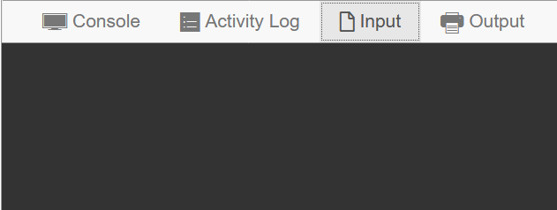
Array of Pointers ➔ Arrays of Arrays
char **ptrArr = (char**)malloc(3*sizeof(char*));
for(i = 0; i < 3; i++)
ptrArr[i] = (char*)malloc((i+1)*sizeof(char));
scanf("%c", &ptrArr[2][1]);
printf("%c", ptrArr[2][1]);
for(i = 0; i < 3; i++)
free(ptrArr[i]);
free(ptrArr);
X
ptrArr[0]
ptrArr[0][0]
ptrArr[1]
ptrArr[1][0]
ptrArr[1][1]
ptrArr
X
X
ptrArr[2]
ptrArr[2][0]
ptrArr[2][1]
ptrArr[2][2]

Slide 14
Array of Pointers/Arrays
Rest assured, the same rules apply as do with pointers
ptrArr[0], ptrArr[1], ptrArr[2] are all arrays of chars
How to access individual elements of these arrays?
Two ways to access index 2 element of str: str[2], *(str+2)
Apply exact same rule ☺: ptrArr[2][2], *(ptrArr[2]+2) both give index 2 element of the array ptrArr[2]
Note that ptrArr[1] does not have 3 elements so ptrArr[1][2] may cause segfault!
char *ptrArr[3], str[3];
for(i = 0; i < 3; i++)
ptrArr[i] = (char*)malloc((i+1)*sizeof(char));

Slide 15
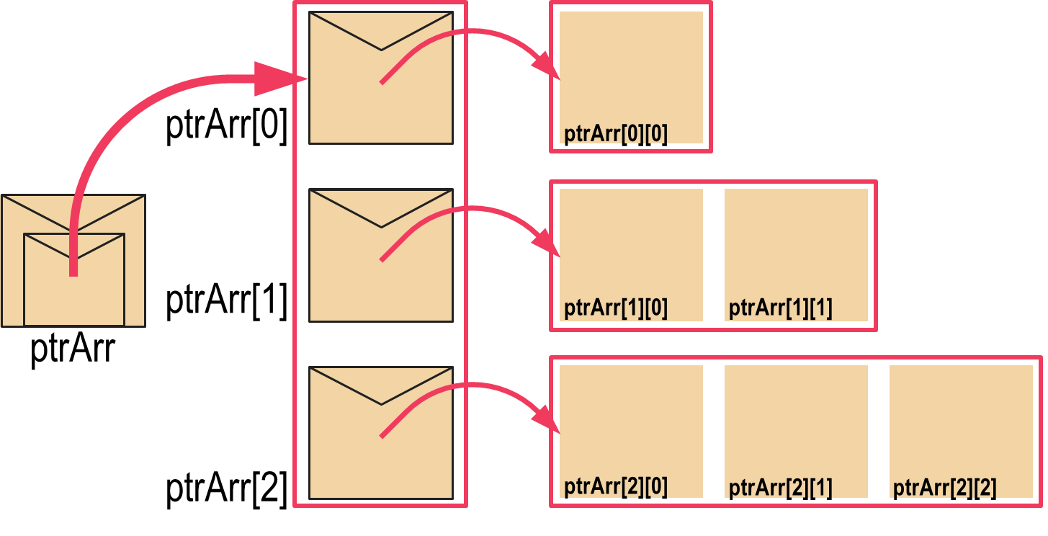

Array of Pointers/Arrays
Don’t write ptrArr++ illegal!
Even str++ illegal!
However, I can write char* qtr = str; qtr++; Now qtr points to str[1]
Rest assured, the same rules apply as do with pointers
You can show-off your skills by cool array access tricks ☺
Remember that str is a pointer to str[0]
In the same way, ptrArr is also a pointer to ptrArr[0] (which is an array)
str + 2 gives address of str[2]
ptrArr + 2 also gives address of ptrArr[2] (pointers take 8 bytes) – same rules!
We can access index 2 of the third array in many ways ptrArr[2][2],*(ptrArr[2] + 2),*(*(ptrArr + 2) + 2),(*(ptrArr+2))[2]
char *ptrArr[3], str[3];
for(i = 0; i < 3; i++)
ptrArr[i] = (char*)malloc((i+1)*sizeof(char));
I can also write char** rtr = ptrArr; rtr++; Now rtr points to ptrArr[1]
Don’t worry. I won’t ask exam questions on int (*ptr)[5];
I will ask questions on pointers to pointers, array of pointers, etc though
Just one potentially confusing notation in C
int *ptr[5]; is an array of 5 pointers to int but
int (*ptr)[5] is a single pointer to an array of 5 ints ☹
Your avatar befits you ☺

Slide 16


2D Arrays in C
int mat[3][5];
Declares a matrix (2D array) with 3 rows 5 columns
Rows numbered 0, 1, 2. Columns numbered 0, 1, 2, 3, 4
Element at row-index i and column-index j is an int variable
Can access it using several ways mat[i][j],*(mat[i] + j),*(*(mat + i) + j),(*(mat + i))[j]
This looks exactly like the way we access an array of arrays – what is the difference?
Not that much actually – let me show you the differences

Slide 17
2D arrays vs Array of arrays
2D Arrays
Array of arrays
Number of elements in each row is the same
All elements of 2D array are located contiguously in memory
Easier to initialize
Very convenient ☺
Different arrays can have different number of elements – more flexibility
Elements of a single array are contiguous but different arrays could be located far off in memory
Have to be initialized element by element
More power, responsibility
int mat[3][5] = { {1,2}, {3}, {4,5,6},{7,8,9,10,11},{-1,2,3,4}};

Slide 18
Memory layout of 2D arrays
000000
000001
000002
000003
000004
000005
000006
000007
000008
000009
000010
000011
000012
000013
000014
000015
000016
000017
000018
000019
000020
000021
000022
000023
…
char str[3][5];
str[0][0]
str[0][1]
str[0][2]
str[0][3]
str[0][4]
str[1][0]
str[1][1]
str[1][2]
str[1][3]
str[1][4]
str[2][0]
str[2][1]
str[2][2]
str[2][3]
str[2][4]
Location of the str pointer not shown
First all elements of row 0 stored in continuous sequence
Then without breaking sequence, all elements of row 1 stored and so on
char* ptr = *str; // ptr points to str[0][0]
ptr += 5; // ptr now points to str[1][0]
ptr += 5; // ptr now points to str[2][0]
ptr += 3; // ptr now points to str[2][3]

