Slide 1
Finally … Functions!
ESC101: Fundamentals of Computing
Purushottam Kar

Slide 2
Announcements
Mid-sem lab exam marks available on Prutor
Maximum: 150, Average: 80, Standard deviation: 47
See rubric on website carefully before applying for regrading
Frivolous regrading requests will simply get penalty negative marks
Last date for dropping Advanced Track October 12
Application must be an email to instructor, mentors, teammates
Last date for dropping ESC101 course October 12
Application must be on standard DoAA course drop form – no email!
Joint tutorial for B1 and B14 on October 12
12 – 1 PM (same time), L19 - just an arrangement for this week ☺

Slide 3
The Golden Rules of Pointers
RULE 1: All pointers store addresses, take 8 bytes to store
Does not matter whether pointer to variable, to array, to another pointer etc
RULE 2 (Reference): &a gives address of variable a
Does not matter whether variable a is char, long, or even a pointer variable
Special case for static array variables – next slide
RULE 3: (Dereference): Whenever expression expr generates an address, *(expr) gives value stored at that address
Careful! Value at the address given by expr is interpreted as type of expr
RULE 4: (Arithmetic): Pointer arithmetic is w.r.t datatype
char* arithmetic w.r.t. 1 byte blocks, int* w.r.t. 4 byte blocks, double* 8 bytes
RULE 5: Name of array points to first element of array
Does not matter whether malloc-ed array or static array

Slide 4
The Curious Case of Static Arrays
a, b, c all point to their respective first elements ☺
I will hide the location of the pointer a and b from you since I store these pointers secretly in a location called the symbol table – no access!!
Three types of arrays studied so far
Static arrays of fixed size int a[10];
Static arrays of variable size int n; scanf("%d",&n); int b[n];
Dynamic malloc/calloc/realloc-ed arrays int *c = (int*)malloc(n * sizeof(int));
For static arrays (fixed/variable length) sizeof() gives total size of array. However, for malloc-ed arrays, sizeof(c) just gives 8, the space required to store the pointer c ☹
&c gives us the address where the pointer c is stored ☺
&a just gives us the address of first element a[0] again ☹
&b just gives us the address of first element b[0] again ☹
You can modify the pointer c by saying c++ but I will not allow you to say things like a++, b++. I also dont allow you to free/realloc a and b ☺

Slide 5


2D Arrays in C
int mat[3][5];
Declares a matrix (2D array) with 3 rows 5 columns
Rows numbered 0, 1, 2. Columns numbered 0, 1, 2, 3, 4
Element at row-index i and column-index j is an int variable
Can access it using several ways mat[i][j],*(mat[i] + j),*(*(mat + i) + j),(*(mat + i))[j]
Careful! **(mat + i +j) ≠ *(*(mat + i) + j) ≠ *(*mat + i + j)
Not that much actually – let me show you the differences
This looks exactly like the way we access an array of arrays – what is the difference?

Slide 6
2D arrays vs Array of arrays
2D Arrays
Array of arrays
Number of elements in each row is the same
All elements of 2D array are located contiguously in memory
Easier to initialize
Very convenient ☺
Different arrays can have different number of elements – more flexibility
Elements of a single array are contiguous but different arrays could be located far off in memory
Have to be initialized element by element
More power, responsibility
int mat[3][5] = { {1,2}, {3}, {4,5,6},{7,8,9,10,11},{-1,2,3,4}};

Slide 7
Memory layout of 2D arrays
000000
000001
000002
000003
000004
000005
000006
000007
000008
000009
000010
000011
000012
000013
000014
000015
000016
000017
000018
000019
000020
000021
000022
000023
…
char str[3][4] = {"Hi","Ok","Bye"};
str[0][0]
str[0][1]
str[0][2]
str[0][3]
str[1][0]
str[1][1]
str[1][2]
str[1][3]
str[2][0]
str[2][1]
str[2][2]
str[2][3]
H
i
\0
\0
O
k
\0
\0
B
y
e
\0
Location of the str pointer not shown
First all elements of row 0 stored in continuous sequence
Then without breaking sequence, all elements of row 1 stored and so on
char* ptr = *str; // ptr points to str[0][0]
ptr += 4; // ptr now points to str[1][0]
ptr += 4; // ptr now points to str[2][0]
ptr += 1; // ptr now points to str[2][1]

Slide 8
Layout of arrays of arrays
000000
000001
000002
000003
000004
000005
000006
000007
000008
000009
000010
000011
000012
000013
000014
000015
000016
000017
000018
000019
000020
000021
000022
000023
…
char **str = (char**)malloc(3*sizeof(char*));
str[0] = (char*)malloc(4*sizeof(char));
str[1] = (char*)malloc(4*sizeof(char));
str
0 0 0 0 0 1 0 1
str[0]
str[1]
str[2]
0 0 0 0 1 0 0 1
0 0 0 0 1 1 1 1
0 0 0 1 0 1 1 0
str[0][0]
str[0][1]
str[0][2]
str[0][3]
Element within a single array always stored in sequence
Different arrays may be stored far away from each other
str[1][0]
str[1][1]
str[1][2]
str[1][3]
str[2][0]
str[2][1]
str[2][2]
str[2][3]

Slide 9

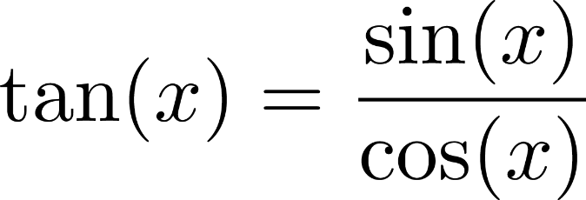
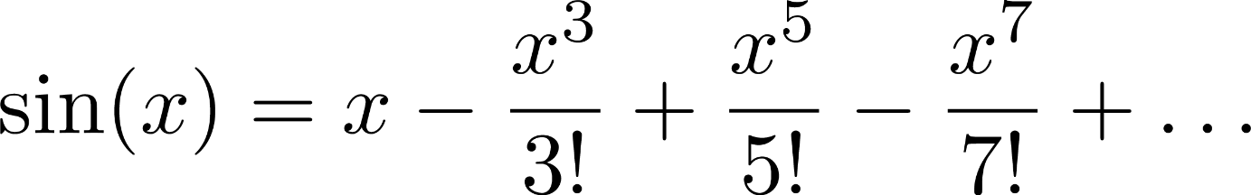

Mr C takes a Math Lesson
Although we can write tan(x) in terms of addition, subtraction, multiplication and division, we almost never do that. We always write tan(x) = sin(x)/cos(x)
Mathematics is full of functions - we define more powerful functions using simple functions
sin(x) itself can be defined w.r.t addition, factorial, division
Factorial can be defined in terms of multiplication ☺
Multiplication can be defined in terms of addition ☺
Helps us write much cleaner math expressions, as well as we do not make mistakes very often
I too allow you to write your own functions for your comfort and to make your code easier to read and easier to debug!

