Slide 1
Fun Facts about Functions with Mr C
ESC101: Fundamentals of Computing
Purushottam Kar

Slide 2
Announcements
Last date for dropping Advanced Track October 12
Application must be an email to instructor, mentors, teammates
Last date for dropping ESC101 course October 12
Application must be on standard DoAA course drop form – no email!
Joint tutorial for B1 and B14 on October 12
12 – 1 PM (same time), L19 - just an arrangement for this week ☺

Slide 3

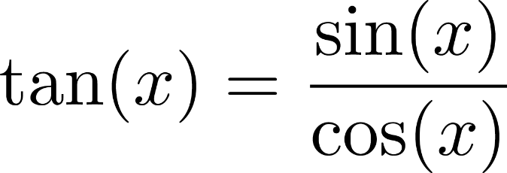
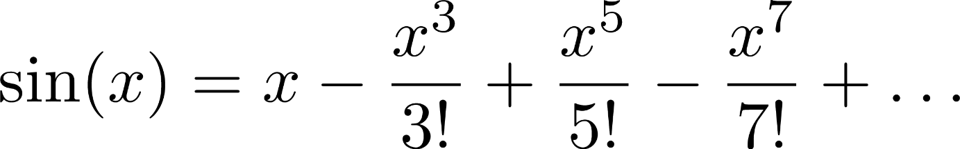

Mr C takes a Math Lesson
Although we can write tan(x) in terms of addition, subtraction, multiplication and division, we almost never do that. We always write tan(x) = sin(x)/cos(x)
Mathematics is full of functions - we define more powerful functions using simple functions
sin(x) itself can be defined w.r.t addition, factorial, division
Factorial can be defined in terms of multiplication ☺
Multiplication can be defined in terms of addition ☺
Helps us write much cleaner math expressions, as well as we do not make mistakes very often
I too allow you to write your own functions for your comfort and to make your code easier to read and easier to debug!

Slide 4

The Anatomy of a C Function
How we must speak to mr. compiler
How we usually speak to a human
int isUpperAlpha(char x){
int a = (x >= 'A') && (x <= 'Z');
return a;
}
isUpperAlpha is a function that takes in a character (let us call that character x) as input and gives an integer as output
Upon receiving input, please create an integer variable a and store 1 in a if input is upper case alphabet else store 0 in a
Please output the value of a to whomever used this function
Yes you can! But you have to be a bit clever about doing so
We will teach you 3 ways to return more than one output in this course ☺
Programmers often call the process of giving inputs to a function as passing arguments to the function
Name of function: isUpperAlpha
Arguments: one character
Return type: integer
Inputs to a function are called its arguments
A function returns its output
☹ So I cant write a function that returns 2 integers – say x and y coordinates?
A function may have many inputs but only one output

Slide 5
Functional Terminology
Function Name: must be a valid identifier abc, a124, _ab1
Arguments: can be int, long, float, double, char
Can also have pointers and even arrays as input – soon!
Return type: what does the function return
When you use a function, we say you have called that function. If the function outputs something, we say the function returned that output back to you
The English word return has two meanings I returned from the ESC101 lab at 5PM I returned the two books I had issued from the library
Functions return back values to you just as you return books
You must define the function before using the function (within main or your own functions)

Slide 6
Some Functional Exercises
Define a function to input two integers, output their max
Define a function to print Hello World
Define a function to output 1 if input is prime else 0
Define a function to input two integers and print Hello World if their max is prime
Define a function to print the max of 3 numbers
Define a function to input a character, output its upper case version if lower case else output the character itself

Slide 7
Arguments and Return types
You can define a function that takes in no input and gives no output
Even void print(){ … } works
You can define a function that takes inputs but gives no output
You can define a function that takes no input but gives an output
Even char getFirstAlpha(){ … } works
void print(void){
printf("Hello World");
}
void sum(int a, int b){
printf("Sum %d", a+b);
}
char getFirstAlpha(void){
return 'A';
}

Slide 8
More on Arguments
The names you give to the input variables of a function when writing a function can be any valid identifiers
They can even be variable names you are using in other functions e.g. inside the main() function
Warning: do not expect Mr C to automatically copy values from one function to another just because two variable have the same name!
Calling a function is like creating a clone of Mr C. This clone starts afresh, with any inputs you have given. The clone forgets all old variable names and values.
Will see more about this “cloning” behaviour tomorrow

Slide 9
More on Arguments
If you have promised to give a function two integers, please give it two integers
If you give it only one or three integers, compilation error
If you give it two floats or else one char and one int, automatic typecasting will take place
Be careful to not make typecasting errors

Slide 10
More on Return
For functions that do not need to return anything i.e. void return type, you can either say return; or else not write return at all inside the function body in which case the entire body will get executed
May write return statement many times inside a function
When Mr C (his clone actually) sees a return statement, he immediately generates the output and function execution stops there.
The clone dies and the original Mr C takes over ☺
Warning: if you have promised that a function returns an integer, all return statements in that function must return an integer value – otherwise compilation error!
If you return a float/double value from a function with int return type, automatic typecasting will take place.
Be careful to not make typecasting mistakes

Slide 11
More on Return
main() is also a function with return type int
main() is like a reserved function name. Cannot name your function main
The value that is returned can be used safely just as a normal variable of that same data type
You can freely use returned values in expressions
Be careful of type though
Did you know that the printf function also returns an integer (the number of characters printed) ☺
scanf() also returns an integer – find out what that is !!
int sum(int x, int y){
return x + y;
}
int main(){
printf("%d", sum(3,4) - sum(5,6));
return 0;
}

Slide 12
Benefits of writing functions
Allows you to think very clearly
E.g. if you want to do something if the integer n is a prime number or if it is divisible by 11
Write the body of the if condition without worrying about primality testing etc and then define the functions later ☺
You can break your code into chunks – called modules
Each module handled using a separate function
E.g. in this case, primality testing is one module, checking for divisibility by 11 is another module
if(isPrime(n) || isDivby11(n)){
…
}
Writing code that has modules is a type of modular programming – it is the the industry standard!

Slide 13
Benefits of writing functions
Functions allow you to write very neat, readable code
Use function names that describe what the function does
Your co-workers/team-mates will be able to understand your code much better if it has nice readable functions
Functions allow you to debug your program faster
If code is broken into function, to debug, find out which function is not working properly ☺
Rest of code need not be touched, only faulty function needs to be fixed – again the industry standard of code maintenance.

Slide 14
Benefits of writing functions
Functions allow you to reuse code
We are so grateful some one wrote functions like sqrt(), abs() in math.h that we are able to use again and again ☺
printf() and scanf() are also functions. Think of how much we use them in every single program
We are reusing code that some helpful C expert wrote in the printf(), scanf(), sqrt(), abs() and other functions
If some piece of code keeps getting used in your program again and again – put it inside a function!
We reused code in today’s codes – didn’t have to rewrite code – may make mistakes if you write same code again

