Slide 1
The Eloquent Mr C
ESC101: Foundations of Computing
Purushottam Kar

Slide 2
Announcements
CHM101 sectioning has caused some clashes
This week we are allowing students to attend lab out of order
Met DoAA officials to resolve the matter – lets hope for the best ☺
Unable to access the website?
Are you using a data plan on your smart phone?
Our course website, Prutor are internal, not accessible outside IITK
Solution 1: use IITK computers (CC, NCL, hostel)
Solution 2: install a VPN app on your smart phone https://www.iitk.ac.in/ccnew/index.php/13-network/99-how-to-use-ssl-vpn
Gradescope, Piazza are accessible from all places
Thanks to Nikita Awasthi (tutor) for pointing this out

Slide 3



Writing pretty code is an art
Very important in industry – large groups collaborate
Important even for solo projects – maintenance
Will learn several good coding habits over time
Commenting, Indentation, Code-structuring
int main(){
int a;
int b;
a = 5;
b = 4;
a + b;
return 0;
}
int main(){
int a;
int b;
a = 5;
b = 4;
a + b;
return 0;
}
int main(){
int a;
int b;
a=5;
b= 4;
a+b;
return 0;
}

Slide 4
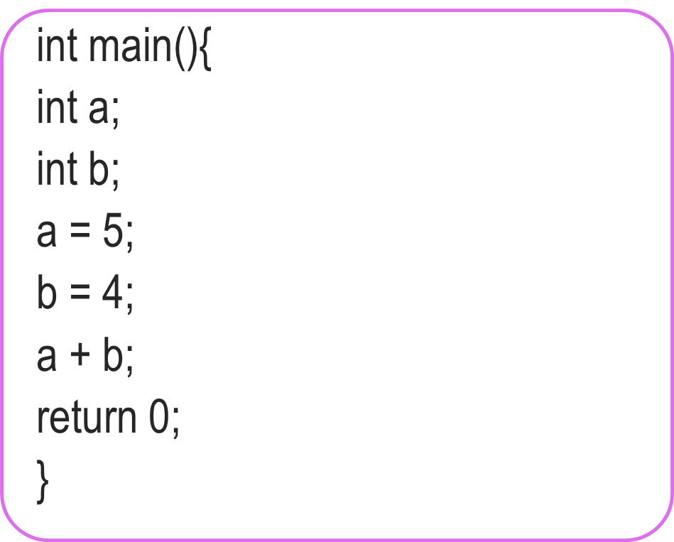
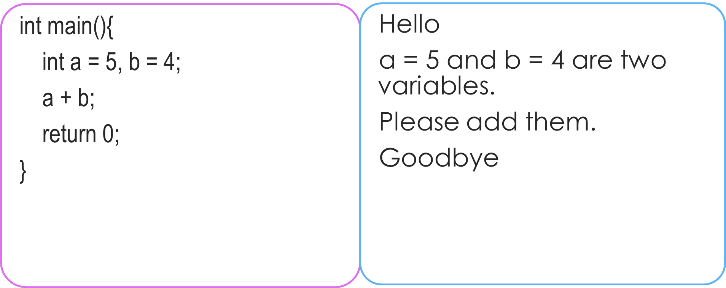
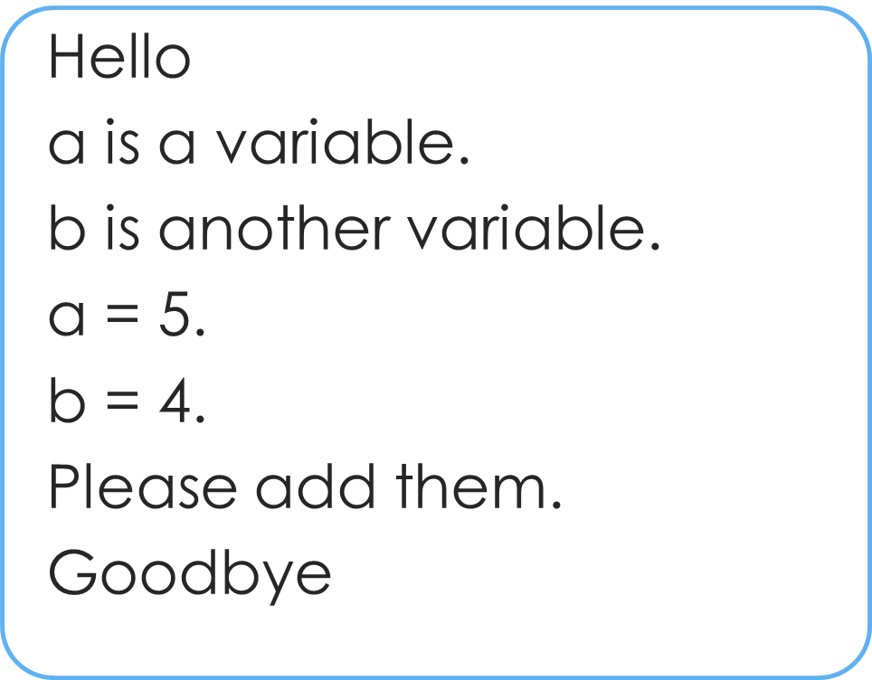
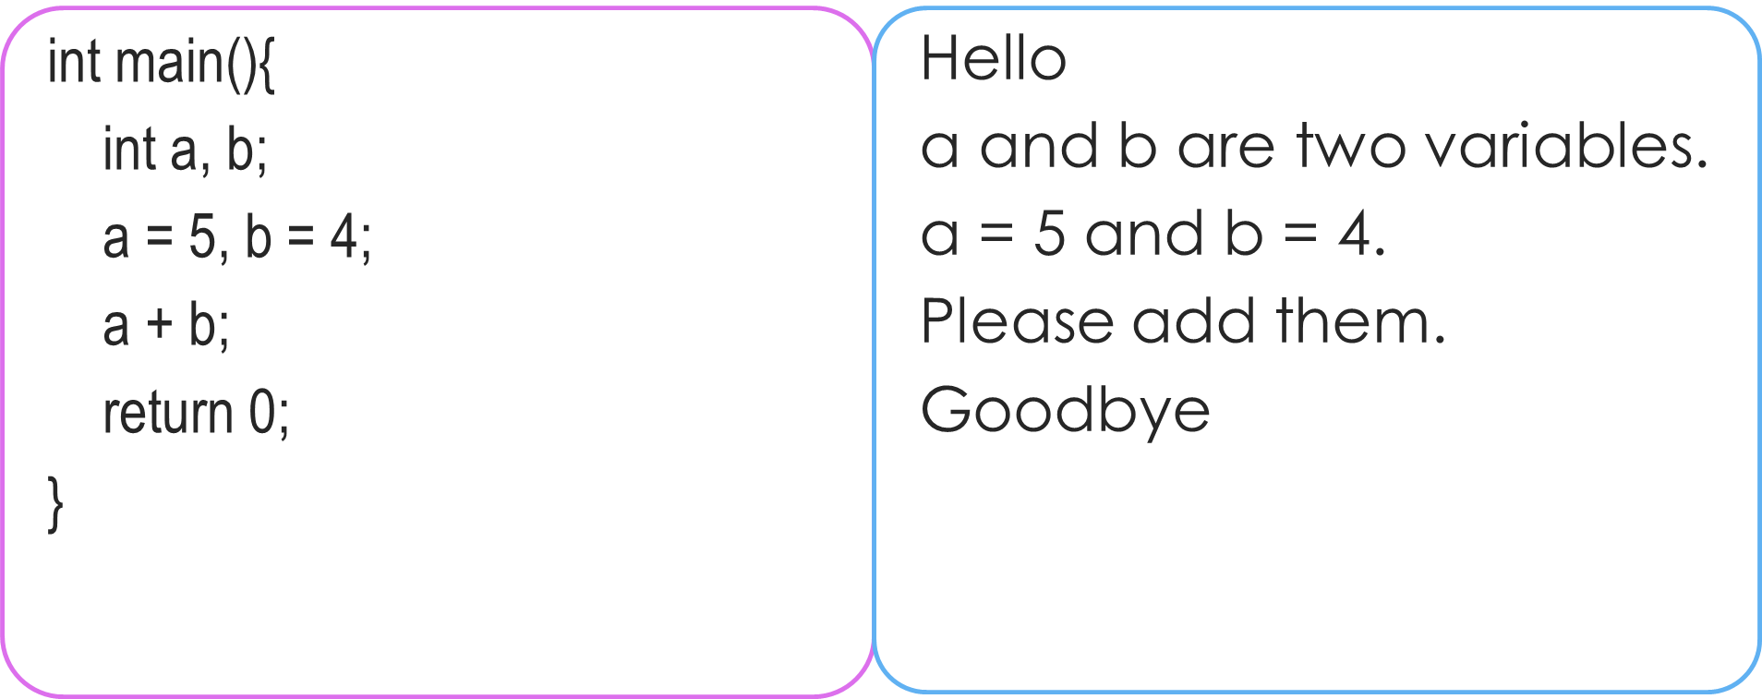
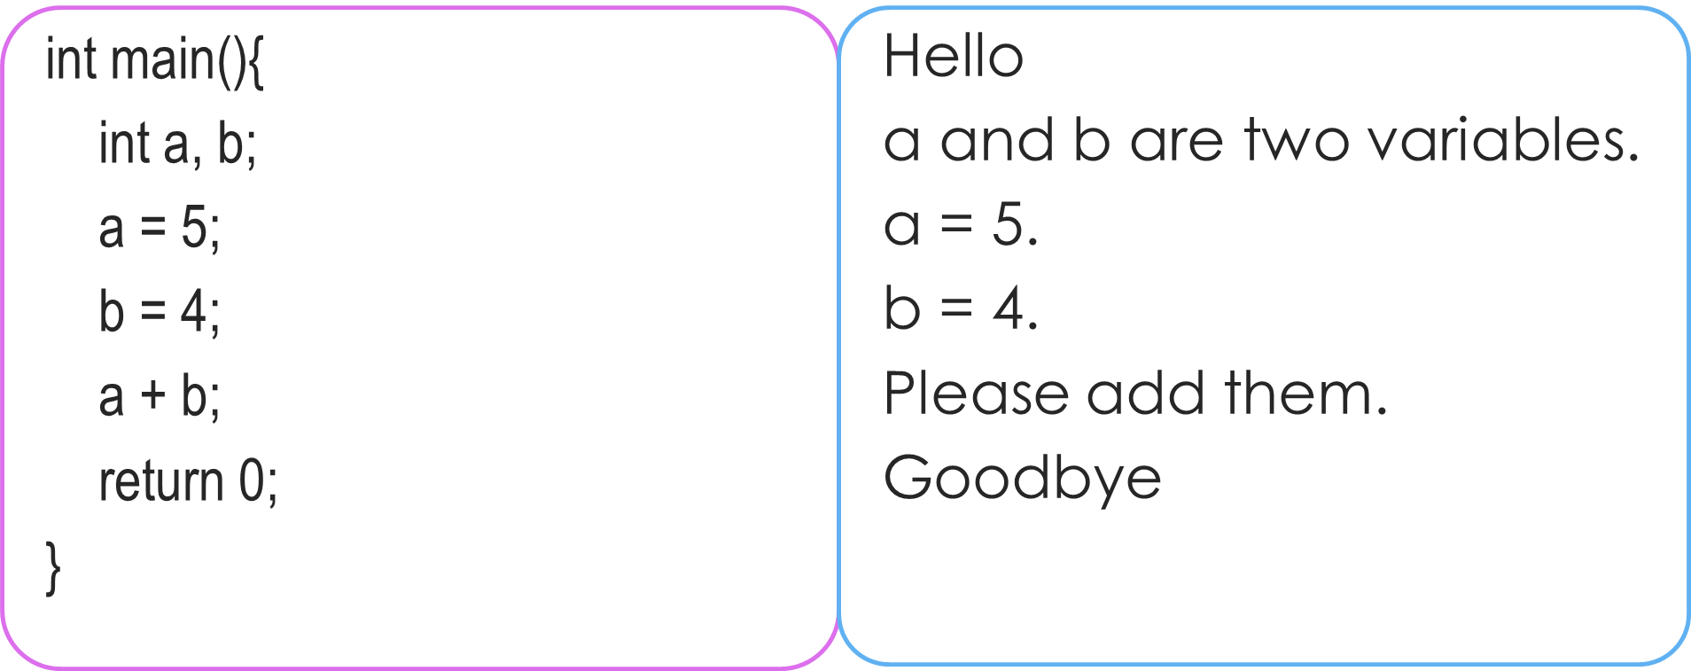


A handy shorthand
How we must speak to mr. compiler
How we usually speak to a human
Explore, practice. It will take only few days to internalize.
No need to mug!
How will I remember all this?

Slide 5

Printing the sum of two numbers
How we must speak to mr. compiler
How we usually speak to a human
#include<stdio.h>
int main(){
int a, b, c;
a = 5, b = 4;
c = a + b;
printf(“%d”,c);
return 0;
}
Do you speak English?
Hello
a,b,c are variables.
a = 5 and b = 4.
Please add them and put the result in variable c.
Please tell me value of c.
Goodbye
5
4
Mr C is happy now. He did not have to throw away the value 9 ☺
a
b
9
9
c

Slide 6
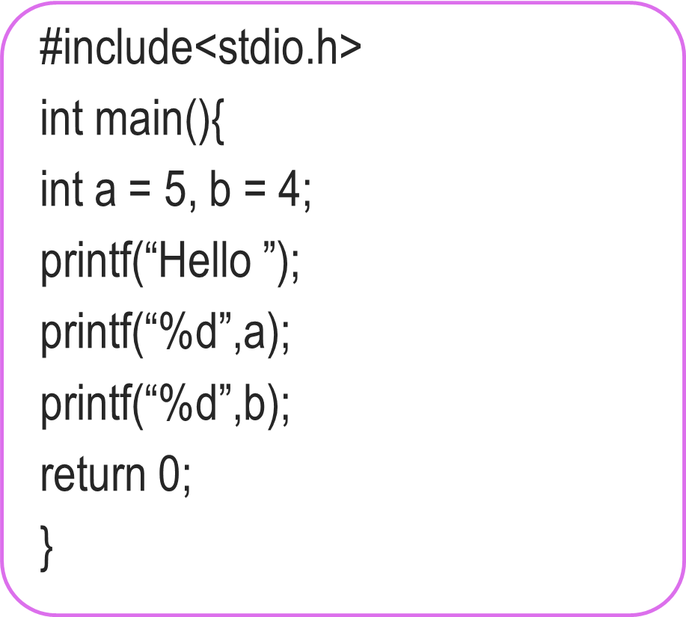


The true power of printf
We have seen how to make Mr. C
Say things like “Hello”
Tell us the value of an integer variable
Don’t be afraid to experiment
#include<stdio.h>
int main(){
int a = 5, b = 4;
printf(“Hello”);
printf(“%d”,a);
printf(“%d”,b);
return 0;
}
No, you can make him speak again and again
Can he speak only once?
Hello54
Hello 54

Slide 7
The true power of printf
We have seen how to make Mr. C
Say things like “Hello”
Tell us the value of an integer variable
Okay, lets see in detail
I am confused ☹
#include<stdio.h>
int main(){
int a = 5, b = 4;
printf(“Hello %d %d”,a,b);
return 0;
}
Yes, very powerful ones!
Any shorthands?
Hello 5 4

Slide 8
The true power of printf
How we must speak to mr. compiler
How we usually speak to a human
printf(“Hello %d %d”,a,b);
Please write the English word Hello, followed by a space, followed by the value of an integer, followed by a space followed by the value of another integer.
By the way, the first integer to be written is a and the second integer to be written is b.
Format string
Format string tells me how to print things, and then I am told what to print
Remember Mr. C likes to be told beforehand what all we are going to ask him to do!
printf follows this exact same rule while telling Mr. C what to print

Slide 9
Fun with printf
If I see \n, I will start printing on a new line
Hello
5
4
Can I print different things on separate lines?
What if I wish to print the character “ (inverted quotes)?
What if I wish to print the character % (percentage sign)?
printf(“Hello\n%d\n%d”,a,b);
If I see \”, I will print “
printf(“\“Hello\““);
“Hello”
If I see %%, I will print %
printf(“90%% marks“);
90% marks

Slide 10
Fun with printf
To print on new line, use \n
To print the character \ (backslash)
To print a tab character (a longer space)
Allows us to print very nicely formatted output ☺
More examples in labs – till then, have fun on your own
printf(“To print on new line, use \\n”);
\n, \” called escape sequences since they “escape” the normal rules
printf(“Very\tNice“);
Very Nice
Need to be careful, especially with things like printf(“\“Hello\““);
Experiment with them to get comfortable

Slide 11

Fun with Integers
Operation | C Code | a | b | c
Addition | c = a + b; | 5 | 4 | 9
Subtraction | c = a – b; | 4 | 5 | -1
Multiplication | c = a * b; | -2 | -4 | 8
Division | c = a / b; | 7 | 2 | 3
Remainder | c = a % b; | 7 | 2 | 1
Be careful: in math we often write z = 2xy
Mr C will not like it.
He will want z = 2 * x * y;
Also be careful about division and remainder
7 / 2 is actually 3.5 but since c is an integer variable, it just stores 3. Remainder is 1
Experiment on your own – will revisit these very soon
Oh! So Mr. C allows us to use constants too?
Not everything needs to be stored in a variable
Yes. The command c = 2 + b;
makes sense to me
printf(“%d %d”,a,10);
is fine too ☺
Come to the lab and give it a try!

Slide 12
Beyond Integers
Lots of fun possible with integers alone
However, the box storing integers is actually not very big
Can only store integers between -2,147,483,648 and 2,147,483,647
Also, what about real numbers (fractions etc)
How to ask Mr C to work with a real number?
How to ask Mr C to print a real number?
Next class: long, float, double, long double
C designers were really nice with names ☺

Slide 13
Emoticons from Flaticon, designed by Twitter
https://www.flaticon.com/packs/smileys-and-people-9 Licensed under CC BY 3.0

