Slide 1
Sorting at Scale
ESC101: Fundamentals of Computing
Purushottam Kar

Slide 2
This Week
Usual lecture schedule Mon, Tue, Wed 12-1PM
Usual lab schedule Mon, Tue, Wed, Thu 2-5PM
Usual tutorial schedule Fri 12-1PM
Joint tutorial for B1 and B5 in L19 (same time as above)
Major quiz and end sem lab exam marks should get declared within this week
Will also release all remaining quiz and lab marks

Slide 3
End-sem Theory Exam
Date: November 25th, 2018 (Sunday)
Time: 9AM – 12 noon (morning)
Not my doing – I like to sleep in on Sundays too ☹
Rooms: assigned seating (like mid sem exam)
Will be mailed to you – sit at your own room/own seat
If you do not then you will waste time moving to your proper seat
Syllabus: till whatever is covered till Nov 16th tutorial
Make-up Exam as per DoAA, SUGC guidelines
Open handwritten notes – no printouts, mobiles, iPads.

Slide 4


What is Sorting?
250
200
$$N$$
150
Useful in itself – internet search and recommendation systems
100
“
50
$$\log{N}$$
50
100
150
200
250
300
350
400
Sorting is the process of arranging items systematically, ordered by some criterion
”
Search within n unsorted elements can take as much as O(n) operations ☹
Makes searching very fast – can search within n sorted elements in just O(log n) operations

Slide 5
Sorting Algorithms
Selection Sort

Slide 6
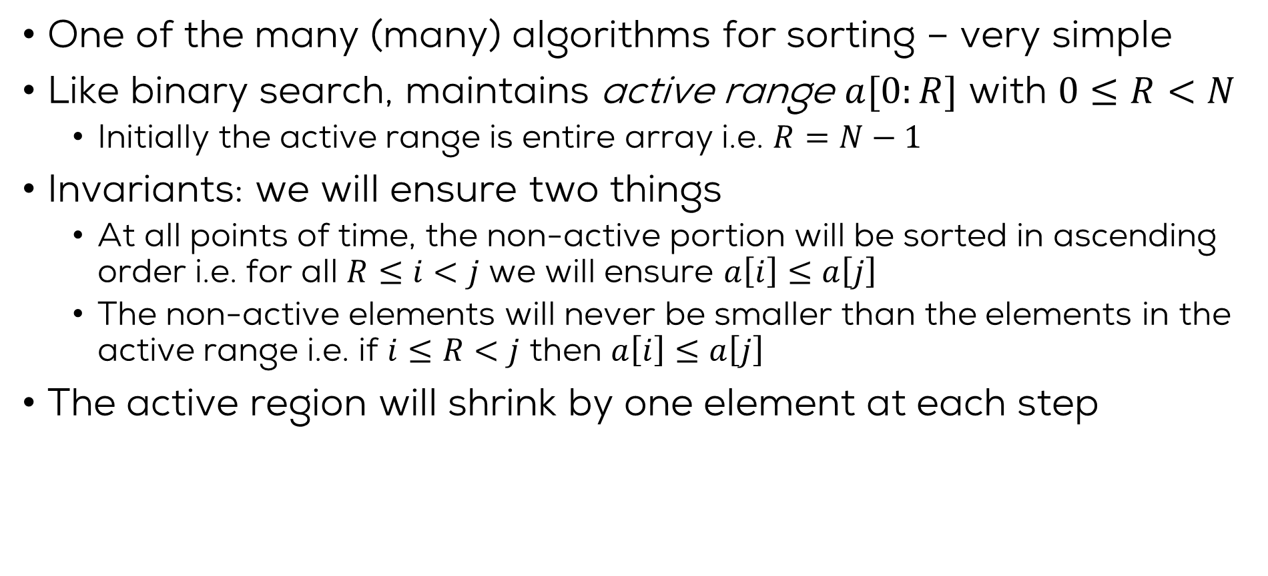
Selection Sort
One of the many (many) algorithms for sorting – very simple
Like binary search, maintains active range $a[0:R]$ with $0≤R<N$
Initially the active range is entire array i.e. $R=N−1$
Invariants: we will ensure two things
At all points of time, the non-active portion will be sorted in ascending order i.e. for all $R≤i<j$ we will ensure $a\left[i\right]≤a\left[j\right]$
The non-active elements will never be smaller than the elements in the active range i.e. if $i≤R<j$ then $a\left[i\right]≤a\left[j\right]$
The active region will shrink by one element at each step
4
1
3
5
6
8
9

Slide 7
Selection Sort
Notice that we never have to touch the non-active region ☺
To maintain the invariant and still shrink the active region
We search for the largest element in the active region
Bring it to the right-most end of the active region using a swap
4
1
3
5
6
8
9
Verify that all promises of the invariant still hold
3
1
4
5
6
8
9

Slide 8
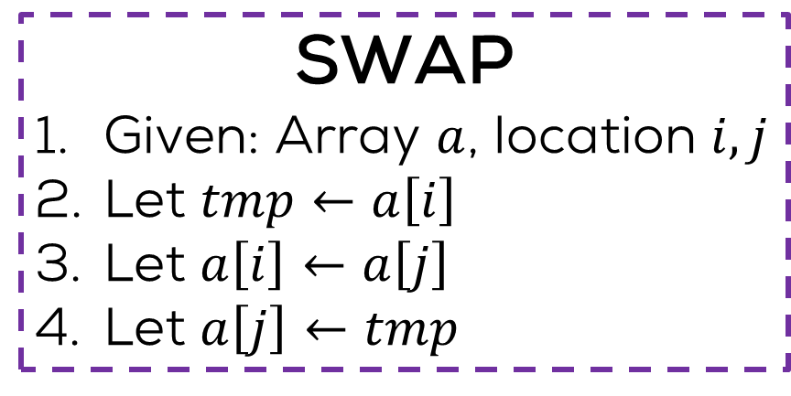
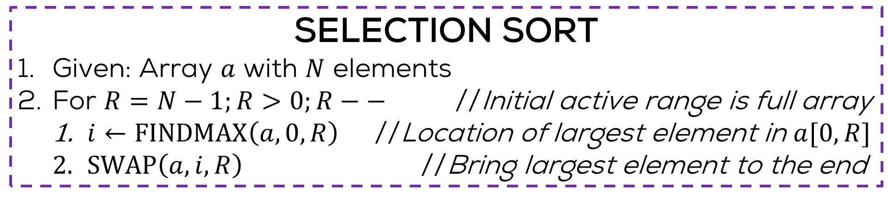
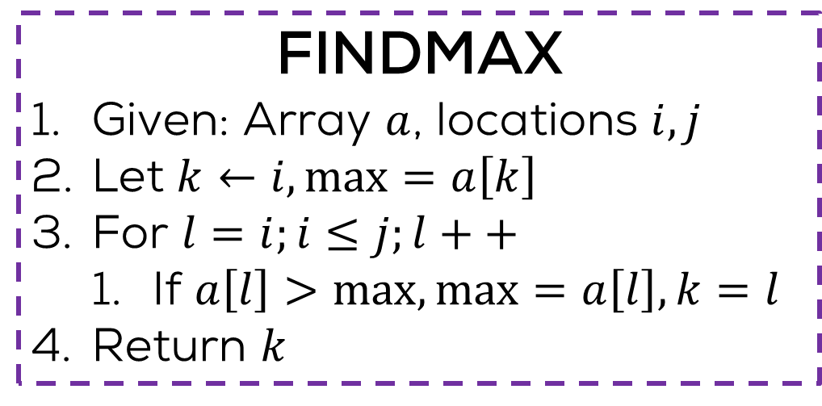
Selection Sort
Exercise: write a recursive version
Exercise: convert this to proper C code
SELECTION SORT
Given: Array $a$ with $N$ elements
For $R=N−1;R>0;R−−$ //Initial active range is full array
$i←FINDMAX\left(a,0,R\right)$ //Location of largest element in $a[0,R]$
$SWAP\left(a,i,R\right)$ //Bring largest element to the end
SWAP
Given: Array $a$, location $i,j$
Let $tmp←a\left[i\right]$
Let $a\left[i\right]←a\left[j\right]$
Let $a\left[j\right]←tmp$
FINDMAX
Given: Array $a$, locations $i,j$
Let $k←i,\max{=a\left[k\right]}$
For $l=i;i≤j;l++$
If $a\left[l\right]>\max{,\max{=a\left[l\right],k=l}}$
Return $k$

Slide 9
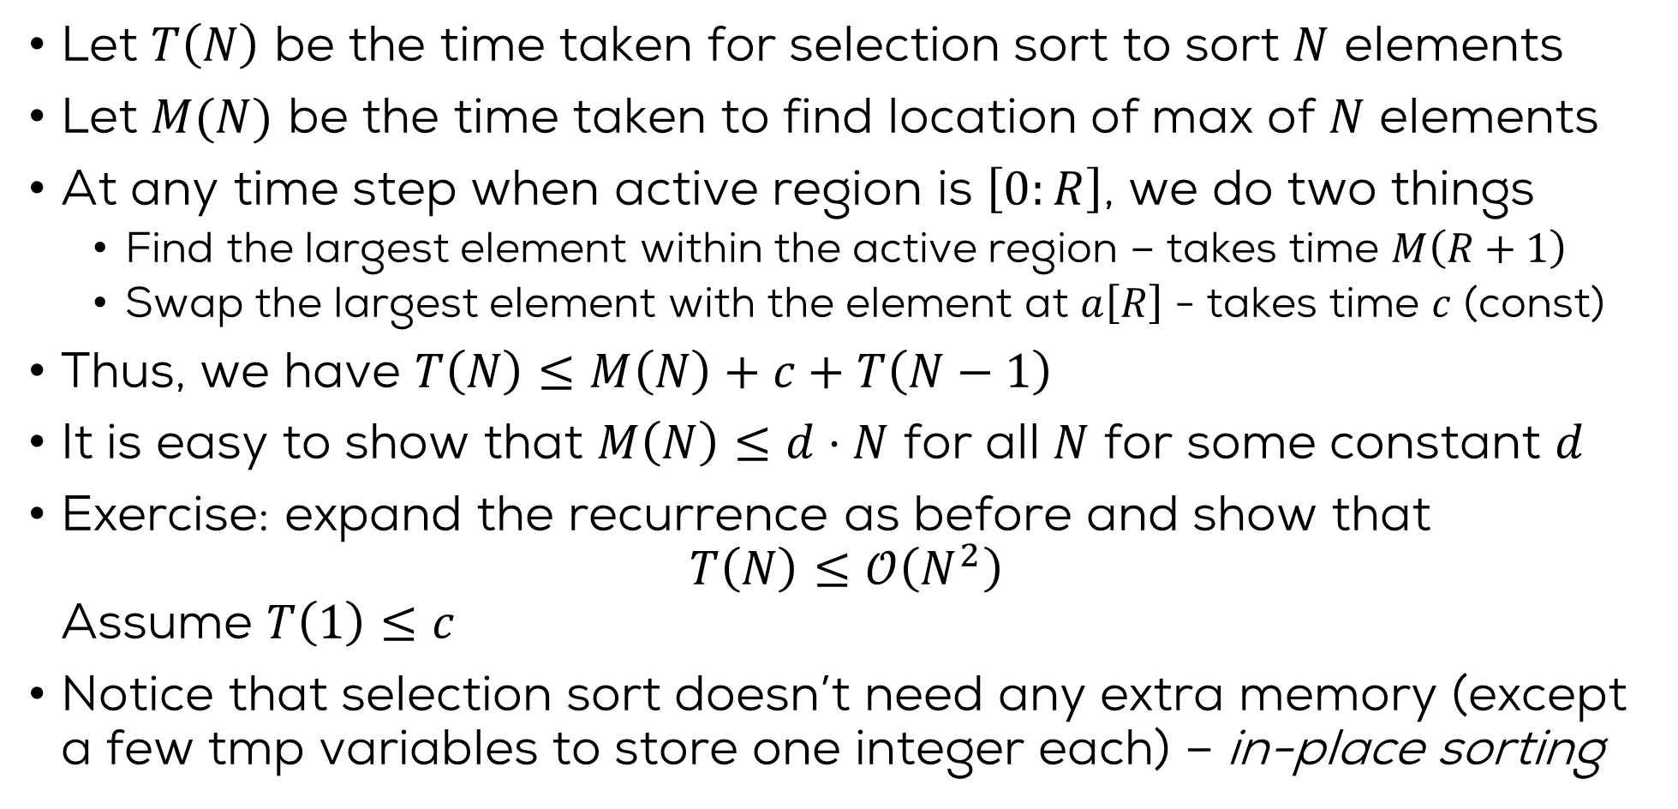
Time Complexity
Let $T\left(N\right)$ be the time taken for selection sort to sort $N$ elements
Let $M(N)$ be the time taken to find location of max of $N$ elements
At any time step when active region is $\left[0:R\right]$, we do two things
Find the largest element within the active region – takes time $M\left(R+1\right)$
Swap the largest element with the element at $a\left[R\right]$ - takes time $c$ (const)
Thus, we have $T\left(N\right)≤M\left(N\right)+c+T\left(N−1\right)$
It is easy to show that $M\left(N\right)≤d⋅N$ for all $N$ for some constant $d$
Exercise: expand the recurrence as before and show that $T\left(N\right)≤𝒪\left(N^{2}\right)$ Assume $T\left(1\right)≤c$
Notice that selection sort doesn’t need any extra memory (except a few tmp variables to store one integer each) – in-place sorting

Slide 10
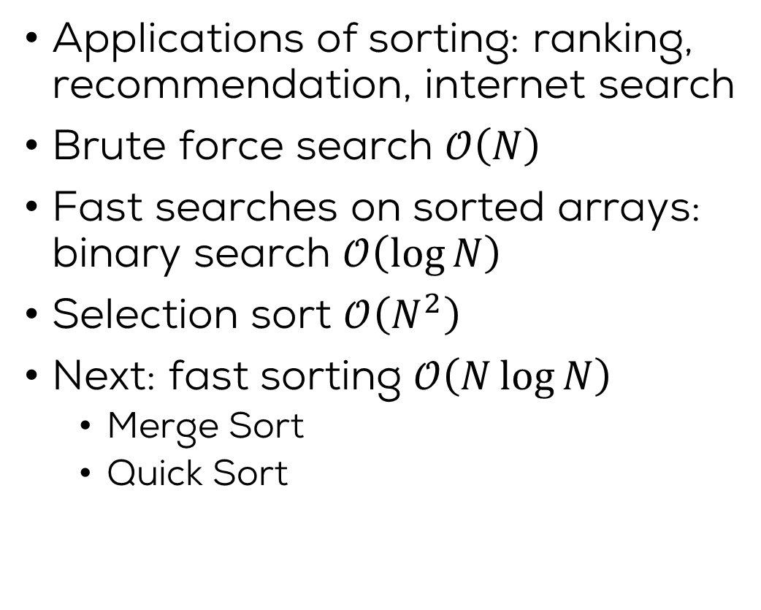
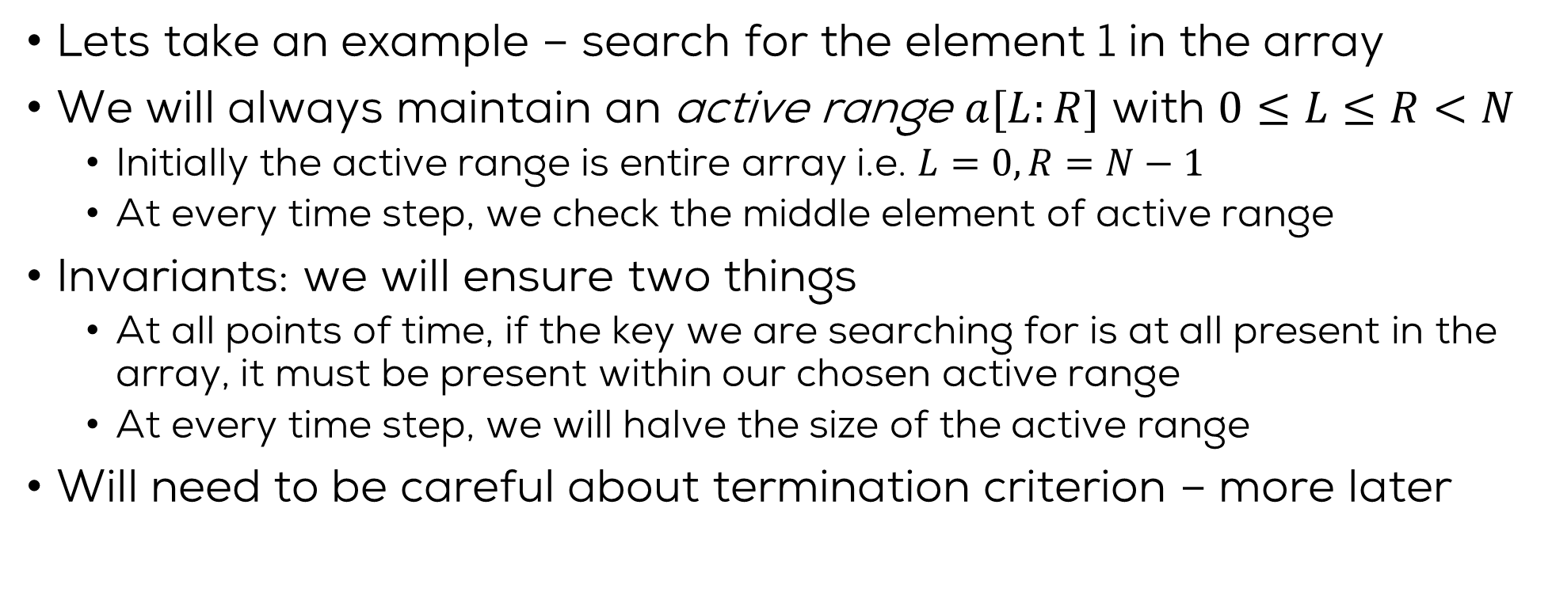
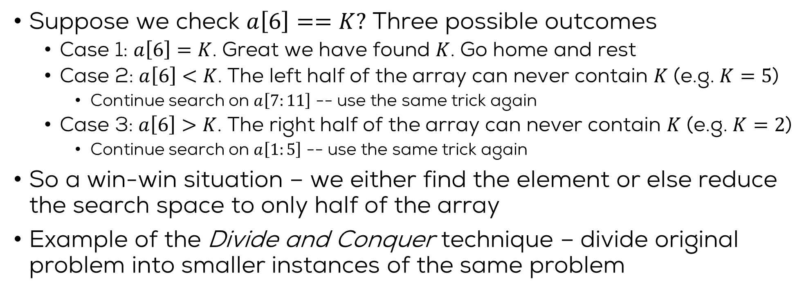
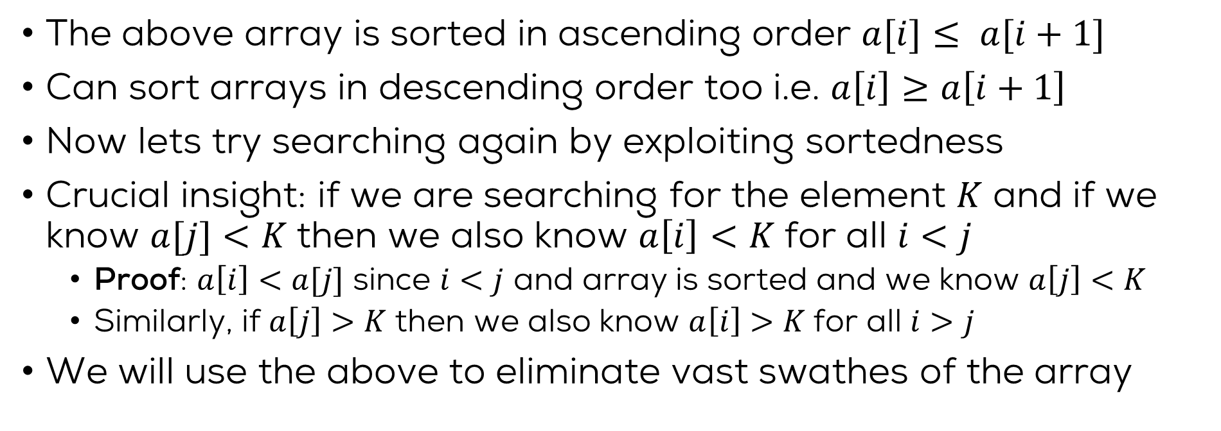

Summary
250
200
$$N$$
Applications of sorting: ranking, recommendation, internet search
Brute force search $𝒪\left(N\right)$
Fast searches on sorted arrays: binary search $𝒪\left(\log{N}\right)$
Selection sort $𝒪\left(N^{2}\right)$
Next: fast sorting $𝒪\left(N\log{N}\right)$
Merge Sort
Quick Sort
150
100
50
$$\log{N}$$
50
100
150
200
250
300
350
400
2500
2000
$$N^{2}$$
1500
$$N\log{N}$$
1000
500
50
100
150
200
250
300
350
400

Slide 11
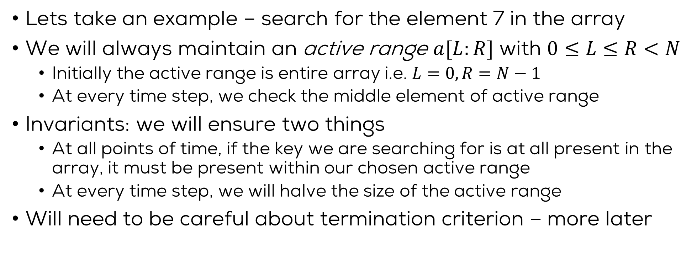
Partition based Sorting Techniques
Let $T\left(N\right)$ be the time taken for selection sort to sort $N$ elements
Let $M(N)$ be the time taken to find location of max of $N$ elements
For selection sort, we have $T\left(N\right)≤M\left(N\right)+c+T\left(N−1\right)$
Active region shrank too slowly which gave us $T\left(N\right)≤𝒪\left(N^{2}\right)$
Selection sort is quite an expensive algorithm (imagine $𝒪\left(N^{2}\right)$ time complexity for $N=1,000,000$ items ☹) – much better can be done
Will study two algorithms based on divide and conquer technique
Both techniques split an array of $N$ elements into two arrays, sorts each smaller array and then does some clean up operations
Merge Sort: popular for sorting large scale databases
Quick Sort: extremely popular in general (see qsort() in stdlib.h)

Slide 12
Sorting Algorithms
Merge Sort

Slide 13
Merge Sort
9
1
9
4
2
1
2
7
5
8
3
5
2
1
4
8
?
Merge Sort
?
Merge Sort
1
1
2
2
4
7
9
9
1
2
3
4
5
5
8
8
?
Merge
1
1
1
2
2
2
3
4
4
5
5
7
8
8
9
9
Trick: Merging two sorted arrays is very easy!

Slide 14
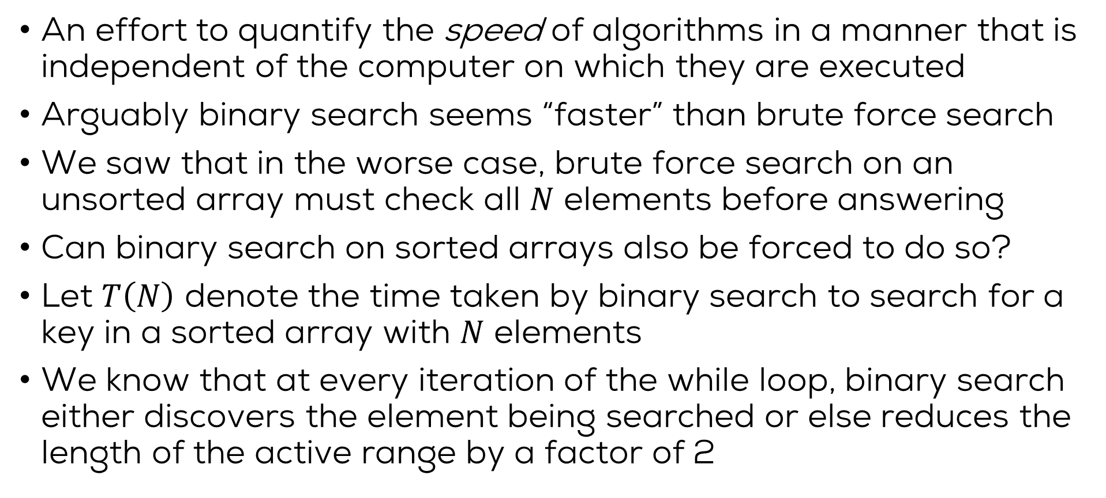
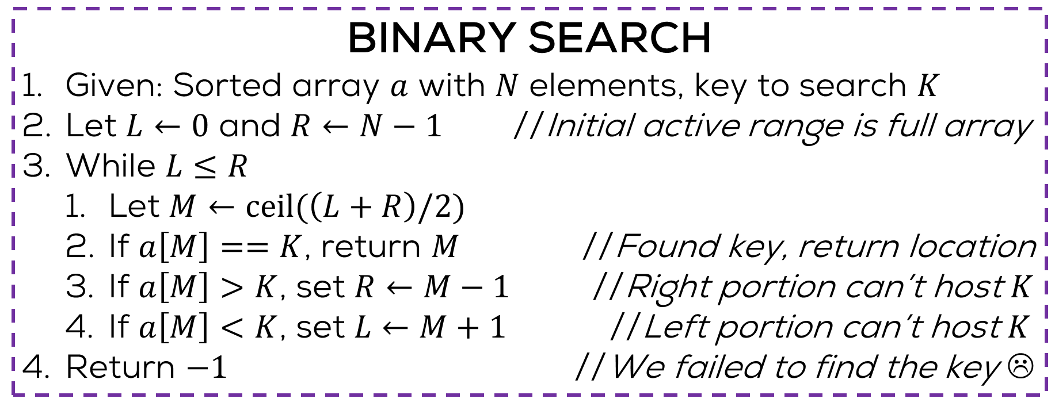
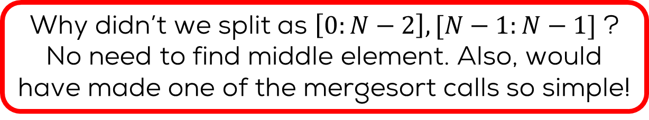
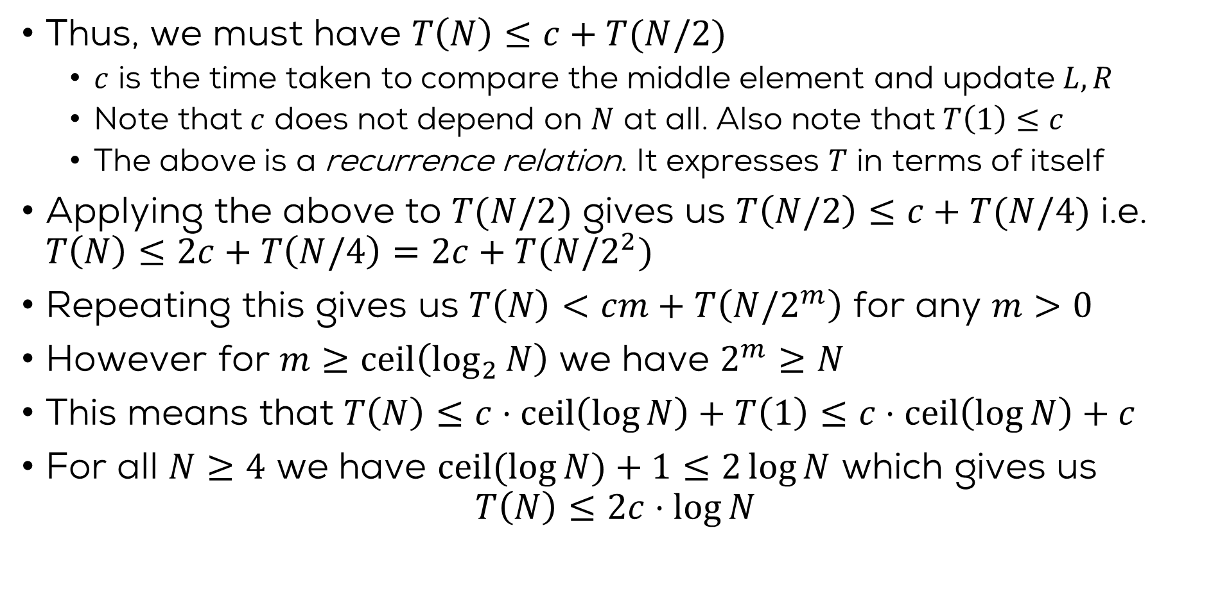
Merge Sort
Why didn’t we split as $\left[0:N−2\right],[N−1:N−1]$ ?
No need to find middle element. Also, would have made one of the mergesort calls so simple!
MERGE SORT
Given: Array $a$ with $N$ elements
If $N<2$ return $a$ //An empty or singleton array is sorted
Let $C←ceil\left(N/2\right)$ //Find the “middle” of the array
$p←$ MERGESORT($a[0:C−1])$ //Sort the left half
$q←$ MERGESORT($a\left[C:N−1\right]$) //Sort the right half
Return MERGE($p,q$) //Merge the two halves
A sort algorithm is called in-place if it does not use extra memory e.g. extra arrays, to sort the given array
Uses a lot of extra memory $p,q$. Even MERGE uses extra memory – not good! Need an in-place version
Why did we split as $\left[0:C−1\right],[C:N−1]$ and not as $\left[0:C\right],[C+1:N−1]$? Hint: end-case.

Slide 15
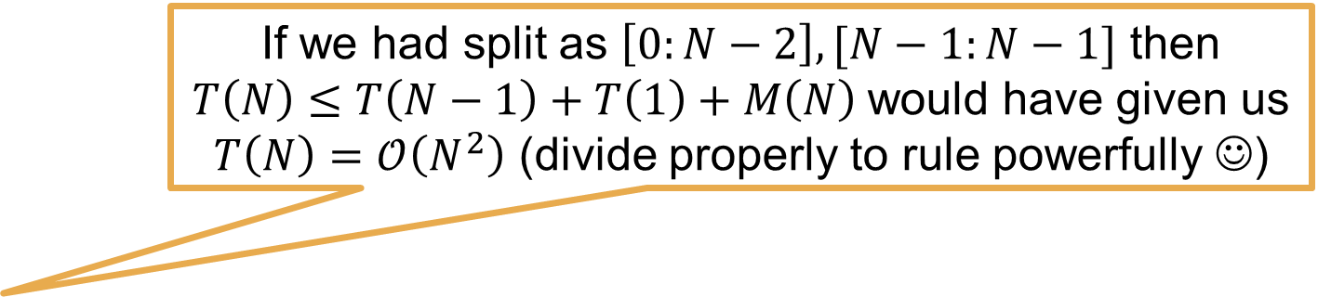
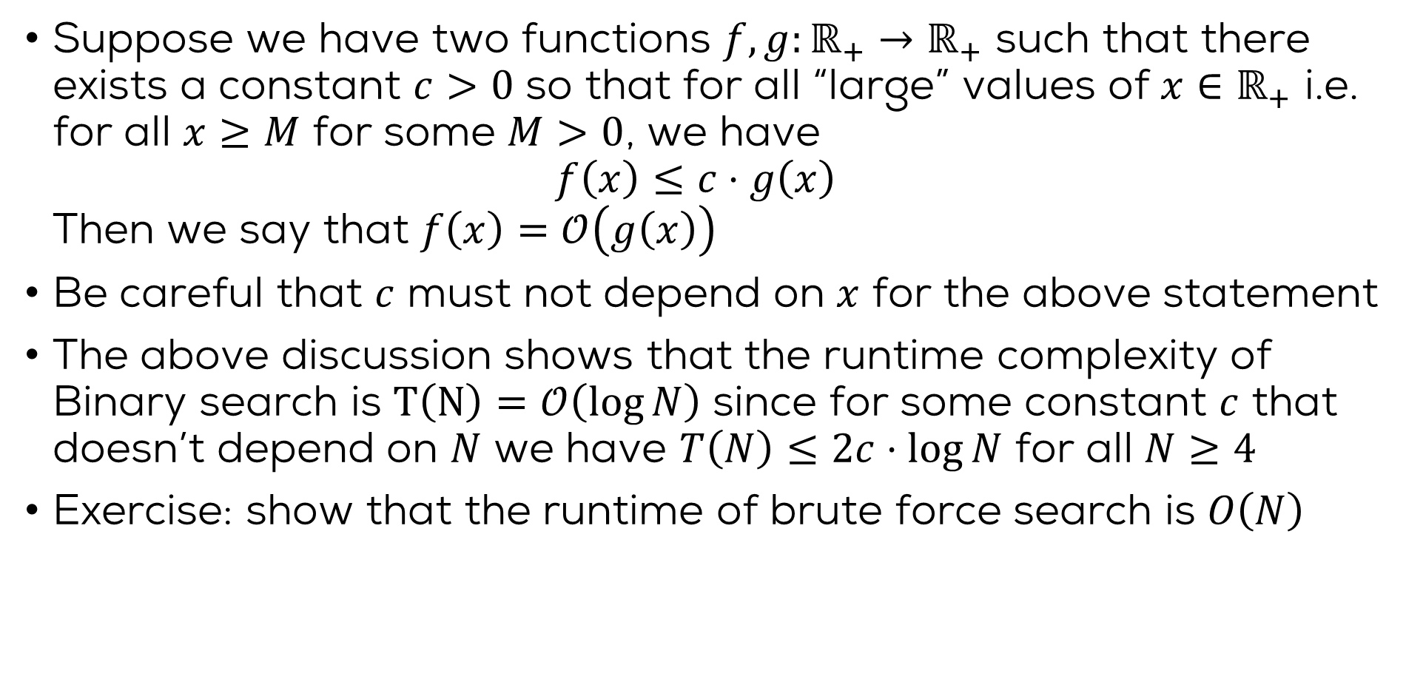
Time Complexity
If we had split as $\left[0:N−2\right],[N−1:N−1]$ then $T\left(N\right)≤T\left(N−1\right)+T\left(1\right)+M\left(N\right)$would have given us
$T\left(N\right)=𝒪\left(N^{2}\right)$ (divide properly to rule powerfully ☺)
Let $T\left(N\right)$ be the time taken for merge sort to sort $N$ elements
Let $M(N)$ be time merging two sorted arrays with total $N$ elements
Thus, we have $T\left(N\right)≤2⋅T\left(N/2\right)+M\left(N\right)+d$ ($d$: find middle index)
We will show next that we can do $M\left(N\right)≤c⋅N$ time
This recurrence is a bit harder to solve but we can still try $T\left(N/2\right)≤2⋅T\left(N/4\right)+c⋅N/2+d$
$$T\left(N\right)≤4⋅T\left(N/4\right)+2c⋅N+\left(1+2\right)⋅d$$
$$T\left(N\right)≤2^{k}⋅T\left(N{/2}^{k}\right)+kc⋅N+2^{k}⋅d$$
Set $k=ceil(\log{N)}$ and use $T\left(1\right)≤c$ to get $T\left(N\right)≤ 𝒪\left(N\log{N}\right)$
The version of merging we will show uses extra $𝒪\left(N\right)$ memory. Can you develop a version that uses only 2-3 extra integer variables i.e. an in-place version of merge sort?

Slide 16
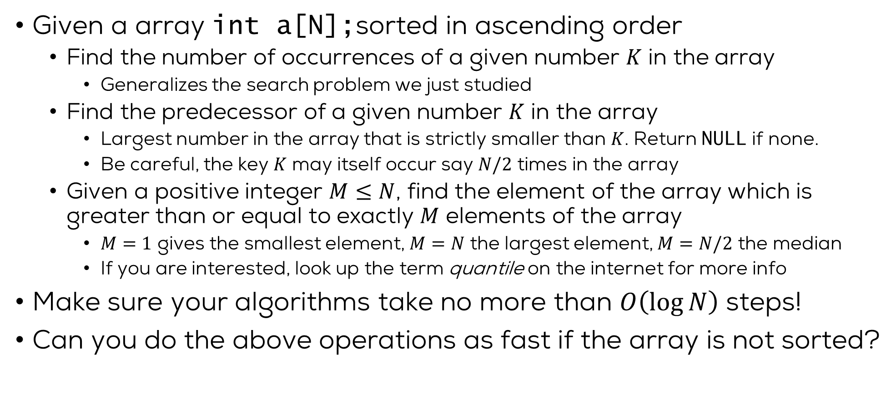
The Merge Operation
Actually, we have already done this – see Week 7 Monday lab question 1 ☺
Given 2 arrays $int a\left[M\right],b\left[N\right];$ both sorted in ascending order
Want a combined array $int c\left[M+N\right];$ sorted in ascending order
Will maintain active ranges for both arrays $a[0:R_{1}]$ and $b\left[0:R_{2}\right]$ with $0≤R_{1}<M$ and $0≤R_{2}<N$
Initially the active ranges are the entire arrays i.e. $R_{1}=M−1,R_{2}=N−1$
Invariant: at all points of time, we will ensure that elements in the non-active regions of the arrays would have been inserted into $c$ at their proper locations
At least one active region will shrink by one element at each step
Trick: the largest element of $c$ can be found in $𝒪\left(1\right)$ time since the arrays $a,b$ are sorted. If unsorted it would have taken $𝒪\left(M+N\right)$

Slide 17
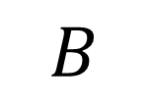
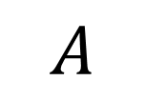
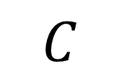
The Merge Operation
1
1
2
2
4
7
9
9
1
2
3
4
5
5
8
8
$$A$$
$$B$$
Merge
1
1
1
2
2
2
3
4
4
5
5
7
8
8
9
9
$$C$$
9 is larger: A wins
9 is larger: A wins again
8 is larger: B wins
8 is larger: B wins again

Slide 18
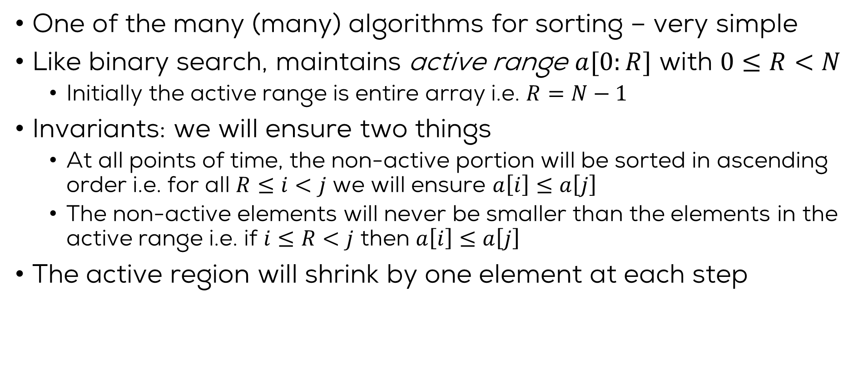
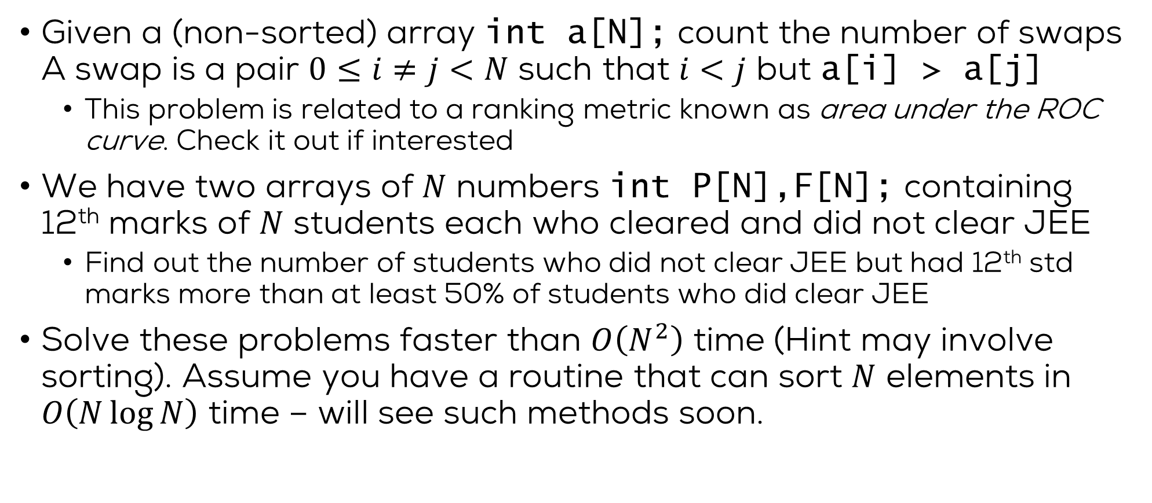
The Merge Operation
MERGE
Given: Sorted arrays $a,b$ with $M,N$ elements respectively.
Let $int c\left[M+N\right], R_{1}←M−1,R_{2}←N−1$
For $k=M+N−1;k≥0;k$--
If $R_{1}<0$ then $c\left[k\right]=b\left[R_{2}\right];R_{2}$-- //We exhausted a
Elseif $R_{2}<0$ then $c\left[k\right]=a\left[R_{1}\right];R_{1}$-- //We exhausted b
Elseif $a\left[R_{1}\right]≥b\left[R_{2}\right]$ then $c\left[k\right]=a\left[R_{1}\right];R_{1}$-- //Both active, a wins
Else $c\left[k\right]=b\left[R_{2}\right];R_{2}$-- //Both active, b wins
Return $c$
Exercise: write an in-place version – cant allocate $c\left[M+N\right]$
Exercise: show that merging two arrays of size $M,N$ takes time $𝒪\left(M+N\right)$

Slide 19
Sorting Algorithms
Quick Sort

Slide 20
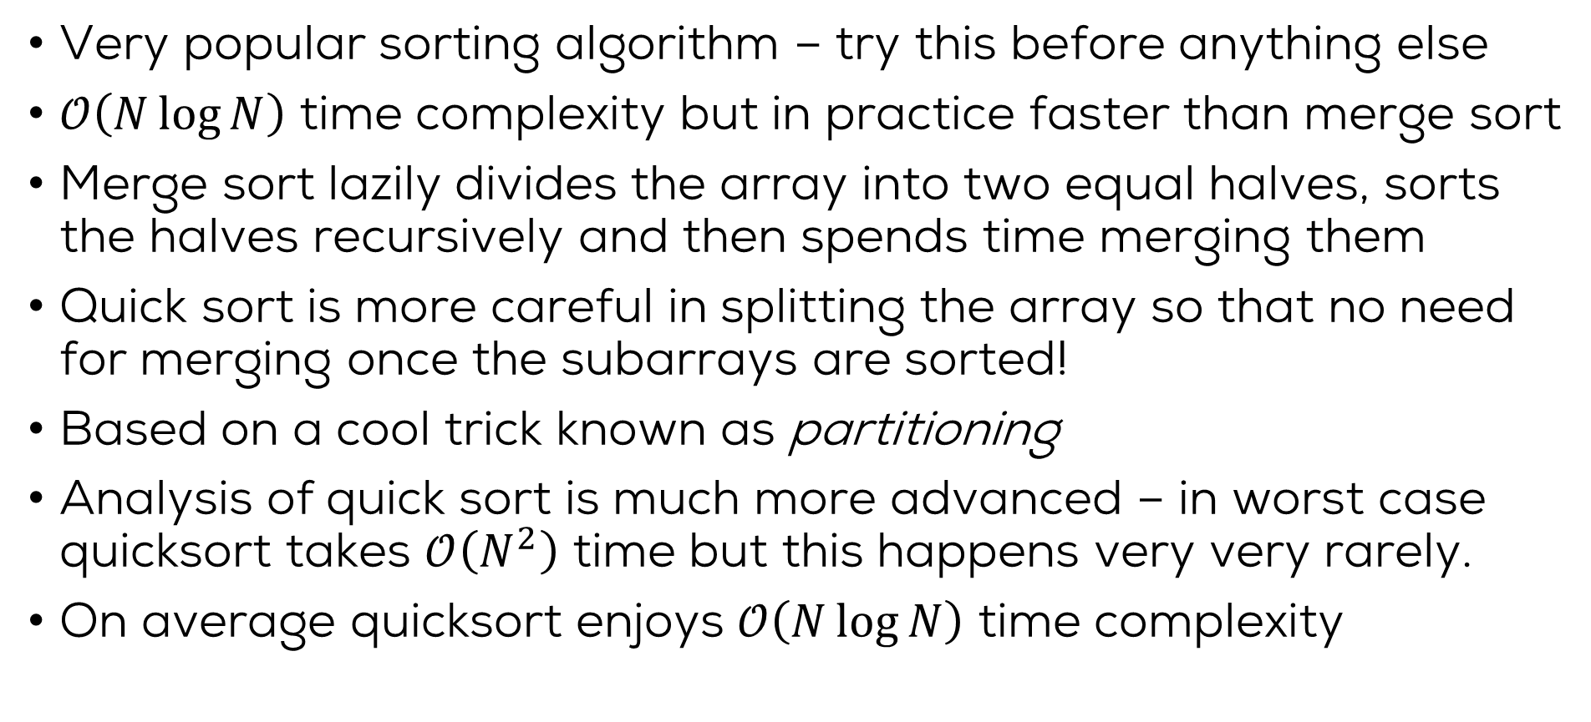
Quick Sort
Very popular sorting algorithm – try this before anything else
$𝒪\left(N\log{N}\right)$ time complexity but in practice faster than merge sort
Merge sort lazily divides the array into two equal halves, sorts the halves recursively and then spends time merging them
Quick sort is more careful in splitting the array so that no need for merging once the subarrays are sorted!
Based on a cool trick known as partitioning
Analysis of quick sort is much more advanced – in worst case quicksort takes $𝒪\left(N^{2}\right)$ time but this happens very very rarely.
On average quicksort enjoys $𝒪\left(N\log{N}\right)$ time complexity

Slide 21

The Partition Technique
Given array $int a\left[N\right]$ and any element of the array $p$ (called pivot)
Create a new array $int b\left[N\right]$ which is arranged as follows $\left[elements of a≤p, p, elements of a≥p\right]$
Notice that left and right halves are not sorted yet! 😐
Also, the two halves are not balanced (of same size) either 😐
9
1
9
4
2
1
2
7
5
8
3
5
2
1
4
8
1
2
1
2
2
1
3
8
4
5
8
5
7
4
9
9

Slide 22
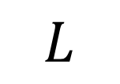
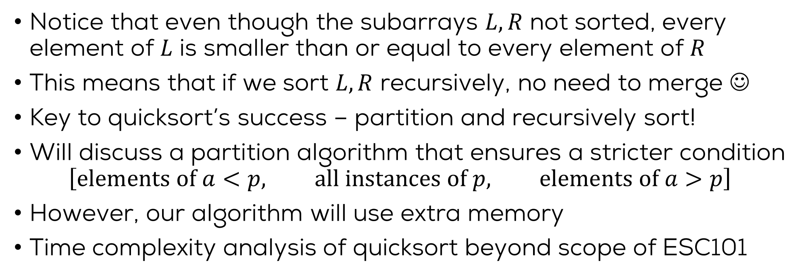
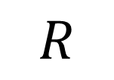
Quick Sort
1
2
1
2
2
1
3
8
4
5
8
5
7
4
9
9
$$L$$
$$R$$
Notice that even though the subarrays $L,R$ not sorted, every element of $L$ is smaller than or equal to every element of $R$
This means that if we sort $L,R$ recursively, no need to merge ☺
Key to quicksort’s success – partition and recursively sort!
Will discuss a partition algorithm that ensures a stricter condition $\left[elements of a<p, all instances of p, elements of a>p\right]$
However, our algorithm will use extra memory
Time complexity analysis of quicksort beyond scope of ESC101

Slide 23
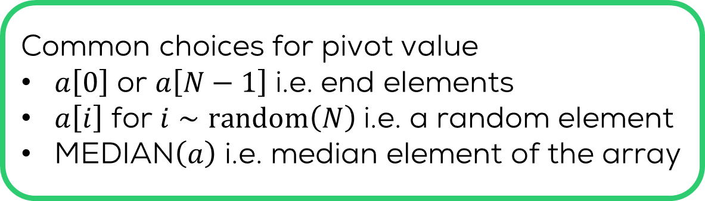
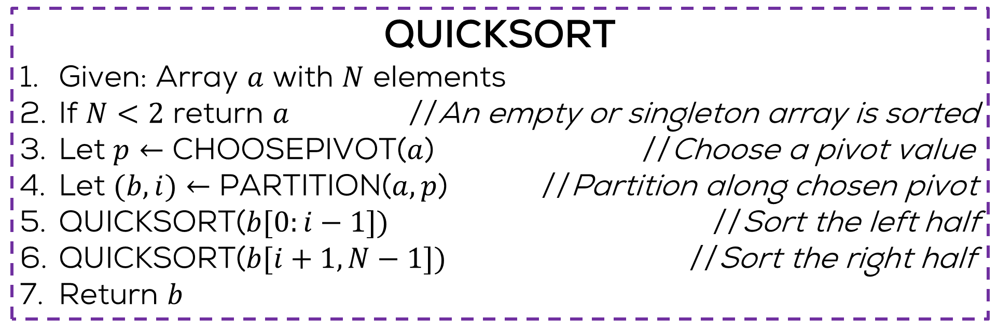

Quick Sort
QUICKSORT
Given: Array $a$ with $N$ elements
If $N<2$ return $a$ //An empty or singleton array is sorted
Let $p←$ CHOOSEPIVOT($a$) //Choose a pivot value
Let $(b,i)←$ PARTITION($a,p$) //Partition along chosen pivot
QUICKSORT($b[0:i−1])$ //Sort the left half
QUICKSORT($b[i+1,N−1])$ //Sort the right half
Return $b$
$i$ is the new location of the pivot element
Most popular, inexpensive
Common choices for pivot value
$a\left[0\right]$ or $a\left[N−1\right]$ i.e. end elements
$a\left[i\right]$ for $i∼random\left(N\right)$ i.e. a random element
MEDIAN$\left(a\right)$ i.e. median element of the array
Also common, inexpensive
Ensures balanced partition but expensive

Slide 24


The Partition Procedure
The partition procedure maintains an interesting structure of one active region sandwiched between two inactive regions ☺
Invariant: elements in the left inactive region are strictly less than the pivot, those in right invariant region strictly larger than pivot
What about element(s) equal to the pivot – need to be careful
Lets see a visualization of the partition procedure in action
Note: these regions will be maintained on a separate array and not the original array – we will only take a simple left-to-right pass on the original array
$$L$$
$$R$$

Slide 25
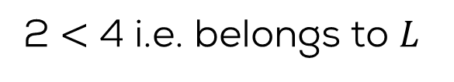
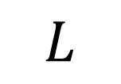
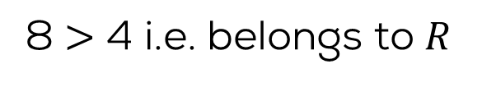
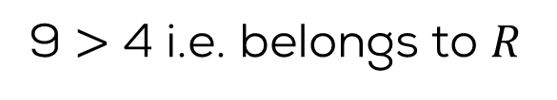
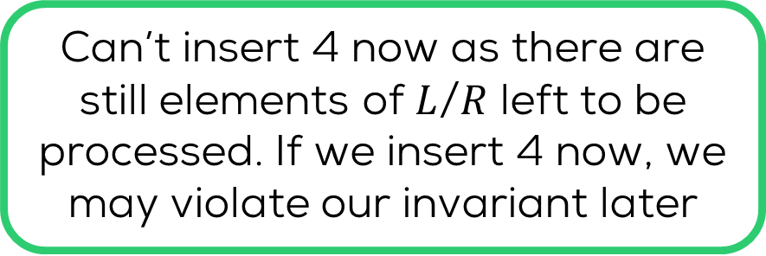
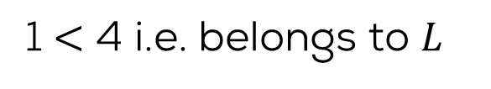
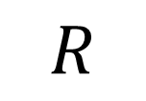
The Partition Procedure
We are sure now that any blank spaces left must be occurrences of pivot 4 that we omitted earlier
We will insert all occurrences of the pivot element 4 after we are done with non-pivot elements
PIVOT =
4
9
1
9
4
2
1
2
7
5
8
3
5
2
1
4
8
1
2
1
2
3
2
1
4
4
8
5
8
5
7
9
9
$$L$$
$$R$$
Can’t insert 4 now as there are still elements of $L$/$R$ left to be processed. If we insert 4 now, we may violate our invariant later
9 $>$ 4 i.e. belongs to $R$
1 $<$ 4 i.e. belongs to $L$
9 $>$ 4 i.e. belongs to $R$
8 $>$ 4 i.e. belongs to $R$
2 $<$ 4 i.e. belongs to $L$

Slide 26

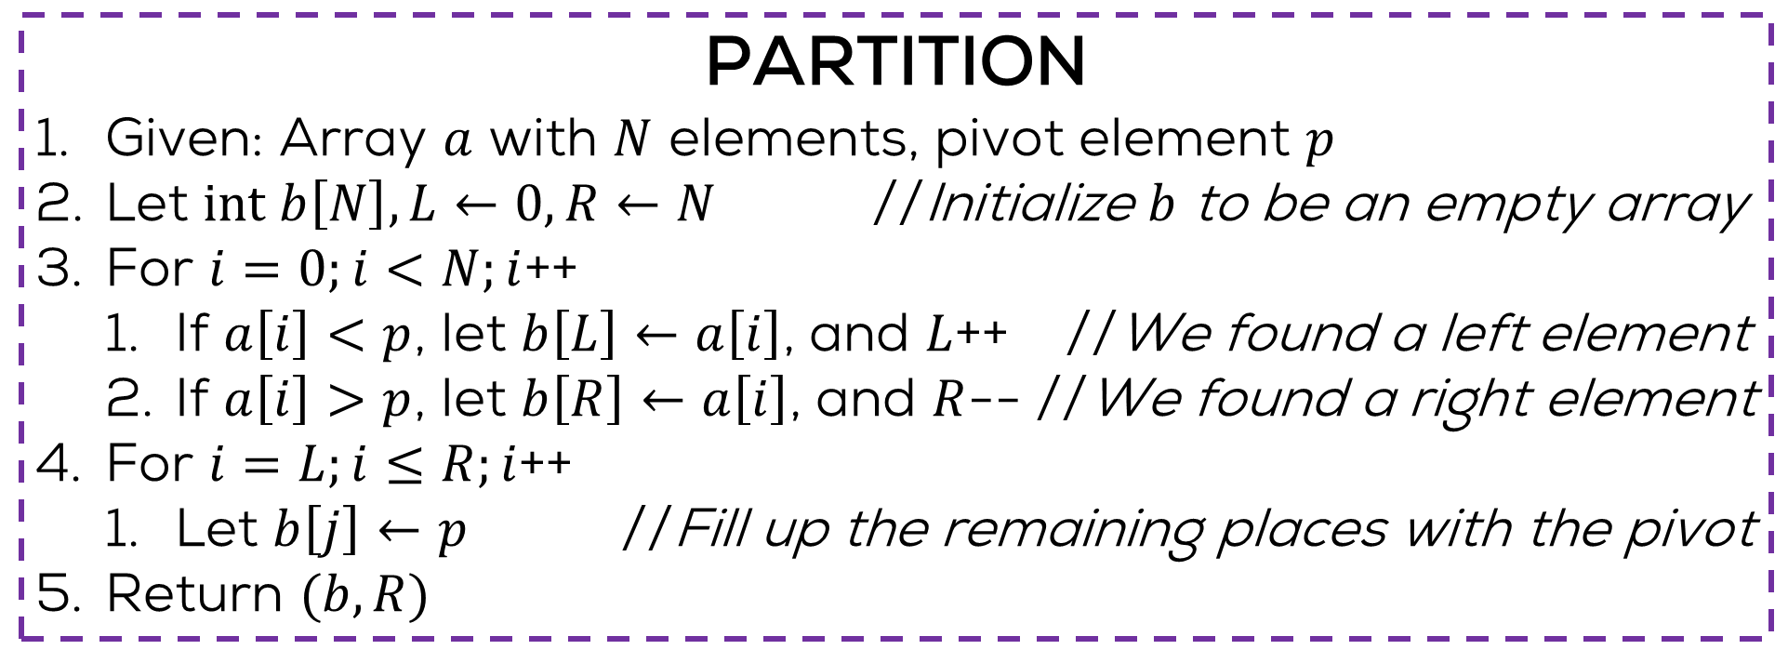
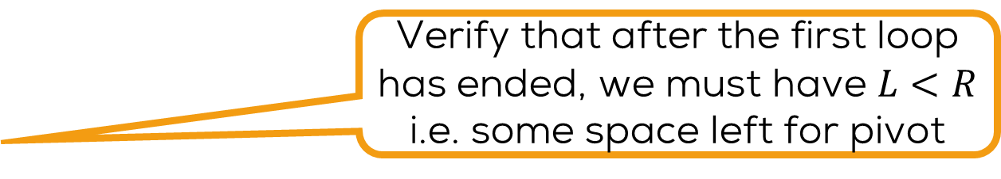
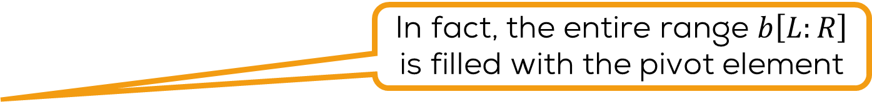
The Partition Procedure
PARTITION
Given: Array $a$ with $N$ elements, pivot element $p$
Let $int b\left[N\right], L←0,R←N$ //Initialize $b$ to be an empty array
For $i=0;i<N;i$++
If $a\left[i\right]<p$, let $b\left[L\right]←a\left[i\right]$, and $L$++ //We found a left element
If $a\left[i\right]>p$, let $b\left[R\right]←a\left[i\right]$, and $R$-- //We found a right element
For $i=L;i≤R;i$++
Let $b\left[j\right]←p$ //Fill up the remaining places with the pivot
Return $(b,R)$
Verify that after the first loop has ended, we must have $L<R$ i.e. some space left for pivot
In fact, the entire range $b\left[L:R\right]$ is filled with the pivot element
$R$ has to be (one of) the new location(s) of the pivot element
Hint: the in-place algorithm uses an identical notion of inactive regions but swaps elements at the boundaries of the regions which are wrongly placed
Explore/invent yourself an
in-place partitioning algorithm

Slide 27

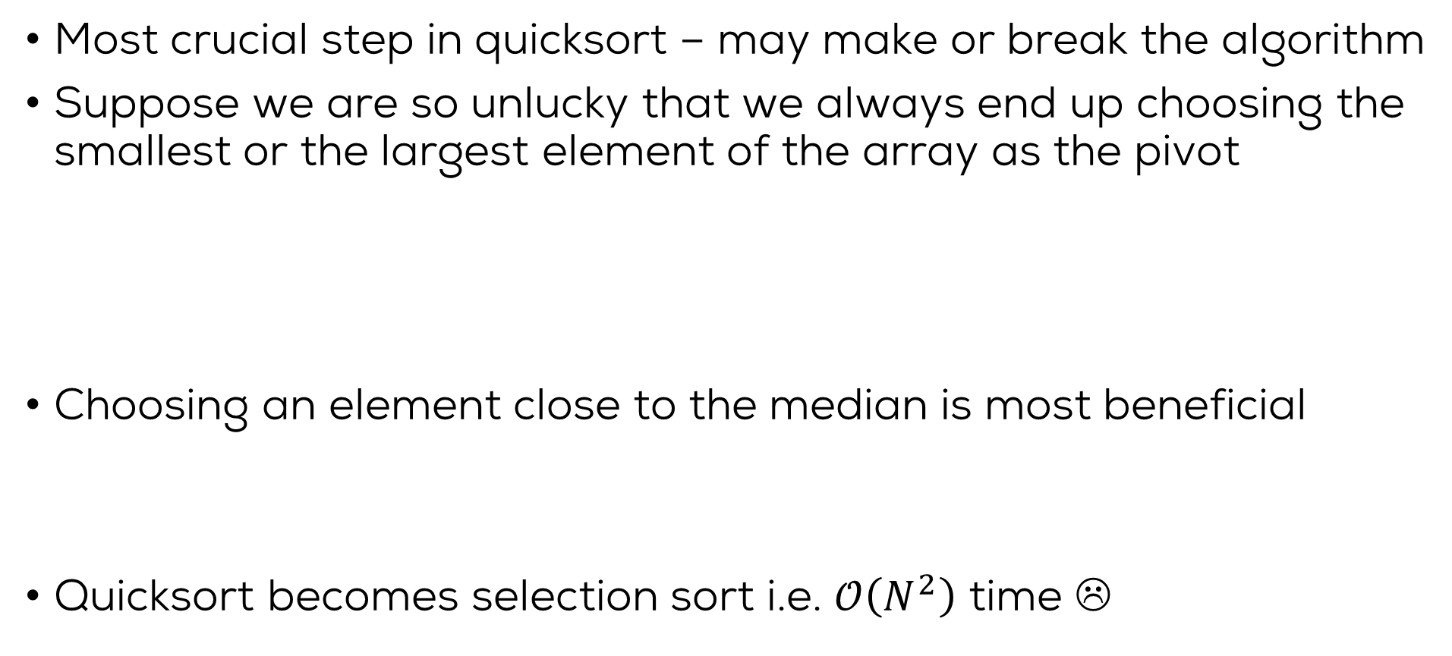
Choice of Pivot
Ironically, if the array is already sorted and we use end elements as pivots, then quicksort takes $𝒪\left(N^{2}\right)$ time ☹
Most crucial step in quicksort – may make or break the algorithm
Suppose we are so unlucky that we always end up choosing the smallest or the largest element of the array as the pivot
Choosing an element close to the median is most beneficial
Quicksort becomes selection sort i.e. $𝒪\left(N^{2}\right)$ time ☹
9
1
8
4
2
1
2
7
5
8
3
5
2
1
4
8
1
2
1
2
2
1
3
8
4
5
8
5
7
4
8
9

Slide 28
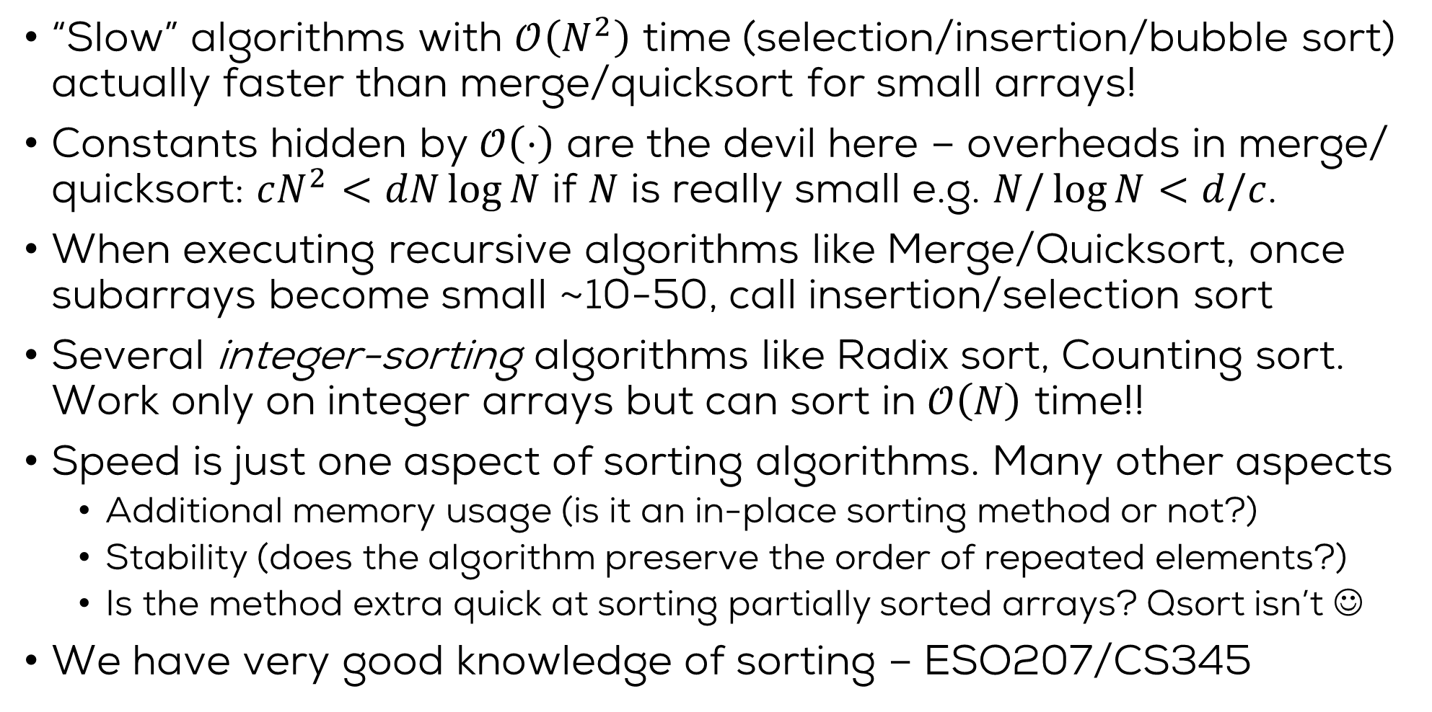
Some folklore wisdom
“Slow” algorithms with $𝒪\left(N^{2}\right)$ time (selection/insertion/bubble sort) actually faster than merge/quicksort for small arrays!
Constants hidden by $𝒪\left(⋅\right)$ are the devil here – overheads in merge/ quicksort: $cN^{2}<dN\log{N}$ if $N$ is really small e.g. $N/\log{N}<d/c$.
When executing recursive algorithms like Merge/Quicksort, once subarrays become small ~10-50, call insertion/selection sort
Several integer-sorting algorithms like Radix sort, Counting sort. Work only on integer arrays but can sort in $𝒪\left(N\right)$ time!!
Speed is just one aspect of sorting algorithms. Many other aspects
Additional memory usage (is it an in-place sorting method or not?)
Stability (does the algorithm preserve the order of repeated elements?)
Is the method extra quick at sorting partially sorted arrays? Qsort isn’t ☺
We have very good knowledge of sorting – ESO207/CS345

