Slide 1
Let us give Mr C a Complement
ESC101: Fundamentals of Computing
Purushottam Kar

Slide 2
The Binary Number System
Just two digits – 0 and 1
We will today see how the binary system is used to represent negative and fractional numbers
1
0
1
1
0
1
= 1 x 2⁰ + 0 x 2¹ + 1 x 2² + 1 x 2³ + 0 x 2⁴ + 1 x 2⁵
= 1 + 0 + 4 + 8 + 0 + 32
= 45

Slide 3


Bitwise Operators
Note: the word is complement and not compliment ☺
Operation | C Code | a | b | c | d | e | f
BITWISE AND | c = a & b | 0000 | 1111 | 0000 | 1111 | 1111 | 1111
BITWISE OR | d = a | b | 0101 | 1100 | 0100 | 1101 | 1001 | 1010
BITWISE XOR | e = a ^ b | 1010 | 1110 | 1010 | 1110 | 0100 | 0101
BITWISE COMPLEMENT | f = ~a | 1001 | 0111 | 0001 | 1111 | 1110 | 0110
The word compliment means to praise someone, complement means to enhance something

Slide 4
Bitwise And Operator &
The output of bitwise AND is 1 if the corresponding bits of two operands is 1. If either bit of an operand is 0, the result of corresponding bit is evaluated to 0
In C Programming, bitwise AND operator is denoted by &
12 = 00001100 (In Binary)
25 = 00011001 (In Binary)
Bitwise AND of 12 and 25
0000 1100
& 0001 1001
_________
0000 1000 = 8 (In decimal)
#include <stdio.h>
int main(){
int a = 12, b = 25;
printf("Output = %d", a & b);
return 0;
}

Slide 5
Bitwise OR Operator |
The output of bitwise OR is 1 if at least one corresponding bit of two operands is 1
In C Programming, bitwise OR operator is denoted by |
12 = 00001100 (In Binary)
25 = 00011001 (In Binary)
Bitwise OR of 12 and 25
0000 1100
| 0001 1001
________
00011101 = 29 (In decimal)
#include <stdio.h>
int main(){
int a = 12, b = 25;
printf("Output = %d", a | b);
return 0;
}

Slide 6
Bitwise XOR Operator ^
The result of bitwise XOR operator is 1 if the corresponding bits of two operands are opposite i.e. one is 1 and the other is 0
In C Programming, bitwise XOR operator is denoted by ^
12 = 00001100 (In Binary)
25 = 00011001 (In Binary)
Bitwise XOR of 12 and 25
00001100
^ 00011001
________
00010101 = 21 (In decimal)
#include <stdio.h>
int main(){
int a = 12, b = 25;
printf("Output = %d", a^b);
return 0;
}

Slide 7

Bitwise Complement Operator ~
Why does flipping bits of 12 generate -13?
A unary operator that simply flips each bit of the input
In C Programming, bitwise complement operator is denoted by ~
Wait just a sec – I will teach you how negative numbers are represented
12 = 0000 0000 0000 0000 0000 0000 0000 1100 Bitwise complement of 12 00001100
~ 0000 0000 0000 0000 0000 0000 0000 1100
_____________________________________
1111 1111 1111 1111 1111 1111 1111 0011
= -13 (decimal)
#include <stdio.h>
int main(){
int a = 12;
printf("Output = %d", ~a);
return 0;
}

Slide 8
Right Shift Operator >>
Right shift operator shifts all bits towards right by a certain number of locations
Bits that “fall off” from the right most end are lost
Blank spaces in the leftmost positions are filled with 0s
212 = 0000 0000 0000 0000 0000 0000 1101 0100
212 >> 0 = 0000 0000 0000 0000 0000 0000 1101 0100
212 >> 4 = 0000 0000 0000 0000 0000 0000 0000 1101
212 >> 6 = 0000 0000 0000 0000 0000 0000 0000 0011
212 >> 3 = 0000 0000 0000 0000 0000 0000 0001 1010
Right shift by k is equivalent to integer division with 2^{k} ☺

Slide 9
Left Shift Operator <<
However, be warned. If you left shift too much, multiplication with 2^{k} may give you a number too large to be represented by an int. You may get garbage results.
Left shift operator shifts all bits towards left by a certain number of locations
Bits that “fall off” from the left most end are lost
Blank spaces in the right positions are filled with 0s
212 = 0000 0000 0000 0000 0000 0000 1101 0100
212 << 0 = 0000 0000 0000 0000 0000 0000 1101 0100
212 << 4 = 0000 0000 0000 0000 0000 1101 0100 0000
212 << 6 = 0000 0000 0000 0000 0011 0101 0000 0000
212 << 28 = 0100 0000 0000 0000 0000 0000 0000 0000
Left shift by k is equivalent to integer multiplication with 2^{k}

Slide 10
Example use of bitwise operators
Can use “masks” to extract certain bits of a number
Suppose I want to look at the last 6 bits of a number a
Create a mask with only last bits set to 1 and take & with a
a = 0000 0000 0000 0000 0000 0001 1010 1011
p = 0000 0000 0000 0000 0000 0000 0000 0001
q = 0000 0000 0000 0000 0000 0000 0100 0000
m = 0000 0000 0000 0000 0000 0000 0011 1111
r = 0000 0000 0000 0000 0000 0000 0010 1011
int a = 427;
int p = 1;
int q = p << 6;
int m = q – 1;
int r = a & m;
printf("%d", r); // 43

Slide 11
BODMAS table has more members
Operator Name | Symbol/Sign | Associativity
Brackets (array subscript), Post increment/decrement, structure field selection (dot and arrow) | (), [] ++, --, ., -> | Left
Unary negation, Pre-increment/decrement, NOT, (de)reference, sizeof, bitwise complement | -, ++, --, !, *, &, sizeof, ~ | Right
Multiplication/division/remainder | *, /, % | Left
Addition/subtraction | +, - | Left
Bitwise left shift and right shift | <<, >>
Relational | <, <=, >, >= | Left
Relational | ==, != | Left
Bitwise AND | & | Left
Bitwise XOR | ^ | Left
Bitwise OR | | | Left
Logical AND | && | Left
Logical OR | || | Left
Ternary Conditional | ? : | Right
Assignment, Compound assignment | =, +=, -=, *=, /=, %=, &=, ^=, |=, <<=, >>= | Right
HIGH
LOW

Slide 12
One’s Compliment
If we have n bits, then using one’s compliment, we can represent numbers between –(2^{n-1} – 1) and +(2^{n-1} – 1)
The one’s compliment of a binary number) is simply the bitwise compliment of that binary number
A long time ago (25-30 years ago) one’s compliment used to be used to represent negative numbers
35 as a 4 byte int is represented as 0000 0000 0000 0000 0000 0000 0010 0011
So, in those old computers, -35 used to be represented as 1111 1111 1111 1111 1111 1111 1101 1100
Note that b + ~b = 11111111 11111111 11111111 11111111
Used no more. These days, computers use two’s compliment to represent negative numbers
The first bit acts as a sign bit – if the first bit is 1, it is treated as a negative number, if the first bit is 0, it is treated as a positive number
Largest positive number is 01111111 11111111 11111111 11111111
Smallest negative number is 1000000 00000000 00000000 00000000
Weird thing – negative 0 ☺
11111111 11111111 11111111 11111111

Slide 13
Two’s Compliment
These days, the two’s complement of a number represents the negative of that number e.g. -9 is represented as two’s complement of 9
Advantages over one’s compliment
Arithmetic circuits inside microprocessors do not need to look at sign bits
There is no weirdness about positive zero and negative zero
Two’s compliment of an n-bit binary number is the number which when added to this number, gives 2^{n}
This means two’s compliment of b is 2^{n} – b
Recall that b + ~b = all ones = 2^{n} – 1 i.e. two’s compliment of b is 2^{n} – b = ~b + 1
Easier way of calculating two’s compliment – take the one’s compliment and add 1 to the binary string ☺
So for any integer n, bitwise complement of n will be -(n+1)
If we have n bits, then using one’s compliment, we can represent numbers between –2^{n-1} and +(2^{n-1} – 1)
The first bit acts as a sign bit – if the first bit is 1, it is treated as a negative number, if the first bit is 0, it is treated as a positive number
Largest positive number is 01111111 11111111 11111111 11111111
Smallest negative number is 1000000 00000000 00000000 00000000
11111111 11111111 11111111 11111111 now represents -1 ☺

Slide 14
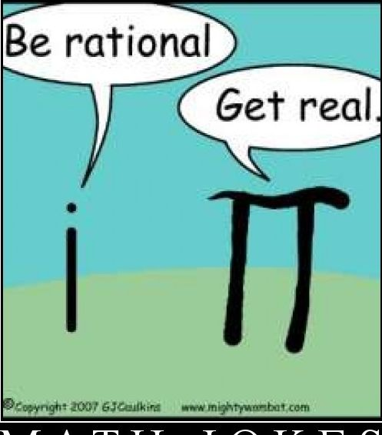
Floating Point Representation
Have to represent three things
Sign: uses 1 bit
Mantissa: uses 23 bits
Exponent: uses 8 bits
Base 2: d_{i} ‘s are binary digits 0 or 1.
Its value is
p is called the precision of the representation.
Here base of the representation is 2. In general, the base could be different from 2. e.g., scientific calculators typically use base 10.

Slide 15
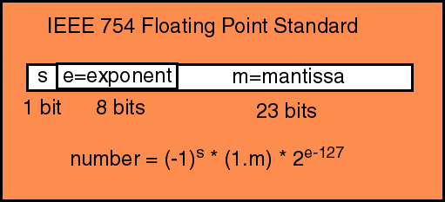
IEEE 754 Floating Point Representation

Slide 16
Range of Representation
Base 2: d_{i} ‘s are binary digits 0 or 1.
E.g., for number (0.1)₁₀ (i.e., 0.1 in decimal), p =24, the representation is
(1.10011001100110011001100) X 2⁻⁴
1/16 + 1/32 + 1/256 + 1/512 = 51/512, ….
(0.1)₁₀ is not “exactly” represented in binary.
Real numbers cannot be exactly represented with finite precision and limited exponent.

Slide 17
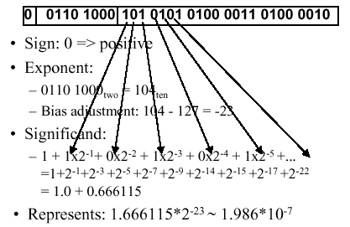
Single-precision (float)
This is what you’re using when you are invoking float

Slide 18
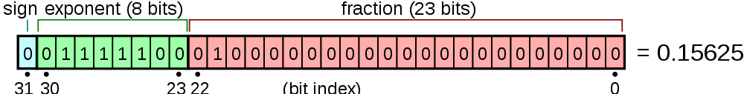
Imprecise Representation
Next number: (1 + ¼ + 2⁻²³)2¹²⁴⁻¹²⁷ = 0.15625+2⁻²⁶
0
0111100
01000000000000000000001
Given number: 0.15625
Previous number: (1+1/8+1/16+…2⁻²³ )2⁻³
= (1+1/4-2⁻²³)2⁻³ ⁼ 0.15625-2⁻²⁶
0
0111100
00111111111111111111111
Real numbers in-between 0.15625 and 0.15625 +2⁻²⁶ may
be all represented as 0.15625.
Discrete representation: leads to approximation errors.

Slide 19
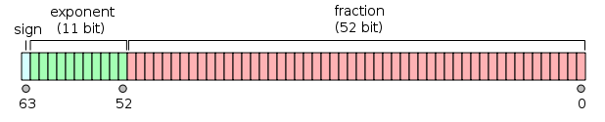
Double Precision (double)
Same logic as single precision, but with 64 bits of memory

Slide 20
Underflow and Overflow
Consider IEEE single precision.
Numbers smaller than 2⁻¹²⁸ are indistinguishable from 0.
Such numbers occurring in calculations are said to be in underflow and are treated as 0.
Numbers that are larger than 2¹²⁸ cannot be represented.
Such numbers occurring in calculations are said to have overflowed.
Warning: IEEE representation allows for +0.00 and –0.00. Be careful.

