Slide 1
Mr. C gets Interactive
ESC101: Foundations of Computing
Purushottam Kar

Slide 2
Announcements - Lab
Please go to lab only on the day of your section, be on time
Section-day allotment same as before (please check course website)
Contact DoAA office in case section not allotted etc
Please bring your IITK ID card (no PAN, Aadhar card) to lab
Set your proxy to relproxy before lab starts – for minor quiz
Piazza will be deactivated during lab hours Mon-Thu 2-5PM
Only handwritten notes allowed in lab (no photocopies, slides etc)
Do not browse internet during lab (YouTube, Google, StackExchange)
Will be considered cheating
In case of doubt, as TA, tutor, instructor

Slide 3
Announcements - Piazza
If not enrolled on Piazza or not activated account, please do so asap
You will miss out on useful discussions, hints, tips
May also miss out on important announcements
How to use Piazza
Please read etiquettes on course website
Not a good thing to give out solutions (Piazza not a place to show off)
When asking question
Please check if it has been already answered
Websites like StackExchange may ban you if you do not do this ☺
Please give details of what went wrong
“Why is this not working” is not at all helpful for someone trying to help you

Slide 4
Fun with Integers
Operation | C Code | a | b | c
Addition | c = a + b; | 5 | 4 | 9
Subtraction | c = a – b; | 4 | 5 | -1
Multiplication | c = a * b; | -2 | -4 | 8
Division | c = a / b; | 7 | 2 | 3
Remainder | c = a % b; | 7 | 2 | 1
Bracketing | c = (a+b)/2; | 5 | 1 | 3
 | c = a + b/2; | 5 | 1 | 5
Recall your BODMAS rules from high school
Mr. C follows similar rules – will see in detail soon
Good practice to bracket your formulae
Minimize confusion as well as chances of error
Play with brackets in lab to practice

Slide 5
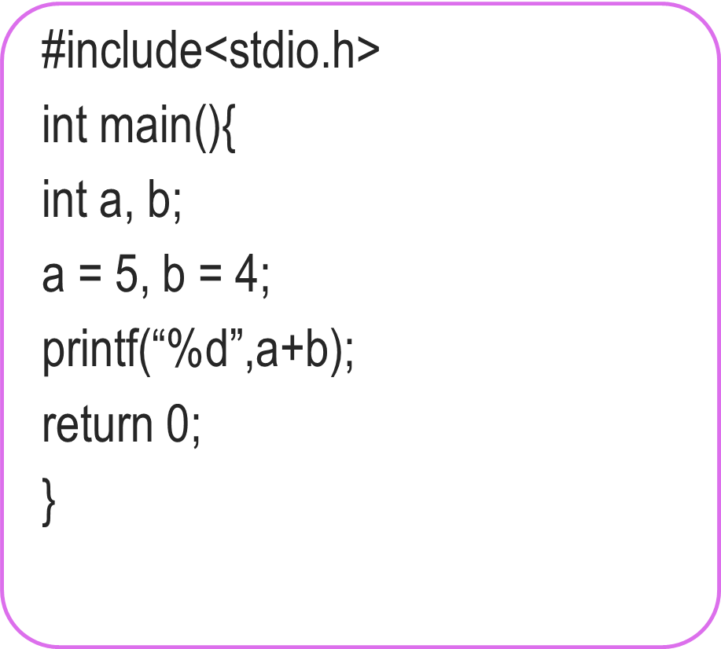

A handy shortcut
How we must speak to mr. compiler
How we usually speak to a human
#include<stdio.h>
int main(){
int a, b, c;
a = 5, b = 4;
c = a + b;
printf(“%d”,c);
return 0;
}
Do you speak English?
Hello
a,b are integer variables.
a = 5 and b = 4.
Please add tell me their sum.
Goodbye
Do you speak English?
Hello
a,b,c are variables.
a = 5 and b = 4.
Please add them and put the result in variable c.
Please tell me value of c.
Goodbye
Nice! I do not have to declare variables unless I really need them ☺
5
4
5
4
a
b
a
b
9
9
9
9
Mr C is also not complaining that the value a+b is unused – since it got printed!
c

Slide 6
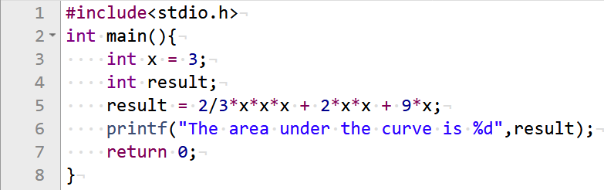


A handy tip while solving problems
Print your solutions to each one of these pieces to see where going wrong
I have no idea what is going wrong here!
Try breaking up the problem into smaller pieces

Slide 7

Writing pretty code is an art
Okay. I will add your two numbers
Last week we learnt about “indentation”
Let us learn about “comments” today
Absolutely essential in industry, even self projects
What we see
What Mr C sees
int main(){
int a;
int b;
a = 5, b = 4;
a + b;
return 0;
}
int main(){
int a; // My first int
int b; // The other int
// Assign them values
a = 5, b = 4;
a + b;
return 0;
}
int main(){
int a;
int b;
a = 5, b = 4;
a + b;
return 0;
}

Slide 8


Commenting Styles
Since it is an art form, artists differ on what is more pretty
int main(){
int a; // My first int
int b; // The other int
// Assign them values
a = 5, b = 4;
a + b;
return 0;
}
int main(){
int a; /* My first int */
int b; /* The other int */
/* Assign them values */
a = 5, b = 4;
a + b;
return 0;
}
int main(){
int a; // My first int
int b; // The other int
/* Assign them values */
a = 5, b = 4;
a + b;
return 0;
}
Yes. In fact /* */ is used to comment several lines at once – shortcut!
So I can mix and match?
Just be a bit careful. Some compilers don’t understand // comments

Slide 9
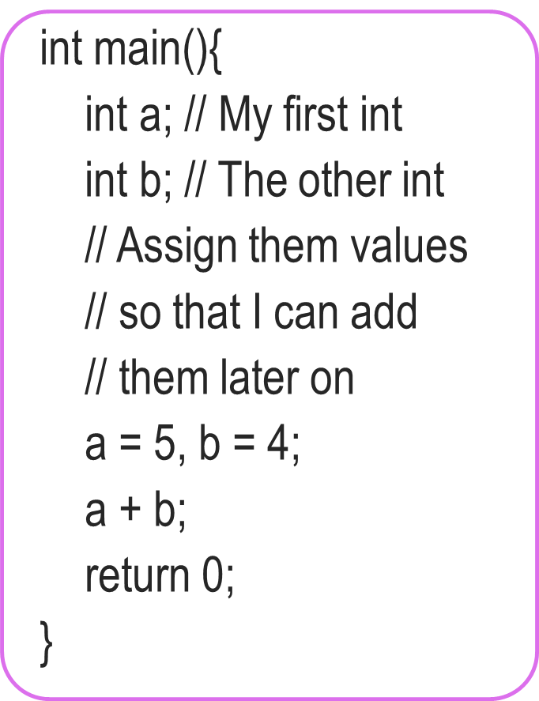
More on Comments
Use comments to describe why you defined each variable and what each step of your code is doing
You will thank yourself for doing this when you are looking at your own code before the endsem exams ☺ ☺
Your team members in your company/research group will also thank you
Multiline comments very handy. No need to write // on every line ☺
int main(){
int a; // My first int
int b; // The other int
/* Assign them values
so that I can add
them later on */
a = 5, b = 4;
a + b;
return 0;
}

Slide 10


A handy tip while solving problems
Comments can be also used to identify where is error
Mr C will tell you (compile) where he thinks the error is
Commenting out lines can also help identify the error
Error!
Okay!
Okay!
int main(){
int a, b;
c = a + b;
a = 5;
b = 4;
return 0;
}
int main(){
int a, b;
// c = a + b;
a = 5;
b = 4;
return 0;
}
int main(){
int a, b, c;
c = a + b;
a = 5;
b = 4;
return 0;
}
Aha! I forgot to declare c

Slide 11
Most Awaited scanf ☺
A bit frustrating
Mr C can add two numbers but both have to be written into code
Also called “hardcoding”
A bit like a calculator which can only add 5 and 4 ☺
To add 6 and 9, write a new calculator ☹
Can’t we ask Mr C to request us for the numbers when he is executing our requests i.e. at runtime?
Of course – take input from the user using scanf

Slide 12
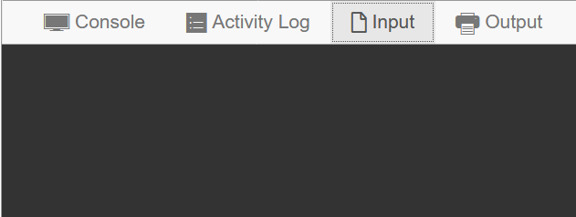

Adding two unknown numbers
How we must speak to mr. compiler
How we usually speak to a human
#include <stdio.h>
int main(){
int a, b;
scanf(“%d”, &a);
scanf(“%d”, &b);
printf(“%d”, a + b);
return 0;
}
Do you speak English?
Hello
a, b are two variables.
Please ask me for value of a.
Please ask me for value of b.
Please print their sum.
Goodbye
3
8
a
b
Thanks. Let me get back to work
11
Please give me input
11

Slide 13



Words of Caution
In Prutor, input has to be specified before “Execute”
Please be very careful about this common mistake
Will explain what this & means, in few weeks
Tomorrow, will learn shorthand for multiple inputs
scanf(“%d”,a);
scanf(“%d”,&a);
Both work! Experiment!

