Slide 1
Mr. C can Float!
ESC101: Foundations of Computing
Purushottam Kar

Slide 2
Announcements - Holiday
No lecture, no lab this Wednesday (institute holiday)
Extra lecture this Saturday 18 August 2018
12 noon, L20 (same as usual)
Extra lab for B10, B11, B12, B14 this Saturday 18 August
2PM – 5PM, New Core Labs CC-01 and CC-02 (same as usual)

Slide 3
Announcements – Marks
Lab marks and minor quiz marks for a particular week will be released after all labs for next week are over
Marks for last week will be released after Saturday lab this week
Lab problems already released as practice problems – practice!
Hidden test cases for these lab-practice problems will also be released
Your questions were auto-graded – no grace marks!
If you discover, autograder made a mistake (hidden test case), you may request for regrading
Useless regrading requests will be given negative marks – be very careful before making request!

Slide 4
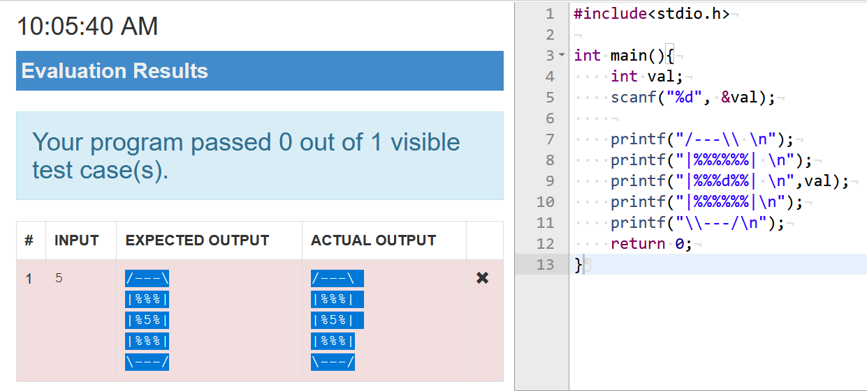
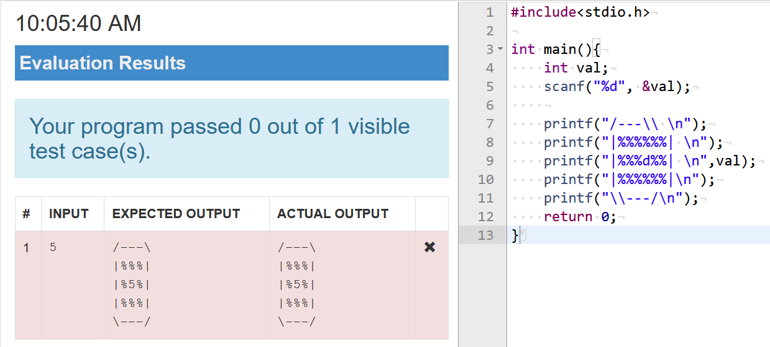
A handy Tip for Prutor
How to check if you have extra spaces or not ☺
Select both the expected output and your output. Any extra spaces will get revealed.

Slide 5


Hidden trick with Integer division
Integer division might seem useless 2 / 3 = 0, 5 / 2 = 2 ☹
Have to use % to obtain remainder 2 % 3 = 2, 5 % 2 = 1 😐
Be careful when doing the above with negative integers
Different C compilers handle sign a bit differently
In Prutor, 5 % 2 = 1 but 5 % -2 = 1 as well
However, all compilers ensure that a = (a/b) * b + a % b
Integer division can be used to extract digits of an integer
12345 % 10 = 5 (the last digit)
12345 / 10 = 1234 (the remaining digits)
Wow, this could be a really useful in lab or exam questions!
Yup, my solution for the bonus problem used this exact same trick ☺
Oh, Hi Puru. Nice of you to drop by

Slide 6


Rounding errors with Integer division
In the first program 5/2 = 2 (loss of 0.5) and 7/2 = 3 (loss of 0.5). Total loss of 1.0
Recall that integer division throws away decimal portion
Errors can accumulate if done too many times
Minimize the number of times you do integer division
5
6
#include <stdio.h>
int main(){
int a = 5, b = 7;
printf(“Average %d”, a/2 + b/2);
return 0;
}
#include <stdio.h>
int main(){
int a = 5, b = 7;
printf(“Average %d”, (a + b)/2);
return 0;
}

Slide 7
Int type
Can store integers b/w -2,147,483,648 and 2,147,483,647
#include <stdio.h>
int main(){
int a;
scanf(“%d”, &a);
printf(“My first int %d”, a);
return 0;
}
Integer arithmetic applies to long int as well +, -, /, *, %, ()
Have worked with them a lot so far
a

Slide 8
Long int type
Really long – can store integers between
-9,223,372,036,854,775,808 and 9,223,372,036,854,775,807
#include <stdio.h>
int main(){
long a; //long int also
scanf(“%ld”, &a);
printf(“My first long int %ld”, a);
return 0;
}
Integer arithmetic applies to long int as well +, -, /, *, %, ()
Try them out on Prutor
How does long work with int int + long, int * long?
Will see today
a

Slide 9
Float type
int, long allow us to store, do math formulae with integers
float allows us to store, do math formulae with reals
#include <stdio.h>
int main(){
float a;
scanf(“%f”, &a);
printf(“My first real %f”, a);
return 0;
}
Very large range ± 3.4e+38
Arithmetic operations apply to float as well +, -, /, *, ()
Try them out on Prutor
a

Slide 10
Double type
Double can also handle real numbers but very large ones
Similar relation to float as long has to int
#include <stdio.h>
int main(){
double a;
scanf(“%f”, &a);
printf(“My first real %f”, a);
return 0;
}
Very large range ± 1.79e+308
Arithmetic operations apply to double as well +, -, /, *, ()
There is something called long double as well ☺
Use %Lf to work with long doubles
Try these out on Prutor
a
%lf works too!

Slide 11

Fun with Printing floats and doubles
Too many decimal digits being printed. Can I just print one or two?
Both %f and %lf work for float and double
For long double, %Lf needed
Can use %e if want answer in exponential notation
Value of a = 123.456700
Value of a = 1.234567e+02
Value of a = 123.46
Value of a = 1.23e+02
Of course. Use %0.2f to print 2 decimal places
Oh right. The usual rules of rounding apply here too. 1.5644 will become 1.56 if rounded to 2 places but 1.5654 will become 1.57
#include <stdio.h>
int main(){
double a = 123.4567;
printf(“Value of a = %f”, a);
return 0;
}
#include <stdio.h>
int main(){
double a = 123.4567;
printf(“Value of a = %e”, a);
return 0;
}
Be careful, I am rounding while giving answer correct to 2 decimal places
123.4567 → 123.46
1.234567 → 1.23
Correct!
%0.2f”, a);
%0.2e”, a);

Slide 12
Mixed-type formulae
Because I see this as a mixed type formula and convert everything to long to avoid mistakes
int a; long b; float c; double d;
Recall the care we took when working with long and int
We saw that b = a + a; could cause errors
Mr C will first try to store a + a into a temporary integer variable
To force him to store a + a into a long variable, do typecasting
b = (long) a + (long) a;
b = a + (long) a;
Similar care must be taken with int + float, int + double
To avoid integer division, typecast integers to floats or doubles int a = 2;
c = a / (a+1); → 0
c = (float) a / (a + 1); → 0.666666666
c = a / (a + 1.0); → 0.666666666
So, 2.0 is not the same is 2 for Mr C ☺ - resolved!
See, I am so helpful!
1.0 is a float for me so I begin typecasting everything else to float ☺
Thank you Mr. C!
Why does this work too?
Hmm.. So just because I typecasted one of the variables in the formula, you typecasted the rest for free

Slide 13
Reverse typecasting problems
float can store bigger numbers yet sometimes when int is typecast to float, there are errors
Details of this error will be covered later in the course
Mr. C has a lot of things to store for float variables
What are the digits in the number
Where is the decimal point placed
If your integer is too long, Mr C will approximate it when storing it as a float even though the value of the number is well within Mr C’s range of numbers

Slide 14
math.h
A really nice library of lots of mathematical functions
abs(x): absolute value of integer x
fabs(x): absolute value of x if x is float or double
ceil(x): ceiling function (smallest integer greater than x)
floor(x): floor function (largest integer smaller than x)
log(x): logarithm of x (do not give negative value of x)
pow(x,y): x to the power y (both doubles – typecast if int)
sqrt(x): square root of double x (typecast if not double)
cos(x), sin(x), tan(x) etc are also present – explore!

Slide 15
Operators
We have seen quite a few math operators till now
+, -, *, /, %
All take two numbers and give one number as answer
Called binary operators for this reason. Binary = two
Many unary operators also exist
Have seen two till now:
Unary negation int a = -21; b = -a;
Typecasting c = (int) a;
Will see several more operators in the next class
Also will start expanding our programming power
Conditional statements and relational operators

