Slide 1
Mr C makes a Choice
ESC101: Fundamentals of Computing
Purushottam Kar

Slide 2
Announcements - Lab
Solutions uploaded to the website
Grades released after lab over this evening
No grace marks for “I wrote at least some code” or “just a small calculation mistake”
Only when autograder makes mistake – regrading
Recall, useless regrading requests will be penalized

Slide 3
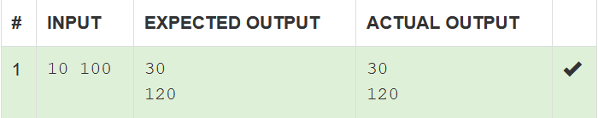
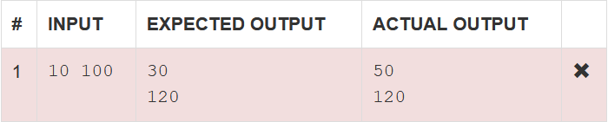
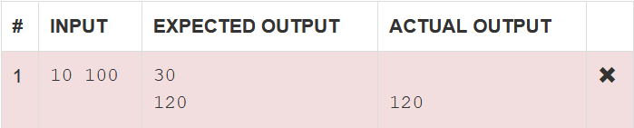
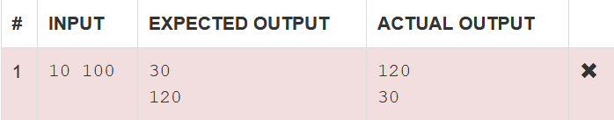

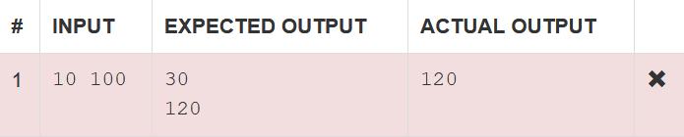
How autograding was done
100% marks, both lines correct
50% marks, first line incorrect but second line correct
50% marks, first line blank (incorrect), second line correct
Keep these rules in mind very carefully before submitting any regrading requests
0% marks, no line matches the expected output line (wrong order)
0% marks, no line matches the expected output line

Slide 4
Announcements – Minor Quiz
Will be released very soon
Some delay in setting up Gradescope
Sorry for the delay

Slide 5




Announcements - Bonus
Bonus question (Monster Multiply) has been cancelled
Won’t be graded, won’t add towards course
Reports of students taking unfair help from seniors and A batch students with prior programming experience
No more bonus problems from now on
Sometimes, challenge practice problem – not graded
But I did not cheat. Why not grade my solution?
But I did not cheat. Why not grade my solution?
But I did not cheat. Why not grade my solution?
In June, CBSE question paper got leaked. Only 10-20 students involved in leak but retest was done for all lakhs of students to be fair to all
But I did not cheat. Why not grade my solution?

Slide 6

Error in previous slide (corrected)
HIGH PRECEDENCE
Operator Name | Symbol/Sign | Associativity
Bracket | () | Left
Unary negation | - | Right
Multiplication/division/remainder | *, /, % | Left
Addition/subtraction | +, - | Left
Assignment | = | Right
Sorry about the error
So bracket has higher priority than unary negation
LOW PRECEDENCE

Slide 7


A Few Helpful Tips
Double and float are both happy with %f for printf
However, in scanf, double insists on %lf (%f gives junk)
For problems where you care about the exact digits (lab problems), avoid float, double as far as possible
For problems where you do not mind approximations, use float, double
When you say long a = 3213213210, since the number is within range of long, I will preserve every digit of it carefully
What is the difference?
Range of float is larger. What if I store it as a float?
When you say float a = 3213213210, I will store 3213213184.00
The number is like 3.2 x 10⁹ and my error was just 26. Don’t blame me ☹

Slide 8

A Cute Trick for Higher Precision
Want to read a number like 123456789.987654321?
Don’t read it as a float or double or even long double
Read it as two int variables, separated by a decimal
Can use long too!
#include <stdio.h>
int main(){
int a, b;
scanf(“%d.%d”, &a, &b);
return 0;
}
Yeah. Too many digit errors will take place ☹ So What do I do?

Slide 9

Two New Shortcuts
Works only for incrementing or decrementing by one
Incrementing a variable by one
sum = sum + 1;
sum++;
++sum;
Decrementing a variable by one
sum = sum – 1;
sum--;
--sum;
Remember expressions generate values
int a = 3, b = 5, c;
a + b generates value 8, and c = 7 generates value 7
Both a++ and ++a will result in new value of a being 4
But a++ will generate 3 (old value) ++a will generate 4 (new value)
sum++, -- sum etc are valid expressions
Post-increment
There is an entire family of shortcuts
Pre-increment
Next slide ☺
Difference between post and pre?
Post-decrement
What if I want to increment by 2?
Pre-decrement
Remember, don’t need to write sum = sum++; or sum = ++sum;
sum++; will itself assign the incremented value to the sum variable. Similarly sum--; or –sum;
Show me an example

Slide 10
Okay … many more new shortcuts
a = a + b;
a = a – b;
a = a * b;
a = a / b;
a = a % b;
a += b;
a -= b;
a *= b;
a /= b;
a %= b;

Slide 11

BODMAS table has new members
Write this table down in your notebook. Allowed in labs, quizzes, exams. No need to memorize.
HIGH PRECEDENCE
Operator Name | Symbol/Sign | Associativity
Bracket, Post increment/decrement | (), ++, -- | Left
Unary negation, Pre increment/decrement | -, ++, -- | Right
Multiplication/division/remainder | *, /, % | Left
Addition/subtraction | +, - | Left
Assignment, Compound assignment | =, +=, -=, *=, /=, %= | Right
LOW PRECEDENCE

Slide 12
Back to If Statements
How to write more powerful choices
If something happens do this, else do that
If this AND this happens do this, else if that OR that happens, do that
How to avoid common errors

Slide 13
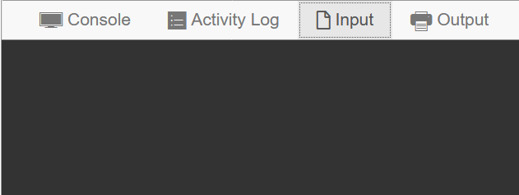
The if statement
How we must speak to mr. compiler
How we usually speak to a human
11
05
#include <stdio.h>
int main(){
int m;
scanf(“%d”,&m);
if(m < 10){
printf(“0”);
}
printf(“%d”,m);
}
Do you speak English?
Hello
m is an integer variable.
Please ask me for value of m.
If the value of m is less than 10, then please print a 0
Now please print value of m
Goodbye
Brackets essential in case you want me to do many things if m < 10, not just print one 0
This statement is always executed whether m < 10 or not
Missing brackets - common mistake
These curly brackets are used to tell Mr. C what all we want him to do if m < 10
11
5

Slide 14

Freedom of Choice
Yes, but calm down a bit first
If m is less than 10
If a is greater than or equal to b + c
If p is equal to q
If m is not equal to 15
<, <=, >, >=, ==, != 6 new operators for Mr C!
if(m < 10){ ... }
WORDS OF CAUTION
Do not forget brackets
Note: it is p == q, not p = q
Risky to use p == q and p != q with float, double
Use these freely with int, long
<, <=, >, >= fine with int, long, float, and double
if(a >= b+c){ ... }
if(p == q){ ... }
I can do so much with these!
if(m != 15){ ... }

Slide 15
More powerful conditionals
How we must speak to mr. compiler
How we usually speak to a human
if((a + b)/2.0 < 0.5){
printf(“Small”);
c++;
}else{
printf(“Big”);
c--;
}
printf(“Goodbye”);
If the average of a and b is less than 0.5, do the following
Say Small to me. Then increment c by 1
Else if average of a and b is not less than 0.5, do the following
Say Big to me. Then decrement c by 1
No matter what the average of a and b, say Goodbye to me

Slide 16


Writing pretty code is an art
How we must speak to mr. compiler
How we usually speak to a human
if((a + b)/2.0 < 0.5){
printf(“Small”);
c++;
}else{
printf(“Big”);
c--;
}
printf(“Goodbye”);
If the average of a and b is less than 0.5, do the following
Say Small to me. Then increment c by 1
Else if average of a and b is not less than 0.5, do the following
Say Big to me. Then decrement c by 1
No matter what the average of a and b, say Goodbye to me
if((a + b)/2.0 < 0.5){printf(“Small”);
c++;}else{printf(“Big”);c--;} printf(“Goodbye”);
if((a + b)/2.0 < 0.5)
{
printf(“Small”);
c++;
}
else
{
printf(“Big”);
c--;
}
printf(“Goodbye”);
Artists sometimes differ on what is prettier

Slide 17
Even more powerful conditionals
if((a + b)/2.0 < 0.5){
}else{
}
Only < 0.5
if((a + b)/2.0 < 0.25){
printf(“Very small”);
}else{
printf(“Small”);
}
Any number of statements!
< 0.5 as well as < 0.25
Of course! Called a nested if-else statement
< 0.5 but not < 0.25
Only >= 0.5
What all can I put inside these curly brackets
if((a + b)/2.0 > 0.75){
printf(“Very Big”);
}else{
printf(“Big”);
}
>= 0.5 as well as > 0.75
Can I put another if-else condition inside?
>= 0.5 but not > 0.75

Slide 18


The Goldilocks Challenge
Write a program to take a temperature and print
Too Cold if temperature is below 22
Just Right if between 22 and 27
Too Hot if temperature is above 27
Mr C considers 0 to be FALSE and 1 (or anything non-zero) to be TRUE
if(temp < 22){
printf(“Too Cold”);
}else{
if (22 <= temp <= 27){
printf(“Just Right”);
}else{
printf(“Too Hot”);
}
}
If the expression inside if( … ) evaluates to 1 or something non-zero, Mr C executes the if part. If the expression evaluates to 0, Mr C executes the else part
Remember, expressions generate values
If temp is less than 22, it generates value 1. If temp is greater than or equal to 22, it generates value 0
What just happened?
What value does temp < 22 generate?

Slide 19
Complex Relational Expressions
<, <=, ==, >, >=, != are called relational operators
Expressions containing these operators generate 0 or 1
All have left to right associativity (just like +, -, *, /)
22 <= temp <= 27 became ((22 <= temp) <= 27)
When we entered 30, Mr C evaluated ((22 <= 30) <= 27)
This became (1 <= 27) which is true so the final result is 1
This is why Mr C printed Just Right even when temp = 30
So how do I get Mr C to do something when temperature is between 22 and 27?

Slide 20
Logical Operators
Used to create powerful conditions and choices
If we want temp >= 22 AND temp <= 27
If we want temp >= 22 OR temp <= 27
If we want NOT a % 2 == 0 (to select odd numbers)
if((22 <= temp) && (temp <= 27)){ ... }
if((temp >= 22) && (temp <= 27)){ ... }
Bracket yourself to avoid errors and confusion
if((temp >= 22) || (temp <= 27)){ ... }
Lets show them the new table
if(!(a %2 == 0) ){ ... }
if(a %2 != 0){ ... }
If you don’t put brackets, Mr C will put brackets according to his table

