Slide 1
SDG-11
Smart cities and communities
Power Grid Anomaly Detection and Prediction of Physical and Cyber Attacks
Submitted by:
NAME | USN
Sanjay CM | 1RV23ET039
Siddhant Shah | 1RV23EI066
Abu Arshian | 1RV23EC005
Satkrit Samyaan | 1RV23ET069
Dhruvi Bhandari | 1RV23EC048

Slide 2
INTRODUCTION
Power grids now generate large volumes of time-dependent sensor and network data, making manual monitoring impractical.
Cyber intrusions increasingly manifest as subtle statistical deviations rather than obvious failures.
Physical faults often appear as small drifts in voltage, current, or power, which are missed by static thresholds.
Data-driven learning models can learn normal operational patterns and flag deviations without prior attack signatures.

Slide 3
LITERATURE SURVEY
Paper Title | Publisher | Authors | Summary
A Method of Abnormal Detection for Power Grid Control System Metrics Based on AI Platform | IEEE-2024 | Gao Shang,Ji Xuechun,Shen Jialing | This paper shows how to overcome the limitations of fixed-threshold monitoring methods The approach uses sliding-window time-series analysis to detect both slow-climbing anomalies and sudden mutation anomalies in system metrics. A multi-algorithm ensemble learning strategy improves detection accuracy and reduces false alarms compared to single-algorithm methods. Dynamic thresholds generated through short-term prediction enable adaptive and real-time anomaly detection under changing operating conditions. Although the work focuses on operational anomalies, the abnormal metric patterns identified are similar to those caused by cyber-attacks such as false data injection.
Enhancing Smart Grid Security : An Data-Driven Anomaly Detection Framework | IEEE-2024 | Darshan Vishwarao, Arun Kumar, Ngyuen Khanh | The framework employs a Gaussian Mixture Model (GMM) to learn normal operational behavior and detect anomalies using adaptive probability thresholds. Detected anomalies are then classified into cyber-attacks or natural events using supervised machine learning models, where Random Forest achieves the best performance. SHAP is integrated to provide explainability and feature importance analysis, enhancing transparency and trust.

Slide 4
LITERATURE SURVEY
Paper Title | Publisher | Authors | Summary
Cybersecurity in Smart Grids using Machine Learning: A Systematic Literature Review | IEEE-2025 | Norman Nelufule,Crestinah Mudau,Boitumelo Nkwe | This review summarizes ML- and DL-based cybersecurity techniques for smart grids, covering intrusion detection, false data injection mitigation, anomaly detection, privacy preservation, and secure communication. While learning-based and privacy-aware methods achieve high detection accuracy in controlled settings, their real-world deployment is limited by reliance on simulated datasets, high computational complexity, scalability issues, and adversarial vulnerabilities. The paper highlights the need for standardized real-world data, lightweight and explainable models, and scalable privacy-preserving frameworks to enable practical and robust smart grid security.
Advancing Cyber-Attack Detection in Power Systems: A Comparative Study of Machine Learning and Graph Neural Network Approaches | IEEE-2024 | Tianzhixi Yin,Syed Ahsan Raza Naqvi,Sai Pushpak Nandanoori | This paper compares conventional ML, deep learning, and graph neural network (GNN) methods for detecting cyber-attacks in power systems using simulated IEEE 68-bus time-series data. Results show that GNN-based models (GAT and GDN) outperform k-means and autoencoders, especially for low-magnitude and complex attacks, by leveraging grid topology. However, accurately localizing subtle attacks such as riding-the-wave remains challenging, indicating the need for further improvement in realistic scenarios.

Slide 5
LITERATURE SURVEY
Paper Title | Publisher | Authors | Summary
Development of an AI-Based Cybersecurity Framework for Reliable Smart Grid Energy Management | IEEE-2025 | Dr. Uppin Chandrashekhar,Salvadi kasturi | This paper proposes a real-time AI-based cybersecurity framework for smart grids by integrating machine learning and models such as SVM, Random Forest, ANN, and LSTM the framework performs intrusion detection using network and device-level data, supported by feature selection and dimensionality reduction. LSTM effectively captures temporal patterns in smart grid data, while Random Forest provides robust classification with low false positives. Integration with EMS enables automated threat response.
A Comprehensive Review of Machine Learning and Deep Learning-Based Intrusion Detection Systems | IEEE-2025 | V Ebenezer,Divya M K | This paper categorizes IDS approaches into signature-based and anomaly-based methods and highlights the superiority of ML/DL techniques in detecting unknown and zero-day attacks. Models such as Random Forest, SVM, CNN, and LSTM are analyzed for their effectiveness in handling high-dimensional and time-dependent network data. The paper identifies key challenges including scalability, data imbalance, high false-alarm rates, and lack of real-time adaptability.

Slide 6
RESEARCH GAP
Most existing approaches treat cyber and physical anomaly detection independently, ignoring their interdependence in cyber-physical systems.
Many methods rely on single-model detection, which limits robustness against diverse and evolving anomaly patterns.
Temporal behavior is often underutilized, leading to poor discrimination between transient fluctuations and true anomalies.
Limited emphasis is placed on severity assessment and interpretability, reducing the usefulness of detection results for operational decision-making.

Slide 7
PROBLEM STATEMENT
Current monitoring systems struggle to reliably distinguish normal operational variations from malicious or faulty behavior in time-series cyber and power grid data, resulting in false alarms and missed anomalies.

Slide 8
OBJECTIVE
To model normal behavior in cyber traffic using time-series learning in order to detect deviations indicative of attacks.
To identify physical anomalies in power systems by predicting expected sensor values and comparing them against real measurements.
To improve detection reliability through ensemble decision-making across multiple machine learning models.
To present detected anomalies as actionable insights using severity scoring, visualization, and real-time system interfaces.

Slide 9
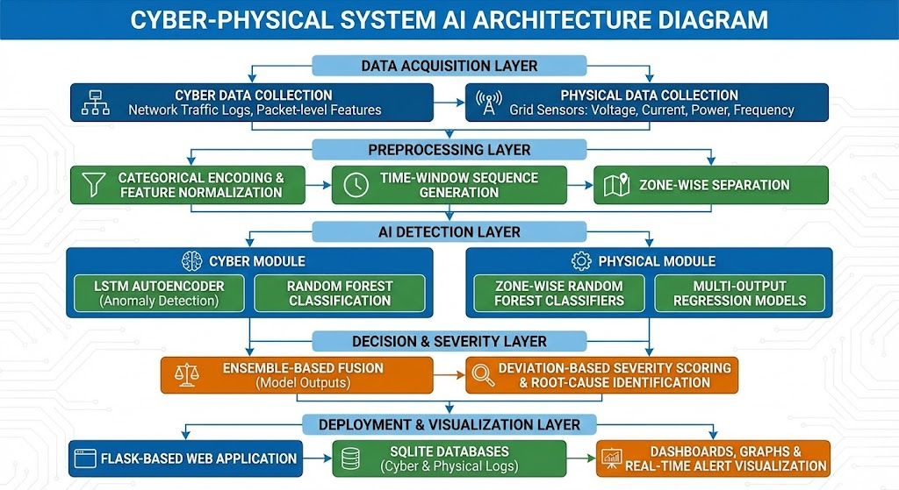
METHODOLOGY

Slide 10
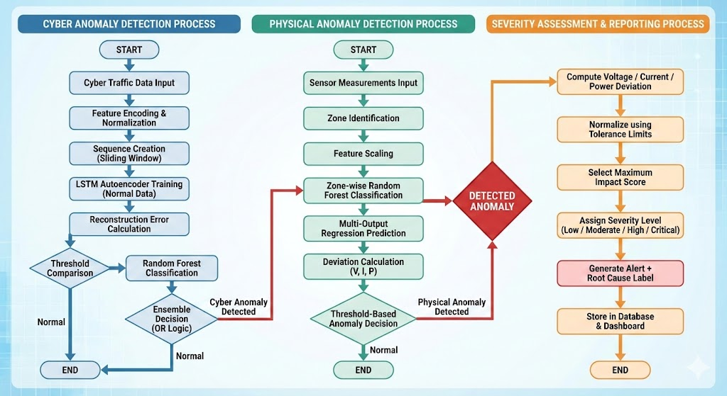
METHODOLOGY

Slide 11
METHODOLOGY
Cyber Dataset
Type: Network traffic time-series data
Features Used:
  Timestamp
  Source_IP, Destination_IP
  Port, Protocol
  Packet_Size, Duration
  Packet_Loss, Latency, Throughput, Jitter
  Authentication_Failure
  Attack_Type
Target Label: Is_Attack (Normal / Attack)
Physical Dataset
Type: Power grid sensor measurements
Features Used:
  Timestamp
  Sensor_ID, Location
  Voltage (V), Current (A), Power (kW)
  Frequency (Hz), Power_Factor
Target Label: Anomaly_Label (Normal / Anomaly)

Slide 12
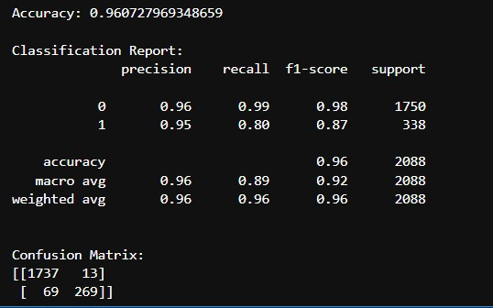
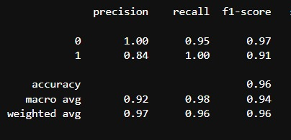
RESULTS
For Physical
For Cyber

Slide 13
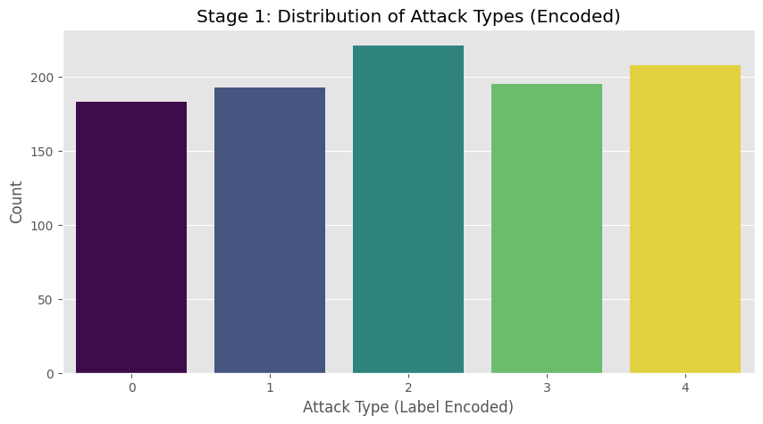
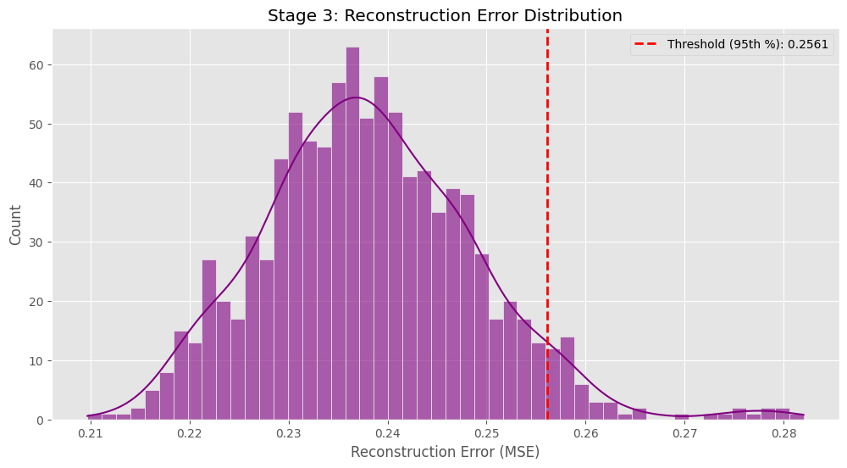
RESULTS

Slide 14
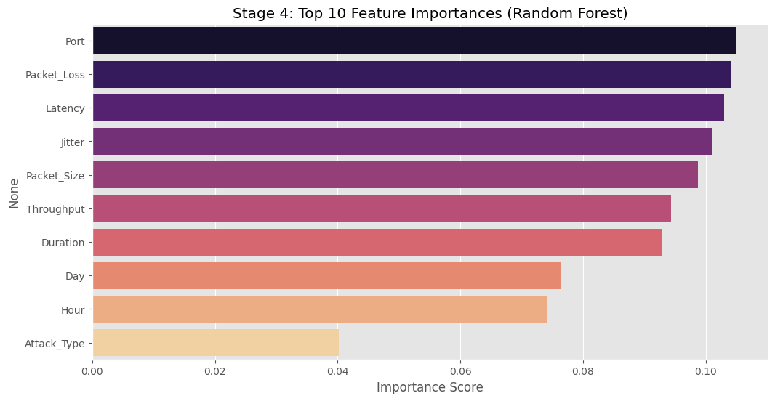
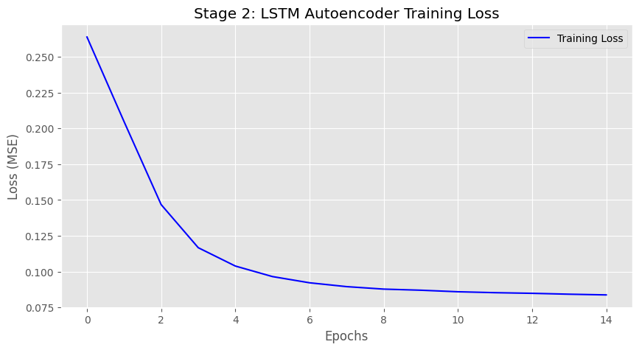
RESULTS

Slide 15
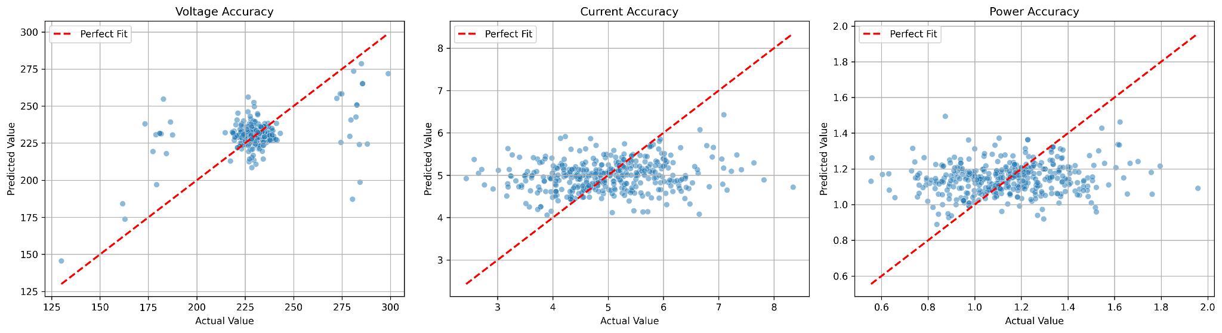
RESULTS

Slide 16
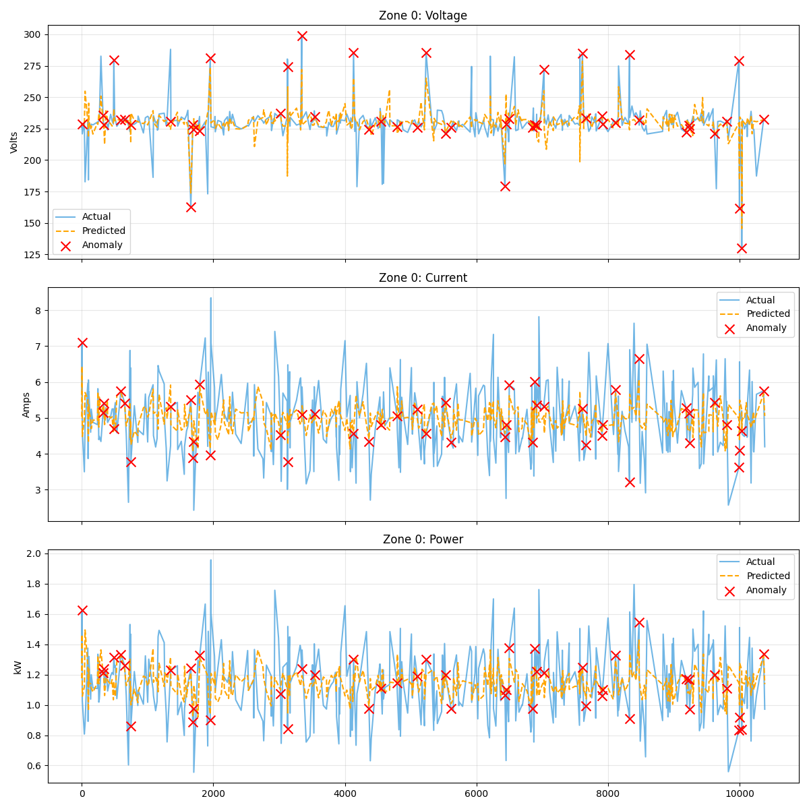
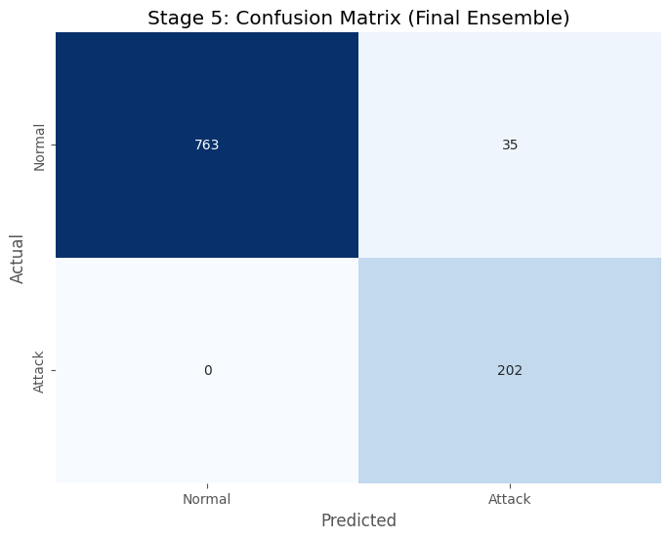
RESULTS

Slide 17
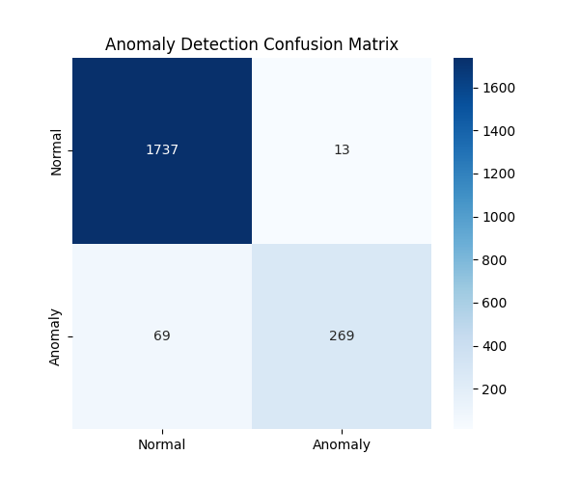
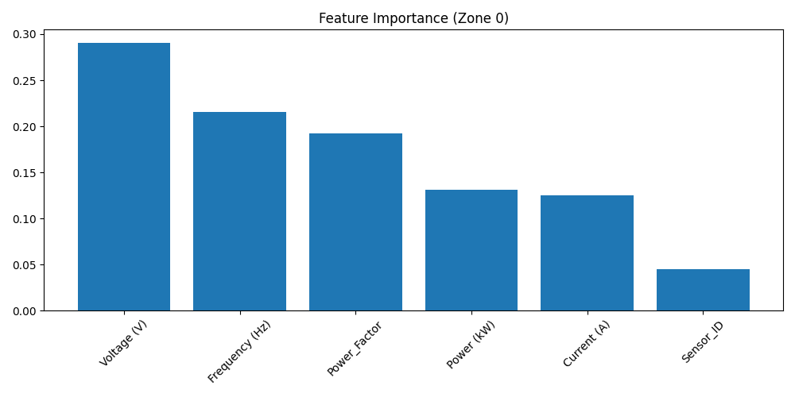
RESULTS

Slide 18
CONCLUSION
The proposed system successfully detects both cyber and physical anomalies by jointly analyzing network traffic and power grid sensor data.
Temporal learning and ensemble-based decision fusion significantly improve detection reliability compared to single-model approaches.
Severity scoring and root-cause identification transform raw predictions into actionable alerts suitable for operational use.
The end-to-end implementation, from model training to web-based deployment, demonstrates the practical feasibility of cyber-physical anomaly monitoring.

Slide 19
REFERENCES
T. Yin, S. A. R. Naqvi, S. P. Nandanoori and S. Kundu, "Advancing Cyber-Attack Detection in Power Systems: A Comparative Study of Machine Learning and Graph Neural Network Approaches," 2024 Resilience Week (RWS), Austin, TX, USA, 2024
Y. Xu, "A Review of Cyber Security Risks of Power Systems: From Static to Dynamic False Data Attacks," in Protection and Control of Modern Power Systems, vol. 5, no. 3, pp. 1-12, July 2020
G. Liang, J. Zhao, F. Luo, S. R. Weller and Z. Y. Dong, "A Review of False Data Injection Attacks Against Modern Power Systems," in IEEE Transactions on Smart Grid, vol. 8, no. 4, pp. 1630-1638, July 2017
O. A. Beg, L. V. Nguyen, T. T. Johnson and A. Davoudi, "Cyber-Physical Anomaly Detection in Microgrids Using Time-Frequency Logic Formalism," in IEEE Access, vol. 9, pp. 20012-20021, 2021,
A. Ameli, A. Ayad, E. F. El-Saadany, M. M. A. Salama and A. Youssef, "A Learning-Based Framework for Detecting Cyber-Attacks Against Line Current Differential Relays," in IEEE Transactions on Power Delivery, vol. 36, no. 4, pp. 2274-2286, Aug. 2021
N. K. Son, A. Kumar Sangaiah, D. V. Medhane, M. J. F. Alenazi and S. A. AlQahtani, "Enhancing Smart Grid Security: An Data-Driven Anomaly Detection Framework," 2024 IEEE Conference on Communications and Network Security (CNS), Taipei, Taiwan, 2024
D. M K and V. Ebenezer, "A Comprehensive Review of Machine Learning and Deep Learning-Based Intrusion Detection Systems," 2025 First International Conference on Intelligent Computing and Communication Systems (CICCS), Bengaluru, India, 2025

Slide 20
REFERENCES
S. Jialing, J. Xuechun, G. Shang, K. Yanru, L. Hao and L. Yingying, "A Method of Abnormal Detection for Power Grid Control System Metrics Based on AI Platform," 2024 IEEE 8th Conference on Energy Internet and Energy System Integration (EI2), Shenyang, China, 2024,
S. Li, A. Pandey, B. Hooi, C. Faloutsos and L. Pileggi, "Dynamic Graph-Based Anomaly Detection in the Electrical Grid," in IEEE Transactions on Power Systems, vol. 37, no. 5, pp. 3408-3422, Sept. 2022
T. Das, S. Rath and S. Sengupta, "Telling Apart: ML Framework Towards Cyber Attack and Fault Differentiation in Microgrids," 2024 IEEE 7th International Conference on Industrial Cyber-Physical Systems (ICPS), St. Louis, MO, USA, 2024,
A. A. Khalif et al., "Enhancing Smart Grid Security with Machine Learning: A Comparative Study of Supervised and Unsupervised Techniques," 2025 International Conference on New Trends in Computing Sciences (ICTCS), Amman, Jordan, 2025
T. Choi, Y. Wu and R. K. L. Ko, "Hybrid AI Anomaly Detection for Smart-Grid Electricity Theft," 2025 IEEE PES 35th Australasian Universities Power Engineering Conference (AUPEC), Brisbane, Australia, 2025
S. S. Bhanu, V. S. Kumar, K. H. Krishna, A. R. Reddy, B. V. S. Reddy and P. M. Khan, "Adaptive Cyber Attack Detection in Distribution Systems using Machine Learning and Spatiotemporal Patterns," 2025 International Conference on Intelligent Computing and Control Systems (ICICCS), Erode, India, 2025

Slide 21
REFERENCES
T. Ige, C. Kiekintveld and A. Piplai, "An Investigation into the Performances of the State-of-the-art Machine Learning Approaches for Various Cyber-attack Detection: A Survey," 2024 IEEE International Conference on Electro Information Technology (eIT), Eau Claire, WI, USA, 2024
S. Sankar, R. Dutta and S. Karmakar, "Cyber Threat Prediction and Assessment with Machine Learning Approaches," 2024 IEEE 21st India Council International Conference (INDICON), Kharagpur, India, 2024
Y. R. Bhavyashree, M. K. Kavyashree and K. R. Amrutha, "Systematic Review on Frameworks for Intrusion Detection using Machine Learning and Deep Learning Algorithms," 2024 Second International Conference on Networks, Multimedia and Information Technology (NMITCON), Bengaluru, India, 2024
M. Baptiste, F. Julien and S. Franck, "Systematic and Efficient Anomaly Detection Framework using Machine Learning on Public ICS Datasets," 2021 IEEE International Conference on Cyber Security and Resilience (CSR), Rhodes, Greece, 2021,
D. M K and V. Ebenezer, "A Comprehensive Review of Machine Learning and Deep Learning-Based Intrusion Detection Systems," 2025 First International Conference on Intelligent Computing and Communication Systems (CICCS), Bengaluru, India, 2025
N. Nelufule, C. Mudau, B. Nkwe, S. Chishiri, L. Mncwango and M. Mutenwa, "Cybersecurity in Smart Grids using Machine Learning: A Systematic Literature Review," 2025 6th International Conference on IoT Based Control Networks and Intelligent Systems (ICICNIS), Bengaluru, India, 2025
S. Kasturi, U. Chandrashekhar, M. V. Galindo, A. B. M. Valencia, T. C. Manjunath and S. Vashishtha, "Development of an AI-Based Cybersecurity Framework for Reliable Smart Grid Energy Management," 2025 International Conference on Sustainability, Innovation & Technology (ICSIT), Nagpur, India, 2025
M. N. Kurt, O. Ogundijo, C. Li and X. Wang, "Online Cyber-Attack Detection in Smart Grid: A Reinforcement Learning Approach," in IEEE Transactions on Smart Grid, vol. 10, no. 5, pp. 5174-5185, Sept. 2019

