Slide 1

Employee Data Analysis using Excel
STUDENT NAME: SANJAY KUMAR V
REGISTER NO: 312202428
DEPARTMENT:B.COM (COMPUTER APPLICATIONS)
COLLEGE: JAYA COLLEGE ARTS OF AND SCIENCE

Slide 2
PROJECT TITLE
Employee Performance Analysis using Excel.

Slide 3


AGENDA
Problem Statement
Project Overview
End Users
Our Solution and Proposition
Dataset Description
Modelling Approach
Results and Discussion
Conclusion
3/21/2024 Annual Review

Slide 4

PROBLEM STATEMENT
In order to streamline performance monitoring, lower errors, and enable management to make data-driven decisions, the project intends to develop an Excel-based system for employee performance analysis. It will include structured data entry, automatic calculations, and visual dashboards.

Slide 5

PROJECT OVERVIEW
The goal is to provide an Excel-based solution for efficiently analyzing employee performance, automating computations, and delivering visual dashboards to enable data-driven decision-making and boost productivity.

Slide 6

WHO ARE THE END USERS?
HR Managers
Line Managers
Team Leads
Training and Development Professionals
Senior Leaders
Employees

Slide 7

OUR SOLUTION AND ITS VALUE PROPOSITION
Conditional formatting - Missing
Filter - remove
Formula - performance
Pivot -summary
Graph- data visualization

Slide 8
Dataset Description
Employee=from naan mudhalvan
26 -features
9- features
Employee id-num
Name-text
Employee type
Performance level
Gender-male female
Employee rating-num

Slide 9

THE "WOW" IN OUR SOLUTION
Performance level =IFS(Z8>=5,"VERYHIGH",Z8>=4,"HIGH",Z8>=3,"MEDIUM",TRUE,"LOW")
3/21/2024 Annual Review
9

Slide 10
Modelling
Data collection:
1)EDUNET dashboard
Features collection:
employee i’d
first name
last name
business unit
employee status
employe type
employee classification type
gender code
performance score
current eemployee rating
10

Slide 11
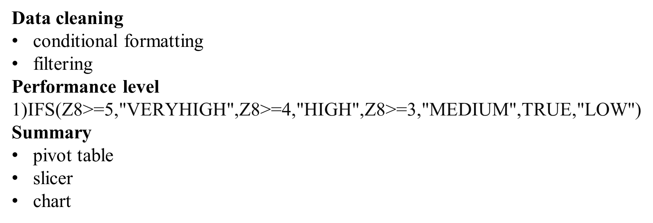

Slide 12
Results
12

Slide 13
Conclusion
The Employee Performance Analysis System is a game-changing technology that revolutionizes how businesses approach people management.

