Slide 1

Introduction to Multiple Imputation
Francis Bursa

Slide 2
Introduction
Multiple Imputation is a method for dealing with missing data.
Principal benefits:
Tries to account for uncertainty due to the missing data.
(Supposed to be) easy to use.

Slide 3
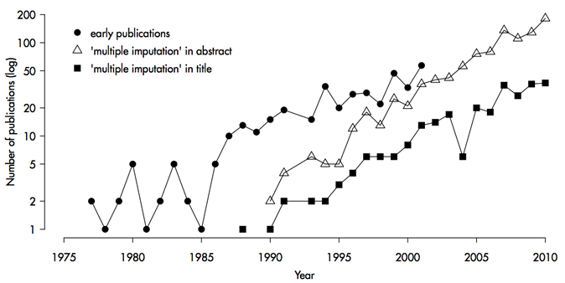
History
Originally developed by Donald Rubin (Rubin 1987).
Use of MI has expanded exponentially in recent years:
www.multiple-imputation.com

Slide 4
Overview
A multiple imputation analysis consists of three steps:
Multiple data sets are created in which missing values have been imputed. Each imputed data set will be different.
A model is fit to each data set, giving multiple parameter estimates.
The estimates are combined.

Slide 5
Imputing multiple data sets
Imputing multiple data sets
This is the most complicated step. Imputation must be “proper” (Rubin 1996).
Simple approach:
Fit a model to the observed data.
Simulate random draws from this model to impute missing data.
This is wrong: doesn’t include uncertainty in model parameters.

Slide 6
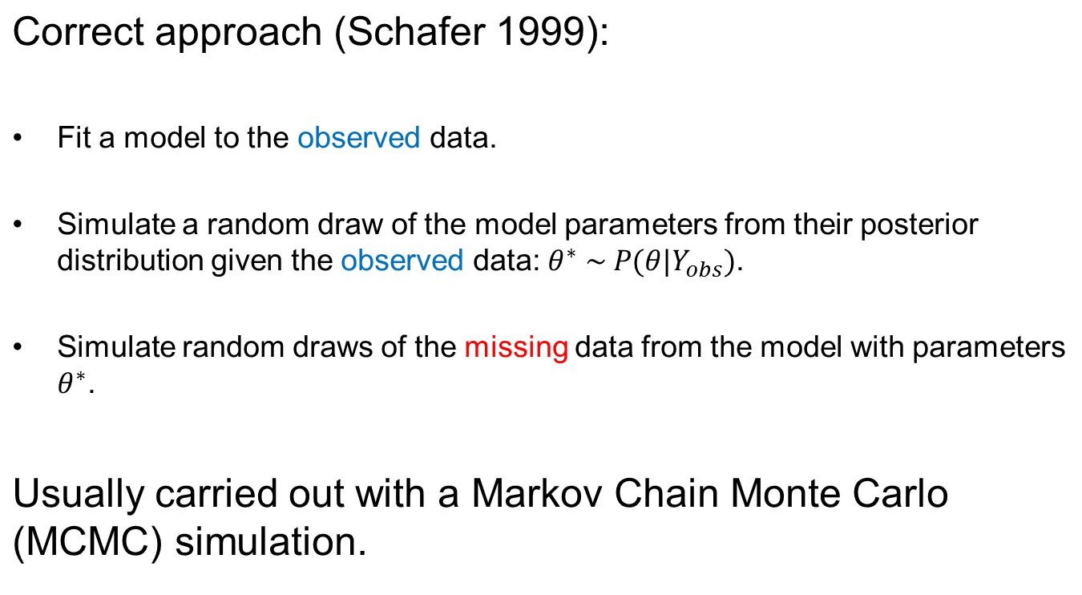
Imputing multiple data sets

Slide 7
Imputing multiple data sets
No. of imputed data sets is m. How large should m be?
3-5. This is enough for point estimates.
m ≈ percentage of missing data. This is enough for standard errors (Allison 2012).
Choice of model for imputing.
Must be at least as general as model that will be used for analysis, otherwise can get biases.
E.g. if an interaction is not included in imputation step, estimates of it would be biased towards zero in analysis step.

Slide 8
Fitting each data set
2. Fitting each data set
Any method can be used to fit the m complete data sets.
Only restriction:
Must not be more general than model used for imputation.

Slide 9
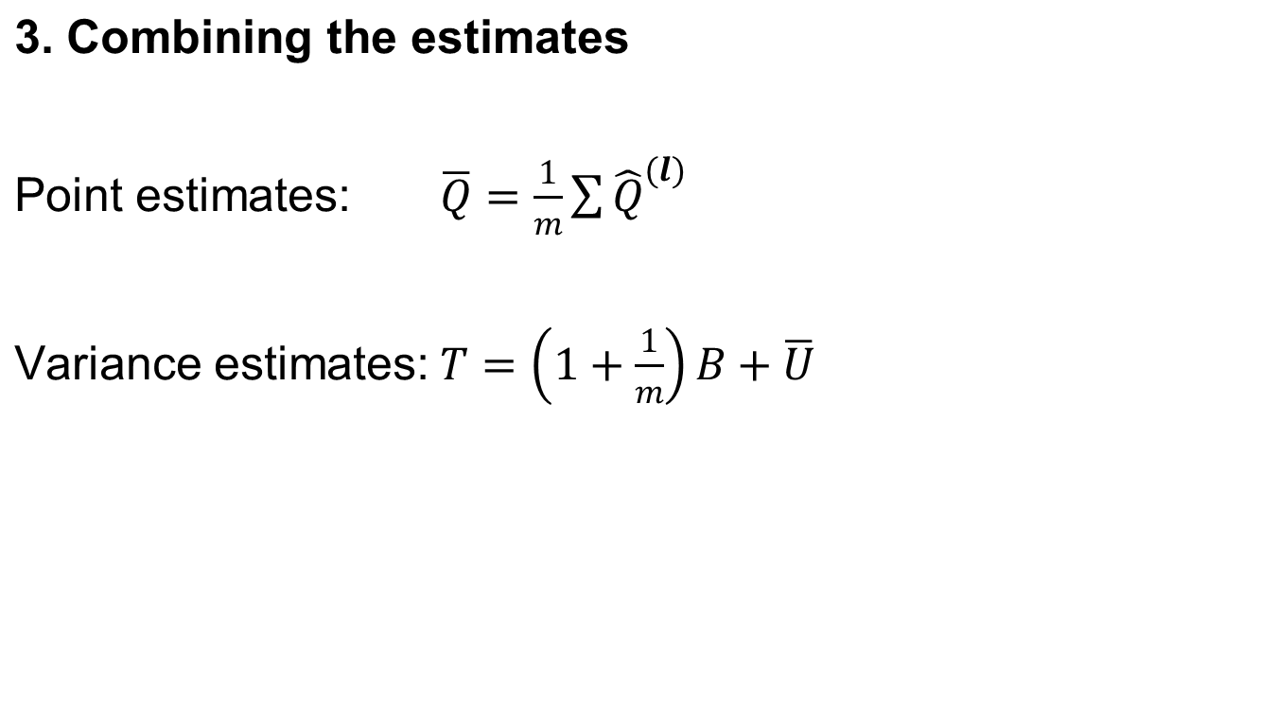
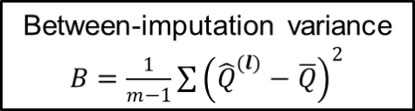
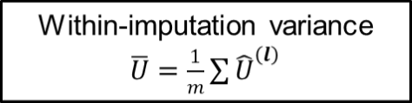
Combining the estimates

Slide 10
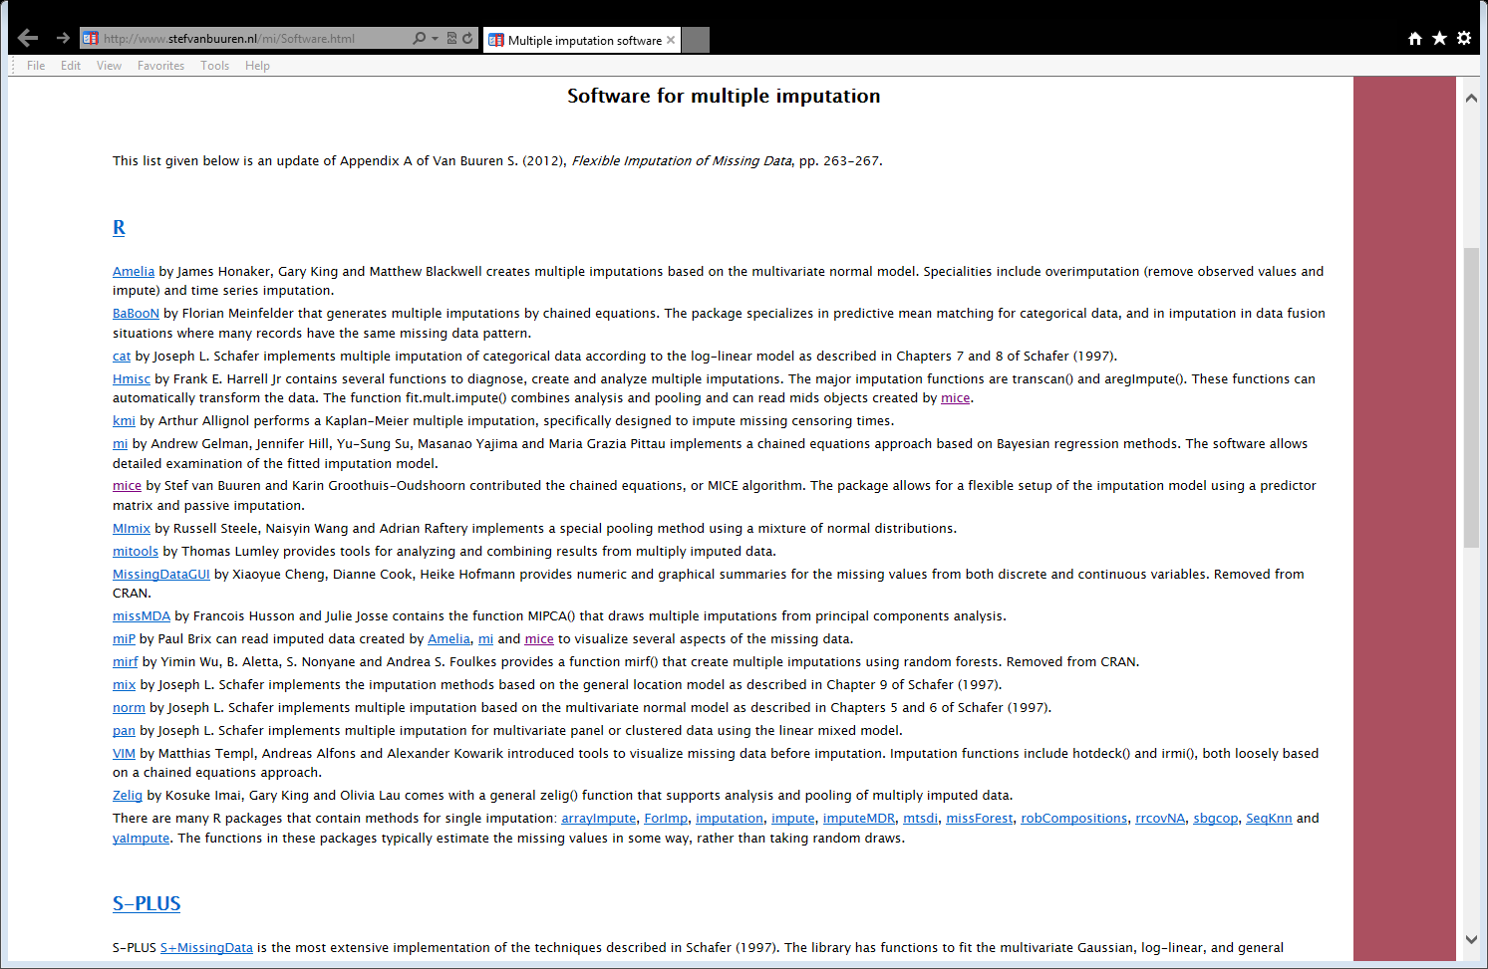
Software
Lots of software available for R, SAS, SPSS…
http://www.stefvanbuuren.nl/mi/Software.html

Slide 11
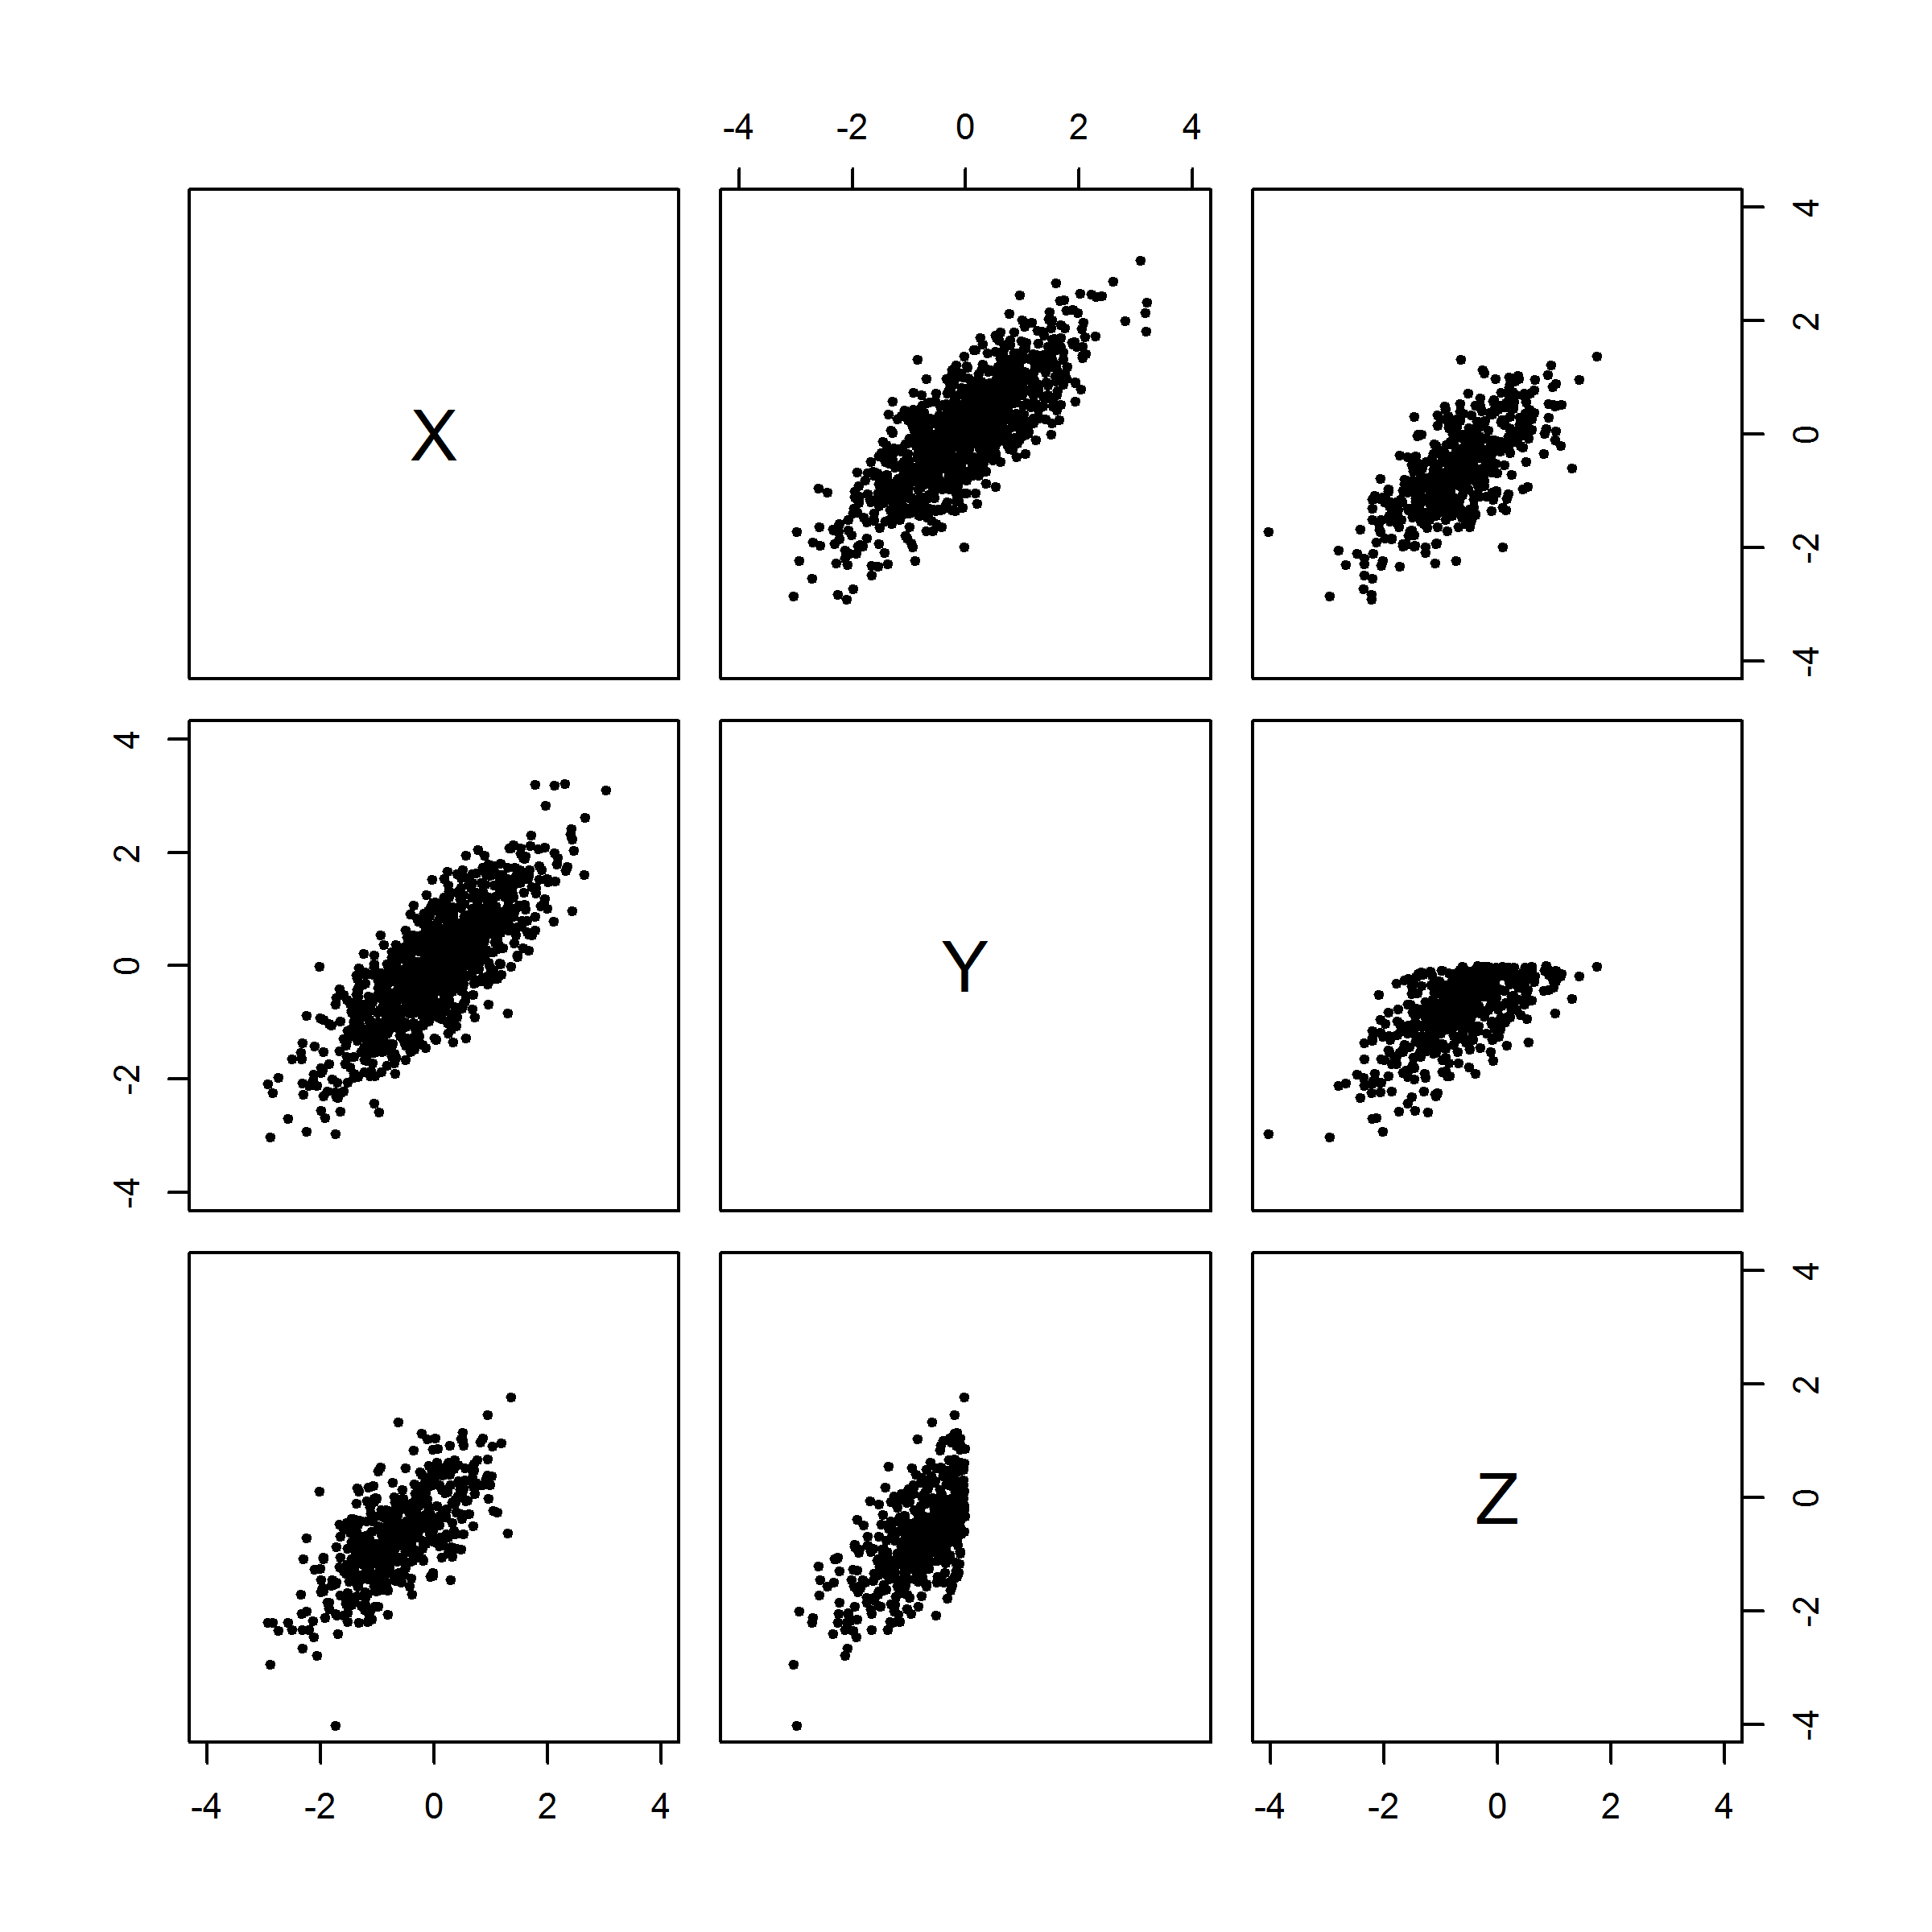
A simple example
A simple example using the MICE package for R:
1000 points with 3 correlated variables X,Y,Z.
Remove Z for all cases with Y>0.
Fit to all data:
Z = -0.05(2) + 0.81(2) X
Fit to observed data:
Z = -0.22(3) + 0.72(3) X

Slide 12
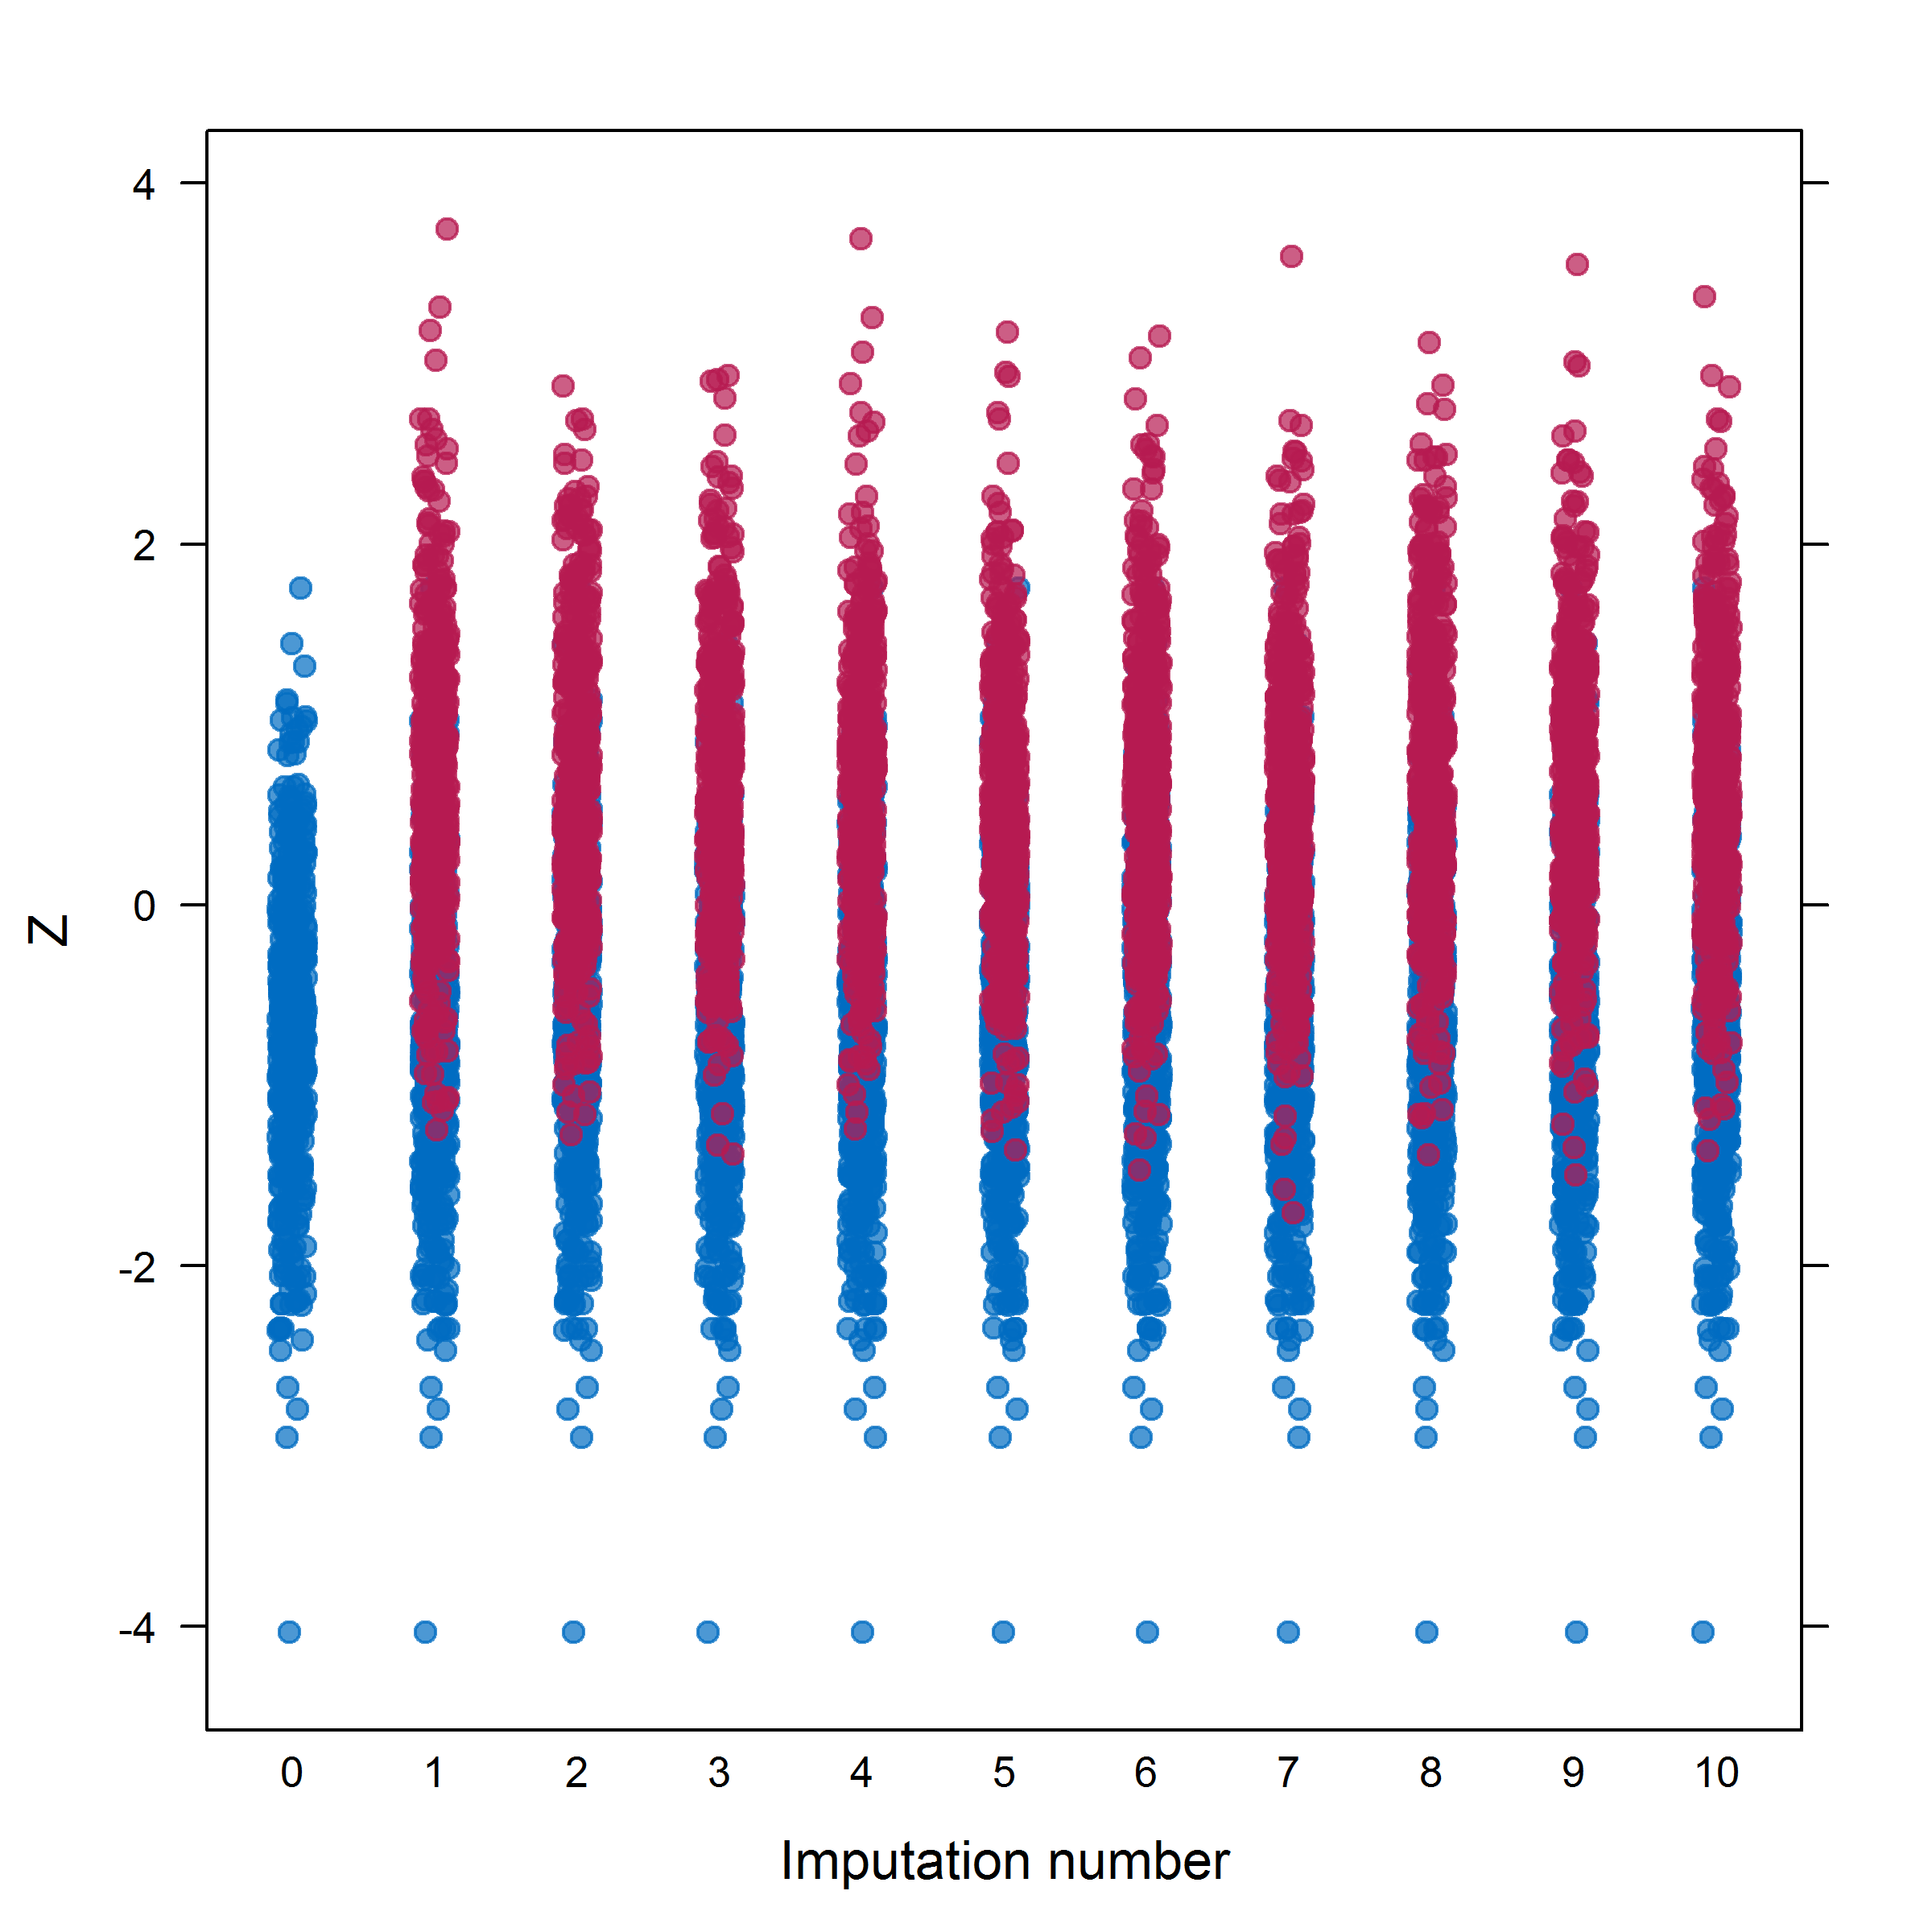
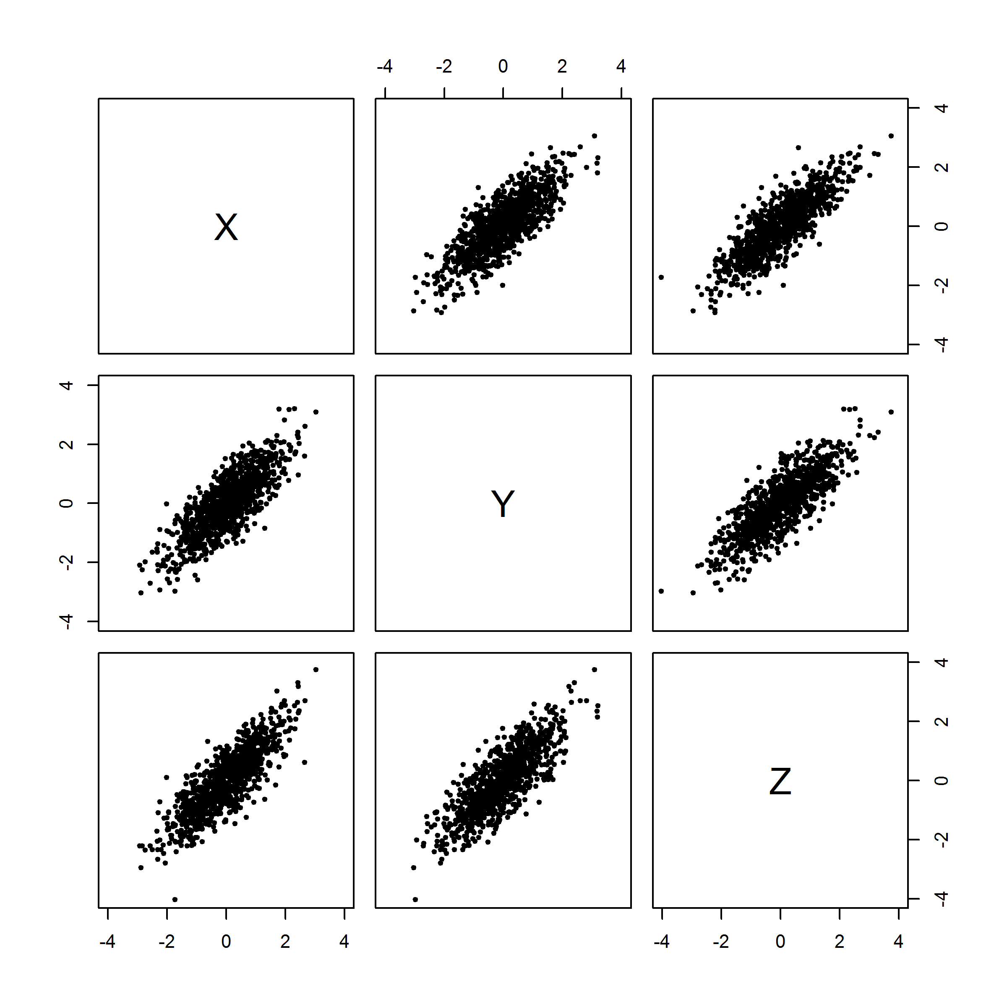
A simple example
Create m=10 imputed data sets:

Slide 13
A simple example
Fit each data set:
Z = 0.00(2) + 0.89(2) X
Z = -0.02(2) + 0.87(2) X
Z = -0.03(2) + 0.86(2) X
Combine them:
Z = -0.03(3) + 0.85(3) X
Consistent with estimate from all data.
…

Slide 14
Other methods
Alternative methods:
Use only complete cases
Single imputation
Maximum-likelihood methods
First two can lead to biases. Maximum-likelihood can be complicated.

Slide 15
Pros and cons
Advantages of multiple imputation:
Accounts for uncertainty due to missing data.
No biases (if imputation model is correct).
Can be used for any type of analysis.
Easy to use.
Disadvantages:
Have to think about imputation model in addition to analysis model.

Slide 16
References
Allison P. (2012). Why You Probably Need More Imputations Than You Think. http://www.statisticalhorizons.com/more-imputations. Retrieved 11/10/2013.
Rubin, D.B. (1987). Multiple Imputation for Nonresponse in Surveys, New York: John Wiley.
Rubin, D.B. (1996). Multiple Imputation After 18+ Years. Journal of the American Statistical Association, 91, 434 473-489.
Schafer J (1999). Multiple imputation: a primer. Statistical Methods in Medical Research, 8, 3-15.

