Slide 1
Porsche EV Marketing Analytics
Customer Zipcode Attention Recommendation (CZAR)
Sanjay Jain - srajkumarjain1@student.gsu.edu
Shashank Goswami - sgoswami7@student.gsu.edu
Jennifer S. Johnson - jstanjohn@gmail.com
Patrick Hackett - patrick.d.hackett@gmail.com
Phase 2 Submission

Slide 2
Model Benefits
Marketing Recommendation model delivers business ready geographical drilldowns on optimized marketing targets segmented by consumer profile that can immediately be used in marketing strategy.
A simulated wait time model provides a heat map of prioritized charging station locations based on consumer need as well as a weighted version to coincide marketing strategy for greatest ROI.
Models allow for continuous improvement, allowing Porsche to improve its regional predictions over time.
Clusters are segmented along PCA orthogonal vectors to allow most robust segmentation.
Simulation can integrate Bayesian updating with new data.
Heatmaps can be trained and tuned in conjunction with new marketing data to ensure greatest ROI of marketing campaigns.
The end-to-end model uses columnar data, machine learning models in python, and integrated live Tableau dashboard deliverables, so is easy to implement and can scale quickly based on data availability.

Slide 3
Q1 Optimized Charging Station Locations

Slide 4
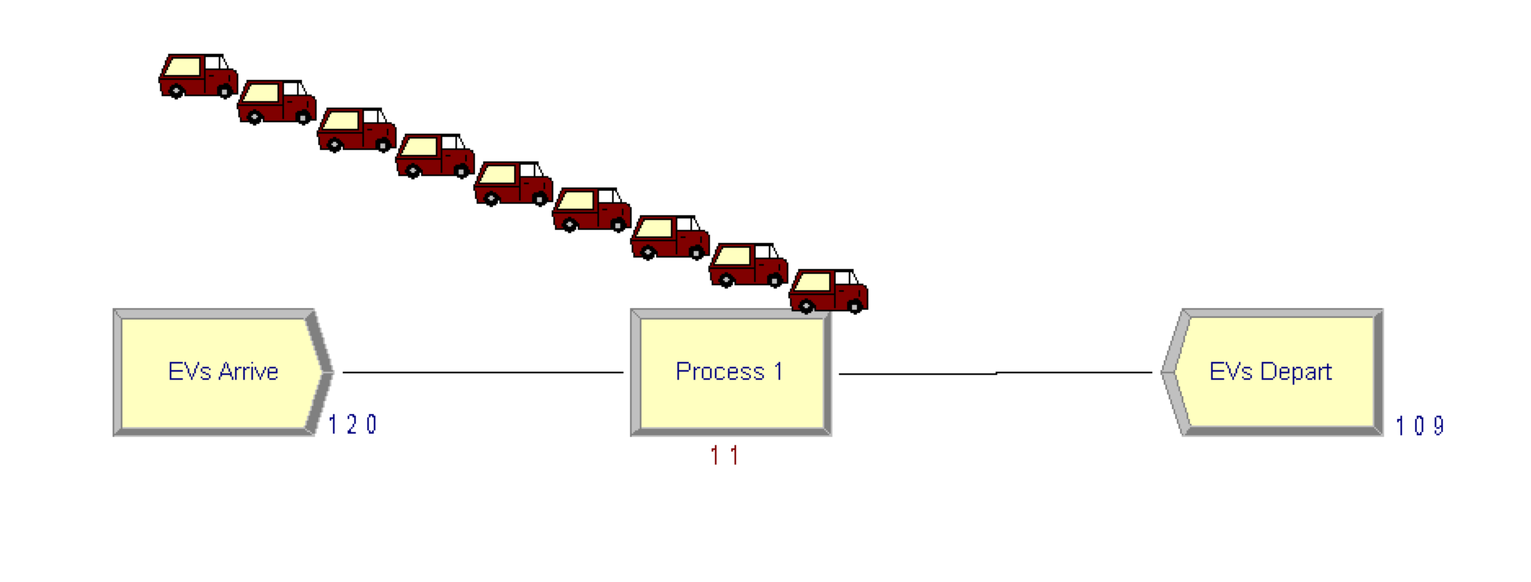
Simulated Customer Wait Times
Simulated wait times at charging locations over a five-hour period based on Chargepoint API data
Ran simulations using SimPy and replicated in Arena to visualize long queue
Created charging stations; EVs modeled with exponential interarrival times
Wait times range from 0 to 122.215 minutes
Simulation is easily scalable as more charger location data become available
(Pre-Optimization) EV Charging Simulation
Iterated on simulation model with varying feature inputs to reduce wait times
Determined direct relationship between quantity of charging stations and wait times.
Improved custom wait time by a factor of 4 in Arena simulation
Optimized EV Charging Simulation

Slide 5
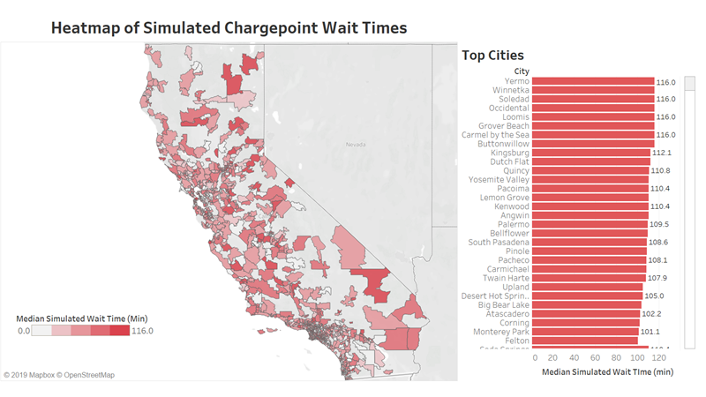
Notes:
Tableau dashboard, live connection to the data.
Drilldowns possible.
Fully productionalizable to the cloud on on-prem enterprise data systems.

Slide 6
Q1 Technical Explanation
Using Python and Arena, simulated wait times at EV charging locations (by zip code) using exponential interarrival of EVs and publicly available Chargepoint network data.
Normalize charging times across Levels 1-3 chargers to account for differences in charging rates and to find the equivalent number of total chargers (NUM_CHARGERS).
Set charge time as a random variable on the range of 30 to 120 minutes.
Set up and start the simulation.
Create charging locations, initial EVs, and arranged for additional EVs with exponential interarrival times in minutes.
EV arrives at the charging location and requests a charger.
Begin the charging process (in parallel if NUM_CHARGERS > 0), waits for it to finish, and leaves the charging location.
Simulated wait times are used to provide suggested Chargepoint build numbers/zipcode on a heat map.
This technical solution is easily scalable as actual wait times and charger location data are made available and/or updated.

Slide 7
Q2 Customer Clustering Model and Segmentation into Marketing Personas

Slide 8
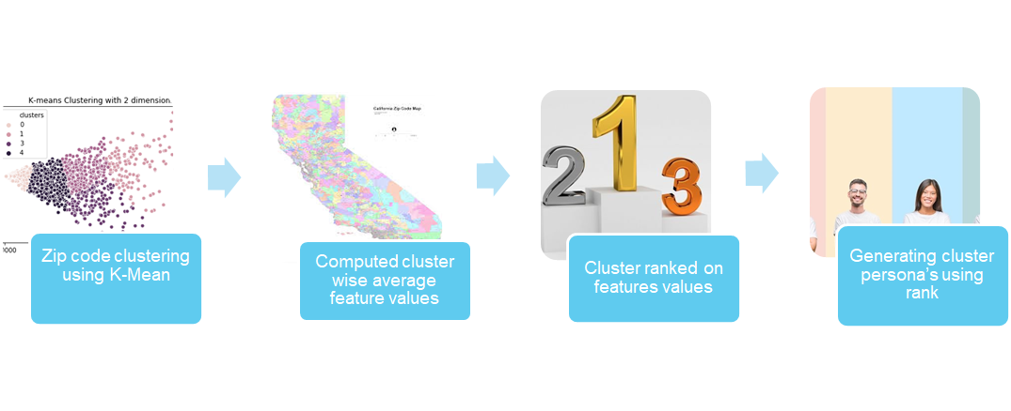
Q2 Technical Explanation
Using principal component analysis, customers are clustered based on buying habits, demographics, and regional car proportions across fuel type including car cost and engine type. These clusters are identified as personas for targeted market strategies.
Notes:
Data Steps –
1)Got vehicle count data by zip code from california’s dmv
2)It had data grouped by zip code, fueltype and make.
3)Segregated each fueltype and make by the price range. we selected price ranges as 0-20k, 20-30k, 30-40k, 40k-70k, 100k+
4)www.factfinder.census.gov was our main sources of DEMOGRAPHY DATA. We collected data by zipcode of California for housing units, income by age and employment
,different education standards by level and age, gender and population estimate, estimates of different occupation by population level in a zip code and median age by means of transport to work.
5) Got the number of level2 and level3 chargers by each zip code from afdc website.
6) Augmented all of the above data keeping ZIP code as the primary key.
Technique – 1) K mean clustering performed on the raw data, to group zip code
2) Computed average of feature values for every cluster
3) Ranked clusters for every features( Good - Rank 1, Bad – Rank 5)
4) Best and worst features of the clusters highlights its persona’s characteristics
in technique add one more step of standadizing the data after clustering.. 1) added all the types of cars in a zip code.. and divide it each column by that total in each zip code to get the proportion 2) added all the housing units and divided the housing columns by this estimate and likewise for population estimates
Data Steps – 1)Got vehicle count data by zip code from california’s dmv 2)It had data grouped by zip code, fueltype and make. 3)Segregated each fueltype and make by the price range. we selected price ranges as 0-20k, 20-30k, 30-40k, 40k-70k, 100k+ 4)www.factfinder.census.gov was our main sources of DEMOGRAPHY DATA. We collected data by zipcode of California for housing units, income by age and employment ,different education standards by level and age, gender and population estimate, estimates of different occupation by population level in a zip code and median age by means of transport to work. 5) Got the number of level2 and level3 chargers by each zip code from afdc website. 6) Augmented all of the above data keeping ZIP code as the primary key.
Technique – 1) K mean clustering performed on the raw data, to group zip code 2) Computed average of feature values for every cluster 3) Ranked clusters for every features( Good - Rank 1, Bad – Rank 5) 4) Best and worst features of the clusters highlights its persona’s characteristics

Slide 9
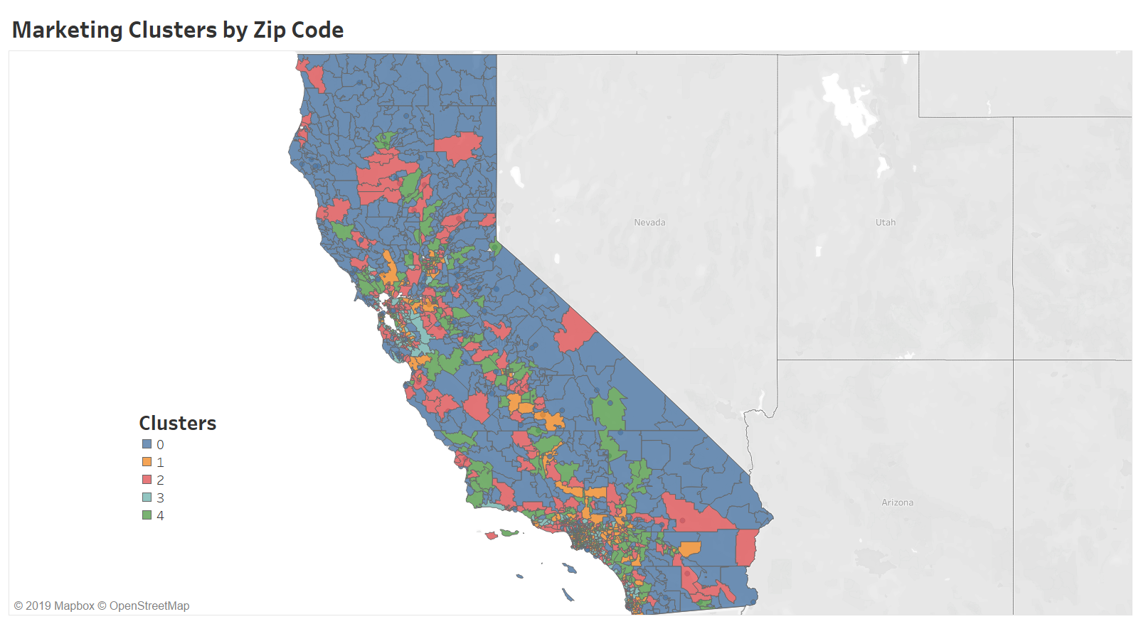

Slide 10


Customer Segmentation
Customer Segmentation
Customer Segments | Stalwarts | Risk Takers | Non Buyers | Upwardly Mobile | Pragmatists
Cluster | 0 | 1 | 2 | 3 | 4
Gender | male | -- | -- | -- | female
Highest Education Level | Associate Degree | High School | -- | Master’s Degree | Some college
EV Types within Cluster | Battery Electric Plug-in Hybrid | Battery Electric | none | Battery Electric Plug-in Hybrid | Battery Electric Plug-in Hybrid
Top Vehicle Price | $40k | $100k | $30k | $100k | $30k
Income | $0 - $49k | $ 50k - $99k | -- | $100k+ | --
Occupation | construction maintenance | sales transportation | -- | arts | service
Housing | homeowner | homeowner; owns 3 vehicles | -- | mix of homeowners & tenants; owns 1-2 vehicles | mix of homeowners & tenants
Home Value/ Rent | $50k - $150k | -- | -- | $500k - $1M/ $1500+ | $150k - $500k/ $500 - $1500

Slide 11
Q3 Marketing Recommendations: Recommended dollar spend per zipcode provided based on user-inputted EV type and cost

Slide 12
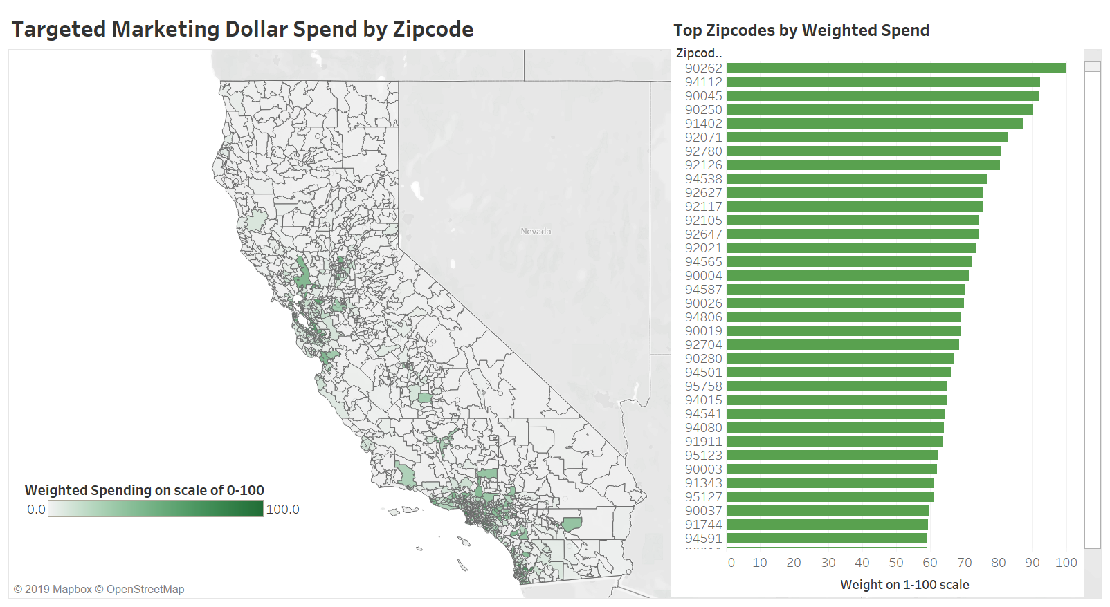

Slide 13
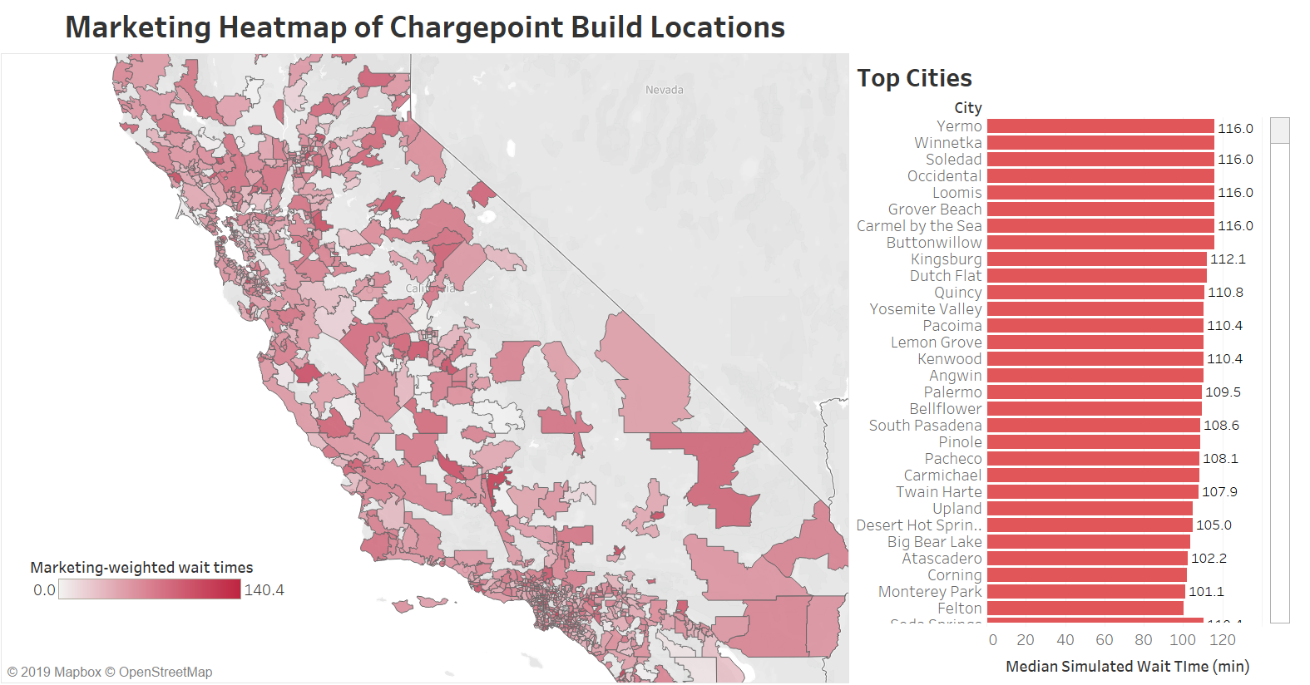

Slide 14
Q3 Technical Explanation
Taking an inputted Porsche car profile, a weighted marketing dollars suggestion towards each cluster is provided on a live heatmap.
Weighting is based on cluster output and proportion of each car type and price range owned out of total cars owned in each zipcode, a per-cluster weighting of inputted.
Weights can be varied via linear regression of coefficient of different demographic values and how they influence likelihood to purchase targeted vehicle.

Slide 15
Future Steps
Deliver Model to Production system and Workbooks to business users, end-to-end POC is provided.
Ingest data into cloud or on-prem server.
Run python script in Databricks to deliver clustering results to tables on the cloud server.
Use a live connection of the data to Tableau.
Business stakeholders can use live Tableau workbooks to plan marketing decisions
Continuously iterate, tune, and improve model.
Collect data from marketing campaigns, use A/B testing to refine marketing model and materials.
Future Model Iterations
Collect and ingest data on effect of marketing on $ lift in revenue from the targeted zip code, using A/B testing where possible against a control variable. Integrate this data to fine tune clustering model and continuously improve regional marketing strategy.
Update simulation model of wait times with distribution of new recorded wait time data.
Reweight Q1 chargepoint heat map with marketing recommendations found in Q3, using a Bayesian computation of the updated function formed by Q1 and Q3 distributions via Monte Carlo approximation of the posterior distribution

Slide 16
Data sources
https://factfinder.census.gov/faces/nav/jsf/pages/searchresults.xhtml?refresh=t&keepList=t (DEMOGRAPHY DATA)
https://afdc.energy.gov/data/?q=electricity (PUBLIC EV CHARGER DATA)
https://www.dmv.ca.gov/portal/dmv/detail/pubs/media_center/statistics (VEHICLE STATS)
Selected 5-digit tabulation areas within California
Selected dataset for desired topics from the topics tab

Slide 17
Thank you!

Slide 18
Additional Materials (not to be presented)

Slide 19
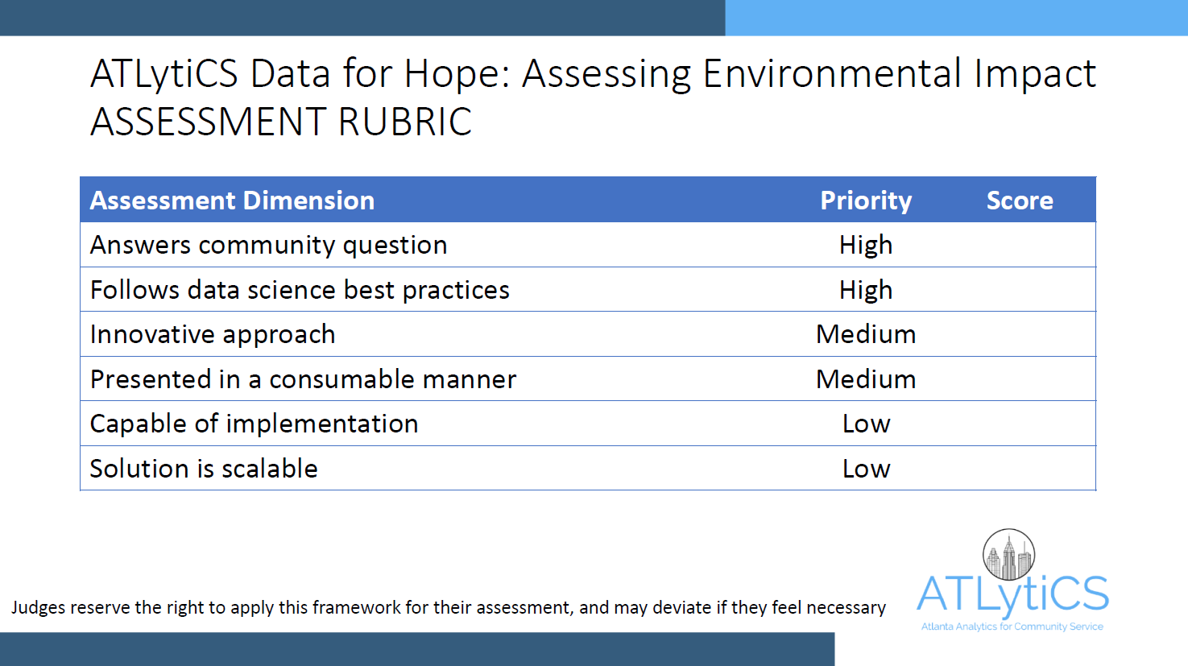

Slide 20
Recall the Three Community Questions
Where to build which charging stations and why?
What customers are likely to buy which EVs, which ones aren’t?
Who should we market to, what kind of cars, and where?

Slide 21
1. Where to build which charging stations and why?
What we will deliver:
Prioritized ranking by Return on Investment (ROI) of each charging station type with product components, type of location it would be installed (e.g., corporate offices, hotels, stores, gas stations), and in which zip code.
Example deliverable
Charging Type | Location Type | White Glove/ Elite Service | Zip Code | Quantity | Charging Time | Connectors | ROI
Level 2 | Supermarket | Yes | 30316 | 5 | 2 - 8 hrs | SAE J1772 | 40-50 customers per day
Level 2 | Mall | Yes | 30324 | 15-20 | 2 - 8 hrs | SAE J1772 | 500-1000 customers per day
Level 2 | Amusement parks | Yes | 30349 | 15-20 | 2 - 8 hrs | SAE J1772 | 500-1000 customers per day
Level 3 | Government Office and Buildings | No | 30301 | 4-5 | 0.5-1 hr | CCS connector | 100-150 customers per day
Notes:
Government plays an important role in making it compulsory for each facility to have a minimum amount of car chargers. Such as a law passed in atlanta, georgia.
White glove service. ROI subjective, due to driver comfort

Slide 22
1. How we will deliver charging station recommendations:
Using the following data:
Quantitative
• Last used (by car type)
• Hours of operation
• Population
• Proximity to major city, shopping, work, industrial area
• EV car # to charger # proportion per zip code
• Chargepoint API
Qualitative
• Geographical location of existing EV charging stations
• EV charging types:
• Level 1
• Level 2
• Level 3/DC Fast Chargers
• Customer feedback on charger types and preferences
We will use the following modeling approach:
Using current data on number of EV owners per zip code compared to locations of publicly available charging stations in conjunction with chargepoint data on waiting lines, we will simulate charging station placement to minimize wait lines for EV users in high traffic areas.
Simulation results will be used in conjunction with Q2 location clusters for zipcodes most likely to purchase target Porsche models to create a linear optimization model to increase availability in target regions while taking into account cost constraints.
Charging preferences by consumers will be regressed against specific location types to add additional weights to the optimization model and specify types of locations/buildings within a zip code to target.
Notes:
Discuss scalability – data can automatically flow from source to model to output in dashboard with daily refresh to be viewed and consumed by on the ground business at Porsche for decision making.

Slide 23
2. How we will deliver customer segments:
Using the following demographic data:
Quantitative
• Demographics of Electric vehicles consumer of each state by Age, income(dual-income), gender, location, profession, industry, degree
• Type of vehicle like SUV, Sedan or Hatchback and its price, Type of Home.
• Same Demographics above of Consumers having gasoline cars above $100k to understand the buying trends and factors.
Qualitative
• Each state's regulation policies and laws (Tax-Rebates).
• Social media analysis of Reviews of EV to understand behavioral trends.
We will use the following modeling approach:
Segmenting customers using K-means, we can build a classifier model in each segment to determine the probability of a customer buying the vehicle or not.
Notes:
Discuss scalability – data can automatically flow from source to model to output in dashboard with daily refresh to be viewed and consumed by on the ground business at Porsche for decision making.

Slide 24
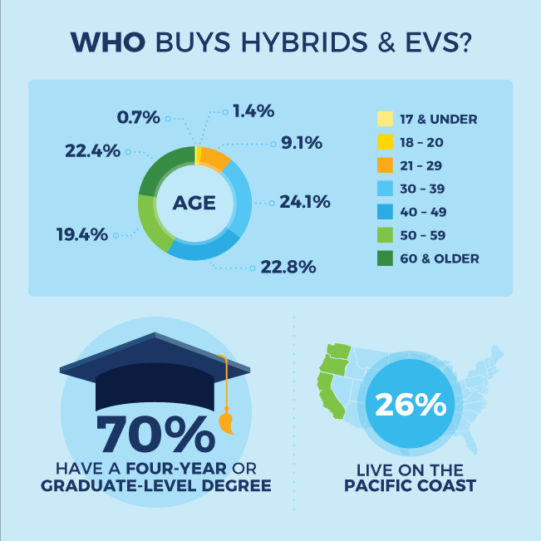
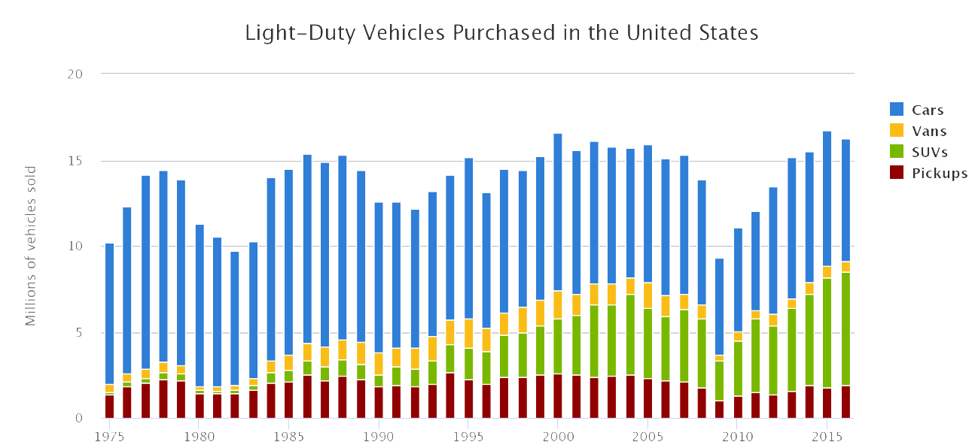
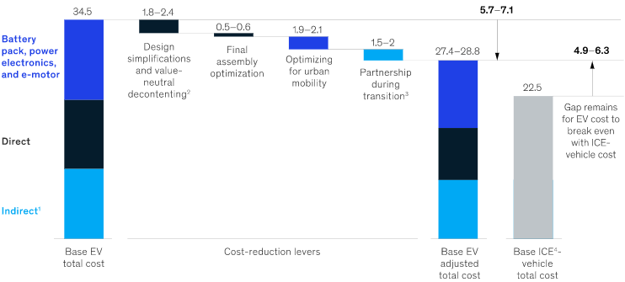
3. What kind of cars should be marketed to who and where?
What we will deliver:
Per car, which persona it should be marketed to in which manner to which region, ranked by probability of opportunity and number of expected sales.
Visualization of marketing guidance:
Notes:
Note: See table on slide 10 also

Slide 25
3. How we will suggest marketing recommendations:
Using the following data:
Quantitative
•Demography of each state by Age, income(dual-income), gender, location(zip-code,rural,urban) , profession, industry, degree(very important)...
•Type of vehicle like gasoline, hybrid and which kind of vehicle like suv, sedan
•Price of vehicle
•Persona clusters and data defined in response to question 2.
•Marketing campaign data w/ sales trends
Qualitative
•Each state's regulation policies and laws
•Persona clusters and data defined in response to question
We will use the following modeling approach:
Using decision tree algorithms based on EV features, we will be able to pair any EV build and cost to our persona clusters, and provide a breakdown of marketing dollar spend for each customer group and location based on probability of purchase.
Notes:
Discuss scalability – data can automatically flow from source to model to output in dashboard with daily refresh to be viewed and consumed by on the ground business at Porsche for decision making.

Slide 26
3. What kind of cars should be marketed to who and where?
Example deliverable
Customer Segment | Vehicle Type & Ranked Probability | Marketing & Advertising | % Marketing Budget | Region | Expected Sales
Pragmatists | BMW i3 (44%) Nissan LEAF (27%) Tesla Model 3 (16%) | Online ads including banner ads and social media | Online Ads: 100% | Southeast | $200M
Risk Takers | Tesla Model S (52%) Tesla Model X (41%) Jaguar I-PACE (9%) | Online and Print Ads | Online Ads: 50% Print Ads: 50% | West Northeast | $178M
Upwardly Mobile | Tesla Model S (62%) Jaguar I-PACE (6%) | Online and Print Ads | Online Ads: 35% Print Ads: 65% | Mideast Southeast | $105M
Near-Retirees | Tesla Model X (60%) Tesla Model S Long Range (32%) | Print ads including direct mail, flyers, and ads in magazines and newspapers | Print Ads: 100% | Southeast Midwest | $50M
Notes:
NOTE: Can use this table for Q3 (JSJ)

Slide 27
General Marketing Ideas and Suggestions
•Charging Infrastructure
Invest in chargers in public spaces
Disseminate information on charger locations
•Consumer Awareness
Establish public demonstration of PEVs
Develop a consumer education plan
•Cost Reduction
Alleviate battery ownership risk
Optimizing EV designs – Decontenting, design revision
Collaborating with competitors to reduce R&D, tooling and plants cost.
New Business Models – Battery Leasing and fleet sales

Slide 28
Optimal Strategy
•Favorable Geography
Provide tax incentives for purchase
Invest in chargers in public spaces
•Preferred type
Cars, SUVs occupy major chunk in Light-Duty Vehicles
•Customer Targeting
Advanced degree holders
Household income > $100,000
Access to free charging(Workplace/Public)
Solar PV adoption among PEV owners

Slide 29
Data Sources
Scrape Chargepoint site or use Chargepoint API
https://volttron.readthedocs.io/en/develop/specifications/chargepoint_driver.html
Alternative Fuel Stations
https://developer.nrel.gov/docs/transportation/alt-fuel-stations-v1/
Porsche Taycan Models (Literature Review)
https://www.porsche.com/usa/models/taycan/taycan-models/taycan-turbo/
Charging Up the Porsche Taycan: Fast Charging and More (Literature Review)
https://www.chargepoint.com/blog/charging-porsche-taycan-fast-charging-and-more/

Slide 30
Data Type
1) VEHICLE REGISTRATION of new york
2) vehicle registration of california -
3) vehicle counts of illinois
4)scrapped user reviews of electric vehicle and find out the difficulties they are facing and analyze their sentiments by natural language processing.
Record Type | VIN | Registration Class | City | State | Zip | County | Model Year | Make | Body Type | Fuel Type | Unladen Weight | Maximum Gross Weight | Passengers | Reg Valid Date | Reg Expiration Date | Color | Scofflaw Indicator | Suspension Indicator | Revocation Indicator
Registration Class | ZIP | Model Year | Fuel | Make | Duty | Vehicles

Slide 31

Business Deliverables
Where to build which charging stations and why?
What customers are likely to buy which EVs, which ones aren’t?
Who should we market to, what kind of cars, and where?

Slide 32
Iteration I
Porsche EV Strategy Iteration 1: Q1. Simulated waiting times and proportion regional charging point to EV users are minimized in a linear optimization model to provide suggested chargepoint numbers/zipcode on a heat map.
Q2: Using principal component analysis, customers are clustered based on buying habits, demographics, and regional car proportions across fuel type. These clusters are identified for targeted market strategies.
Q3: For a Porsche car profile, a weighted marketing dollars suggestion towards each cluster is given on a live heatmap.
Future steps: Improve simulation to Bayesian simulation combining prior of exponential function and a Monte Carlo simulation based on existing data to get more accurate wait times. Weight chargepoint locations by marketing strategy.

