Slide 1
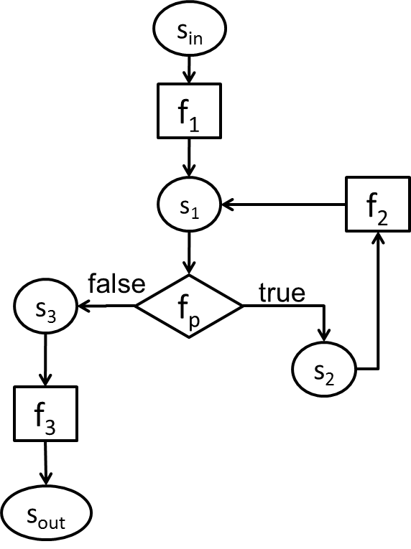
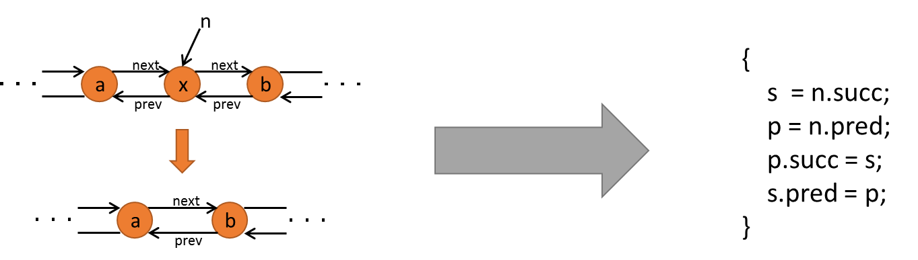
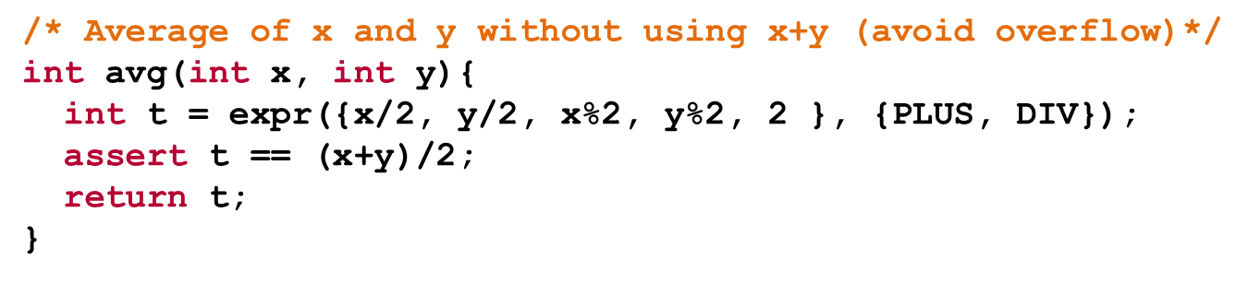
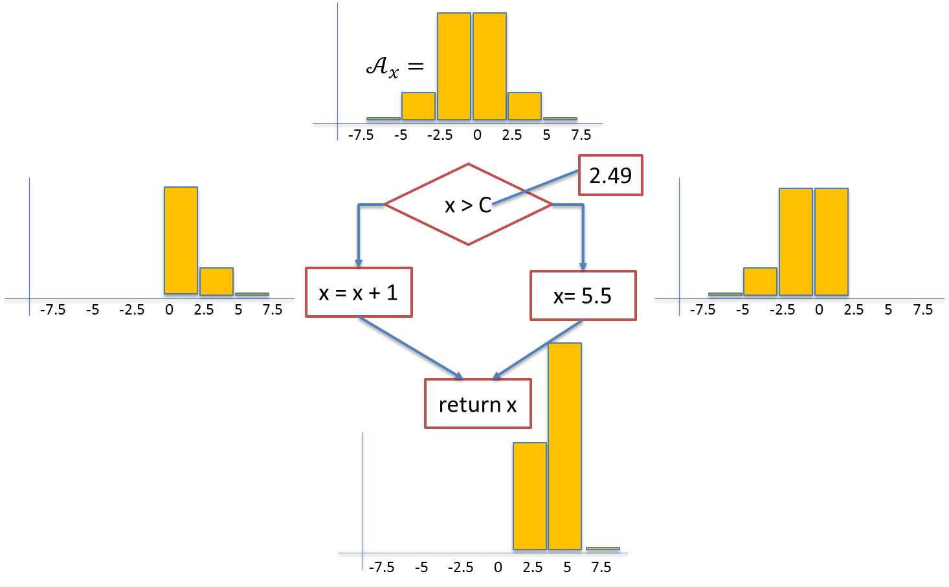
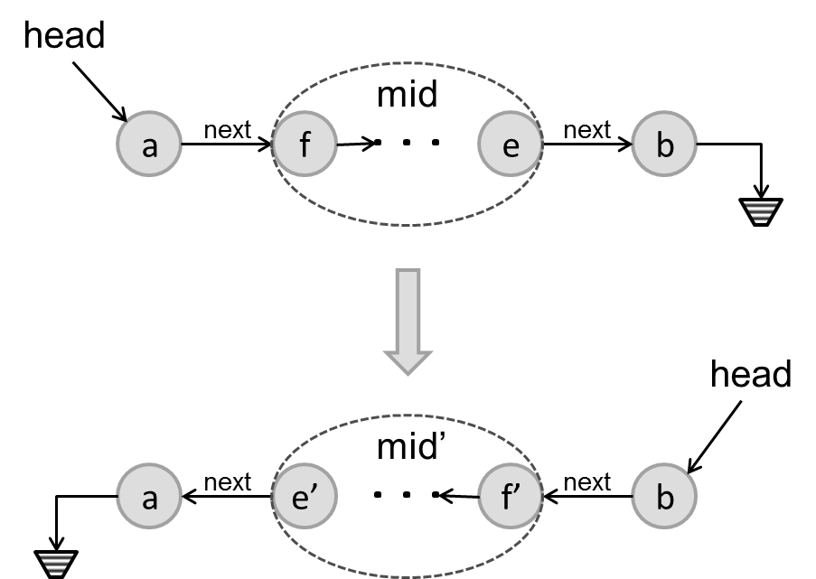
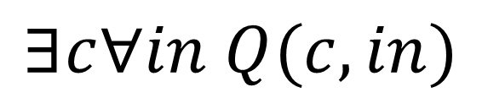
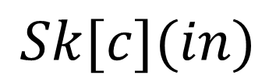
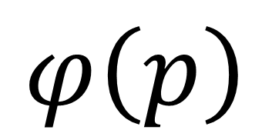
Introduction to
Program Synthesis
6.S981
$$∃c∀in Q(c,in)$$
$$φ\left(p\right)$$
$$Sk[c](in)$$

Slide 2
Lecture 1
Course Overview and Introduction to Synthesis
Armando Solar-Lezama

Slide 3
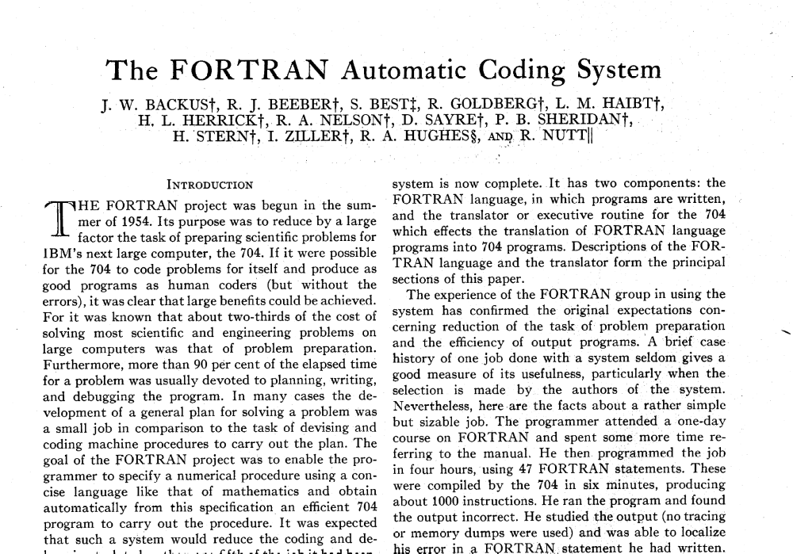
The promise of automation
Notes:
As the earlier quote by Turing illustrates, the notion of automation has been with us for a very long time.
In fact, when fortran first came on the scene back in 1957, it was introduced as an “automatic coding system”

Slide 4
The promise of automation
Notes:
This sentence in particular illustrates the ambition of the Fortran project: “to produce as good programs as human coders, but without the errors”.
The Fortran project was widely successful in “automating those processes that were quite mechanical” and were becoming a drudge. In the ensuing years, the field of compilers, very much born out of the Fortran project, has made great strides in continuing this automation, enabling small teams of programmers to develop systems that 30 years ago would have required small armies of developers.
And yet, it’s hard to argue that the problem of automation has been solved.

Slide 5
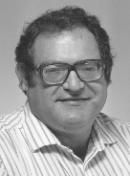
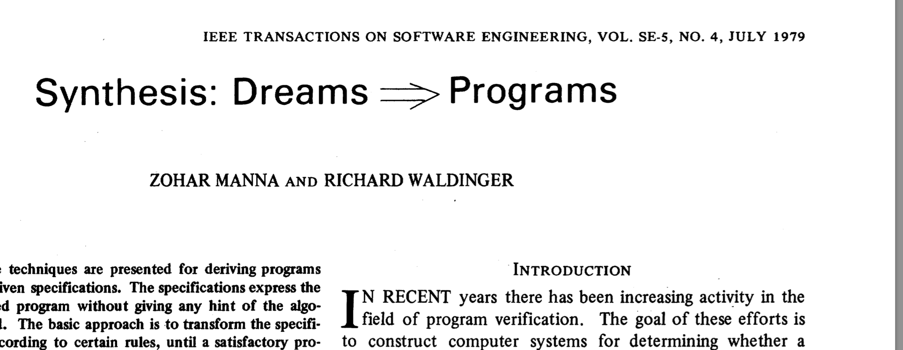
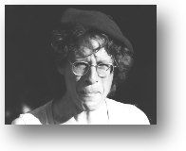
What is software synthesis?
Zohar Manna
Richard Waldinger
Notes:
What we intuitively think of as synthesis is probably better characterized by the title of this famous paper from 1979.
Z. Manna, R. Waldinger. IEEE Trans. Soft. Eng., 5(4), July 1979, 294-328
This was not the first synthesis paper, but it is credited with creating the field.
A central aspect was that you told the computer “what” you wanted and the system would figure out how to do it.
It was too ambitious given the technology of the time.

Slide 6
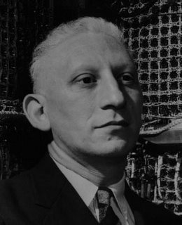
What is software synthesis?
When someone says "I want a programming language in which I need only say what I wish done," give him a lollipop.
-Allan Perlis 1982
Notes:
The hubris is best captured by this quote from Allan Perlis from the early eighties.
Since then, and in particular in the last 10 years, the technology for synthesis has advanced a lot, but one could argue that Perlis quote is still current. Beyond a certain level of complexity, it is unreasonable to expect a synthesizer to derive from scratch algorithms that have taken years to develop by the best minds in our field.
In addition to the harness question, there was a second critique to the Dreams=>Programs agenda: dreams don’t make very good specs.

Slide 7

The synthesis conundrum
I don’t want to program
  The machine should program for me
But I need to tell the machine what I want
  I need a notation to describe what I want
  with great precision with little room for ambiguity
So instead of “programming”
  I will write detailed step by step descriptions of system behavior
  In a notation that requires great mathematical sophistication
  That I have never used before (unlike my favorite programming language which I started using in grade school)

Slide 8


What is software synthesis?
Programmer’s Apprentice (MIT 1987)
  Codify expert knowledge on how to solve programming problems
  User guided synthesis
  Collaborative model is strictly additive
    Programmer is not prevented from just writing code, but gets assistance when required
Charles Rich
Richard C. Waters
Notes:
A different view of what is synthesis could be was embodied by a system called the programmer’s assistant.
http://citeseerx.ist.psu.edu/viewdoc/download?doi=10.1.1.131.3917&rep=rep1&type=pdf
http://hdl.handle.net/1721.1/6054
The Apprentice is an active agent in the software process, rather than a passive tool. This provides the programmer with a familiar cooperation model, namely cooperation with an assistant, through which to introduce new kinds of automation
The project was heavily constrained by the technology of the day, but throughout the course, we’ll keep coming back to many of the themes pioneered by this project.

Slide 9
Software synthesis checklist
Are you generating software?
How do you express what you want the software to do?
  what => how
How sensitive is the system to how you write the spec?
  C compiler?
How much is the system doing for you at compile-time?
  Declarative programming, e.g., Prolog?

Slide 10
Structure of the Course
Unit 1: Inductive Synthesis
Unit 2: Functional Synthesis
Unit 3: Learning and Neurosymbolic techniques

Slide 11
Themes for the course
How do you tell the system what you want?
  What is the specification formalism
  What is the interaction model
  What happens when there is ambiguity
How do you represent domain knowledge?
  How do you guide the system towards relevant programs
  How can you take advantage of the structure of the
  space of programs you care about
How does the system find the program you actually want?
  And how does it know it is the program you want
Notes:
As we talk about these different forms of synthesis, we are going to be

Slide 12
Unit 1: Inductive Synthesis
Synthesize a program whose behavior satisfies a set of examples
  Doesn’t machine learning do that?
Traditional Machine Learning
Inductive Synthesis
Learn a function from a set of examples
Scalability is very important, algorithms must scale to millions of data points
Data is assumed to be noisy;
  need to avoid overfitting
Space of possible functions is highly stylized
Background knowledge incorporated as preprocessing and feature selection
Learn a function from a set of examples
Scalability is not so important, usually we are dealing with small numbers of examples
Data is assumed to be clean
  It’s annoying when user says f(x)=y and the system assumes the user is wrong and decides that f(x)=z
Space of possible functions can be arbitrary
Background knowledge encoded in the description of the space and in the search itself

Slide 13
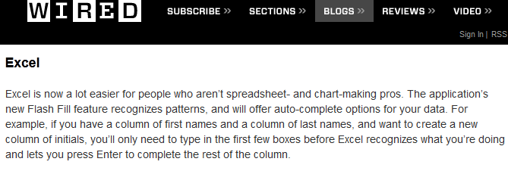

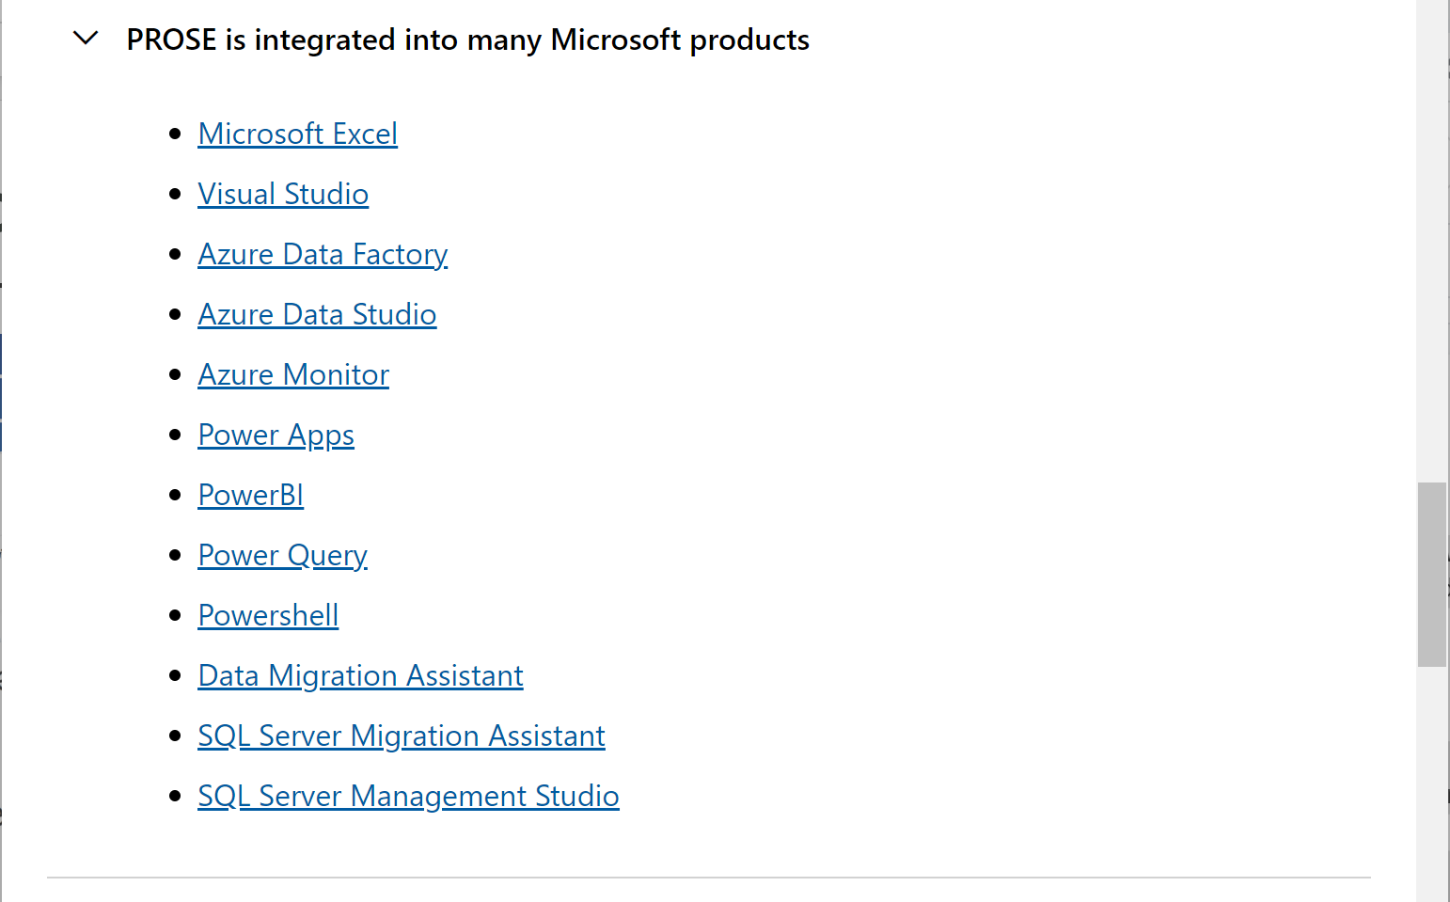
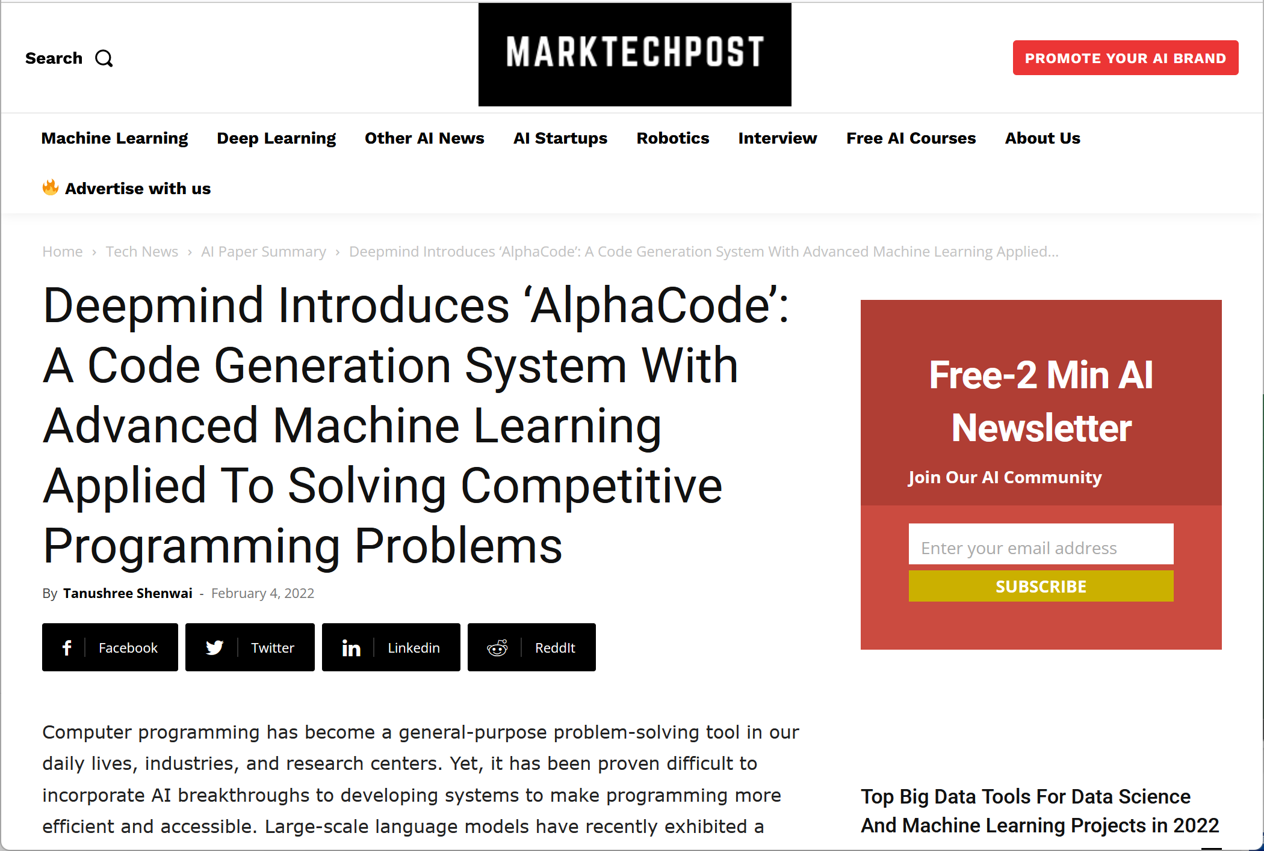
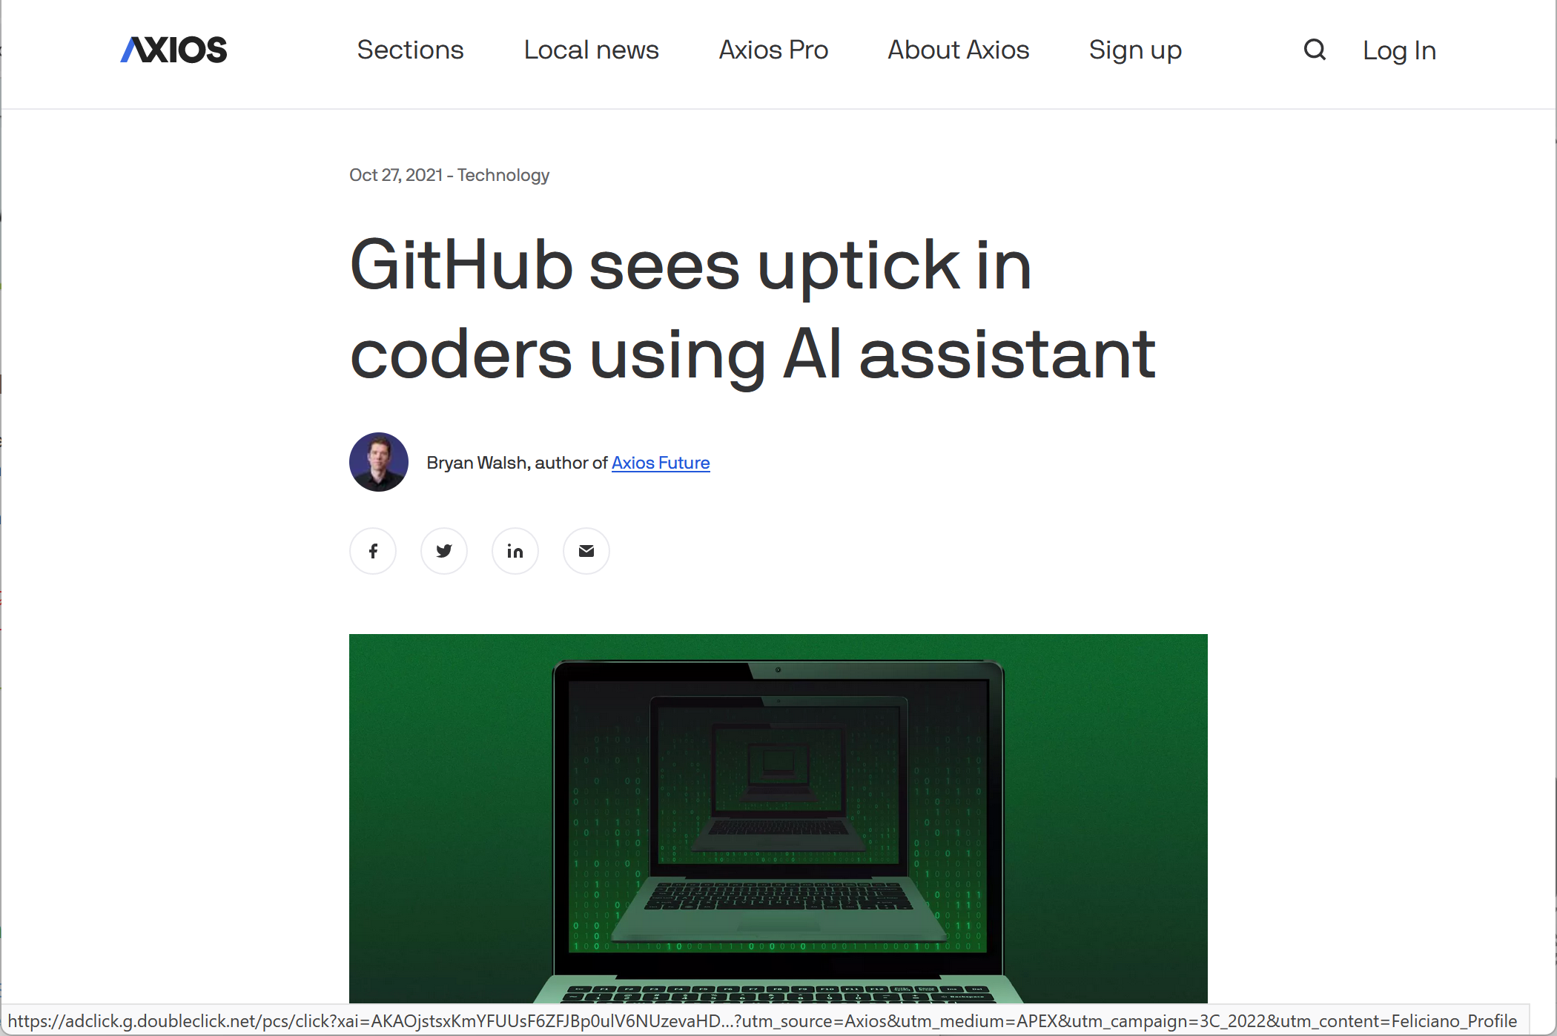
Synthesis has escaped the lab

Slide 14
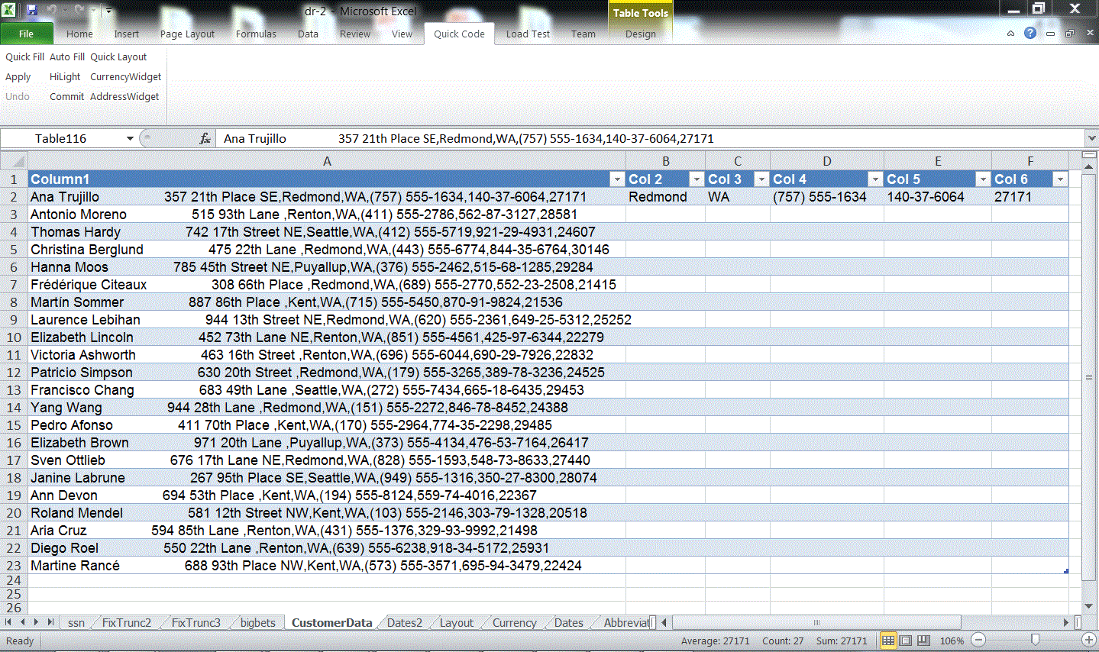
FlashFill: a feature of Excel 2013 (Sumit Gulwani et al.)
Provide one example
Notes:
One recent exciting example of domain specific synthesis was developed by Gulwani for automatically producing Excel macros from examples. In this slide we see that column A contains a line of text with personal data. Columns B, C, D, E, and F contain extracted elements of the data in column A, as shown in the first row. Using the first row, Gulwani’s system will synthesize a program that, given data in column A, will produce the data on columns B to E. As shown in the next slide, this program can then be applied to the remaining rows to produce the desired result.

Slide 15
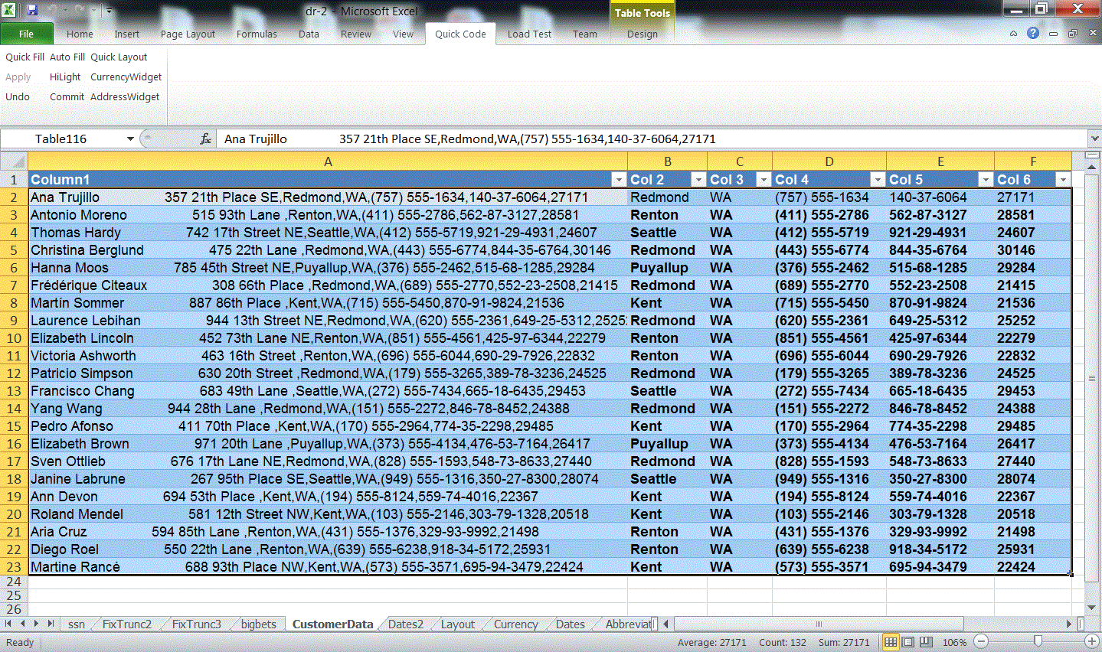
FlashFill: a feature of Excel 2013 (Sumit Gulwani et al.)
The synthesizer discovers the program and fills in the rest
Notes:
Result of the program generated from the first row applied to the remaining rows.

Slide 16
FlashFill Demo

Slide 17
Unit 2: Functional Synthesis
Goal: Synthesize a function that satisfies a specification
  How do we know the specification has been satisfied? Isn’t verification itself already quite hard?
  Can we leverage inductive synthesis machinery for this problem?
  What is the relevant space of functions?
  How do we explore this space efficiently?

Slide 18
Example: Least Significant Zero Bit
  0010 0101 → 0000 0010
Trick:
  Adding 1 to a string of ones turns the next zero to a 1
  i.e. 000111 + 1 = 001000
int W = 32;
bit[W] isolate0 (bit[W] x) { // W: word size
bit[W] ret = 0;
for (int i = 0; i < W; i++)
if (!x[i]) { ret[i] = 1; return ret; }
}

Slide 19
Space of possible implementations
/**
* Generate the set of all bit-vector expressions
* involving +, &, xor and bitwise negation (~).
* the bnd param limits the size of the generated expression.
*/
generator bit[W] gen(bit[W] x, int bnd){
assert bnd > 0;
if(??) return x;
if(??) return ??;
if(??) return ~gen(x, bnd-1);
if(??){
return {| gen(x, bnd-1) (+ | & | ^) gen(x, bnd-1) |};
}
}

Slide 20
Example: Least Significant Zero Bit
generator bit[W] gen(bit[W] x, int bnd){
assert bnd > 0;
if(??) return x;
if(??) return ??;
if(??) return ~gen(x, bnd-1);
if(??){
return {| gen(x, bnd-1) (+ | & | ^) gen(x, bnd-1) |};
}
}
bit[W] isolate0sk (bit[W] x) implements isolate0 {
return gen(x, 3);
}

Slide 21
Sketch Demo

Slide 22
Storyboard Programming
Led by Rishabh Singh
head
next
mid
next
x’ = f
x’= e
x’
a
f
e
b
mid
f
e
x’ = f
e = e’
next
mid
head
x’
f’
e’
next
mid’
next
a
e’
f’
b
Abstract Scenarios
void llReverse(Node head)
{
?? /*1*/
while (?? /*p*/)
{
?? /*2*/
}
?? /*3*/
}
head
head
head
a
next
b
a
head
head
head
a
next
b
a
Concrete Scenarios
Structural Info
Notes:
Explain – we have a text notation not a UI yet.

Slide 23
Storyboard Programming
void llReverse(Node head)
{
Node temp1 = null, temp2 = null,
temp3 = null;
temp1 = head;
while (temp1 != null)
{
// unfold temp1;
head = temp1;
temp1 = temp1.next;
head.next = head;
head.next = temp3;
temp3 = head;
// fold temp3;
}
}
Notes:
It generates the code as well as the unfold and fold annotations that are useful to verify the synthesized implementation.

Slide 24
Unit 3: Learning and Neurosymbolic Synthesis
Boolean specifications are often insufficient
  They can be too hard to write
  Fail to capture important properties of the problem
  How do we leverage the power of neural nets to associate meaning with unstructured inputs?
A Bayesian view of synthesis
  Probabilities reflect our belief about which program is wanted
  Priors over programs are updated with new evidence
  Need new mechanisms to capture distributions over programs
  Search must be guided by these probabilities
Learning to Synthesize
  How do we leverage the large amounts of code already in existence?
  How can the machine teach itself to code?

Slide 25
Copilot demo

Slide 26
Applications

Slide 27
Reverse engineering
Oracle-guided component-based program synthesis
  ICSE 2010 paper by Jha, Gulwani, Seshia and Tiwari
Pioneered a number of new ideas at the algorithmic level
Synthesis for reverse engineering
Notes:
Another very impactful piece of work during these early stages in this new approach to synthesis was a paper by Susmit Jha, Sumit Gulwani, Sanjit Seshia and Ashish Tiwari.
This paper introduced a number of new ideas at the level of synthesis algorithms, but just as importantly, it pointed to another high-impact application of synthesis. Up to this point, most of us were thinking about synthesis from the perspective of automated programming. How do you get the machine to do the coding for you, but this paper pointed to another application that has proven to be extremely relevant in the context of software engineering: reverse engineering, explaining the behavior of a complex piece of code.

Slide 28
Reverse engineering
Implementation
Specification
Notes:
Traditionally, when we think of synthesis, we think of a user writing a small compact specification, and the synthesizer producing a matching implementation.
In this search-based view of synthesis, however, a bigger implementation often implies an exponentially larger search space, so there are strong limitations to the scope of this approach.

Slide 29
Reverse engineering
Implementation
Specification
Notes:
On the other hand, there are many situations where the user already has the big complex implementation, and wants to understand it in terms of a small compact specification.
Because the complexity of the process is driven by the size of the search space, this direction can sometimes be much more tractable.
This paper used as a motivating example the problem of reverse engineering malware, but as we shall see, this is an idea that has demonstrated significant promise beyond that space.

Slide 30


Verified Lifting
Synthesis based reverse engineering can help with optimization
Recent work with by Alvin Cheung and Shoaib Kamil

Slide 31




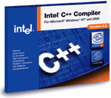
Optimization then and now
Naïve source code
Domain specific problem description
Pochoir
ATLAS
Halide
Close to optimal implementation
Optimal executable
Kind-of-OK executable

Slide 32

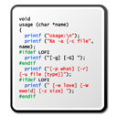
Java to SQL
Methods
SQL Queries
ORM
libraries
Objects
Relations
Application
Database

Slide 33

Java to SQL
Methods
SQL Queries
ORM
libraries
Objects
Relations
Application
Database

Slide 34
Java to SQL
SELECT * FROM user
List getUsersWithRoles () {
List users = User.getAllUsers();
List roles = Role.getAllRoles();
List results = new ArrayList();
for (User u : users) {
for (Role r : roles) {
if (u.roleId == r.id)
results.add(u); }}
return results; }
SELECT * FROM role
List getUsersWithRoles () {
return executeQuery(
“SELECT u FROM user u, role r WHERE u.roleId == r.id
ORDER BY u.roleId, r.id”; }
convert to
Notes:
How bad is the situation? Here is an example from a real-world aplication
What the dev didn’t know is that the first two method calls actually fetch records from the db, as a result when the outer loop is executed a query will be sent to the db, and likewise for the inner one
To speed things up we could have rewritten this code snippet using a simple SQL query as shown here

Slide 35
Join Query
Nested-loop join → Hash join!
O(n²) O(n)
Notes:
Original scales up quadratically as database size increases
There are more experiments in our paper and I invite you to check them out

Slide 36
Example: MultiGrid
DO i3 = 2, n3 - 1
DO i2 = 2, n2 - 1
DO i1 = 1, n1
r1(i1) = r(i1,i2 - 1,i3) + r(i1,i2 + 1,i3) + r(i1,i2,i3 - 1) + r(i1,i2,i3 + 1)
r2(i1) = r(i1,i2 - 1,i3 - 1) + r(i1,i2 + 1,i3 - 1) + r(i1,i2 - 1,i3 + 1) + r(i1,i2 + 1,i3 + 1)
END DO
DO i1 = 2, n1 - 1
u(i1,i2,i3) = u(i1,i2,i3) + c(0) * r(i1,i2,i3) + c(1) * (r(i1 - 1,i2,i3) + r(i1 + 1,i2,i3) + r1(i1)) + c(2) * (r2(i1) + r1(i1 - 1) + r1(i1 + 1))
END DO
END DO
END DO

Slide 37
Example: MultiGrid
/*Range declarations go here */
r1_out(n1) = r(n1,n2-2,n3-1) + r(n1,n2,n3-1) + r(n1,n2-1,n3-2) + r(n1,n2-1,n3)
r2_out(n1) = r(n1,n2-2,n3-2) + r(n1,n2,n3-2) + r(n1,n2-2,n3) + r(n1,n2,n3)
u_out(i1,i2,i3) = u(i1,i2,i3) + c(0) * r(i1,i2,i3)
+ c(1) * (r(i1 - 1,i2,i3) + r(i1 + 1,i2,i3) + r(i1,i2 - 1,i3) + r(i1,i2 + 1,i3) + r(i1,i2,i3 - 1) + r(i1,i2,i3 + 1))
+ c(2) * ((r(i1,i2 - 1,i3 - 1) + r(i1,i2 + 1,i3 - 1) + r(i1,i2 - 1,i3 + 1) + r(i1,i2 + 1,i3 + 1))
+ (r(i1 - 1,i2 - 1,i3) + r(i1 - 1,i2 + 1,i3) + r(i1 - 1,i2,i3 - 1) + r(i1 - 1,i2,i3 + 1))
+ (r(i1 + 1,i2 - 1,i3) + r(i1 + 1,i2 + 1,i3) + r(i1 + 1,i2,i3 - 1) + r(i1 + 1,i2,i3 + 1)))
Tuple my_output(r1_out, r2_out, u_out);

Slide 38
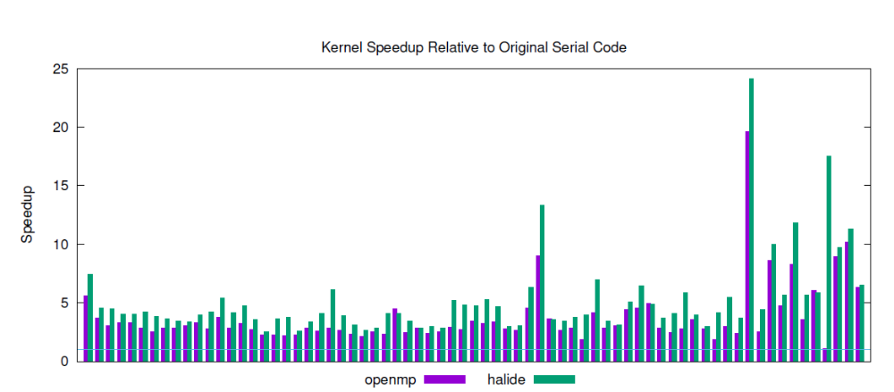
Speedups
Speedups on 24 cores

Slide 39
Framework Models for Symbolic Execution
Pasket system by J. Jeon, X. Qiu, J. Fetter-Degges, J. S. Foster, and A. Solar-Lezama
Application
Event-Driven
Framework
[Environment]
Timer
GPS
User
Event A
API Calls
GPS
Event B
Screen

Slide 40
Pasket
Framework
API (classes, methods, types)
Tutorial
Program
Logs
Pasket
Design Patterns
Framework Model

Slide 41
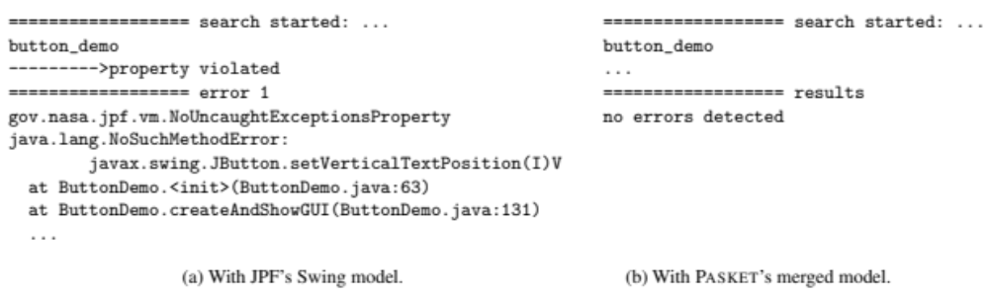
JPF w(/o) Synthesized Model
JPF along with our synthesized model can run tutorials.
JPF’s own hand-written models are insufficient.
  lack of methods: setVerticalTextPosition, etc.
An automated process (via Pasket) can avoid simple but nonetheless frustrating problems, like missing methods.

Slide 42
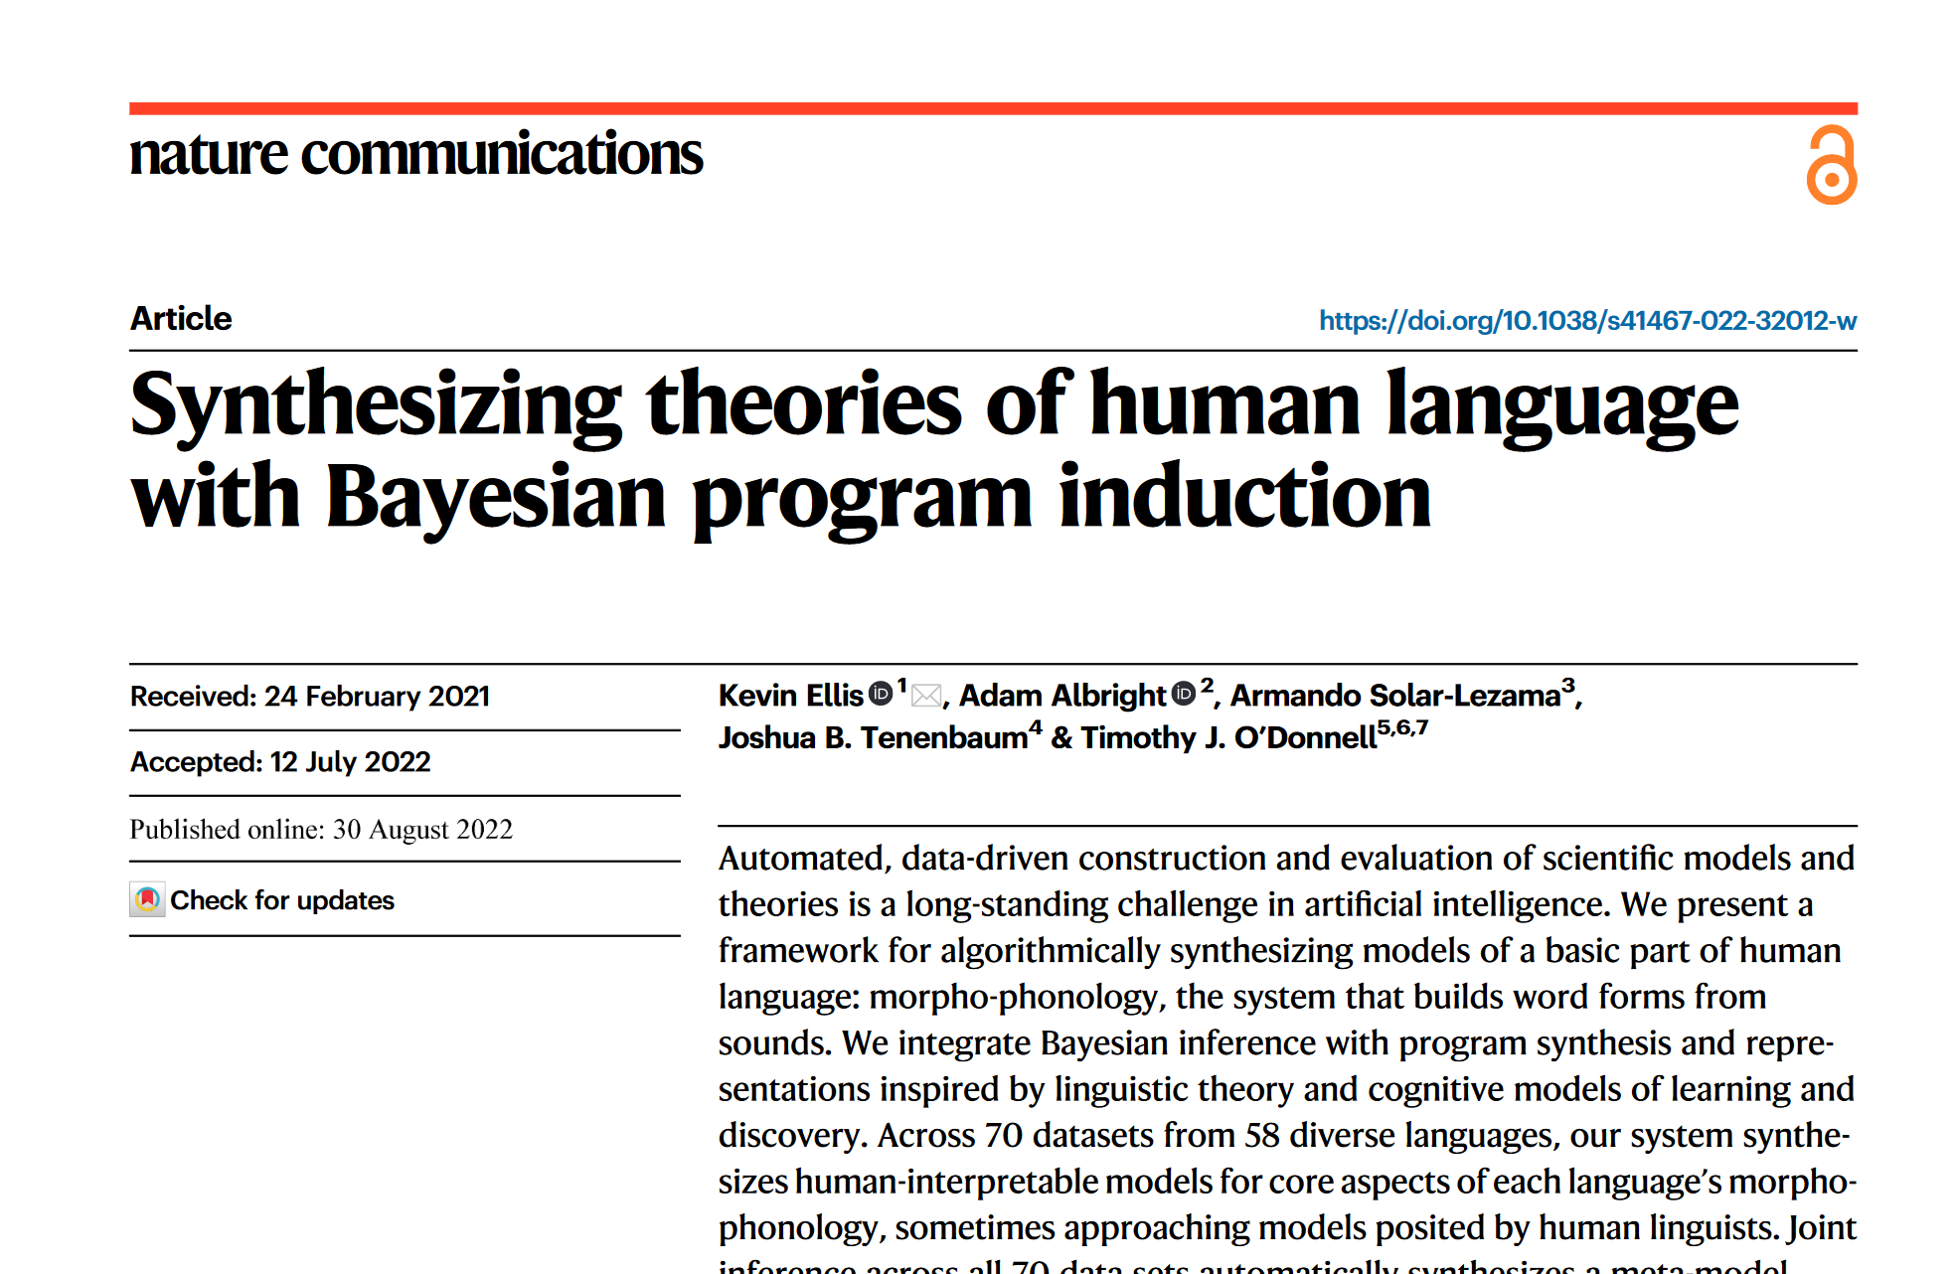
Generating theories

Slide 43
Automated Grading
Led by Rishabh Singh with Sumit Gulwani and myself
public class Program {
public static int[] Reverse(int[] a){
int[] b = a;
for (int i=1; i<b.Length/2; i++){
int temp = b[i];
b[i] = b[b.Length-1-i];
b[b.Length-1-i] = temp;
}
return b;
}
}
This should be a zero
public class Program {
public static int[] Puzzle(int[] b) {
int front, back, temp;
int[]a = b;
front = 0;
back = a.Length-1;
temp = a[back];
while (front > back)
{
a[back] = a[front];
a[front] = temp;
++back;
++front;
temp = a[back];
}
return a;
}
}
This should be a <
This should be -- instead of ++

Slide 44



Prophet/Genesis
Project by Fan Long, Stelios Sidiroglou and Martin Rinard
Patch Generation System
Ranked list of patches
All of which pass test suite
Prophet
Test Suite
Developer chooses correct patch
Goal: rank correct patch first
Inputs
Correct
Outputs

Slide 45
Visual Concept Learning
?
Ellis, Tenenbaum and Solar-Lezama, NIPS 2015

Slide 46
Visual Concept Learning
?
teleport(position[0], 0)
draw(shape[0], scale=1.0)
draw(shape[0], scale=0.5)

