Slide 1
Lecture 13
Functional synthesis with
Sketch
Armando Solar-Lezama

Slide 2
Example
You want to partition N elements over P procs
  How many elements should a processor get?
Obvious answer is N/P
Obvious answer is wrong!
N = 18
P = 5

Slide 3
Synthesizing a partition function
What do we know?
  The interface to the function we want
  Not all processors will get the same # of elements
  The kind of expressions we expect
void partition(int p, int P, int N, ref int ibeg, ref int iend){
if(p< expr({p, P, N, N/P, N%P},{PLUS,TIMES}) ){
iend = expr({p, P, N, N/P, N%P},{PLUS,TIMES});
ibeg = expr({p, P, N, N/P, N%P},{PLUS,TIMES});
}else{
iend = expr({p, P, N, N/P, N%P},{PLUS,TIMES});
ibeg = expr({p, P, N, N/P, N%P},{PLUS,TIMES});
}
}
N
P
N%P
*
+
p
N/P

Slide 4
Synthesizing a partition function
How does the system know what a partition is?
harness void testPartition(int p, int N, int P){
if(p>=P || P < 1){ return; }
int ibeg, iend;
partition(p, P, N, ibeg, iend);
assert iend - ibeg < (N/P) + 2;
if(p+1 < P){
int ibeg2, iend2;
partition(p+1, P, N, ibeg2, iend2);
assert iend == ibeg2;
}
if(p==0){ assert ibeg == 0; }
if(p==P-1){ assert iend == N; }
}
Partitions should be balanced
Adjacent partitions should match
First and last partition should go all the way to the ends

Slide 5
Challenges
Loops and Recursion
CEGIS failures
Limitations of Theory Reasoning

Slide 6
Coping with loops
Success!
Provably correct program
Initial Sketch
VC generation
Sketch with Unknown Invariants
No loops
Failure!
Task may be unsatisfiable,
or complexity of invariant
is just too high for synthesizer.

Slide 7
Coping with loops
Success!
Provably correct program
Initial Sketch
VC generation
Sketch with Unknown Invariants
No loops
Failure!
Task may be unsatisfiable,
or complexity of invariant
is just too high for synthesizer.
Inlining and Unrolling
Bounds for inputs, loops and inlining
Success!
Program is correct within the input
bounds
Sketch with Unknown Invariants
No loops
Loop and recursion free code
VC generation
Failure!
Task is unsatisfiable.

Slide 8
Strategy
Unroll all loops
Inline all functions
Now you have a loop free program
  The method of generating Verification conditions is now fully algorithmic

Slide 9

Loop Unrolling
if(b){
C
while(b){
C
}
}
while(b){
C
}
$$≡$$

Slide 10
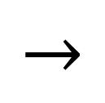
Loop Unrolling
if(b){
C
while(b){
C
}
}
while(b){
C
}
$$≡$$
if(b){
C
while(b){
C
}
}
while(b){
C
}
$$→$$

Slide 11
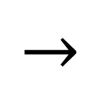
Loop Unrolling
if(b){
C
while(b){
C
}
}
while(b){
C
}
$$≡$$
if(b){
C
while(b){
C
}
}
if(b){
C
if(b){
while(b){
C
}
}
}
while(b){
C
}
$$→$$
$$→$$

Slide 12
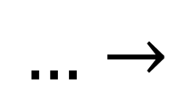
Loop Unrolling
if(b){
C
while(b){
C
}
}
while(b){
C
}
$$≡$$
if(b){
C
if(b){
while(b){
C
}
}
}
…
if(b){
C
if(b){
assert false;
}
}
}
if(b){
C
while(b){
C
}
}
while(b){
C
}
$$→$$
$$→$$
$$…→$$

Slide 13
Loop Unrolling
if(b){
C
while(b){
C
}
}
while(b){
C
}
$$≡$$
Why not assume?
if(b){
C
if(b){
while(b){
C
}
}
}
…
if(b){
C
if(b){
assert false;
}
}
}
if(b){
C
while(b){
C
}
}
while(b){
C
}
$$→$$
$$→$$
$$…→$$

Slide 14
Pros vs. Cons
Pros of unrolling approach
  Can find solutions even for cases where the invariants are too complex to synthesize
  Eliminate risk of non-terminating solution without the need for termination proof
Cons
  Formulas can grow really big
  A lot of “magic numbers” needed to coordinate input bounds, with unrolling bounds of many different loops.
  Solution may be incorrect

Slide 15
CEGIS Failure
generator void(State in, ref State out){
State locIn = in;
State locOut;
repeat(3){
{| Comp0(locIn, locOut)
| Comp1(locIn, locOut)
| Comp2(locIn, locOut)
|}
locIn = locOut;
}
out = locOut;
}
Comp0(in, out)
Comp1(in, out)
Comp2(in, out)
I want to synthesize an arbitrary
permutation of the three components.
Simple sketch but fails to enforce that each component is used exactly once.

Slide 16
CEGIS Failure
generator void(State in, ref State out){
State locIn = in;
State locOut;
bit[3] used;
repeat(3){
if(??){ assert !used[0];
Comp0(locIn, locOut);
used[0] = 1;
} else
if(??){ assert !used[1];
Comp1(locIn, locOut);
used[1] = 1;
} else
if(??){ assert !used[2];
Comp2(locIn, locOut);
used[2] = 1;
}
}
out = locOut; assert used == {1,1,1};
}
Comp0(in, out)
Comp1(in, out)
Comp2(in, out)
I want to synthesize an arbitrary
permutation of the three components.
Sketch enforces the constraint of using each component once, but is more complex and still has the problem that the resulting formula ends up with 3 copies of each component.

Slide 17
CEGIS Failure
generator void(State in, ref State out){
State[3] tin = NonDeterministic();
int fst = ??; // Component in the first pos.
int snd = ??; //Component in the second pos.
int thrd = ??; //Component in the third pos.
assert fst < 3;
assert snd < 3 && snd != fst;
assert thrd < 3 && thrd != snd && thrd != fst;
Comp1(tin[0], tout[0]);
Comp2(tin[1], tout[1]);
Comp3(tin[2], tout[2]);
assume tin[fst] == in;
assume tin[snd] == tout[fst];
assume tin[thrd] == tout[snd];
out = tout[thrd];
}
Comp0(in, out)
Comp1(in, out)
Comp2(in, out)
I want to synthesize an arbitrary
permutation of the three components.
tin is an additional input that we get from calling an uninterpreted function. This version of the problem only requires one copy of each component, but causes CEGIS to work very inefficiently.

Slide 18

CEGIS Failure
$$∀$$
tin[0]
tin[1]
tin[2]
tout[0]
tout[1]
tout[2]
if(in==tin[fst] &&
tin[snd] == tout[fst] &&
tin[thrd] ==tout[snd]){
assert P(tout[thrd]);
}

Slide 19
CEGIS Failure
in
$$∀$$
tin[0]
tin[1]
tin[2]
tout[0]
tout[1]
tout[2]
if(in==tin[1] &&
tin[0] == tout[1] &&
tin[2] ==tout[0]){
assert P(tout[2]);
}
P(out)

Slide 20
CEGIS Failure
in
Counterexample 1:
in = 5
tin[1] = 5
tin[0] = 10
tin[2] = 20
$$∀$$
tin[0]
tin[1]
tin[2]
out = in+10
out=
in*2
out=
in+1
tout[0]
tout[1]
tout[2]
if(in==tin[1] &&
tin[0] == tout[1] &&
tin[2] ==tout[0]){
assert P(tout[2]);
}
P(out)
Assert out = (in+10)*2 + 1

Slide 21
CEGIS Failure
in
Counterexample 1:
in = 5
tin[1] = 5
tin[0] = 10
tin[2] = 20
$$∀$$
tin[0]
tin[1]
tin[2]
out = in+10
out=
in*2
out=
in+1
Counterexample 2:
in = 5
tin[1] = 5
tin[0] = 11
tin[2] = 10
tout[0]
tout[1]
tout[2]
if(in==tin[1] &&
tin[2] == tout[1] &&
tin[0] ==tout[2]){
assert P(tout[0]);
}
P(out)
Assert out = (in+10)*2 + 1

Slide 22
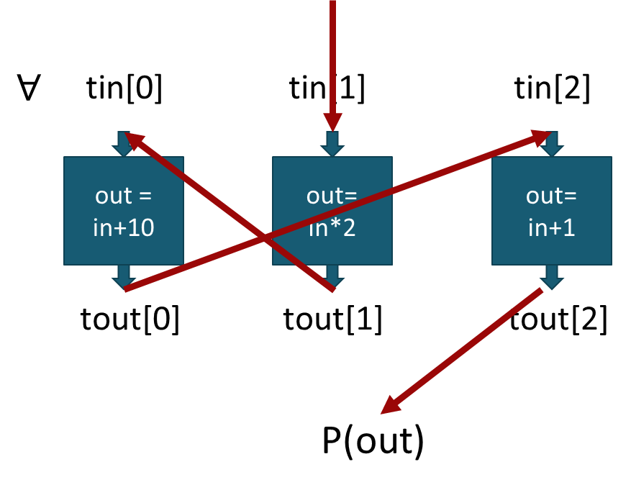
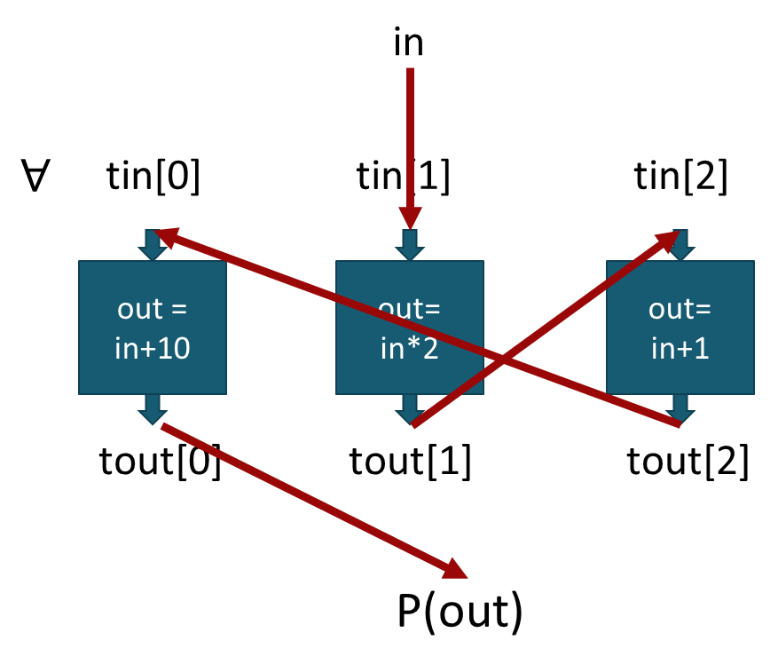
CEGIS Failure
Counterexample 1:
in = 5
tin[1] = 5
tin[0] = 10
tin[2] = 20
Counterexample 2:
in = 5
tin[1] = 5
tin[0] = 11
tin[2] = 10
Counterexample rules out candidate that produced it,
but it cannot even rule out an equivalent candidate

Slide 23
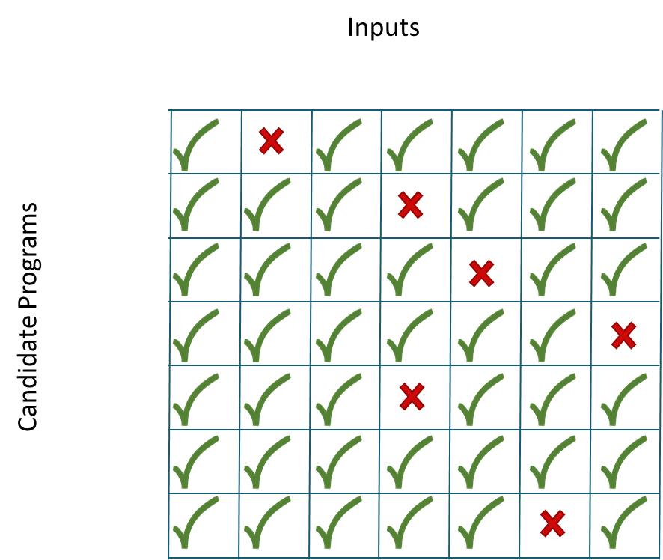
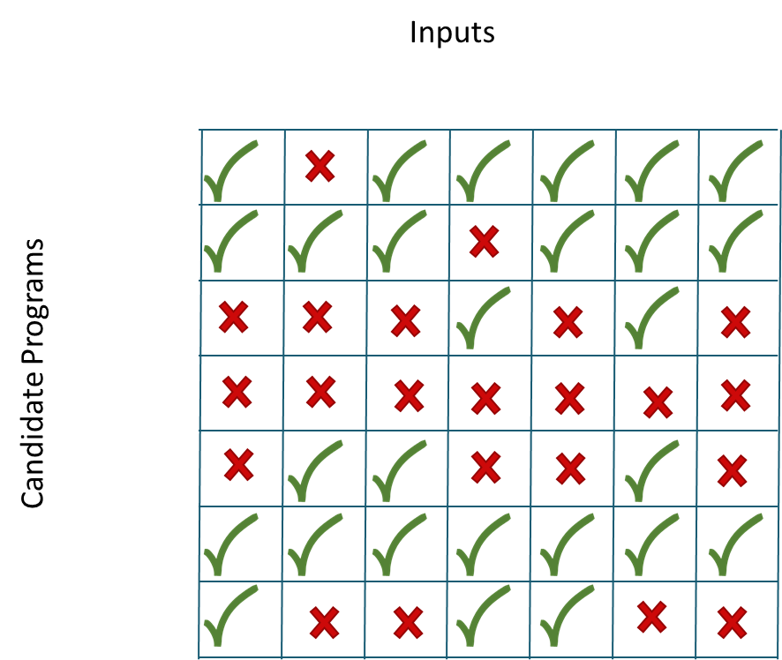
CEGIS Failure

Slide 24
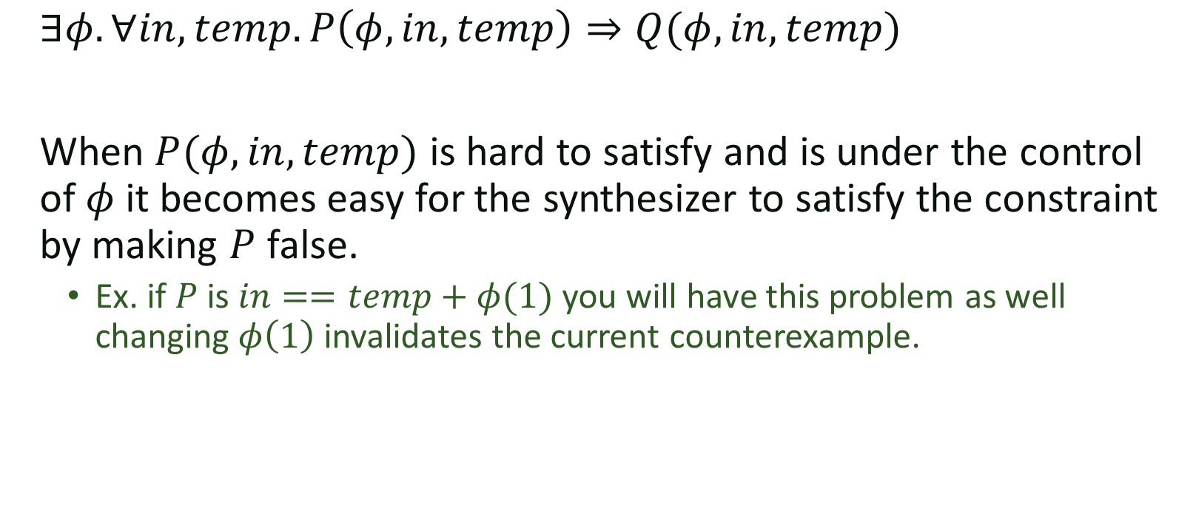
General problem
$∃φ. ∀in,temp. P\left(φ, in, temp\right)⇒Q(φ, in, temp)$
When $P(φ, in, temp)$ is hard to satisfy and is under the control of $φ$ it becomes easy for the synthesizer to satisfy the constraint by making $P$ false.
  Ex. if $P$ is $in==temp+φ(1)$ you will have this problem as well
  changing $φ\left(1\right)$ invalidates the current counterexample.

Slide 25
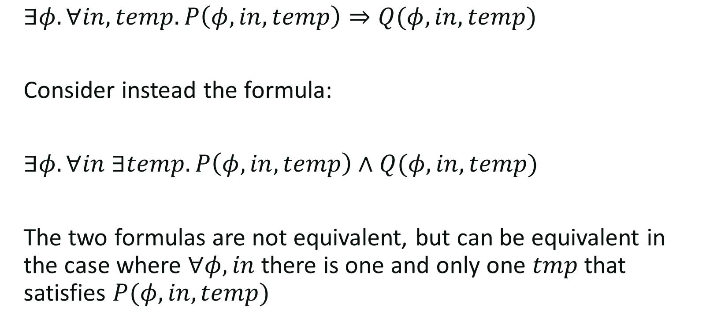
Idea
$∃φ. ∀in,temp. P\left(φ, in, temp\right)⇒Q(φ, in, temp)$
Consider instead the formula:
$∃φ. ∀in ∃temp. P\left(φ, in, temp\right)∧Q(φ, in, temp)$
The two formulas are not equivalent, but can be equivalent in the case where $∀φ, in$ there is one and only one $tmp$ that satisfies $P(φ, in, temp)$

Slide 26
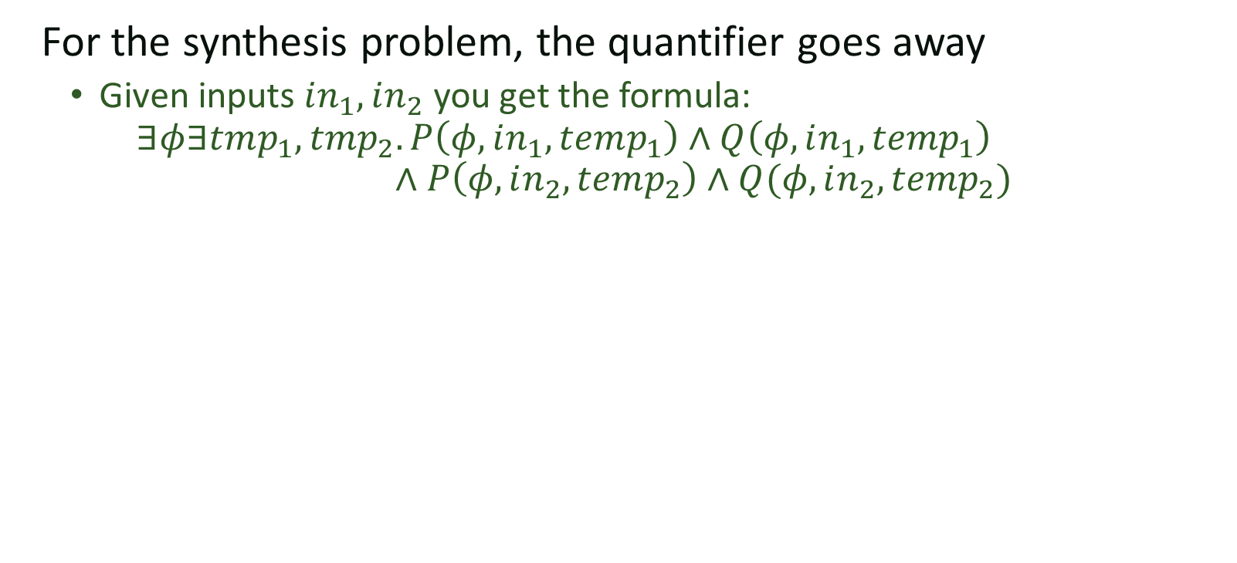
Adding quantifiers makes it easier
For the synthesis problem, the quantifier goes away
  Given inputs $in_{1}, in_{2}$ you get the formula:
  $∃φ∃tmp_{1}, tmp_{2}. P\left(φ, in_{1}, temp_{1}\right)∧Q\left(φ, in_{1}, temp_{1}\right)$
  $∧P\left(φ, in_{2}, temp_{2}\right)∧Q(φ, in_{2}, temp_{2})$

