Slide 1
Lecture 18
Deductive/Inductive
Hybrid Approaches
Armando Solar-Lezama

Slide 2
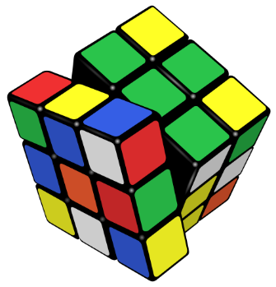



Deductive vs Combinatorial Synthesis
Deductive Synthesis
Combinatorial Synthesis
space of all programs
Space of programs
implementations
more decomposed (into low-level steps)
$$φ\left(p\right)=$$
$$φ_{1}\left(p\right){∧φ}_{2}\left(p\right)∧φ_{3}\left(p\right)$$

Slide 3
StreamBit

Slide 4
Example: DropThird
Many transformations required before you can code in C
Many choices have to be made along the way
Most optimal choices depend on wordsize, cache size, cache speed, etc.
SLOW O(w)
FAST O(log w)
x
x
+
+

Slide 5
Example: DropThird
Many transformations required before you can code in C
x

Slide 6
Example: DropThird
Many transformations required before you can code in C
x

Slide 7
Example: DropThird
Many transformations required before you can code in C

Slide 8
Example: DropThird
Many transformations required before you can code in C

Slide 9
Example: DropThird
Many transformations required before you can code in C
Many choices have to be made along the way
Most optimal choices depend on wordsize, cache size, cache speed, etc.
+
+

Slide 10
Example: DropThird
Many transformations required before you can code in C
Many choices have to be made along the way
Most optimal choices depend on wordsize, cache size, cache speed, etc.

Slide 11
Example: DropThird
Many transformations required before you can code in C
Many choices have to be made along the way
Most optimal choices depend on wordsize, cache size, cache speed, etc.
SLOW O(w)
FAST O(log w)

Slide 12
The strategy
Start with a Synchronous Data Flow language to describe the task at a high level.
The same language can express the low level implementation
  Make each actor correspond to a single low level operation.
Any sequence of transformations that transforms a HL program into an equivalent LL program encodes an implementation
HL program
LL program

Slide 13
Default Implementation
Automatic Transform algorithm
Defines a default implementation for any program
Leveraged by the user for more involved implementations
HL program
LL program

Slide 14
The Full Picture
For every task there is a space of programs that describe it
LL programs
Level of abstraction
(high low)

Slide 15
The Full Picture
For every task there is a space of programs that describe it
Automatic Transform algorithm defines a path from any program to a LL program.
LL programs
Level of abstraction
(high low)

Slide 16
The Full Picture
For every task there is a space of programs that describe it
Automatic Transform algorithm defines a path from any program to a LL program.
LL programs
Level of abstraction
(high low)

Slide 17
The Full Picture
For every task there is a space of programs that describe it
Automatic Transform algorithm defines a path from any program to a LL program.
LL programs
Level of abstraction
(high low)

Slide 18
The Full Picture
For every task there is a space of programs that describe it
Automatic Transform algorithm defines a path from any program to a LL program.
To get a different implementation, define a Halfway Transformation, and let the automaitc algorithm do the rest
LL programs
Level of abstraction
(high low)

Slide 19
The Full Picture
For every task there is a space of programs that describe it
Automatic Transform algorithm defines a path from any program to a LL program.
To get a different implementation, define a Halfway Transformation, and let the automaitc algorithm do the rest
LL programs
Level of abstraction
(high low)

Slide 20
The Full Picture
For every task there is a space of programs that describe it
Automatic Transform algorithm defines a path from any program to a LL program.
To get a different implementation, define a Halfway Transformation, and let the automaitc algorithm do the rest
LL programs
Level of abstraction
(high low)

Slide 21
The Full Picture
For every task there is a space of programs that describe it
Automatic Transform algorithm defines a path from any program to a LL program.
To get a different implementation, define a Halfway Transformation, and let the automaitc algorithm do the rest
If the transformation is difficult, simply provide a Sketch
LL programs
Level of abstraction
(high low)

Slide 22
The Full Picture
For every task there is a space of programs that describe it
Automatic Transform algorithm defines a path from any program to a LL program.
To get a different implementation, define a Halfway Transformation, and let the automaitc algorithm do the rest
If the transformation is difficult, simply provide a Sketch
LL programs
Level of abstraction
(high low)

Slide 23
The Full Picture
For every task there is a space of programs that describe it
Automatic Transform algorithm defines a path from any program to a LL program.
To get a different implementation, define a Halfway Transformation, and let the automaitc algorithm do the rest
If the transformation is difficult, simply provide a Sketch
LL programs
Level of abstraction
(high low)

Slide 24
Half way transformations-example
Half way transformation to specify FAST bit shifting algorithm
1 0 0 0 0 0 0 0 0 0 0 0 0 0 0 0
0 1 0 0 0 0 0 0 0 0 0 0 0 0 0 0
0 0 0 1 0 0 0 0 0 0 0 0 0 0 0 0
0 0 0 0 1 0 0 0 0 0 0 0 0 0 0 0
0 0 0 0 0 0 0 0 0 0 0 0 0 0 0 0
0 0 0 0 0 0 0 0 0 0 0 0 0 0 0 0
0 0 0 0 0 0 1 0 0 0 0 0 0 0 0 0
0 0 0 0 0 0 0 1 0 0 0 0 0 0 0 0
0 0 0 0 0 0 0 0 0 1 0 0 0 0 0 0
0 0 0 0 0 0 0 0 0 0 1 0 0 0 0 0
0 0 0 0 0 0 0 0 0 0 0 0 0 0 0 0
0 0 0 0 0 0 0 0 0 0 0 0 0 0 0 0
0 0 0 0 0 0 0 0 0 0 0 0 1 0 0 0
0 0 0 0 0 0 0 0 0 0 0 0 0 1 0 0
0 0 0 0 0 0 0 0 0 0 0 0 0 0 0 1
0 0 0 0 0 0 0 0 0 0 0 0 0 0 0 0
F.F_1
1 0 0 0 0 0 0 0 0 0 0 0 0 0 0 0
0 1 0 0 0 0 0 0 0 0 0 0 0 0 0 0
0 0 0 1 0 0 0 0 0 0 0 0 0 0 0 0
0 0 0 0 1 0 0 0 0 0 0 0 0 0 0 0
0 0 0 0 0 0 1 0 0 0 0 0 0 0 0 0
0 0 0 0 0 0 0 1 0 0 0 0 0 0 0 0
0 0 0 0 0 0 0 0 0 1 0 0 0 0 0 0
0 0 0 0 0 0 0 0 0 0 1 0 0 0 0 0
0 0 0 0 0 0 0 0 0 0 0 0 1 0 0 0
0 0 0 0 0 0 0 0 0 0 0 0 0 1 0 0
0 0 0 0 0 0 0 0 0 0 0 0 0 0 0 1
F.F_1
F
F.F_2
F.F_3
1 0 0 0 0 0 0 0 0 0 0 0 0 0 0 0
0 1 0 0 0 0 0 0 0 0 0 0 0 0 0 0
0 0 1 0 0 0 0 0 0 0 0 0 0 0 0 0
0 0 0 1 0 0 0 0 0 0 0 0 0 0 0 0
0 0 0 0 0 0 1 0 0 0 0 0 0 0 0 0
0 0 0 0 0 0 0 1 0 0 0 0 0 0 0 0
0 0 0 0 0 0 0 0 1 0 0 0 0 0 0 0
0 0 0 0 0 0 0 0 0 1 0 0 0 0 0 0
0 0 0 0 0 0 0 0 0 0 0 0 0 0 0 0
0 0 0 0 0 0 0 0 0 0 0 0 0 0 0 0
0 0 0 0 0 0 0 0 0 0 0 0 0 0 0 0
0 0 0 0 0 0 0 0 0 0 0 0 0 0 0 0
0 0 0 0 0 0 0 0 0 0 0 0 1 0 0 0
0 0 0 0 0 0 0 0 0 0 0 0 0 1 0 0
0 0 0 0 0 0 0 0 0 0 0 0 0 0 1 0
0 0 0 0 0 0 0 0 0 0 0 0 0 0 0 0
F.F_2
System Expert provides high level decomposition
System Takes care of Lowering F.F_1, F.F_2 and F.F_3
Correctness is guaranteed as long as
[F.F_3]x[F.F_2]x[F.F_1] = F
Fully Specifying F.F._1, F.F_2 and F.F_3 is still too difficult. We would like to be able to sketch them
1 0 0 0 0 0 0 0 0 0 0 0 0 0 0 0
0 1 0 0 0 0 0 0 0 0 0 0 0 0 0 0
0 0 1 0 0 0 0 0 0 0 0 0 0 0 0 0
0 0 0 1 0 0 0 0 0 0 0 0 0 0 0 0
0 0 0 0 1 0 0 0 0 0 0 0 0 0 0 0
0 0 0 0 0 1 0 0 0 0 0 0 0 0 0 0
0 0 0 0 0 0 1 0 0 0 0 0 0 0 0 0
0 0 0 0 0 0 0 1 0 0 0 0 0 0 0 0
0 0 0 0 0 0 0 0 0 0 0 0 1 0 0 0
0 0 0 0 0 0 0 0 0 0 0 0 0 1 0 0
0 0 0 0 0 0 0 0 0 0 0 0 0 0 1 0
F.F_3

Slide 25
Sketching
An implementation sketch:
  Specifies a number of steps in the implementation of a task
  Implicitly defines a matrix decomposition
  Gives constraints on what each step is allowed to do
  System derives an implementation satisfying the constraints and semantically equivalent to original filter
Example. A fragment of TSL for FAST compaction:
  filter = [shift(1:16 by 0 || 1)] ;
  [shift(1:16 by 0 || 2)] ;
  [shift(1:16 by 0 || 4)] ;
functionality

Slide 26
Sketching
An implementation sketch:
  Specifies a number of steps in the implementation of a task
  Implicitly defines a matrix decomposition
  Gives constraints on what each step is allowed to do
  System derives an implementation satisfying the constraints and semantically equivalent to original filter
Example. A fragment of TSL for FAST compaction:
  filter = [shift(1:16 by 0 || 1)] ;
  [shift(1:16 by 0 || 2)] ;
  [shift(1:16 by 0 || 4)] ;
sketch
?
?
?
?
?
?
?
?
?
?
?
?
?
?
?
?
functionality
?
?
?
?
?
?
?
?
?
?
?
?
?
?
?
?
?
?
?
?
?
?
?
?
?
?
?
?
?
?
?
?
?
?
?
?
?
?
?
?
?
?
?
?
?
?
?
?

Slide 27
Sketching
An implementation sketch:
  Specifies a number of steps in the implementation of a task
  Implicitly defines a matrix decomposition
  Gives constraints on what each step is allowed to do
  System derives an implementation satisfying the constraints and semantically equivalent to original filter
Example. A fragment of TSL for FAST compaction:
full implementation
  filter = [shift(1:16 by 0 || 1)] ;
  [shift(1:16 by 0 || 2)] ;
  [shift(1:16 by 0 || 4)] ;
sketch
?
?
?
?
?
?
?
?
?
?
?
?
?
?
?
?
functionality
?
?
?
?
?
?
?
?
?
?
?
?
?
?
?
?
?
?
?
?
?
?
?
?
?
?
?
?
?
?
?
?
?
?
?
?
?
?
?
?
?
?
?
?
?
?
?
?

Slide 28
Deriving divide-and-conquer dynamic programming algorithms using solver-aided transformations.
Shachar Itzhaky, Rohit Singh, Armando Solar-Lezama, Kuat Yessenov, Yongquan Lu, Charles E. Leiserson, Rezaul Alam Chowdhury:

Slide 29
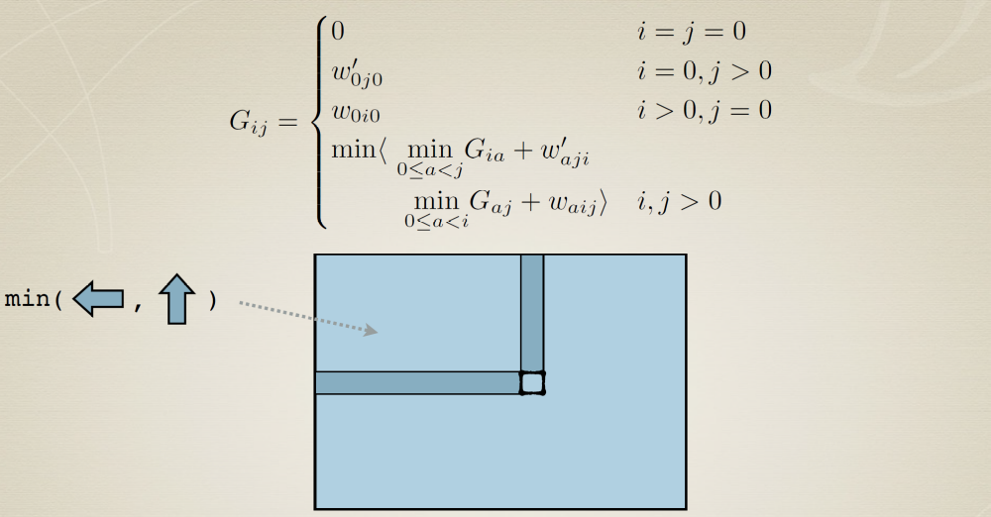
Dynamic Programming

Slide 30

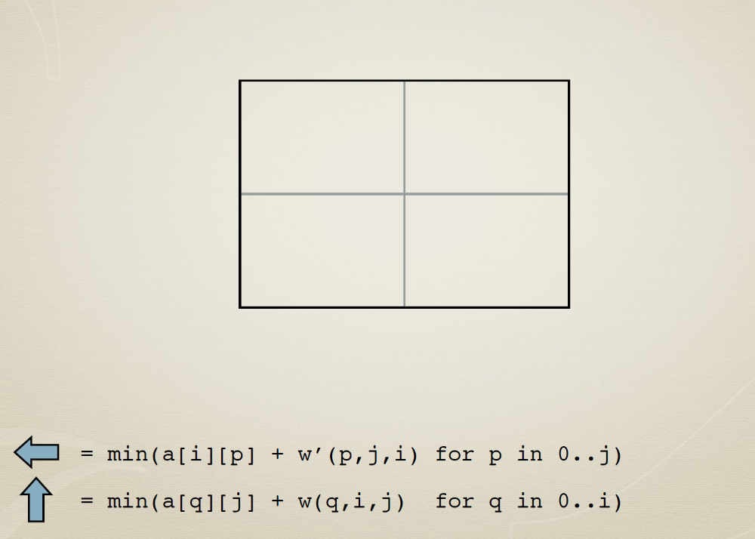
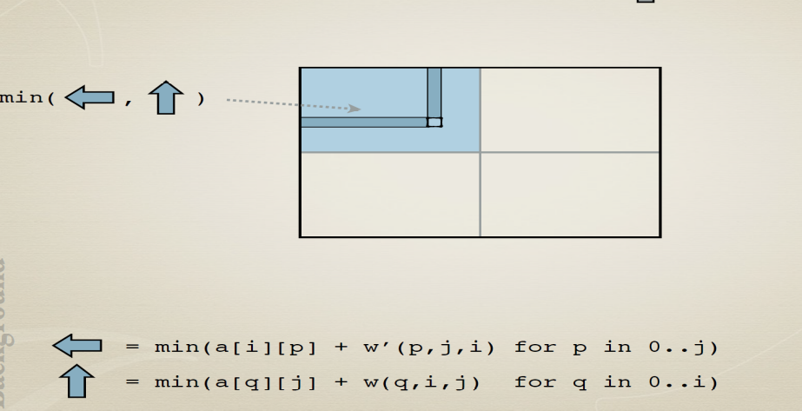
Divide And Conquer

Slide 31
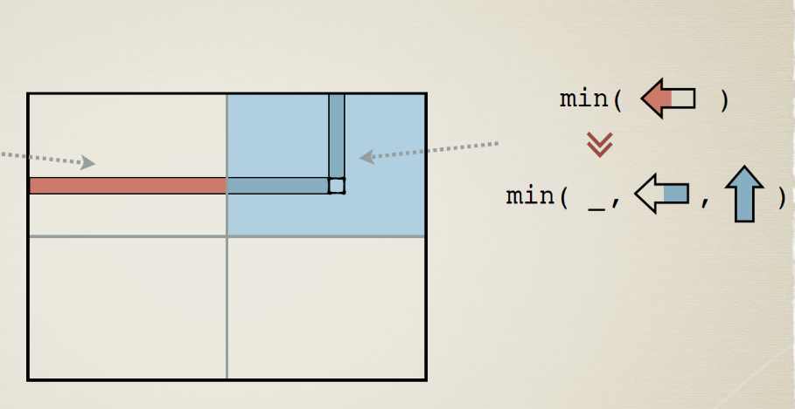
Divide And Conquer

Slide 32
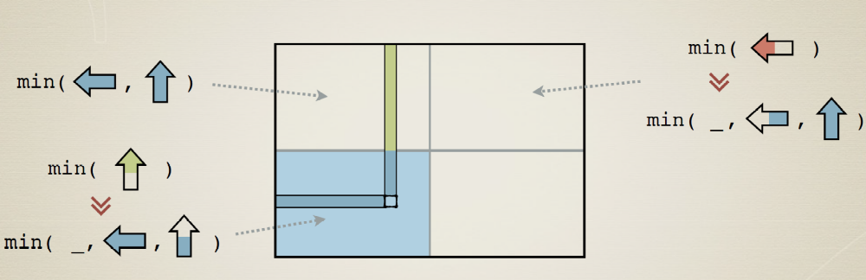
Divide And Conquer

Slide 33
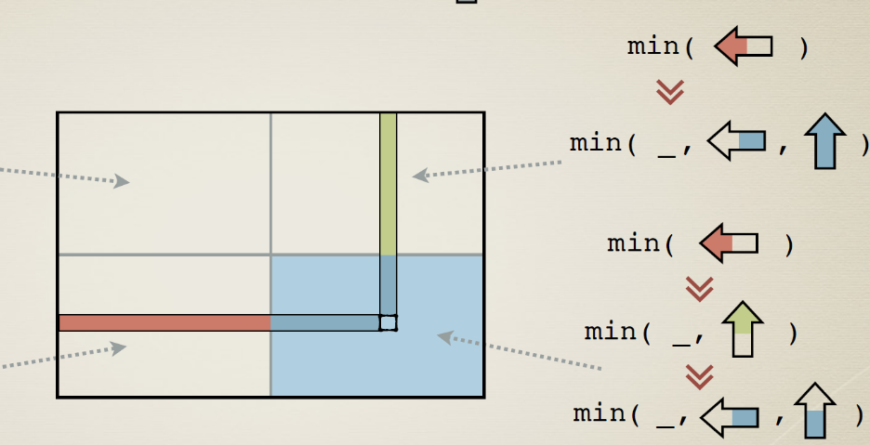
Divide And Conquer

Slide 34
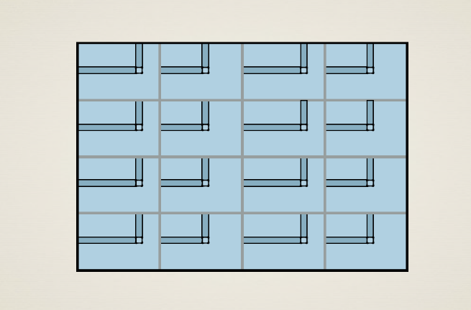
Divide And Conquer

Slide 35
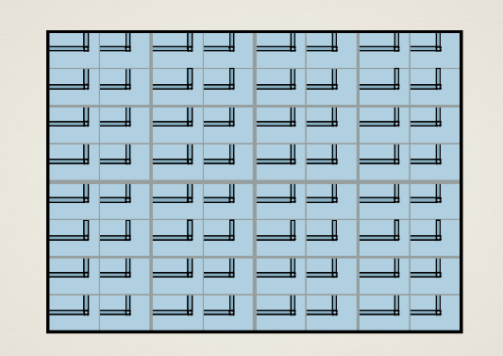
Divide And Conquer

Slide 36
Divide And Conquer

Slide 37
Division of labor
Human provides high-level steps of derivation
  What directions to partition
  How to layer computation into phases
Synthesis provides the low-level details
  precise indexing expressions
  details of sequencing

Slide 38
Workflow
Synthesis steps
Efficient Code
High-level recurence
Compiler
User Guded Steps

Slide 39
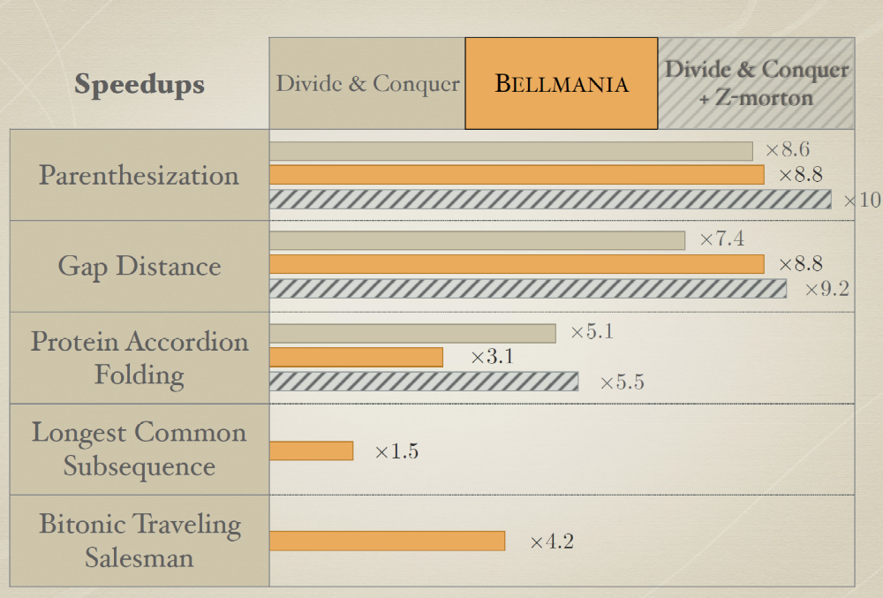
What it buys you
16 Cores

Slide 40
Synthesis modulo recursive functions

Slide 41
Combining Deductive and inductive synthesis
Synthesis modulo recursive functions
  Etienne Kneuss, Ivan Kuraj, Viktor Kuncak and Philippe Suter
Key idea: Apply deductive rules to simplify the problem
  Deduction rules break up large problem into smaller subproblems
  Fall back on CEGIS to solve the more restricted problems
Focus on Scala programs

Slide 42
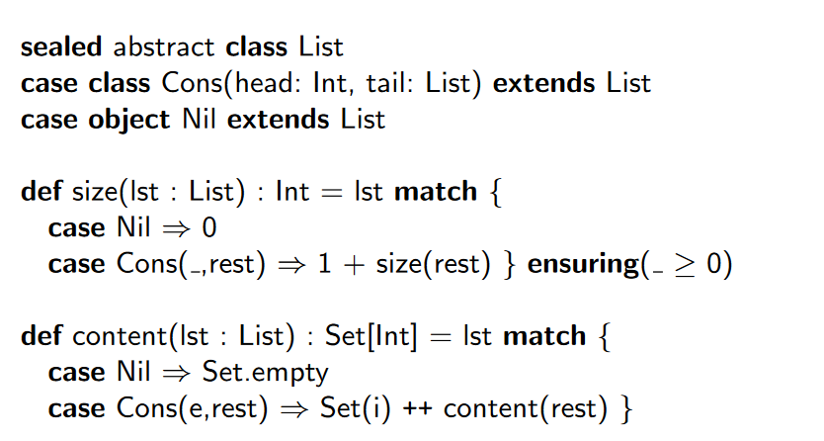
Example: Defining the data

Slide 43
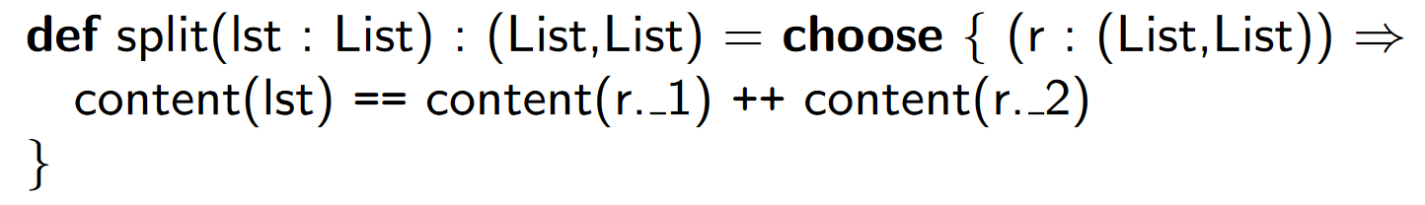
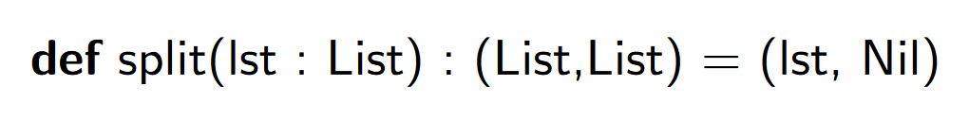
Example: Defining the task
An incomplete specification
Yields a correct but imperfect solution

Slide 44
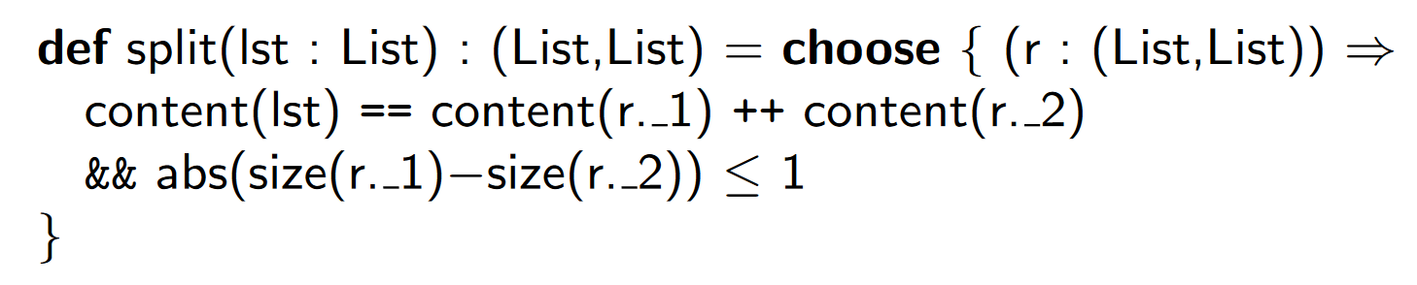
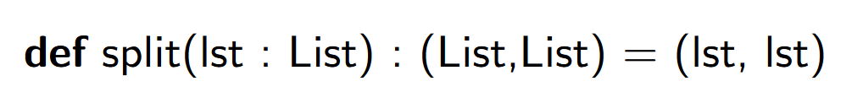
Example: Defining the task
An better specification
but still a terrible solution

Slide 45
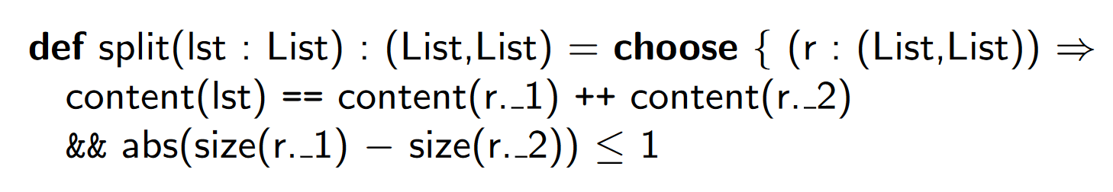
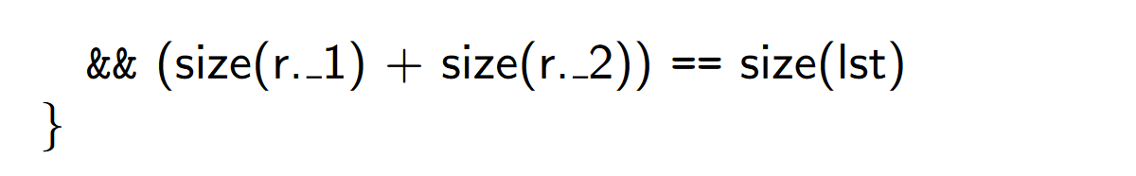
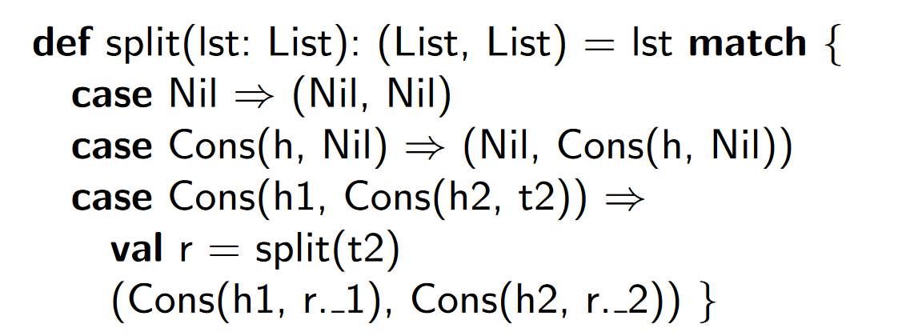
Example: Defining the task
An even better specification
finally yields a good solution

Slide 46

The formalism
$$⟦\overline{a} \left\langle Π⊳φ\right\rangle \overline{x}⟧$$
set of input variables
set of output variables
path condition
synthesis predicate

Slide 47

The formalism
$⟦\overline{a} \left\langle Π⊳φ\right\rangle \overline{x}⟧⊢\left\langle P | \overline{T}\right\rangle$
Program
Precondition

Slide 48
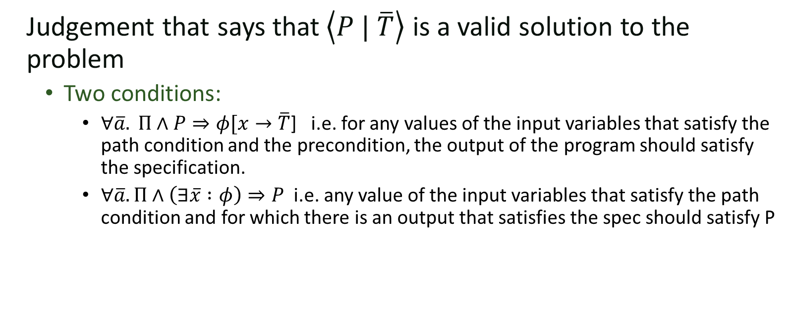
The formalism
$⟦\overline{a} \left\langle Π⊳φ\right\rangle \overline{x}⟧⊢\left\langle P | \overline{T}\right\rangle$
Judgement that says that$\left\langle P | \overline{T}\right\rangle$ is a valid solution to the problem
  Two conditions:
    $∀\overline{a}. Π∧P⇒φ[x→\overline{T}$] i.e. for any values of the input variables that satisfy the path condition and the precondition, the output of the program should satisfy the specification.
    $∀\overline{a}. Π∧\left(∃\overline{x} :φ\right)⇒P$ i.e. any value of the input variables that satisfy the path condition and for which there is an output that satisfies the spec should satisfy P

Slide 49
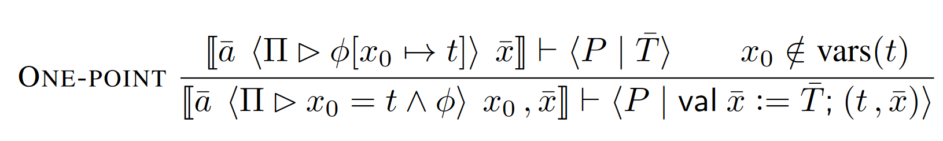
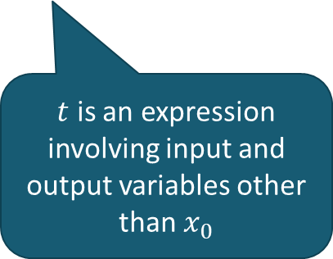
Deductive rules
$t$ is an expression involving input and output variables other than $x_{0}$

Slide 50
Deductive rules

Slide 51
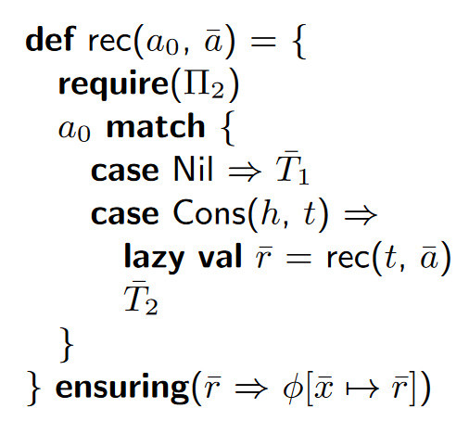


Deductive rules
$$Π_{1}∧P⇒Π_{2}$$
$$Π_{2}\left[a_{0}↦Cons\left(h,t\right)\right]⇒Π_{2}[a_{0}↦t]$$
$$⟦\overline{a} 〈Π_{2}⊳φ \left[a_{0}↦Nil\right] 〉 \overline{x} ⟧⊢〈true |T_{1}〉$$
$$⟦\overline{r}, h, t, \overline{a} 〈Π_{2}\left[a_{0}↦Cons\left(h,t\right)\right] ∧ φ\left[a_{0}↦t, \overline{x}↦\overline{r}\right] ⊳ φ\left[a_{0}↦Cons\left(h,t\right)\right]〉 \overline{x} ⟧⊢〈true | {\overline{T}}_{2}〉$$
$$⟦a_{0},\overline{a} 〈Π_{1}⊳φ〉 \overline{x}⟧⊢〈P|rec\left(a_{0},\overline{a}\right)〉$$
List Recursion

Slide 52
Example
$$let p\left(i, y\right)=\left(y=Nil∧i=Nil\right)∨\left(∃h, t, t^{′}, y=Cons\left(2∗h,t\right)∧i=Cons\left(h, t^{′}\right)∧p\left(t′, t\right)\right)$$
$$⟦in 〈 List(in)⊳p(in, out)〉 out⟧⊢〈P | rec(in)〉$$

Slide 53
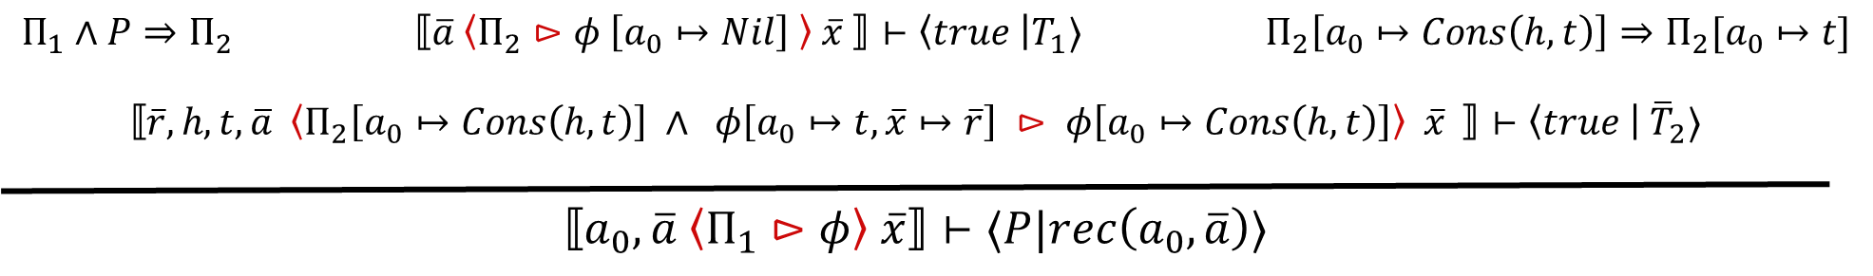



Example
$$let p\left(i, y\right)=\left(y=Nil∧i=Nil\right)∨\left(∃h, t, t^{′}, y=Cons\left(2∗h,t\right)∧i=Cons\left(h, t^{′}\right)∧p\left(t′, t\right)\right)$$
$$P=true$$
$$Π_{1}∧P⇒Π_{2}=List(in)$$
$$List(Cons(h,t))=List(t)$$
$$⟦in 〈 List(in)⊳p(in, out)〉 out⟧⊢〈P | rec(in)〉$$

Slide 54
Example
$$let p\left(i, y\right)=\left(y=Nil∧i=Nil\right)∨\left(∃h, t, t^{′}, y=Cons\left(2∗h,t\right)∧i=Cons\left(h, t^{′}\right)∧p\left(t′, t\right)\right)$$
$$P=true$$
$$Π_{1}∧P⇒Π_{2}=List(in)$$
$$List(Cons(h,t))=List(t)$$
$⟦in 〈 List\left(in\right) ⊳p(Nil, out)〉 out⟧⊢〈true | T_{1}〉$
$⟦r, h, t 〈 List\left(Cons\left(h,t\right)\right)∧p(t,r) ⊳p(Cons(h,t), out)〉 out⟧⊢〈true | T_{2}〉$
$$⟦in 〈 List(in)⊳p(in, out)〉 out⟧⊢〈P | rec(in)〉$$

Slide 55
Example
$$let p\left(i, y\right)=\left(y=Nil∧i=Nil\right)∨\left(∃h, t, t^{′}, y=Cons\left(2∗h,t\right)∧i=Cons\left(h, t^{′}\right)∧p\left(t′, t\right)\right)$$
$$P=true$$
$$Π_{1}∧P⇒Π_{2}=List(in)$$
$$List(Cons(h,t))=List(t)$$
$⟦in 〈 List\left(in\right) ⊳out=Nil∧Nil=Nil〉 out⟧⊢〈true | T_{1}〉$
$⟦r, h, t 〈 List\left(Cons\left(h,t\right)\right)∧p(t,r) ⊳p(Cons(h,t), out)〉 out⟧⊢〈true | T_{2}〉$
$$⟦in 〈 List(in)⊳p(in, out)〉 out⟧⊢〈P | rec(in)〉$$

Slide 56
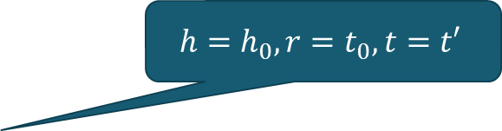
Example
$$let p\left(i, y\right)=\left(y=Nil∧i=Nil\right)∨\left(∃h, t, t^{′}, y=Cons\left(2∗h,t\right)∧i=Cons\left(h, t^{′}\right)∧p\left(t′, t\right)\right)$$
$$P=true$$
$$Π_{1}∧P⇒Π_{2}=List(in)$$
$$List(Cons(h,t))=List(t)$$
$⟦in 〈 List\left(in\right) ⊳out=Nil∧Nil=Nil〉 out⟧⊢〈true | T_{1}〉$
$$h=h_{0}, r=t_{0}, t=t′$$
$⟦r, h, t 〈List\left(Cons\left(h,t\right)\right)∧p\left(t,r\right)⊳∃h_{0},t_{0},t^{′}, \begin{matrix}out=Cons\left(2∗h_{0},t_{0}\right) \\ ∧Cons\left(h,t\right)=Cons(h_{0},t^{′})\end{matrix}∧p\left(t′, t_{0}\right)〉 out⟧⊢〈true | T_{2}〉$
$$⟦in 〈 List(in)⊳p(in, out)〉 out⟧⊢〈P | rec(in)〉$$

Slide 57
Example
$$let p\left(i, y\right)=\left(y=Nil∧i=Nil\right)∨\left(∃h, t, t^{′}, y=Cons\left(2∗h,t\right)∧i=Cons\left(h, t^{′}\right)∧p\left(t′, t\right)\right)$$
$$P=true$$
$$Π_{1}∧P⇒Π_{2}=List(in)$$
$$List(Cons(h,t))=List(t)$$
$⟦in 〈 List\left(in\right) ⊳out=Nil∧Nil=Nil〉 out⟧⊢〈true | T_{1}〉$
$⟦r, h, t 〈List\left(Cons\left(h,t\right)\right)∧p\left(t,r\right)⊳\begin{matrix}out=Cons\left(2∗h,r\right) \\ ∧Cons\left(h,t\right)=Cons(h,t)\end{matrix}∧p\left(t, r\right)〉 out⟧⊢〈true | T_{2}〉$
$$⟦in 〈 List(in)⊳p(in, out)〉 out⟧⊢〈P | rec(in)〉$$

Slide 58
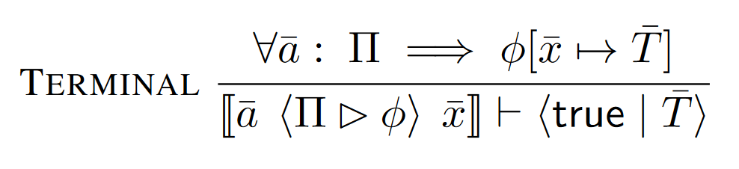
Deductive Rules

Slide 59



$$Π_{1}∧P⇒Π_{2}$$
$$⟦\overline{a} 〈Π_{2}⊳φ \left[a_{0}↦Nil\right] 〉 \overline{x} ⟧⊢〈true |T_{1}〉$$
$$Π_{2}\left[a_{0}↦Cons\left(h,t\right)\right]⇒Π_{2}[a_{0}↦t]$$
$$⟦\overline{r}, h, t, \overline{a} 〈Π_{2}\left[a_{0}↦Cons\left(h,t\right)\right] ∧ φ\left[a_{0}↦t, \overline{x}↦\overline{r}\right] ⊳ φ\left[a_{0}↦Cons\left(h,t\right)\right]〉 \overline{x} ⟧⊢〈true | {\overline{T}}_{2}〉$$
$$⟦a_{0},\overline{a} 〈Π_{1}⊳φ〉 \overline{x}⟧⊢〈P|rec\left(a_{0},\overline{a}\right)〉$$

Slide 60





Bitvector encodings
Jeevana Inala, Rohit Singh, Solar-Lezama
SMT solver
High-level constraint
SAT solver
CNF clauses
msb
lsb
x
y
>
o1
ite
o2
….
….
Goal: Synthesize better code for this translation

Slide 61
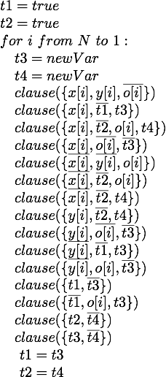
High-level synthesis problem
Boolean predicate P
CNF clauses C
msb
lsb
x
y
>
ite
o

Slide 62


High-level synthesis problem
Space of bitvector encoders
msb
lsb
x
y
>
ite
o
$$φ\left(p\right)=$$
$$φ_{1}\left(p\right){∧φ}_{2}\left(p\right)∧φ_{3}\left(p\right)$$
Equivalent to a given sub-formula
Optimal relative to unit propagation up to a bound

Slide 63
Whole system
Initial Formula
CNF Clauses
Optimized pattern matching based transformation code

Slide 64
Whole system
Corpus of Formulas
Common patterns
Combinatorial Synthesizer
High-level encoding rules
Initial Formula
Rule Compiler
CNF Clauses
Optimized pattern matching based transformation code

Slide 65
Solve more problems
Benchmark Family | Solved by CVC4 → Our Solver
Log-slicing (79) | 33 → 62
ASP (365) | 240 → 288
Mcm (61) | 40 → 43
Brummayerbiere2 (33) | 28 → 29
Float (62) | 59 → 60
Brummayerbiere3 (40) | 23 → 24
Bruttomesso (676) | 623 → 623
TOTAL | 1046 → 1129
83 more problems in total

Slide 66
Cross domain performance
Solver Domain | log-slicing | asp | mcm | brumma2 | float | brumma3 | brutto
log-slicing | 62 | 58 | 36 | 59 | 32 | 35 | 35
asp | 227 | 288 | 255 | 227 | 236 | 253 | 240
mcm | 39 | 38 | 43 | 40 | 39 | 39 | 41
brumma2 | 29 | 28 | 28 | 29 | 29 | 29 | 29
float | 57 | 57 | 59 | 57 | 60 | 60 | 59
brumma3 | 22 | 22 | 25 | 22 | 23 | 24 | 23
brutto | 607 | 606 | 623 | 609 | 623 | 623 | 623
Best
Worst
Notes:
only colors
Shows some domains are very specific
Some are somewhat more general - work well for other domains as well

